Slide 1
January 2-5, 2020 Trip Report

Slide 2
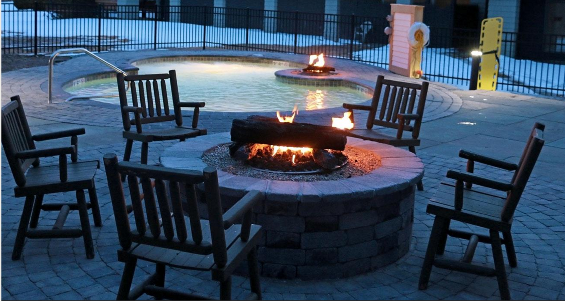
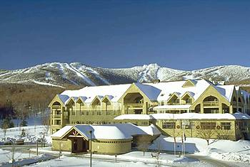
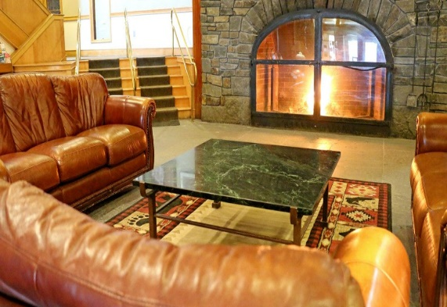
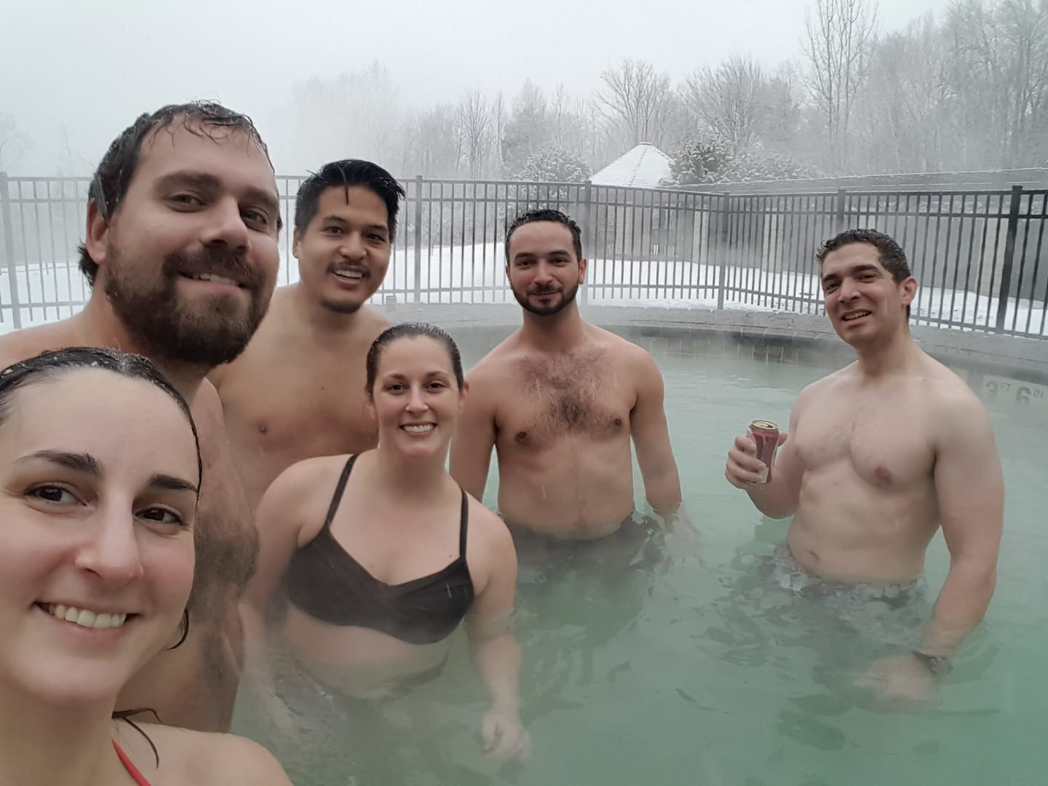
32 attendees – 31 adults, 1 child
50/50 split returnees vs. first-timers
Just shy of trip attendance record (32 adults + 3 children, 2019)
14 person waitlist; planning on expanded room block for 2021
Returned to Killington Mountain Lodge for 5th consecutive year
No major changes, though long-term indoor pool renovation finally completed
Will be back in 2021

Slide 3
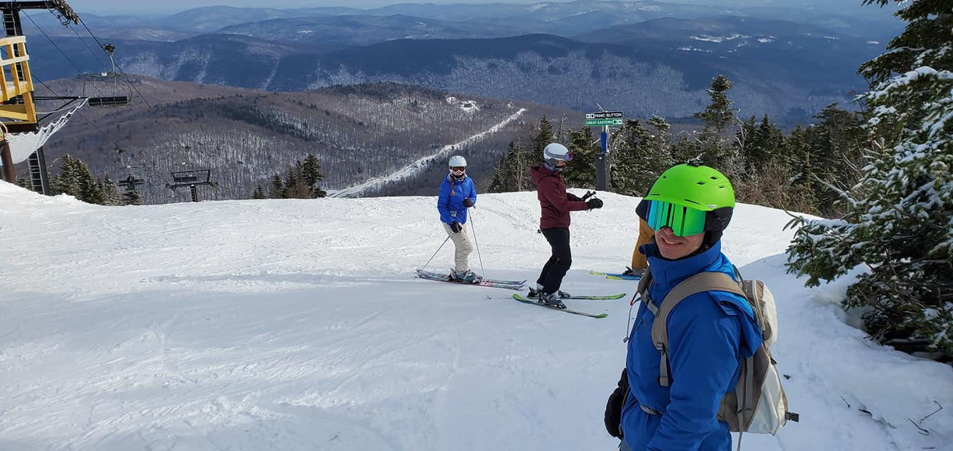
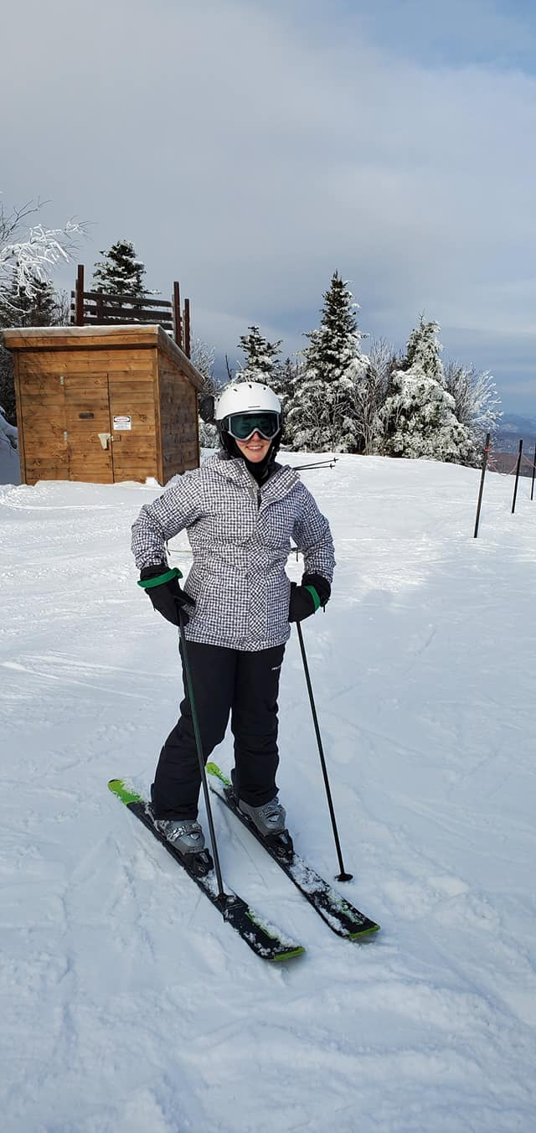
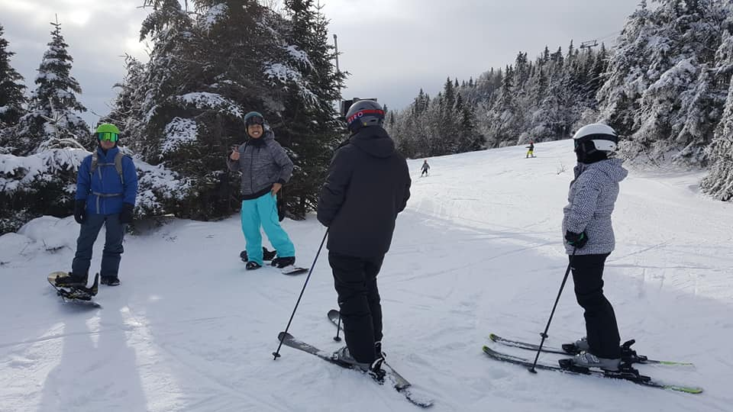
Generally good conditions despite warm snap the week before the trip
All base areas, all lifts, ~110 of 155 runs open
Closed trails mostly ◊◊ terrain and glade runs that require deep cover
Warm, almost spring skiing conditions on Friday
Wintry mix at base left several inches of fresh snow mid-mountain and up on Saturday
Cooler, mix of clouds and sun with leftover snow from day before on Sunday
Unfortunately just missed a major storm system that dropped 20” of snow starting the day after we left ☹

Slide 4
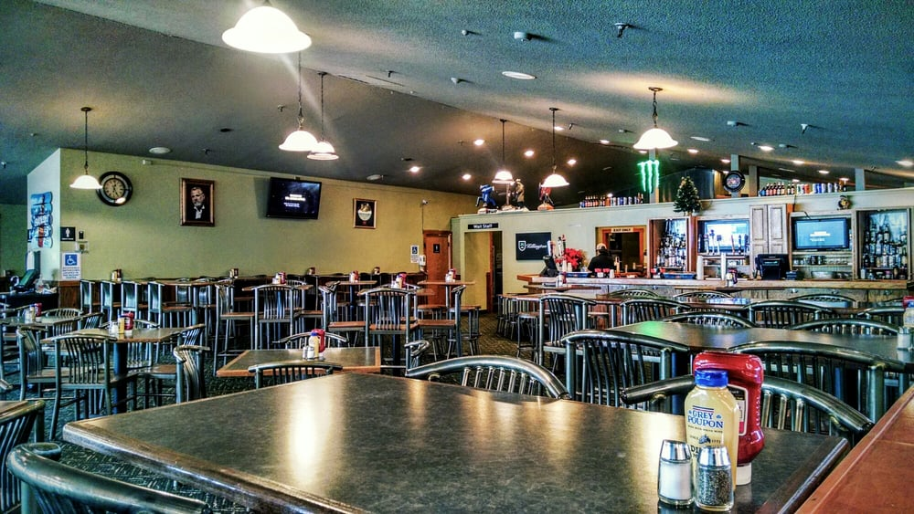
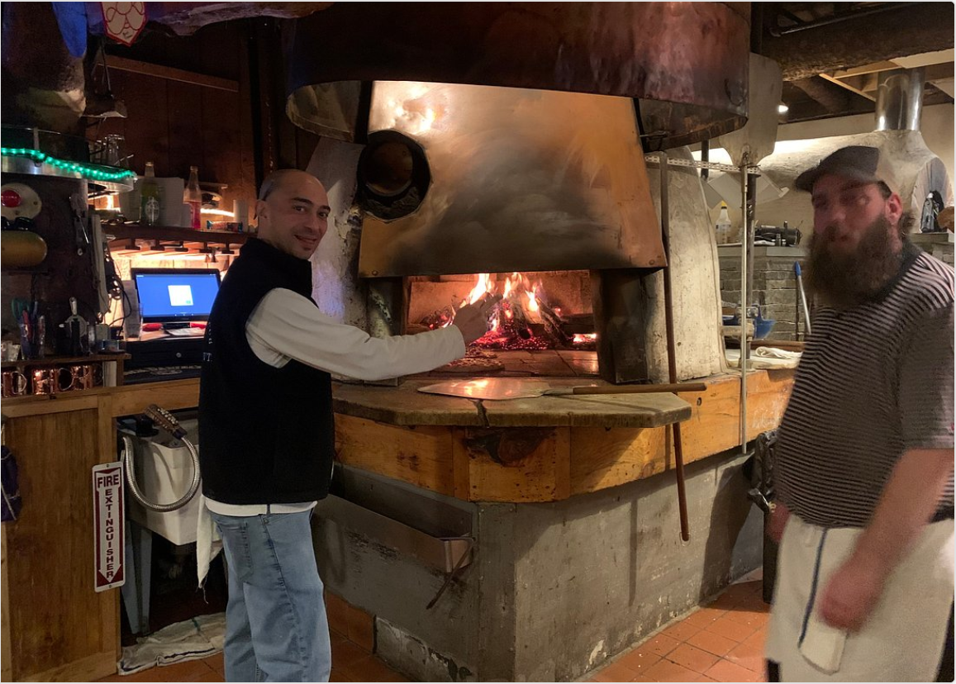
Two club-sponsored apres ski parties
Long Trail Pub at Snowshed Base Area on Friday
Nite Spot (formerly Outback) Pizza near the hotel on Saturday
Live music at both locations
Almost full attendance at both
Club provided beer, wine, & appetizers/pizza for ~2.5 hours
Expect same itinerary and price point for 2021 trip
Slightly later in January than normal due to how calendar falls (Jan 7-10)

