Slide 1
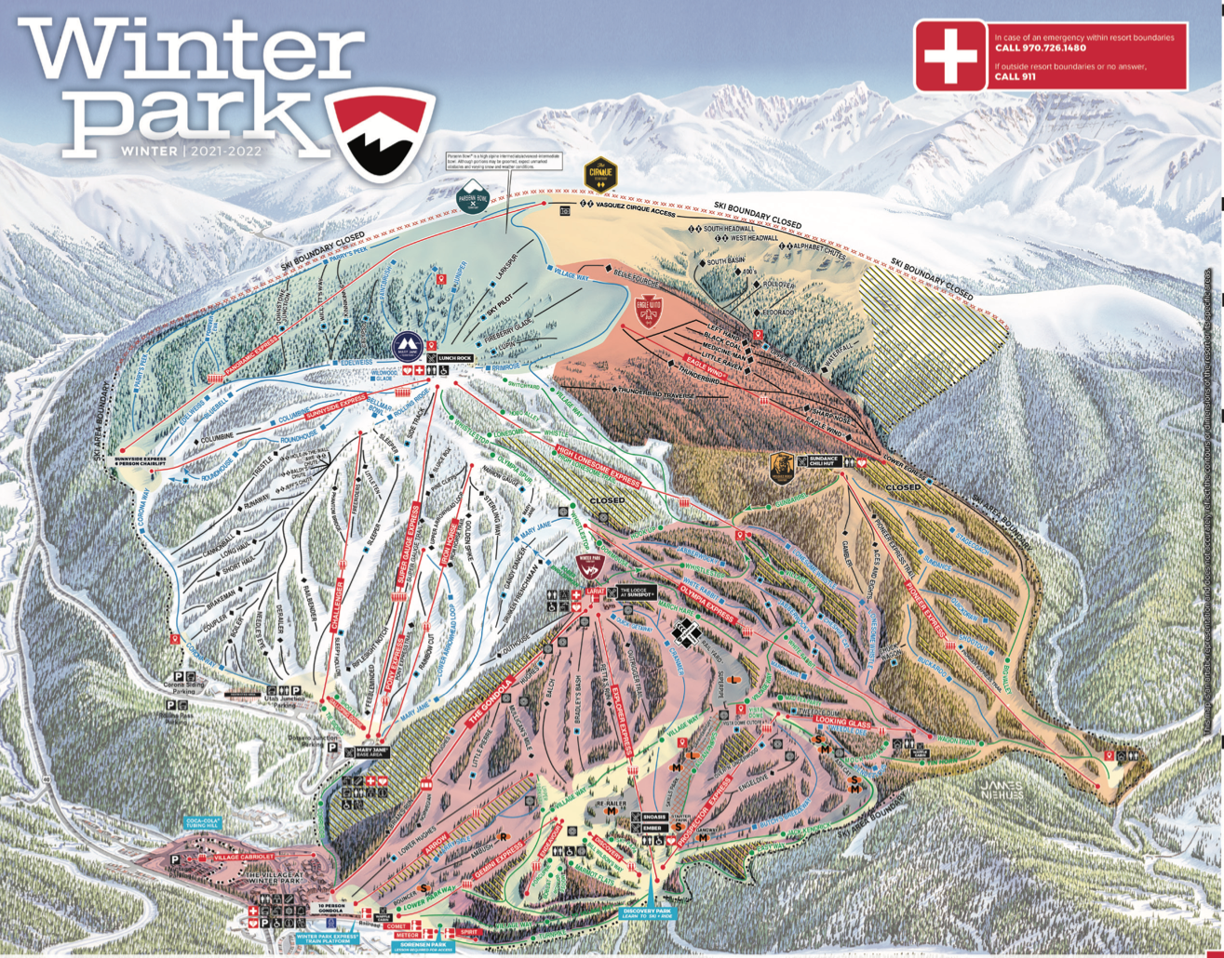
GODDARD SKI CLUB http://gewa.gsfc.nasa.gov/clubs/ski/ 2023 NASA Ski Week Jan 28 – Feb 4, 2023 $1949 person (Studio, Dbl. occupancy) $1999 person (Deluxe studio, Dbl. occupancy)
Mountain Statistics
Voted the #1 Ski Resort in North America by USA Today readers for the 3rd time in the last 4 years!
Average Annual Snowfall: 345”
Vertical Drop: 3,060 vertical feet
Base Elevation: 9,000’
Top Elevation: 12,060’
Skiable Acres: 3,081
Terrain: 21% Beginner, 37% Intermediate, 30% Advanced, 11% Expert
Number of Named Runs: 300 on 4 mountains
Lifts:1 Gondola, 23 total lifts
https://www.winterparkresort.com
COST INCLUDES:
7 Nights Lodging – Studio with kitchenette
Ground transportation
5 days of skiing – Deduct $550 for no lift / Ikon pass
All applicable taxes and fees
Group dinner and apres’ ski
Round Trip airfare: Non-stop on Southwest (BWI) – deduct $350 if providing your own air
AT THESE FANTASTIC RATES, RESERVATIONS WILL GO FAST, SO DON'T WAIT!
MAKE CHECKS PAYABLE TO: GODDARD SKI CLUB AND MAIL TO ADDRESS BELOW (with signed trip and membership applications, which can be found at http://gewa.gsfc.nasa.gov/clubs/ski/) : Payment schedule: $500 by October 1 and Trip Balance by November 20.
TRIP LEADER: | TOM JOHNSON / 240-997-3192 | EMAIL: | Thomas.E.Johnson@nasa.gov
 |  | ADDRESS: | 6222 Knoll Hill Drive Berlin, MD 21811

