Slide 1
A still photographer steps into video: Slide shows and virtual choirs
David Friedlander
Goddard Photo Club, 9 Dec 2020

Slide 2
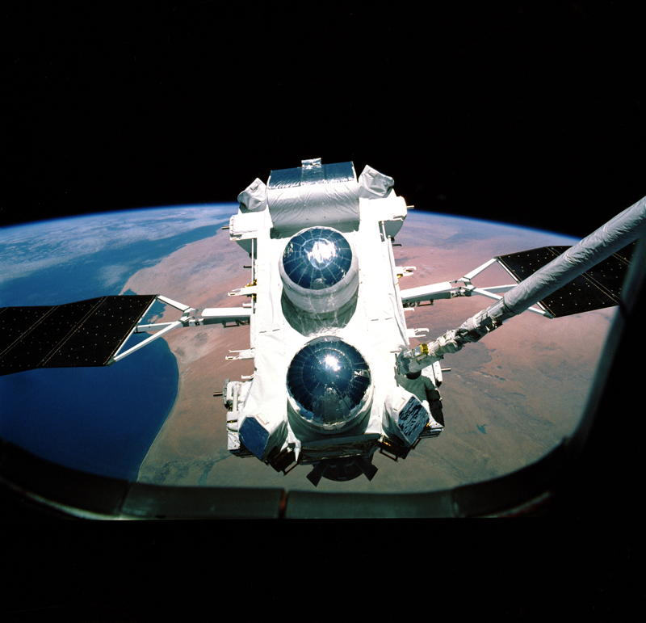
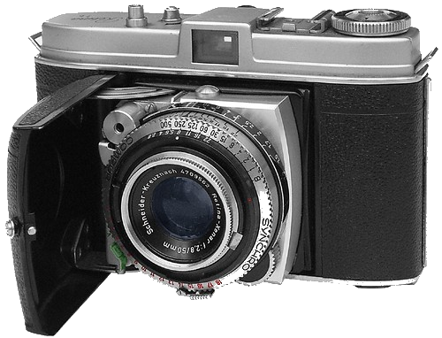
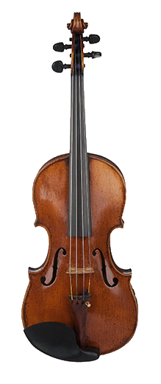
My background (David Friedlander)
At Goddard since 1988
first as Compton Observatory/EGRET (Energetic Gamma Ray Experiment Telescope) Data Manager
then Code 660 Astrophysics Science Division Mac & UNIX system administrator
Serious photographer since age 15
Started with own B&W darkroom work and bulk loading film soon thereafter
Designed and built two darkrooms
Wide photo experience
Code 660 staff photos since 1991
Digital darkroom (film scanner, Photoshop, Lightroom) since 2001
Totally digital since 2005
Studio photography since 2008
Violinist since age 8 (pre-pandemic was playing in four orchestras of different types) – this will be relevant later in the talk!

Slide 3
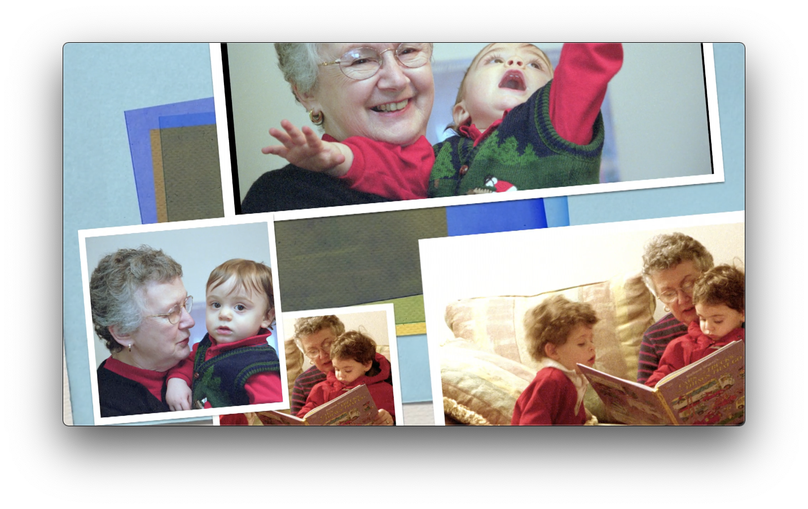
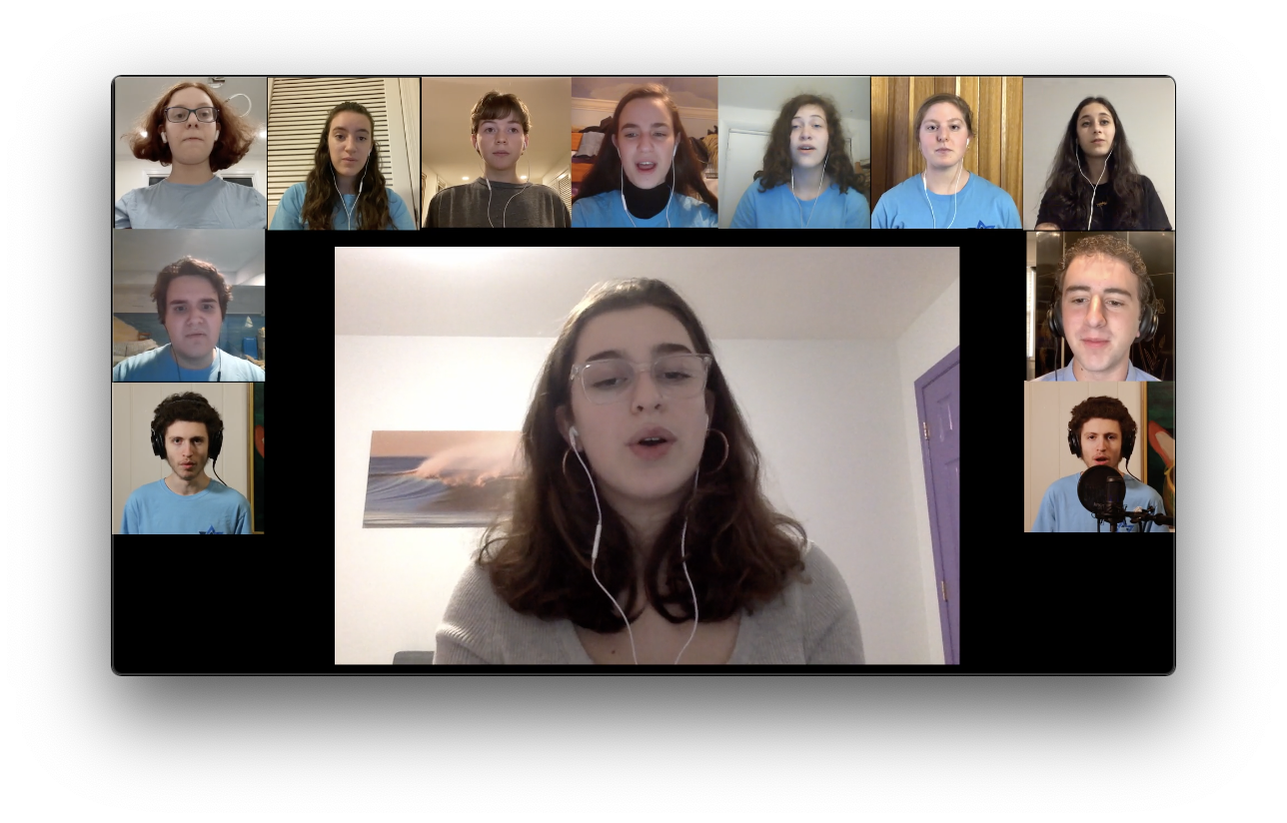
Outline for today’s talk
Digital video slide shows
Still images combined with music
Virtual choir videos
Individual recordings of singers brought together

Slide 4
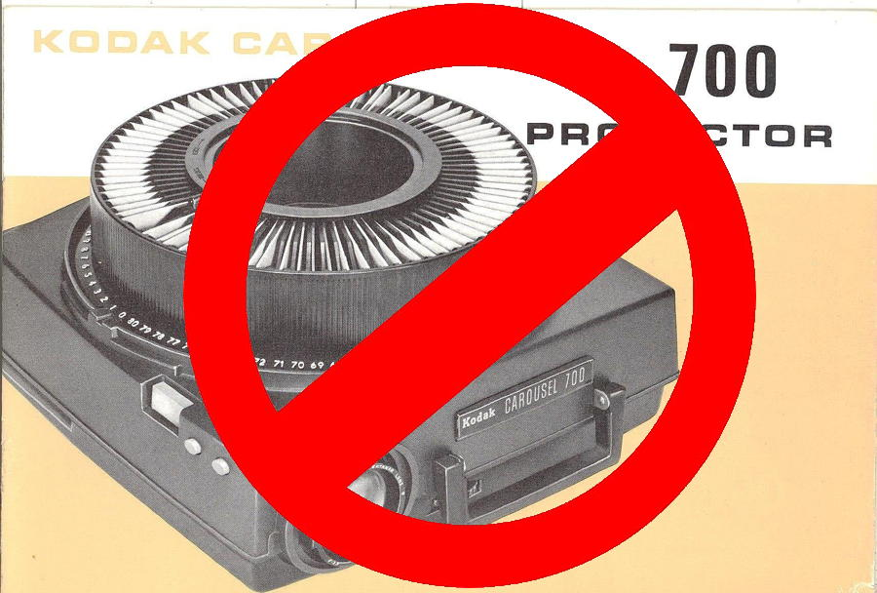
Digital video slide shows
Wanted to create a slide show for public presentation which was not simply one static photo flashing up after another
Keep total length under 8 or 9 minutes
Each photo displays for about 4 seconds, including transitions
Don’t use too many kinds of transitions (just like Powerpoint!) in any one slide show
Background music: choose music meaningful to the person(s) featured in the slide show

Slide 5
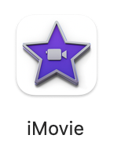
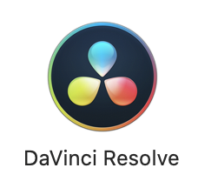
Software used
Apple iMovie (various versions) (NLE (non-linear editor))
Free with a new Mac or available from Mac App Store
https://www.apple.com/imovie/
https://apps.apple.com/us/app/imovie/id408981434?mt=12
Handbrake (video compression)
Free application
https://handbrake.fr/
DaVinci Resolve from Blackmagic Design
https://www.blackmagicdesign.com/products/davinciresolve/

Slide 6
An example slide show (21 second snippet)
(<<2 minutes of 60th anniversary show, especially across musical interlude break)

Slide 7
Source material
Collect photos for slide show, and organize them into categories
Having sections to your videos makes it less interminable for your viewers!
Fix your photos in Photoshop (or similar) so that they look their best (black point, white point, crop, color correction, etc)
Downsample your images: FullHD is 1920x1080, i.e., about 2 megapixels, so no need for 20MP images.

Slide 8
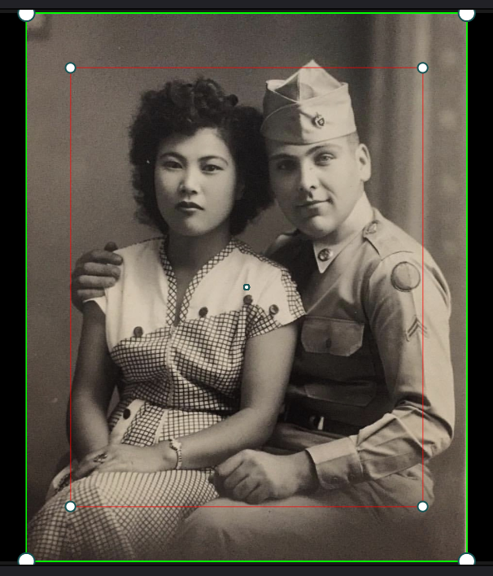
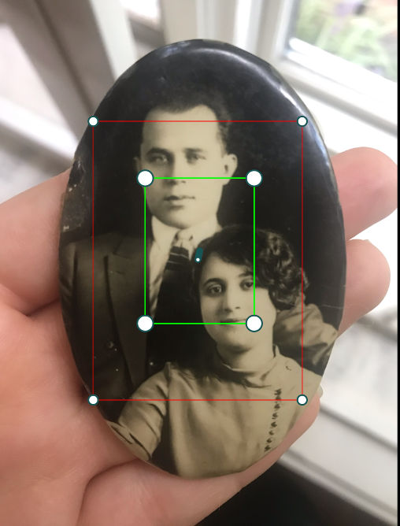
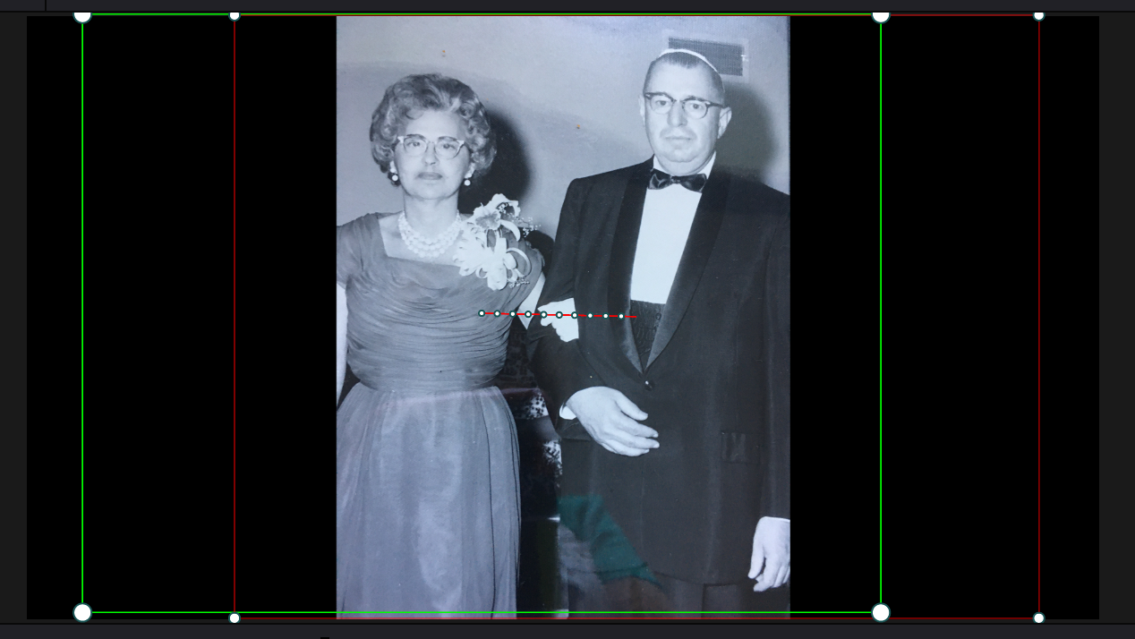
Ken Burns Effect
Allows one to pan/zoom around a photo, to make it less static
Named for documentary film director Ken Burns, who used it in “The Civil War” and subsequently.
Included in many NLE applications (“Ken Burns Effect” in iMovie; “Dynamic Zoom” in DaVinci Resolve)
Set starting point and ending point (usually green and red rectangles) for any one photo, where one sets zoom and pan amount at each point, will automatically adjust from start to end.
There are defaults, but I adjust for every photo individually (looking at composition) and for variety (don’t want to always zoom in, say)

Slide 9
Music for slide shows
Want music relevant to the people involved
Don’t want the music to be distracting
Transition from one musical selection to another
Keep same chord or key, if possible, to make less jarring.
Or simply fade out.
Line up with slide show section changes, if possible
End of entire slide show: have music reach an ending, too (don’t chop off in the middle)
Start of slide show: don’t have to start at beginning of piece, but perhaps start of phrase.

Slide 10
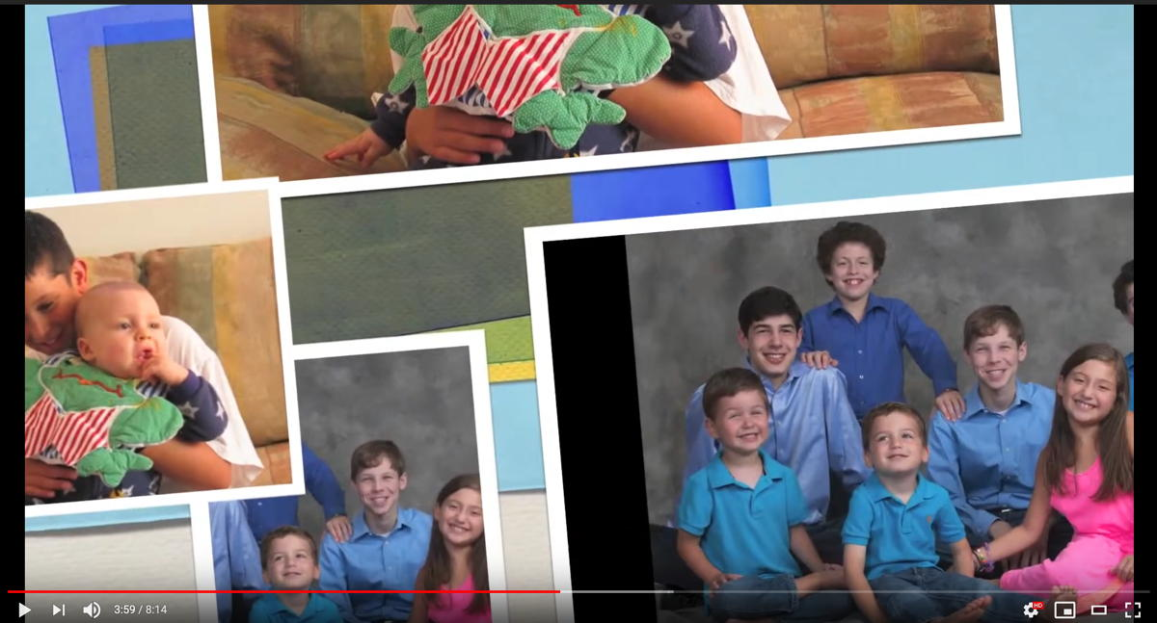
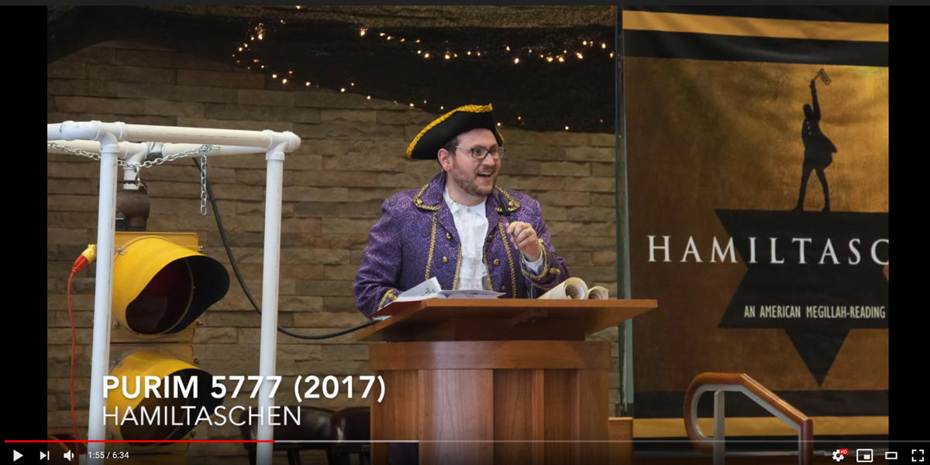
Some complete slide shows
https://davidpfriedlander.net/other/videos/some_slide_shows.html
Or
https://tinyurl.com/dpfSlideShow
My parents’ 60th wedding anniversary (2018)
My younger son’s Bar Mitzvah (2015)
Farewell video for cantor at my synagogue
Memorial video for Yom Kippur 2020

Slide 11
And now for something completely different… Virtual Choirs!
Popularized by Eric Whitacre (pre-pandemic) – Google him –he is spectacular
During the pandemic, musical ensembles completely shut down
Cannot record during Zoom sessions (variable latency per participant)
Virtual choirs (and orchestras) offer a way groups can still “perform” together.

Slide 12
Two minute example of virtual choir
Snippet from “To Make You Feel My Love” (Bob Dylan), performed by students at Walter Johnson High School
Dylan video

Slide 13
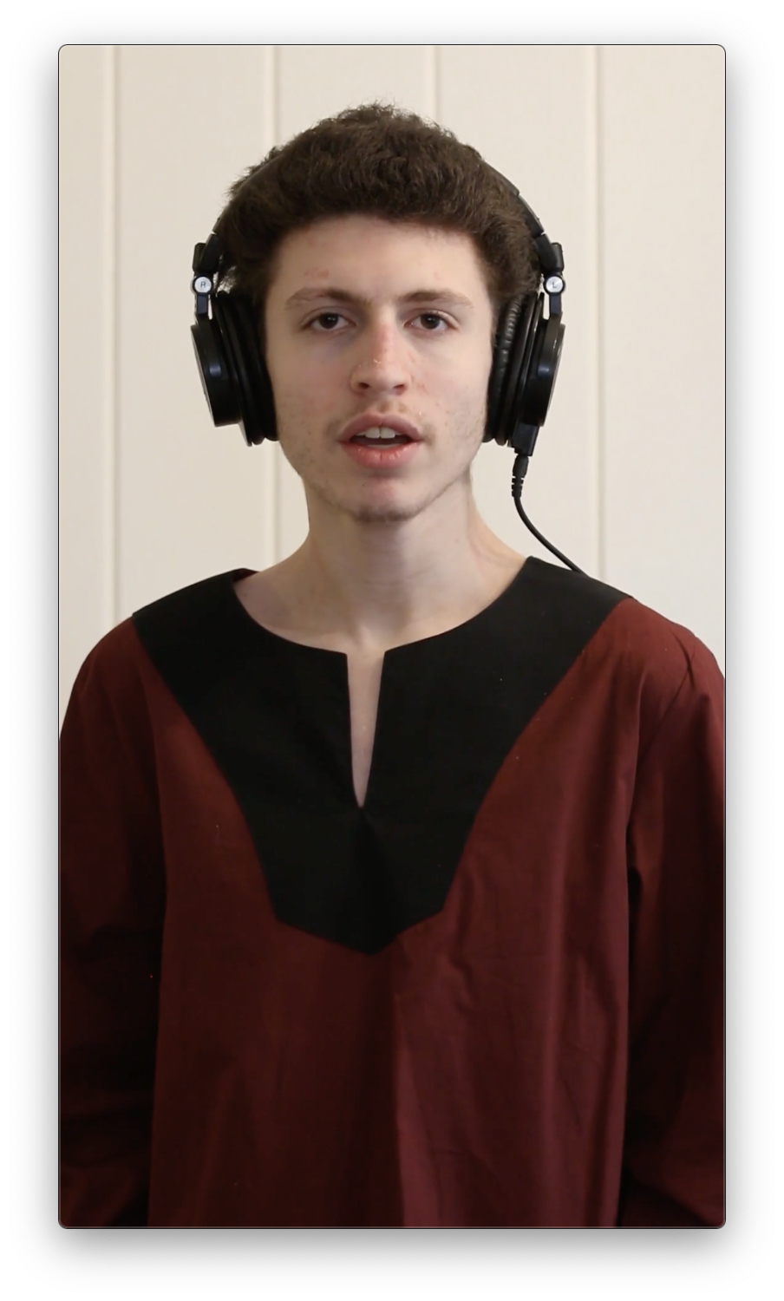
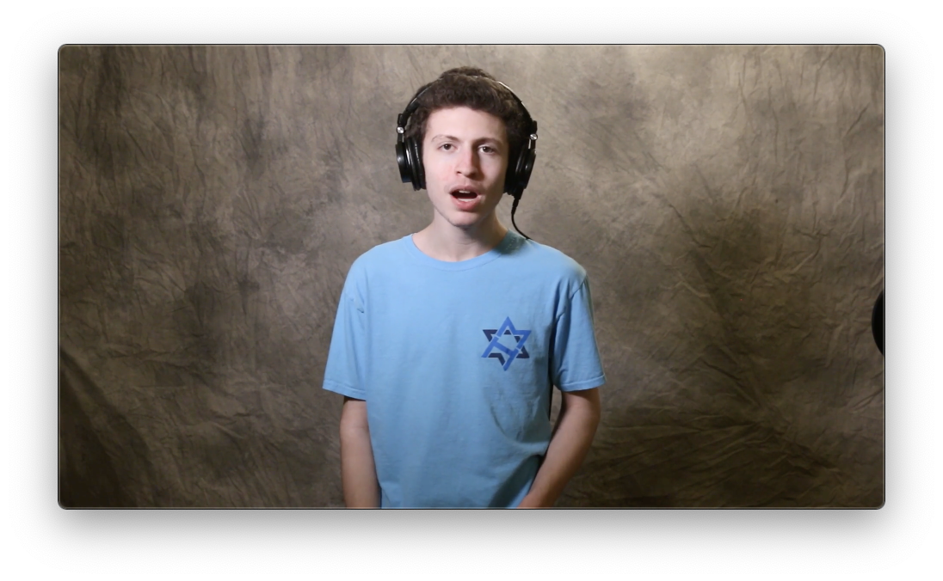
How a virtual choir works
Someone (usually music director) records one foundational “backing track” (say, soprano part)
Using headphones to listen to backing track, someone (else) records other backing tracks (e.g., bass, tenor, alto).
Each member of the group records themselves on video while they listens to the appropriate backing track on headphones.
All of these separate tracks are assembled into a final video

Slide 14
Backing tracks
Backing tracks are preferably video, not just audio, because one can see conducting or other visual cues.
Don’t record to an existing recording of all tracks (SATB)– too hard for the singers to get rhythm and pitch correct.
Provide a “clap” or tone on the backing track to assist lining up all the individual videos
Possibly use visual countdown timers to tell people to smile for ~5 seconds before and after (otherwise one gets a visual of people diving to turn off their video right when they stop singing)
Give singers their starting pitch a second or two before music starts.

Slide 15
When recording
Use portrait or landscape as directed (so videos are consistent)
Wear requested attire (school colors, performance black, whatever)
Have camera at chest level or higher (to avoid “nostril cam”)
Don’t be backlit
Avoid distracting backgrounds (ceiling fans off, etc)
Plan to do multiple takes
Make eye contact with camera (memorize words or have lyrics in line of sight near camera (above or below)), less important for instrumentalists.
Avoid background noise (warn family members before recording)

Slide 16
Role of the video producer
Communicate all of the preceding requirements to the music director, so they can tell their members.
If it is their first time with a virtual choir, the director won’t know about the pitfalls.
Be collaborative with music director:
share progress and draft renders
Don’t be afraid to tell them if an individual needs to re-record.
You have a vision, but you are not doing any of the shooting yourself!

Slide 17
Computer requirements for video editing
One needs a fairly high-end non-linear editing program (Apple Final Cut Pro, Adobe Premiere, or Blackmagic Design’s DaVinci Resolve)
Apple iMovie was not sufficiently flexible for these projects.
Resolve is free and very capable (comes with 3500 page PDF manual; many independent YouTube tutorials available, too)
One needs a pretty beefy computer to handle this (especially with more voices): lots of RAM, video RAM, fast SSD storage. It’s the difference between many hours of rendering time versus minutes.

Slide 18
Editing: First line up the audio
Some applications (Final Cut?) require one to use external video editor; Resolve has built-in audio editor called Fairlight.
Drag the videos into your “timeline” (as separate tracks)
Use the “1-2-3-clap” to get the videos close to lined up
DaVinci Resolve (others can do this too) can adjust tracks to within one frame (1/30th of a second will match your source material)
Choose one track as your foundation, then select a second track to line up with it. Then do the third with the first, 4th with the first, etc.
Cross check that all of one part (say, altos) are lined up together. For a really large group, consider grouping one section together (“compound clip”)
Small adjustments make a huge difference between a total audio mess and a cohesive choir.

Slide 19
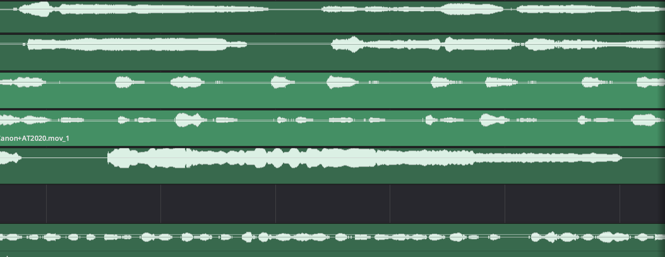
More on lining up tracks
You may not want to line up on the first words or phrase, because sometimes there are ragged entrances and people are not locked into the rhythm yet (their own singing vs their backing track)
So, starting with the second phrase or something with a hard consonant can work better.
Very helpful to have a copy of the music score, so you can see entrances, words, unison spots, solos, etc.

Slide 20
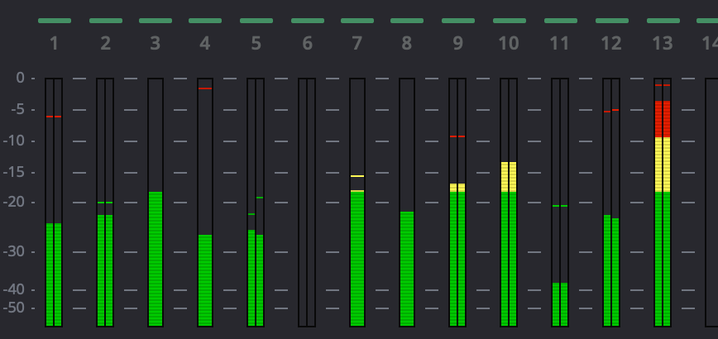
Balancing sound
Once everyone is singing together, go into Fairlight audio editor to work on balance.
Look at level meters and adjust individual singers up or down
Always be cognizant of clipping (individual parts or whole ensemble)

Slide 21
It makes a difference!
Listen for vu-vum, vu-vum, vu-vum (not lined up) versus vum-vum-vum (aligned), as well as balance issues.
These are issues with the editing, not with the singers!

Slide 22
Notes held too long or out of tune
Lots of problems can occur which are far less likely to show up if people are standing together performing in person, e.g., not cutting notes off at the end of a phrase or line, ragged rhythms.
One can use Resolve to simply mute a person for a handful of frames which gets rid of the problem of holding a note too long.
One can also mute one note (but, say, not the ones on either side of it) to solve egregious intonation issues.
Resolve can change pitch for notes, a feature I have not explored. (I don’t want to change these into professional performances.)
One can change timing without changing pitch (speed up one voice by 7%, say.)

Slide 23
Color correction
Resolve made its name as a “color grading” program for Hollywood movies.
Thus, one can do a lot but I have tended to have a light touch.
A solid knowledge of Photoshop-type image adjustments is helpful here: Gain, gamma, curves, white balance.
Small adjustments can make a big difference.
A lot of the tutorials are hand-waving in the just-make-it-look-good category (although sometimes Photoshop/Lightroom tutorials can be too).

Slide 24
Layout: Showing multiple videos at once
Resolve is resolution-independent, so each video appears full-screen (whether, say, 1920x1080 or 1280x720).
Not all source material will even be 16:9 aspect ratio. (You are taking what people submit.)
Videos are stacked: think Photoshop layers
Thus, you will need to reduce sizes (change zoom level) to show more than one video at a time.
Decide on your basic layout, which affects image size
You can crop videos to have less wasted space
All tutorials I saw used rough mouse positioning to “transform” videos ((X,Y) placement)
I wanted something more precise, so wrote python program to handle off-center crops, non-16:9 aspect ratios, non-1920px width videos, and more, then output desired pixel dimensions and zoom ratios for equal sizes.

Slide 25
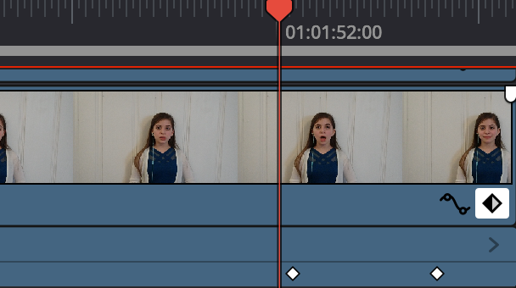
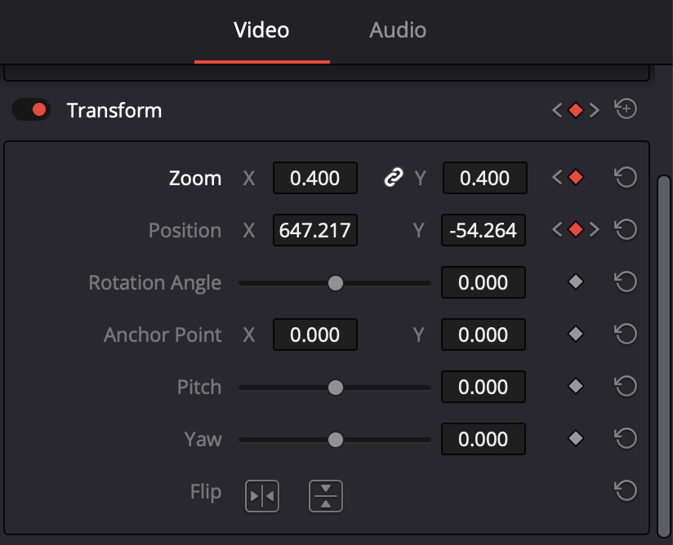
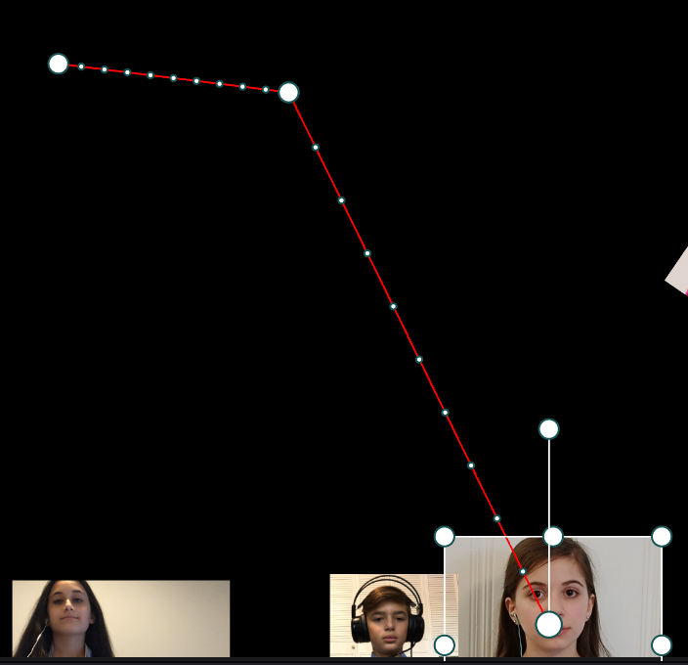
Layout: Part 2–Adding motion
One can have all singers on-screen at all times, or one can use the score to suggest movement and animation.
This is accomplished with “key frames”. One identifies a point in time for specific track (one singer), and then one can set parameters for that key frame: (X,Y) position, opacity, rotation angle, size (zoom).
Then one sets another key frame at a different time and sets one or more of the above parameters. The resulting video will smoothly adjust from one set of settings to another (show example).
As with other types of movements & transitions (think Powerpoint!), less is more. The music should still be the focus.

Slide 26
Example of movement (middle school choir) [21 sec]

Slide 27
Output: Rendering
In- and out-points: allows one to cut out claps, ragged ends of recording, etc, but without deleting them from master video (but that’s an option too)
Use available features to improve rendering times (“optimized media” and Render Cache in Resolve)
Choice of going straight to a compressed format (e.g., H.264 or H.265) or an intermediate near-lossless format (e.g., Apple ProRes), and then to compressed format.
I chose latter approach, because the final compressed file was a lot smaller but still looked good. Handbrake is great for this!
Place on web site or upload to YouTube

Slide 28
Closed captioning/subtitles
It can be very helpful to one’s audience to offer closed captioning (line-by-line on-screen lyrics)
To create this, one needs:
the lyrics, broken up by line or phrase (think poetry)
Precise times of when each line starts, as H:MM:SS:FF (hour, minutes, seconds, frame number) or decimalized as MM.SS.ff, where ff is the fraction FF/framerate (e.g., 18/30 or 21/30)
Numerous different formats (WEBVTT, SBV, etc) but they are all basically:
H:MM:SS.ff → H:MM:SS.ff
This is a line of the song lyrics.
(blank line)

Slide 29
One minute snippet example virtual choir: “Salaam” (“Peace”) performed by Marak Hayom

Slide 30
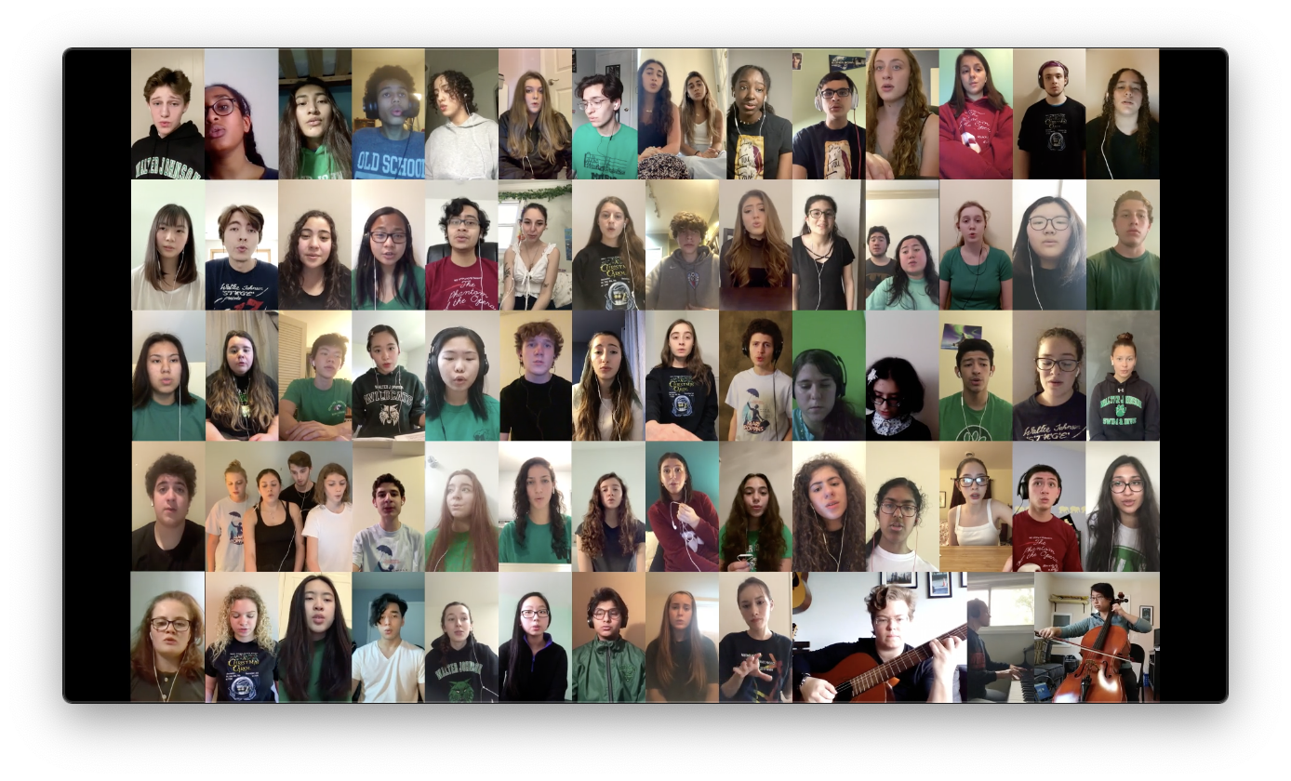
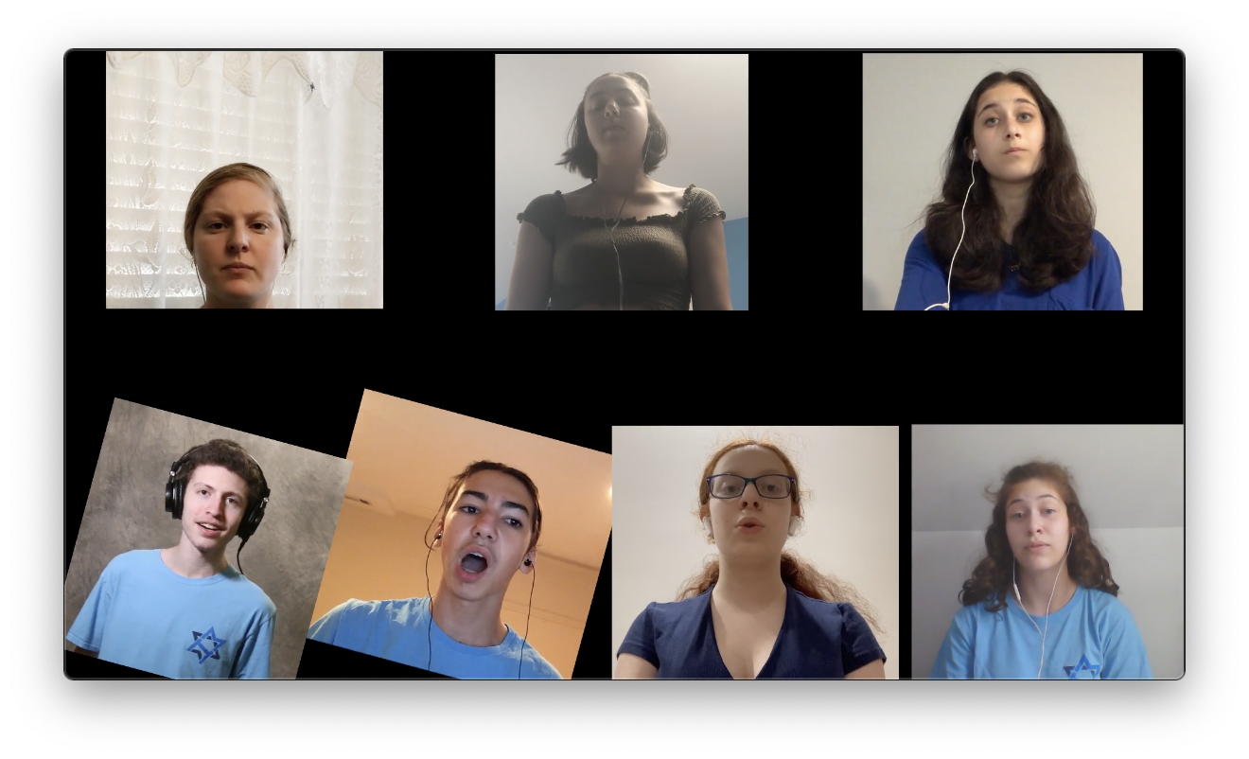
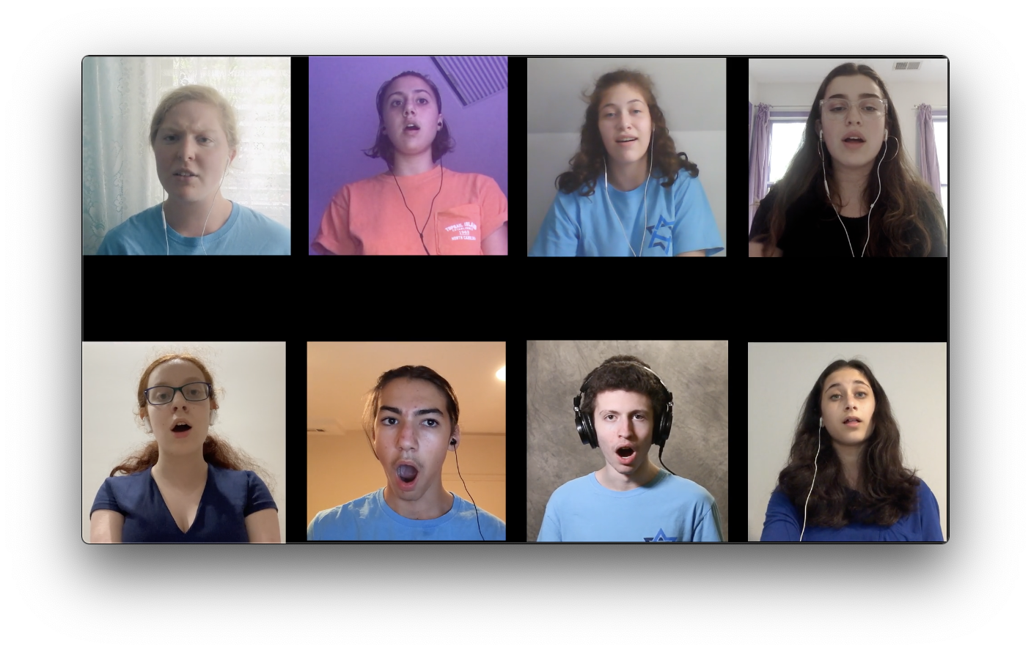
Some complete virtual choirs
https://davidpfriedlander.net/other/videos/some_virtual_choirs.html
Or
https://tinyurl.com/dpfVirtualChoir

Slide 31
Conclusion
Fascinating to apply still photographic experience to video
So much to learn!

Slide 32
Some of my web sites
https://davidpfriedlander.net/photo.html
https://asd.gsfc.nasa.gov/David.Friedlander/dpf_index.html
https://dpfriedlander.smugmug.com
Or, simply: https://tinyurl.com/friedlanderphoto
Email: david.p.friedlander@nasa.gov

