Slide 1
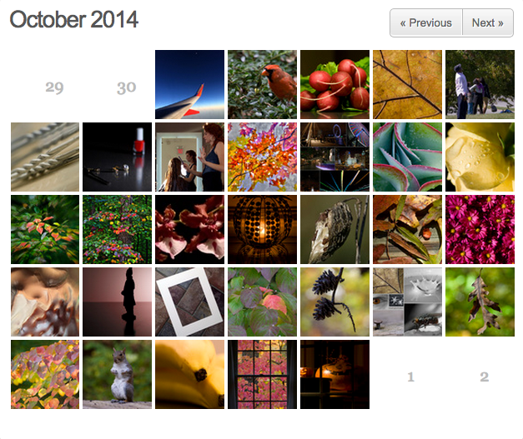
365 Project
Karen Smale

Slide 2
What is 365 Project?
365project.org
FREE online social network for photographers
Idea: take and upload a photo every day
Something to strive for… but you make your own rules
You retain all rights to your photos

Slide 3
How does it work?
Get an account
Take a photo
Upload your photo
Give it a title and description
Tag it with useful keywords (color, topic, technique)
“Follow” other 365ers
Comment on their photos
“Fav” their photos
They may follow you back and comment/fav yours
Participate in themes & challenges

Slide 4
What’s it good for?
Inspiration
View the work of other photographers
Comment on their photos or ask about their process
“Fav” it so you can refer to it later
Themes and challenges are going on all the time
Technique challenge (HDR, light painting, ICM, etc.)
Artist challenge (Take a photo inspired by artist X)
ETSOOI (Edit The S*** Out Of It [with subject/topic])
WWYD (What Would You Do? [i.e., edit this photo])
Mundane/Abstract [with subject/topic]
Get Pushed (partners challenge each other)
Connecting with other photographers

Slide 5
More stuff
View your stats
Search for photos by tag
Look at your progress in the calendar view
See what’s “trending” or “popular”
Participate in discussions, ask for critiques

Slide 6
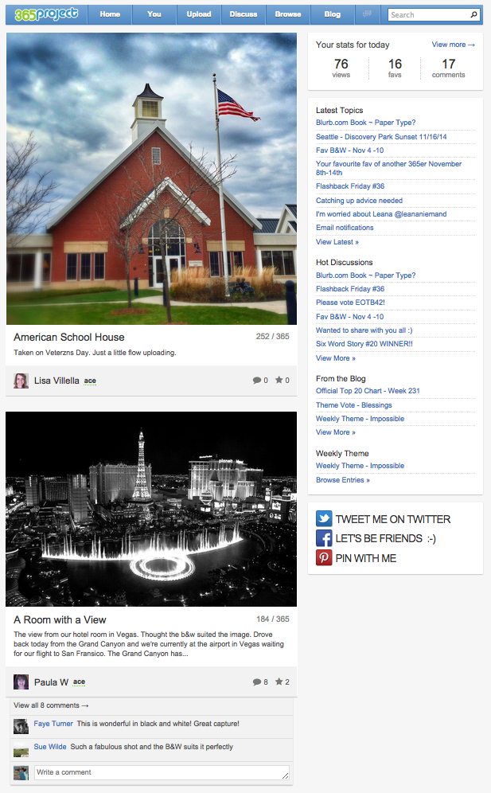
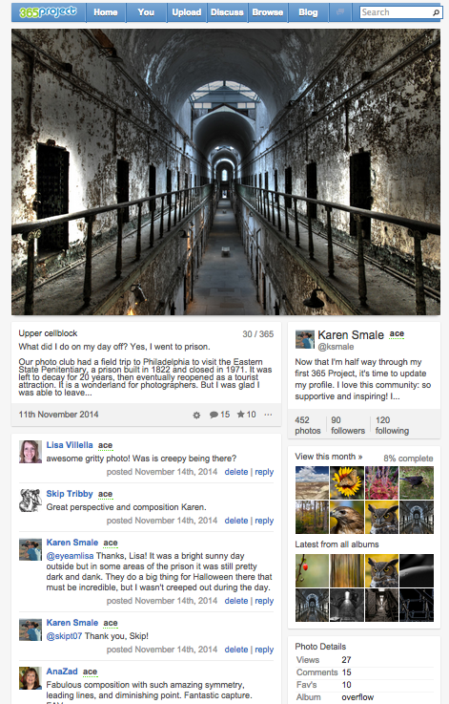
Your Feed
(Home)
<<< >>>
(You)
Your latest photo

Slide 7
