Slide 1
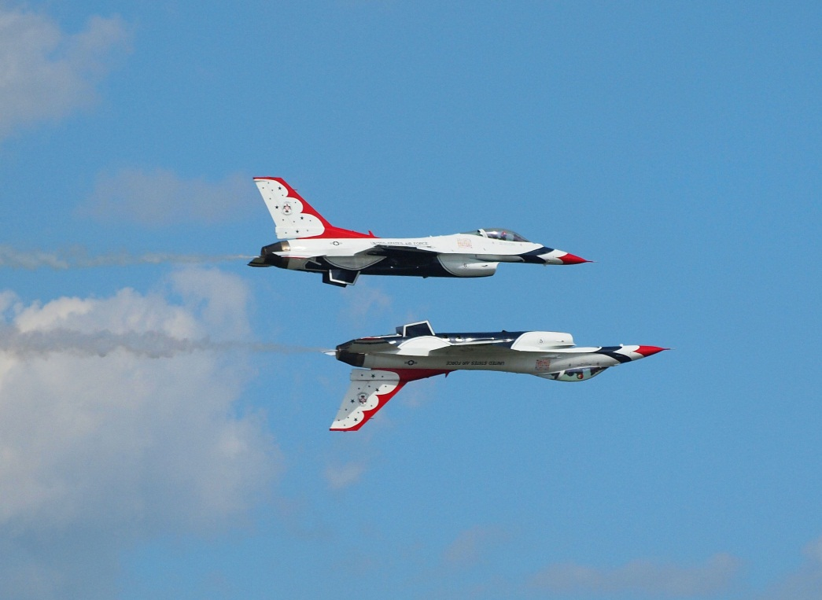
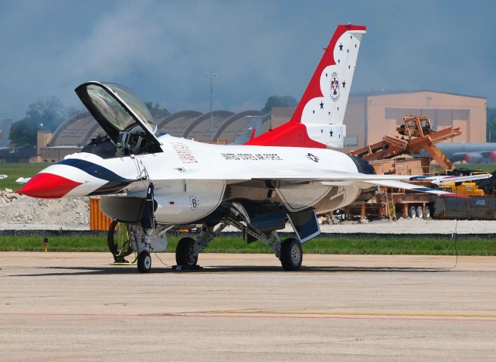
Aerial Photography
Scott Hull
GSFC Photo Club
5/9/2012

Slide 2
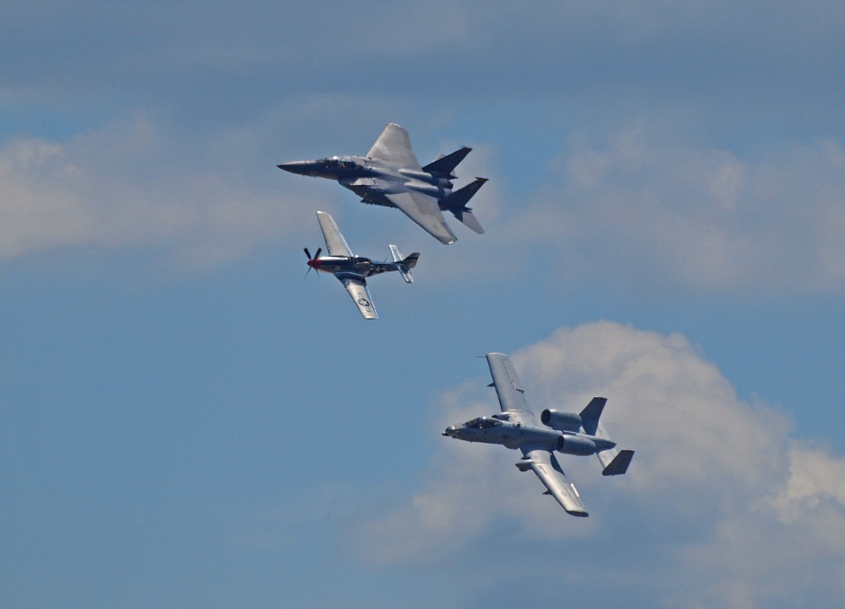
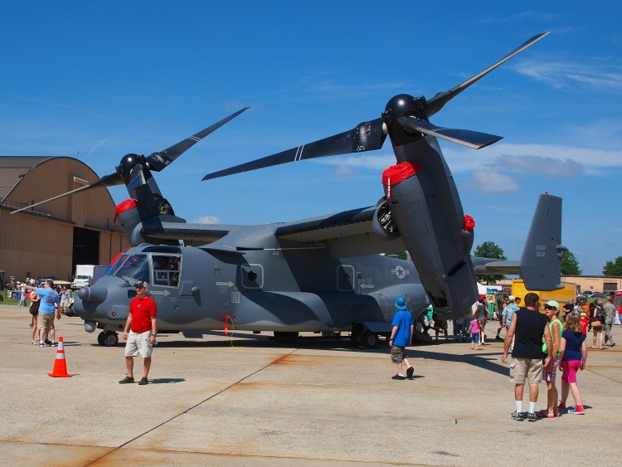
Topics
What to shoot
Flight demonstrations
Static displays
Crowd
When to shoot
Equipment
How to shoot
Exposure modes
Focusing
Files
Shutter speed
Advice
Andrews Air Show details

Slide 3
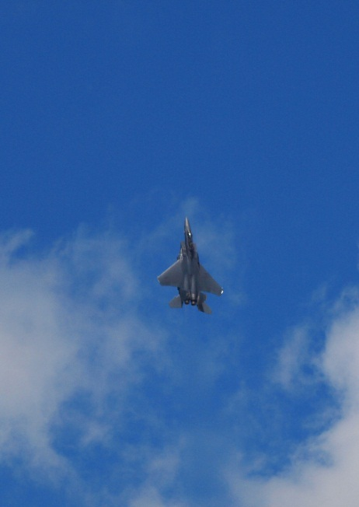
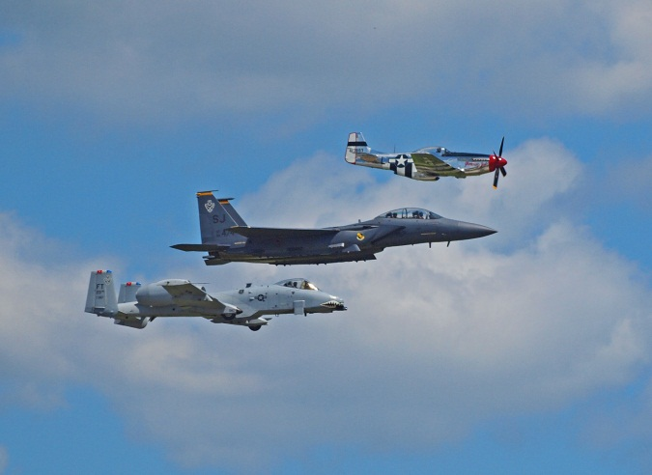
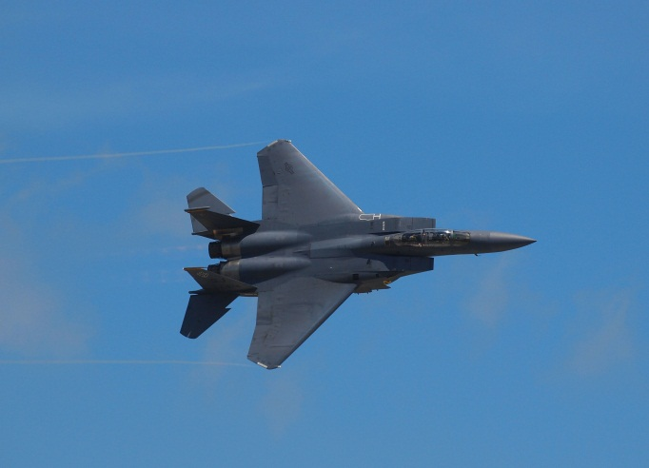
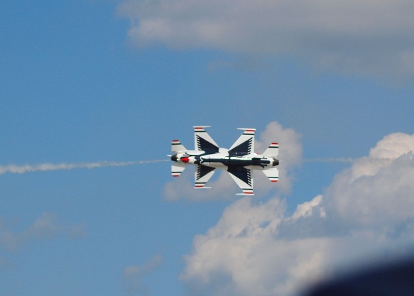
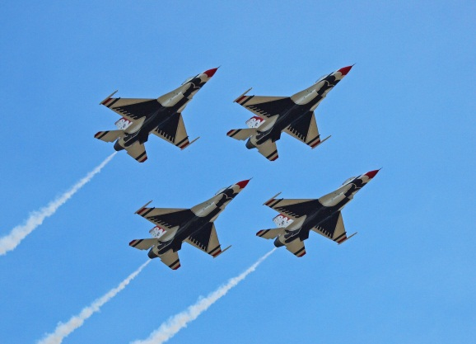
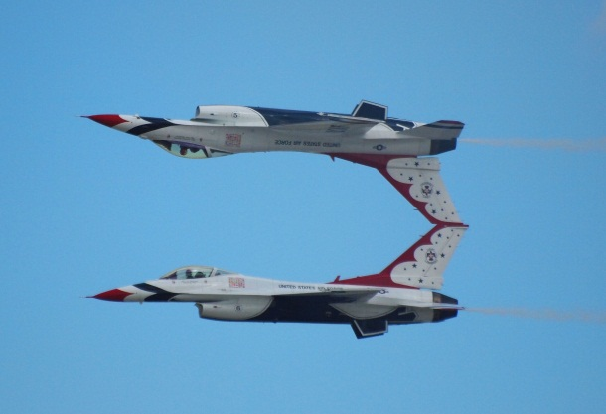
What to Shoot - Aerial Demos

Slide 4
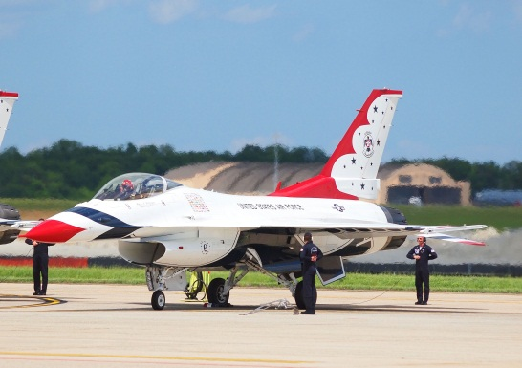
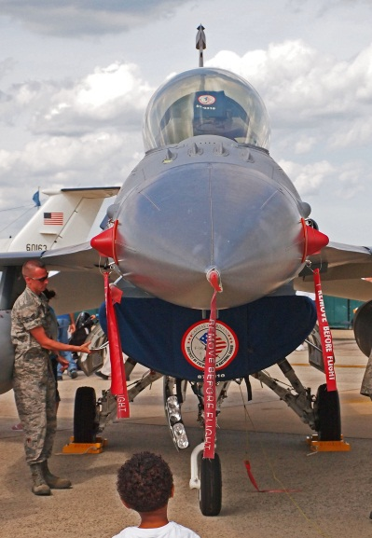
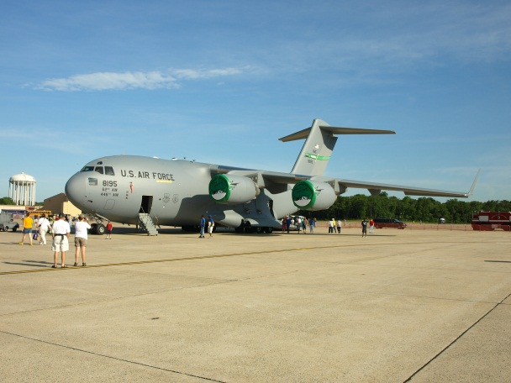
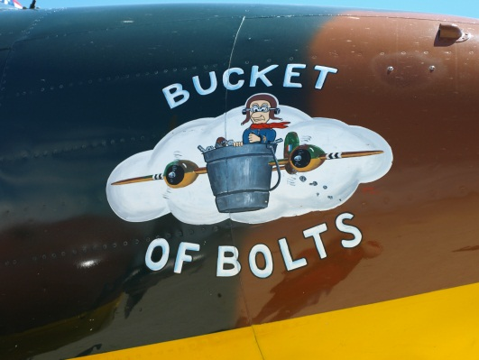
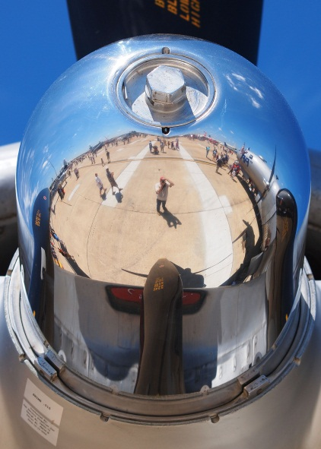
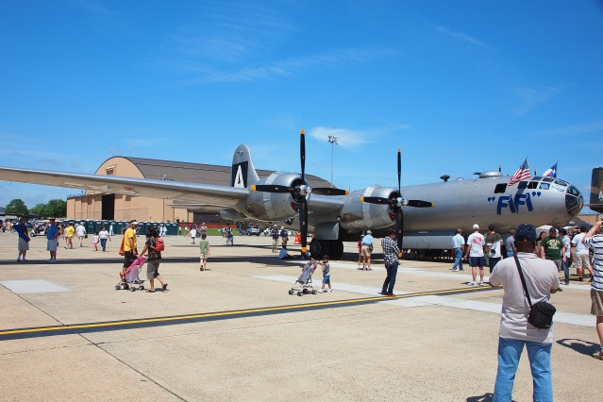
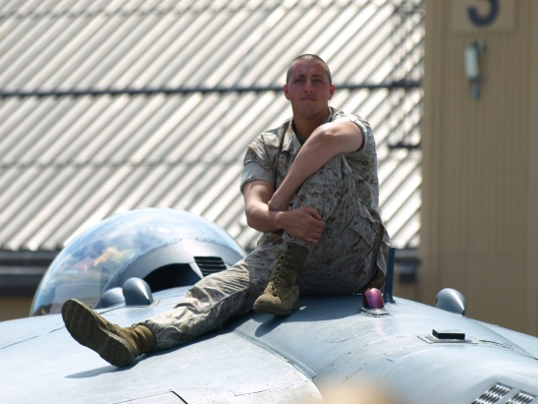
What to Shoot – Static Displays

Slide 5
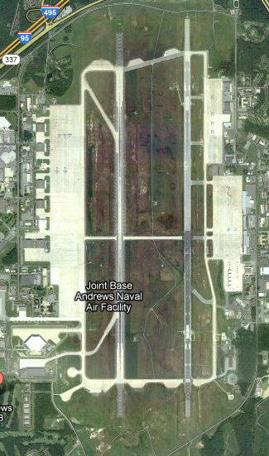
When and Where to Shoot
Static Displays
First thing in the morning
Smaller crowds
Better access to cockpits, etc.
Talk with the exhibitors
Aerial Demos
Throughout the day
Check the sun conditions vs. runway direction
Andrews → North-South
Backlit in the morning
Lit from the right at noon
Perfect in the late afternoon (Blue Angels/ Thunderbirds)

Slide 6
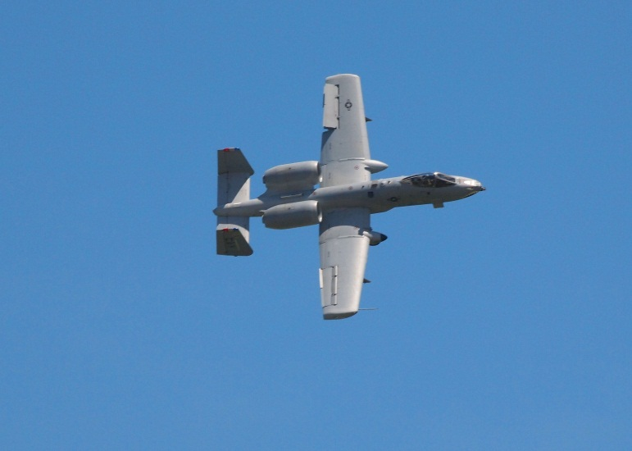
Equipment
Sunscreen / Earplugs / Hat
Wear comfortable shoes
Money
Chair (especially smaller shows)
Camera – DSLR is best, but point and shoot is OK
Lenses – wide zoom for statics, big zoom for aerials
Memory cards – bring all of them
Camera bag / Photo vest / Cargo shorts
Lens hood and Polarizer
Spare battery
Tripod not recommended; maybe a monopod
SUNSCREEN

Slide 7
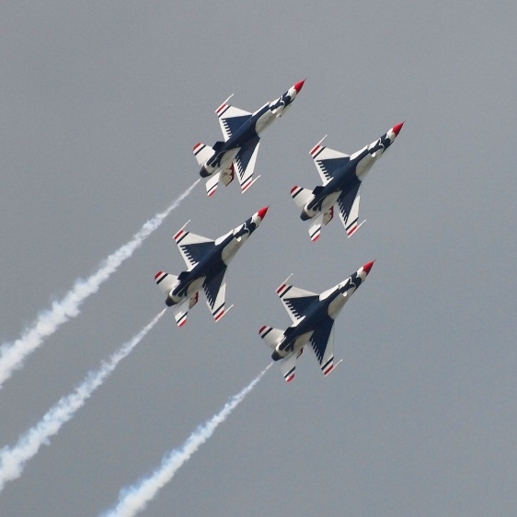
Exposure Modes
Different people have different preferences
Program Mode
Works fine, but less control
Aperture Priority Mode
Wide open aperture during aerial demos, for max speed
Shutter Priority Mode
Set for a fast speed, and hope for enough light
Works best with Auto ISO
Manual Mode
Consistent exposures, despite the lighting
Center weighted or ESP metering
Take a few test shots, and adjust with exposure compensation

Slide 8
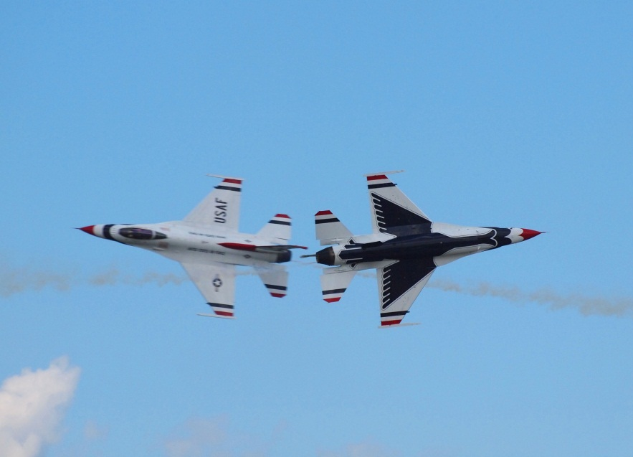
Focusing
Again, varies by the photographer
Can be equipment-driven
Auto Focus
Continuous AF
Tracking (auto focus point selection) if you have it
Best with really fast lenses
Manual Focus
Sometimes you get ‘focus-search’ problems
Focus on a cloud or distant object, and leave it alone
Check after the first shot or two, and tweak
Actually, shutter speed is just as important as focus to getting a sharp picture – need a fast shutter for less blur

Slide 9
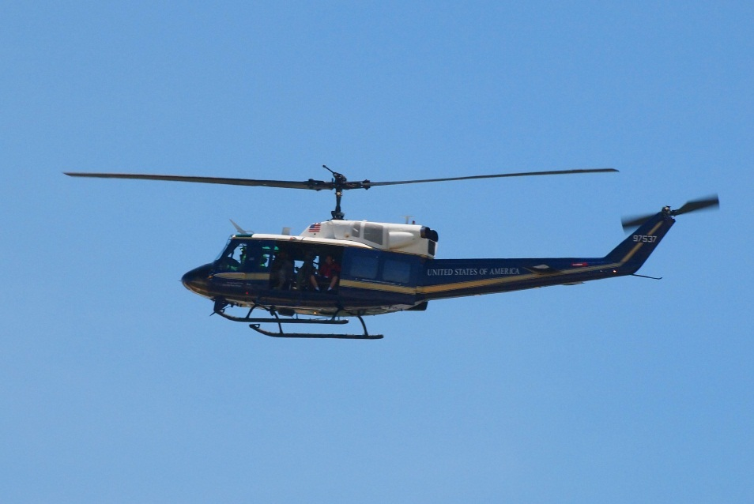
Shutter Speeds / File Types
Shutter Speed
Aerial jet demos: Speed faster than 1/ (2 x Focal Length) sec
300 mm zoom → 1/600 sec or faster
Rotors (helicopter or plane): 1/125 to 1/180 sec ↓
Static displays: less critical, since they are not moving
File Types
JPEG
Faster saving for aerial shots
Takes longer to fill the buffer
RAW
More adjustable later
No losses
Oops! f/9, 1/800 sec Don’t do this!

Slide 10
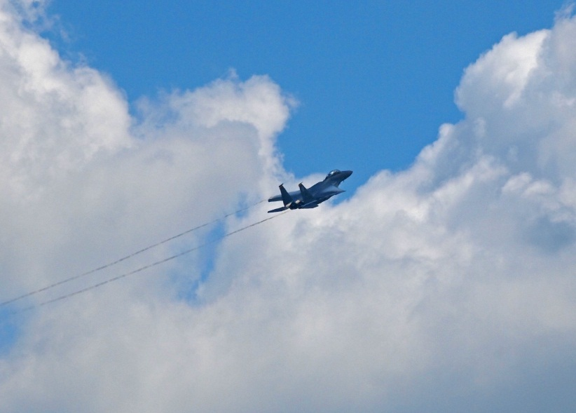
Composition
Aerial demos
Front and side shots are best
Avoid tail shots or belly shots
Exception: tail shot with afterburners, climbing and turning
Leave some room for cropping in post-production
Planes are usually too fast to worry about placement in the frame
Try to lead ahead of the plane, so it has somewhere to go in the final image
Vapor clouds give a sense of speed
Static displays
Overall plane shots are nice for documentation
Close-ups of machinery, guns, cockpits are more fun and artsy
Try crazy shots – they’re only electrons

Slide 11
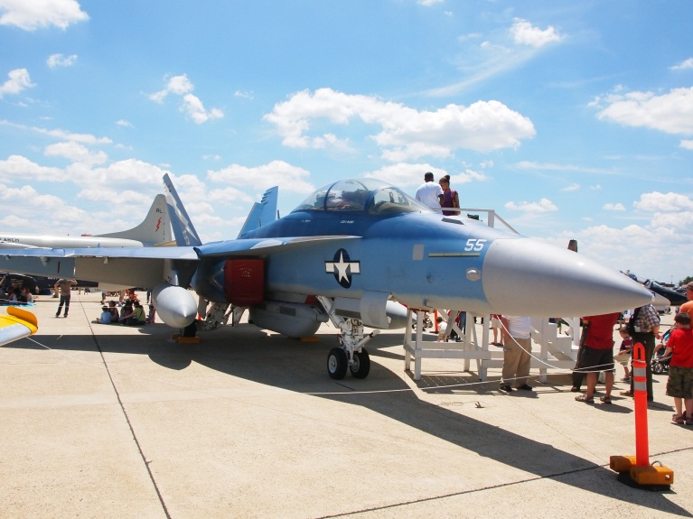
Other Advice
Check security restrictions ahead of time
Be aware of obstructions and sun angles
On cloudy days
The aerial shows will be lower altitude
Bump up your exposure 1 to 1.5 stops; camera will meter on clouds
Rapid fire exposures, Image stabilization turned on
Keep your ISO as low as possible, to reduce noise
The aerial show is geared toward show center, but the action is equally visible back away from the crowd
Bigger acts are usually late in the day (with better light!)
Save some memory card space for them!
Check your display often: is what you’re doing working?
DON’T MISS THE SHOW!!

Slide 12
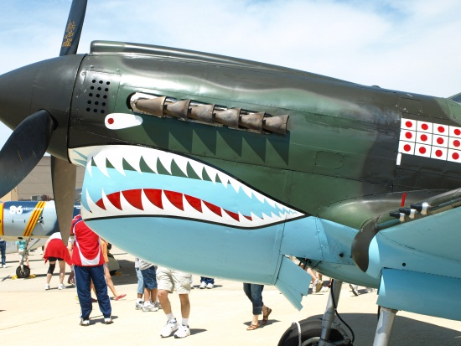
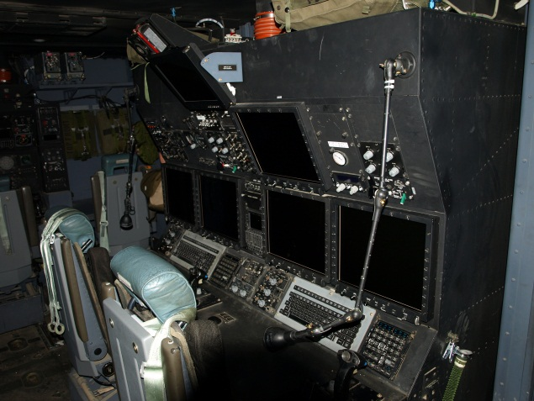
References
http://digital-photography-school.com/air-show-photography-a-guide-for-beginners
http://www.profotos.com/education/promag/articles/jan2004/airshow/
http://www.richard-seaman.com/Photography/Airshows/index.html
http://www.airandfeel.com/ Good artsy inspiration

Slide 13
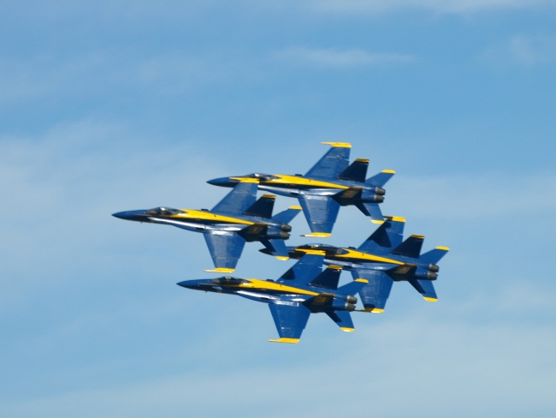
Andrews Open House
May 18 (DoD only), 19, and 20, 8 AM to 5 PM
Free admission; most concessions benefit veterans
Park at FedEx Field; free shuttle departs from 8 am to 1 PM
Camera Bags (Smaller then 1 cubic foot) allowed
Tripods and monopods allowed
Fanny packs allowed
NO FOOD OR DRINK ALLOWED: no coolers, camel packs, etc.
See http://jsoh.org/index.html for details
Reserved seating packages may still be available
Meet near the NASA Super Guppy at noon, or text my cell phone (do not call by voice) 443-745-8618

Slide 14
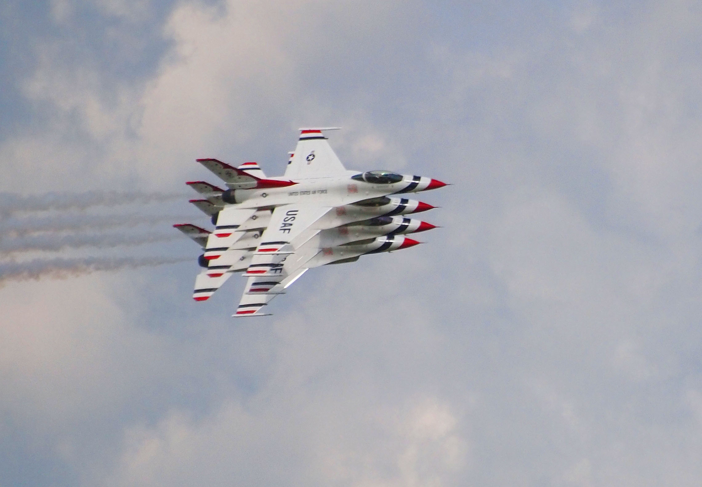
Other Shots

Slide 15
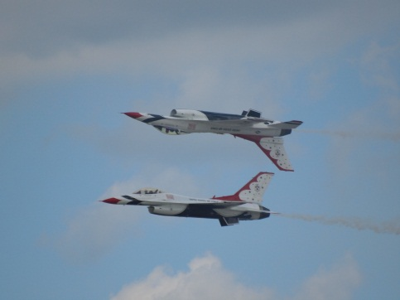
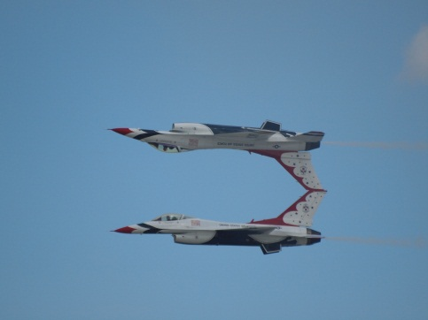
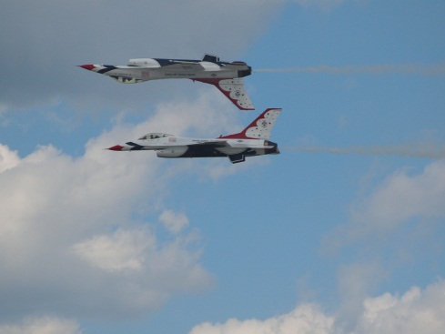
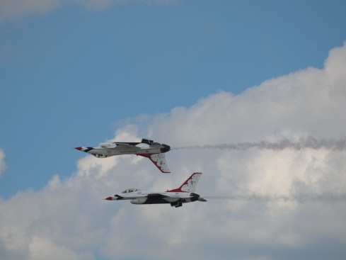
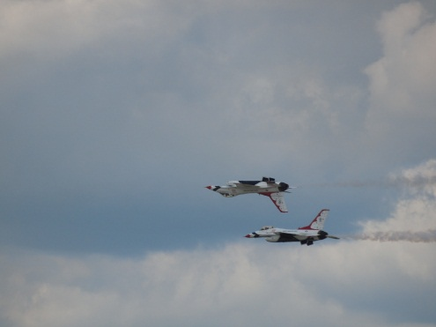
24 Images of one pass, to use 1
Notice how the subject bounces around the frame, despite my best efforts; unretouched images

Slide 16
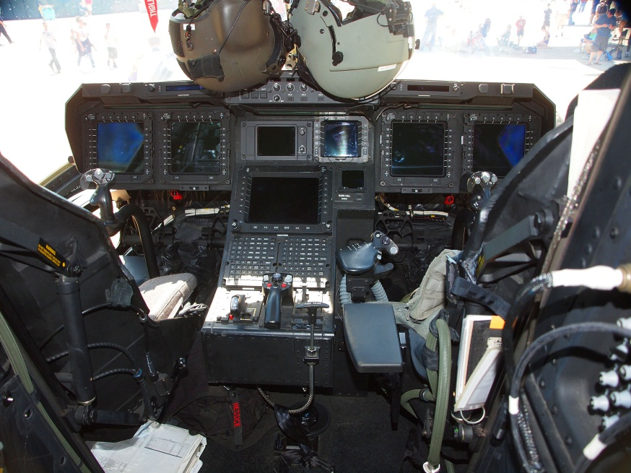
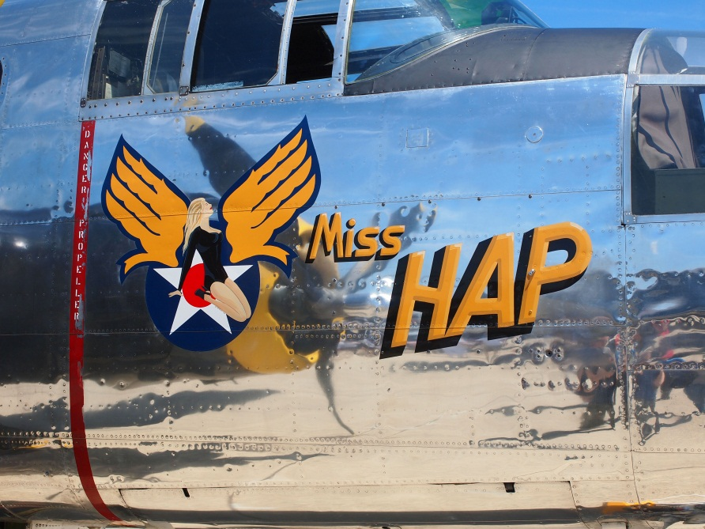
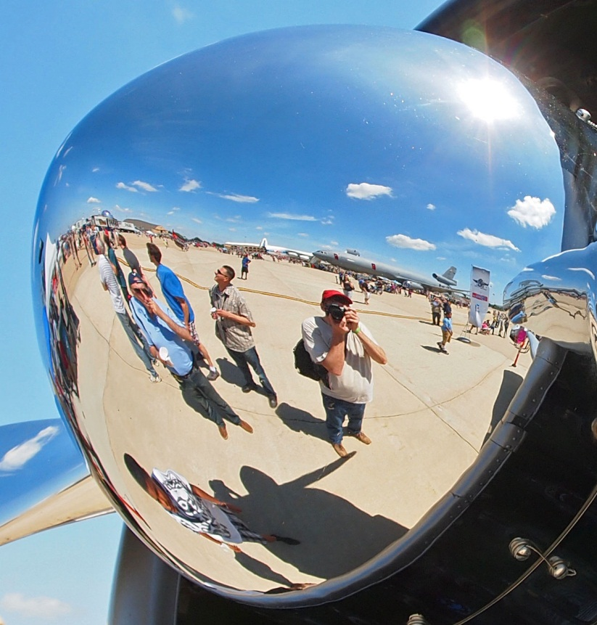
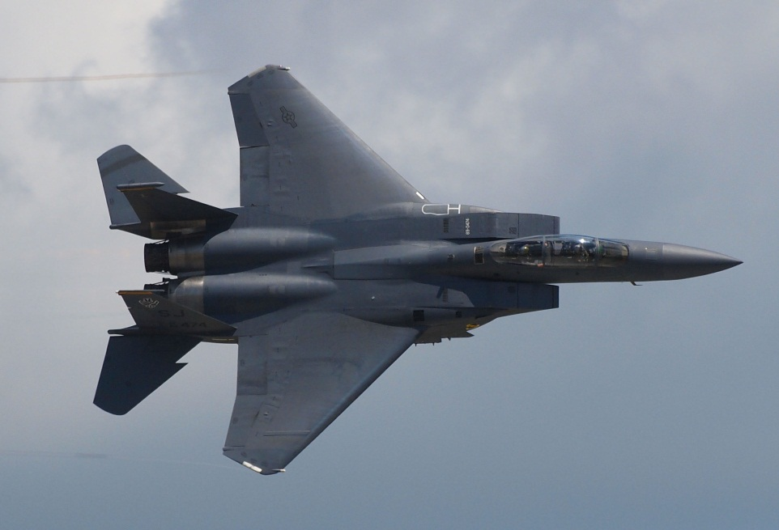

Slide 17
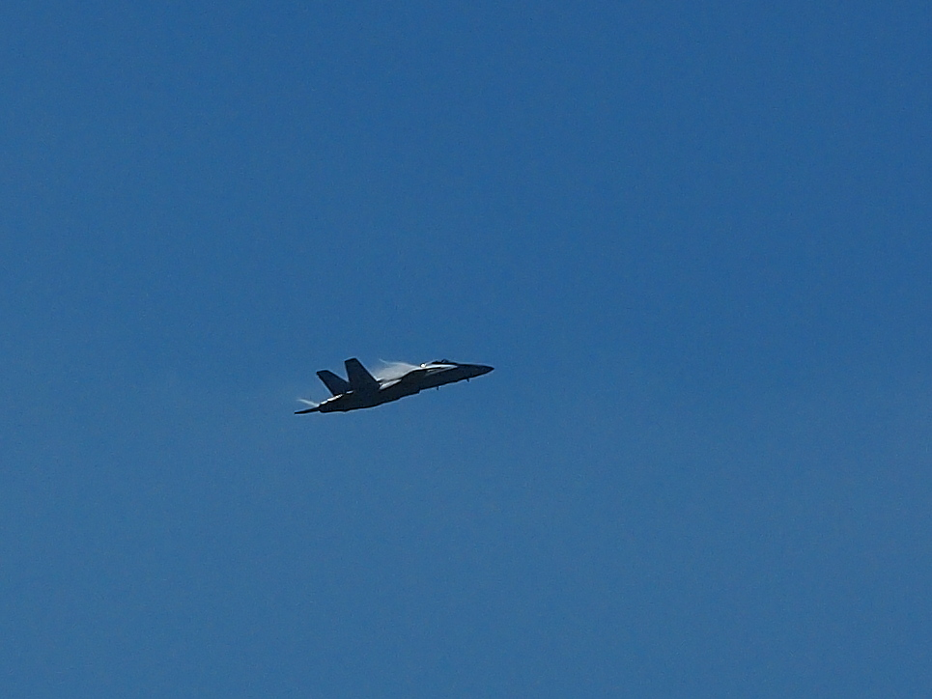
Vapor Trails

Slide 18
Afterburners

Slide 19
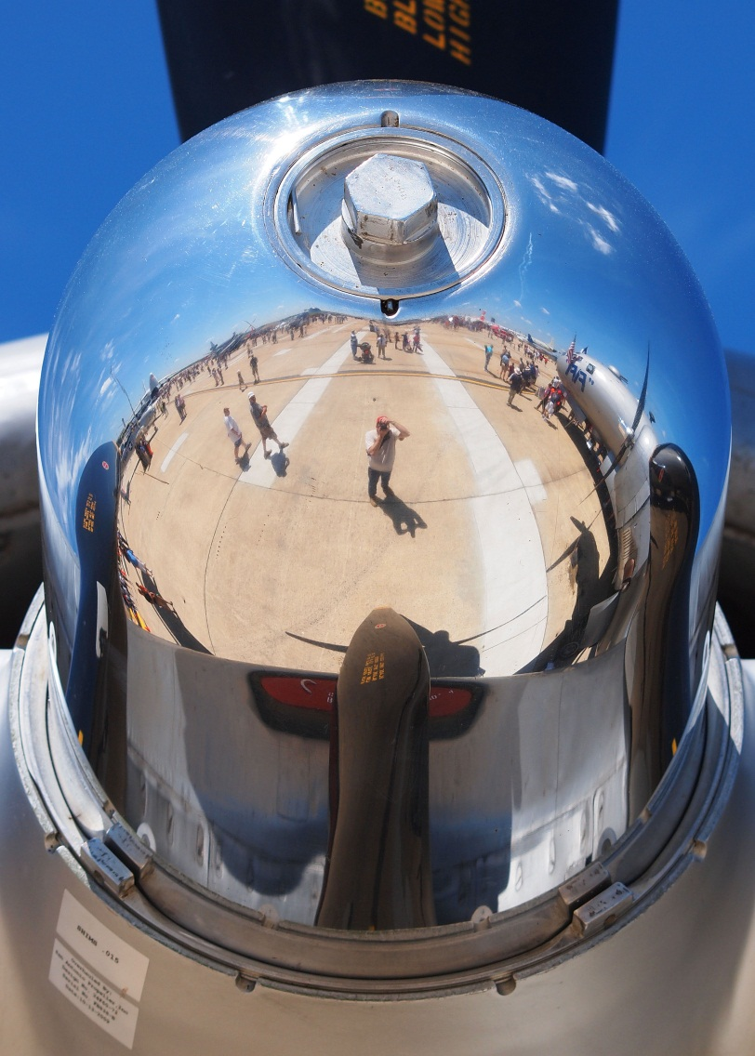
Fifi’s Rotor Hub

