Slide 1
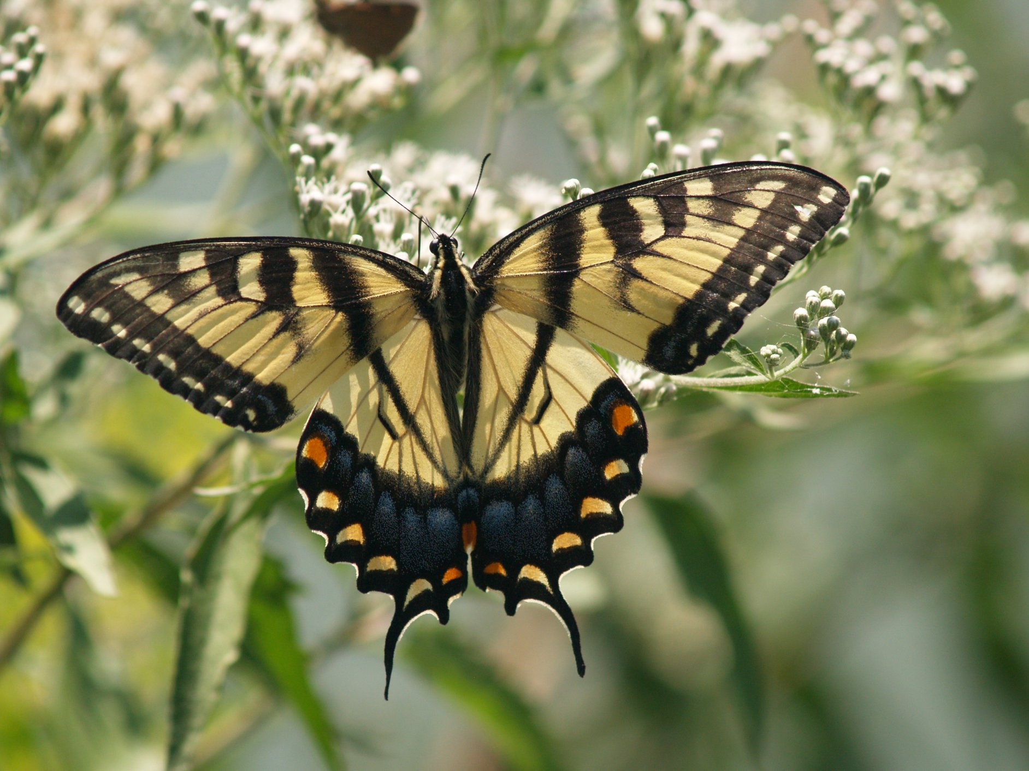
Introduction to Photography
Joel Gambino

Slide 2
Camera Obscura
Mo-Ti, 400 BC
Room with a reflective wall and a hole in the opposite wall
Light rays passed through the hole and created an inverted image on the wall
Not Portable - Led to the Pinhole Camera
Pinhole camera was portable, but aperture was small and image was not permanent

Slide 3
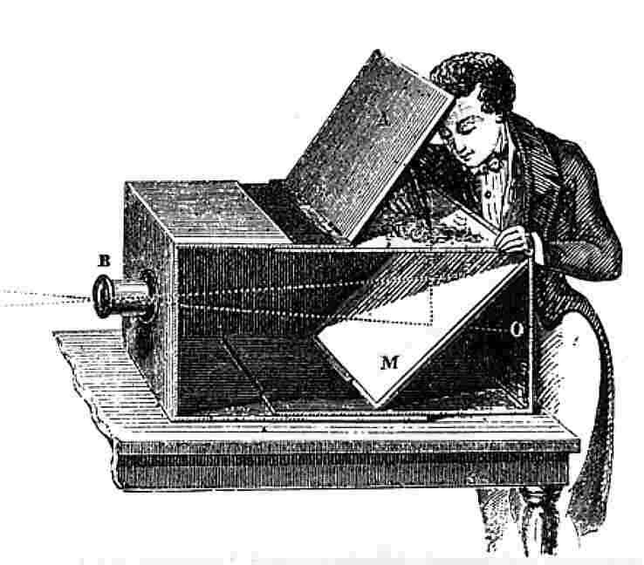
Camera Development
Added Lens
Add Mirror to right image
Eventually (1827) a permanent image was created by Nicéphore Niépce on a pewter plate coated with bitumen.

Slide 4
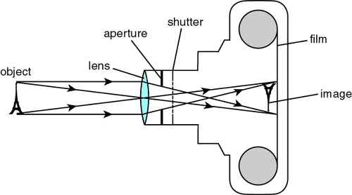
Elements of a Camera
Lens: focus and aperture
Shutter
Focal plane
Film or Sensor
Light Meter

Slide 5
How an Image is Made
Light waves from the subject arrive at the lens.
The lens focuses and opens the proper aperture.
The shutter opens for the proper time and the film or Sensor is exposed to the image.

Slide 6
Aperture, f/ number
Describes how large the lens opening is.
Large aperture = large lens opening
Large f/ number = small lens opening
Controls depth of field
f/ number = focal length/effective aperture

Slide 7
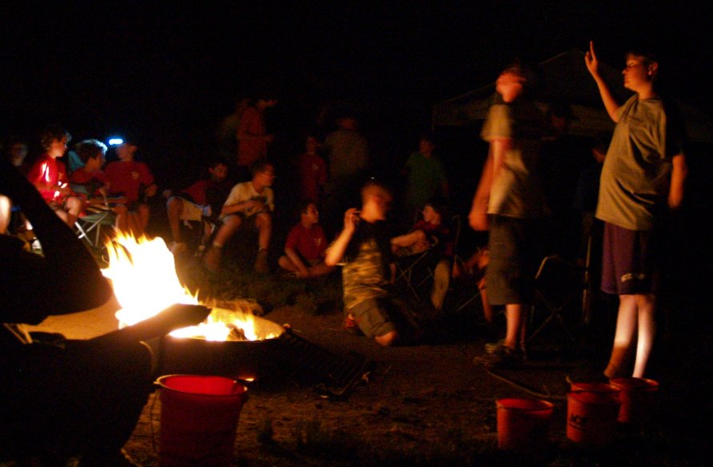
Exposure
Shutter Speed
How long the focal plane is exposed
Aperture
How much light passes through the lens
Preview (stop down) for depth of field
ISO (sensitivity)

Slide 8
Exposure Trio
Aperture: Controls depth of field
Shutter Speed: Controls stop action
ISO / Sensitivity: Noise increases with increasing ISO value

Slide 9
High ISO Noise (ISO 3200)
1/10 sec, f/3.9, ISO 3200

Slide 10
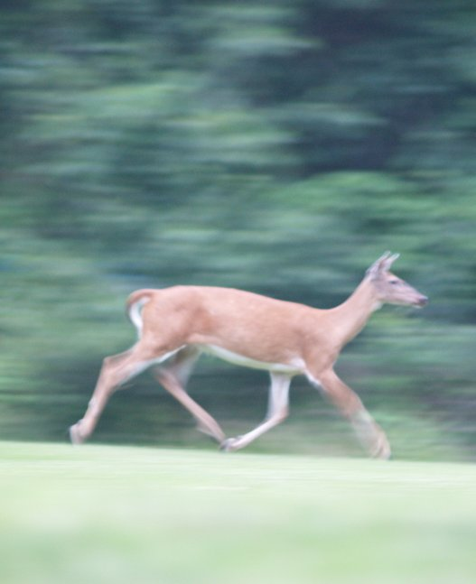
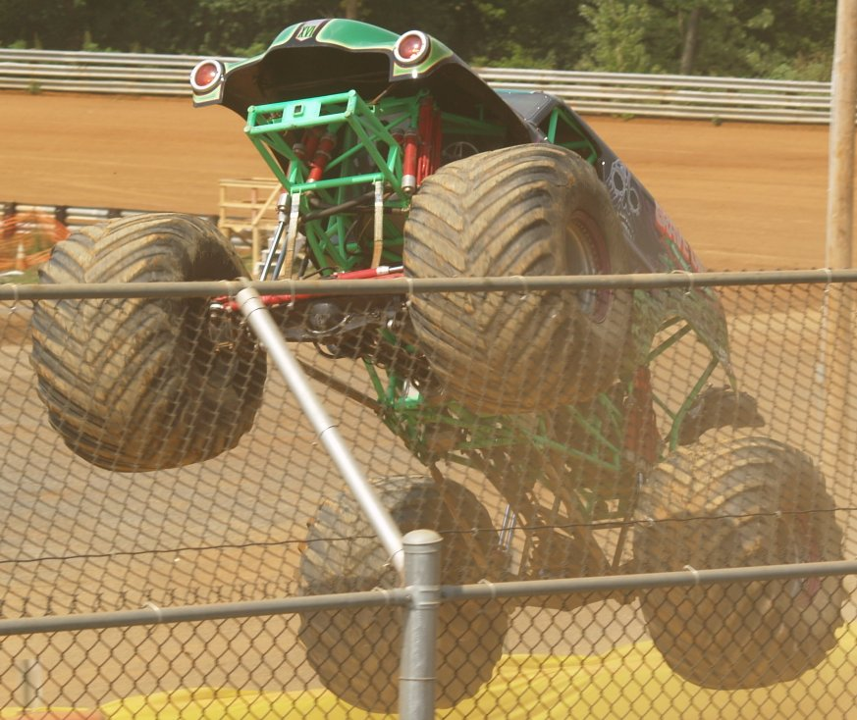
Shutter Speed
Too slow: Blurred
Fast: Freeze motion

Slide 11
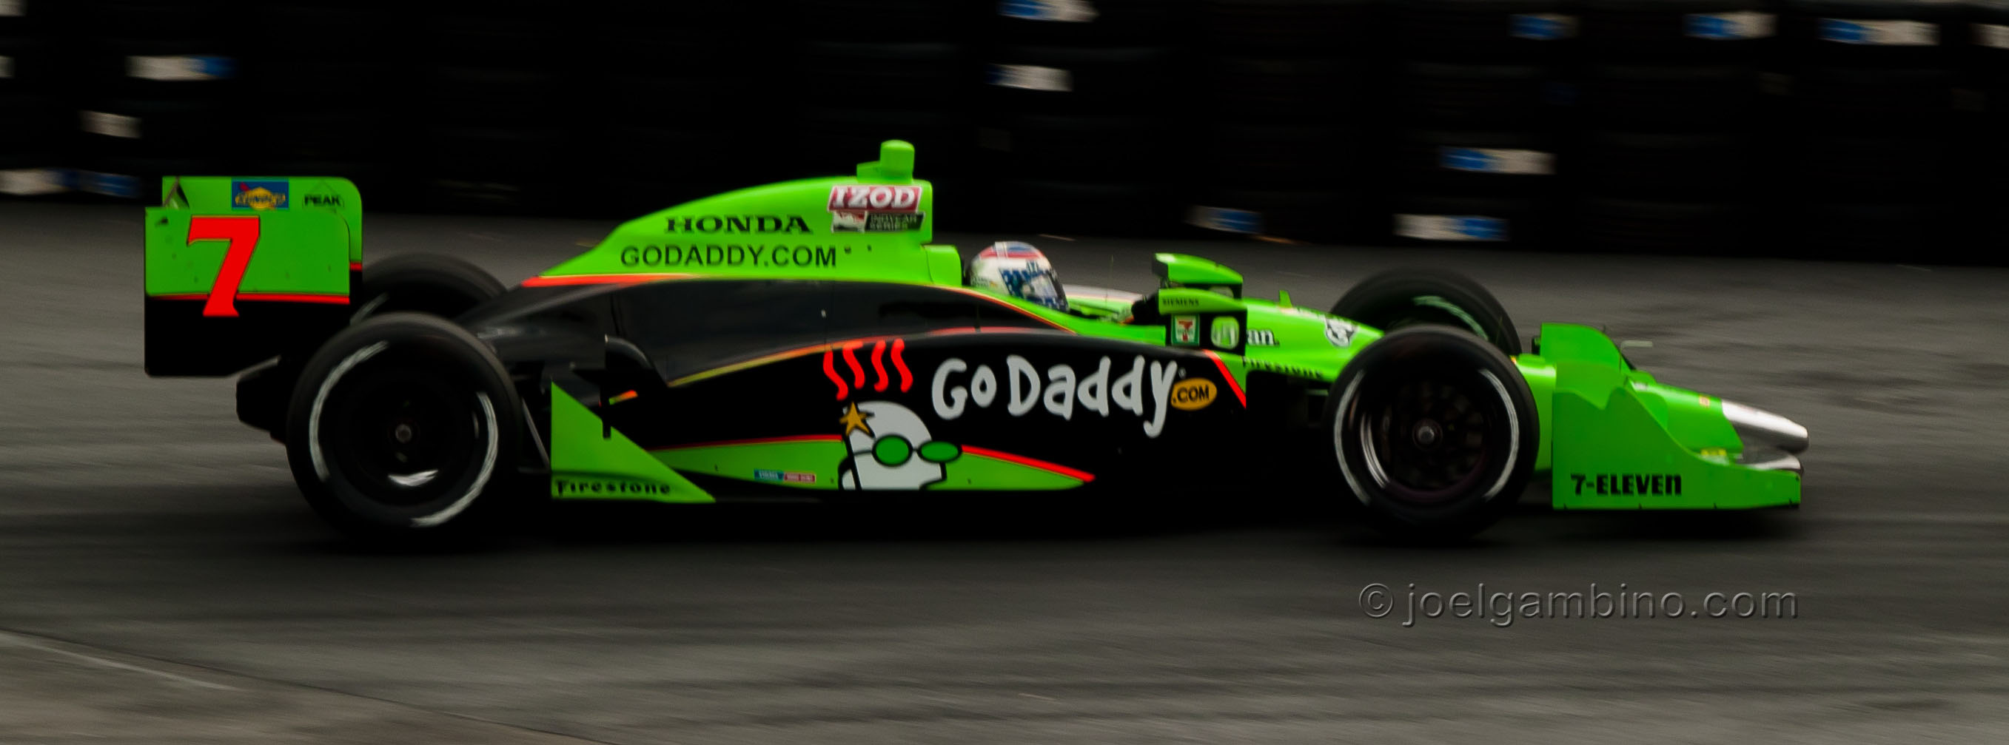
Pan Shot
ISO 200, 1/200 sec, f/7.1

Slide 12
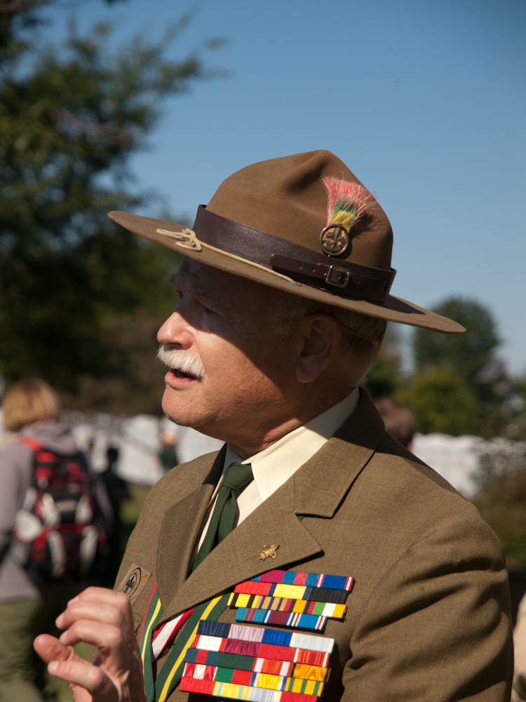
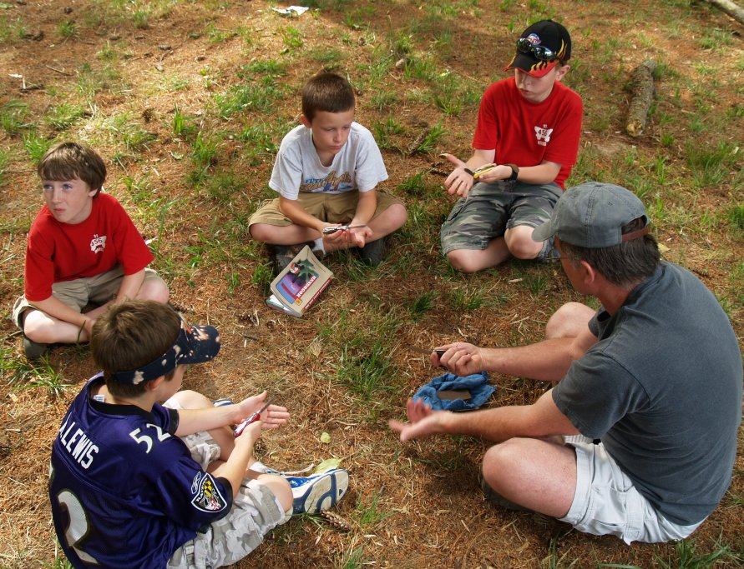
Natural Light
Direct sunlight: Shadowing
Diffuse light: Softer

Slide 13
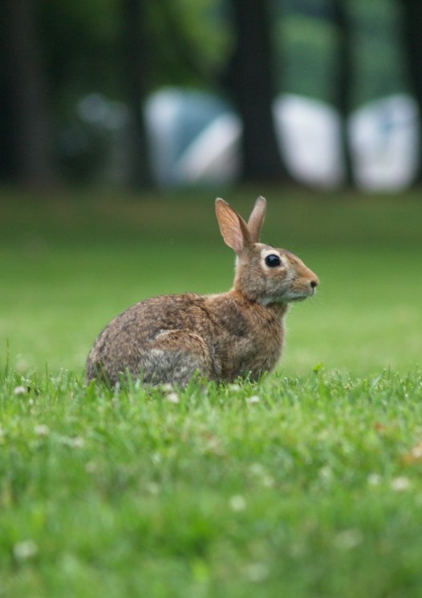
Depth of Field
The range of distance that is in focus
Smaller apertures increase depth of field
The effect is more severe with extreme close ups

Slide 14
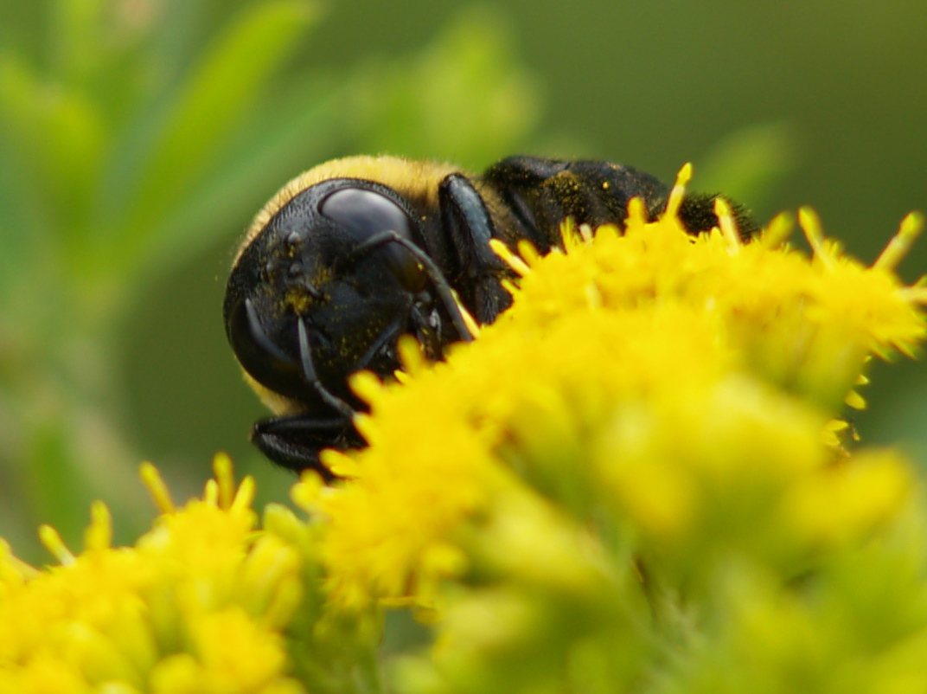

Slide 15
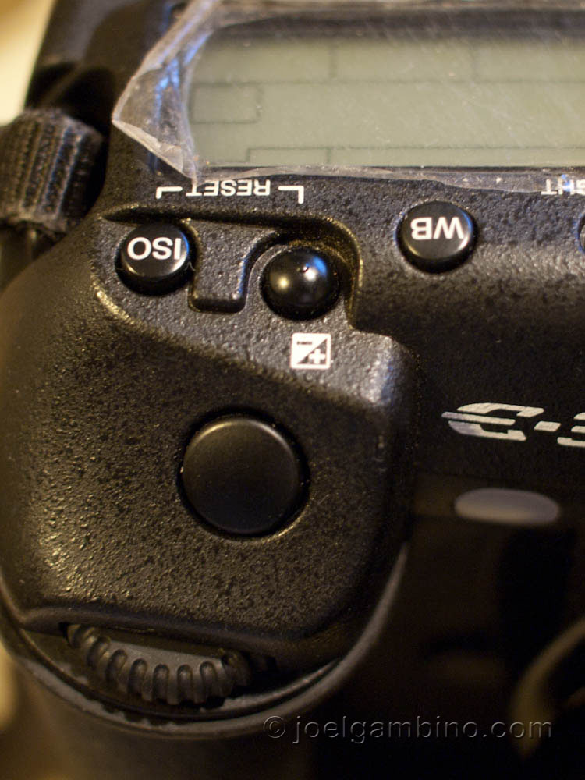
Exposure Compensation
+/- Button
Use to bias the metered exposure
1/3 (0.3) stop increments
Use with highlight preview to avoid blown highlights

Slide 16
Exposure Compensation Example
0.0 Exposure would make this look like daytime
- 1.0 Gives the dark mood that we’re looking for
1 sec, f/2.8, ISO 800

Slide 17
Color Balance
Color Temperature
Adjust for incandescent and fluorescent lighting

Slide 18
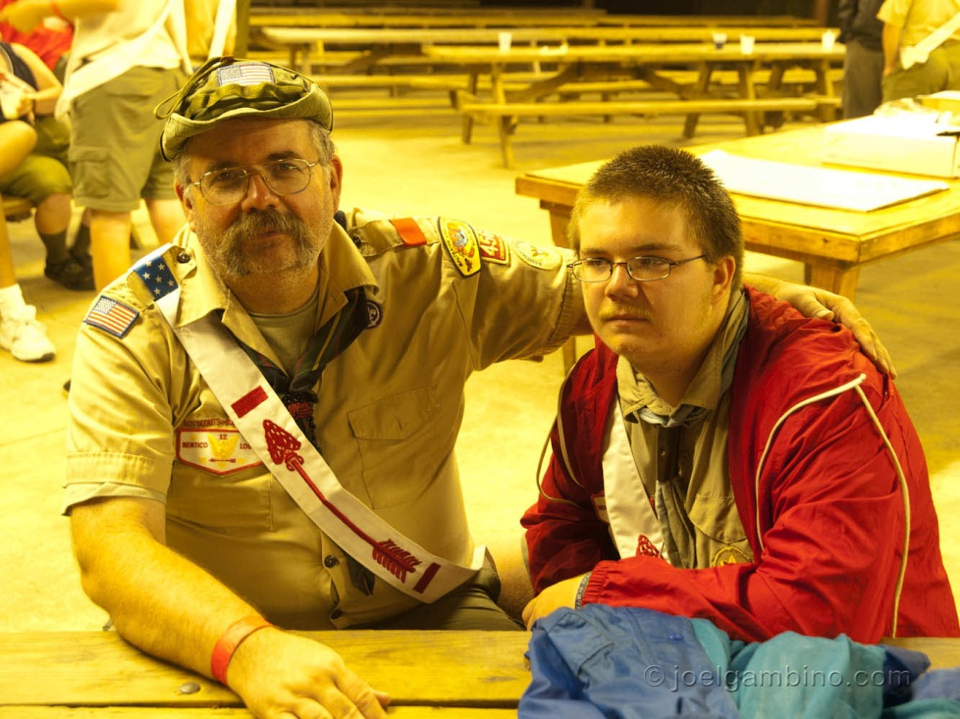
White Balance Adjustment
Uncorrected
Camera set to fluorescent

Slide 19
Using Flash
Stop Action
Allow higher ISO, smaller apertures, and/or faster shutter speeds
“Overwhelm” the background
Fill flash when subject is back lit
Force the flash on
Slow Sync
2nd Curtain
Flashlight/room lights: doesn’t have to be flash

Slide 20
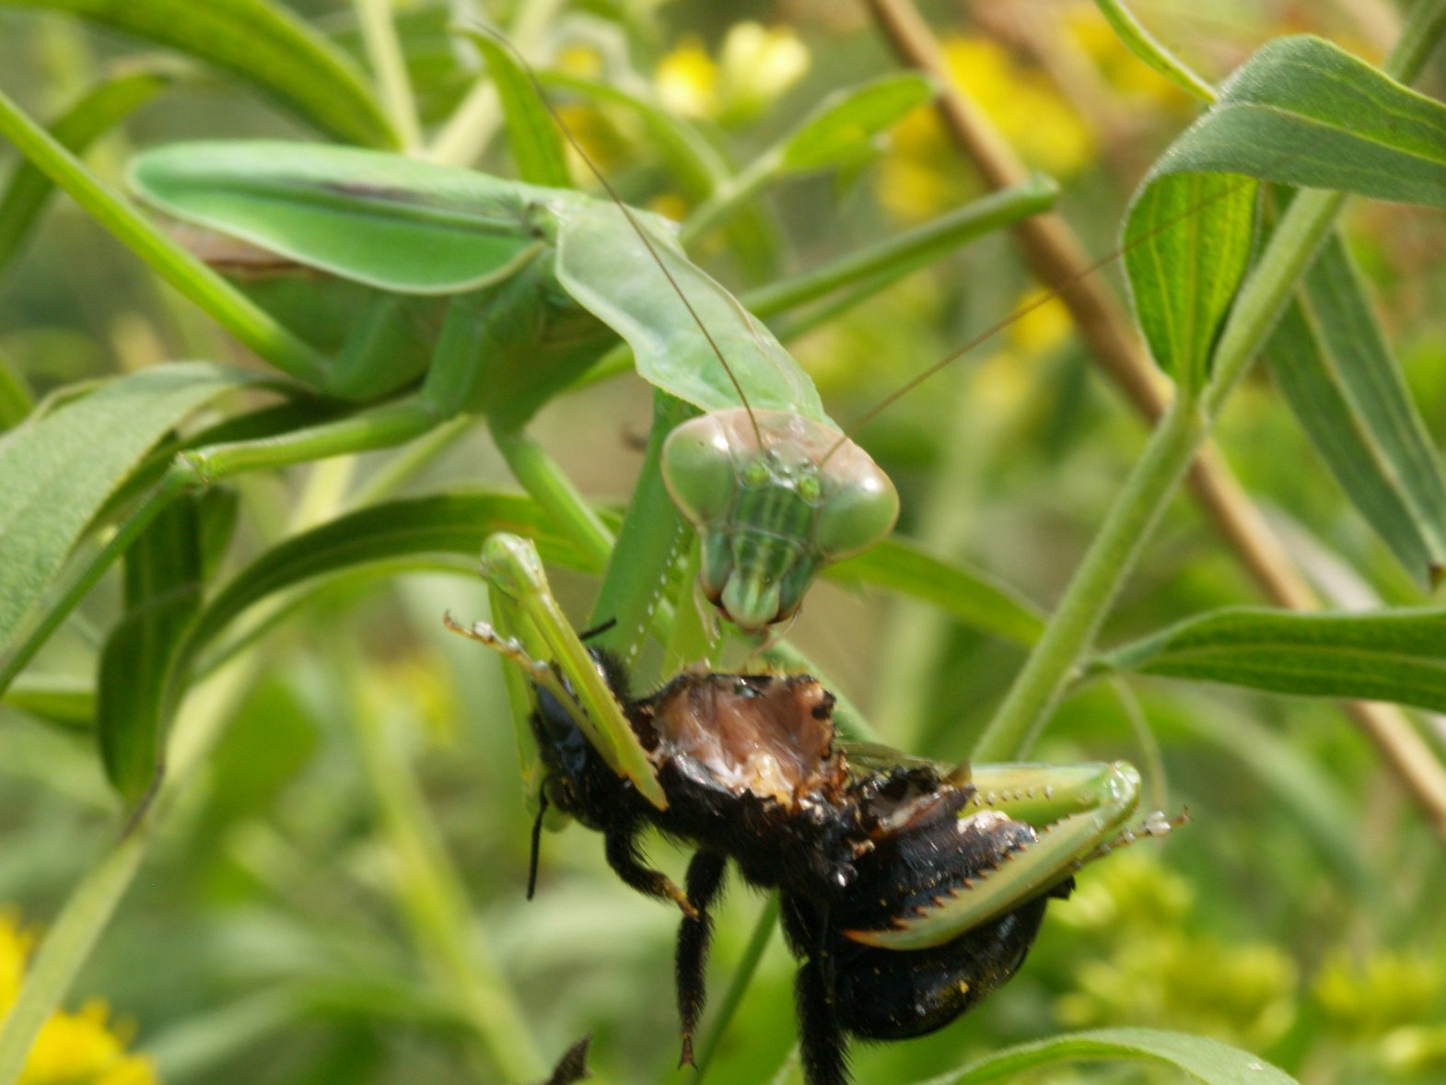
Any Questions?

