Slide 1
GSFC Photography Club Introduction to Digital Photography Class Session 2 – Camera Mechanics
Scott Hull
2/6/2012
Notes:
Welcome to the second session of our first-ever Introduction class. I’m sure that I will learn as much from you as you learn from me. Part of that is learning what works for teaching, and what doesn’t. Please give me some feedback after the class, and let me know what worked and what didn’t.
The class admittedly concentrates on DSLRs. This is intentional, because they are generally more complex. If you can understand how a DSLR works, you will likely understand a point and shoot or bridge camera better. You might learn a little more than you strictly need, but that’s just a bonus. Besides, if you really get into digital photography, you will probably want a DSLR eventually anyway, so you’re informed and ready when you get there.
I can’t promise you that every word in here is strictly correct. I can promise you that it is genuinely what I believe is correct. Whenever you get several photographers together, you will have different opinions, different terminology, different ways of looking at things. This is what works for me, and I hope it works for you. If not, let’s work on it. I try to be available any time to answer questions, either by e-mail or at lunch time. If you need help, just ask, and we’ll work something out. The questions I can’t answer are the best ones, because that means I get to learn, too.
Let’s have fun!

Slide 2
Agenda
Terms
Exposure Review
Camera Types
Camera Parts
Memory Cards
Camera Settings
Shooting Modes and Scene Modes
Lenses
Filters
Flash
Gadgets
Notes:
There is a LOT to cover in this session. I thought an hour would be tight, but now I see that two hours might not be enough. I’ll get as far as I can, then send the slides and notes with you. We can add a session to discuss the rest, if you want. Believe it or not, I left out some stuff.

Slide 3
Terms
ISO (ISO = ASA) (adjustable)
The sensitivity of the CCD sensor chip
Aperture (adjustable)
The amount of the lens diameter that you use
White Balance (adjustable)
The color correction for the light you are in
Optical vs. Digital Zoom
Optical zoom is when the lens moves to expand or contract the image
Digital zoom is a marketing tool – basically just cropping
Live View
The ability to view the image on the display while you compose the shot
Notes:
These are some basic terms we will use, or that I think you should know. If you don’t understand them from this brief description, you may catch on as we use the terms. If you still need help, Wikipedia is an excellent source of general reference information, and I’ll be glad to answer questions.

Slide 4
Stops
A whole ‘stop’ is a change in the amount of light by half or double
1/250 sec ←→ 1/125 sec ←→ 1/60 sec
400 ISO ←→ 200 ISO ←→ 100 ISO
Aperture numbers change by a factor of 1.4
Square root of 2, since double the light is 2x area
Area of a circle is π r²
f/4 ←→ f/2.8 ←→ f/2
Most cameras also show partial stops
Notes:
I promise, this is as bad as the math will get.
Throughout all of photography, the term ‘stops’ is used a lot. It simply means a change of either multiplying or dividing by two. Occasionally, it is easier to round off, like 1/125 to 1/60, but in general it is a straight factor of two.
When we talk about apertures, though the f-stop changes by a factor of 1.4 in order for the light to change by double or half. That’s because the f-stop number refers to the size of the aperture, and the amount of light is determined by the area of the aperture opening. 1.4 is the square root of 2, so changing from f/4 to f/2 is a change of two stops.

Slide 5
Exposure Review Sunny 16 Rule
Stop Action
Tripod Zone →
On a sunny day, at f/16, the shutter speed is 1/ISO
Notes:
By way of a quick review of exposure, the classic rule says that on a sunny day, the correct shutter speed at f/16 is one over the ISO. This gives you one point, but if you want to shoot at something other than those conditions, what do you do? The line here shows what happens if you add 1 or more stops to the aperture size (lower f/ numbers), and subtract the same number of stops from the shutter speed.
Also notice that this graph shows the whole stop designations. Most cameras also display 1/2 or 1/3 partial stops in between, which can be confusing at first.
Graphics by the author

Slide 6
Exposure Review Sunny 16 Rule
Stop Action
Tripod Zone →
On a sunny day, at f/16, the shutter speed is 1/ISO
These ISOs are one stop apart.
Notes:
Another way of adjusting the exposure is to change the ISO of the sensor. This graph shows the ISO 100 line from before, as well as lines for ISO 200, 400, 800, etc. Note that just like aperture and shutter speed, the ISO is changed by one stop each time. Any point on any of these lines should have the exact same exposure. (it isn’t truly exactly the same, but we’ll save that for the advanced class)
Graphics by the author

Slide 7
Exposure Review Sunny 16 Rule – in the shade (-2 stops)
Stop Action
Tripod Zone →
At f/16, the shutter speed is 1/ISO + 2 stops
1/100 sec + 2 stops more light is 1/25 sec
Notes:
In shady conditions, the amount of light is a couple stops less, so the exposure needs to let in a couple stops more light. Notice that now we’re starting to inch into the ‘tripod zone’, but we can still shift ISO or aperture if we don’t have a tripod handy.
Graphics by the author

Slide 8
Exposure Review Sunny 16 Rule – indoors (-4 stops)
Stop Action
Tripod Zone →
At f/16, the shutter speed is 1/ISO + 4 stops
1/100 sec + 4 stops more light is 1/6 sec
Notes:
Indoors, there is a couple stops less light than we had in the shade. Again, shifting the ISO and/or aperture may be preferable to the long exposure at f/16 and ISO 100.
Graphics by the author

Slide 9
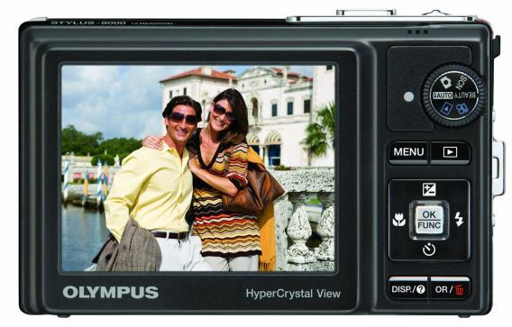
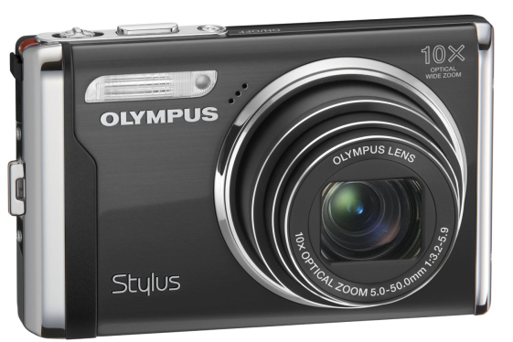
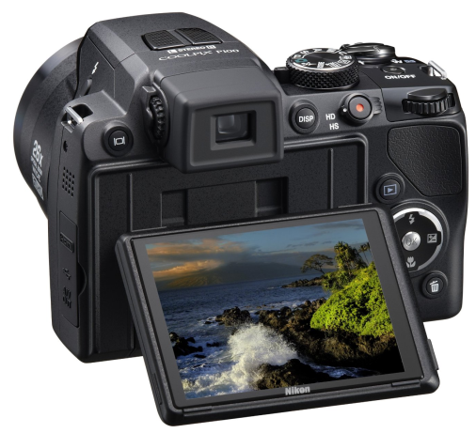
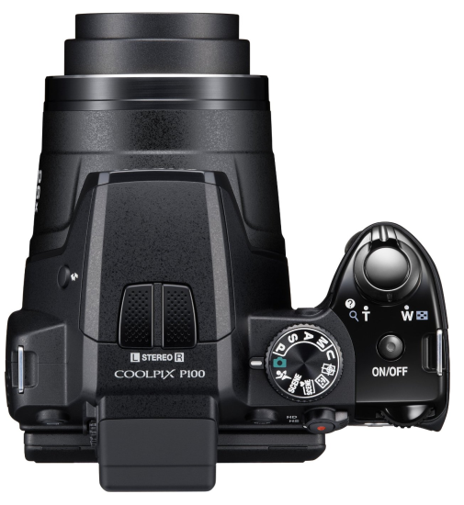
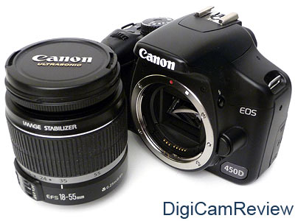
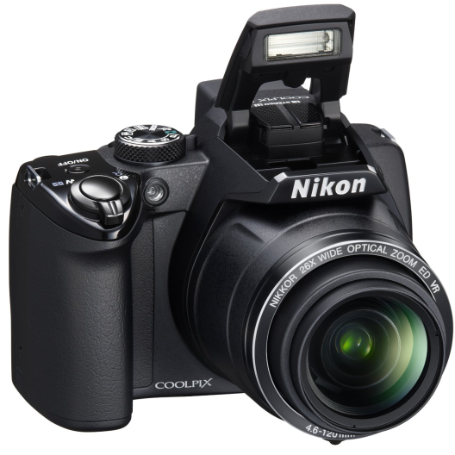
Camera Types
“Pocket”
Camera
“Point
and Shoot”
DSLR
Digital Single
Lens Reflex
“Bridge”
Camera
Notes:
These are three typical types of digital cameras, but by far not a comprehensive list. Another very popular recent addition is the Mirrorless Interchangeable Lens Camera (MILC), including the Olympus PEN line, Sony’s NEX series, and Panasonic’s DMC-G series. This is one style were the ‘big two’ (Canon and Nikon) are coming late to the party, but they are reportedly coming on strong.
I have only recently heard the term ‘bridge camera’ used as shown, but I wanted to distinguish between the very compact pocket cameras and the next step up in size. The term ‘point and shoot’ has been used as a generic term to describe both of these styles.
Pictures from:
http://www.amazon.com/Olympus-Stylus-9000-Stabilized-Black/dp/B001P06PXU
http://www.amazon.com/Nikon-P100-Vibration-Reduction-Black/dp/B0034XFG86/ref=sr_1_1?s=electronics&ie=UTF8&qid=1328500186&sr=1-1
http://www.digicamreview.com/canon_eos_450d_rebel_xsi_dslr_review.htm

Slide 10
Brands
Which is better, Canon or Nikon?
My answer: Olympus
Differences can be subtle
“Feel” – try several, and you’ll know
Layout/ operations tends to follow a pattern
New innovations in one vs. another
Performance vs. image quality
Photographers tend to develop brand loyalty
Lenses are expensive
Easier to shoot in the ‘language’ you know
Choose well, young shutterbug
Notes:
There seems to be a great question among photographers as to which brand is better. The question is rarely asked, but is answered immediately every time you see someone’s camera, because the brand is emblazoned proudly where everyone will see it. Heck, even the camera straps say it, in case you can’t see the front of the camera. It is, largely, the wrong question. The right question is “What brand is better for me?” That one you can only answer for yourself.
The big two manufacturers are clearly Canon and Nikon. In addition to both having usually ten or twelve current offerings (6-7 DSLRs) at different experience and cost levels, there are more after-market lenses and other accessories made for these two brands. However, don’t ignore the others: Olympus, Sony, Leica, Fuji, Panasonic, and Pentax. They are quite often the innovators, developing new ideas first – soon to be followed by the big two, if the idea caught on. The down side of using one of these other brands is that there will be limited support options available for them in future years. This is less a question for point and shoot or bridge cameras, where you probably won’t be looking for that many accessories anyway.
The best thing to do is to go to a real camera store, ask questions, and try them out. This is getting tougher to do now that Penn Camera has scaled back, but you really can’t learn hardly anything from a web site. If there is some annoying button placement, the site probably isn’t going to tell you that, but holding and using the camera for two minutes will. I found very quickly that for me shooting a Canon was like eating left handed – it just didn’t feel comfortable. The Nikon was nice, but not thrilling, and there was a Sony that was almost as comfortable as the Olympus. In the end, I stayed with the Olympus layout that I liked from film days, and that I still had some lenses that I could use with. Your reasons for picking one over another will vary, but how it feels in your hand, and where you expect the buttons to be should be a big driver.
Among the big two, I have always had the feeling that Canon users are looking for performance, and Nikon users value image quality. I could be all wet, but that has been my observation. When there are two dozen photographers shooting bald eagles at the Conowingo Dam, everybody has big lenses, but the Canon guys are more likely to shoot the high speed sequences, and the Nikon guys will grab three or four well-timed shots. Both get good looking pictures, but the Canon shots tend to look a bit crisp and hard to me. Sports photographers almost exclusively shoot Canon, as another example. Nature and landscape photographers tend to shoot Nikon, though not exclusively by any means. There are strengths to both, and almost no one shoots just one kind of picture forever.
One thing to remember is that if you are buying a DSLR, whatever brand you pick will likely be the brand you stay with for a very long time. If you start buying lenses to broaden your opportunities, the base quality lenses will run around $500, mid range $1000-$1500, and then the pro lenses can be $3000 or more. With that kind of investment, you won’t want to start over. Even by selling off the old equipment used, switching brands is an expensive proposition.

Slide 11
Differences Between Camera Types (in a very general sense)
Point and Shoots + phones | Bridge Cameras | DSLRs
Small – shirt pocket | Medium – purse | Large – carry or camera bag
Snapshots | Good snapshots | Documentation to artistry
Very weak flash (~10’) | Stronger flash (~20’) | Internal (~20’) + external
View the display only | Electronic viewfinder | Look through the lens
Short range zoom | Short to very long zoom | Interchangeable lenses
Very small sensor chip | Small sensor chip | Medium to 35mm frame
Auto focus only | Manual focus difficult | Manual or autofocus
Very lightweight | Noticeable weight | Noticeable to heavy weight
Images OK for 5x7 prints | Images OK for 8x10 prints | Images OK for BIG prints
Very inexpensive | Reasonably priced | Can get very expensive
Often keep it with you | Grab and go | Requires preparation
Notes:
There are more differences between the cameras than just those shown here, but this chart hits the high points.
Remember that each has its place and its purpose. My family owns at least one of each of these types, and we use them all frequently. Rarely will one camera do everything.

Slide 12
Camera Parts
All digital cameras have:
Lens
Shutter
Shutter release
Sensor
Computer
Display screen
Battery
Memory card(s)
Most also have:
Viewfinder
Built-in flash
¼ - 20 tripod mount
Some Have:
Hot shoe
Mirror / prism
Grip
Selection dial(s)
Beam splitter
Notes:
To list all the parts of a camera, or to try to address all different types of cameras, would be impossible. We will discuss a few, though, so you can get to know how they work.

Slide 13
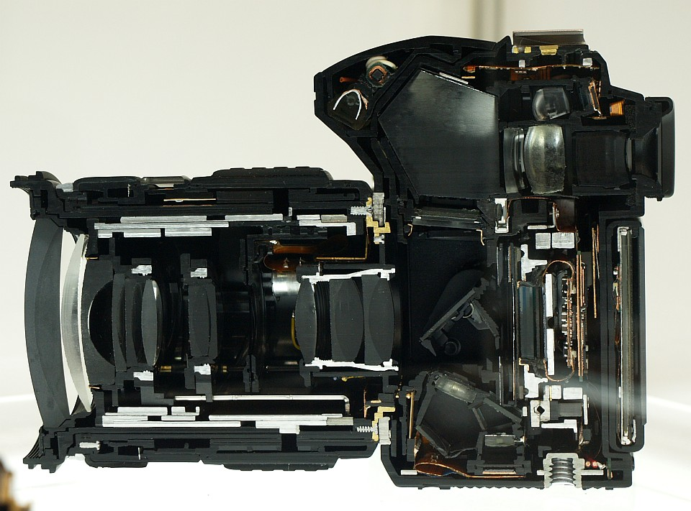
What’s inside a DSLR?
Notes:
This is a cutaway view of an Olympus E-30. In addition to all the internal elements in the lens, you can see the sensor, the display, the internal flash, and some of the electronics. You can easily follow the light path through the lens, off the mirror, into the pentaprism, out through the eyepiece, to the viewfinder.
Picture from: http://en.wikipedia.org/wiki/Digital_single-lens_reflex_camera

Slide 14
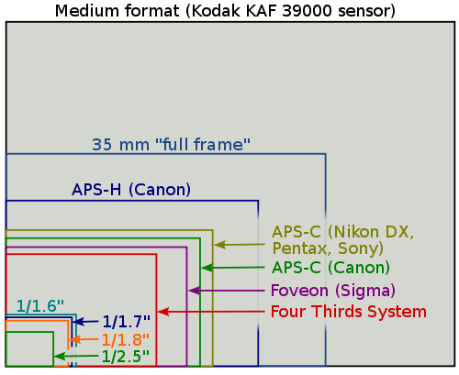
Sensors (size does matter)
Blue box is 35 mm film frame
The difference (white area) is the crop factor
Notes:
The biggest difference between DSLRs and other camera styles is usually the size of the sensor chip. Larger chips mean larger pixels, and that means more light falling on each pixel. The end result is a higher signal to noise ratio, so that you generally get a cleaner image with larger sensors than with smaller sensors. The overall sensor size isn’t all that matters, thought, as you’ll see on the next slide.
Graphics from: http://en.wikipedia.org/wiki/Four_Thirds_system

Slide 15
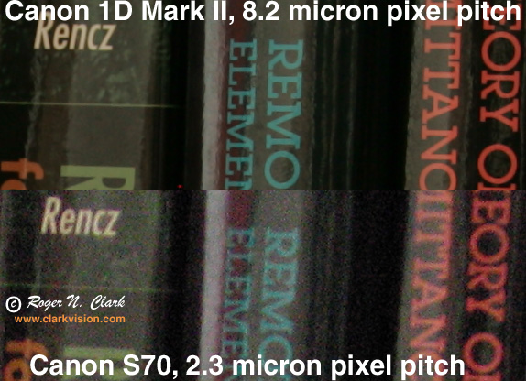
Pixel Size determines light gathering ability
Camera | Pixels (MP) | Sensor Size (mm) | Sensor Size (pixels) | Pixel Size (µm) | Crop Factor
Nikon D40 | 6.0 | 23.7 x 15.5 | 3008 x 2000 | 7.9 | 1.5X
Nikon D200 | 10.0 | 23.6 x 15.8 | 3872 x 2592 | 6.1 | 1.5X
Nikon D90 | 12.3 | 23.6 x 15.8 | 4288 x 2848 | 5.5 | 1.5X
Canon 450D | 12.2 | 22.2 x 14.8 | 4272 x 2848 | 5.2 | 1.6X
Canon Rebel T2i | 18.0 | 22.3 x 14.9 | 5184 x 3456 | 4.3 | 1.6X
Canon 60D | 18.0 | 22.3 x 14.9 | 5184 x 3456 | 4.3 | 1.6X
Olympus E-5 | 12.3 | 17.3 x 13.0 | 4032 x 3024 | 4.3 | 2X
Canon A95 | 5.0 | 7.14 x 5.36 | 2592 x 1944 | 2.8 | -----
Canon PowerShot SX150 IS | 14.1 | 6.17 x 4.55 | 4320 x 3240 | 1.4 | -----
Smaller pixels mean less light, and more noise,
especially in low light
Notes:
These are all cameras that someone in the class has reported having or using. I have looked up the pixel sizes and crop factors for you, so that you can see how they line up. The pictures at the right give a good comparison to show one of the biggest advantages of DSLRs over the point and shoot and bridge cameras. Bigger sensors mean bigger light buckets, and that means more signal and less noise in each pixel. Pixel pitch and pixel sixe are essentially equivalent for these purposes.
Note that the D40 has a relatively modest 6 megapixels resolution, but should have the best low light performance of any camera on this list. Judged purely by megapixels, the PowerShot would be among the best. I’m sure that it has other great qualities (I used to own one), but low light image quality isn’t one of them. Here you see the greatest Achilles' heel of my beloved Olympus E-5.
Picture from http://www.clarkvision.com/articles/does.pixel.size.matter/

Slide 16
Crop Factor
Reported relative to 35 mm film
Same focal length lens that was used on film camera now focuses onto a smaller sensor
The sensor image area becomes expanded when viewing, so it is effectively magnified
Because of this, a 100 mm lens on a Canon APS-C camera gives the same magnification image as a 160 mm lens would on 35 mm film
Notes:
There is a desire to have an ‘apples-to-apples’ comparison method for lens focal lengths, so we have come up with the ‘35 mm equivalent’ standard. Remember that big numbers aren’t always the goal here. If because of a 2X crop factor, the widest your lens will go is 28 mm, that can be limiting when you’re shooting landscape, or especially indoors. Know what the crop factor is for your camera, so that you can better understand which lens will work best for the pictures you like to take.

Slide 17
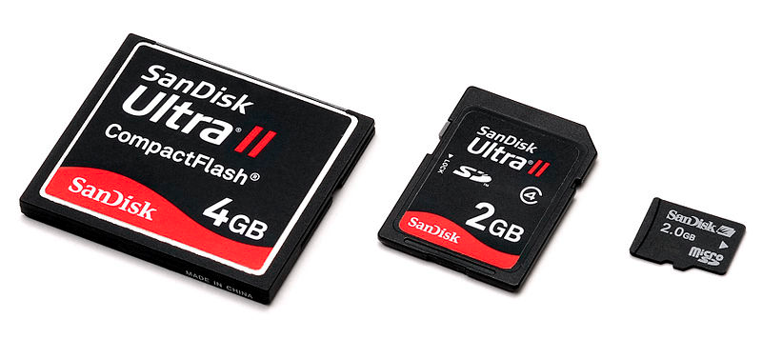
Memory
Most have two types of memory
Internal – holds the picture right after you shoot
Removable cards– for downloading to a computer
Card formats
Limited by the camera
Compact Flash – bigger, faster, often cheaper
Secure Digital – SD, mini SD, micro SD, SDHC, SDXC
Memory Stick, xD, Smart Media are far less common
Make sure you don’t over-buy
Notes:
All cameras have a little bit of ‘buffer’ memory for processing images before saving the file, but primarily we think of the bulk memory cards.
All of the memory cards used by cameras contain what is called flash memory – so does a USB ‘thumb drive’. There have been at least 25 different formats for memory cards over the years. Today, most cameras use Compact Flash, SD, or both, though there are still cameras using other formats. Many cameras now have two memory card slots. Memory cards are primarily described by format, size, and speed. Speed is covered on the next slide.
The examples shown are Compact Flash, SD, and micro SD (left to right). The format that you will need is controlled by what your camera will accept. The size of the card refers to how many gigabytes (GB) it will hold. Today, common sizes are 2, 4, 8, 16, and even 32 GB cards. You can get cards up to 128 GB, but they are extremely expensive. For typical photography, 8 or 16 GB is probably plenty. One thing to check is that your camera can accept the newest, largest cards. If you don’t check, you might find that you have bought a 32 GB card, and can only use 8 GB of it. Check the User’s Manual for any limits, and do your research before you buy.
Pictures from www.sandisk.com

Slide 18
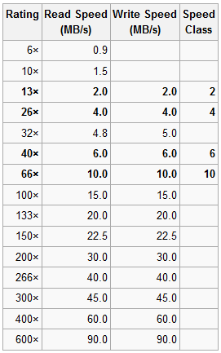
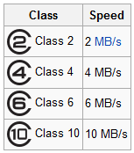
Memory Card Speed
CF usually faster than SD
SD Classes
Snapshots: Class 4
Enthusiast: Class 6
Professional: Class 10
Write speed slower than read speed
CF “X” Ratings
Buy what you can afford
Capacity vs. speed
Video
Fast subject
RAW vs. JPEG
Notes:
Since Compact Flash (CF) and Secure Digital (SD) are the two most common memory formats currently, I will discuss only those two. Information on the others is easily available online.
Between these two formats, CF is easily the winner on speed. The card is a lot bigger, so manufacturers often design in the smaller SD cards, to save space. Some cameras actually have both, so it can be useful to understand the difference between the two. For example, at the airshow, I use my slower SD card for the static displays, and save my faster CF card for the aerial photos.
Among SD cards, class 2 is nearly obsolete now, and class 4 has taken over as the baseline. The chart on the right is somewhat misleading, because it refers primarily to CF memory. In the case of SD, the write speed is a good bit slower (by about ½) than the read speed. When the F-16 is screaming by at 400 knots, and you’re hammering 5 frames per second, that makes a difference. The classes shown are recommended by one of the manufacturers, for use by general photographers, enthusiasts, and for video/professionals. I have already seen a class beyond 10 (10-U1) with reported read and write speeds of up to 90 MB/sec (at $100 for an 8 GB card, vs. $20 for a class 10).
Among CF cards, the same $20 buys an 8GB card almost five times as fast (45 MB/s). With CF cards, that is a write speed, so the card is actually about ten times faster. For example, with my class 4 SD card, I fill the internal buffer memory with seven JPEG shots. With my comparably-priced 30 MB/s CF, the buffer never gets full – I can shoot for at least ten seconds continuously, without the camera having to stop.
The bottom line is that you should first research what your camera can use, then shop around (I really like Amazon for memory cards) and buy as much speed and capacity as you can afford, and your camera can use. Especially if you’re going to shoot video, speed and capacity are important.
Graphics from: http://en.wikipedia.org/wiki/Digital_single-lens_reflex_camera

Slide 19
Camera Settings
Exposure Modes
Shooting Modes
Scene Modes
Focus Modes
Metering/ Exposure Compensation
File Type/ Image Quality
White Balance
Playback
A whole book full of others – read that book!
(the User’s Manual)
Notes:
There are many camera settings to consider, and we only have time to talk about the most important ones. If you see some setting mentioned on your camera, or in the menus, look it up. If you still have questions, e-mail me, and we’ll figure it out together.

Slide 20
Checklist
Notes:
This is the checklist I have made up for my present DSLR, so that I can remember to consider what settings I want for a particular situation. I carry a copy of this with me in my camera bag, and consult it every time I go out. If I’m shooting at the Renaissance Festival, my settings are very different than the Andrews Airshow, for example. I had a different checklist for my earlier DSLR, and the list for your camera would probably be different than either one. If this looks useful to you, consider making a list with the options for your camera.

Slide 21
Exposure Modes
Auto
Camera selects everything: aperture, shutter speed, focus, ISO, flash - all of it, with no overrides
Usually works, often doesn’t
Program
Camera picks aperture & shutter speed; focus can be overridden
Aperture Priority
User picks the aperture, camera picks the shutter speed to match
Often the preferred go-to mode for experienced photographers
Shutter Priority
User picks the shutter speed, camera picks the aperture to match
Manual
User gets to/ has to pick all settings
Notes:
My old film camera had very simple options: manual or ‘auto’. On that camera, auto meant that the camera would choose the shutter speed to match the aperture you had set. That is more correctly called Aperture Priority , and it is still the preferred shooting mode for many experienced photographers.
These days, Auto means a whole lot more. It means that the camera is given control over the aperture, shutter speed, focus point, whether it uses flash – the whole enchilada. That’s OK many times, but neither Canon nor Nikon has perfected a mind-reading chip yet, so the camera still doesn’t know what you wanted to do. Many of the people taking this class are here to learn how to function outside of Auto mode, because they’re ready to take back partial, or even complete, control.
Program mode works from a graph to pick the best combination of aperture and shutter speed, based on how much light is present. It differs from Auto because it is only selecting the exposure, and leaves everything else to you.
Aperture Priority mode allows the user to select how much depth of field you want, and the camera picks the right shutter speed to go with it. I often end up in this mode, but defaulting to near the largest aperture (smallest f/ number), for faster shutter speed.
Shutter Priority works the opposite of Aperture Priority, because it allows the user to select the shutter speed (say 1/1000 sec for freezing action), and the camera opens the aperture to the right amount to accommodate it. If your camera has it, setting the ISO to Auto can help to extend the range of usefulness of Aperture or Shutter Priority modes.
Manual mode is pretty self-explanatory. The user has full control, with all the privileges and responsibility that comes with it. You can do just what you want, but you need to make sure you’ve considered everything before you shoot. This can be the most rewarding or the most frustrating mode to shoot in, depending on how careful and experienced you are. It is also practically required for special effects shots.

Slide 22
Shooting Modes
Single shot
Self-timer
Burst
Short delay
Remote control
Bulb
Bracketing for HDR
Notes:
Practically all digital cameras have the first two modes available, but the others may be limited to bridge cameras and DSLRs. most pictures are taken in Single Shot mode, and we’ve all seen Uncle Harry running to get in the picture after setting the self-timer (including the hilarious picture when he tripped over Aunt Gladys).
Burst mode is where you can keep taking pictures as fast as the camera can, until either the internal memory or the memory card fills up. Burst rates range from a rather relaxed 3 frames per second to a blistering 12 frames per second (your eye only sees 24). This speed is heavily limited by the memory card speed, file size, autofocus mode, and anything else that might slow down the process.
A short delay of usually 2 seconds is often available, to allow any vibrations from depressing the shutter release to settle out (while on a tripod). Remote control is pretty obvious. Bulb is the ability to hold the shutter open a long time – say 4 or 5 seconds for fireworks or lightning, or 30 seconds for a special effects shot.
HDR is a special technique unto itself, which would take a couple hours to present. For now, know that most DSLRs have a way to pre-set the bracketing to take a set of 3 or 5 shots across a range of exposure values: -2 stops, -1, 0, +1, +2, for example. This allows you to capture details in both the highlights and the shadows, when you put all five pictures back together in post-processing.

Slide 23
Scene Modes
Portrait
Landscape
Night Scene
Night Portrait
Sports
Indoor
Candle
Self Portrait
Sunset
Fireworks
Food
Documents
Beach/Snow
Underwater (4 options)
Snow
Close-up
Museum
Backlight
Panorama
Probably many more…
Notes:
This is a sampling of the scene modes available on just three cameras. Your camera may have others, or use different names for them. Note that most advanced DSLRs do not offer scene modes, on the theory that experienced photographers are already accounting for these conditions and modifying their own settings.

Slide 24
A Few Common Scene Modes
Sports
Increases ISO, for faster shutter speed
Landscape
Chooses narrower aperture, for longer depth of field
Portrait
Chooses wider aperture, for short depth of field
Night Portrait
Long exposure for background, plus flash for faces
Fireworks
VERY long exposure (seconds) – must use a tripod
Beach/Snow
Compensates for bright reflections by increasing exposure
Night Scene
Increases ISO, for greater light collection, no flash
Notes:
These are a few of the more common scene modes, and how the camera reacts to each. Check your User’s Manual for more specifics on the modes available in your personal camera.

Slide 25
Focus Modes
Autofocus on most new cameras is pretty darned good
Still not always perfectly crisp
Doesn’t work for all situations
Very dependent on having high contrast areas and lots of light
Focus point can usually be defined on DSLRs
Might still need to tweak the ‘sweet spot’
Single vs. continuous autofocus
Manual focus on point and shoot and bridge cameras is difficult, if possible
Notes:
Autofocus has improved greatly in recent years, so that even experienced pros are starting to use it instead of always manually focusing. Still, autofocus depends on having a high contrast feature at the same distance as the subject. Most cameras have the ability to automatically select the focusing feature, but sometimes your intended subject isn’t the highest contrast area, so it can choose and focus on the wrong place.
DSLR’s generally have the ability for the user to define where the camera should look for a focus point. You can set this point off-center, or often it is useful to define the center spot for focusing. That way, you can half-press the shutter release to get the focus, recompose while holding the button halfway, and take the shot. The camera will hold the focus while the button is depressed halfway.
Another useful feature on most DSLRs is the ability to choose single or continuous autofocusing. If the subject is relatively steady, single autofocus mode will focus once when the shutter release is half depressed, and allow you to recompose. If the subject is moving, however, say a bird or plane in flight, it is better to choose continuous autofocus so that it updates the focus on the moving subject. This poses some challenges, though, if the camera suddenly chooses some other feature to focus on. Selecting a fixed focusing area can be difficult if for example you are tracking a bird and need to keep it in the same part of the frame.
Another thing to keep in mind is that autofocus is much more effective when there is lots of light available. This gets better every year, but if you have a low light solution, you should expect some focusing difficulties.

Slide 26
Metering
Average
Original film approach, not used much anymore
Spot
~1-5% of the field
Location is usually definable, often in the center
Center-weighted average
Central portion represents most of the input
Multi-zone metering (aka Matrix, ESP, others)
Most commonly used default mode
Mysterious algorithms consider many factors including focus point, light distribution, etc.
Use exposure compensation (+/-) to make small adjustments
Notes:
I’ll admit to thinking unconventionally on this one. My belief is that there is just too darned much stress over exposure among experienced photographers who started out shooting film. Film was more finicky about getting just the right amount of light than CCD sensor chips are, so you had to be careful to measure the light, and adjust things just right with every shot. These days, adjusting the brightness and contrast are the easiest of the many sliders and buttons that our editing software gives us, so I don’t find it to be super-critical.
Don’t get me wrong, the first law is still to always get the best image you can in the camera, and rely as little as possible on editing software. If your exposure is off by a stop, you are definitely going to lose some information to either blown-out highlights or black shadows. Software can recover some of that, but it is always best to get it right the first time, if you can.
In the old film days, my camera read all the light, and gave me an exposure based on all of it equally. It usually worked pretty well, but occasionally I would get a bright or dark shot. Now you usually get several options for metering the light. The simplest method is a small spot, often in the center of the image, which you can place on a particular portion of the image to read the right exposure for that feature. You can use it to set your exposure, than recompose and shoot the shot, or just use it directly if the important feature happens to be in that spot. Center-weighted averaging is much the same, but using a larger spot, always in the center. The most commonly available metering across digital cameras is multiple zone metering, reading the light in up to a hundred or more parts of the image, then using that information to figure out what the best exposure should be (reading your mind to some degree along the way).
My best advice is to check the display from time to time, and if you find that the bright areas are getting overexposed, turn it down some. If the darks are too dark, crank it up. Most cameras have a +/- exposure compensation capability for fine tuning. I use this a lot to tweak the exposure, since you can’t rely 100% on the electronics to always do what you want.

Slide 27
Files/ Image Quality
RAW vs. JPEG
RAW is all of the data, straight from the sensor
Largest files, most flexibility later, and highest resolution
JPEG is processed and compressed before saving
Losses occur each time it is saved
Usually several levels of compression available
Why not just maximize everything with RAW?
E-5 Example (12.3 MP camera)
RAW file: 12.4 MB, High quality JPEG: 5.3 MB
Little discernible loss in image quality
In fact, unprocessed RAW looks noisier at high magnification
Memory cards are big, but not infinite capacity
RAW is also not as portable between viewers
Notes:
This topic starts some good ‘animated discussions’ among photographers. Point and shooters, and most bridge shooters can sit this one out, but all DSLRs and some bridge cameras give the option of saving your pictures using RAW, JPEG, or sometimes both formats. It is important to know the differences, but honestly it won’t make an enormous difference in your pictures most of the time. I have heard both amateurs and pros who absolutely always shoot RAW only, and that’s that. But I have also met pros who shoot exclusively JPEG, so don’t think that you can’t be serious about photography without shooting RAW.
Your sensor collects a stream of electronic data about each pixel in the image that strikes it. If the camera saves a RAW format file, 100% of that data flows straight to the memory chip, to be dealt with later by software. If it saves a JPEG file, the data is first processed some, then compressed to take up less room on the memory chip. You can usually adjust how much the image is compressed, but you should realize that you lose some data every time that a JPEG file is saved, and it compounds by saving it again.
That all sounds pretty bad for JPEG, but there are definitely good reasons to use JPEGs. The biggest reason is to save space on a memory card. On an 8 GB memory card, my camera will store a total of about 1148 images at the highest quality JPEG settings, or 522 RAW images, or 360 if I want to cover both bases and save both. That sounds like a lot, but in one day at an air show, I shot almost 1200 pictures. If I want to shoot them all in RAW, I’d better take at least three cards along this year.
Another difficulty in working with RAW files is that not all programs can display them. To start with, they are just raw data, until they get organized and interpreted a little bit: brightness, contrast, color correction, etc. My Olympus software will show the images on my monitor without a lot of interpretation, but Microsoft Picture Manager, windows Photo Viewer, and even Windows Explorer have no way of showing me those images while I’m organizing the files into folders. Adobe can use Camera Raw to interpret the files, but they need to be saved as TIFF or JPEG in order to do much with them outside of specialized software. Most online display options like Facebook, Flickr, etc. need the images to be interpreted and saved in a different format as well.

Slide 28
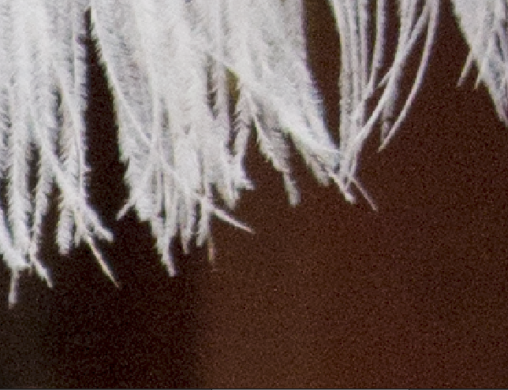
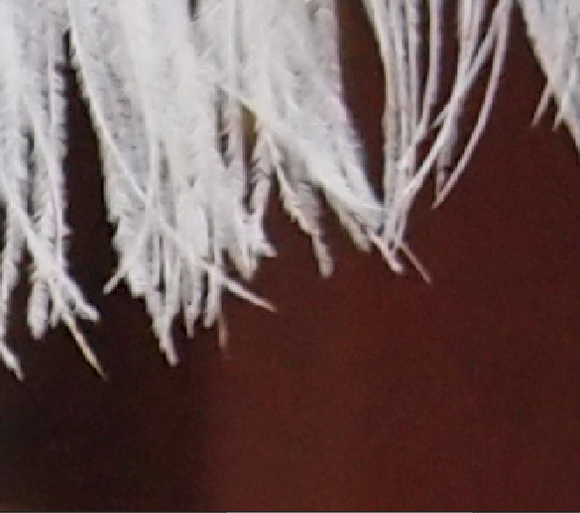
RAW vs. JPEG
Olympus E-5; 12.3 MP camera
(MD Renaissance Festival, 2011)
RAW: 12.4 MB
JPEG: 5.3 MB
Notes:
This is a comparison between the RAW and JPEG images that my camera saved of the same shot. I like it because it shows some of what the camera is doing when it processes the image. This close-up is much closer than you would ever really look at the image, but by magnifying the differences, it makes them easier to see.
Notice that in the RAW image, the tiniest hairs in the feather are discernible, where they blend together in the JPEG image. This is an artifact of the compression process. This level of detail is lost forever in every picture, if all you ever shoot is JPEG.
Also notice that the color has shifted from yellowish to a reddish hue in the background. This probably came from the automatic white balance choice of the light source. It can be shifted later in post-processing, but it will never look as natural as it does when adjusted from the RAW image.
Finally, notice that the RAW image looks much noisier. This is probably mostly a result of the compression, but perhaps also some other processing in the camera before the image was saved. If you’re mostly going to look at pictures straight out of the camera, or do very little post-processing (especially as a beginner), this effect may actually be a benefit to you.
Remember also that the JPEG format is more universally displayable, and that the file size is smaller. What is important is to make an informed choice, and don’t feel like you need to stay with one or the other forever. Know that the benefits and limitations are for both formats.
Pictures from the author

Slide 29
White Balance
Colors change based on the source of the light
Light brown shirt in incandescent light can look green in fluorescent light
Even sunlight vs. shade makes a difference
Image is interpreted differently based on settings
Auto white balance is pretty good ~98% of the time
Check your display frequently, and change the WB if necessary
RAW images are not corrected, so you can change it later if it was off
Can also be set WB manually for unusual situations
Notes:
Different light sources have different temperatures, and therefore give off a different mixture of reds, yellows, and blues in the light. These temperatures are referred to in Kelvin, or K, which is an extension of the Celcius scale. Flames, for example are relatively cool at about 1800 K, and give off a very reddish light. The tungsten light bulbs that we grew up with run at about 3000 K, with a more balanced spectrum, but still on the warm side. Fluorescent bulbs in an office setting tend to give off an equivalent of about 4100 K, though fluorescent bulbs can be bought anywhere from 2700 to 6500 K. The higher the temperature, the more blue (and seemingly ‘hard’) the light. You may, therefore, need to tell the camera what type of light you are looking at.
Automatic white balance has gotten better and better, but it can still be fooled. I took pictures in the conference room, and it picked correctly when looking down the sides, but the shot of the projector screen looked way too red. I have had this happen even between pictures two minutes apart, because cloud cover changed, and the AWB chose differently. The best defense is to check your display frequently, and if the colors suddenly drift, take over the selection yourself. Just remember to return to AWB afterwards, or you may be in for a surprise later. I once set my balance for shooting around a campfire, then forgot to change it the next day, and had dozens of blue pictures (Doh!!).
Another defense against bad color correction is to shoot in RAW format, where you can easily adjust the color temperature to what looks best.

Slide 30
Lenses
Built-in vs. interchangeable
Depends on the camera type
Fixed vs. zoom
Fixed is typically lighter and higher image quality
Zoom is more flexible
Cheap vs. expensive
More expensive lenses have more elements, better coatings, wider apertures, heavier weight
Macro capability
Highly detailed close-up images
Teleconverters
Goes between camera and lens to produce 1.4, 1.6, or even 2.0 x the focal length
Notes:
The biggest difference between DSLRs and most other types of cameras is that they have interchangeable lenses. The lens can be chosen that is best for the particular shooting conditions, and over time the lens can be upgraded. Most lens attachment mechanisms are unique to the manufacturer, which more than anything else inspires brand loyalty.
Fixed lenses definitely have their place, and if you are going to shoot a lot using the same conditions (portraits, for example), it is better to have a lens optimized for that one focal length. They tend to have the widest aperture availability, since the same body doesn’t need to accommodate such a range of focal lengths. On the other hand, zoom lenses are more versatile and convenient. You might carry one lens most of the day, and rarely need to change it.
You really do get what you pay for, and the day I bought my first mid-range lens my pictures took a huge leap forward. The things that make a lens better often end up making it heavier, so be ready for that. Many pro lenses are almost impossible to hand-hold, they’re so heavy. If you expect to shoot a lot of macro subjects, then macro lenses will be more valuable to you. They essentially have the ability to move the lens further away from the sensor, much like a built-in extension tube.
Be a little careful with teleconverters. I have a 2X myself, and I use it frequently, but be aware that just by the physics involved they will reduce your lowest aperture by a factor of 1 to 2 stops. If you need to reach way out, but also stop action, maybe you’re better off cropping. A blurry closeup at 1/60 sec is worse than a cropped and expanded 1/240 second exposure. For long exposures, though, they can really help to sharpen you final images by preventing the need to crop the image.

Slide 31
Zoom Lens Cautions
A ‘wobble’ of only 0.03° will cause the image to move by 1/8” at 20 feet
With a 50 mm lens, you may not see that
With a 400 mm lens, it is 8 times bigger, and very noticeable
Zoom lenses are also usually unbalanced when hand held
More likely to get that 0.03° - or more
They also tend to have smaller apertures, so longer exposure times
Tripods help, but faster shutter speeds are more practical
Tripod pointing is awkward and slow
Usually means higher ISO, though → more noise
Thus, the driver for more expensive, “faster” zoom lenses
Notes:
One of the images submitted for the class was a bird at a bird feeder. It was shot with a very high quality 100-400 mm image stabilized lens, but the shot was blurry. The question was, how did this image end up fuzzy? The best explanation is that the shot was hand-held for 1/60 second, as opposed to being on a tripod. That short exposure may not seem too bad, but at 400 mm any tiny shake is exaggerated. At 400 mm, that lens has a widest aperture of f/5.6, which is what pushed the shutter speed up to 1/60 second. The only two remedies would have been to go to a tripod (while the bird flies away), or to increase the ISO and accept any noise that came along with it. Another possibility might be to deliberately underexpose the image by a stop for a faster shutter speed, then brighten it in post-processing (sacrificing the information in the shadows in the process). Looking more closely at the image, though, I can’t be certain that the autofocus had done its job perfectly, either.
The bottom line is that high power zoom lenses give you a lot of power, but when the light isn’t really bright they can require a lot of care to get a good image. When the light is good, though, and you don’t have to work at the very edge of the envelope, it’s a real blast to dance with a 300-400 mm zoom lens.

Slide 32
Macro
Traditionally, image on negative larger than life
Today, 4x6 print larger than life
Options
Macro lens
Many lenses have macro capability built-in
Extension tubes
Moves the lens further from the sensor
Add-on adapters – cheap and poor image quality
Reversing adapters
Focus and depth of field are very difficult
Lighting can be a real challenge
Short working distance – can be less than an inch!
Notes:
In the film days, macro photography meant taking a picture where the image on the negative was bigger than the subject was in real life. For example, a full-frame image of a dime. These days, since sensors are different sizes (most smaller than 35 mm film), and it is rarely practical to expand the image that much, the definition has shifted. The new definition of a printed image larger than the original subject is really kind of hazy, since any image can be blown up to be huge, although the image quality will suffer. A better definition is a printed image larger than the original when the full image is printed on a 4x6 print. Suffice it to say that ‘macrophotography’ still means taking pictures of really small stuff. When you’re shooting macro, it is often necessary to move the camera to focus, as opposed to using autofocus, or adjusting the focus ring.
There are at least four ways of doing this, with macro lenses being the most common. I have used the first two listed here. The photograph here was one of the first digital pictures I ever took, and used the standard kit lens. I was able to stay several inches from the fly, so the depth of field wasn’t such a challenge. Think of depth of field as a percentage of the working distance (distance between the lens and the subject). The closer you are, the less depth of field you get, so you may need to really close down the aperture (and use a tripod to steady your camera) if you really move in close. Macro lenses generally have a minimum focusing distance of about 6-10”. Many lenses will perform well at photographing small objects without specifically being designated as ‘macro’ lenses, so try it out.
Extension tubes can also be used to expand the image by moving the lens further away from the sensor. This can have a radical effect on the working distance, though, so you need to be careful not to crash your lens into the subject. Things can work kind of backwards, too, so go slowly. For example, with my 70-300 lens by itself, I get a minimum working distance of about 26” across all focal lengths. By adding a 25 mm extension tube, that distance goes to about 8” at 70 mm (and the focus ring fine-tunes the size), and 21” at 300 mm closest focus (~1.5 X 70 mm size), and more than 10 feet at infinity focus (much smaller image than at 70 mm). A 28mm lens with the extension gives working distances of about ¾ inch across the focus range, with very large images (focusing fine-tuned the magnification). Funky stuff, so go slowly, and be careful.
Getting light onto the subject, but not glaring into the lens, can be difficult when the working distance gets under a couple inches. The built-in flash is useless that close, since the lens casts a shadow over the subject.
Picture by the author

Slide 33
Image Stabilization
Uses tiny gyroscopes to detect movement
Optical Image Stabilization
Lens shifts the optical path, to stabilize the image
Unique to the lens; extra $ for each lens
Canon, Nikon, some Sony, Panasonic
Sensor shift
Sensor is moved to stabilize image
Works with all lenses, even old film lenses
Olympus, Pentax, some Sony, Konica-Minolta
Digital Image Stabilization
Used in some video cameras
Computer changes the pixel region from frame to frame
Performance is rated in equivalent stops improvement
Turn image stabilization OFF when using a tripod
Notes:
One of the big advances in digital photography has been image stabilization. This has allowed the photographer to hand-hold a 1/30 second exposure, and expect as sharp an image as might otherwise be gotten at 1/125 second. That opens up the envelope considerably in terms of practical exposure choices. At faster exposures, it can help to sharpen the image.
There are two basic approaches to image stabilization: optical and sensor-shift. Optical stabilization is built into the lens, so it isn’t always available on all your lenses (unless you paid extra for that feature). Sensor shift stabilization is built into the camera, so it is available for any lens.
There are times when image stabilization can work against you. If the camera is already rock-solid on a tripod, the gyroscopes may have not read zero shake as precisely zero, so they could actually induce some shake into the image, which otherwise was already solid. There are often special modes to account for panning the camera, so that the camera knows what is going on, and compensates correctly. Your User’s Manual will give the details on whether you have them, and when to use them.

Slide 34
Filters
Ultraviolet
Mostly to protect the lens
Cheap, and nearly invisible in the image
Polarizer
Reduces glare
Rotate for best effectiveness
Infrared
Sees heat, for an ‘other-worldly’ effect
Neutral Density
Reduces light, without shifting colors
Color
Highlights individual colors
Gradient
Neutral density on one end to clear on the other
Great for darkening skies
Notes:
You really only ‘need’ a couple filters to get you through most situations. The more you have, though, the more prepared you will be to achieve just what effect you want. I should admit that I have actually only used UV and polarizer filters, though I have many more on my wish-list. Remember that every filter robs a little light, and adds a little distortion, so higher quality and fewer pieces of glass are your friends.
One important thing to understand is that because they screw onto the front of the lens, filters have a unique diameter associated with them. If you have lenses in three different diameters, you may want filters in all three diameters, which can get expensive pretty quickly. Fortunately, many lenses share the same diameter. There is also the option of a square filter holder with step-down rings, so that it can be used on different lens diameters. A polarizer is often installed and uninstalled, so hard coatings pay off for this one. Without care it can get scratched up pretty easily.
More so than with most other accessories (except lenses), the quality of your filters can make a big difference in the image quality. More expensive filters have antireflective coatings, harder surfaces for durability, less distortion, etc. For example, a 58 mm polarizing filter can be purchased for $5, $10, $25, $58, $85, up to $105. Each step gets a bit better. How good do you need? I’d shoot for the $50 polarizer if you can afford it, the $25 if you can’t. UV filters are about half that price. I saw one three filter kit for $7.50, but do you really want to take that chance with your pictures? You get what you pay for, usually.
Using a polarizing filter takes just a second longer than other filters. For best results, you need to rotate the polarizer to get the effect you want. The filter itself rotates within the frame that screws onto the lens, so it is easy to rotate. Watch the sky especially as you rotate the filter, and you will see the change. This effect seems less prominent with circular polarizing filters.

Slide 35
Flash
Obviously used to brighten a scene
Flash power is determined by the Guide Number
GN = distance x aperture, at a specific ISO
Example: 18m at ISO 200 (Olympus E-5 internal)
Means that at f/5.6 and 200 ISO, anything beyond 3.2 m (~11 ft) will not be fully illuminated
External flash
GN is typically about 30 to 50
Can be moved off-axis, to control shadows
Many are remote triggered; can use multiple units
Notes:
Everybody knows about flash, right? Even my phone has a flash, so these things are dead simple, right? NOT!! We recently did a whole club meeting on flash, and still missed most of the stuff on this slide.
You can get very complicated with multiple radio-triggered flashes, keep it simple with your built-in flash, or many steps in between. What you need to know is that the strength of the flash is rated by the guide number, but not all guide numbers are directly comparable because there is an ISO component. (Hint: if the guy at Best Buy, Target, Ritz, etc. doesn’t know this, run away) It’s nice to understand where the numbers come from, but you really won’t calculate this stuff each time. You just get a feel for how your flash will perform under the given conditions.
An important thing to understand about flash is what will happen to the back If your flash is good to 11 feet (example above), and your friend is standing 8 feet away, near a wall, expect a hard shadow on the wall. If she is 3-4 feet away from the wall, the background will be more subtle, and you may not see much of a shadow at all.
One thing I didn’t have room for here is fill-flash. If you want to provide just a little light to fill in shadows (or to overcome backlighting), most cameras have a setting for providing reduced flash. Experiment with this, until you get the result you want. It usually takes me about 3-4 tries until I get the strength of the fill-flash just right.
If you learn only one thing about flash, know that it is useless (and often counterproductive) to use a flash in a concert. Not only will your flash never in a million years reach that far, but many cameras reduce the shutter speed to compensate for the flash. The result is that your picture is actually darker than without the flash. At best, you get a picture of the back of some guy’s head, and little else. Your only hope is to jack up the ISO, steady your camera as best you can, and hope the picture isn’t too blurry. Really, just take a mind-picture to remember it, and have fun not stressing out about taking pictures. Now, join me in laughing at all those flashes you see going off throughout the crowd in concerts.

Slide 36
Gadgets
Tripod
Shutter release/ Remote control
Monopod
Ballhead
Quick release
Camera Bag
Lens caps
Spare batteries
Screen protector
Spare memory cards
Reflectors/ diffusers
GPS data tagger
The list goes on and on…
Notes:
We have had whole club meetings on just discussing favorite gadgets. Tripods, camera bags, and a few others are obvious; others less so. I’ll point out a few of my favorites.
I use my monopod almost every time I go out to shoot. It is much more convenient than a tripod most of the time. It gives just enough stability and, the flexibility to swing around in a different direction like a tripod would never do. It also makes a great hiking stick, with the camera removed. I have equipped mine with a ball head and a quick release, so I can pop my camera on and off in under a second. The ballhead lets me make infinite adjustments to angles, and still lock down the stability.
I have a collection of spare batteries, and often rely on them. Your camera uses a little battery power even sitting on the shelf, so you never really know when you might run dry. My personal experience is that the $5-10 knock-offs available on Amazon have been almost as good as the $50 manufacturer batteries. I’d rather have the capacity of 3 knock-offs than 1 ‘real’ battery.
After investing a bunch of money in even a cheap camera, the last thing you want is to scratch up the display. Screen protectors are cheap and easy to install. My favorites are made by Boxwave; about $7 from Amazon, I like the anti-glare, but there is also a clear option.
Finally, I love my sling style camera bags: Tamrac Evolution and LowePro Slingshot. You can wear these packs over one shoulder, then within a few seconds spin then forward, pull out your camera, and start shooting. I have not yet found a faster, more convenient bag. I also like that my spare lenses, filters, and other gadgets are available, but won’t fall out when the bag is in front of me. They also make a handy table when slung around to the front.

Slide 37
What next?
Now that I figured out my camera and I’m taking great pictures, I have a bunch of pretty files. What can I do with them?
Photoshop Elements
If you think they look great now, just wait…
Elements has the same basic tools at ~1/10 the price
Prints
Costco, Target, Wal-Mart, etc.
Probably not worth using your own printer
Usually clog up if you don’t print a lot of pictures
Create a photo book about a subject (cheaper than you think)
Online software and Elements both make it pretty easy
Post them online
Recommend a Flickr free account
Photo Club Flickr site – we want to see what you’ve done!
Facebook, other social media
Digital photo frame display
Notes:
I find the challenge of just taking pictures better to be enjoyable, but eventually it is nice to share them and DO something with all those pretty pictures.
First, learn how to use Photoshop, or some other ‘post-processing’ software. I have been able to make lots of so-so pictures much, much better in only about five minutes by using these tools. I like Elements, especially for beginners. It has guided tools to help you ease into the modification process.
I have most of my best images online, and rarely print them. When I do, I have found that my printer at home is always clogged up, and produces bad images. You need relatively high volume to keep the equipment working well. My local Costco (in Columbia) does an awesome job of printing, at lower cost than I could do it for at home. Try different places until you find one you like. My advice would be to try to resist printing 8 x 10’s, unless you are going to exhibit them on a big wall or a display with many other photos. They are often just too big, unless the main purpose is specifically to show off the picture.
Photo books are a great way to pull together a couple dozen pictures with a common theme. You can often find double-sided photo books that you can order and pick up in a day for only about $20 for 8 x 10s or $6 for smaller size books. These are a great way to display your pictures, or share as gifts. What the heck – show off a little!
I like to display my best images online. I usually select about 10-15% of my shots for cleanup, then post them to my Flickr site. You can get a free account (like the club has), or for about $25 a year you can customize it and get unlimited uploads. Most post-processing software can upload directly to Flickr, Facebook, or other sites. The nice thing about Flickr is that your friends don’t need to log in to see your pictures.
Finally, you could set up a digital photo frame with a constantly cycling display of your pictures, at home or even on your desk at work. Not only do you get to show off your best shots, but you get to enjoy them as well. These frames have gotten much cheaper over the past few years, and you can even keep different collections on different memory devices, so you can swap out subjects.

Slide 38
Recommended References
Your camera User’s Manual – read it!
Download it for easy searching at home
Carry it in your camera bag for reference
Web sites
www.penncamera.com
www.DPReview.com
www.learnmyshot.com
www.photoextremist.com
Wikipedia
TV show Wild Photo Adventures
Magazines
Digital Photo
Popular Photography
Notes:
I routinely use all of these and more. If you find some more good ones, let me know and I’ll add them to the list.

Slide 39
Exercises (mostly for DSLRs)
Depth of Field
Select a subject separated from a detailed background, or an inclined floor (grass or carpet)
Use manual focus on the subject and aperture priority mode
Shoot a set of images at each of the whole stops (2.8, 4, 5.6, 8,…)
Compare the area in focus in each
Repeat, but changing ISO by full stops and keep constant f/8
Notice where the image starts to get grainy for your camera
Repeat, but changing only the white balance
Which image matches reality? Did Auto WB pick correctly?
Speed
Use manual focus and shutter priority mode
Focusing on the street, hold your camera steady, and shoot images of moving cars at 1 sec, ½ sec, ¼ sec,… to the fastest your camera will go
Compare the ability to stop the action vs. shutter speed
Also notice what happens to the steady background in each shot
Do the same thing while panning
Notes:
These exercises may require a camera with manual overrides, but you might be able to get the same sort of lessons if you are creative with even a point and shoot. You can usually display the image data on your computer by looking at the EXIF data in your software, to tell you the aperture, shutter speed, white balance, mode, flash, etc., so you don’t need to worry about remembering or writing down the settings.
The first is intended to give you a feel for how the aperture affects the depth of field in the shot, and also how much depth of field you should expect from your specific lens. Note that this will change at different focal lengths, and different focusing distances (the distance from the camera to the subject).
The second exercise will help you determine where your camera starts to get noisy. In general, the newer the camera, or the larger the pixel size, the higher you can go with ISO before the image gets noisy. It may be easier to see noise in a relatively plain part of the image, like a blurred background. Viewing the image on the computer at higher magnification will help to identify this as well. It may seem like this is overkill, but the noise is actually very visible in the final image most of the time. My first DSLR topped out at 400 ISO; if I went beyond even that low sensitivity, the image got noisy (which is pretty pathetic). By knowing that fact, though, I saved myself a lot of grainy, nasty images. My new camera starts going soft o me at 3200 ISO, which has changed the way that I shoot. Noise always increases as the ISO is increased, but there will be a point where it jumps up, and it is important to know where that is.
The third exercise is quick and simple, but valuable. Keep everything else the same, and change only the white balance. Take the first shot using auto white balance, then tell the camera to use sunlight, shade, tungsten, fluorescent, etc. Compare the pictures on your computer monitor to see the effect. You can try this a few times, with a sunlit subject, then indoors. You may find that there are conditions where forcing a ‘wrong’ white balance gives you an effect you like: warming or cooling the image. You’re the driver, so make the image the way you like it.
The last exercise can be fun, and introduces a creative skill – panning. If you do this on the street, make sure you’re safe, and not where people will get offended – in front of 1600 Pennsylvania Avenue is NOT a good choice. First, get a feeling for how fast the shutter speed needs to be to stop action. Of course, the faster your subject, the faster you need to be to stop it. Next, look at what happened to your background – that will tell you how much you were shaking, since the background was steady. Finally, track the moving subject as you shoot, and vary the shutter speed to get the subject in focus and the background whizzing by. Have fun with it. Kids running or cycling make good subjects as well.

Slide 40
More Exercises
Minimum focusing distance
Take a picture straight-on of a newspaper page, at your lowest zoom focal length
Move closer, until the auto focus won’t focus any more
Repeat at the highest zoom focal length
Compare the highest magnification and the working distance
Image stabilization
Hand-hold, without IS, in shutter priority, and take longer and longer exposures of the same sharp subject
Where does the image get soft?
Repeat with IS on, if you have it
Repeat at different zoom focal lengths
Notes:
These exercises work equally well with any camera.
The first is designed to help you determine the limitations of your camera, and what range of pictures you can get. Remember that you can always crop the image later, so if you can’t get quite as high magnification as you want, taking a sharp picture at lower magnification is always better than pushing beyond the camera’s limits. It’s an amazing little machine, but it does have limits – know and respect them.
The second exercise is designed to help you determine your personal steadiness, and then how much image stabilization can help you. Again, there are limits, and it is best not to push past them. This exercise helps you to define where you and your camera enter the tripod zone. Note that it will be much sooner at higher focal lengths.

