Slide 1
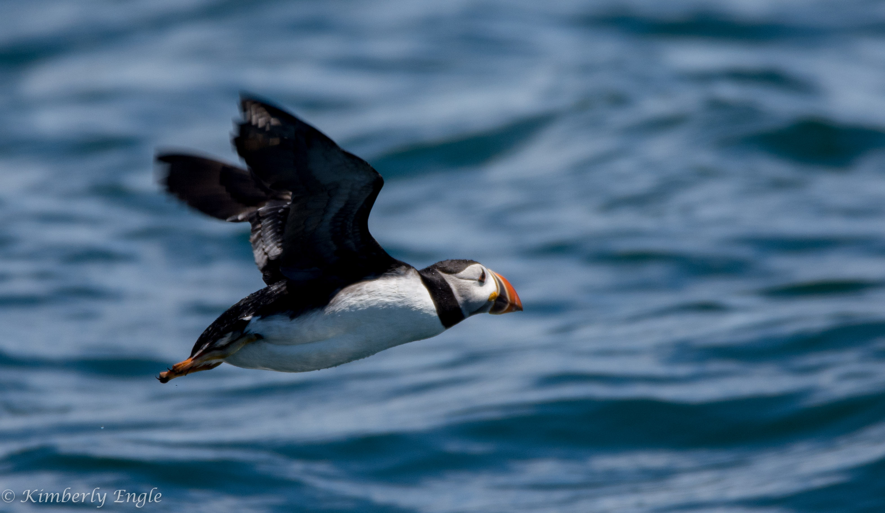
Photographing Birds
Smaller birds- Songbirds,Warblers
Waterfowl
Kimberly Engle
GSFC Photo Club Meeting
April 8, 2020

Slide 2
Things to consider before heading out
* What is my OBJECTIVE?
* Formulate a PLAN
* What GEAR and EQUIPMENT do I need?
* Which camera SETTINGS should I use?
* Locate your SUBJECT
* Create a pleasing COMPOSITION

Slide 3
What is my Objective?
* Are you interested only in incidental or casual pictures?
* Or are you in search of a specific bird?

Slide 4
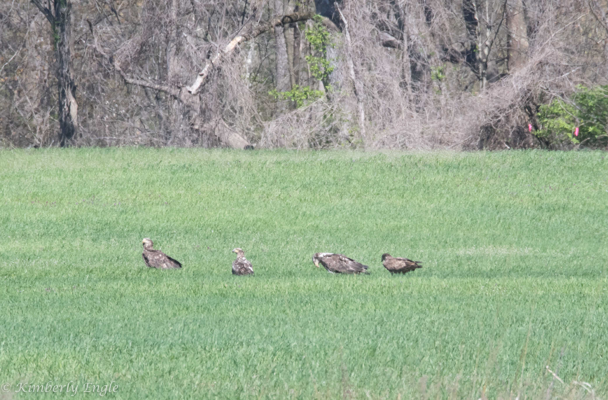
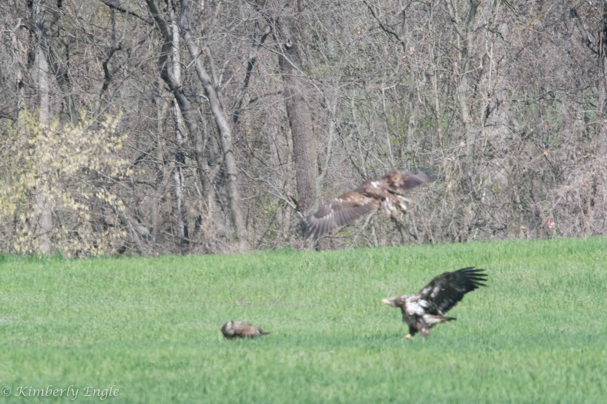
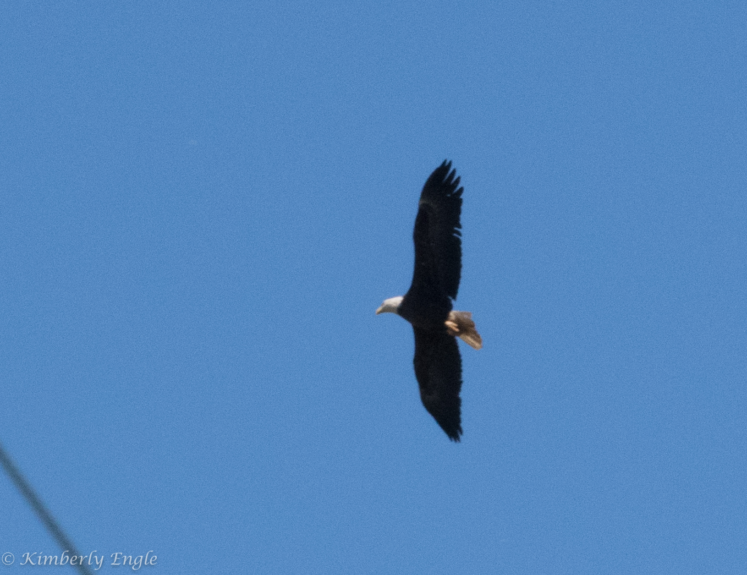
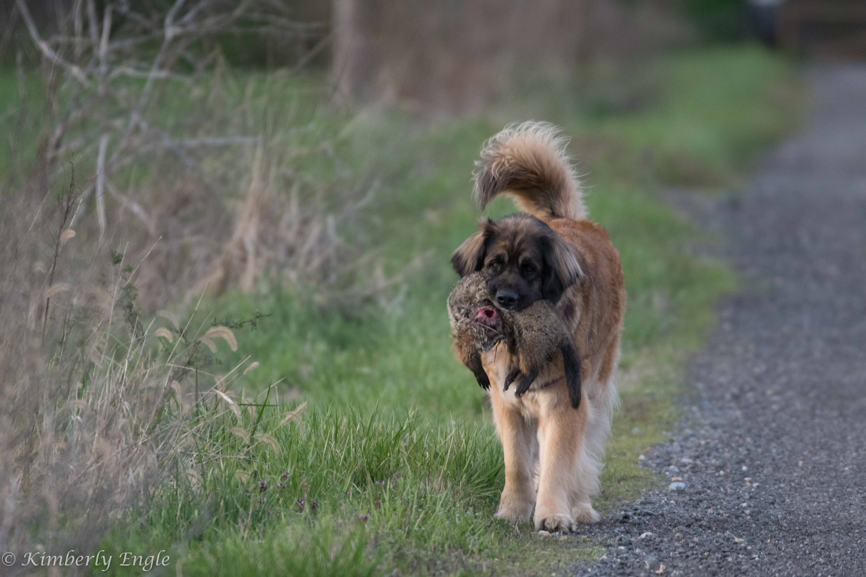
Incidental or Casual
I take my camera with me every day when I walk my dogs, so I’m prepared in case I see something interesting. I’m not looking for anything specific or maybe I plan to take pictures of something else, like deer.
Being prepared allowed me to get a few shots of at 6 female, male, and immature bald eagles in my neighbor’s farm field. And pic of what caused the commotion.

Slide 5
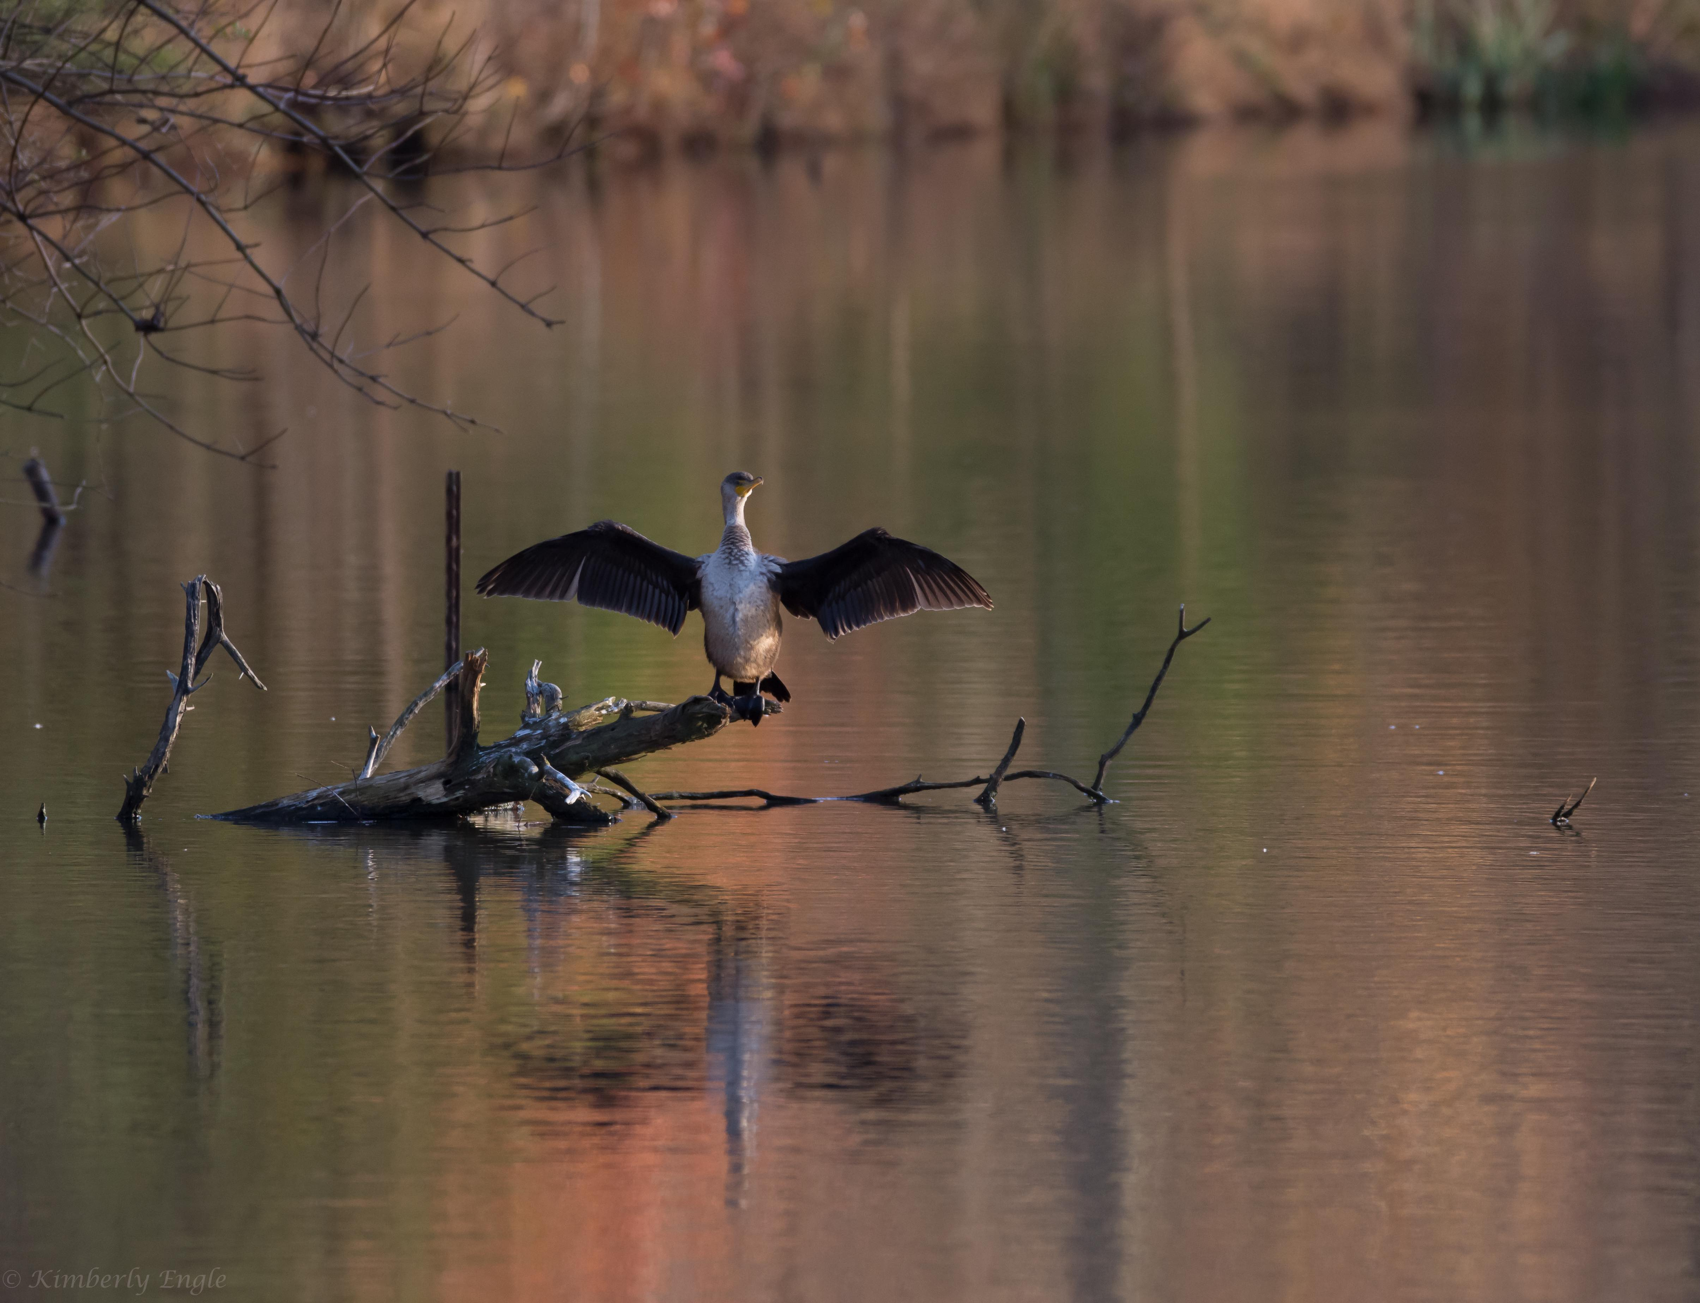
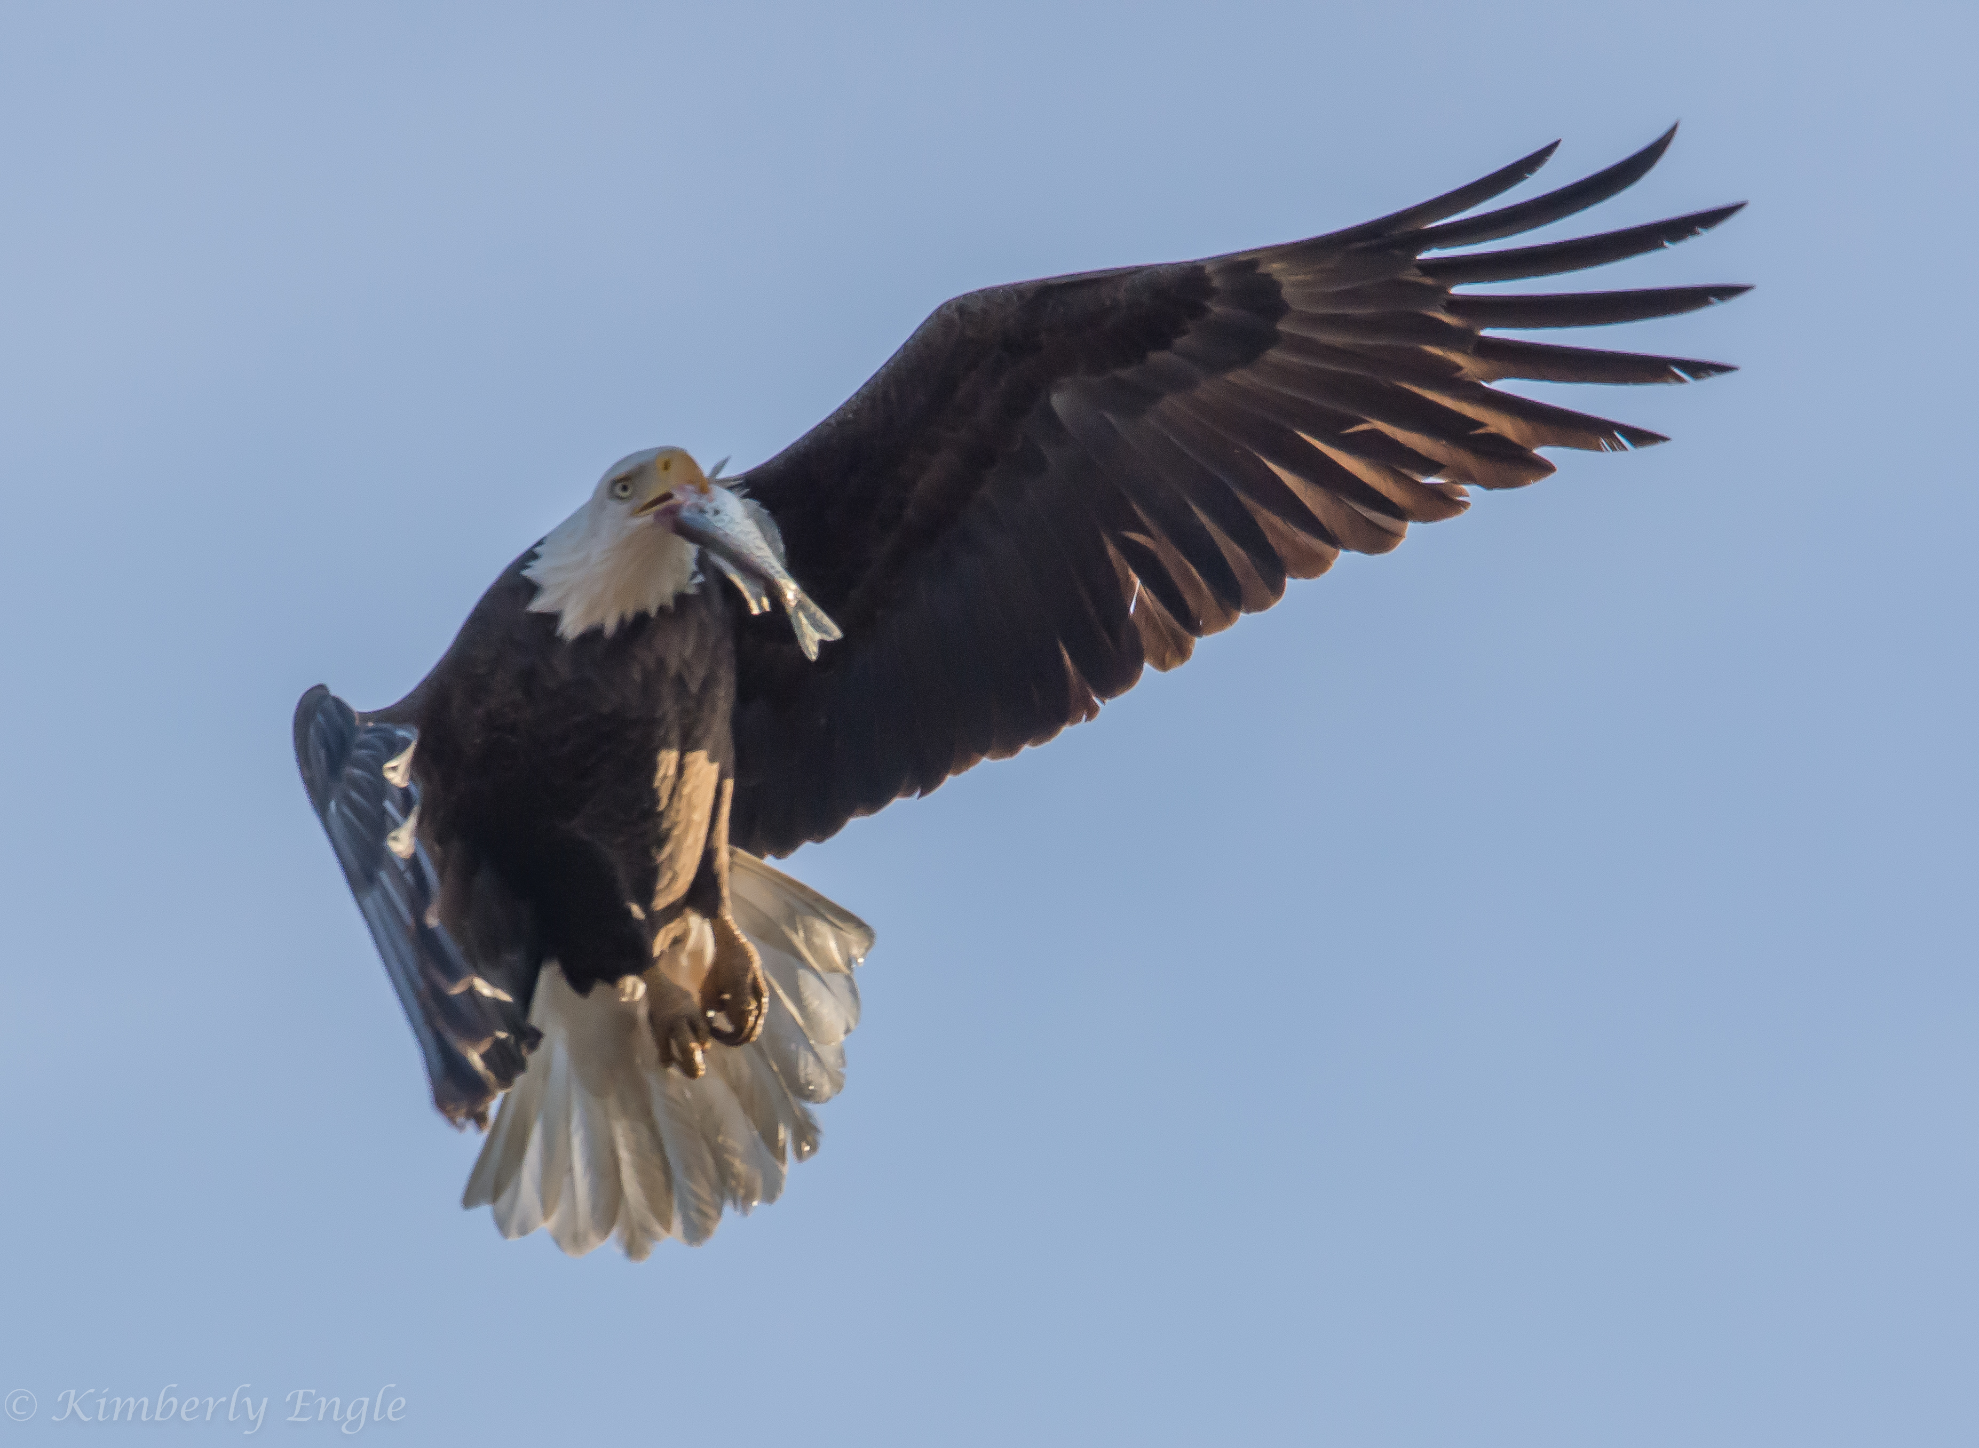
Incidental or Casual cont.
Sometimes I head out with the desire or intension of taking bird pictures, but I don’t know what I’ll see. Or I am looking for one subject and I find something else.

Slide 6
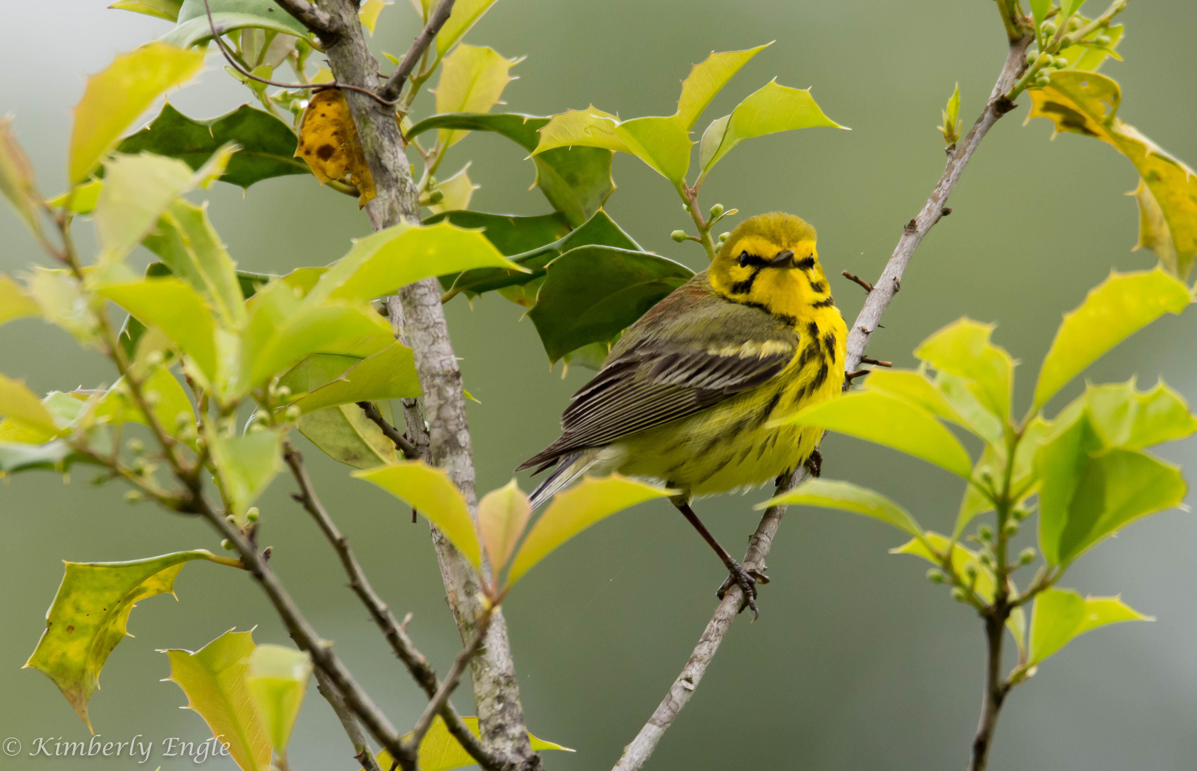
Specific Bird
If you want to photograph a specific bird, you should be familiar with that bird’s appearance, habitat, behavior (like time of day the bird is active), migration schedule (if applicable), and vocalizations.
I wanted to see and take a picture of a prairie warbler, so studied what they like, figured out if and when they migrate to this area, the type of habitat they prefer, when they’re active, and memorized their call. I wound up going to a specific region of the Patuxent Research Refuge and found my warbler pretty easily by listening for its song.

Slide 7
Specific Bird
If you want to photograph a specific bird, you should be familiar with that bird’s appearance, habitat, behavior (like time of day the bird is active), migration schedule (if applicable), and vocalizations.
I wanted to see and take a picture of a prairie warbler, so studied what they like, figured out if and when they migrate to this area, the type of habitat they prefer, when they’re active, and memorized their call. I wound up going to a specific region of the Patuxent Research Refuge and found my warbler pretty easily by listening for its song.

Slide 8
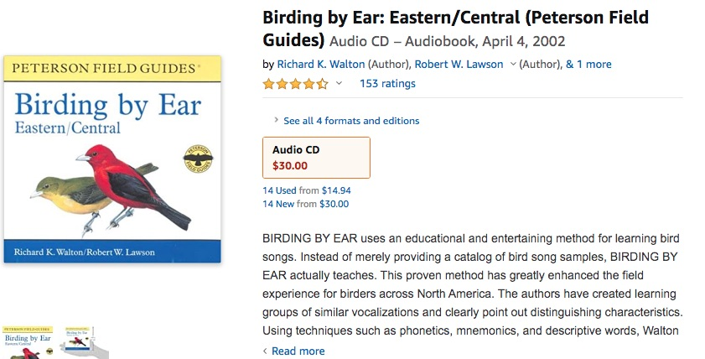
Formulate a Plan: Use Bird Information Resources
https://www.audubon.org/bird-guide (general habitat and behavior info, pictures, songs)
https://ebird.org/ (migration schedules, hot spots, rare bird alerts)

Slide 9
Gear and Equipment
* Binoculars!
- 8x is good
- 10x42 works better for me
* DSLR with fast focus + zoom lens
- I use a Nikon D7200 or D7500
- 300mm min zoom
- I have a Sigma 150-600mm (love this lens!)
* camera with superzoom (~1800mm)
- nice for stationary objects and a clear view
- focus is usually too slow
- need a tripod, especially for larger zooms

Slide 10
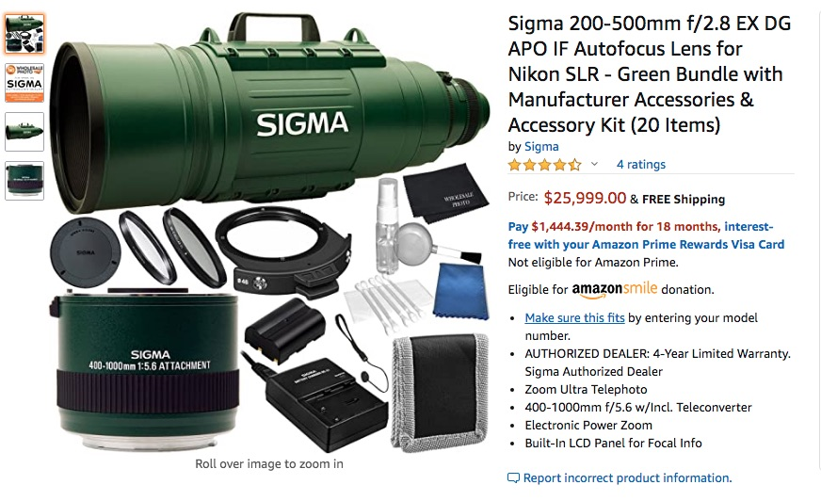
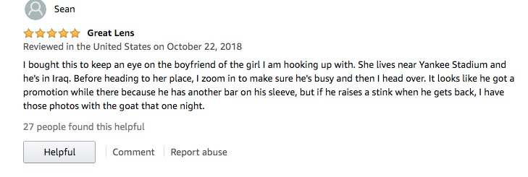
“You can’t go birding without this lens!”

Slide 11
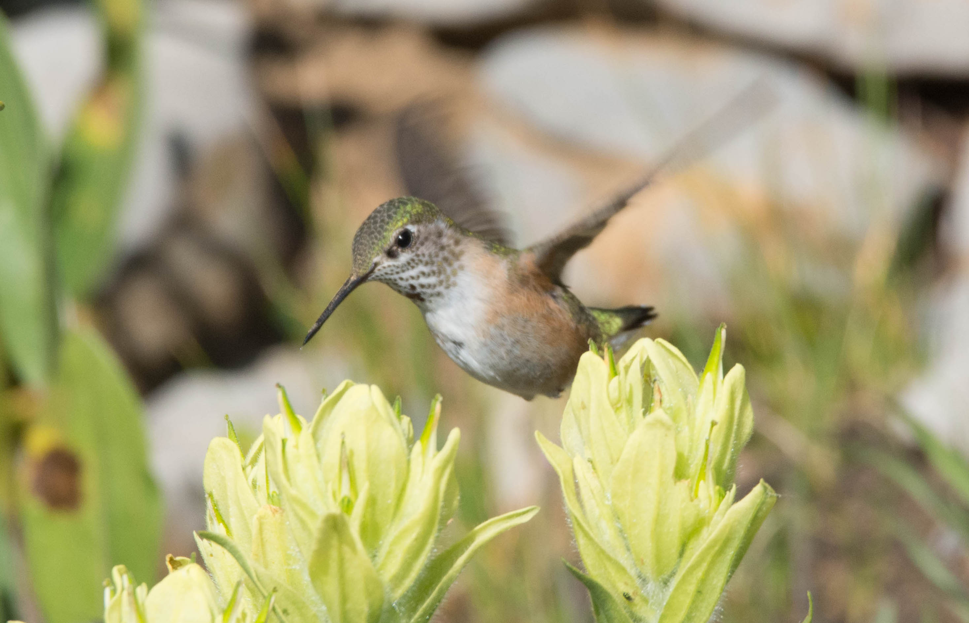
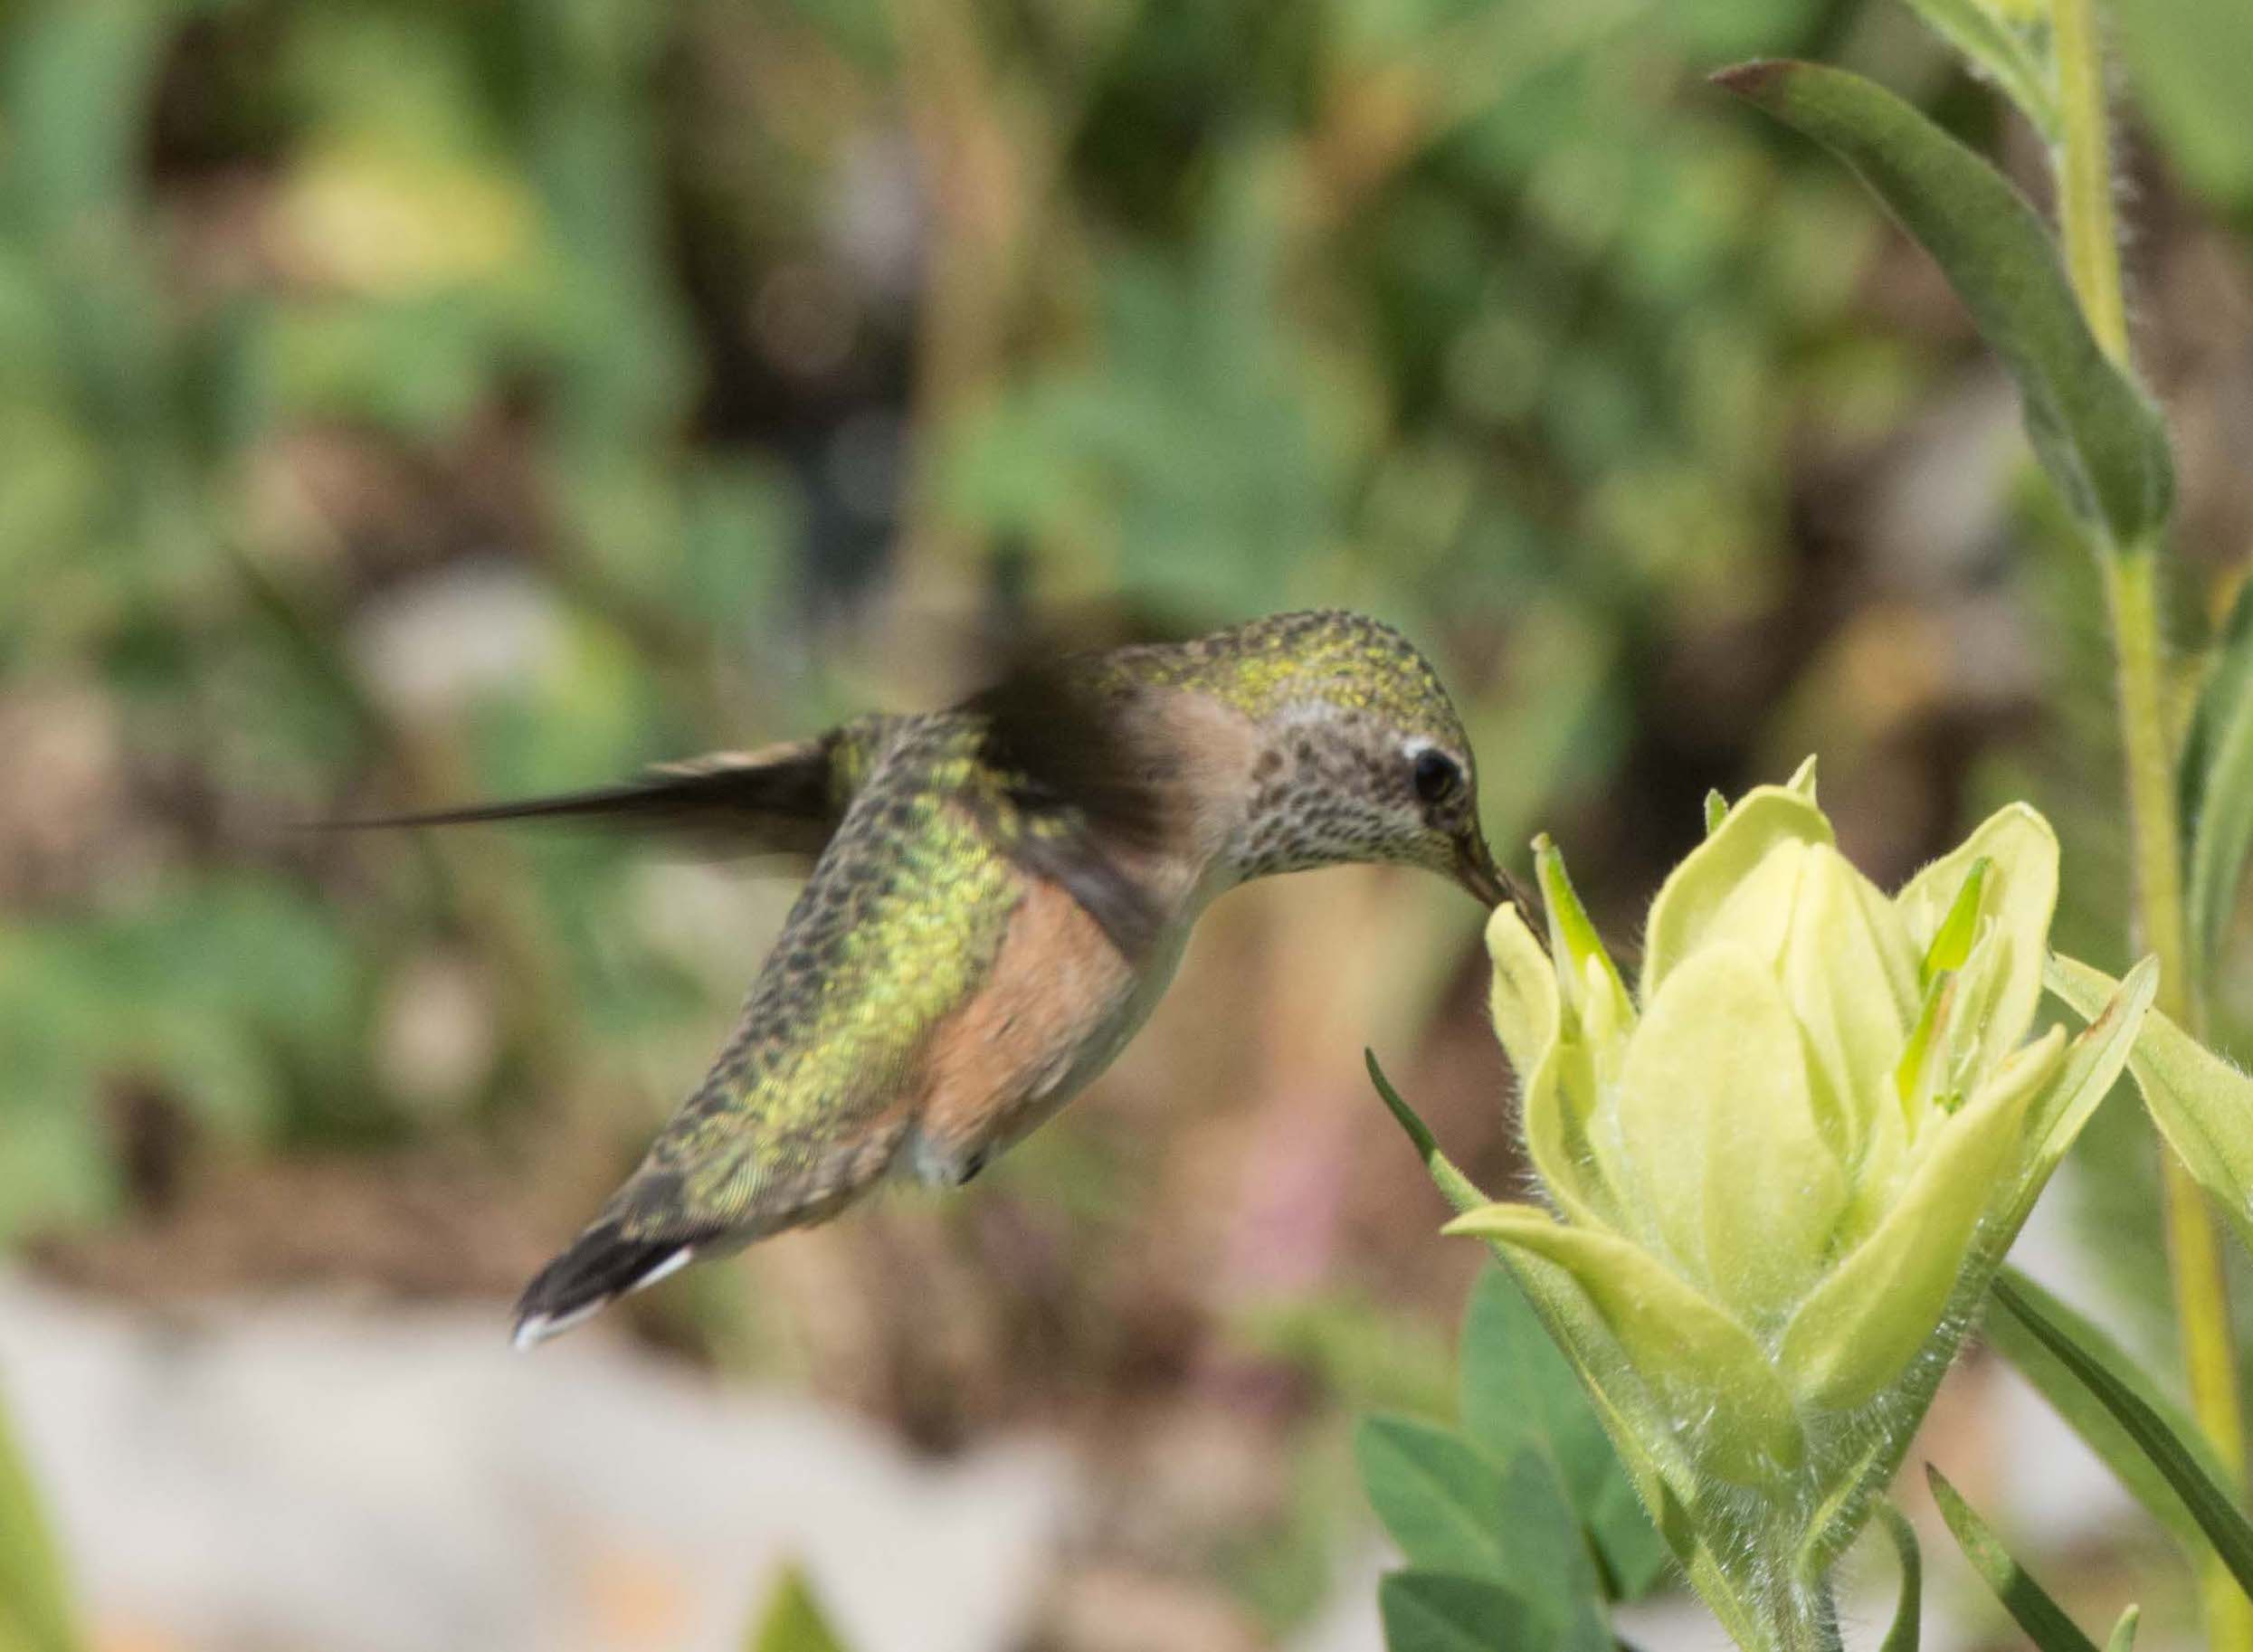
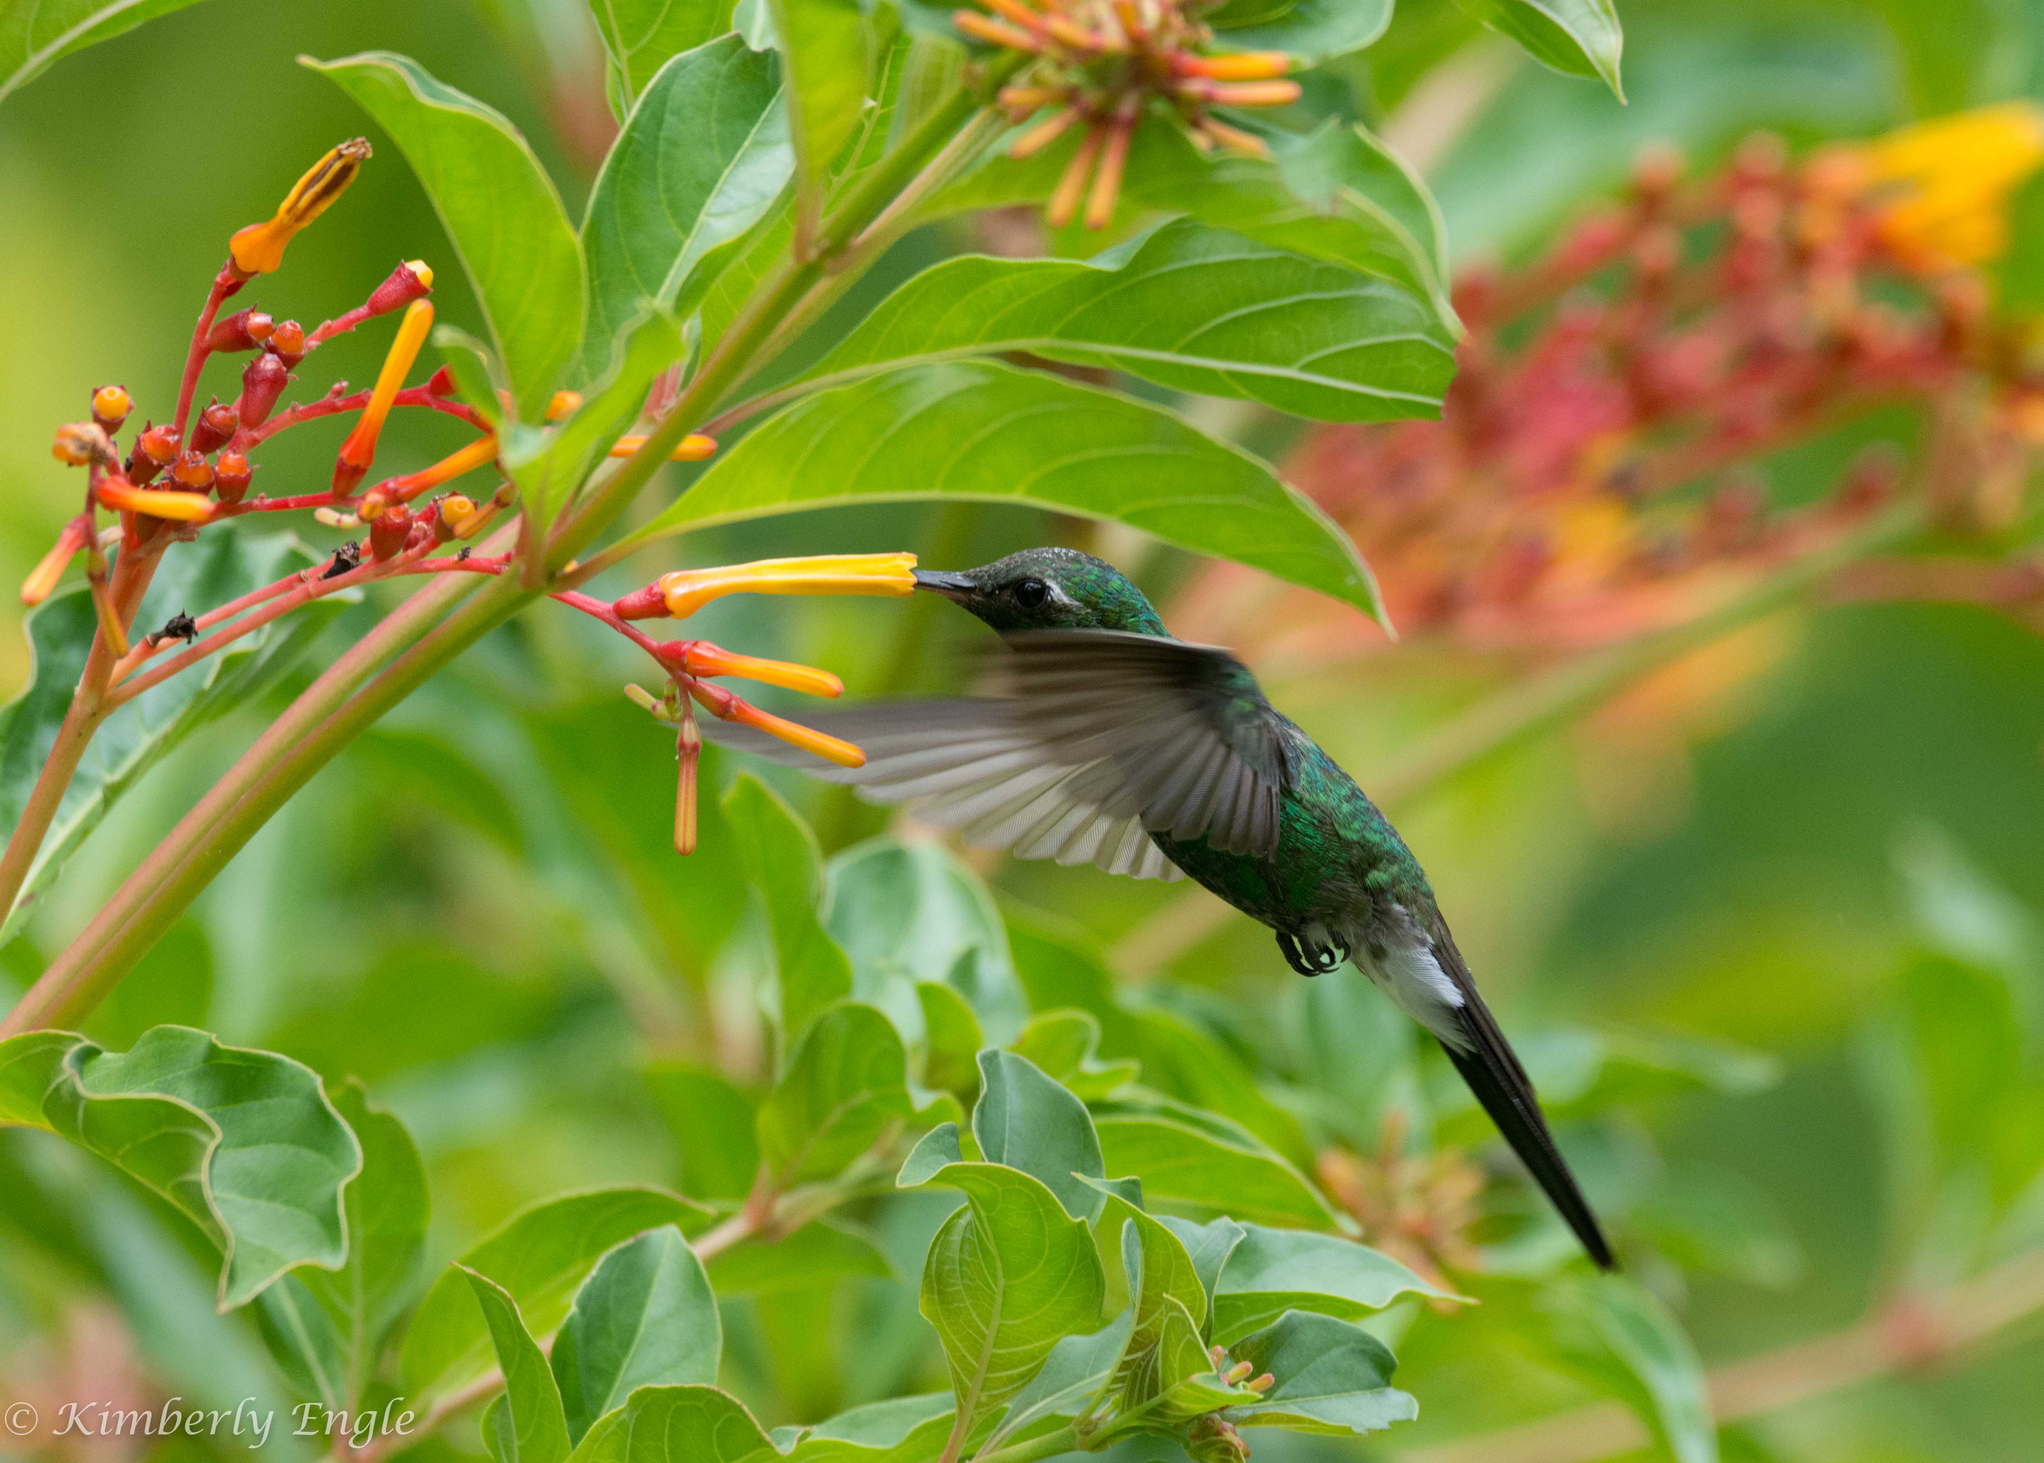
Camera Settings
* I prefer Shutter Priority, 1/640 min, depends on the bird
- 1/800 sufficient for most birds
- 1/1000 - 1/1250 for hummingbirds
- 1/1600 for puffins
* Set Aperture range, or free
* Set ISO range or max
* I use Continuous Shooting (Burst Mode), low or high
* I always shoot in Camera Raw so I can adjust photos later
* Focus on the eyes!

Slide 12
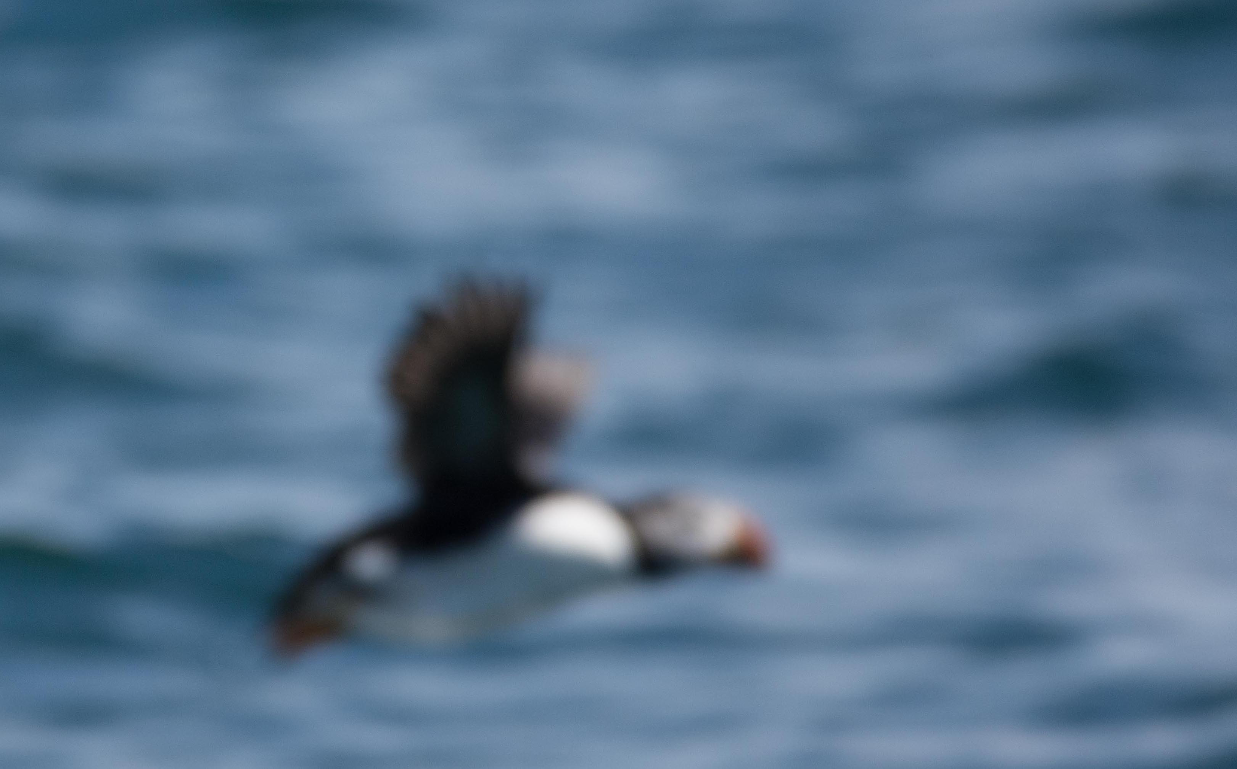
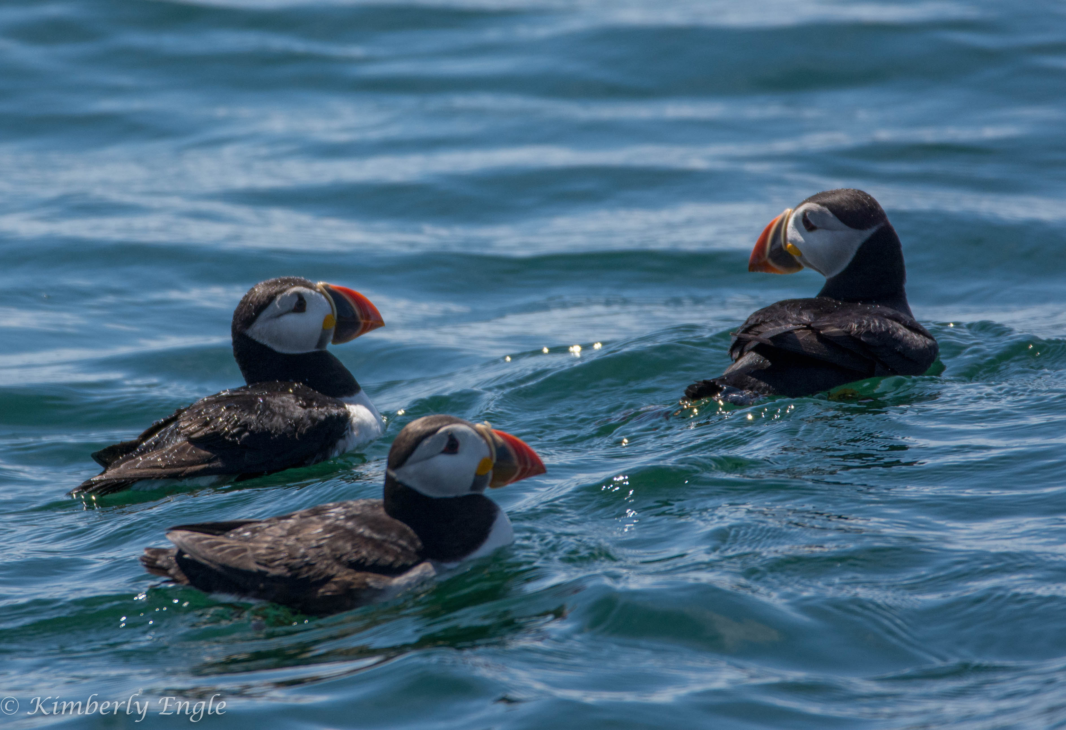
Camera Settings cont.

Slide 13
Locate your subject
If you want to explore and take photographs of whatever birds you
happen to see, some great places to go include:
- The Goddard Pond!
- Patuxent Research Refuge https://www.fws.gov/refuge/patuxent/
- Patuxent River Park http://outdoors.pgparks.com/3436/Patuxent-River-Park
- Buddy Attick Lake Park https://www.greenbeltmd.gov/Home/Components/FacilityDirectory/FacilityDirectory/4/511
- Blackwater Wildlife Refuge https://www.fws.gov/refuge/blackwater/
- “Warbler Road” http://www.wildlifesouth.com/Locations/Virginia/WarblerRoad.html

Slide 14
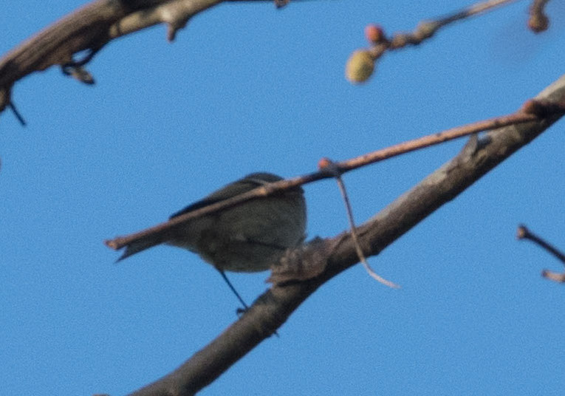
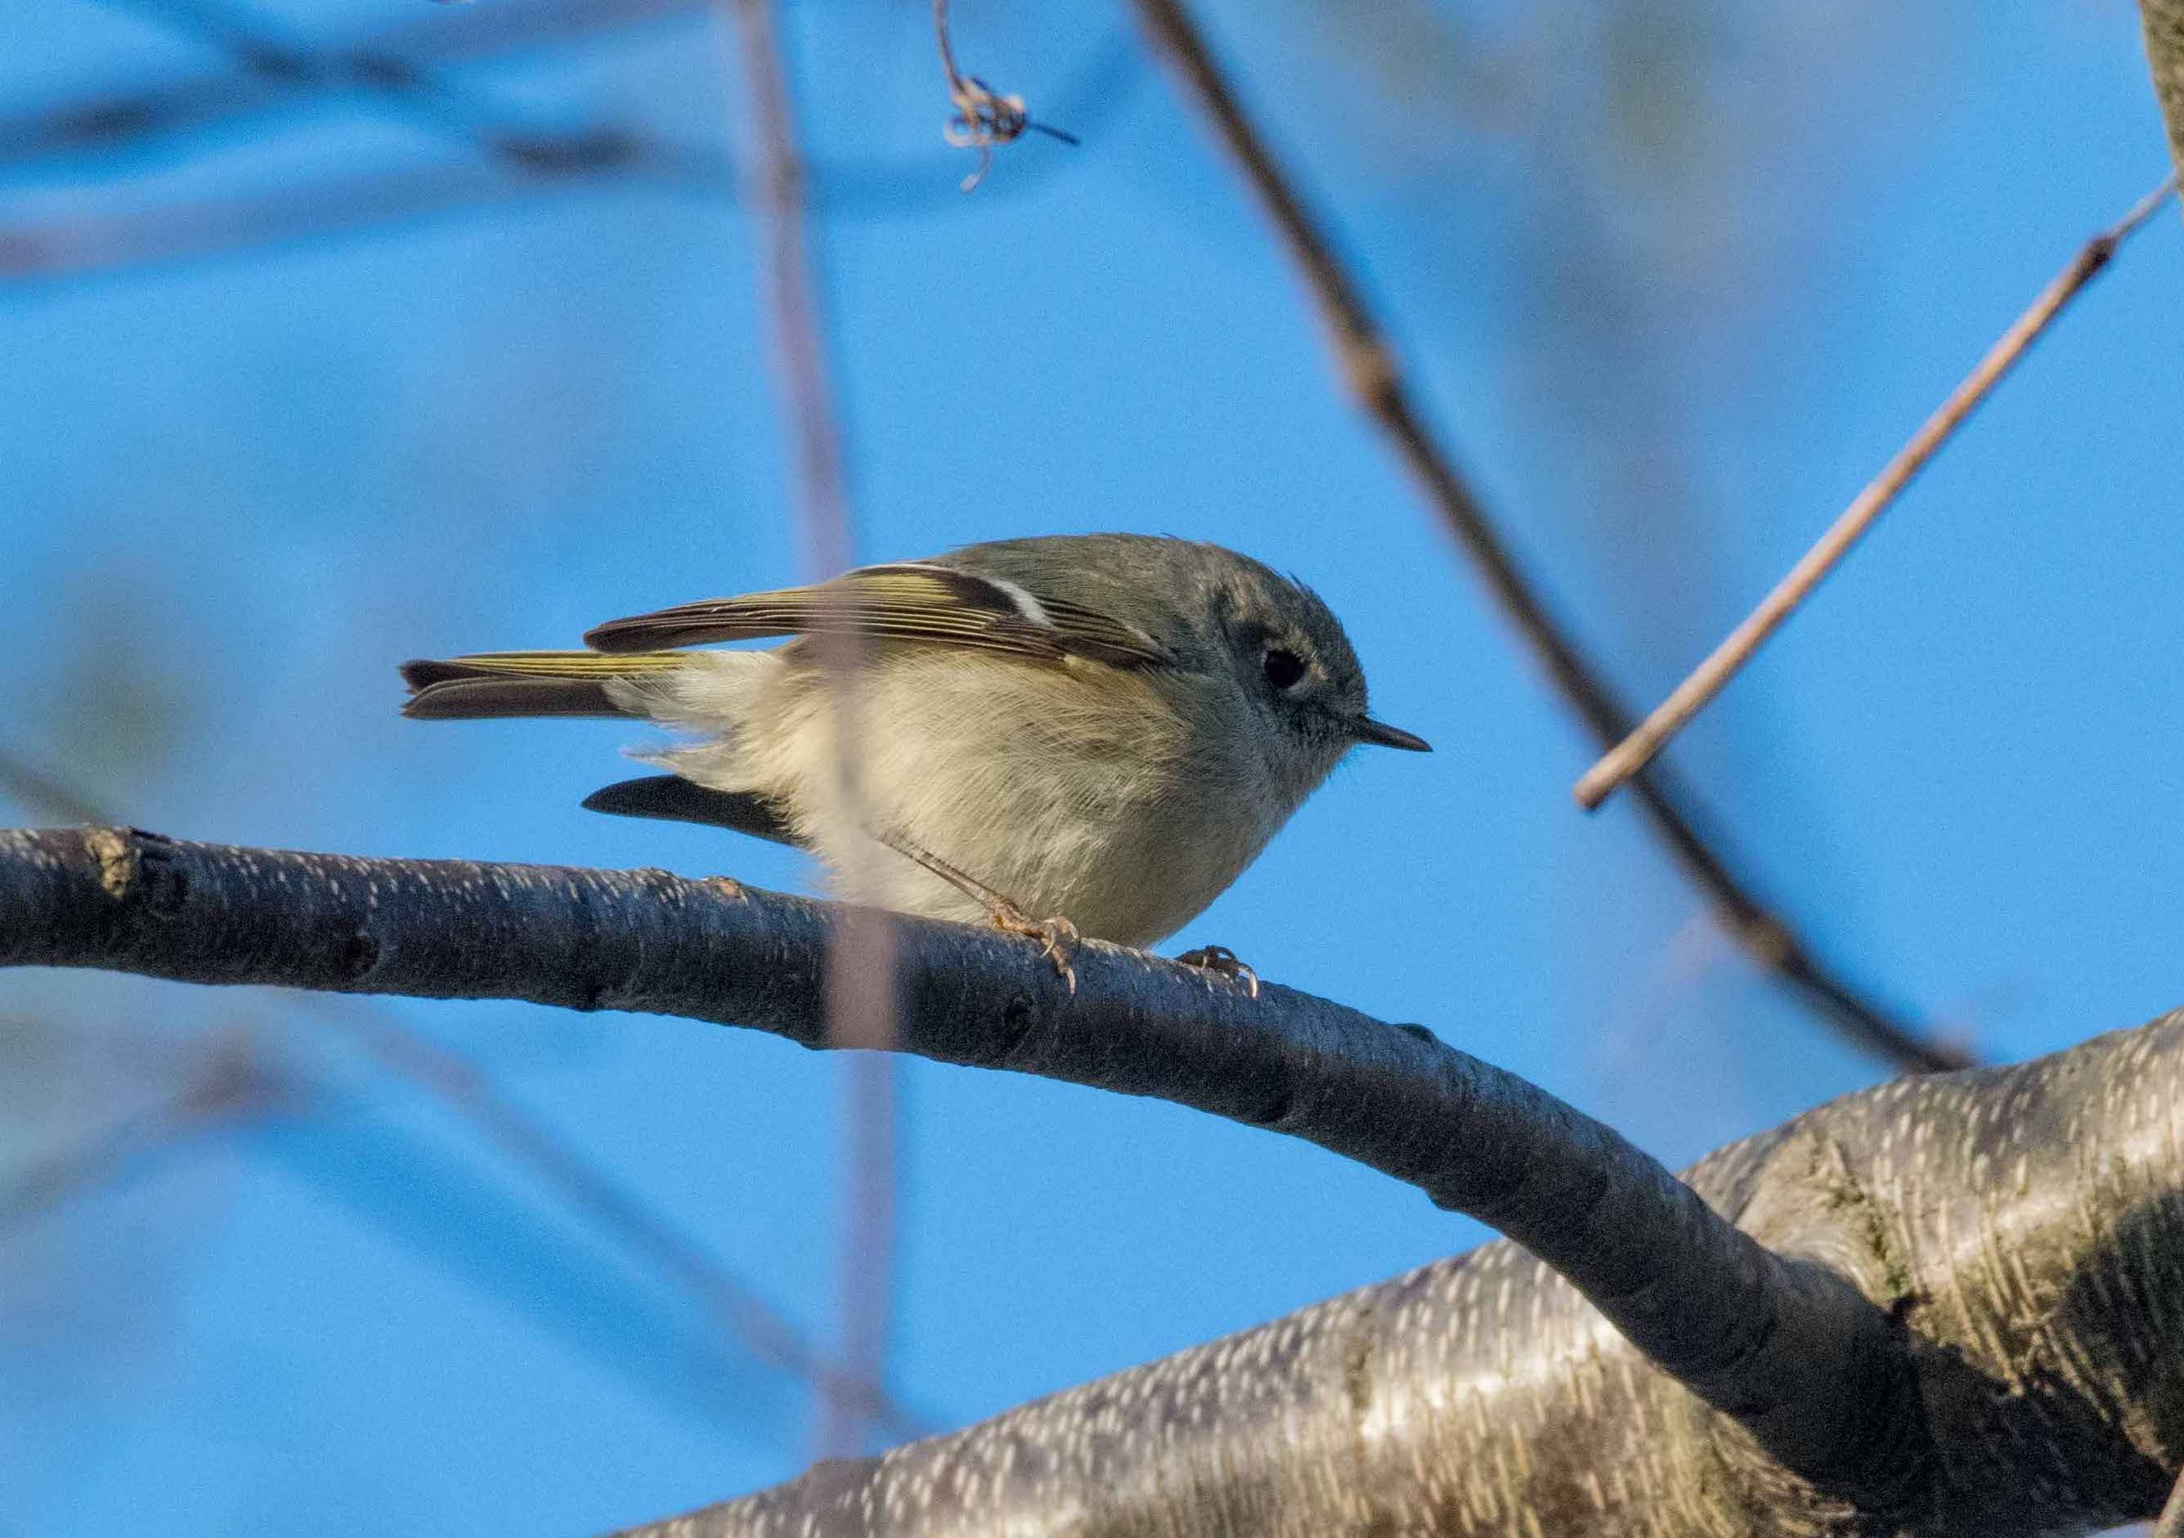
Composition
* “Rule of Thirds” helps create a pleasing image
* Avoid distractions such as branches
* Choose an interesting background if you can, or blur it using a low f-stop or in post processing
* Try to photographs the bird doing something interesting, like flying, singing, eating a worm
* A catch light in the eye makes the bird come alive
* Be patient!

Slide 15
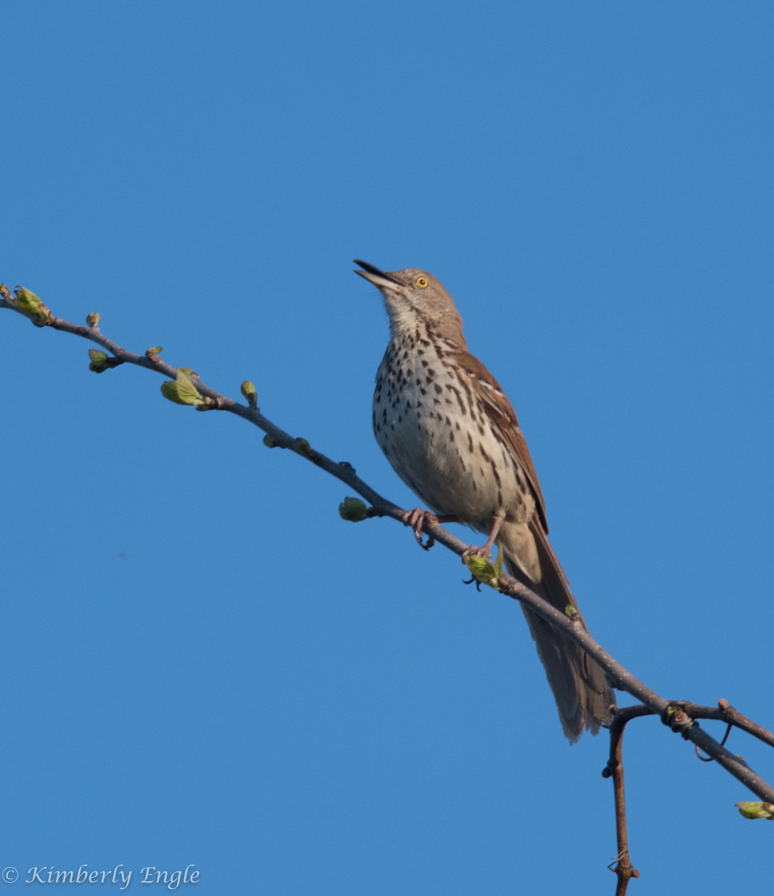
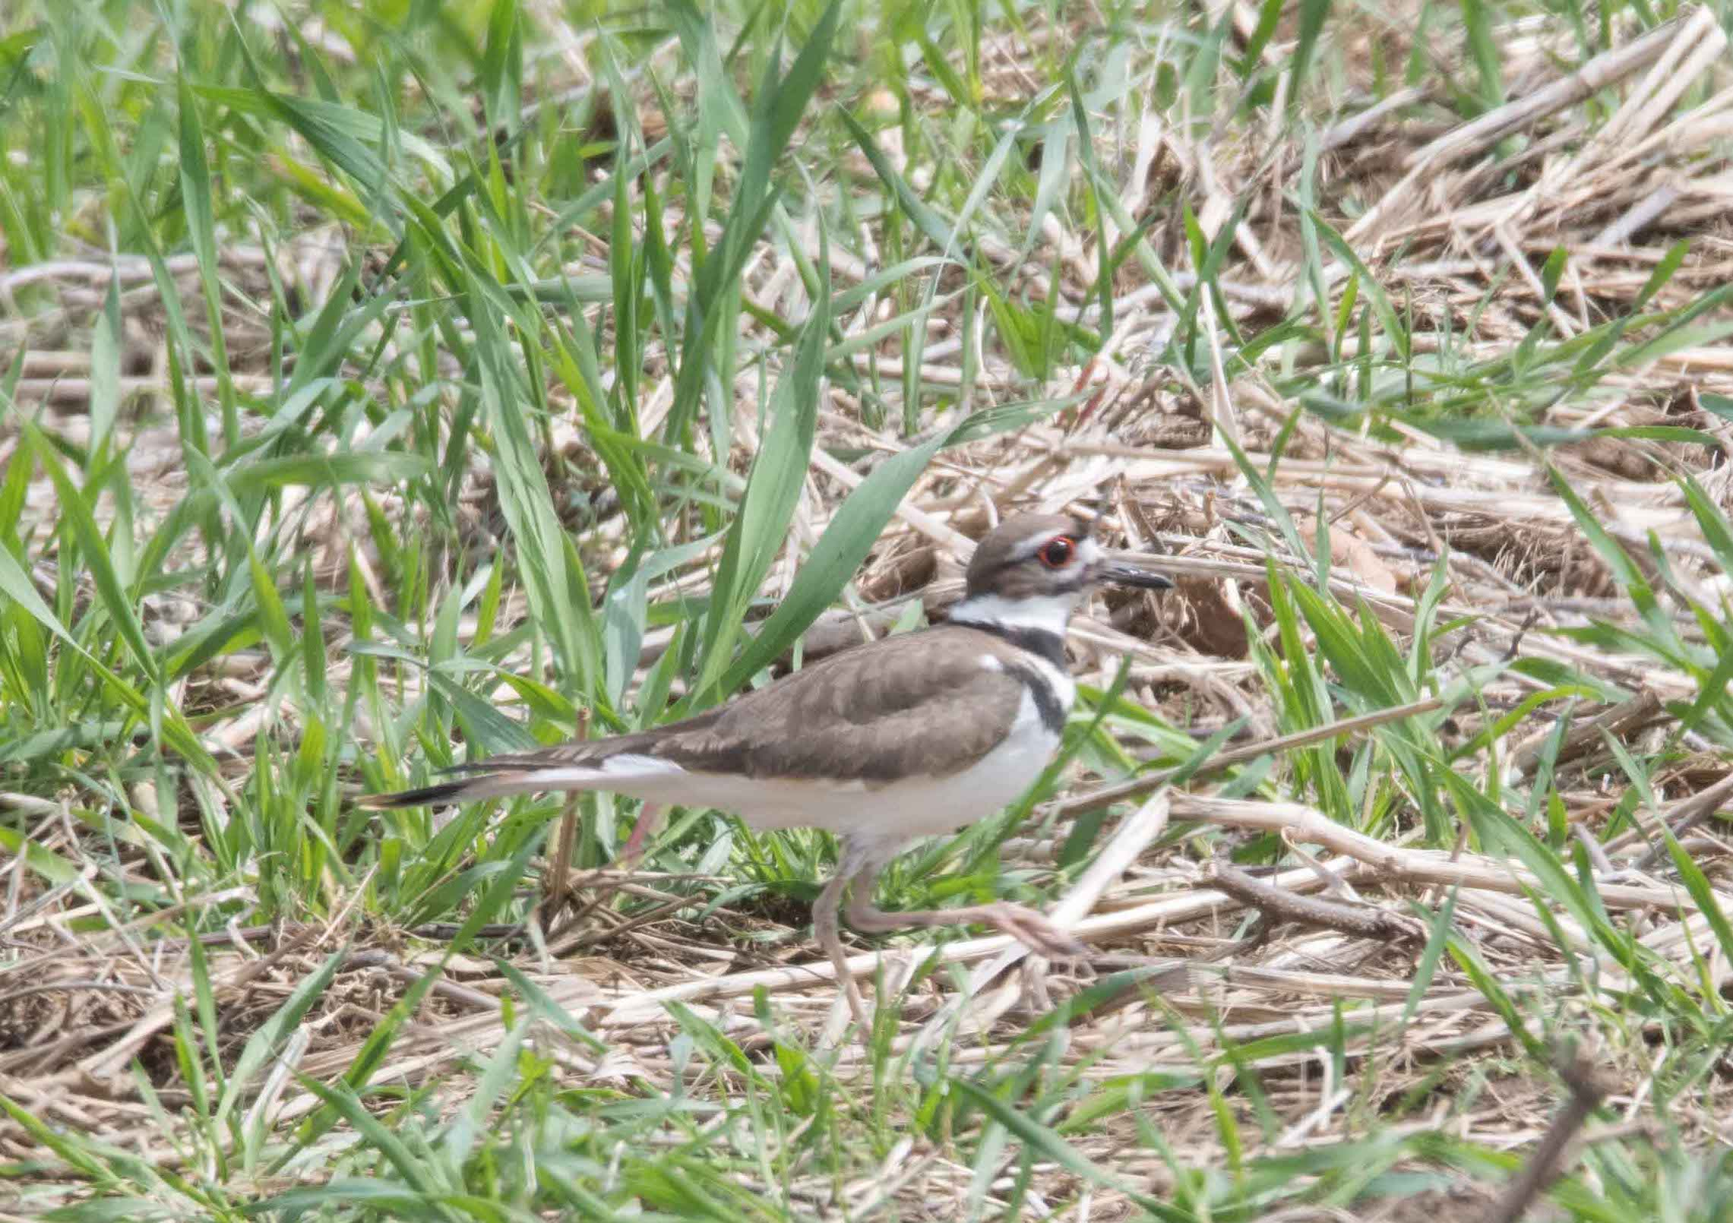
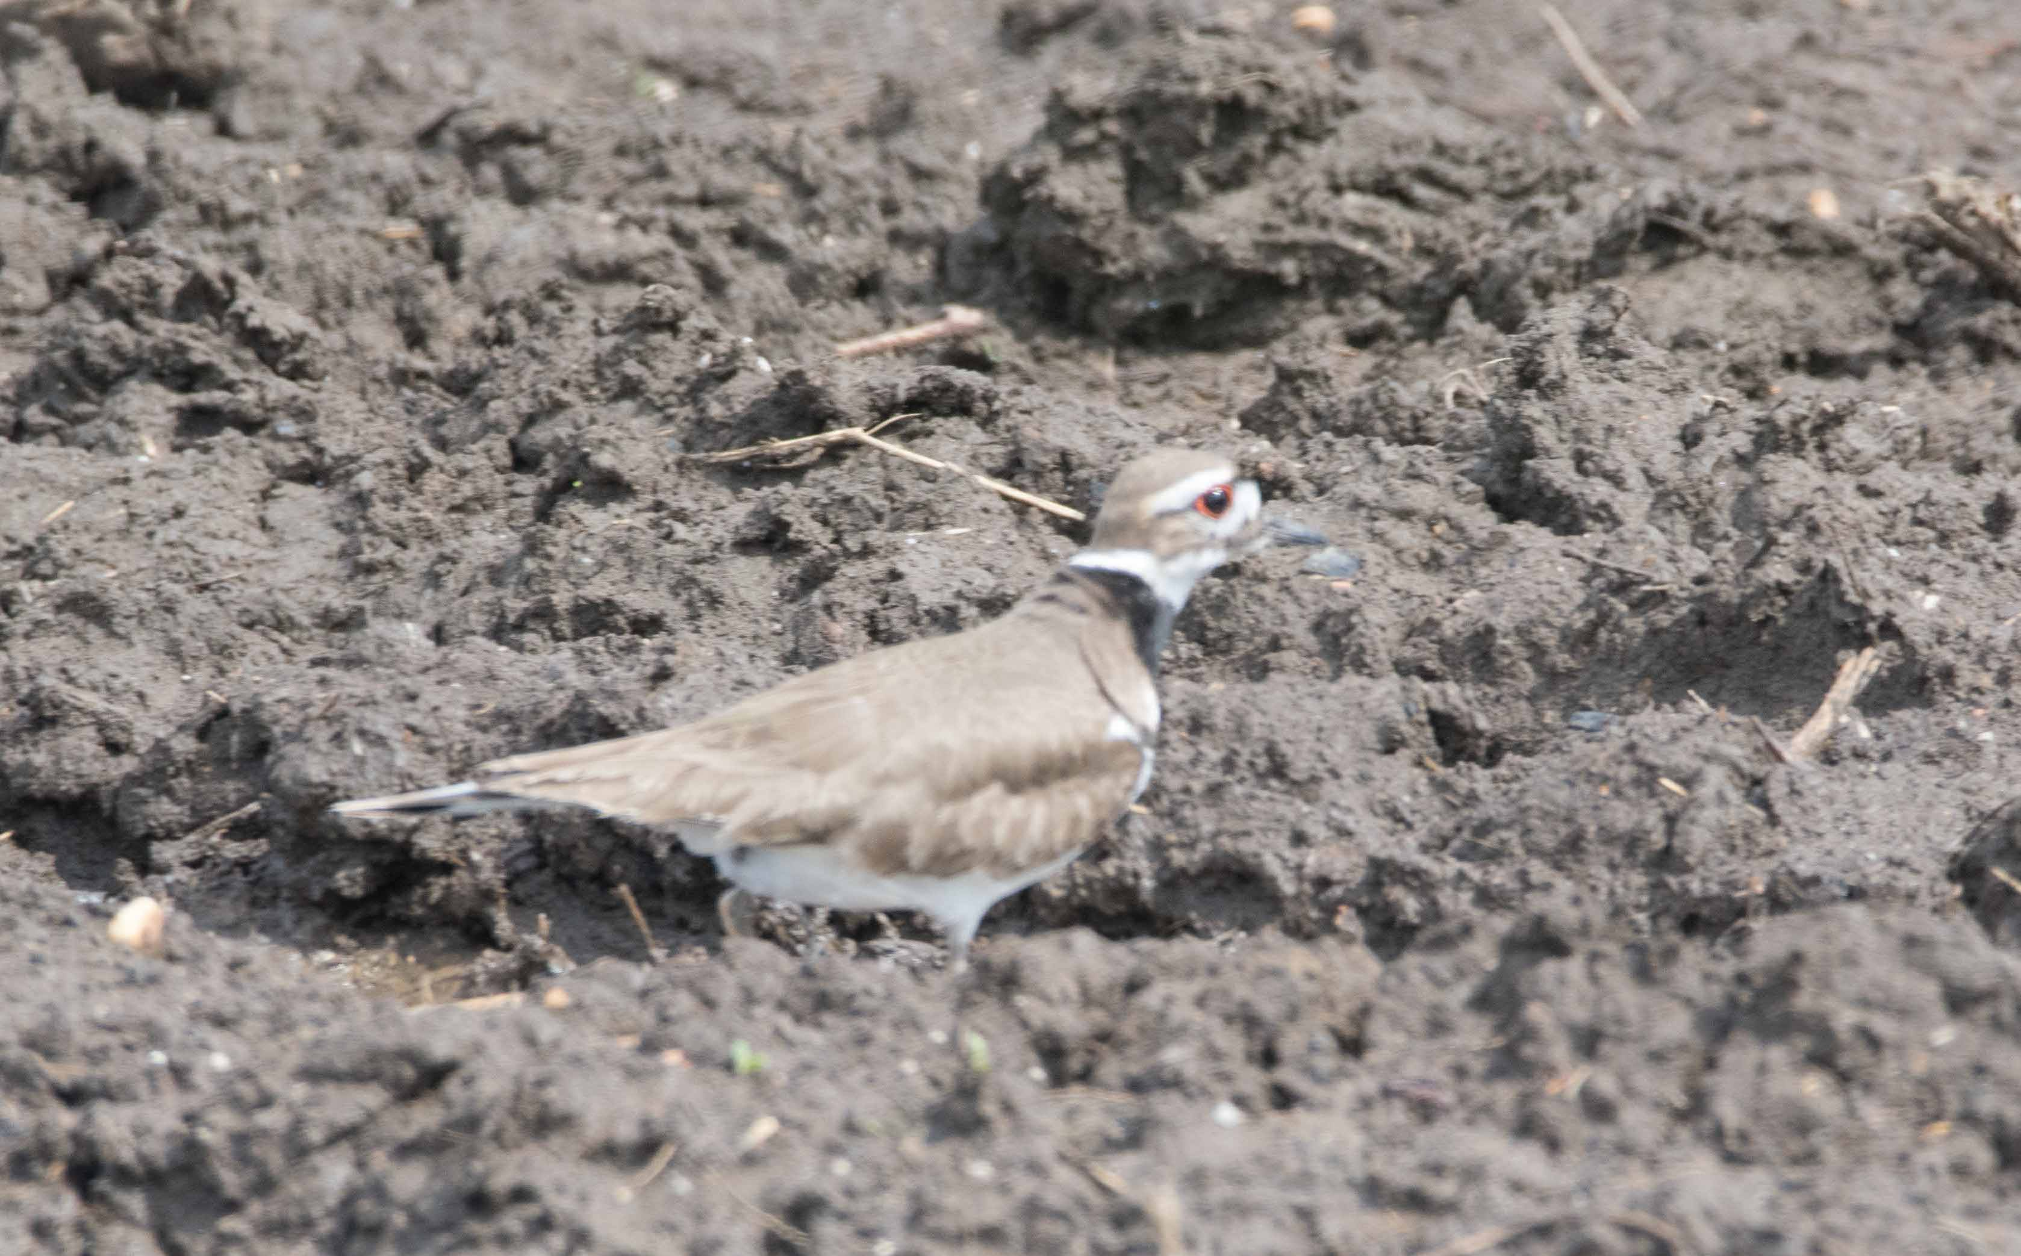
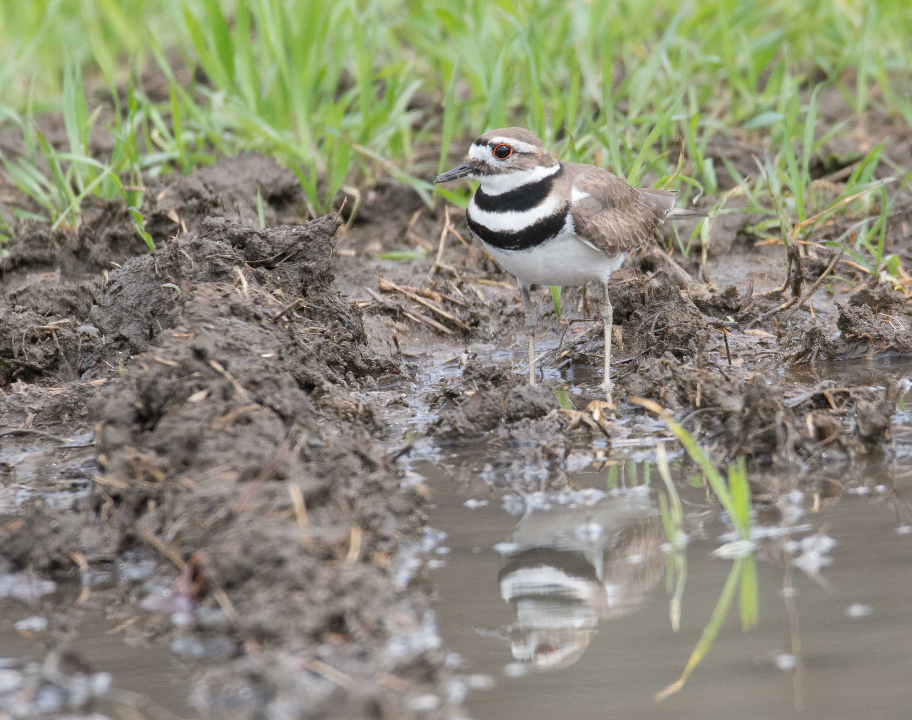
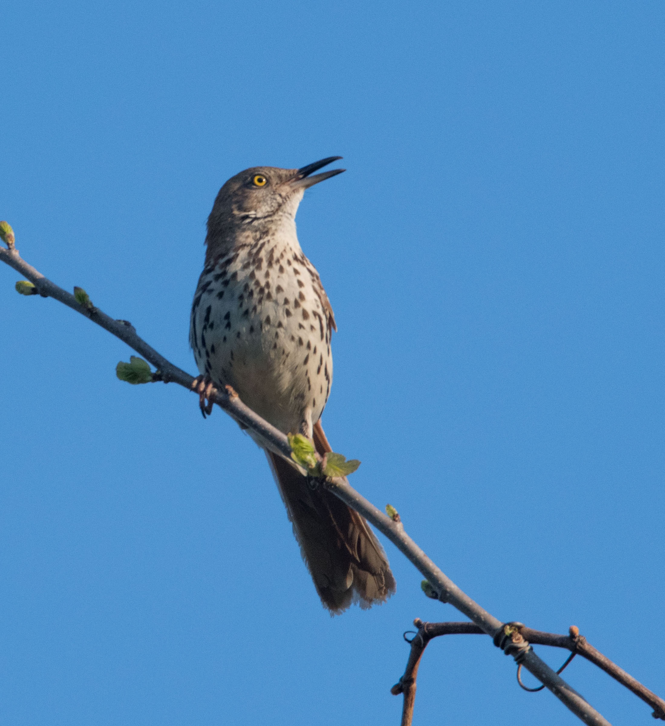
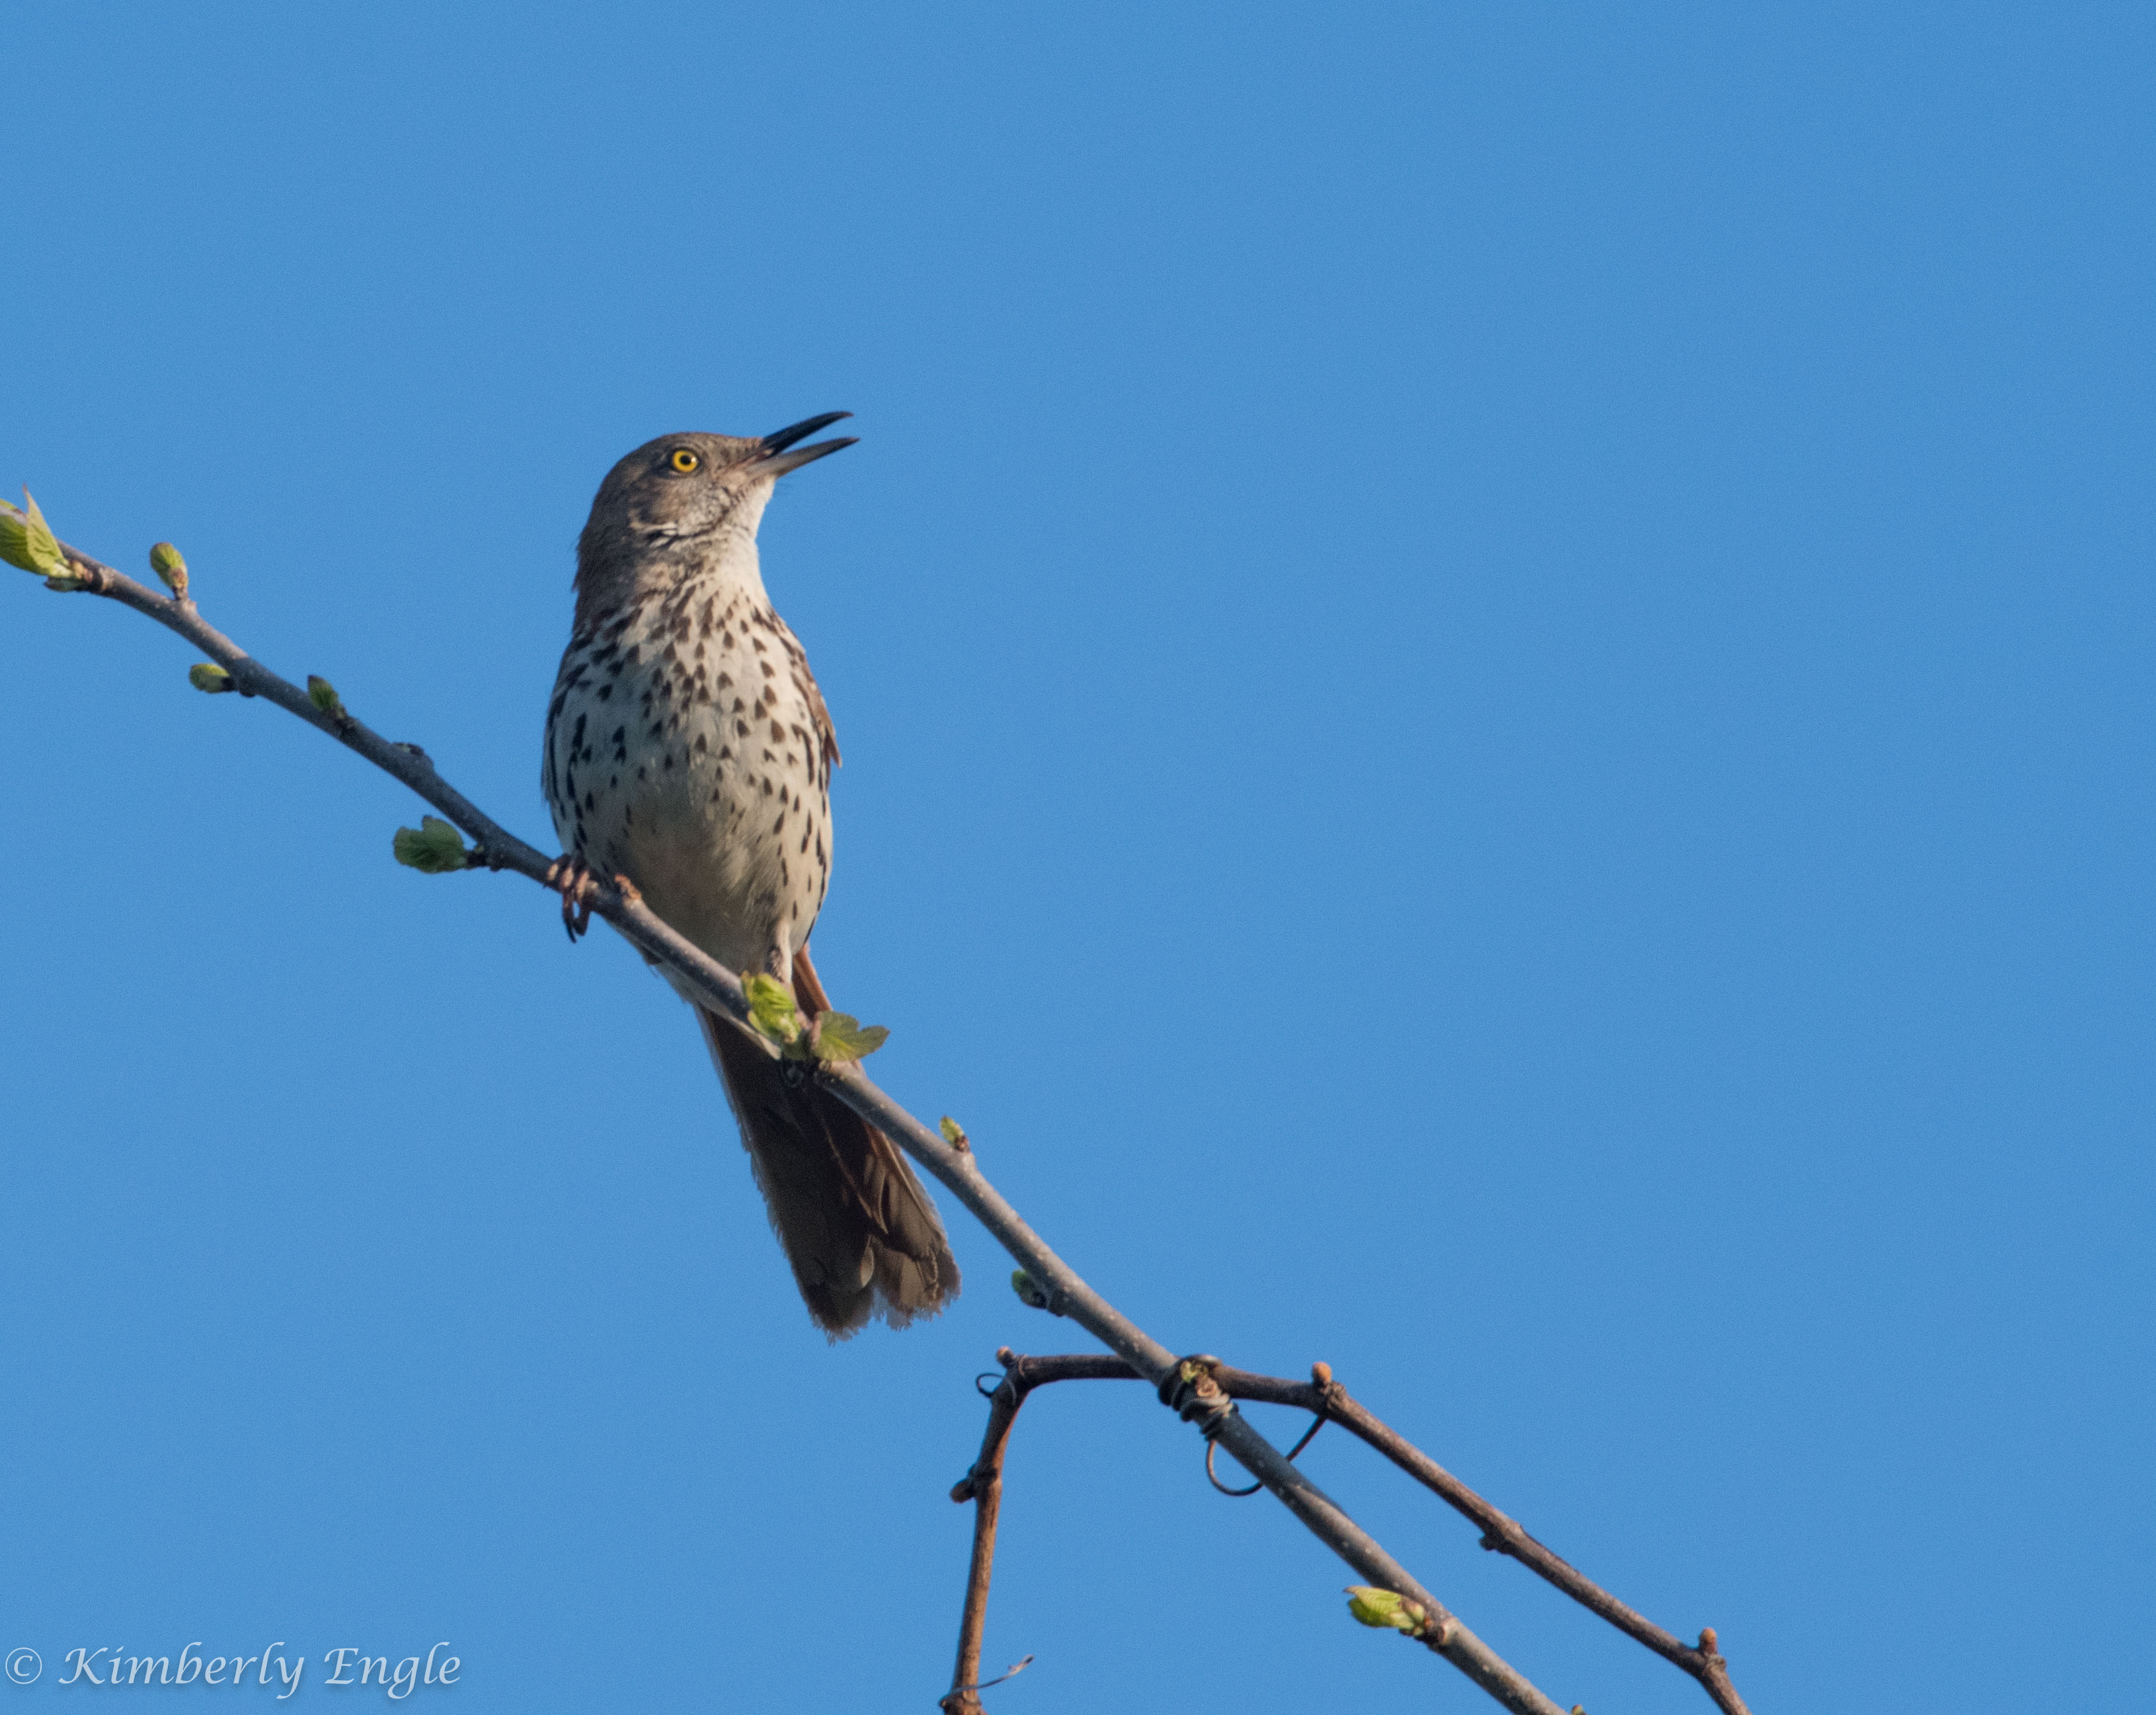
Composition cont.

Slide 16
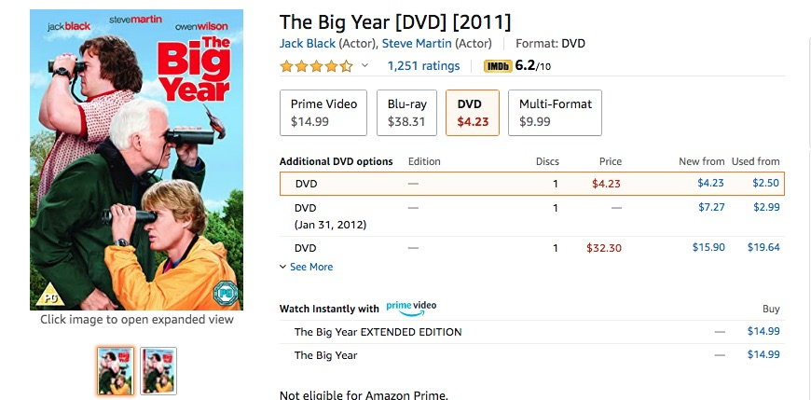
For more tips on photographing birds, check out:
https://expertphotography.com/bird-photography-basics-how-to-take-great-photos-of-birds/
https://digital-photography-school.com/10-incredible-bird-photography-tips-beginners/
https://www.audubon.org/photography/how-tos
And if you’re bored and running out of things to watch on TV, this is a fun birding movie starring Steve Martin, Jack Black, and Owen Wilson.
The End

