Slide 1
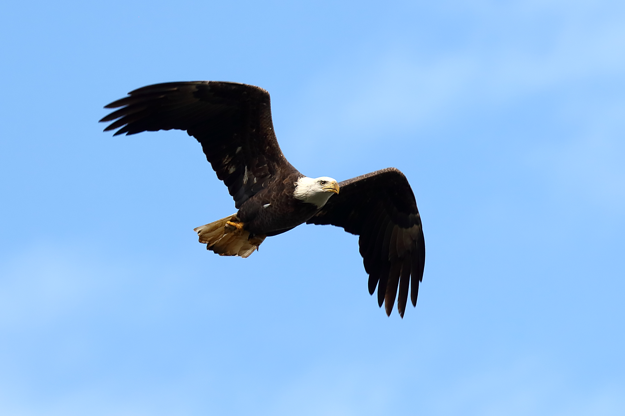
Photographing Birds in Flight
Larger birds
Eliot Malumuth
GSFC Photo Club Meeting
April 8, 2020

Slide 2
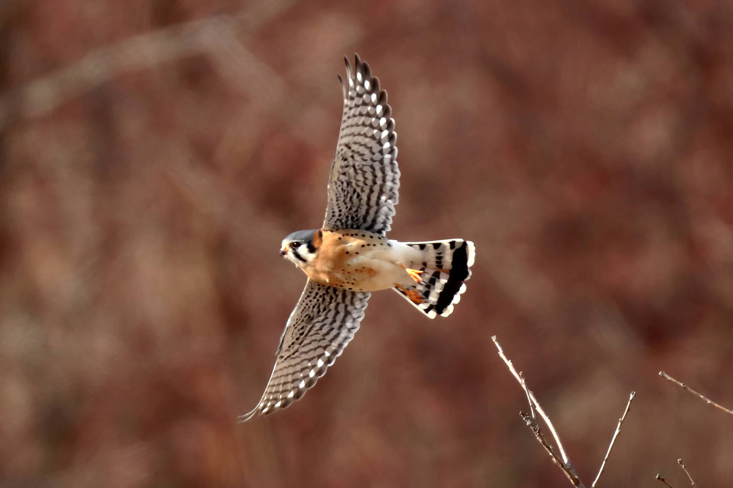
Some things you need to photograph Large Birds in Flight
Travel
Opportunity
Patience
Equipment
Settings
Selectivity

Slide 3
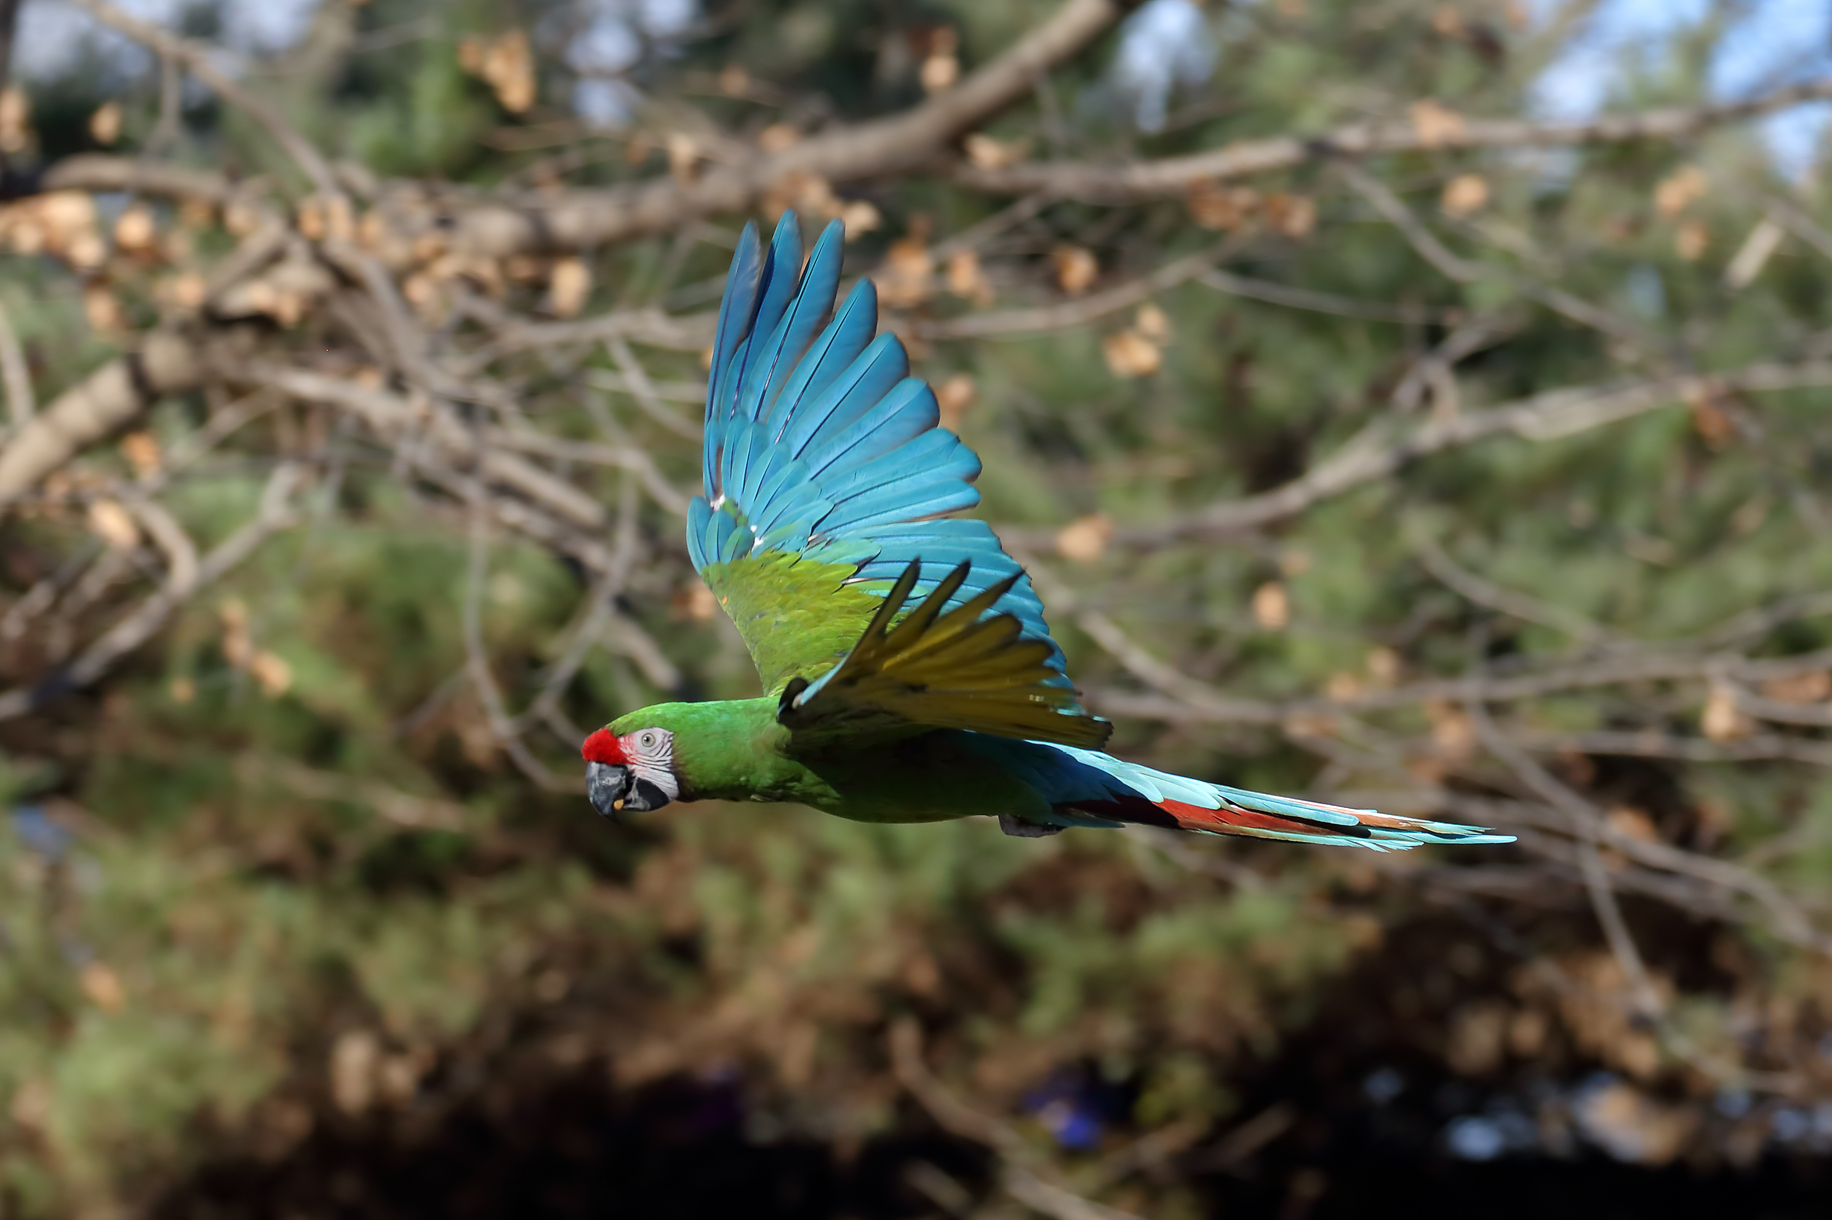
Some things you need to photograph Large Birds in Flight
Travel
Opportunity
Opportunity – Unless you are lucky you aren’t in a location where you will see the target birds (especially large raptors). To get photographs of large birds (especially flying) you may need to Travel to where the birds are. I usually will travel within a ~2 hour radius to be where the birds are
Conowingo Dam ~1:15
Blackwater NWR ~2:00
Bombay Hook NWR ~2:00
North Beach Pier ~1:00
Shady Side ~1:00
Piney Point/St Georges Island ~2:00

Slide 4
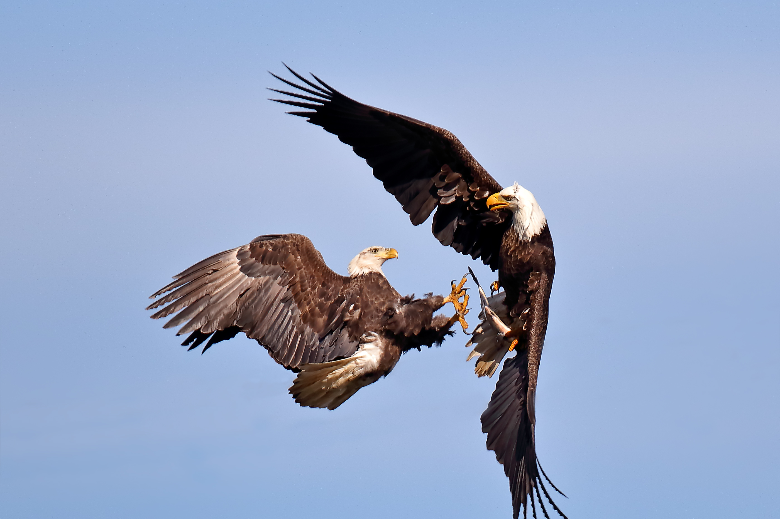
Some things you need to photograph Large Birds in Flight
Patience
This may be obvious but even if you are in a great location, the birds are free to come and go as they please and you may have to wait a considerable time to have the opportunity to get a bird doing what will make a great photo. For example at
Conowingo Dam you may get some opportunities to get a flyby of an eagle with a, relatively short wait, but to get eagles interacting (fighting) and close enough to you to make a great photo, you may need to come several times and wait many hours. You must exercise Patience to get the shot you want (at least of wild birds).

Slide 5
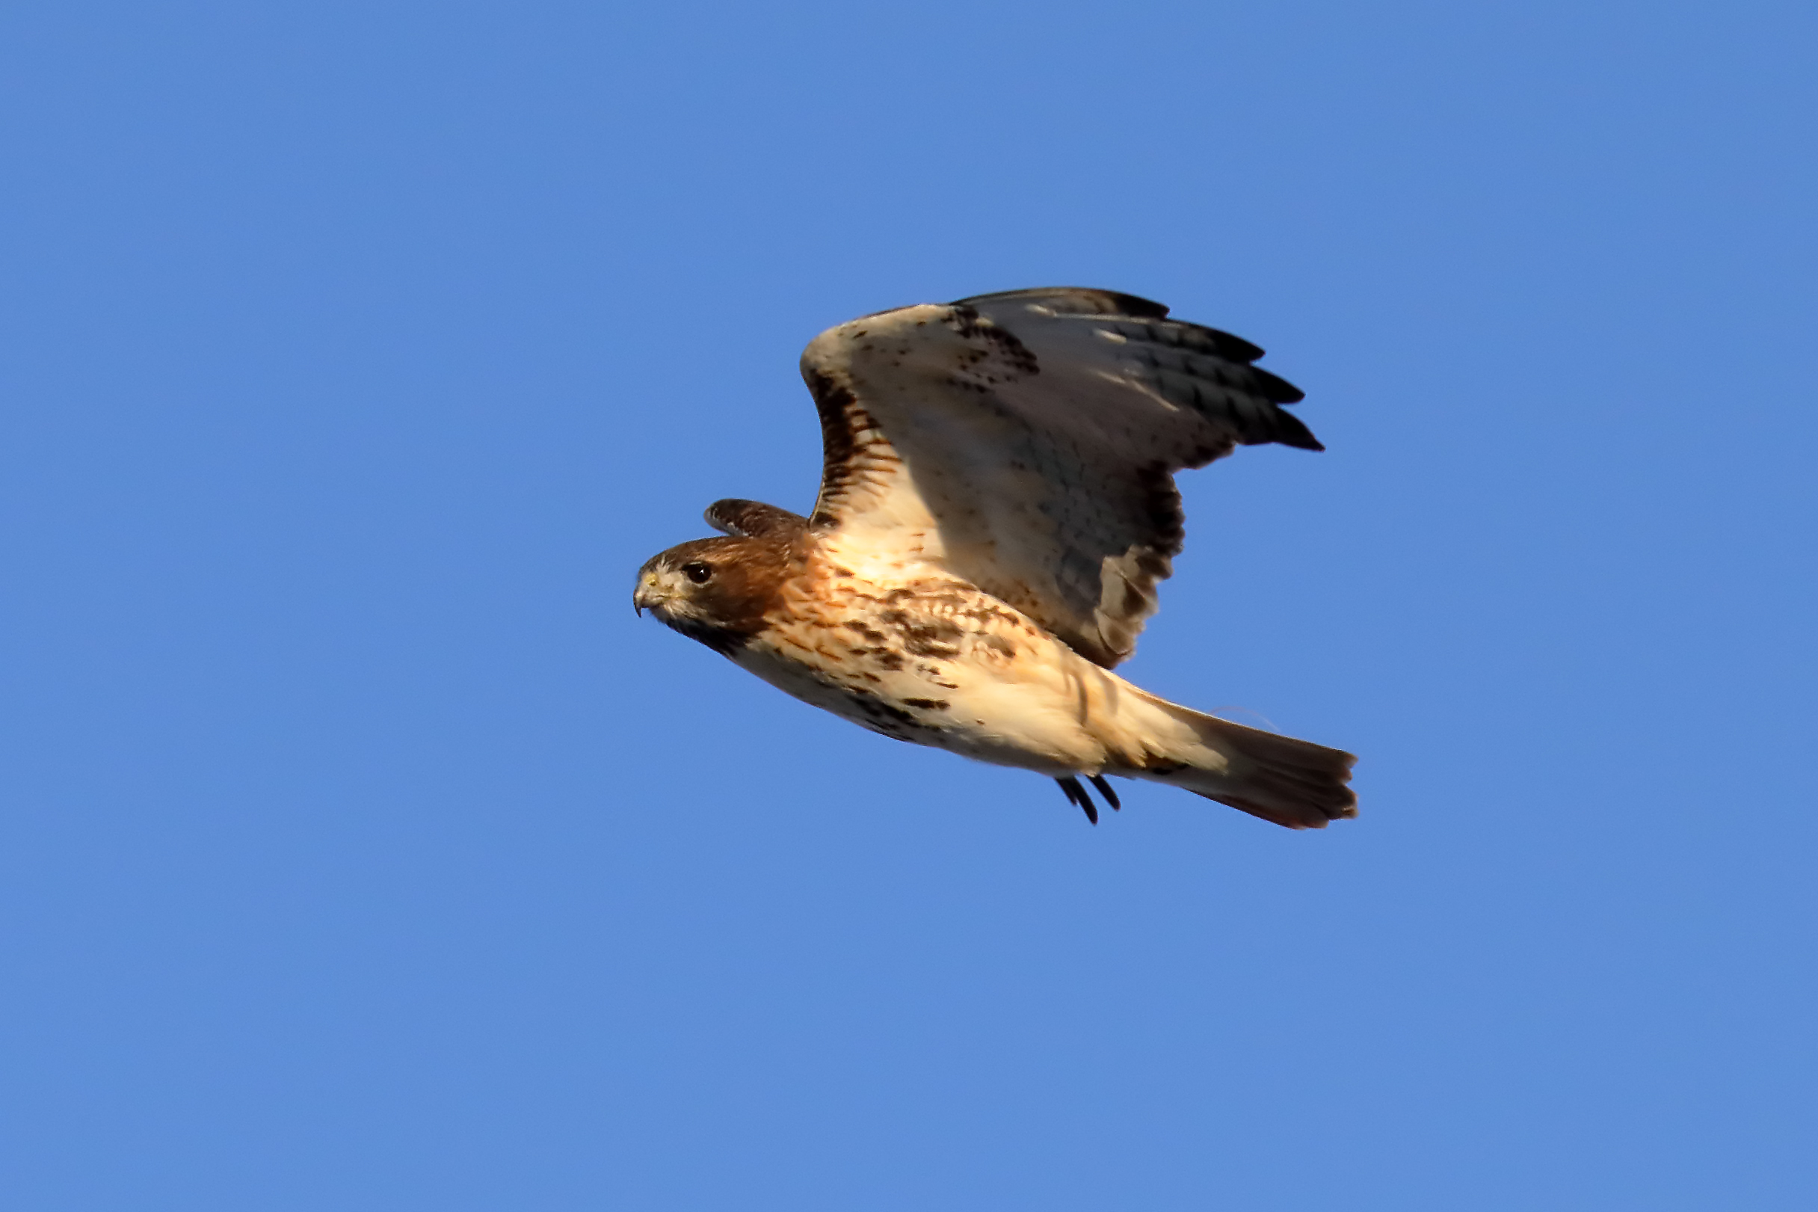
Some things you need to photograph Large Birds in Flight
Equipment
I have heard it said that a great photographer can take great photographs with any equipment. That may be true but for birds in flight for me the equipment Camera Body and Lens is critical. You need a camera/lens combination that is very fast (in several senses of fast). The focus system has to be fast enough to lock onto and track a fast and possible erratically moving bird. A slowly adjusting focus system or lens will kill you. It also helps a lot to be optically fast (low aperture number). I get by with F5.6 with my 100-400mm zoom, but I do better with my F4.0 500mm prime (usually used at 4.5, 5.0 or 5.6). If you are at F8 or more it better be a bright day. And a fast burst speed and a deep buffer also help.

Slide 6
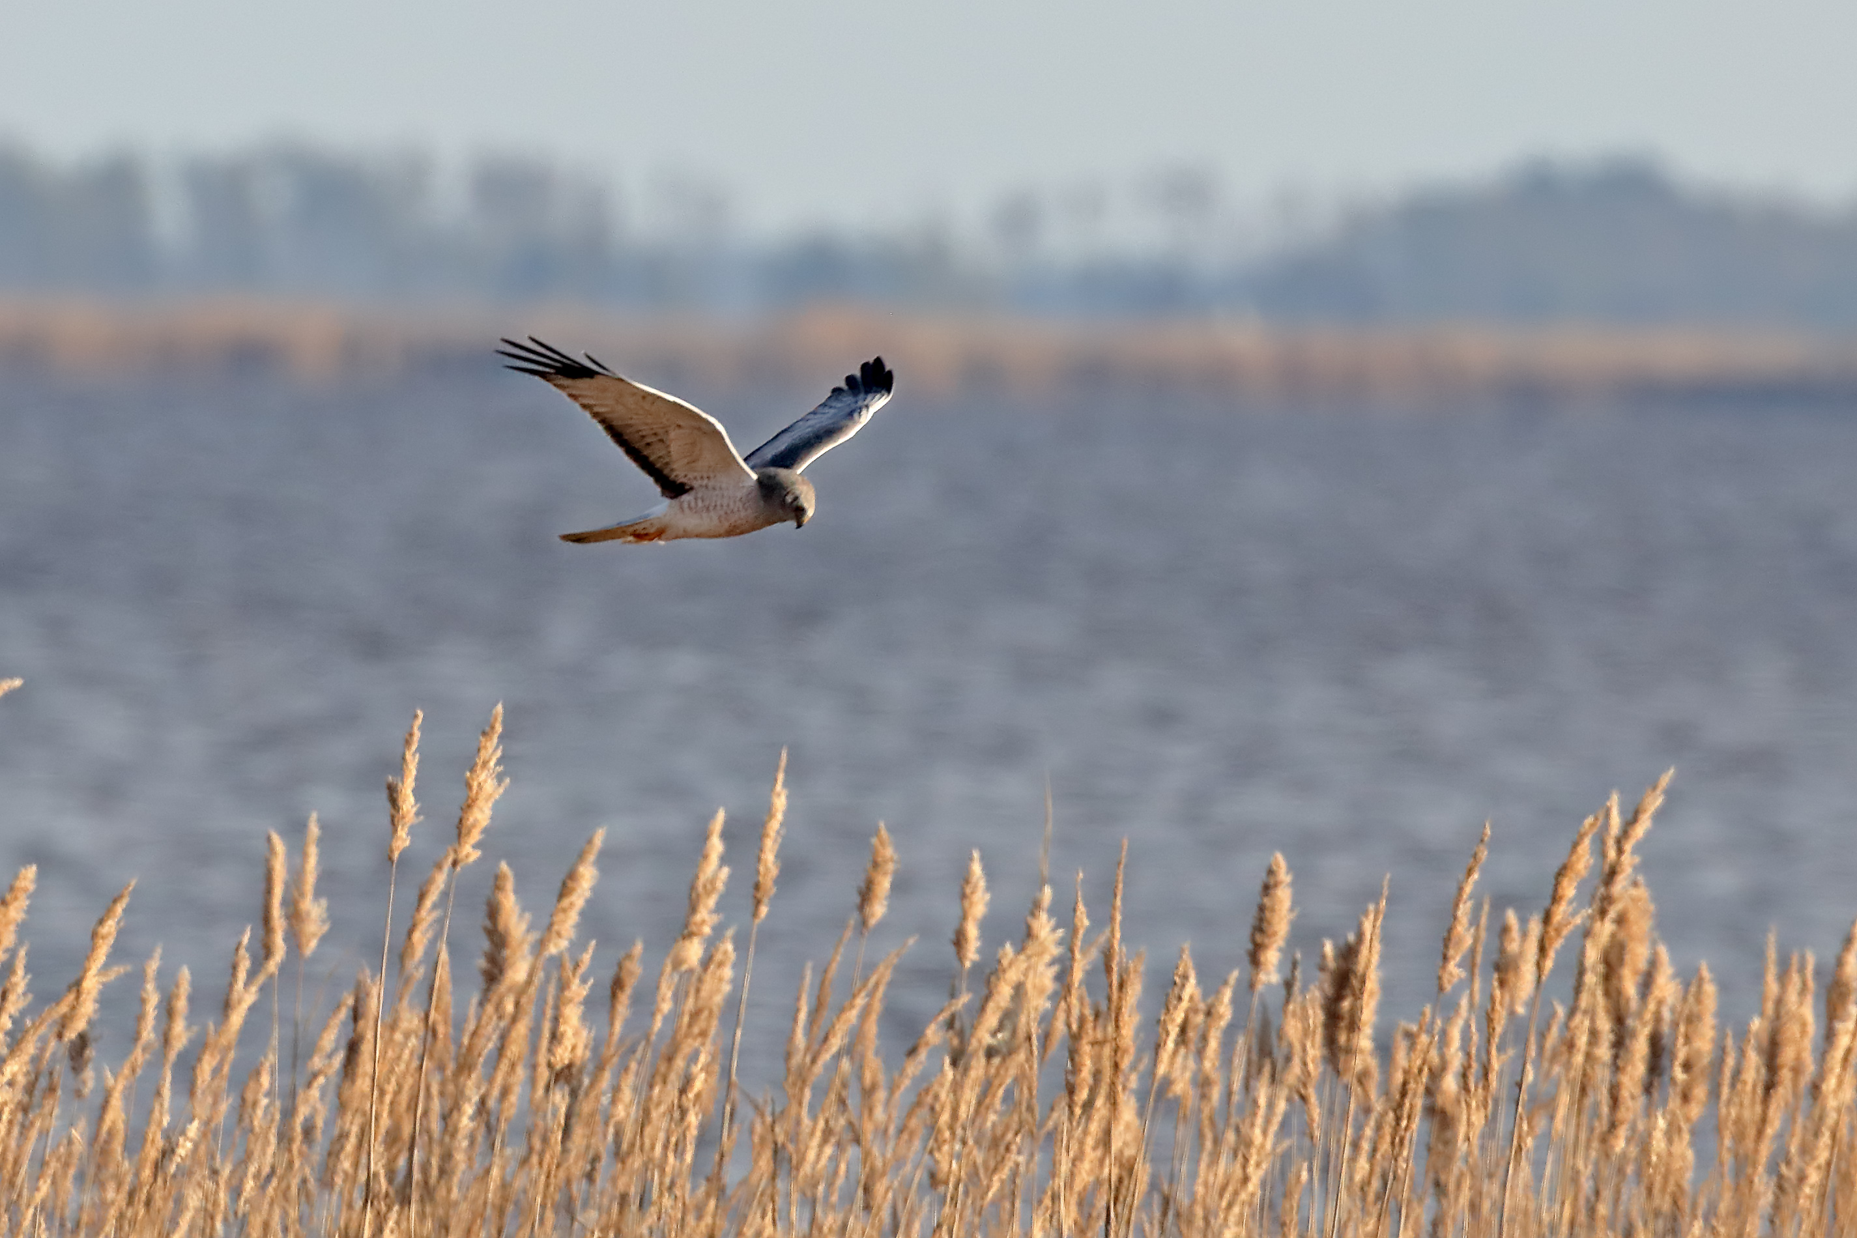
Some things you need to photograph Large Birds in Flight
Equipment
The primary camera I use is a Canon 7D mark II which takes (in Raw) 10 photos a second and the buffer can handle about 30 photos before it slows down.
The lens is also important, not just for speed and quality but also for reach. You usually won’t be right need your subject and it may fly away if you approach it (even if you can). So long lenses are a must. A minimum of 200mm, but 300mm, or more better.
My primary lenses are
EF 100-400mm L zoom
EF 500mm L

Slide 7
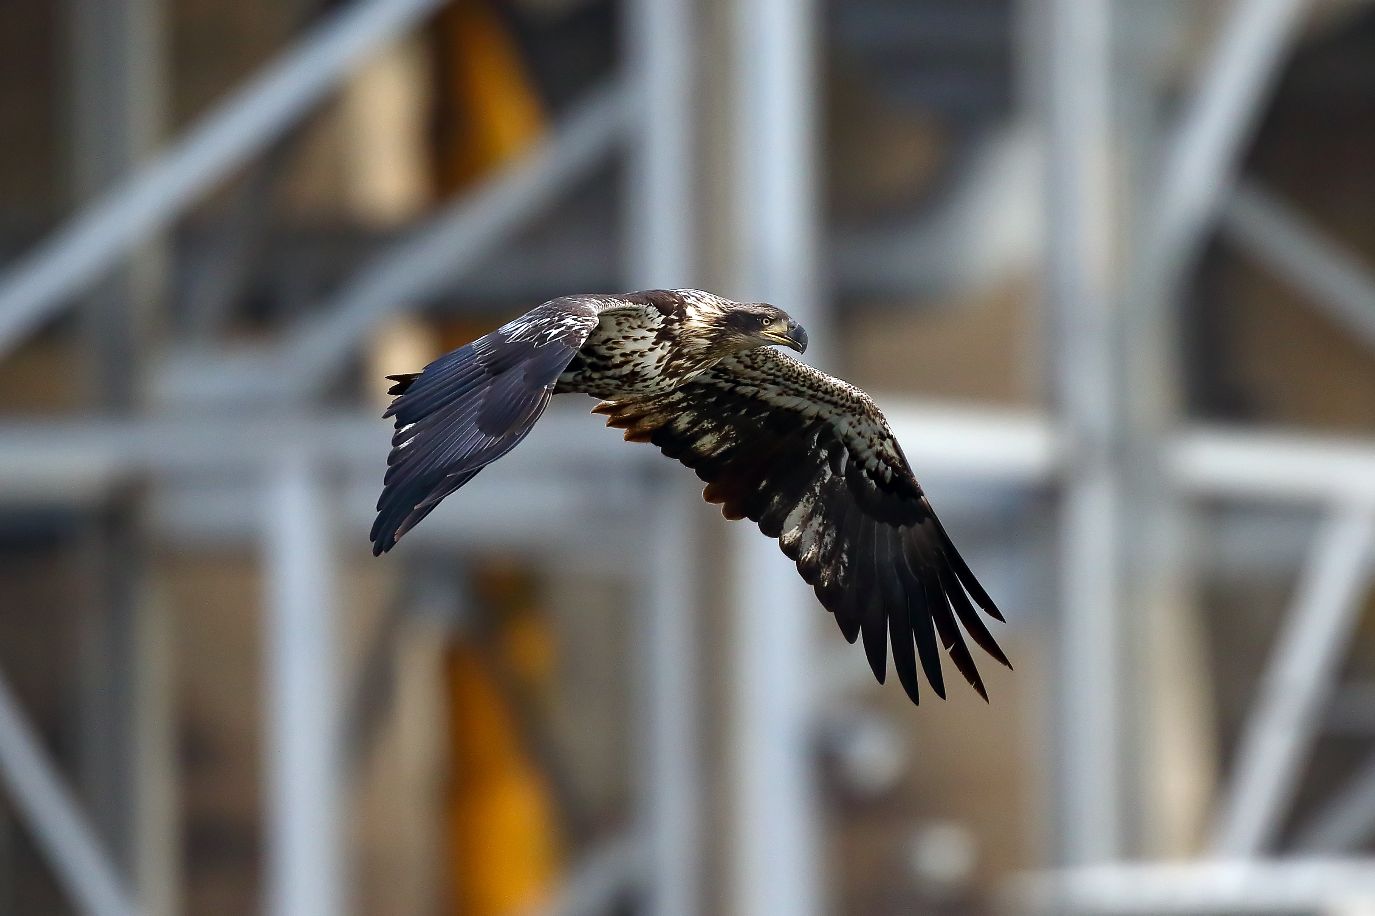
Some things you need to photograph Large Birds in Flight
Equipment
Recently I added a Canon M6 mark II mirrorless camera. There are some issues in getting the bird in focus to begin with, but once in focus it does a good job following and is 14 photos/sec.
Here is one web site with some camera choices
https://birdwatchinghq.com/best-cameras-wildlife-photography/
Nikon D5 In descending Price
Canon 1DX Mark II Red -> $5– 7 K
Nikon D500
Canon 7D Mark II Orange -> $1 – 2 K
Nikon D7200
Canon Rebel T5i Green -> < $1 K
Nikon D5300

Slide 8
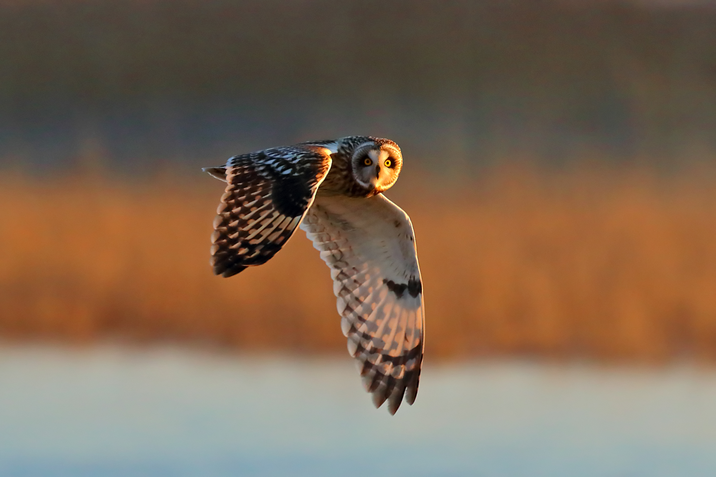
Some things you need to photograph Large Birds in Flight
Settings
The number one most important setting to me for birds in flight is Shutter speed. The shutter has to be fast enough to freeze the action, both the motion of the bird and camera shake are issues. To me 1/1000 sec is the slowest that I want to ever go, and even at that the wing tips will sometimes blur. The faster the better. But of course there is always the trade off of exposure time, vs. aperture vs. ISO. At fast shutter speed you have to open the shutter as wide as possible (and you can live with) but that decreases the depth of focus, or raise the ISO which degrades the quality of the image. This is the reason good quality optically fast lenses are a great advantage.

Slide 9
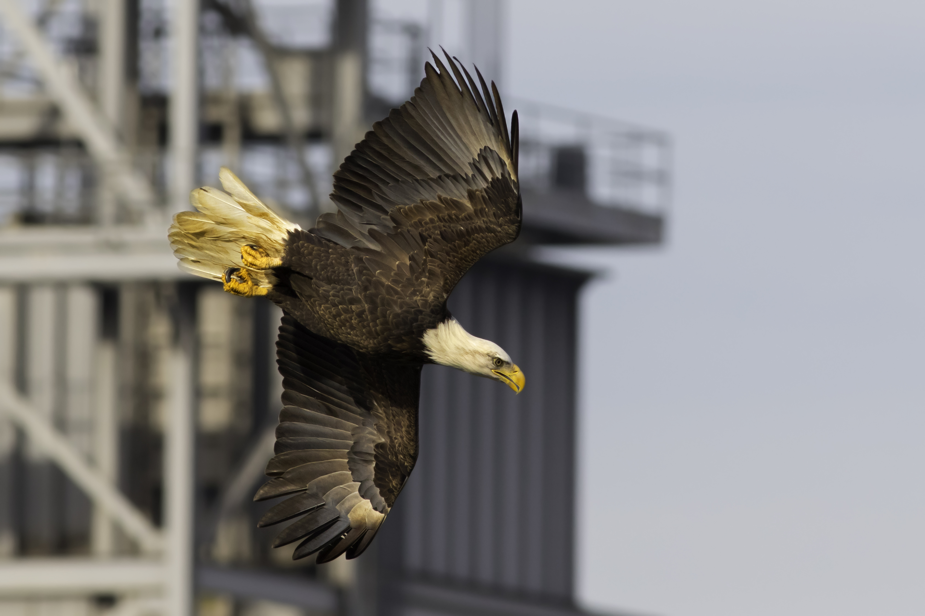
Some things you need to photograph Large Birds in Flight
Settings
But be careful because when you are following a bird in flight the lighting of the whole scene (of which the bird may be a small part) can change rapidly depending on the background. Even when spot metering you can easily fool the light meter. You might track the bird from against a bright blue sky to down in front of some dark trees. Different people have different approaches to this problem. Some use Shutter priority (often with auto ISO), others use Manual (also sometime with auto ISO). I use straight Manual. I choose a shutter speed, aperture, and ISO that I think appropriate for the lighting conditions and the bird I’m after. I start with a base of 1/1000 sec F5.6 and ISO = 400 (for my EOS 7D II).

Slide 10
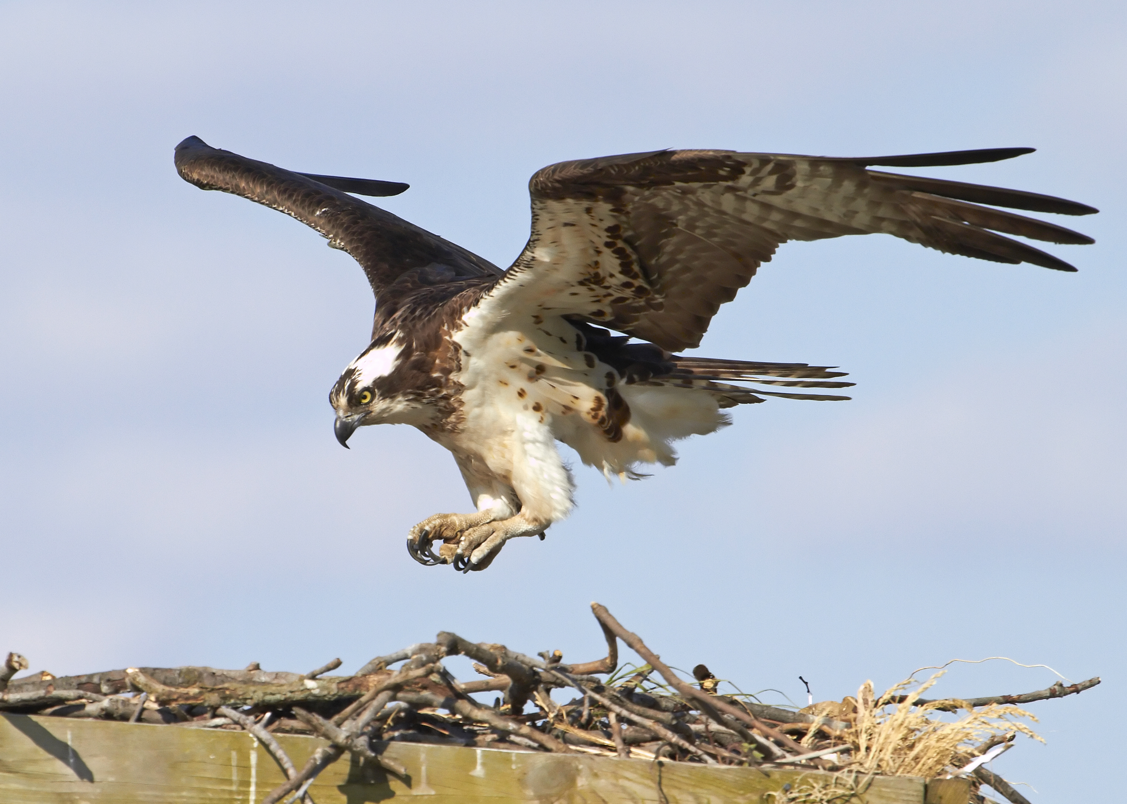
Some things you need to photograph Large Birds in Flight
Settings
And adjust from there based on a good setting for the bird – Bald Eagles and Osprey both have white and dark brown on them. I always shoot in Raw to give more latitude to adjust the exposure in processing.
Focus system settings – Know your focus system and what adjustments you can make. I’ll go over setting for my EOS 7D Mark II. Other high end Canon bodies have similar (or better) systems.

Slide 11
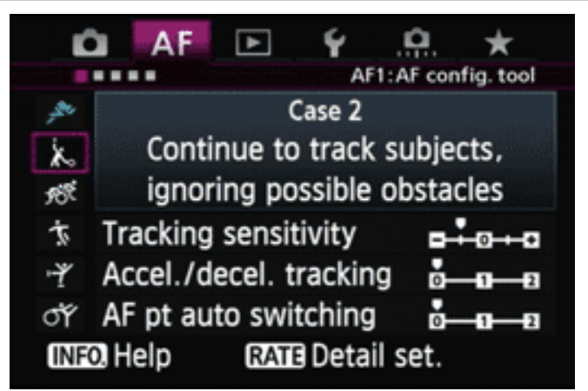
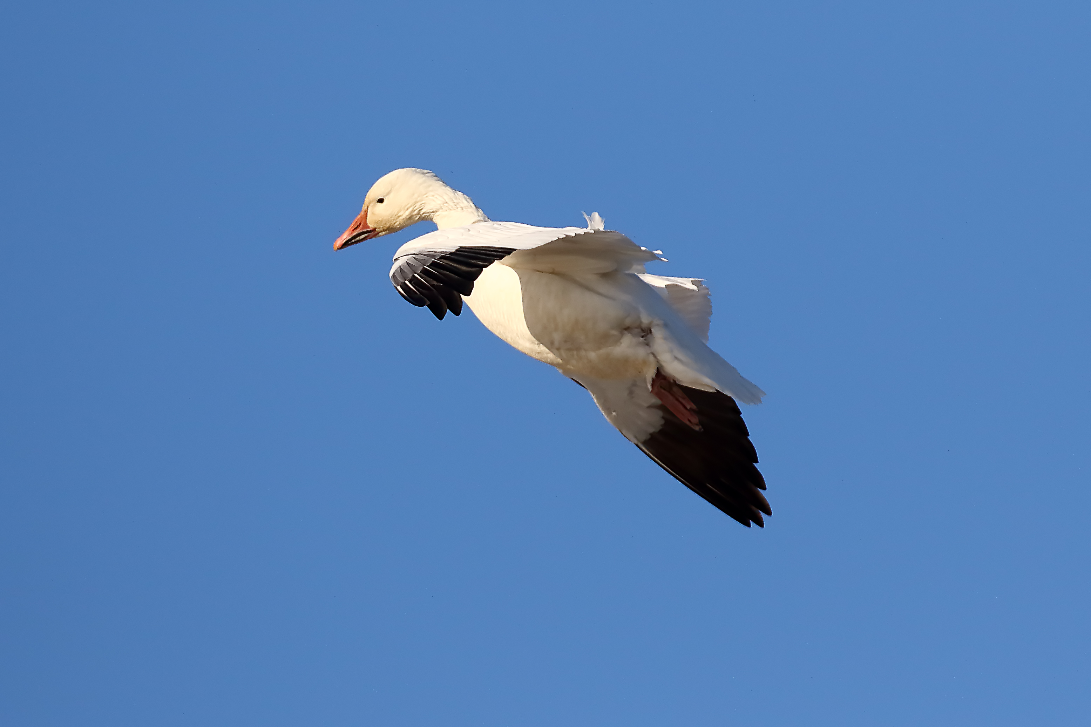
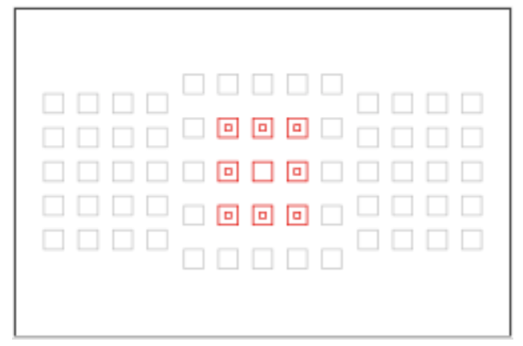
Some things you need to photograph Large Birds in Flight
Settings (Focus system)

Slide 12
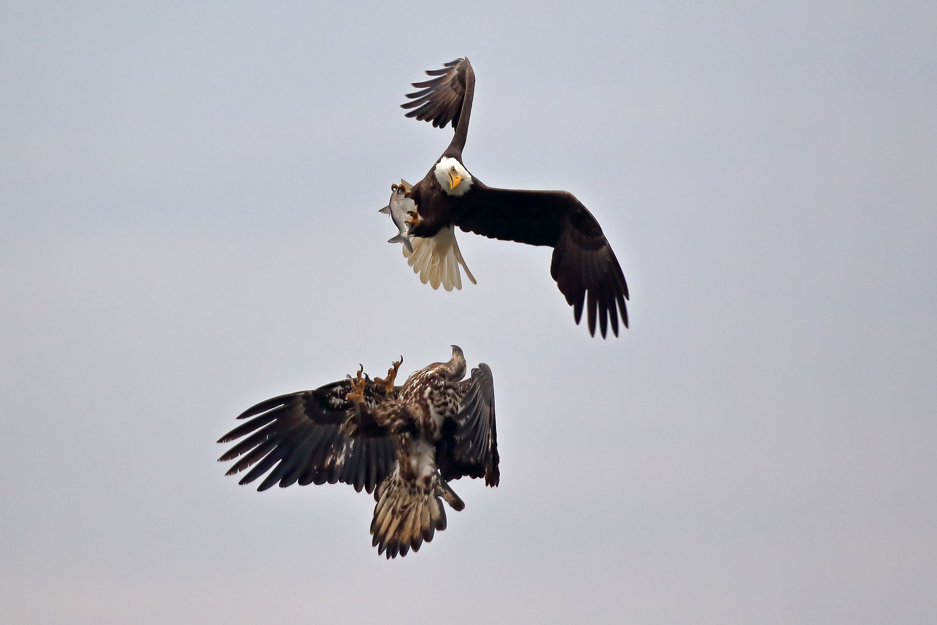
Some things you need to photograph Large Birds in Flight
Selectivity
With the rapid burst speed and the deep buffer you may end up with a lot of photographs. Your “hit rate” may be low (very low). That is of no matter. You are looking to get that 1 shot. Your hit rate will depend on the other factors of TOPESS. But you should be Selective in those photos that you process, post, print, share or otherwise show to people. Delete or just leave on you disk drive any photos that don’t live up to your standards.

