Slide 1
How to choose a new camera
October 13, 2021

Slide 2
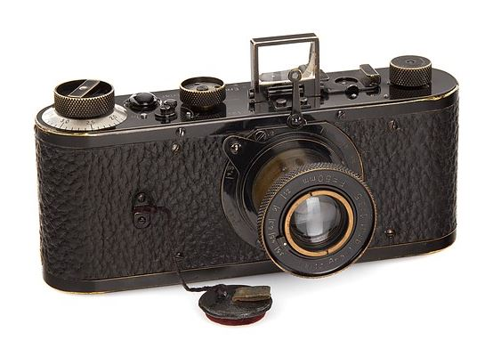

Slide 3
Film or digital?
This presentation will concentrate solely on digital.

Slide 4
Camera types
Point and shoot (including phone)
Digital Single Lens Reflex (DSLR)
Mirrorless
Medium and large format (not covered)

Slide 5
New to photography or updating old equipment
Sensor size and sensitivity
sensor size: full frame, crop sensor, or much smaller point and shoot and phone as well
how many megapixels
ability to photograph in low light and ISO capability with low noise
Lens selection
compatible with lenses you currently own
large selection of lenses
Autofocus
Number of focus points and types of focus points (phase detection and contrast detection)
Phase detection is fast (except in low light)
Contrast detection works well in low light
Most modern cameras have both
Features like tracking moving subjects within the frame, birds, race cars
How quickly the camera or camera/lens combination focuses, sports photography
Speed and buffer size
How many frames per second
Sports photography, or even wild life movement need burst photos
Buffers can fill up on some older cameras, but newer cameras have bigger buffers so not an issue

Slide 6
New to photography or updating old equipment
Size and weight
Most newer cameras are getting lighter, lighter materials
Ergonomics, big or small hands, some find mirrorless cameras difficult because they are smaller
Depth of field
Crop sensor cameras will give a longer depth of field that FF cameras, given the same equipment
Full frame sensors can generally give a shallower depth of field
P&S and phone cameras have to get VERY close to subject to get a shallow depth of field
Field of view
Full frame sensors give a larger field of view, good for indoor without having to use an ultra-wide angle lens, good for real estate photos
Crop sensors have an apparent zoom factor (crop factor) which makes it harder to take wide angle photos: example a 14mm lens on a Olympus body seems like a 28mm lens on a FF.
P&S and phone cameras do pretty well with wide angles but with indoor low light they boost the ISO automatically and get more noise, or need to use flash which gives a snapshot look
Dynamic range: hard to quantify so not discussing but the better sensors have larger range ($$$)

Slide 7
Point and shoot and phone
Pros
Ease of use
Inexpensive
Small, some aren’t so small
Zoom lens
Many manufacturers, colors
Unique features, mounts, waterproof, flash
Cons
Cheap material, mostly plastic
Small sensor
Limited features
Not good in low-light
Flash (underwater)

Slide 8
Point and shoot
Things to look for
Megapixels – resolution of image, how much detail, web only?
Zoom – many have a large range from short to very long, what range do you expect to shoot? Indoor? Outdoor?
Storage medium – SD is most common, but some have unique cards
Flash – for underwater you want to make sure you can force flash ON. Can attach external flash?
Screen – Viewing screens aren’t bright so hard to see in sunny situations
Battery life – how many pictures can you get on one charge? Can you replace battery easily, is battery unique and you need a spare? Some use AA.
Video – most have this capability but today 4k is becoming more common
Miscellaneous – tripod mount, industrial strength, file output (do you need raw or only jpeg), download capability (cable to computer?), warranty, image stabilization

Slide 9
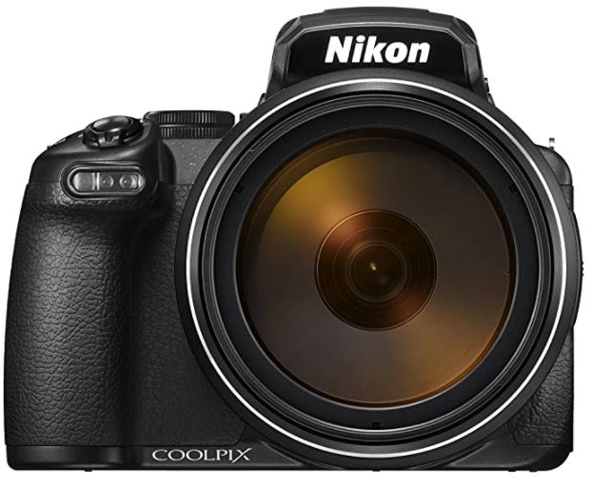
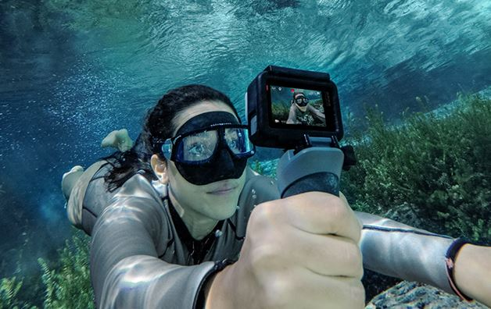
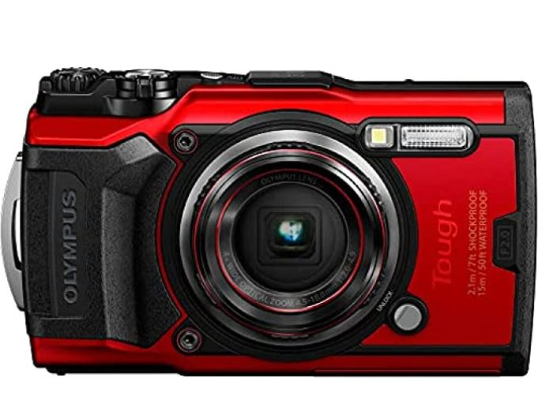
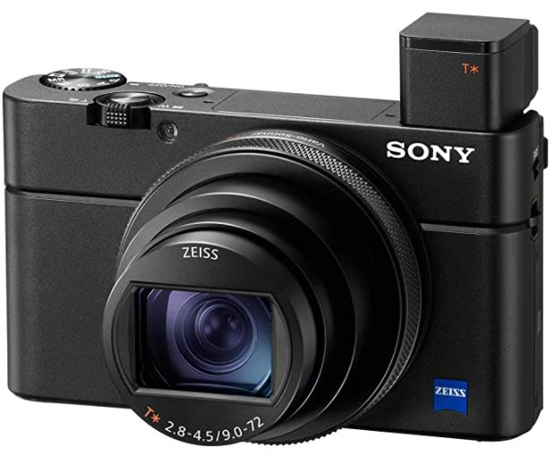
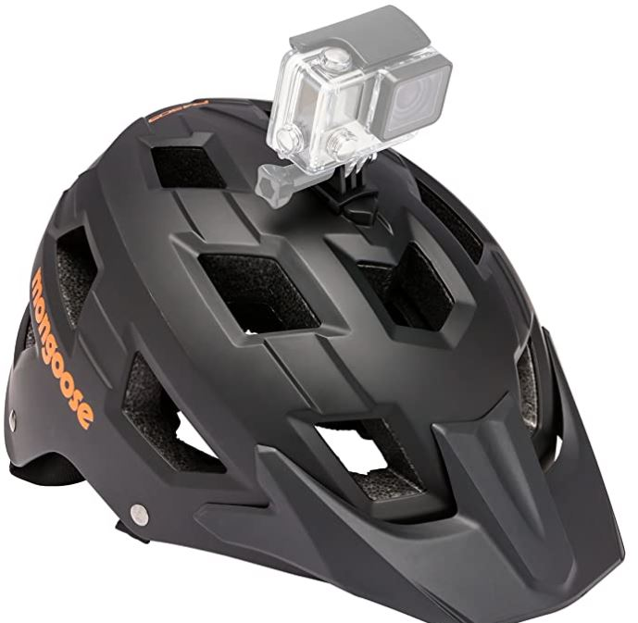
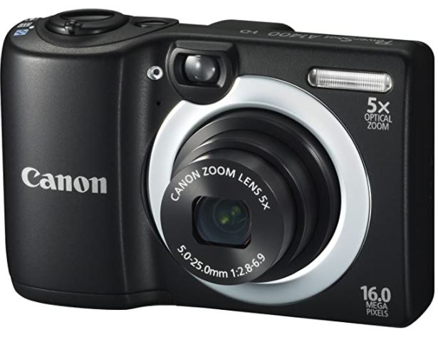

Slide 10
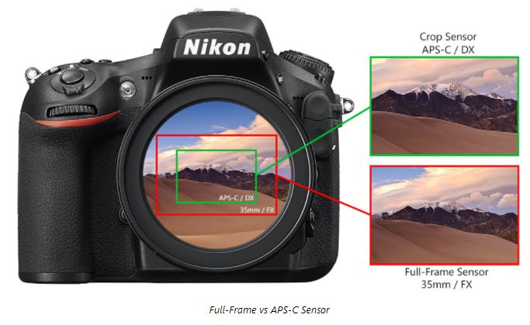
Crop Factor/Sensor size

Slide 11
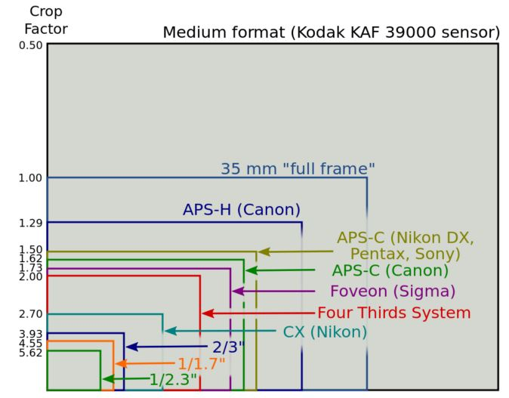
Crop Factor/Sensor size
Full Frame = 36mm x 24mm

Slide 12
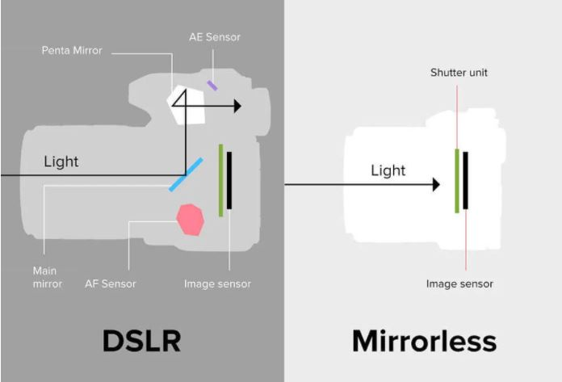
Mirrorless vs DSLR

Slide 13
DSLR
Pros
Many features – built in HDR, screen output (what’s in focus, what is clipped), burst photos, articulating screen, EVF, ISO, exposure bracketing
Larger sensor – better low light
Many manufacturers/choices
Changeable lens – larger selection, zoom, prime, macro, fish-eye
Image stabilization very important for larger/heavier lenses (some in lens, some in body)
Unique features - mounts, waterproof (mostly external cases), flash (on camera or hot-shoe)
Cons
Some can be heavy
Prime lens, use feet to compose picture
Can buy kit that includes a lot of things but mostly low-end components, depends on usage

Slide 14
Mirrorless
Pros
Light, small and compact
Less moving parts, they’re quieter than DSLRs
No flicking mirror means less camera shake
Reliable video mode
The electronic viewfinder can be used in video mode, while the viewfinder on a DSLR cannot. Also, you see the image as exposed in the EVF, not with DSLR.
In-body stabilization
Cons
Battery life (though getting better)
Ergonomics (small, maybe too small for anyone with big hands)
Limited lens selection (but getting better)
Electronic viewfinder - limited in low light environments

Slide 15
DSLR/Mirrorless
Things to look for
Sensor – size and resolution, what is the prime use of camera? Landscape, portrait, wildlife, sports, architecture. More pixels can bog down the buffer for sports but most cameras are getting larger and larger buffers.
Crop Factor – affects the focal length of lens vs reality (Nikon 1.5, Canon 1.6, Olympus 2.0)
Focus – some high-end cameras have fast focus, with lots of focus points and work well in low light, while low-end models don’t work well in low-light
Frames per second (FPS) – also related buffer size, sports photography?
Storage medium – SD is most common, but there are newer faster versions like CFexpress, QXD, Cfast (these aren’t cheap)
Viewfinder – some are 0.9x (or similar) to allow some room on edges so you don’t cut off your subject
Battery life – how many pictures can you get on one charge? Can you replace battery easily, is battery unique and you need a spare? After-market, IMO, doesn’t last as long.
Video – most have this capability but today 4k is becoming more common
Lens compatibility – some newer low-end cameras aren’t compatible with some older AF lenses, some work but only in manual mode
Miscellaneous –file output (do you need raw or only jpeg), download capability (cable to computer? Card reader? Wifi?), warranty, image stabilization

Slide 16
Sensor noise
ISO 200
ISO 3200

Slide 17
Lenses
Brands – most are lens/camera specific, Canon lenses only fit on Canons
Third party – Sigma, Tamron and some others make lenses that will fit most common camera brands
Older lenses – for Nikon old manual lenses will fit and work on any camera, but only in manual mode, some older autofocus lenses won’t work with all newer cameras
Mirrorless cameras – most manufacturers are making adapters to fit DSLR lenses
Type of lenses – prime and zoom
Basic ranges – wide angle, telephoto, standard, macro
Specialty (fish-eye, tilt shift, infra-red)
Aperture – smaller numbers are larger openings, equals more expensive
Miscellaneous – some lenses have Vibration Reduction (VR) in lens instead of camera body, some are weather sealed, some larger ones are heavy and need a tripod (have a collar).

Slide 18
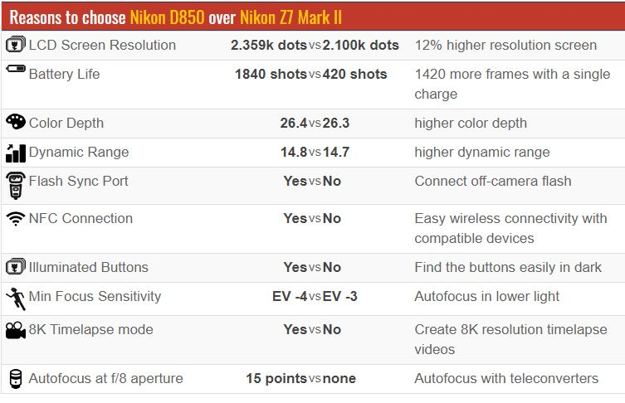
Mirrorless vs DSLR
https://cameradecision.com/compare/Nikon-D850-vs-Nikon-Z7-Mark-II

Slide 19
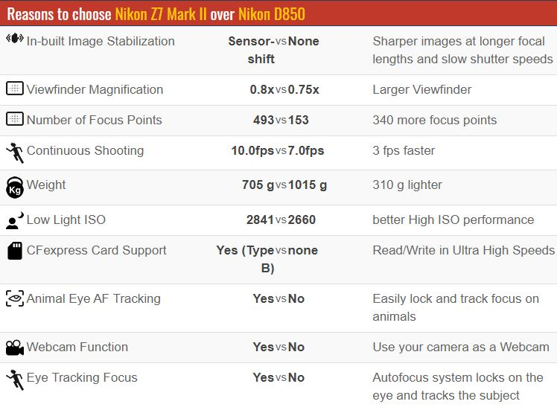
Mirrorless vs DSLR

Slide 20
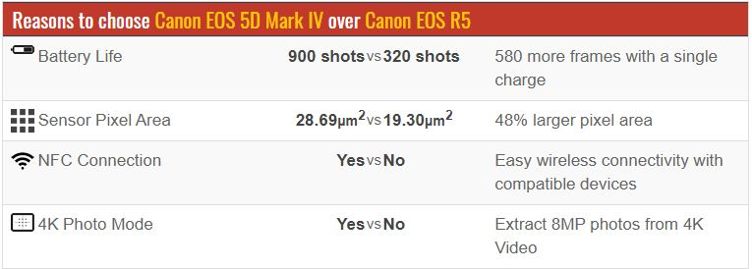
Mirrorless vs DSLR

Slide 21
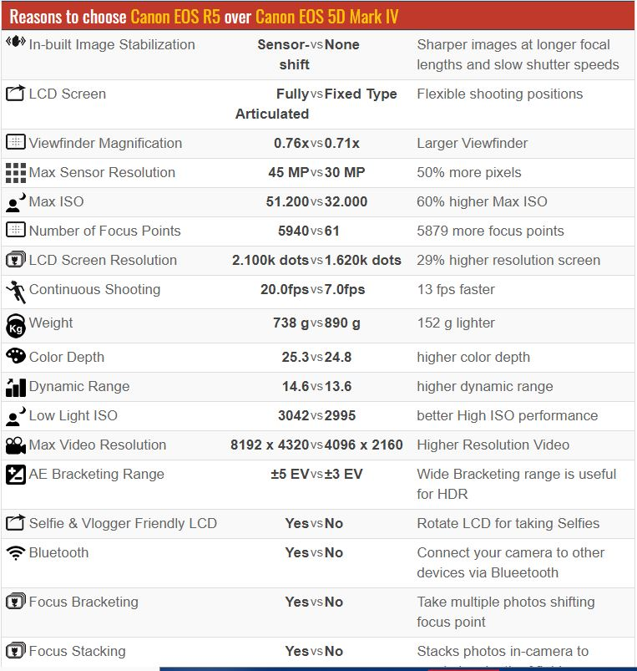
Mirrorless vs DSLR

