Slide 1
Common Edits Using Adobe Lightroom
Nancy Rosenbaum
August 11, 2021

Slide 2
Overview
PhotoShop (PS), PhotoShop Elements (PSE), and Lightroom (LR) use different methods to edit
I usually start with LR for basic edits, but may switch to PS for some things
Today we will stick with LR but can do another session if desired to demonstrate the same things in either PSE or PS
All of the features covered here are in LR’s Develop module

Slide 3
Topics
Tone Control
Horizon perspective
Spot removal
Masking (Adjustment Brush)
Cropping
Vignette

Slide 4
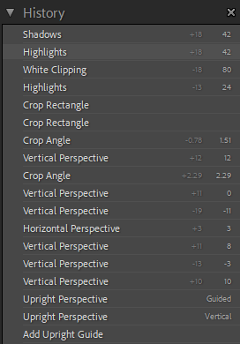
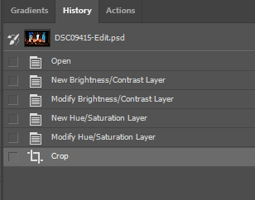
LR vs. PS/PSE – History of Actions
LR
PS/PSE
History retained with an image; can go back to a previous state even after closing file
History retained only while file is open (without the settings)
Note
settings

Slide 5
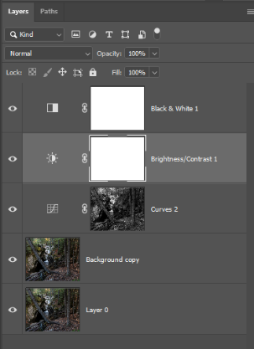
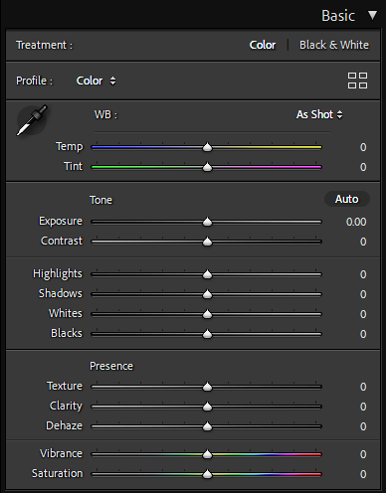
LR vs. PS/PSE – Dashboard vs. Layers
LR
PS/PSE
Common adjustments available as dashboard; easy to go back and forth between sliders
Use adjustment layers for each edit
Adobe Camera Raw (ACR) has workspace similar to LR

Slide 6
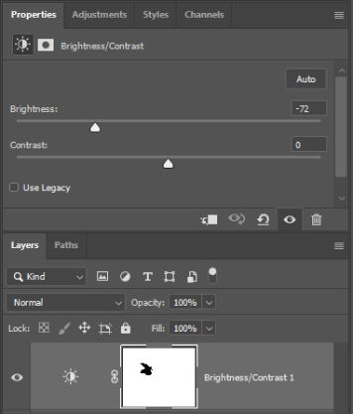
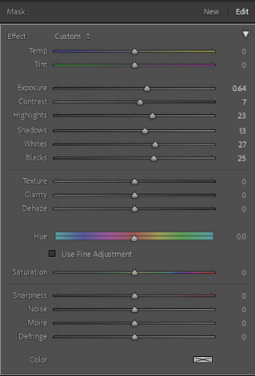
LR vs. PS/PSE
LR
PS/PSE
Apply multiple adjustments with a single mask, using brush tool
Apply each adjustment as a single mask, using brush or selection tools
Mask settings
Layer
settings
Brightness/
contrast adjustment layer
Mask

Slide 7
LR vs. PS/PSE
LR
PS/PSE
Limited spot removal capability | Multiple tools for spot removal, including content-aware fill for removing objects
Sliders for vignetting make it easy | Vignetting done manually or using actions (similar to macros)

Slide 8
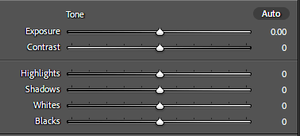
Tone Control
16-bar gray scale with full
tonal range of black to white
Tone control sliders

Slide 9
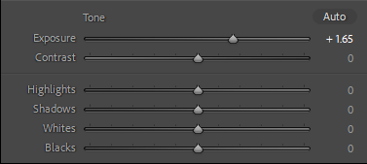
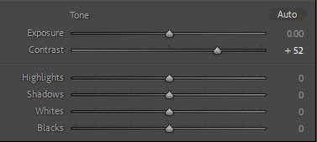
Brightness and Contrast
Small changes to brightness and contrast can make a big difference
Exposure increased (+1.65). If overused, can create loss of differentiation in brights or darks
Exposure brightens or
darkens uniformly across all tones
Contrast increased (+52), driving more tones to appear black or white
Contrast disproportionately affects brightest and darkest tones

Slide 10
Highlights, Shadows, Whites, and Blacks
These sliders break the tonal range into four regions to adjust more selectively
Note how the histogram changes with the adjustments
Can mouse over histogram and slide to adjust that region of tones
Blacks
Shadows
Highlights
Whites

Slide 11
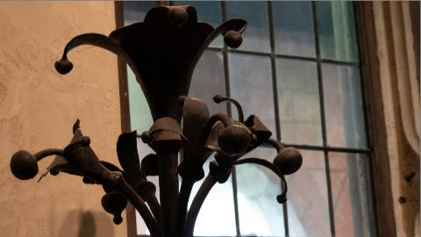
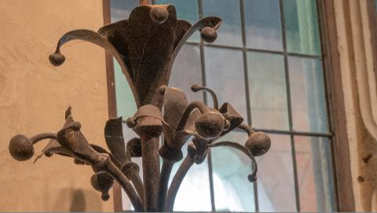
Tone Control
The background is correctly exposed, but the sculpture is underexposed. What to do?
Original
Tone adjustments:
Exposure +.34
Highlights -46
Shadows +84
Whites -67
Blacks +56
Adjusted
TIP: Press the J key to view clipping (values that are “blown out, or exceed the tonal range)

Slide 12
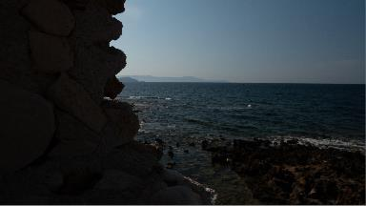
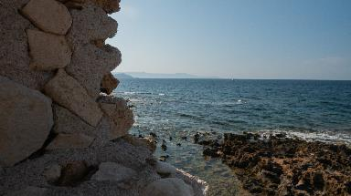
Another Tone Control Example
This image was clearly underexposed, but I liked the richness of the sky. Here’s what I did:
I started with exposure adjustment. That recovered details in the wall, but lightened the sky too much.
I then adjusted highlights and whites. This recovered the sky, but the image looked too flat for my liking.
I bumped up the contrast a little bit, which gave the water more punch. However, this also made the wall a little bit darker.
Lastly, I bumped up the blacks and shadows to recover the wall.
Original
Tone adjustments:
Exposure +1.79
Contrast +19
Highlights --75
Shadows +35
Whites -80
Blacks +28
Adjusted

Slide 13
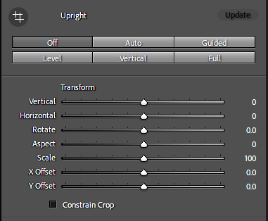
Horizon and Perspective (Transform Tool)
Converging verticals and sometimes horizontals can sometimes detract from the image. The Transform tool can correct this.
Click any of the buttons along the top of the panel to automatically correct level, vertical, or all (Full).
Use the Vertical and Horizontal sliders to manually adjust the perspective. When you mouse over the slider, a grid appears to guide you.
Use the Rotate slider to adjust the horizon.
Click Done when finished.
TIP: Correct perspective and horizon lines before cropping the image.

Slide 14
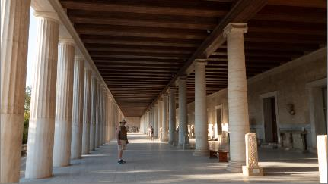
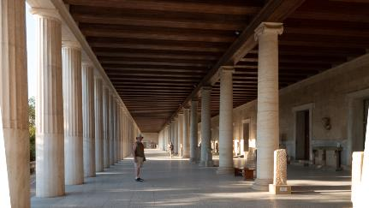
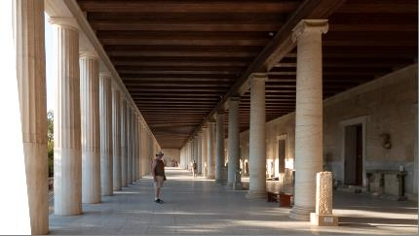
Transform Tool
Original
With vertical adjustment to correct keystoning
Note that the adjustment has changed the shape of the image (see left side), so the image will need to be cropped. Use the Scale slider to enlarge the image to fit the proportions without reducing file size.
With vertical and horizontal adjustment

Slide 15
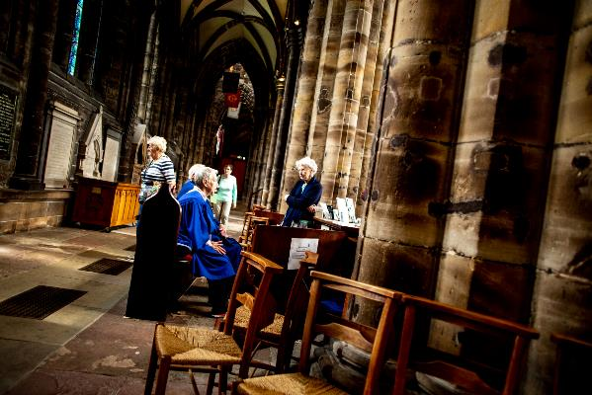
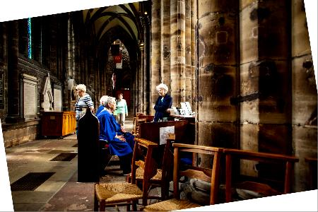
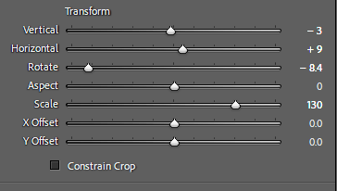
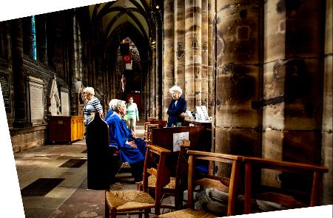
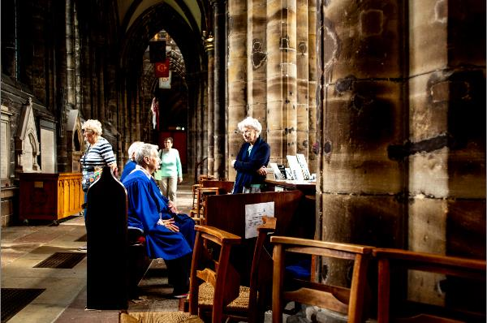
Another Transform Tool Example
Take on the most dominant issue first, then adjust the rest.
The horizon is the most dominant issue in this image. I used Rotate to level the floor first.
Original
Final settings:
I then worked the vertical perspective, followed by horizontal.
Adjusted
I had to go back and tweak previous settings a bit.
I finished up with adjusting Aspect to crop out the white edges.
Image courtesy of Bill Dusterwald

Slide 16
Spot Removal
Original
Dirt on the lens really shows up in areas without a lot of detail!
Select Spot Removal tool (shortcut = Q)
Under Brush, select Clone (duplicates sampled area to selected area) or Heal (matches texture, lighting, and shading of sampled area to selected area).
Use right or left bracket keys to adjust brush size to slightly larger than spot.
Center brush over spot and click.
LR shows the area sampled and the result.
With Spot Removal

Slide 17
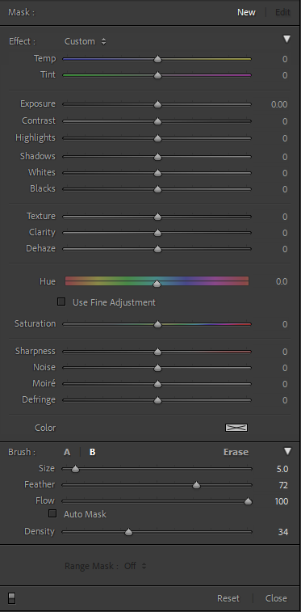
Masking (Adjustment Brush)
The Adjustment Brush allows you to create a mask using a “brush”. You can then selectively adjust the masked areas.
Select Adjustment Brush tool (shortcut = K).
Adjust brush settings: A & B – allows you to have two brush settings: for example, a hard brush and a soft brush. Erase – allows you remove areas from the mask. Size – controls the size of the brush (can also use the bracket keys on the keyboard). Feather – determines how hard the transition is between the masked area and unmasked area. Flow – determines how your brush strokes add up to reach 100% coverage. Auto Mask – When checked, automatically determines borders in the image and keeps brush actions inside them. Density – strength of the brush.
Brush the areas you would like to adjust. A small circle appears where you started brushing. Use the checkbox, Show Selected Mask Overlay (located under your image), to show or hide the brushed area.
Use the sliders to adjust masked area as desired.
New creates an additional mask.
Click Done when finished.
Adjustments
Brush settings

Slide 18
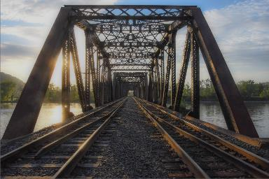
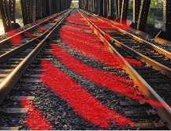
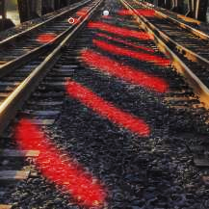
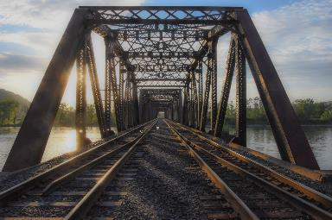
Masking (Adjustment Brush)
Feedback from the Snap and Share critique: Emphasize highlights and shadows on the rails
Shadow mask (red overlay)
Original
Highlight mask
Adjusted
Image courtesy of Kimberly Engle

Slide 19
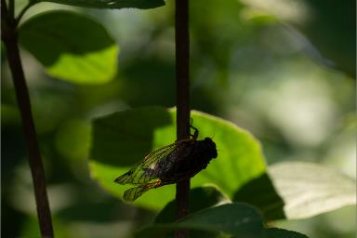
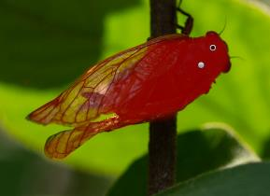
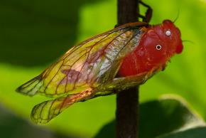
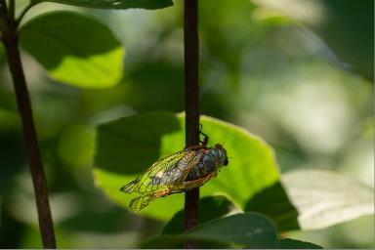
Masking
Mask 1:
Exposure +2.44
Highlights 41
Whites 24
Original
Mask 2:
Exposure +.50
Contrast 35
Adjusted
Basic adjustment:
Exposure +.57
Highlights -33
Whites -19

Slide 20
Cropping
Select the crop tool (shortcut key = R).
Drag the cropping handles to change the crop.
To keep the subject centered while cropping, hold down the Alt key on a PC or the option key on Mac.
Click the double triangle next to “Original” to select another aspect ratio.
Click the X key to toggle the frame between portrait and landscape orientation.
To do a free-form crop, click the padlock icon to unlock the aspect ratio. You can then move each side independently of the others.
To cycle through different composition overlays, click the O key.
To hide surrounding panels, click the L key once to partially hide, and again to completely hide them. Click again to return to the original view.
To rotate the image, click outside the cropping frame and drag … OR… Click the spirit level icon and drag a vertical or horizontal line. LR adjusts the image accordingly.
Click Done.

Slide 21
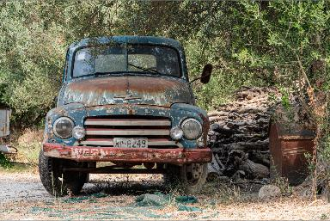
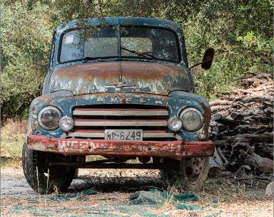
Cropping
With selective cropping, you may
Remove unwanted distractions to emphasize the subject
Make the subject more prominent
Direct the viewer’s eye
Original
Cropped

Slide 22
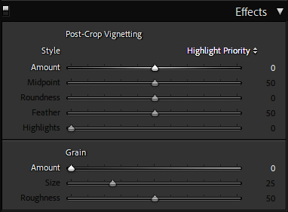
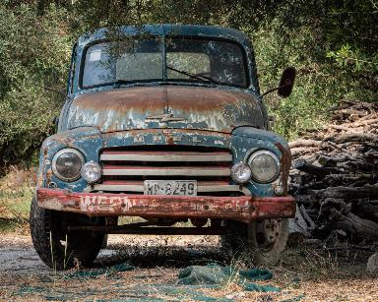
Vignette
A vignette lightens or darkens the edges, creating a halo or frame to draw the viewer’s eye to the subject.
Original
Style
Highlight Priority – default. Preserves natural colors and saturation in the vignette areas
Color Priority – preserves natural colors in the vignette areas
Paint Overlay – paints a black or white vignette over the image
Amount – sliding to the left darkens; sliding to the right lightens.
Midpoint – size of the vignette’s midpoint
Roundness – ranges from round to oval
Feather – hardness or softness of the transition
Highlights – allow bright areas to “shine through” vignette
Adjusted

Slide 23
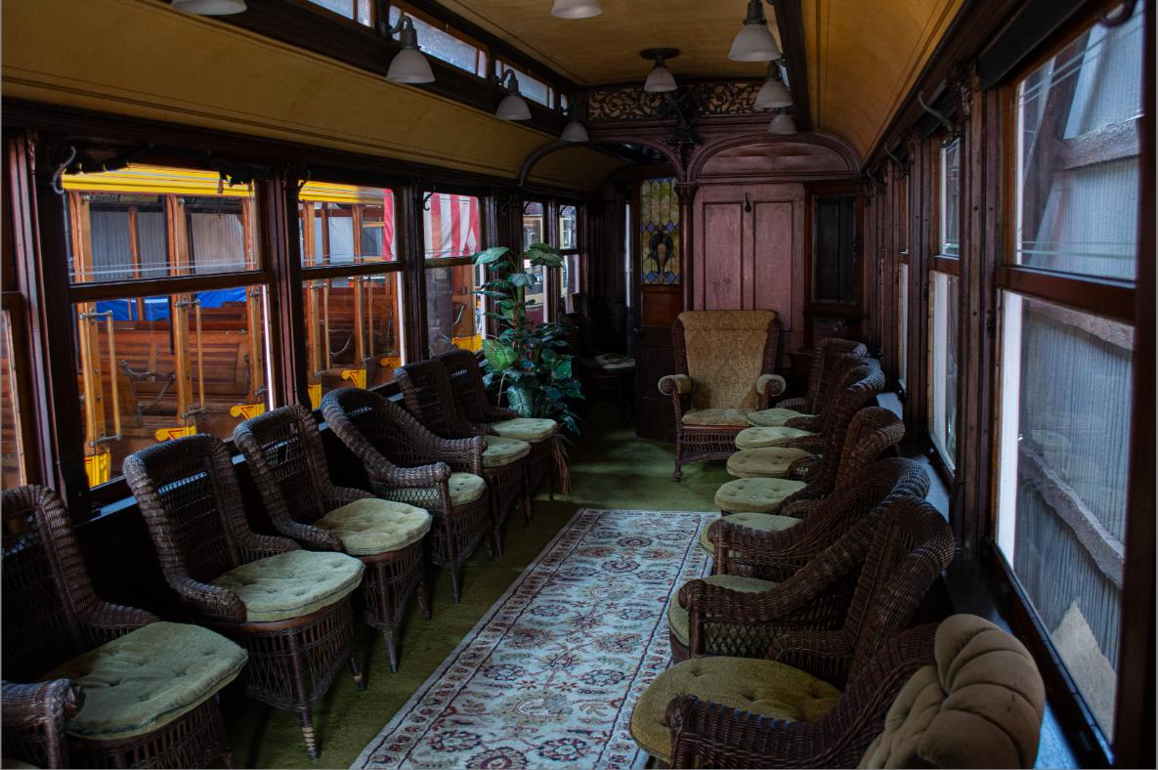
One More…
What could you do with this photo?

Slide 24
Lightroom Editing Terms
Term | Definition
Adjustment Brush | Select areas for adjustment by “painting on them
Clipping | The result of value intensity outside the range that can be represented
Clone | Copy pixels from one location to another
Crop | Trim a portion of an image to improve composition
Heal | Match texture, lighting, and shading of sampled area to selected area
Histogram | Graphical representation of tonal values : i.e., the amount of pixels of each level of brightness in the image.
Keystone | Convergence of verticals or horizontals in an image due to camera sensor not being parallel with the subject
Mask | Adjustment area selected with the brush
Mask Overlay | A red-tinted transparent sheet showing areas selected for adjustment
Slider | Adjustment to control how much of an effect is used
Tone | Brightness or darkness in different parts of the image
Transform | Scale, shrink, enlarge, skew, distort, rotate, or change the perspective of an image
Vignette | Reduce or enhance of an image’s brightness or saturation at its edges compared to its center

