Slide 1
Cropping Your Photos
What to Photograph
Not necessarily the subject, but what part of the subject.
Distill
Composition and Rules
Balance
Positive/Negative Space
Rule of Thirds and others
Mechanics of Cropping
Get it right in the camera
Post Processing
Aspect Ratio
Camera Distortion
Anti-cropping

Slide 2
Cropping Your Photos What to Photograph
First decide why your are taking the photo (what attracted you)
Colorful architecture
Family faces
Wildlife
Then distill it and distill it again
By distilling there will be less confusion about what and how to crop later
Distilling also results in a more impactful photo
Capture the essence of the object not the object itself
Art vs documentary photo

Slide 3
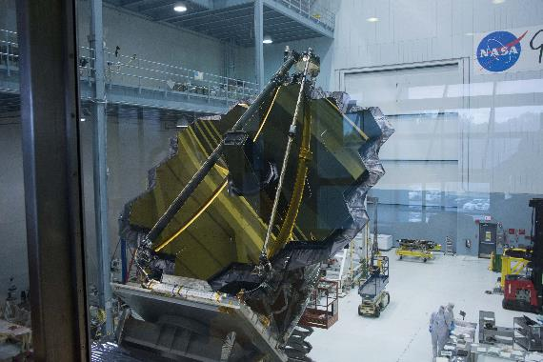
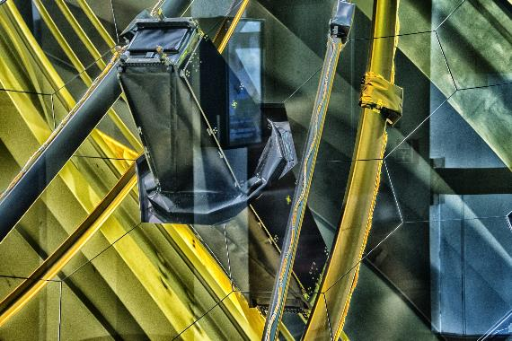
Cropping Your Photos What to Photograph
Documentary
Art

Slide 4
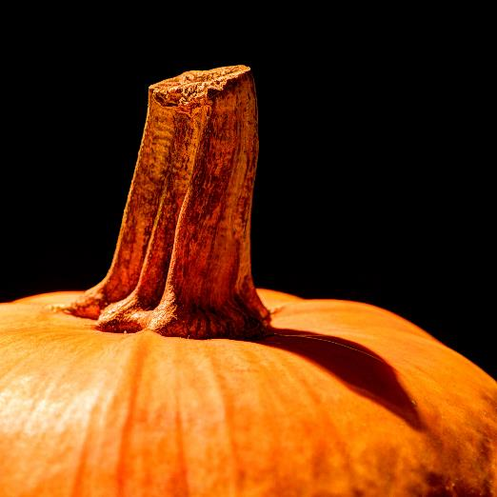
Cropping Your Photos What to Photograph
Karen Smale

Slide 5
Cropping Your Photos Composition and Rules
Try to achieve these qualities in the frame of the camera
Just feels right
Balance
Harmony
Weight
Negative space is good
Negative space can counterbalance positive space. Can add emotional weight
Rule of Thirds

Slide 6
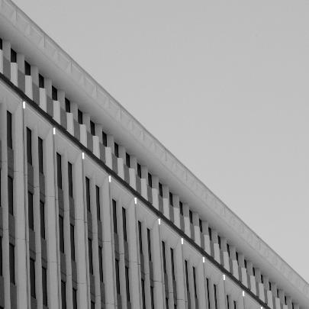
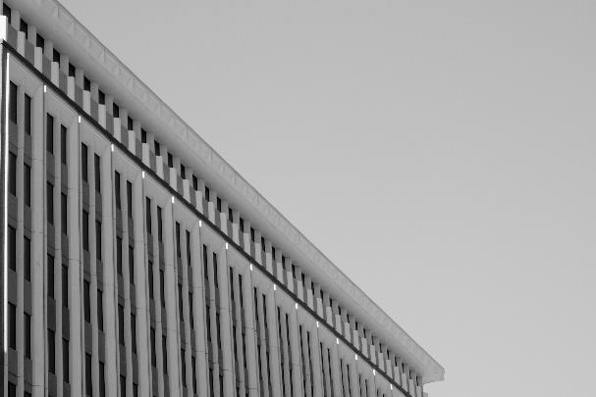
Cropping Your Photos Composition and Rules
Feels cramped and unbalanced
Negative balances positive and the photo breathes

Slide 7
Cropping Your Photos Composition and Rules
Hiroshi Sugimoto Seascapes

Slide 8
Cropping Your Photos Mechanics of Cropping
Get it right in the camera
Decide upfront portrait or landscape
Zoom in and out
Use windows doors gutters architecture details to frame, level and balance. Leave space to correct camera distortion.
No unwanted distractions unless you are sure you can Photoshop out later
It's ok to cut off things (Adventure Theater)

Slide 9
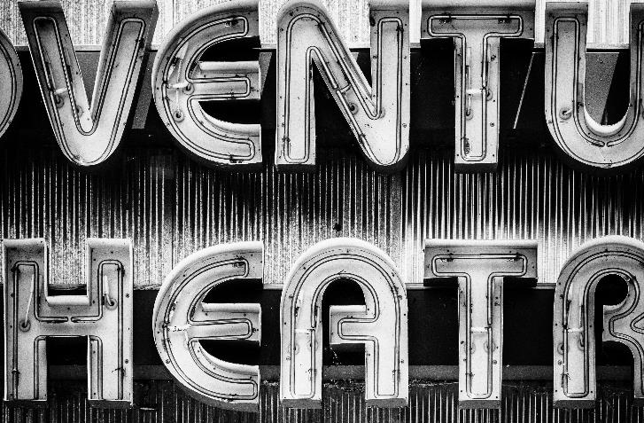
Cropping Your Photos Mechanics of Cropping
Adventure Theater, Glen Echo, MD

Slide 10
Cropping Your Photos Post Processing
Try different aspect ratios
Square vs 16 by 9 vs custom vs…
Don't be scared to use unconventional aspect ratios
Rotate the image and fix camera distortion if possible.
Again, use windows doors gutters architecture details to frame, level and balance
Remove unwanted objects by cropping or using Clone Stamp or other Photoshop tool.
Anti-cropping

Slide 11
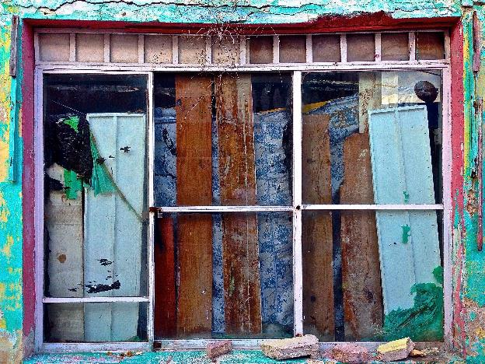
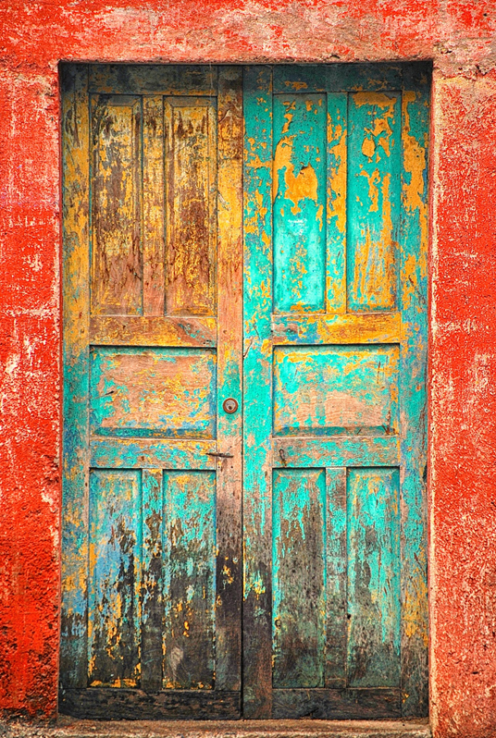
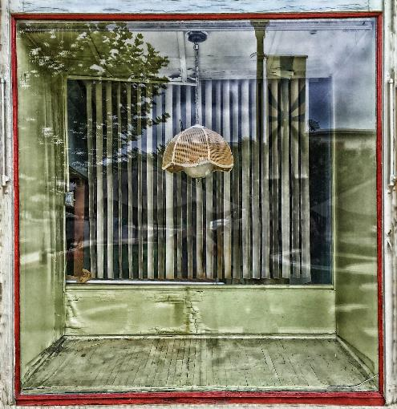
Cropping Your Photos Post Processing
Landscape
Square
Portrait

Slide 12
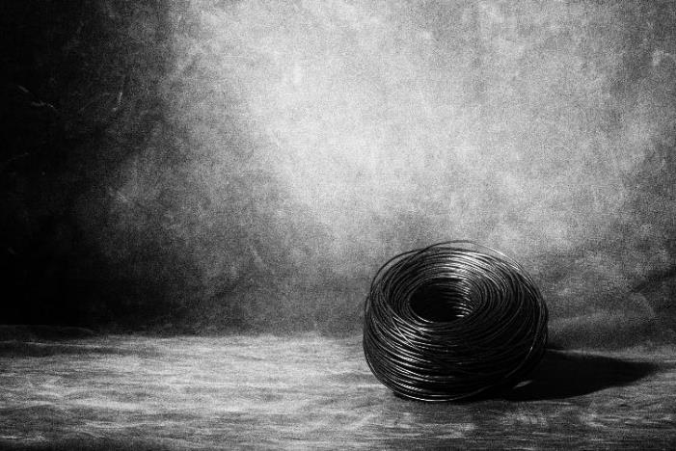
Cropping Your Photos Post Processing
Anti-Cropping

