Slide 1
GSFC Photo Club Extreme Shutter Speeds
Tyler Evans
Wednesday August 13th, 2014

Slide 2
Overview
Short shutter speeds to freeze motion
Ex: water droplets falling into pool of water
Long shutter speeds to blur motion
Ex: car headlights and brake lights, water flowing, light painting, time lapse photography

Slide 3
Fast Shutter Speed

Slide 4
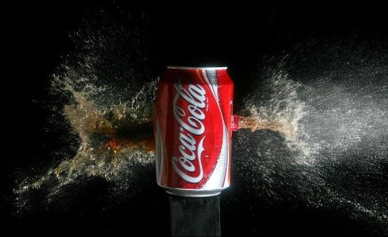
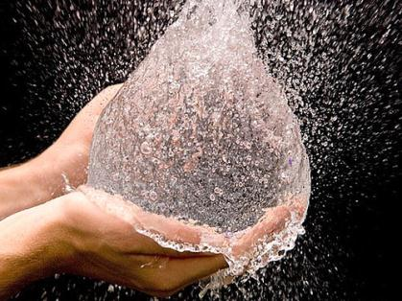
High-Speed Photography
Generally defined as greater than 128 frames per second
Most DSLR’s only shoot up to 5 fps images
Most DSLR’s shoot up to 60 fps video
Can be used to show water droplets impacting water, fruit exploding, water balloons popping, etc.
Bullet images are probably the most famous
GoPro has Hero3+ for $300 that captures 10MP photos with 10fps burst, or 720p HD video at 120 fps

Slide 5
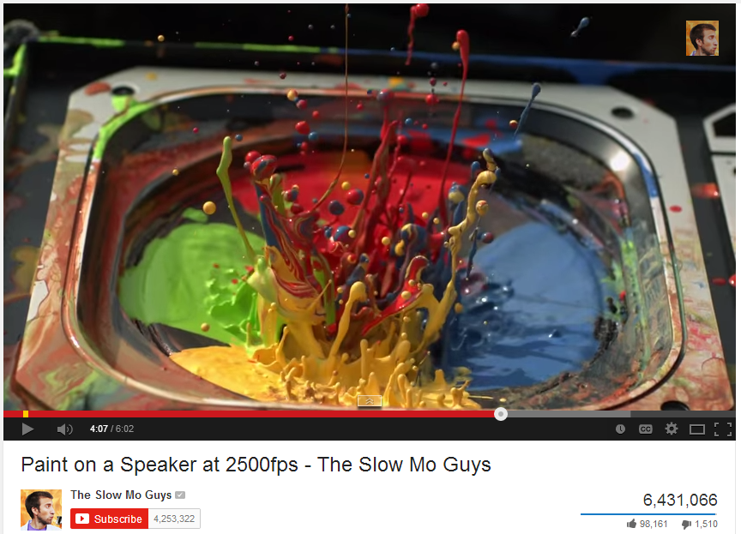
Slow Mo Guys on YouTube 3 minute video
http://youtu.be/5WKU7gG_ApU?t=1m27s

Slide 6
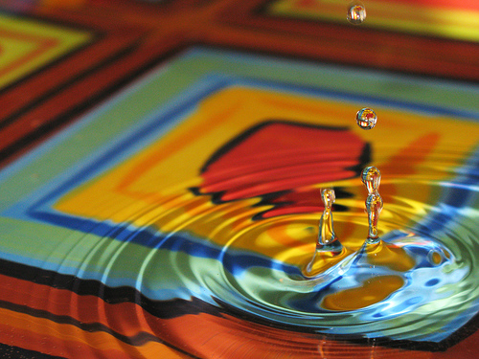
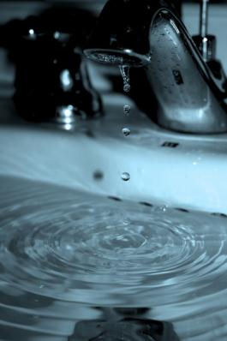
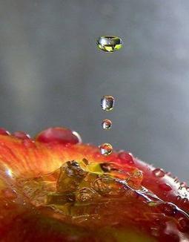
How to Photograph Water Drops
Don’t need fancy camera, but do need patience
Background ideas
Nicely colored bowl, wider is better
DVDs in bottom of bowl add reflections
Oil ripples spread slower than water
Milk makes better “crown” splashes
Before shot, hold a ruler where water drops would be to set and lock focus
Settings
Shutter Speed – Fast to freeze motion (~1/500)
Aperture – big opening to let in light and blur background (f/2.4)
Focal length – Close, with macro lens if possible
Tripod, not for shake but for repeatable shots
Burst mode if possible
Need lots of light with fast shutter speed
Method for dropping water
Hand dropper or turkey baster
Water bottle with loose cap or punched hole
Dripping faucet
Dripping rag
Canon Powershot G9
http://digital-photography-school.com/forum/how-i-took/10164-patterned-water-drop-shots.html (user Aperthetic)

Slide 7
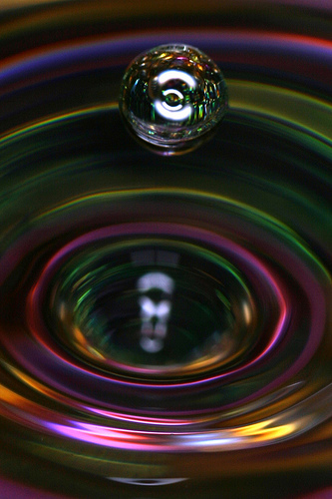
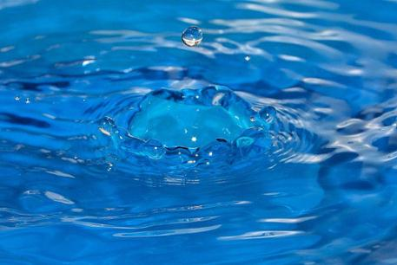
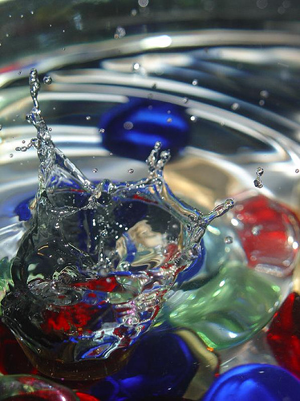
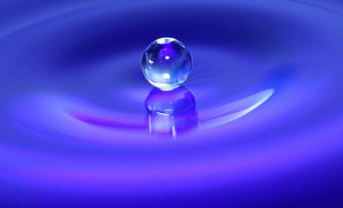
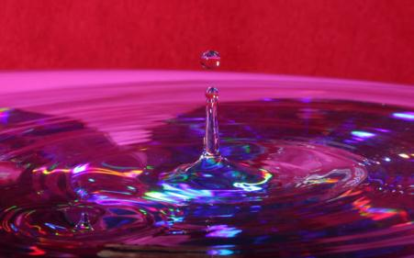
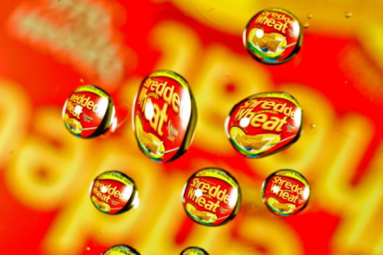
More Water photo examples
Colored Rocks
Clear Wine Glass wrapped in colored foil
Plastic dog bowl
Martini Glass
DVDs in bottom of bowl
Final Tip: Don’t get your camera wet! Zoom a little if you need to be farther away

Slide 8
Slow Shutter Speed (> 1 second)

Slide 9
Shutter Speed vs. Aperture (f/#) Concept
If you decrease the amount of time your shutter is open by a factor of 2, half the light gets in
Ex: Go from shutter speed of 1 second, to 1/2 second, to 1/4 second
If you decrease the area of your aperture size by a factor of 2, half the light gets in
*Remember: f/small number = big hole = more light f/big number = small hole = less light
Area = pi * radius²
Go from f/2.8 to f/4 to f/5.6 (increase by sqrt of 2)
(2.8² = 8) to (4² = 16) to (5.6² = 32)

Slide 10
Shutter Speed vs. Aperture (f/#) Application
You may notice that on your camera, the shutter speeds all change by about a factor of 2
1 second, 1/2, 1/4, 1/8, 1/15, 1/30, 1/60, 1/125, 1/250, 1/500, 1/1000, 1/2000, 1/4000
The Apertures change by the sqrt of 2
f/2.8, f/4, f/5.6, f/8, f/11, f/16
If you increase the speed by 1 step, and decrease the f number by one step, the same amount of light gets into the camera
1 second at f/5.6 = 1/2 second at f/4 = 1/4 second at f/2.8

Slide 11
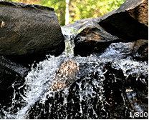
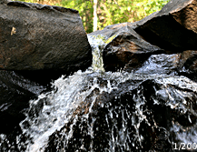
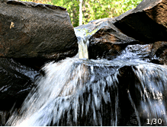
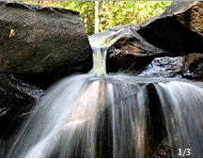
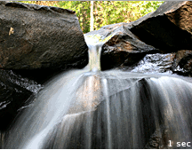
Waterfall at various shutter speeds
Shutter Speed in Seconds
1/800 1/200 1/30 1/3 1
Set camera to Shutter Priority Mode (usually “S” symbol) or manual (“M”)
For slow shutter speeds, go with higher f/# to let in less light (f/big number)
For extreme cases, or sunny days, put an ND filter on your lens for less light
For slow shutter speeds, use tripod or set on a rock
Use a remote or self-timer to eliminate camera shake of pressing button
http://en.wikipedia.org/wiki/Shutter_speed

Slide 12
Rule of thumb for camera shake Shutter speed = 1 / lens in mm
Generally, the rule of thumb for how long of a shutter speed you can use is equal to the lens of the camera you are using
For an 18-55mm lens set to 55 mm, a 1/50 second exposure could be used without a tripod
For a zoomed in picture at 200mm, a 1/200 second exposure could be used without a tripod

Slide 13
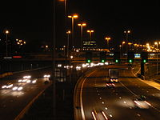
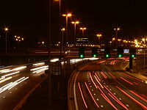
Slow shutter speeds for cars
Image on right was taken with slower shutter speed than the one on the left, creating longer streaks of light from car brake lights and headlights

Slide 14
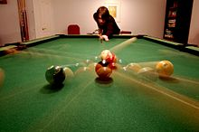
Slow shutter speed for sports
Can be used to tell the story of past, present, and future in a game of pool
This image was a 3 second exposure

Slide 15
Light Painting

Slide 16
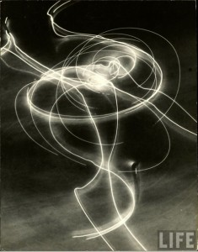
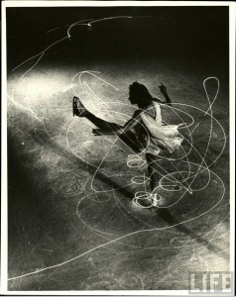
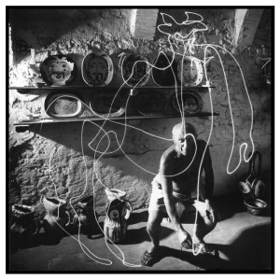
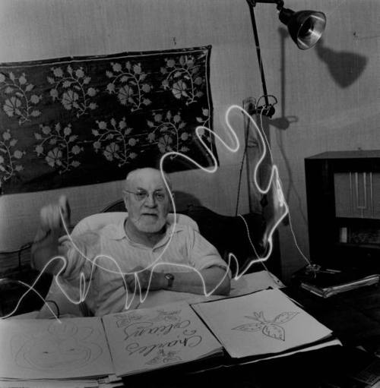
Light Painting History
Gjon Mili: Pioneered light painting in the 1930’s and 1940’s
Worked with MIT to pioneer photoflash photography
Attached lights to boots of ice skaters featured in LIFE magazine
Photographed Pablo Picasso and Henri Matisse for LIFE Magazine painting light

Slide 17
Light Painting Technique
Can either move the object or the camera, most are done by moving the object
Common objects include sparklers, glow-sticks, LED lights, candles, colored flashlights, steel wool, etc. (safety first!)
Safety first if swinging something that is on fire, for person swinging and for camera person and camera (goggles, long sleeves, long zoom, etc)
Glow sticks on a string would be much safer
Can be used to draw designs or spell out words

Slide 18
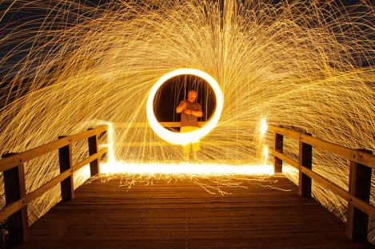
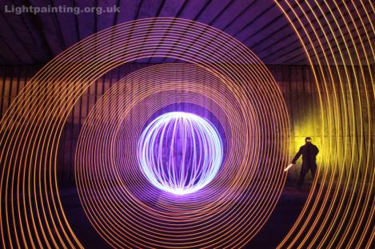
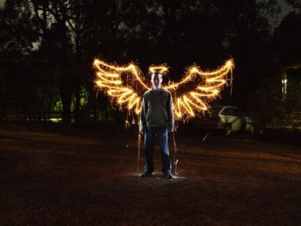
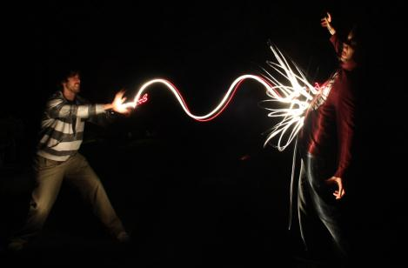
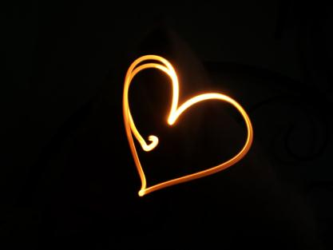
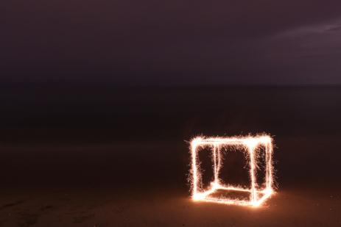
Light Painting Examples

Slide 19
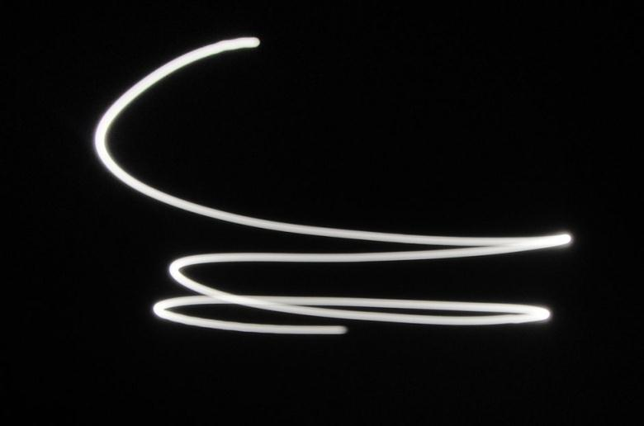
Using the full moon to paint
Using a dark night and bright moon, you can move your camera during a long exposure to “paint” the moon across the sky

Slide 20
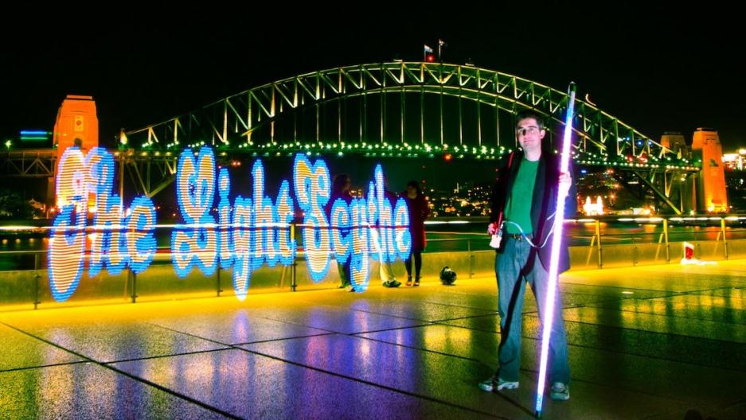
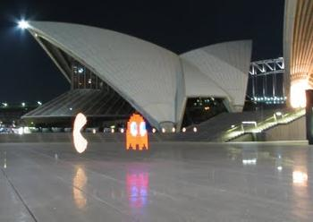
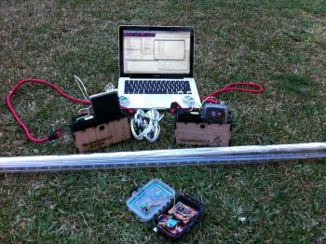
Open Source Light Scythe
Open source with plans online to build programmable LED light stick for light painting photography
https://sites.google.com/site/mechatronicsguy/lightscythe

Slide 21
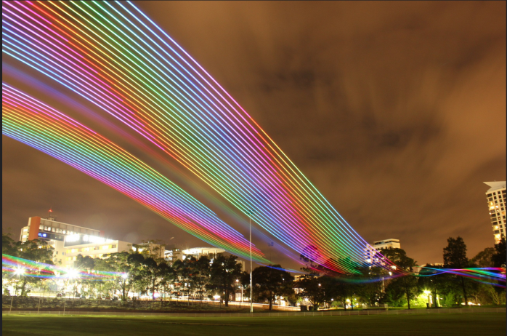
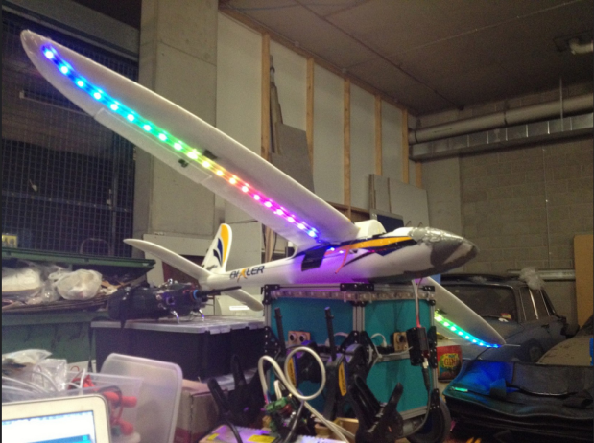
Light painting with a plane
Flight scythe, put LED strip on a remote control airplane and flew it over park

Slide 22
Time Lapse Photography

Slide 23
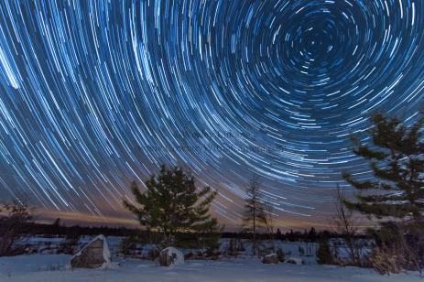
Time Lapse Photography
Common subjects include
Cloudscapes and star trails
Plants growing or blossoming
Evolution of a project
People or cars in a city
HDR timelapse (taking 3 photos of each scene exposed differently) enables light and dark subjects to show
Blossoming Pelargonium. 2 hours are collapsed to a few seconds

Slide 24
Intervalometer
Intervalometer is a device which counts intervals of time. Can be used to activate a camera every 30 seconds for example
Can be done through software on camera
Magic Lantern is a 3rd party firmware update for canon DSLR cameras and gives the user more settings such as an intervaolometer, bulb timer up to 8 hours, etc.
Most Nikon cameras have built in intervalometers
They also sell external intervalometers that you can plug into your camera

Slide 25
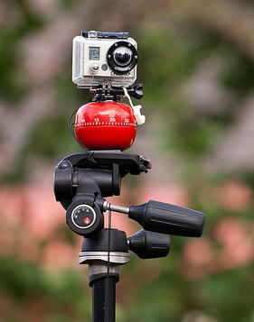
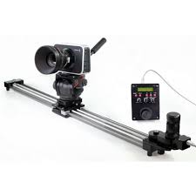
Time Lapse Rigs
To convey motion, during a time lapse photo shoot, some people move their cameras very slowly and controlled at a constant speed
Low-tech solution is strapping your camera to a kitchen timer
People also build or buy rail systems to get a slow pan effect

Slide 26
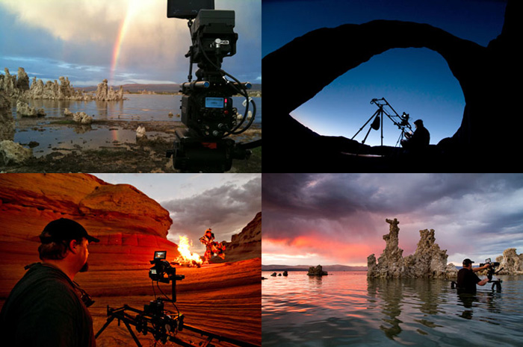
TimeScapes
TimeScapes (from astronomy photographer of the year, Tom Lowe)
http://www.timescapes.org/
http://vimeo.com/42785517 for 2 minute trailer to TimeScapes movie

Slide 27
Conclusion

Slide 28
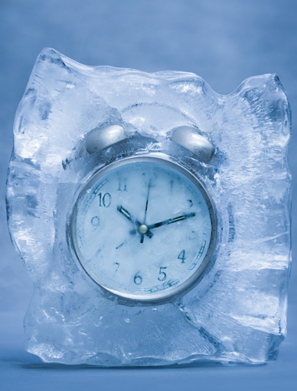
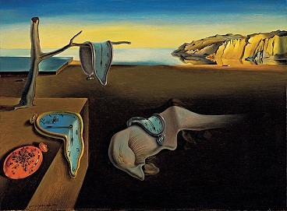
Freezing Time
Photography is all about freezing time
It’s all about how much time you want to freeze, from a thousandth of a second, to hours strung together

