Slide 1
Who’s Using your Photos Online? Find Stolen Images
Karen Smale
January 2023
Notes:
We’ve all made images and posted them online: Facebook, Twitter, Instagram, Flickr, etc. Some of those photos may have been downloaded/screenshotted by other internet users and claimed as their own, or used on their websites without your permission. How do you find out if that’s been done?

Slide 2
Services
Pixsy.com – Upload images or sync to social media apps to continuously search; help with legal/compensation
Copytrack.com – Upload or use Lightroom plugin to continuously search; help with legal/compensation
One-time image checks
Images.google.com – Upload an image and find exact matches and similar images
Chrome extension – recently rolled into Google Lens (images.google.com)
AI databases
Haveibeentrained.com – search billions of images used to train popular AI art models, flag yours for removal if you like
Full Service

Slide 3
Test image
Notes:
Most popular of my images on my Flickr site. Is on multiple sites (Flickr x 2, Fine Art America, Facebook, etc.)

Slide 4
Google image search
images.google.com
Notes:
a.k.a., Google Lens. Did not find Flickr accounts or my Fine Art America account (true of ALL services I’ve tried).

Slide 5
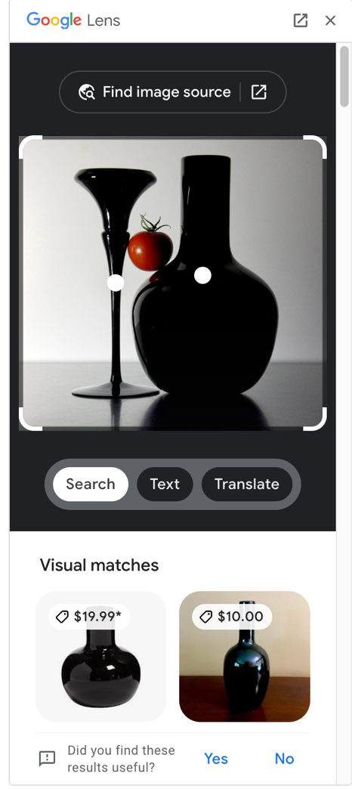
Chrome browser extension
Click this to get the pages where the image appears
Recently rolled into Google Lens (images.google.com) so you no longer need to install the extension
Right-click on an image and select “Search Images with Google Lens”
Can do this from your Flickr page or any other web-based image
ONLY WORKS IN CHROME
Bonus: great way to find product matches
Notes:
WAS an extension. Now rolled into Google Lens. Image has to be on a website first. Great solutions for single image search.

Slide 6
Pixsy pixsy.com
Import from services like Flickr, Instagram, Smugmug, Google Drive (with new images synced automatically)
Can also upload individual images from computer
Free account: 500 images monitored (for $19/m up to 2000 images)
Always looking for matches
Matches: you have to look and compare. If a famous location, lots of matches that aren’t actually matches, will be rated “low accuracy”.
Found a “high accuracy” match very in minutes – on the Photo Club website (same as Google Lens found)
Can mark as “approved use”, “not my image”, “ignore”
Will help you with legal efforts; operates in 19 countries, but with world-wide reach; 50% fee for compensation
Notes:
Multiple images simultaneously; continues to look.

Slide 7
Pixsy Positive Result

Slide 8
Copytrack copytrack.com
Upload images, or use the Adobe Lightroom plugin (which will help you sync images automatically)
Photo upload limited to 10MB per image, so you might need to resize before uploading if you’re doing this from your computer file structure.
Free account for up to 500 images
Always looking for matches
Will help with take-down, getting licensing fees (45% fee for compensation); EU-based, cases in 190 countries
NOTE: I didn’t receive ANY hits from this site, and I should have. Not sure I recommend.
Notes:
Could not find info about costs if > 500 images

Slide 9
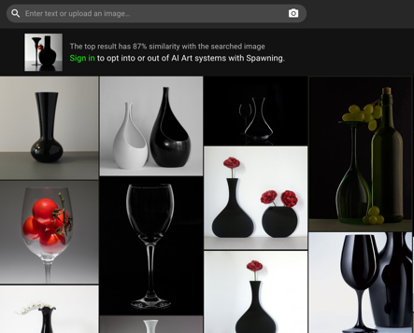
Have I Been Trained
Check to see if your images are being used to train AI
Enter text or upload photo
balance black vase and candlestick red fruit
Can opt in or opt out of allowing your images to be used to train AI
Read more: https://arstechnica.com/information-technology/2022/09/have-ai-image-generators-assimilated-your-art-new-tool-lets-you-check/ and https://www.vice.com/en/article/3ad58k/ai-is-probably-using-your-images-and-its-not-easy-to-opt-out
Adobe Cloud is also using images to train its AI: https://www.dpreview.com/news/6341509927/adobes-content-analysis-program-raises-privacy-concern h/t Bill Dusterwald
Text search results
Image upload search results
Notes:
If you take a lot of pictures of traffic lights or crosswalks…

Slide 10
Comparison
Service | Cost | Uploads | Ongoing? | Help with take-down, licensing?
Images.google.com | Free | One image at a time | Instantaneous search | N
Chrome browser extension | Free | None – uses image on the web already; one image at a time | Instantaneous search | N
Pixsy.com | Free up to 500 images | From computer and mass-upload from many image services like Flickr, Instagram | Ongoing search | Y, will take a big cut of licensing fee
Copytrack.com | Free up to 500 images | From computer and via Lightroom plugin | Ongoing search | Y, will take a big cut of licensing fee
Have I Been Trained | Free | One image (or description) at a time | Instantaneous search | Can flag for take-down from their dataset
Notes:
If anyone has used other services or tools, please chime in now!

