Slide 1
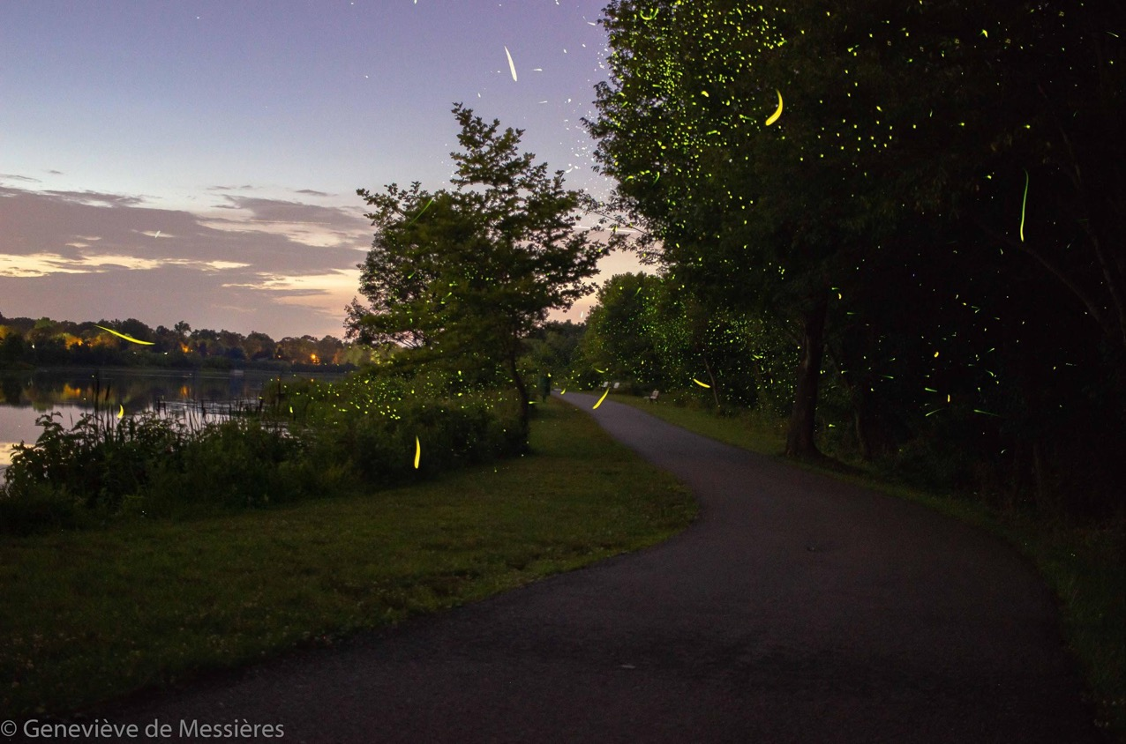
Firefly Photography
Notes:
All images by Geneviève de Messières unless otherwise noted. Please don’t re-use without permission.
demessieresgenevieve@gmail.com
All of these images were taken in Maryland.
I feel so lucky to live in a place where I can see these incredible natural displays. Watching a firefly display makes me marvel at the wonders of our home planet.
I’ve just started to learn how to take these images. I look forward to learning more about:
Composing dynamic images - the fireflies alone can’t make a great image
Close up shots
Merging night sky and firefly shots

Slide 2
The Basics: What do you need?
Safety:
Apply bug spray before you enter the woods
Check for ticks as soon as you get home
Flashlight
Tripod
Shutter release
Chair
A scenic spot
Fireflies!
Notes:
Source:https://gfycat.com/gifs/search/fireflies+bugs
Apply bug spray to protect yourself from mosquitoes, but don’t spray it around liberally in a firefly habitat - you will drive away or harm the fireflies as well as other insects. It’s best to spray it carefully on yourself close to home.
You’ll need a relatively dark spot to find fireflies - usually in the woods, in a field, or around a stream. But it doesn’t have to be remote - these were taken from inside the Washington DC Beltway. Fireflies need darkness so they can display for each other. One of the reasons we should control light pollution is to preserve habitat for these creatures as well as so many others that need darkness in order to go about their lives.

Slide 3
The Extras
Large aperture lens
Intervalometer
Photoshop or similar
Decent processing power (RAM)
Notes:
I was using f/1.4 and f/2.8 lenses.
Do I need to use Lightroom or Photoshop?
No, there are other good options out there, including free alternatives.
Source: https://giphy.com/gifs/i-firefly-adam-baldwin-XbfbMoFQKPyms

Slide 4
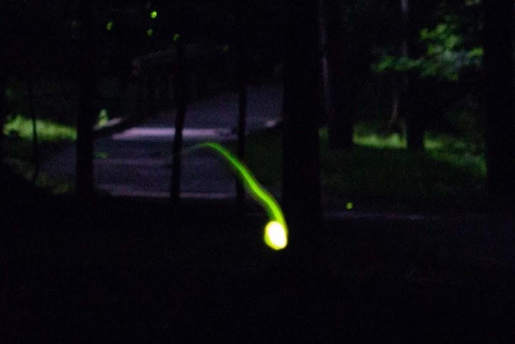
Planning
Best time:
Late May - late June
Shortly after dusk
Go scouting
Notes:
Before pulling out all your gear, spend a few nights walking around just enjoying the displays and making note of where they are found. Where do the fireflies tend to congregate? (And when? They sometimes only flash for an hour or so after dusk before getting tired, sometimes longer.)
What are some interesting features of the scene that could make a good focal point for your image - like a gnarled tree, a stream as a leading line, a meadow surrounded by thickets?

Slide 5
Single Exposure or Multiple Shot?
Can you get firefly photos with a single exposure?
Yes! But …
Multiple shot:
1 longer background shot (or combination shot)
Dozens of short firefly shots
Stack in Photoshop or similar
Notes:
Many people prefer to get a good shot right out of the camera and to do little, if any, post-processing. This is something you can do with firefly photography, but it limits what you can do. This is a good chance to try practicing combining multiple shots into one exposure.
With a single shot, you usually can’t exceed about 15 seconds without overexposing the background (depending on how dark your conditions are). As your exposure gets longer, your fireflies will be fainter compared to the rest of the image. It’s worth trying a single shot if you can’t do multiple shot, but I recommend going straight to multiple shot if you can.
A lot of the skills you use for multiple shot firefly images will also be useful for star trails, meteor shower images, and night sky images.
You’ll probably have a noisy image either way. A single long digital exposure builds up a lot of noise. Normally, multiple shot helps you reduce noise, but this particular processing method for fireflies will retain a lot of the noise.
Some tutorials and examples:
https://petapixel.com/2013/06/05/how-to-shoot-starry-photos-of-fireflies/
https://www.shutterstock.com/blog/hristo-svinarov-photos-fireflies-tips
Source: https://boardgamegeek.com/thread/1910361/shiny-its-firefly-werewolf/page/0

Slide 6
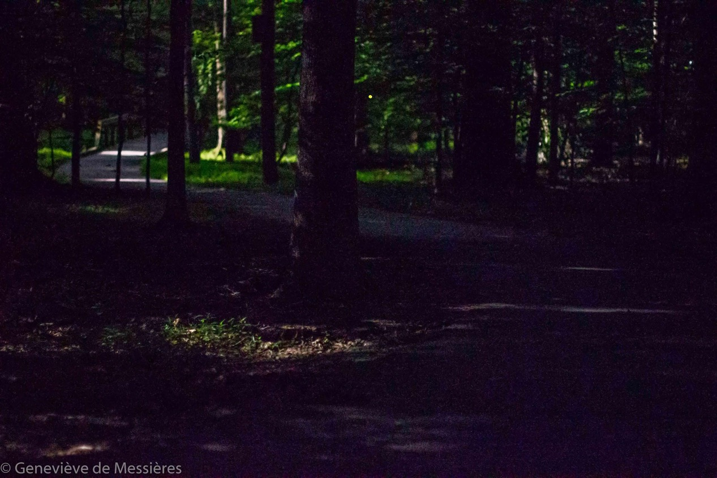
Background image
50 mm, f/1.4, 10 sec, ISO 6400
Notes:
For easy processing: your background image should be visible, but on the dark side: most parts of your background image should be darker than the fireflies in your stack images.
The firefly images should be mostly black (definitely darker than the background image) except for the fireflies and any scene highlights. To maintain the yellow green color of the flashes, make sure the fireflies don’t overexpose (except for the core of the brightest ones).
To summarize: the fireflies in the individual images should be brightest, but not overexposed; the main background image should be intermediate brightness; the background of the individual firefly images should be significantly darker than the same areas on the background image.
For this image:
Background image: 50 mm, f/1.4, 10 sec, ISO 6400
Firefly stack images: 24 images, 50 mm, f 1.4, 6 sec, ISO 3200

Slide 7
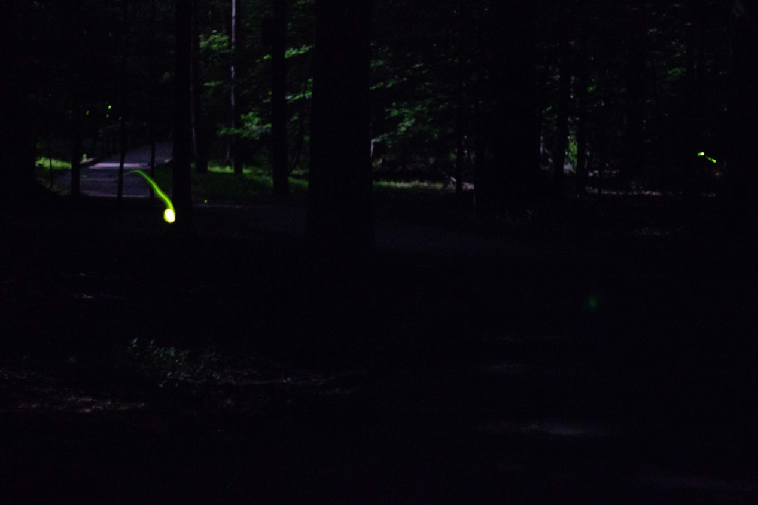
Stack images (one of 24)
50 mm, f/1.4, 6 sec, ISO 3200
Notes:
For easy processing: your background image should be visible, but on the dark side: most parts of your background image should be darker than the fireflies in your stack images.
The firefly images should be mostly black (definitely darker than the background image) except for the fireflies and any scene highlights. To maintain the yellow green color of the flashes, make sure the fireflies don’t overexpose (except for the core of the brightest ones).
To summarize: the fireflies in the individual images should be brightest, but not overexposed; the main background image should be intermediate brightness; the background of the individual firefly images should be significantly darker than the same areas on the background image.
For this image:
Background image: 50 mm, f/1.4, 10 sec, ISO 6400
Firefly stack images: 24 images, 50 mm, f 1.4, 6 sec, ISO 3200

Slide 8
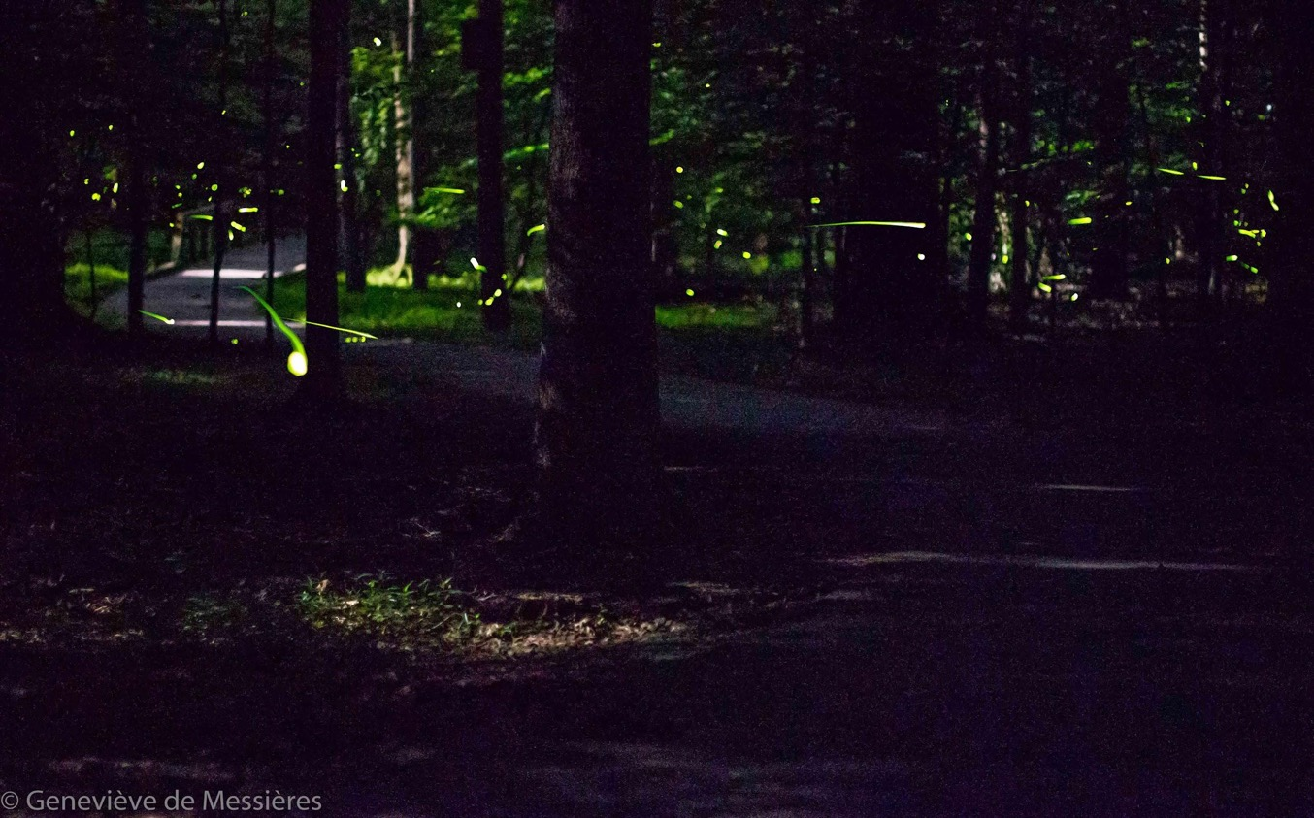
Notes:
Final result.
Overall the image is a bit dark, the contrast with the moonlit parts of the path a bit too strong, and there are unfortunately no fireflies in the lower half of the image. But there’s a good leading line (the path) and a sense of motion (the fireflies mainly moving toward the right), plus a couple of dramatic firefly flashes from the closer ones. One of my better results.

Slide 9
Getting Organized
Organize by scene
Mark your background image
Batch processing
Select the shots with fireflies. Decide which are worth keeping.
Notes:
My workflow when I get the pictures onto the computer:
Load all images into Lightroom
Organize by scene: Rename groups of images by date and scene (eg 20190620-Bog-001). With the firefly stack images being so dark, it would be easy to mix up fireflies from multiple scenes - clear organization will really help you out. You might prefer to organize them into folders.
Mark the background images (or the ones that you will combine to make the background image) differently. I usually flag them as “picked” and rate them as 3. Even the background images are so dark that it can be easy to lose track of them.
Do any batch processing that applies to all images in a scene (maybe a little noise reduction, or increasing the midtones on the stack images so that the fainter fireflies are more obvious without overexposing the brighter ones)
Go through the stack images and mark the ones with fireflies. I usually flag them as “picked” and rate them as 2. The bright flashes will be really obvious, but the human brain is excellent at noticing change, so by toggling back and forth, you will be able to notice which images have even small flashes.
Export groups of images (about 10 at a time) into Photoshop for the next step.
Why not just keep all of the images, because the ones without fireflies won’t end up making any difference to the blended stack?
Well, they won’t add any fireflies, but they will add to the noise (any bright pixels from them will propagate upward with the “lighten” method). You’ll also have more images to process which will take more time. It’s worth a few minutes to sort through which ones have fireflies - and it’s fun!
Should I bother keeping an image with two tiny specks of light?
It might not be worth your time or processing power to include those. However, don’t discount the mass effect of those tiny specks once you add them all together. Look for a compromise where you are including plenty of little background specks to add to the magic of the final scene, but not wasting a lot of time on them when the big flashes in the foreground are more important.
Do I need to use Lightroom or Photoshop?
No, there are other good options out there. You can organize the photos using a photo viewer on your computer and sort them into folders. There are free alternatives to Photoshop.
Source: https://m.imgur.com/gallery/FxhxhI7

Slide 10
Post-Processing Method
Details:https://petapixel.com/2013/06/05/how-to-shoot-starry-photos-of-fireflies/
Divide your firefly stack into manageable groups of about ten
Auto-align the images in each group
Blend them using “lighten”
Flatten each group into a single image
Auto-align all of the flattened images to the background image
Blend using “lighten” again
Reduce noise
Notes:
See this tutorial for specifics: https://petapixel.com/2013/06/05/how-to-shoot-starry-photos-of-fireflies/
It’s time consuming but not fussy, and it really works! You start with a group of about ten relatively boring firefly images, align them, combine them using the “lighten” method, and suddenly you have a pretty awesome collection of firefly flashes. Align those results together and combine them again, and it turns into a really amazing scene.
The main ways I deviated from this tutorial are:
I used smaller groups of about 10 images instead of working with all of the stacked images at once. My computer wasn’t powerful enough to do more images at once. If you try to process too many images at once, your computer will freeze up. Experiment until you find an efficient group size for your computer’s power.
I used auto-align more than once: I used it to align each group of ten images, and then once I had a flattened image from each group, I auto-aligned all of those to the background image. Auto-align is your friend!
I used smart objects sometimes, but I’m not sure if they were necessary - I’m still getting to know Photoshop
If you don’t mind saving huge files (using Photoshop’s .psb format), save your work before flattening each group of 10 images. If you want to keep file sizes more manageable and you don’t mind retracing your steps if you want to change something, flatten each group and then save the file - it’ll be a much smaller Photoshop file (so you can use .psd format).
If your computer is struggling under the processing load, save your work often, restart Photoshop now and then to clear up RAM, and restart your computer if it’s slowing down.
The “lighten” or “lighter color” method will tend to increase noise in your final image, because any bright pixel from one of the exposures will rise through the levels and end up in the final image. If the result is too noisy for your taste, you can use noise reduction algorithms to reduce the noise, or use your background image (which is relatively low-noise) to patch over some of the high-noise areas of your image which don’t have as many fireflies. (see later slide for an example)
Source: https://m.imgur.com/gallery/IYS5j/comment/199513699

Slide 11
The principles of composition still apply!
But fireflies don’t care ...
Notes:
Simple background and a focal point of interest
A firefly passing up close can make a great focal point, but you need a scene too
An interesting tree in an otherwise simple scene is a good choice. But fireflies seem to like tangled briars!
Focus - hard to accomplish in the dark.
Consider how to get an element of the scene (like a tree) in focus - use a flashlight if you need to, but be careful, the fireflies might leave and not come back.
Consider if you want the fireflies somewhat in focus, or totally bokeh (which makes them bigger but also fainter).

Slide 12
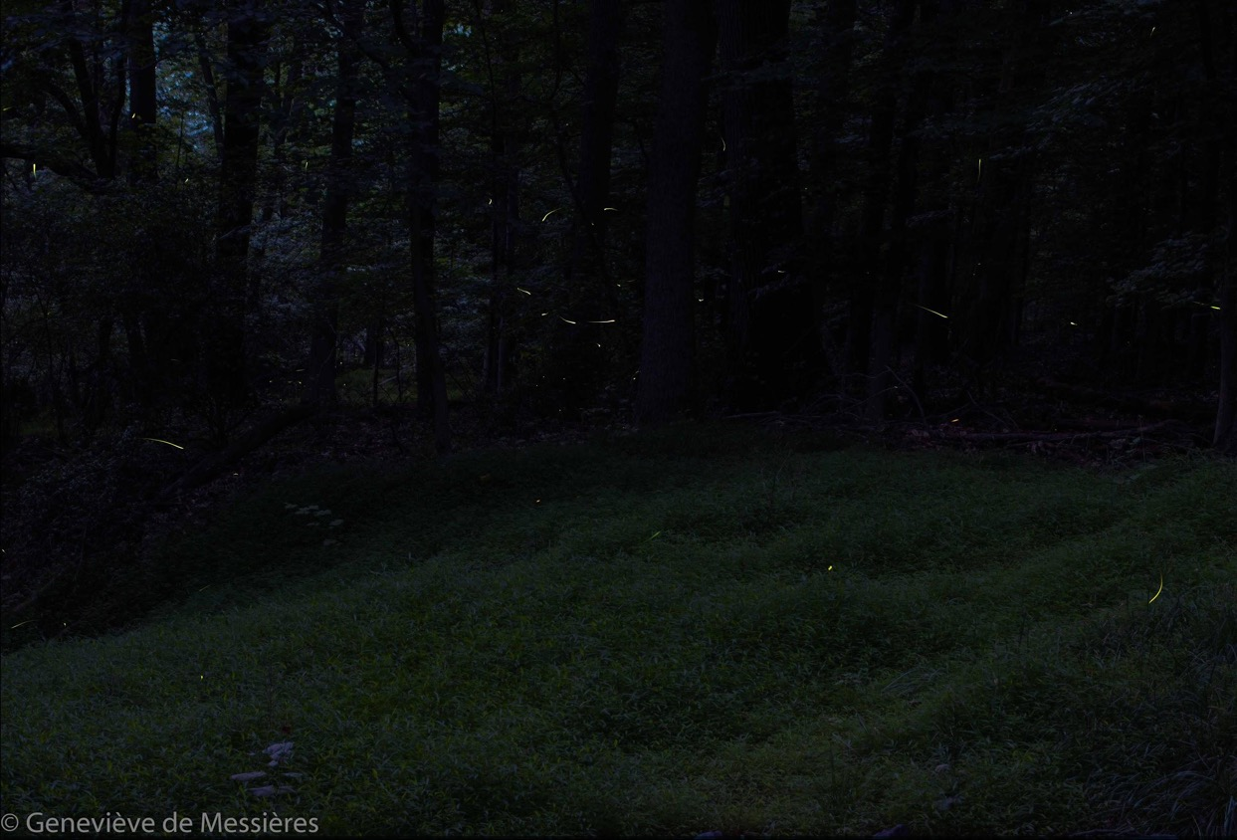
Notes:
I thought this would make a pretty image. A blanket of green (invasive stiltgrass, but pretty) for a clean foreground. When I was scouting it, there were lots of fireflies there.
But the fireflies didn’t cooperate. By the time I was set up and shooting, they had mostly moved on, the few remaining were far away (faint, and no dramatic focal element to draw the eye), and they made a goofy smiley face...

Slide 13
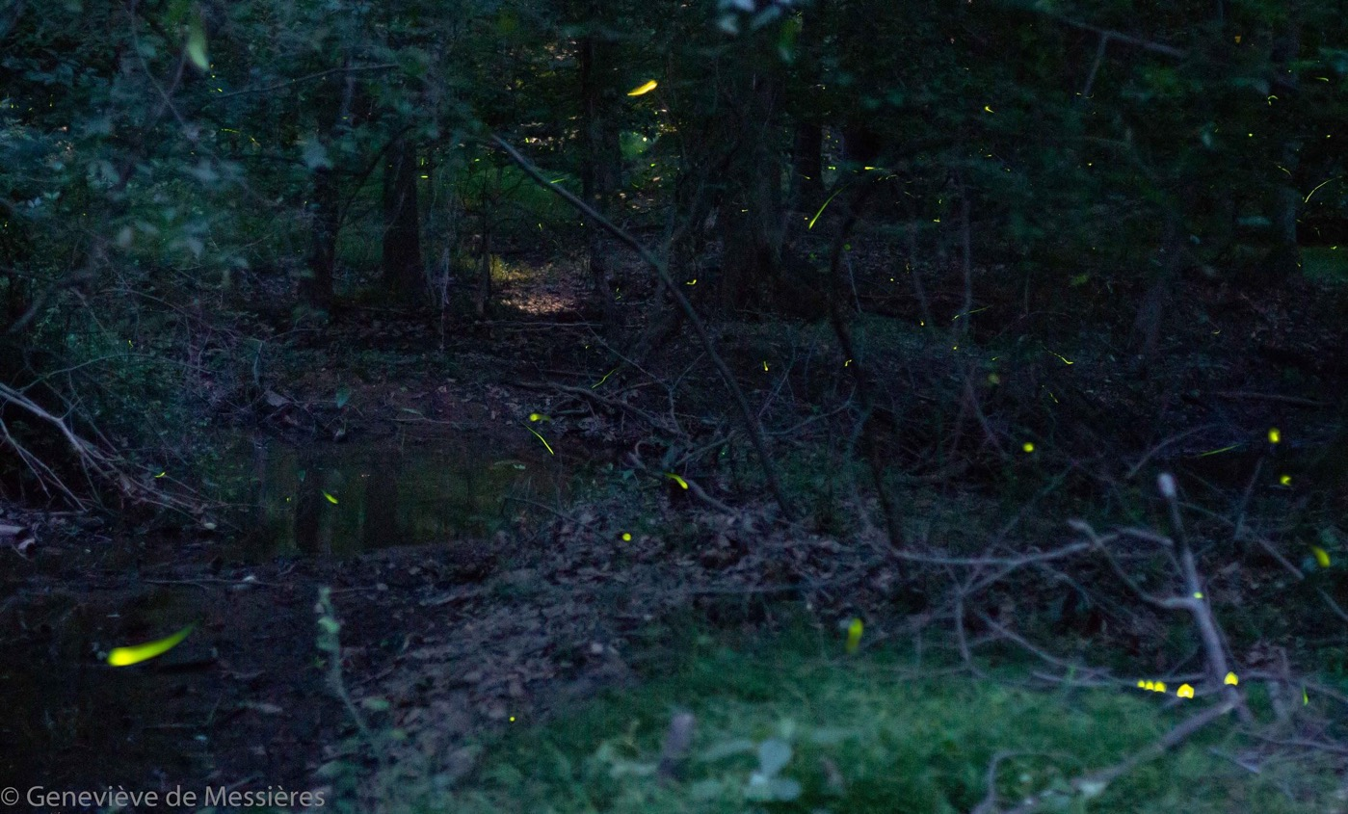
Notes:
The fireflies were all over this spot, so I moved there. But I couldn’t find a good picture. It's hard to compose in the dark! There’s a little bit of a leading line with the creek and the moonlight in the background, but mostly it’s a tangled mess of branches.
Kind of fun getting a perched firefly slowly moving along a twig, though (lower right).

Slide 14
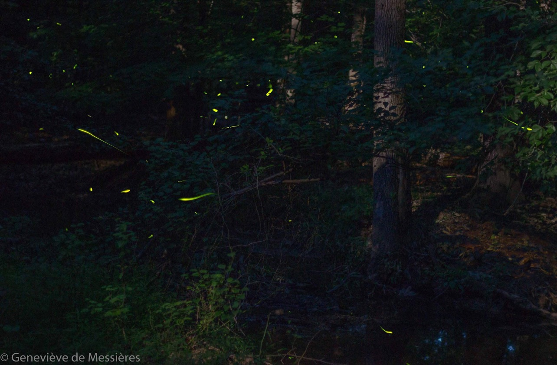
Notes:
Here’s another one - happy fireflies, tangled woods, no good focal point.

Slide 15
The bugs won’t cooperate!
Patience …
Persistence ...
Notes:
Be patient:
Keep trying different compositions to get both great fireflies and a great scene.
Look for different angles or look for a different spot.
Is the scene just hopeless? Try going abstract: make it all blurred out with big, out of focus fireflies making trails across the image. Try skipping the background and just going for the fireflies themselves.
Try going macro: get a close up of a single firefly. (This is super hard! I spent hours and haven’t been successful yet. Focus is very challenging because the firefly is only lit for a few seconds, and even a perched firefly usually crawls around, and the macro focal plane is so sensitive.)
Just enjoy the show and try a different night!
Source: https://gettrendygifs.wordpress.com/2016/06/03/new-trending-gif-tagged-morena-baccarin-firefly-joss/

Slide 16
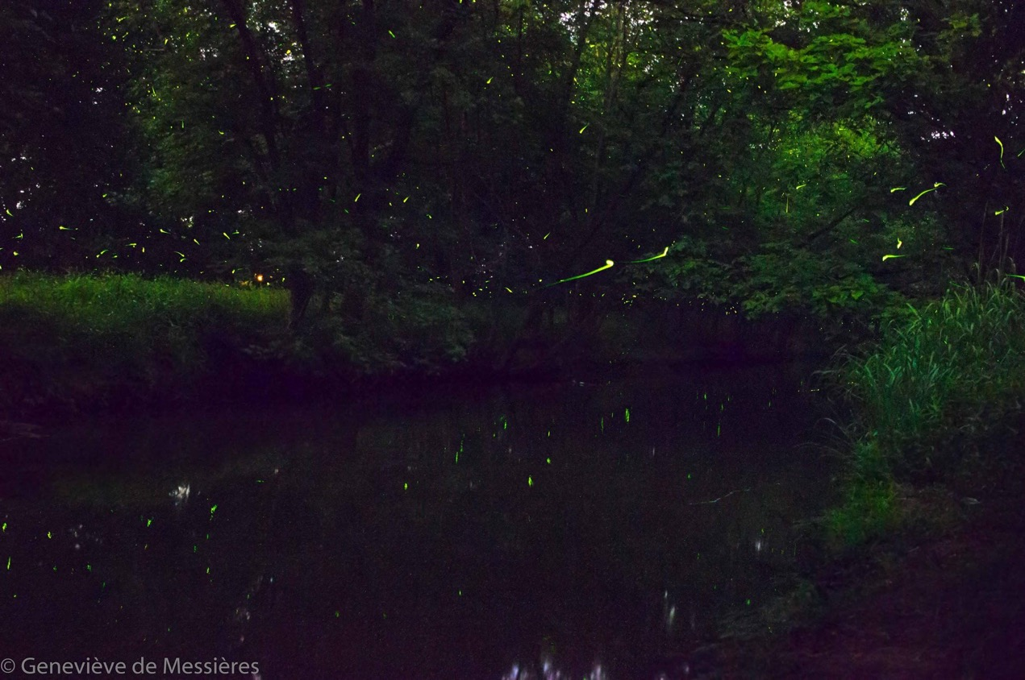
Notes:
This one is a bit better, with fireflies reflected in the wide creek. However, there is no real focal point to draw the eye.
Stack: 45 exposures, ISO 6400, 24mm, f/2.8, 17 sec.
Background: a median of about ten of the stack images, brightened a little.

Slide 17
You can use your stack images to make a background image.
45 stack images
24 mm, f/2.8, 17 sec, ISO 6400
Notes:
In this case, I didn’t take a separate background image. Instead, I took about ten of the stack images, and combined them in Photoshop using the median method to get a decent low-noise background with no fireflies. Then I brightened it, and blended it (using the “lighten” method) with the firefly stack images to get the almost-final image.

Slide 18
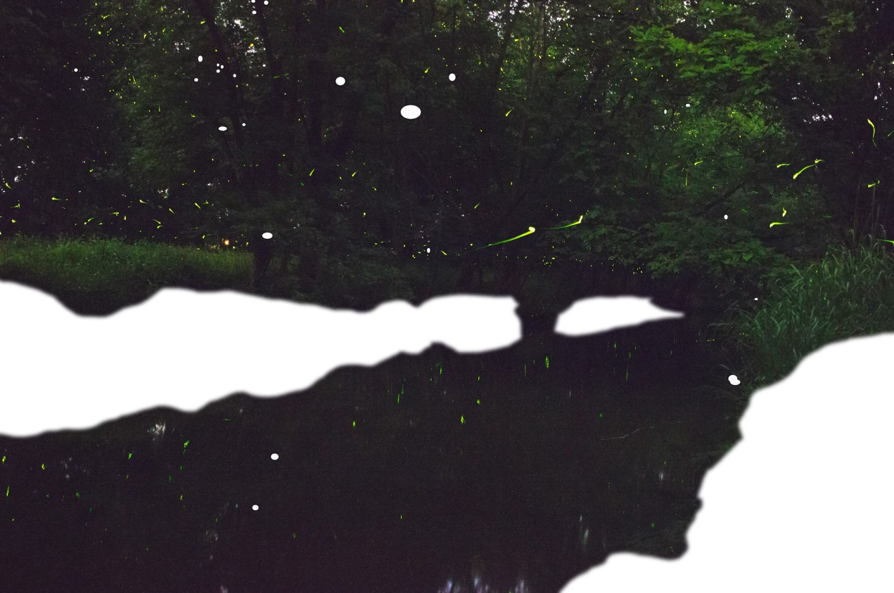
Notes:
How to fix up high noise areas of the final image:
The “lighten” method of blending layers makes it super easy to get all those firefly flashes in the final image - also a good trick for star trail and meteor shower photography! But the downside is that it also propagates noise through to the final image. I wasn’t happy with the noise level in some areas of the blended image.
So I erased some areas of the blended image where there weren’t any fireflies and the noise level seemed high. The white parts here are the areas that I erased.
The layer below this one was the background image, which was low noise (being made of a median of ten images). So when I erased these high noise areas, the low-noise background showed through, making a nicer final image (next slide).

Slide 19
Notes:
Final image again

Slide 20
How important are those rules … ?
Notes:
Post processing is easiest if you stick with this rule: the fireflies in the individual images should be brightest, but not overexposed; the main background image should be intermediate brightness; the background of the individual firefly images should be significantly darker than the same areas on the background image.
But what if you want to break that rule?
Source: https://imgur.com/gallery/I0UBy

Slide 21
Notes:
This was my favorite result from last year. It was also a nuisance to create, because I broke one of the rules. The stack images (with the fireflies) had a brighter sky than the final background image. Huge pain.

Slide 22
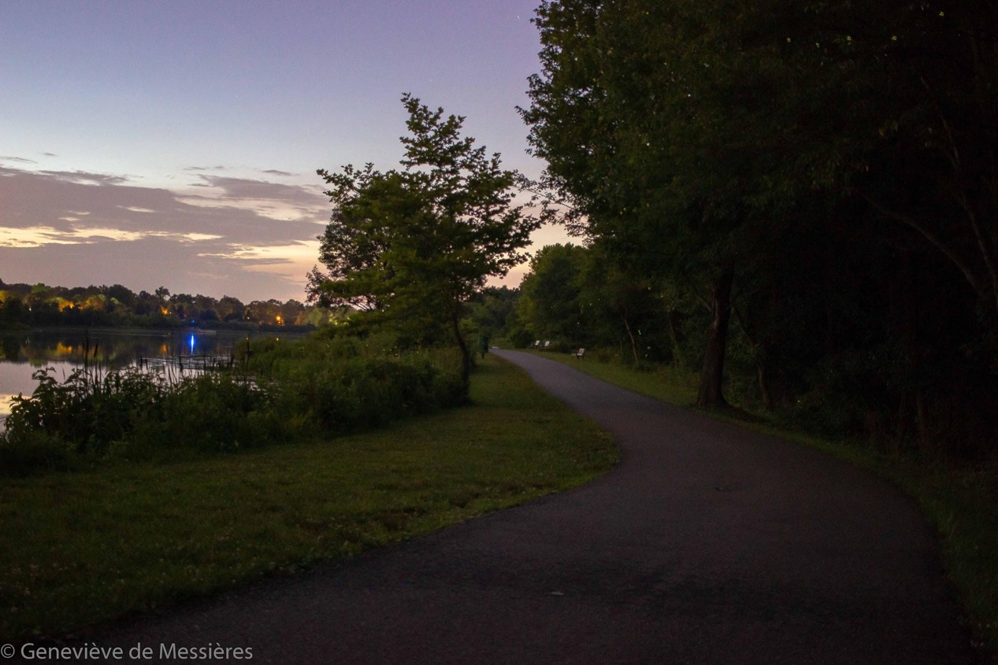
Notes:
Background image: an HDR (high dynamic range) composite at 24mm of these images:
ISO 6400 f/2.8 5 sec (bright part)
ISO 400 f/4.5 6 sec (medium)
ISO 400 f/8.0 5 sec (faint part)

Slide 23
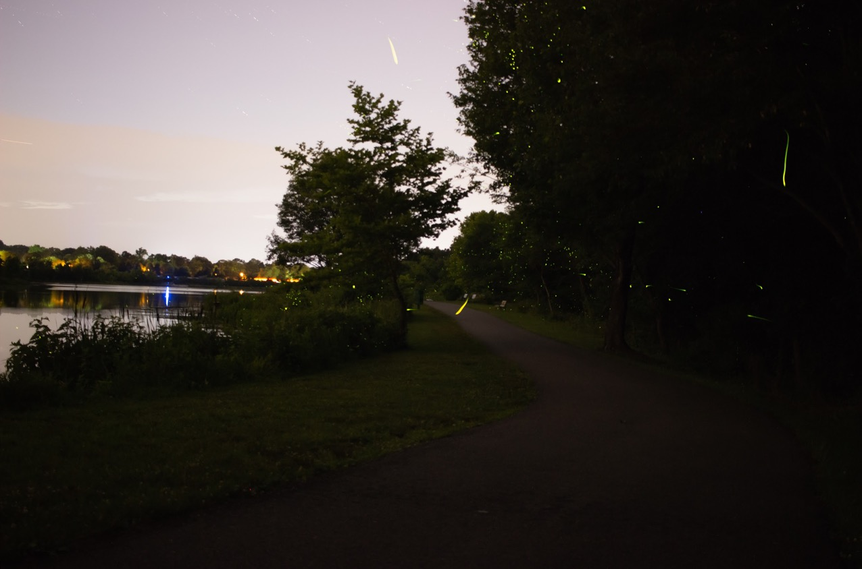
Notes:
This is a subset of the firefly stack of images. Note that it’s properly exposed for the fireflies - you can see them against both the trees and the sky, and they are not overexposed or too faint. But the sky is bright. Here in the city, the sky never really gets dark - this is taken well after dusk. If you have the sky in your field of view, you are going to have problems with it being bright.
My HDR image for the background included an image with the aperture stopped way down so that the sky was reasonably dark, so my final background has a darker sky than this. That’s what gave me grief.
The total stack was 140 images (! it took me awhile to work through them). This image is a combination of about ten of them. (Remember, I divide them up into manageable chunks of about 10 images each so that the processing doesn’t overload my computer.)
Each of the stack images was 24mm, f/2.8, ISO 200. Most were 4 sec, some were 5, 6 or 7 sec. (Because it was dusk, light levels were changing during my exposure set.)

Slide 24
Notes:
Final result again.
The “lighten” blending method worked fine in the other parts of the image like against the trees or grass, but I had to do a lot of manual work in Photoshop. The main things I had to do were:
To get the fireflies against the sky: the final stacked image of fireflies had many fireflies against a bright sky. I used the magic wand tool to select the fireflies and separate them from the bright sky - hard because they were not strongly contrasted against the sky. With them separated, I could place them against the background image’s darker sky.
It was really hard to stitch the dark sky from the background image against the firefly-stuffed tree image from the stacked image. I spent a long time with magic wand and manual selector drawing the line between bright sky and tree.

Slide 25
Notes:
Just be prepared for some extra headache if you have anything in your stack images - like a bright sky - which is brighter than the corresponding area of your background image.
After hours of work, I dropped my hard drive containing my photos and Lightroom and Photoshop files. I hadn’t backed up in almost a year. I was looking at losing all of my images for a year, including all of my firefly images that I had spent so many hours on. Fortunately, a data recovery company was able to repair the drive and recover my data, but it cost a lot of money. Back up your data! In multiple ways - protect against human error (overwriting), accident (fire, flood, dropping), theft, hacking. Keep at least one backup offsite or in the cloud.
Source: https://www.pinterest.com/pin/229613280988627280/

Slide 26
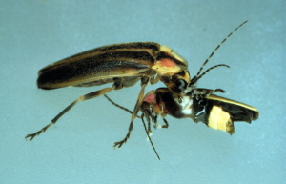
Enjoy these amazing animals!
Notes:
Fireflies have all kinds of interesting traits including a tangled web of inter-species deception and predation. This is a female Photuris eating a male Photonis in order to harvest defensive chemical compounds. She lured him over by pretending to be a female Photonis.
Image source: https://news.cornell.edu/stories/1997/09/cornell-biologists-report-mimicry-and-murder-night
More cool information about fireflies: https://www.firefly.org/facts-about-fireflies.html

Slide 27
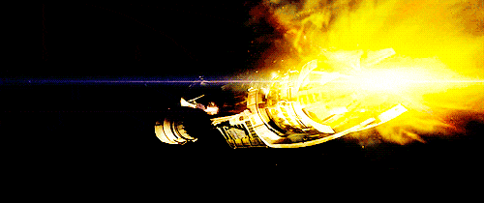
Questions?
Notes:
Source: https://giphy.com/gifs/firefly-serenity-spaceship-hXsKGwsat02Pe

