Slide 1
Flip the Composition
Don’t be afraid.
Everything will be alright.
An examination of the way photographs are viewed, with an eye towards making your photographs
more compelling.
By Bill Dusterwald

Slide 2
The Bill D. Theory of Viewer motion thru a photograph.
This has not been verified with other compositional guidelines. The assertion I make could not be googled on the Internet.
To take advantage of what I am about to present you must ask yourself a question:
As a photographer, am I a photojournalist or am I trying to be an artist?
1) A photojournalist looks thru the viewfinder and determines how to record what he sees as accurately as possible.
2) The artist looks thru the viewfinder and asks how do I feel about what I’m seeing and how can I communicate that?
I once suggested the technique that I’m about to present to a friend of mine and he objected.
“That was not what it looked like” he said.
Proposed the following:
European and American eyes will enter a photograph from the left and move to the right, because that is how we read.
If the subject is in the left hand side of the photograph, there is little reason for the viewer to move thru the entire image.
Having the viewer spending time looking at the image is what the photographer would want. It allows time for the viewer to be able to get the message of the image and even view the image as multidimensional, having sub-stories within the image.
During the taking of the image, often it is not possible to a compose the subject within the frame as you would like. Post processing can give you a powerful tool to save the image.

Slide 3
The psychology of the viewer :
Photographs with People:
A portrait has the advantage that the viewer will be drawn the face, no matter where in the frame it is.
The viewer will examine the face for emotion, fear, anger, along with the posture and body language.
The viewer will then look beyond the person to look at the importance of the person by seeing the person
within the context of the frame. Do they dominate or are they a small part of the frame of the photograph and therefore an element of the composition?
Photographs with a landscape image the eye will be drawn to the brightest tone in the image first.
If the brightest tone is in the left hand side of the image, the viewer might stall there before moving on. If the brightest area is on the right hand side then the viewer will move across the image, registering the content before coming to rest on the brightest tone.
Compositional guidelines:
The PHI Grid : It divides the frame into 9 rectangles, each having a golden Ratio of one side of the rectangle to the other of 1 to 1.618 [Similar to the rule of Thirds]. Placing main subjects at the intersections of the grid seems to create an image that the viewer will feel comfortable with and using the eyes of the subject at the intersection seems pleasing to the viewer..
The golden spiral is based on the Fibonacci sequence. The sequence is something that is echoed in all of nature. The branches on a tree are arranged as a Fibonacci sequence, as well as the arrangement of leaves on a stem, or best envisioned as conch shell cut away. I’m not saying that the trees or plants take a mathematics course before developing, I’m saying that the sequence that Fibonacci developed fits the needs of the living world. Echoing that which we subconsciously see all the time within the composition of our photographs lends the viewer a comfort level that allows continued viewing of the picture.

Slide 4
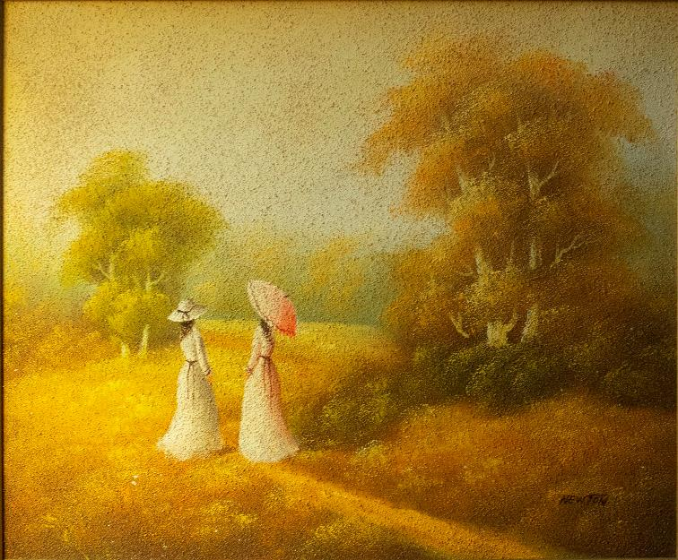
Picture by an artist named Newton in the pointillism method. The main subject is on the left hand side of the picture.
The eye is drawn to the people and to the fact that they are lighter than the rest of the painting. The fact that their faces are hidden reduces their importance to most viewers. This depiction shows human interaction as part of a bucolic scene. Their size in the frame reduces their importance.

Slide 5
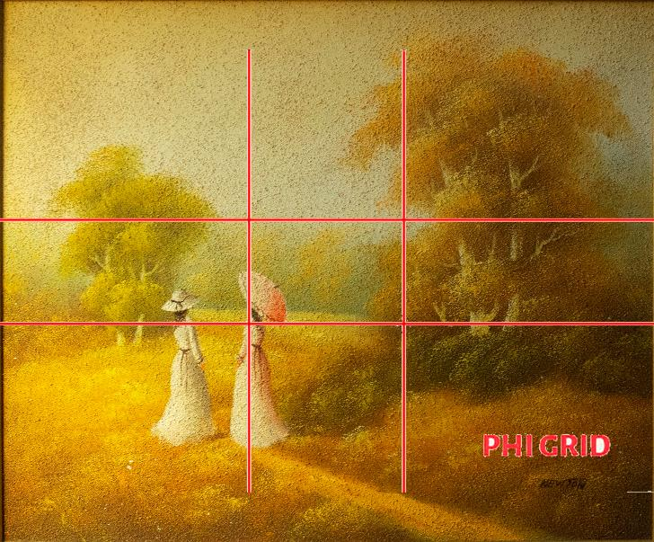
Superimposing the PHI grid shows that the placement of the subjects is correct.

Slide 6
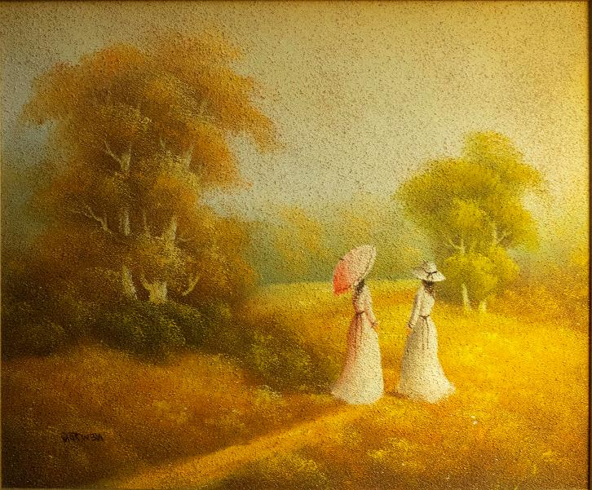
Using the Image/Image Rotation/Flip canvas Horizontal gives this result.
Now the subjects are in the right hand part of the canvas.
The viewer’s eye transition from the darkness of the trees
[diagonal path from the top of the trees] into the bright of two women and on to the brightness of the faraway trees.
I believe that this is a better “photograph” because it increases the time the viewer spends in the picture.

Slide 7
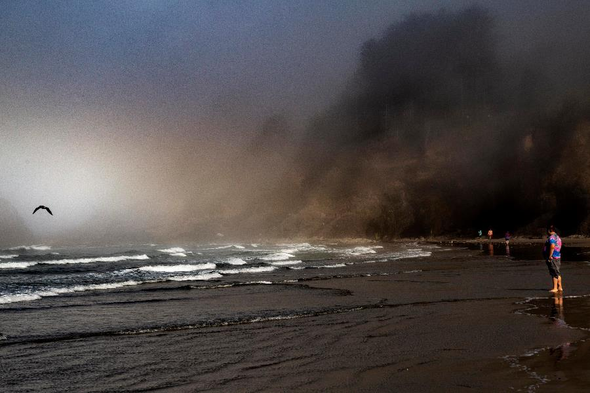
This is an example of a bright spot in the left hand side of the frame. The viewer sees it first and may lose interest in the rest of the frame.

Slide 8
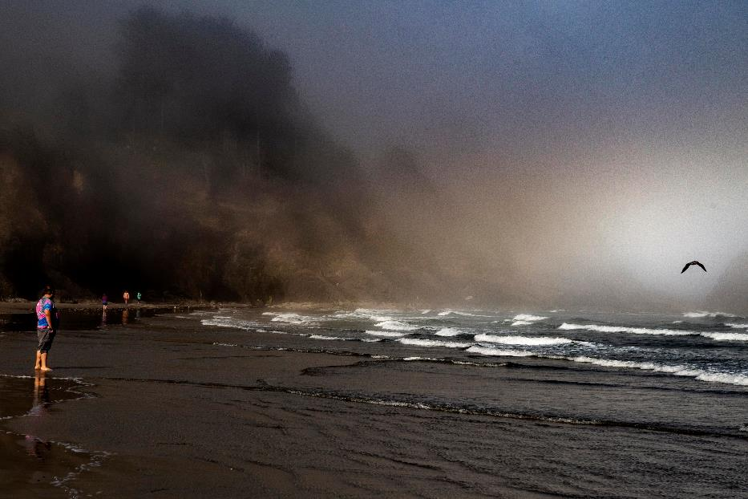
With the image flipped the viewer sees the people on the beach first then the foggy hillside, then the ocean and finally the bird highlighted.
The ocean waves may draw the viewer back into the frame where they can cycle thru again, examining the size relationships between the people. The fact that the primary person(my son) is facing away, reduces his importance in the frame.

Slide 9
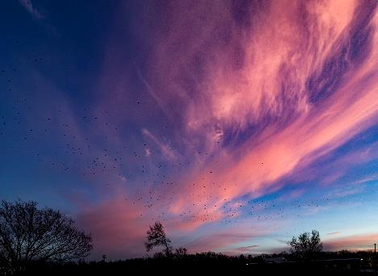
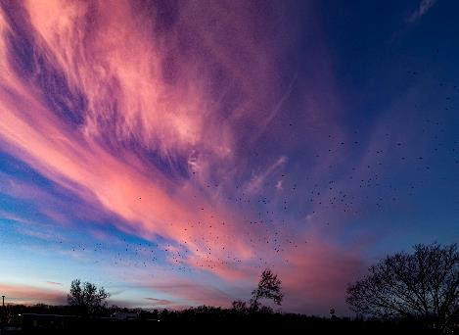
This is a sunset at Goddard as seen exiting Building 12
The eye is drawn to the clouds moving the eye trhu the frame, which is a good thing. The tree seems to be catching something.
This is the composition flipped. Now the clouds are leading the eye thru the composition and appear to be blowing the tree. This is the opposite of what I proposed in the beginning of this slide show. The eye is drawn to the bright cloud and lead to the tree. Use the composition to tell a story. The clouds are like a cosmic sky entity that is impacting the Earth.

Slide 10
One of the fun things you can do is to flip a photo, and then mate it with the original. This is a waterfall scene and it’s flipped image. Next slide shows it as a new photograph.

Slide 11
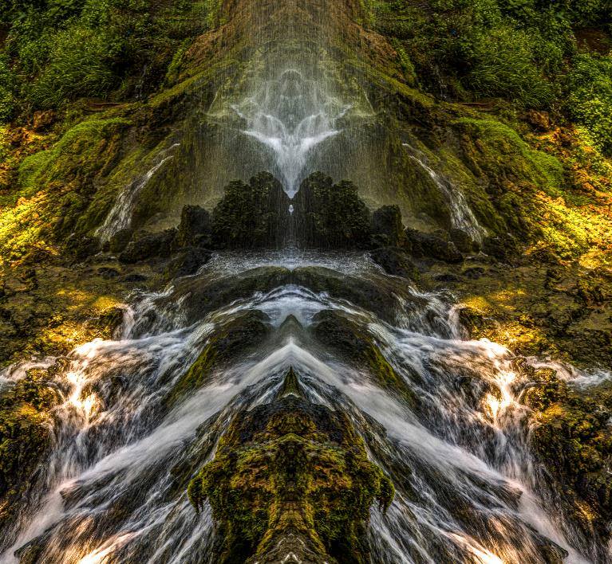
Can you see the water gnome? I believe that symmetry is what the mind finds when looking for human intervention. The water gnome appears to be a statue placed in the waterfall.

Slide 12
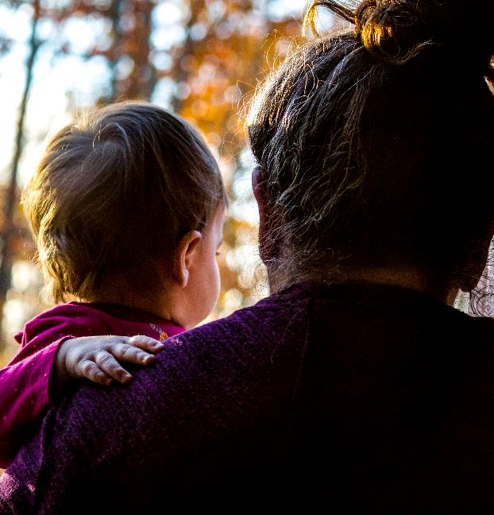
I took this at Thanksgiving last year. The lady is my sister-in-law and the child is her granddaughter, my great niece.
The child is in brighter light and draws the attention. Because they are both facing away from the camera, the viewer should be drawn to the child.

Slide 13
With the picture flipped, the bright portion is on the right side and the shadow of her grandmother forms a diagonal from the corner to the child. I think that it is a better photograph.

Slide 14
So next time you are doing post, look at your photographs, and if you want to try something different, try going into Image/Image Rotation/Flip canvas Horizontal.
Don’t be afeerd, if you don’t like it you can hit cntl Z and everything will be normal again.
However, in some cases you will like the result.
But remember, put on your artist hat beffor you flip.

