Slide 1
Focusing Lessons (I should have) Learned
Scott Hull
October 10, 2018

Slide 2
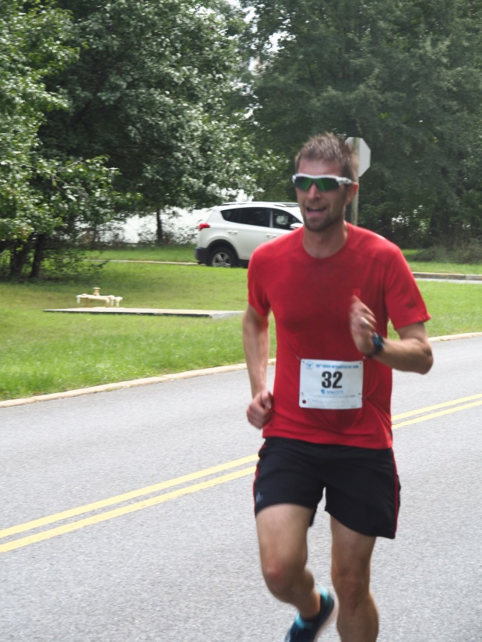
Sources of Blur
Subject movement → increase shutter speed, maybe sensitivity (CF/small subject)
Camera movement → image stabilization, monopod, tripod
Slow autofocus → patience; maximize the light input
Misplaced focus → check your AF point; learn to recompose → focus 1/3 into the field
Confused camera and/or operator → deep cleansing breath; re-check your settings
Too little depth of field → chimp a lot; when in doubt, retake w/ several apertures
Camera focus point
Intended subject

Slide 3
Low Light Issues
Causes lots of problems
Low contrast
AF searching and slow
Long exposure and camera shake
Possibly subject movement
Sources
Poorly lit subject
Polarizing filter
Low sensitivity

Slide 4
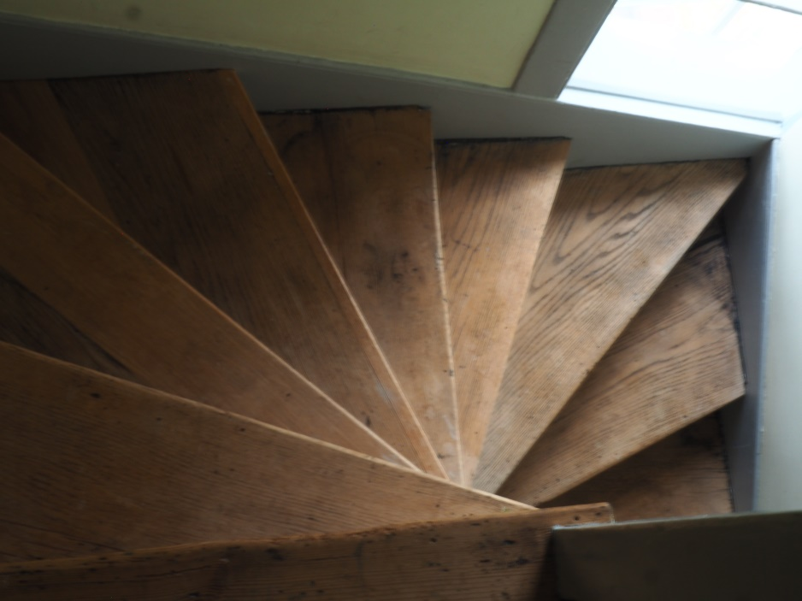
Manual Focus Mode
Steady subject and camera, works great
Focus your viewfinder first!
Some lenses have a switch for MF/AF
Live view or EVF can magnify the image
I have a button set to switch AF/MF
Don’t forget you’re in MF, though!

Slide 5
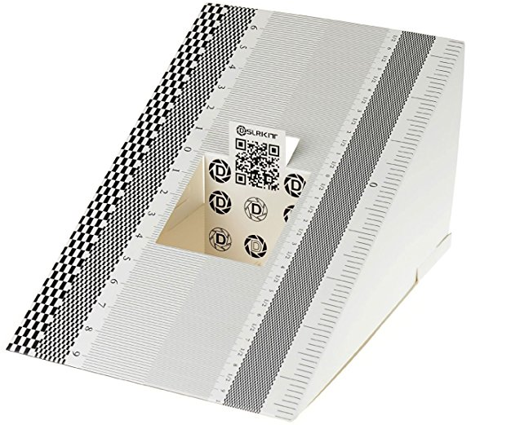
Test Your AF (or practice MF)
DSLRKIT Lens Focus Calibration Tool
Printed on cardstock
Folds to form a wedge
Focus targets at the zero point
Test to see where AF really focuses
Some cameras can calibrate the AF settings
About $2-3

Slide 6
Video Tips
https://www.youtube.com/watch?v=x4bQc36r5ek
Somewhat dated (2012) when he references “new” equipment
Pick a Focus Point
Focus and Recompose
Look for High Contrast Regions
Manual Pre-focus for Action
Live View Magnification

