Slide 1
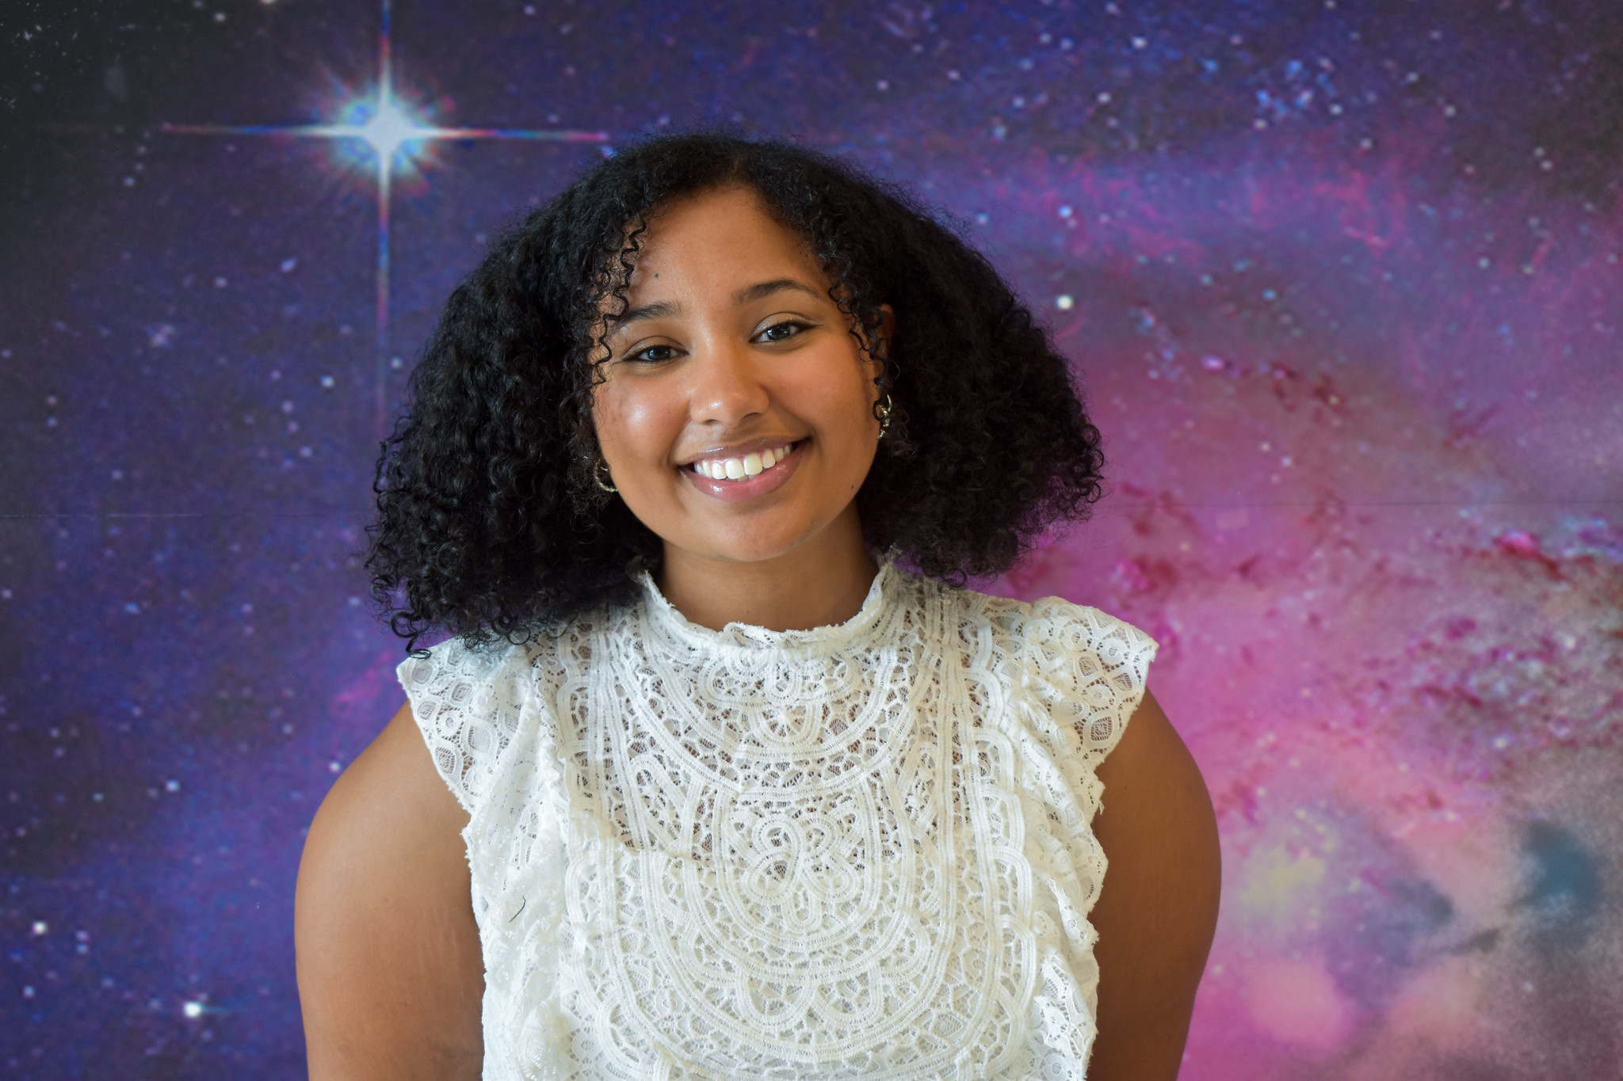
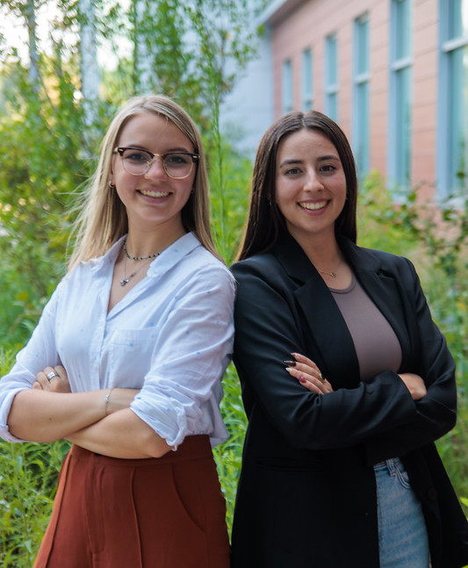
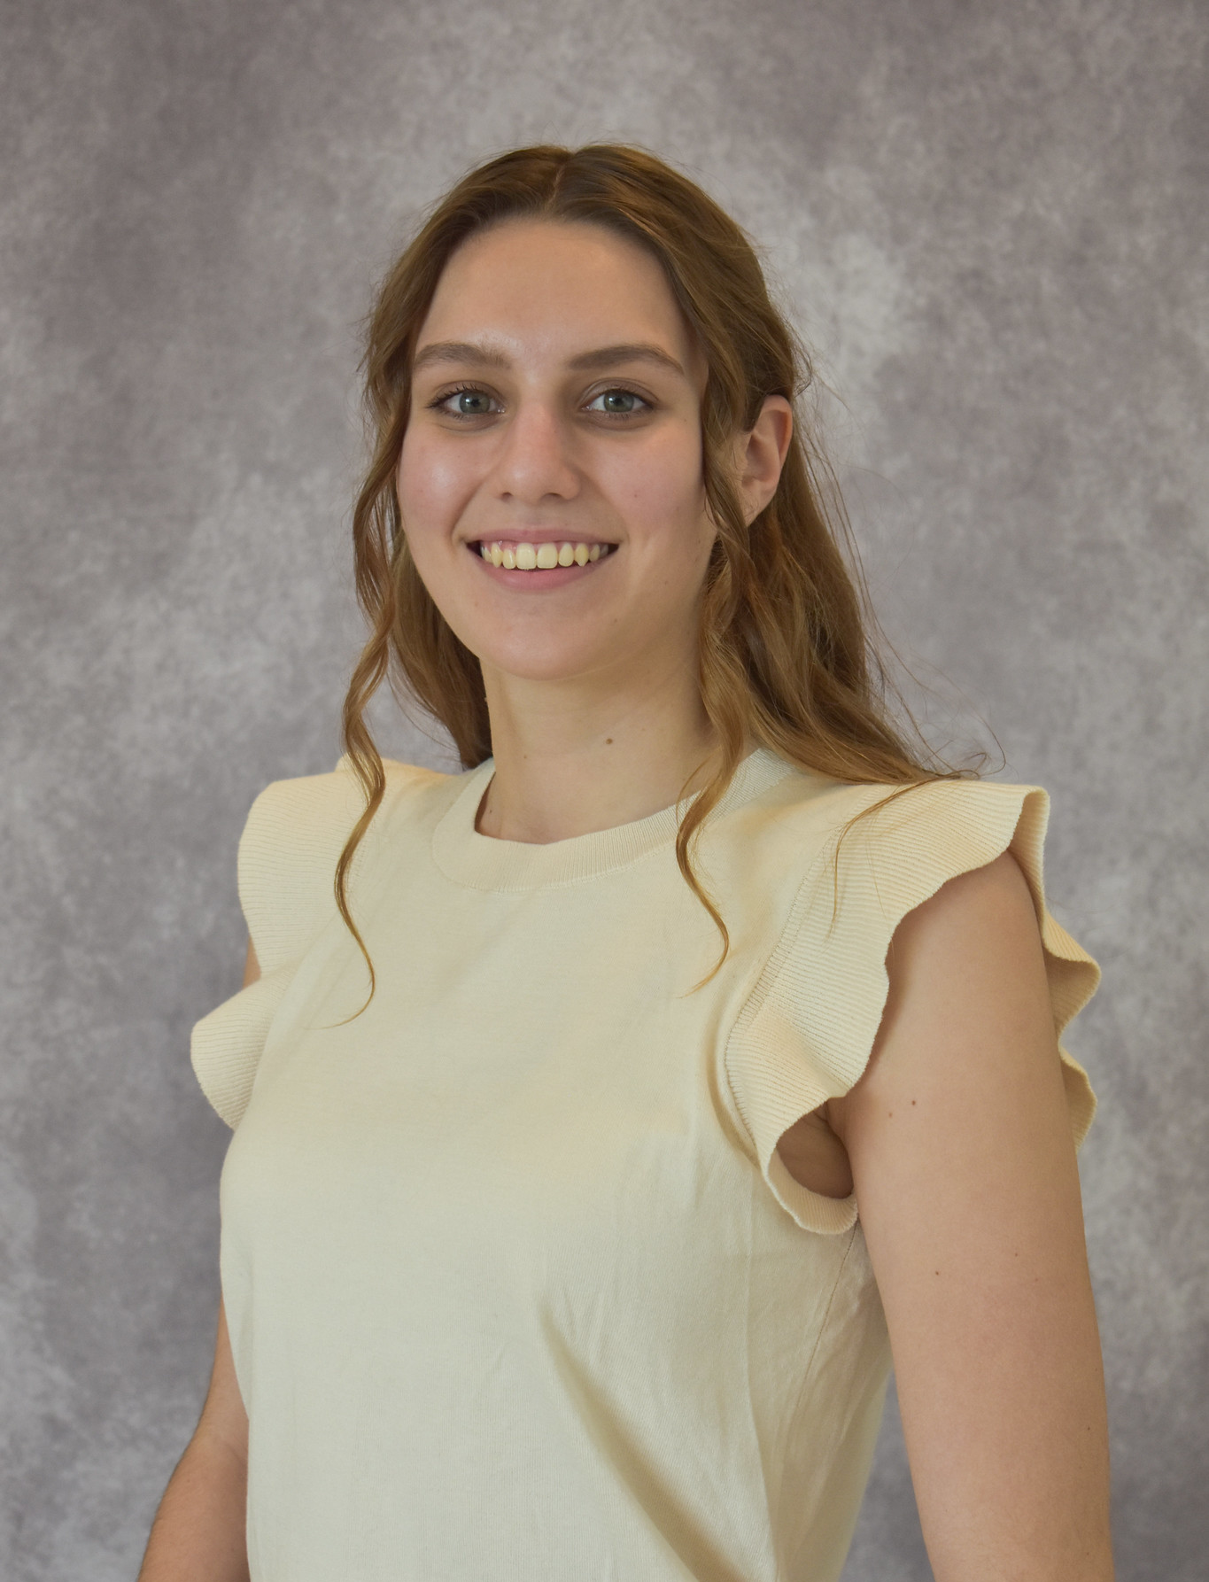
Lessons Learned from Headshot Workshops
Emily Beckman, Geneviève de Messières, Seth Abramczyk, Kristin Rutkowski, Scott Hull

Slide 2
The Basics

Slide 3
Composition
Headshots should include mid-chest and upward.
Body shots should include waist and up, or knees and up, occasionally full body.
You're welcome to take some of these, just make sure you capture a few more traditional headshots as well
Make it wider than needed because they can crop it later for their purposes.
Remove unnecessary headspace

Slide 4
Camera settings and lens choice
Mid to telephoto (50 mm to 150 mm) is best
Wide angle can produce distorted portraits.
Shutter speed should be 1/100 or faster.
Aperture should be f/3.5 or narrower (higher number) to avoid situations where their nose is blurry when eyes are in focus
Higher ISO is okay
Automatic focus. Subject/eye tracking, zone, or point AF are all acceptable.

Slide 5
Lighting and Color
Bounce flashes, bright indoor lights, and bright indirect natural light are all very helpful
In places with natural lighting in addition to our studio lights, keep an eye on how even the light is on the subject’s face.
For a while as the sun was setting through the atrium window, I had to turn off one light to balance it out.
Try getting them lit from all angles
Left, straight on, right
Be mindful of white balance, especially if there is both interior and natural lighting in play. Try using a gray card.

Slide 6
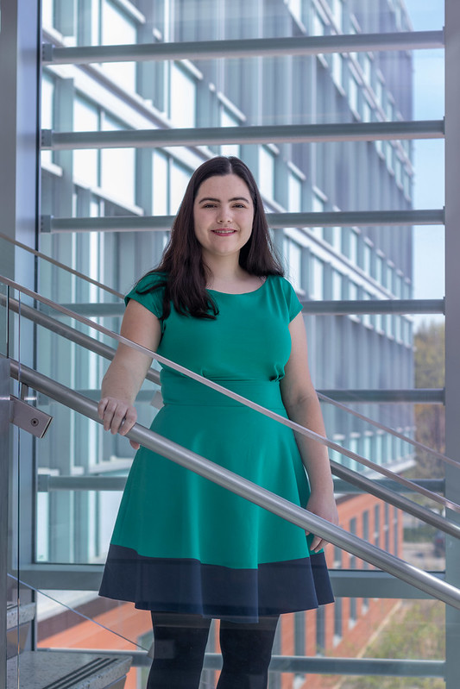
Watch out for Hot Spots
Bright spots can be a problem (eg on stairwell in B36), especially on face, torso, and hands. Near impossible to fix in post.
Don't hesitate to tell the subject to move to avoid them.
Stay alert, the light changes quickly.
Someone holding a big diffuser would be a big help there - could task the next subject in line to do this.
Hotspots
No Hotspots

Slide 7
Posing

Slide 8
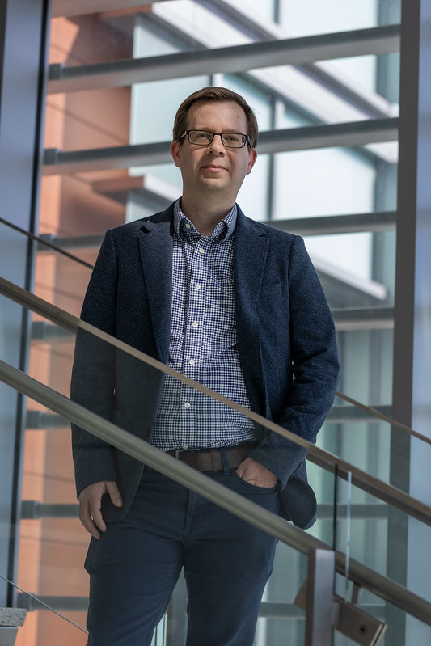
Getting Started
Remember that you are the leader of the portrait session! Subjects may feel nervous, and it helps to have a photographer show confidence and tell them how to stand. Psych yourself up to be the director.
Remove everything from pockets
Even something as small as chapstick can look weird when shadows outline it
Remove badge
Items in pockets cause problems

Slide 9
Basic Posing
Remind: “Lengthen your spine" or "sit up straight, shoulders back”
Makes the most difference in the resulting picture
Subjects welcome the reminder. They know they slouch
Make a joke about sounding like their grandma if it starts getting too awkward – this usually gets a good smile too
Keep an eye on head tilt
If they tilt, take a few photos that way, it can work
Then ask them to straighten it out – typically better for a professional photo
Invite them to try jacket on and off, glasses on and off

Slide 10
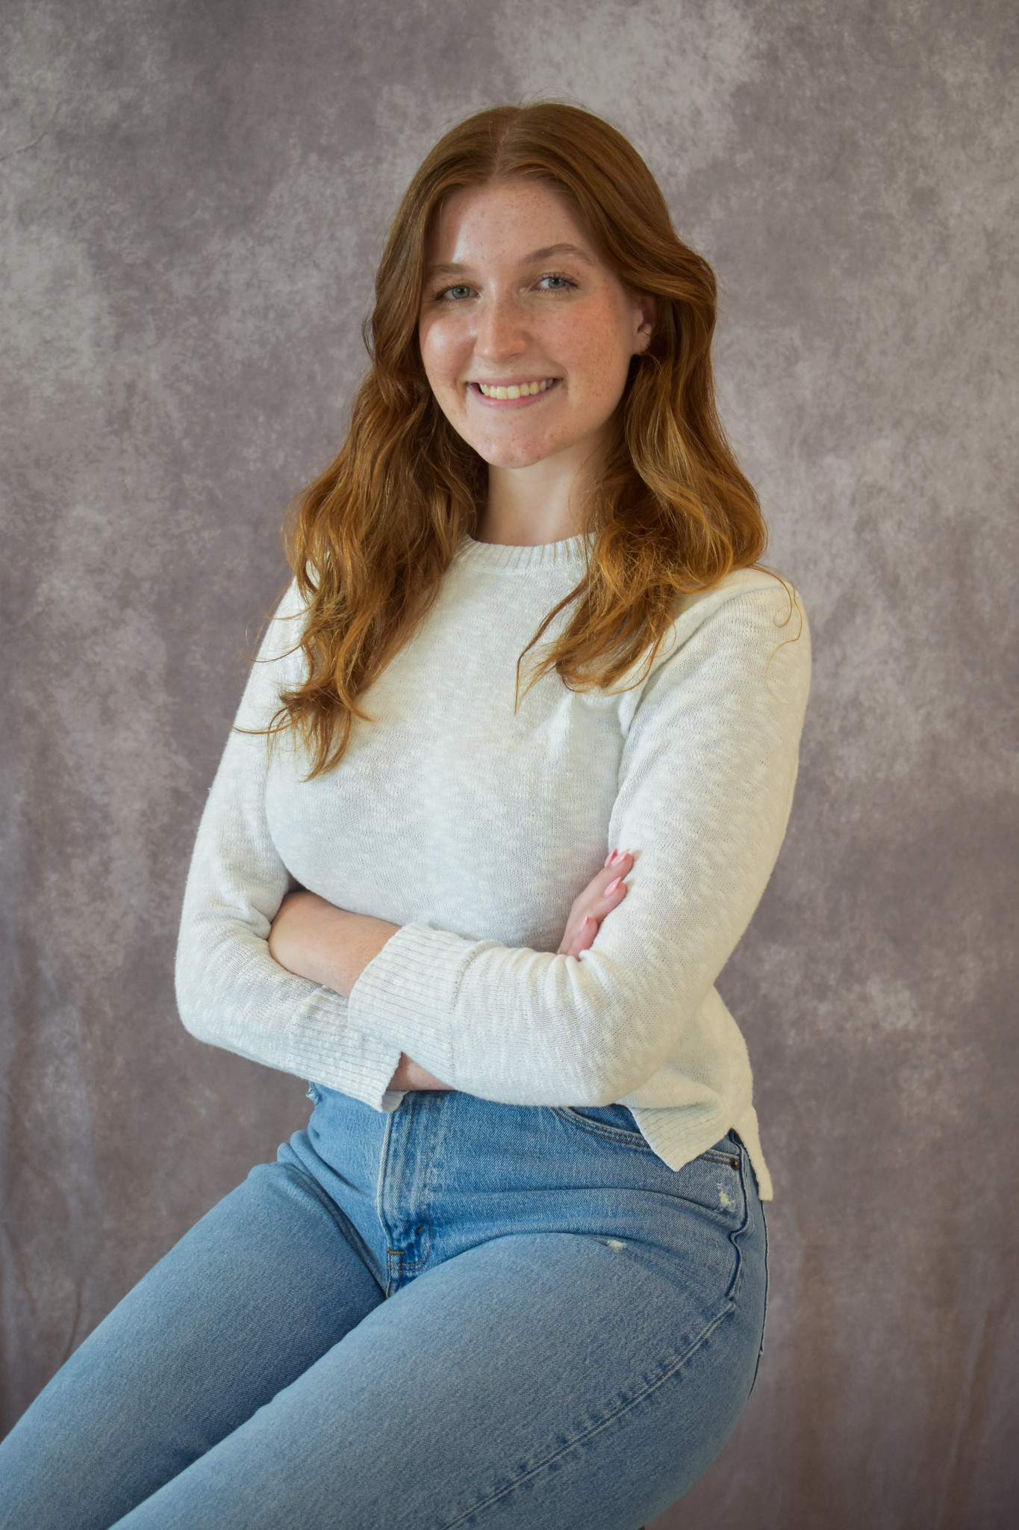
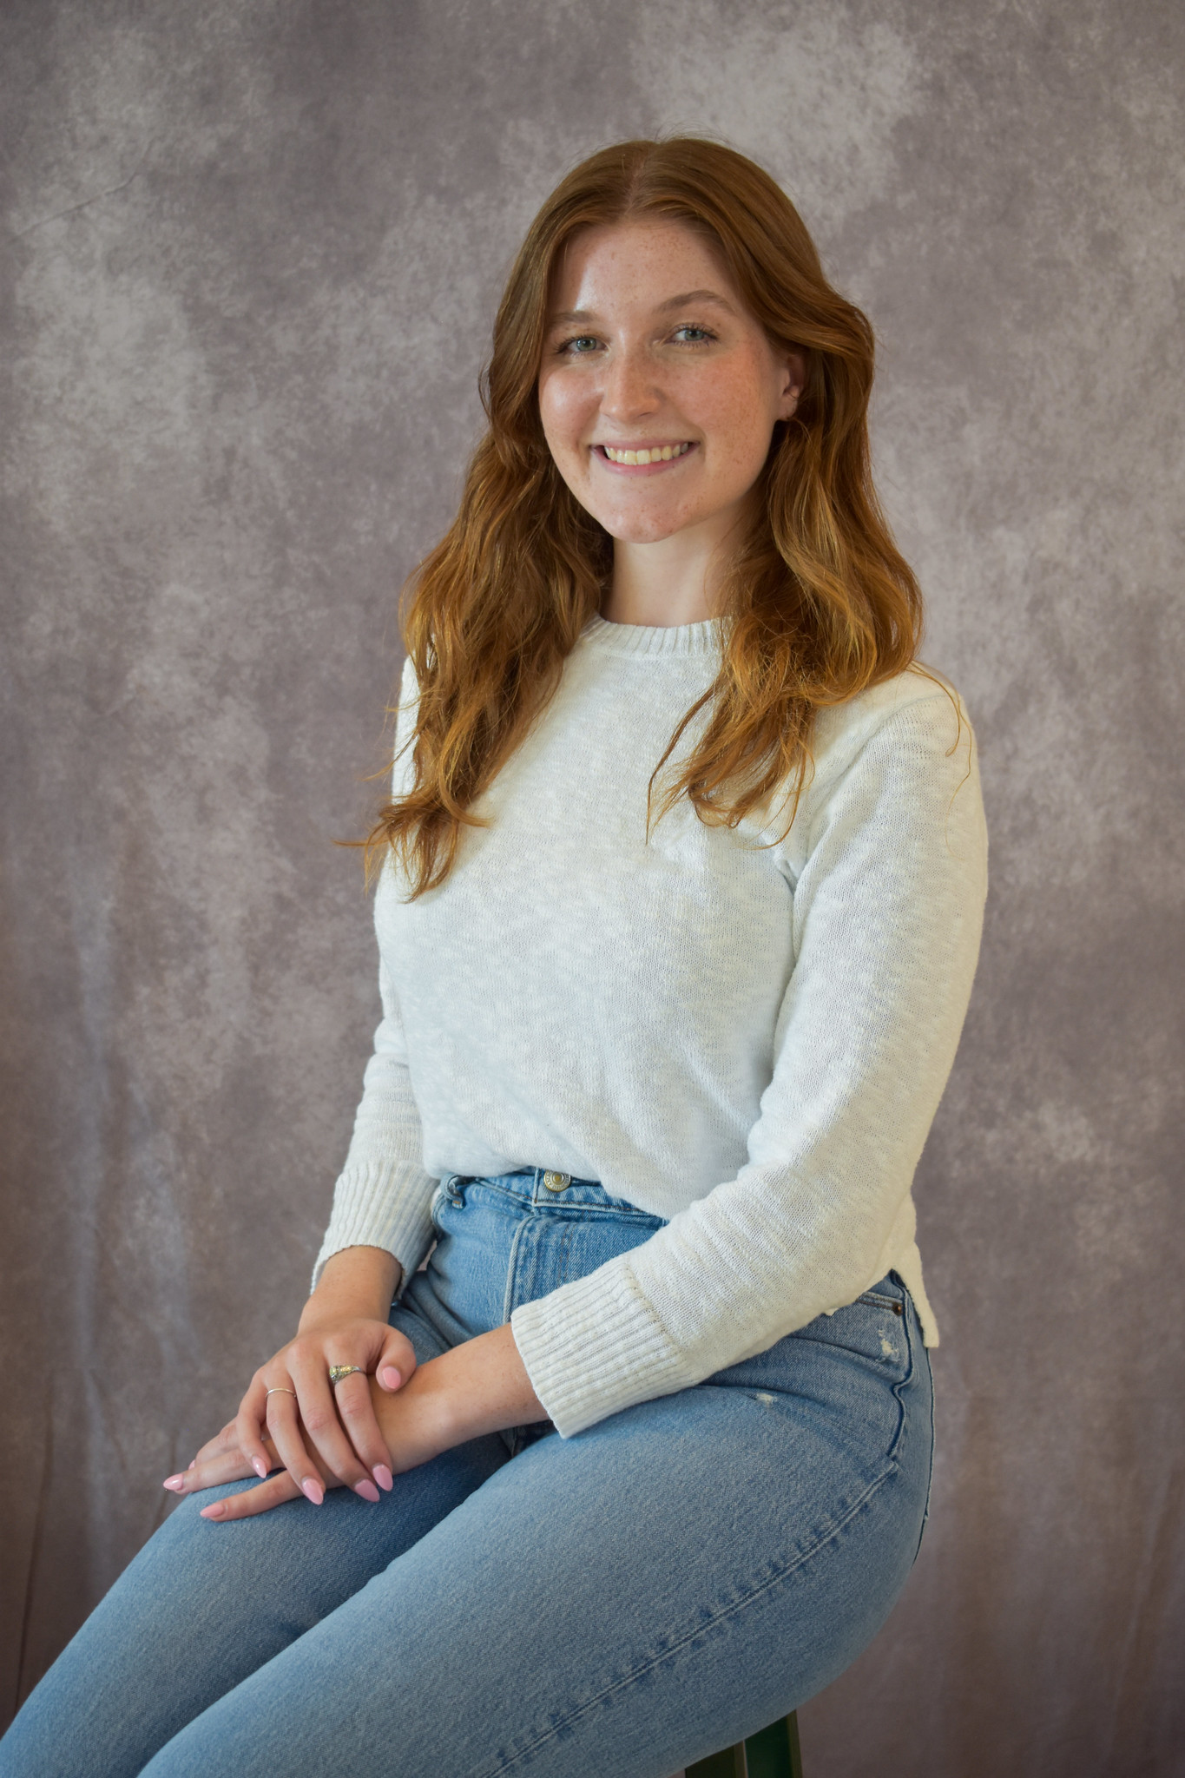
Basic Sitting
Turn slightly to the side
Hands
Both hands on one leg
Arms crossed

Slide 11
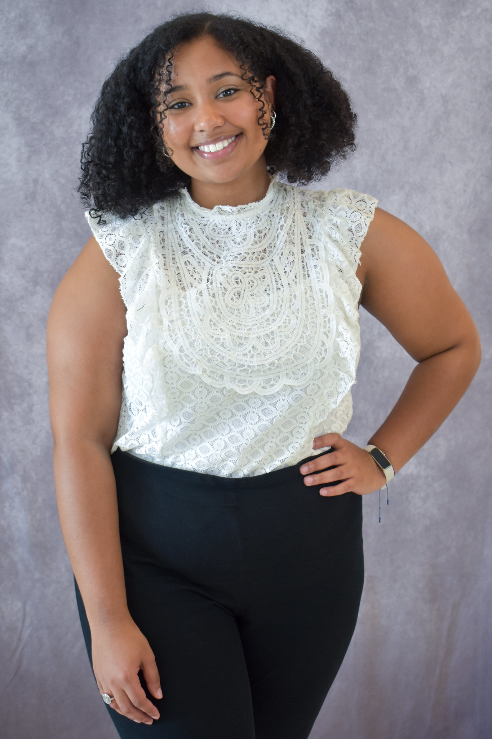
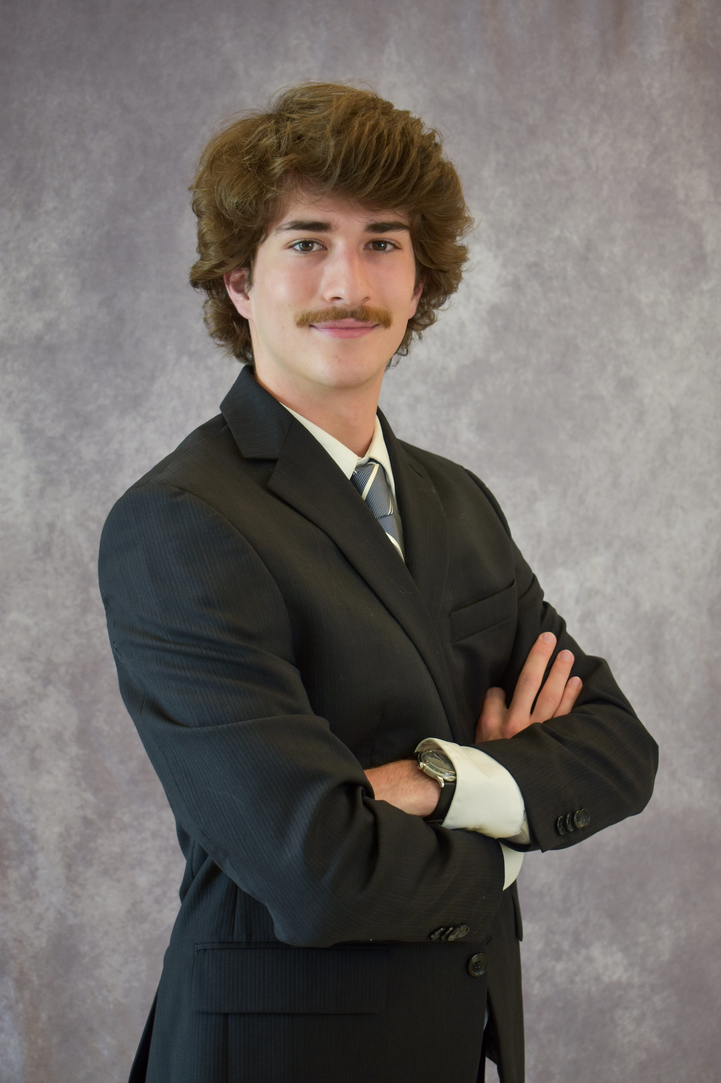
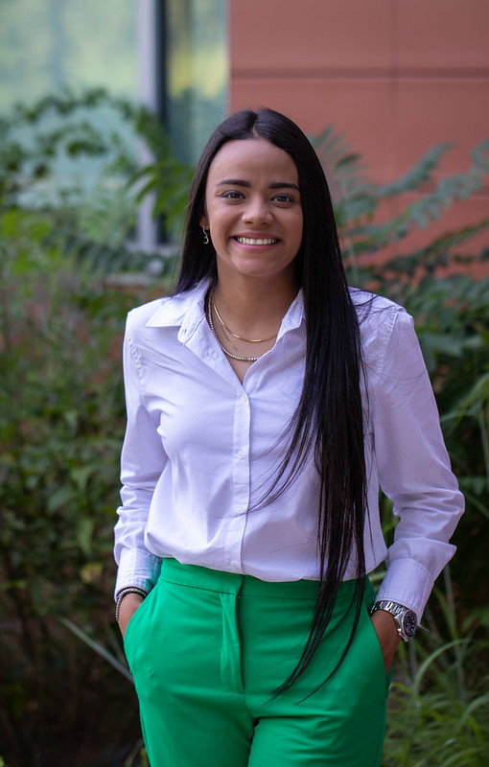
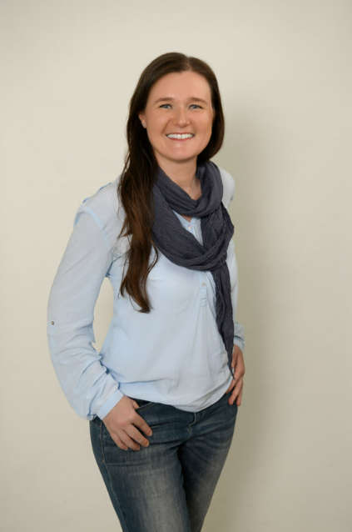
Free-Standing Poses
Shift weight to back leg, point front leg to camera
Arms crossed, hands on hips, thumbs in pockets, resting on leg, etc.

Slide 12
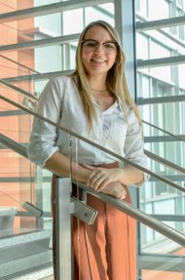
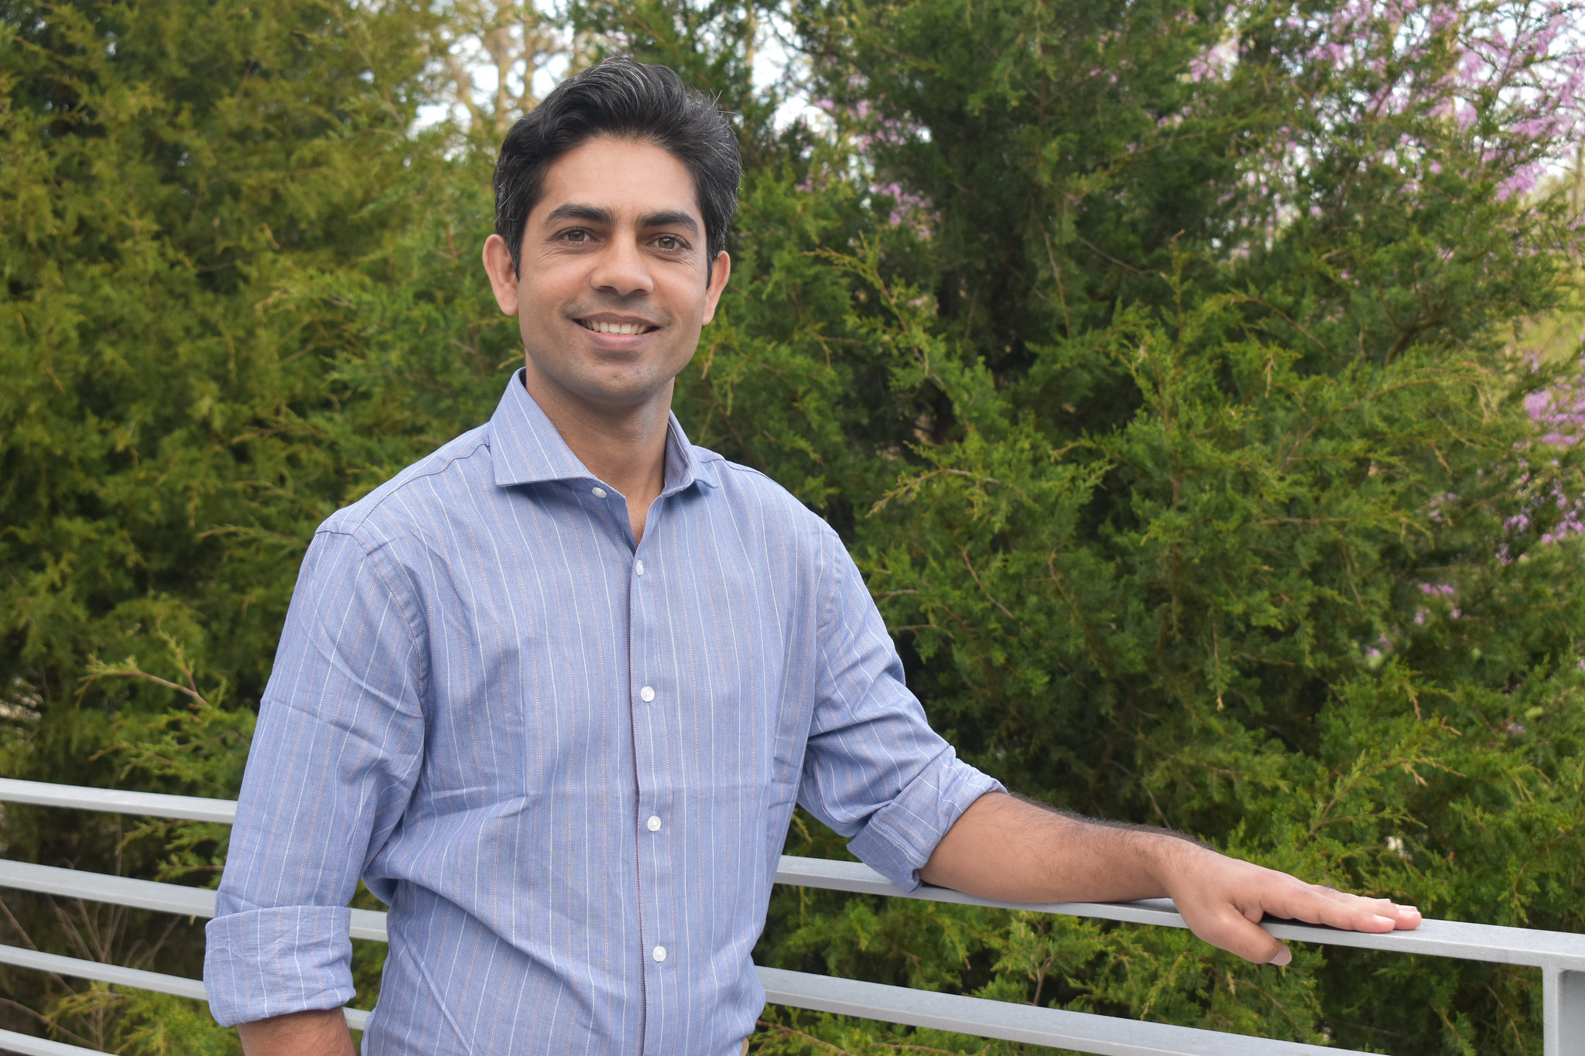
Leaning Poses
Leaning against a railing in front of them
May have to adjust for different heights
Leaning against a vertical post
Generally avoid leaning against a table or low wall

Slide 13
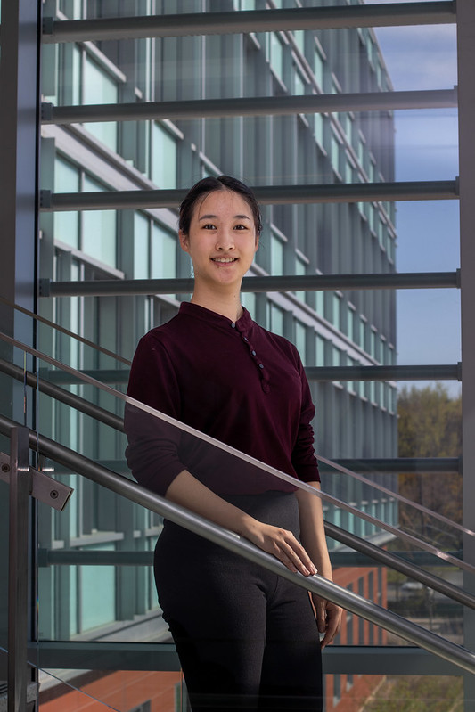
Lean In
Make a traditional headshot photo engaging by emphasizing the subject's upper body and face, by having them a bit closer to the lens
Having the subject closer to the camera achieves engagement better
This rule can be broken!
Closer rail -
Better
Further rail -
Less engaging

Slide 14
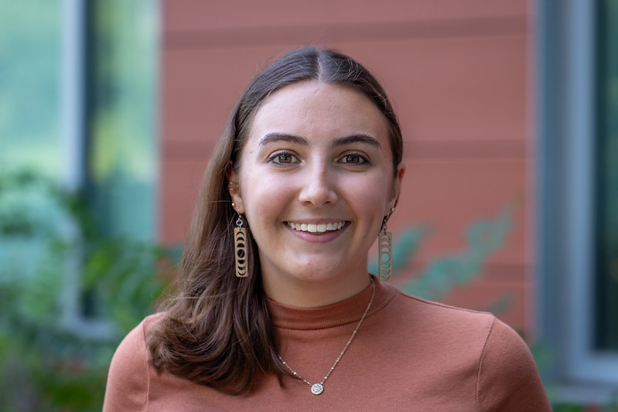
Try Multiple Hair Positions
It can make a big difference to have hair hanging down behind, in front on both sides, in front on one side, or with a few wisps in front
Give them the choice
Avoid flyaways in front of eyes

Slide 15
Common Problems and What to Do About It

Slide 16
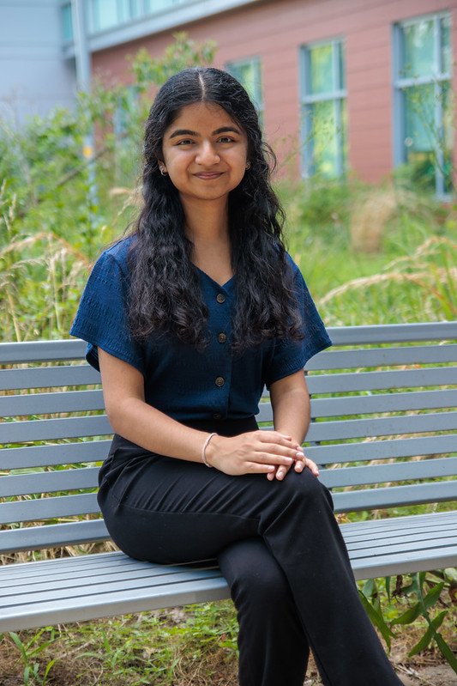
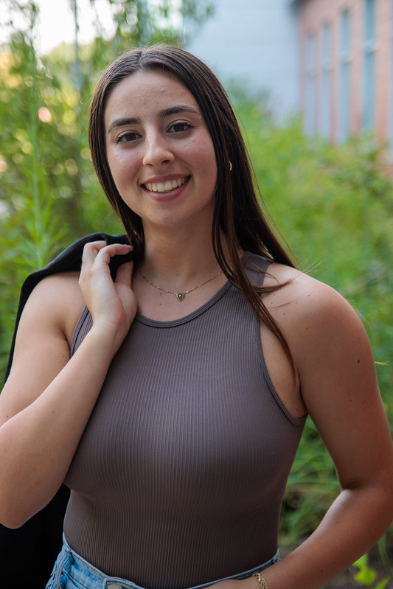
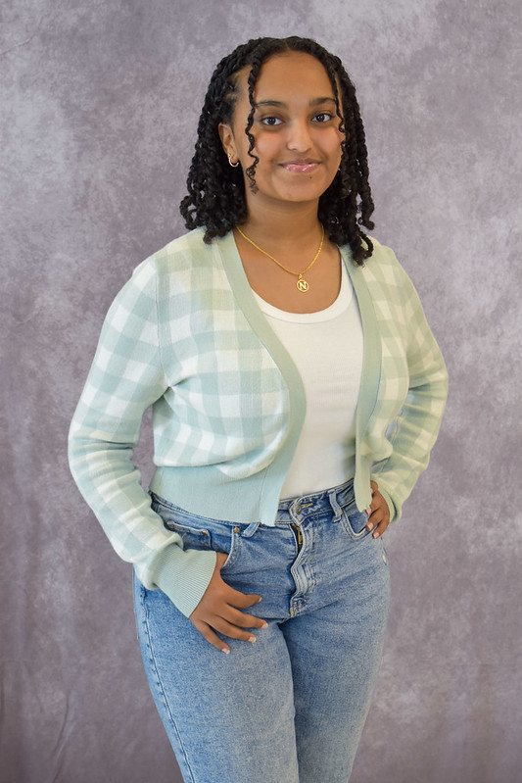
Keep Hands Busy and Relaxed
Seated on a stool, hands loose in lap
Standing, one hand in a pocket
Try hooking a thumb on the pocket or belt loop, or putting the hand only slightly in the pocket
Don't put weight on the pocket
Holding onto their lapels or a coat
Loosely resting hands on a railing
Standing, one hand on hip
Standing, two hands on hips, angled body

Slide 17
Refusal to Smile
No Smile
Smile
Ask for them to show teeth if just "smile" doesn't work
If you can manage to get one picture with teeth, you can show them that picture to prove that it looks good
I do try to pay attention to whether a non-smiler has braces. In that case, I tried to get one or two with teeth, but didn't push it as much

Slide 18
Tense/Hunched
Tense
Relaxed
The shoulders back reminder usually helps here as well
Remind them that they can take up space
Ask them to close their eyes and relax their body, and then come back to a “shoulders back” pose
A drifting arm could be pinned next to their body and causing it – a thumb in a pocket, hand on hip, etc. could fix it

Slide 19
Cheesy Smile
First Pictures
“Chin Down”
I do find this one more challenging because I don't want to insult their smile
Sometimes asking them to bring their chin down just slightly helps a lot
If still struggling, say something along the lines of "you look tense," or "you look a bit nervous." Ask them to fully relax their face, maybe even close their eyes for a second, and then go back to smiling

Slide 20
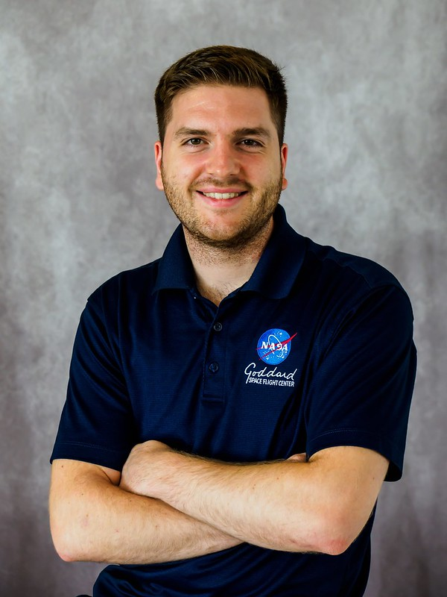
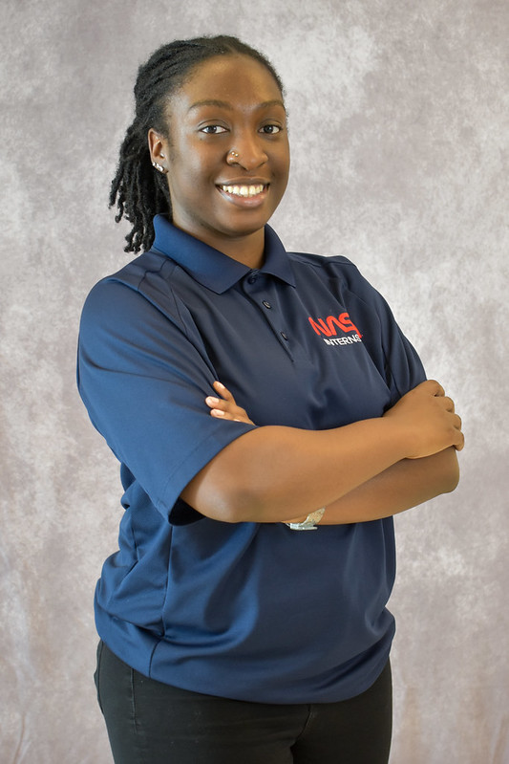
Crossed Arms
Often makes for a great photo
Ask them to lengthen spine (put shoulders back), keep hands visible and relaxed rather than tucked or clenched
Hands Tucked In:
Defensive body language
Hands Visible, Relaxed:
Confident body
language

Slide 21
Other Suggestions

Slide 22
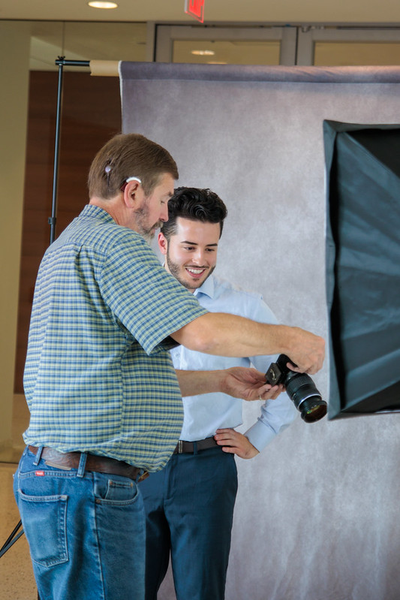
Involve Them
Show them their first photos, ask what they like.
Make a mental or actual note of what they liked.

Slide 23
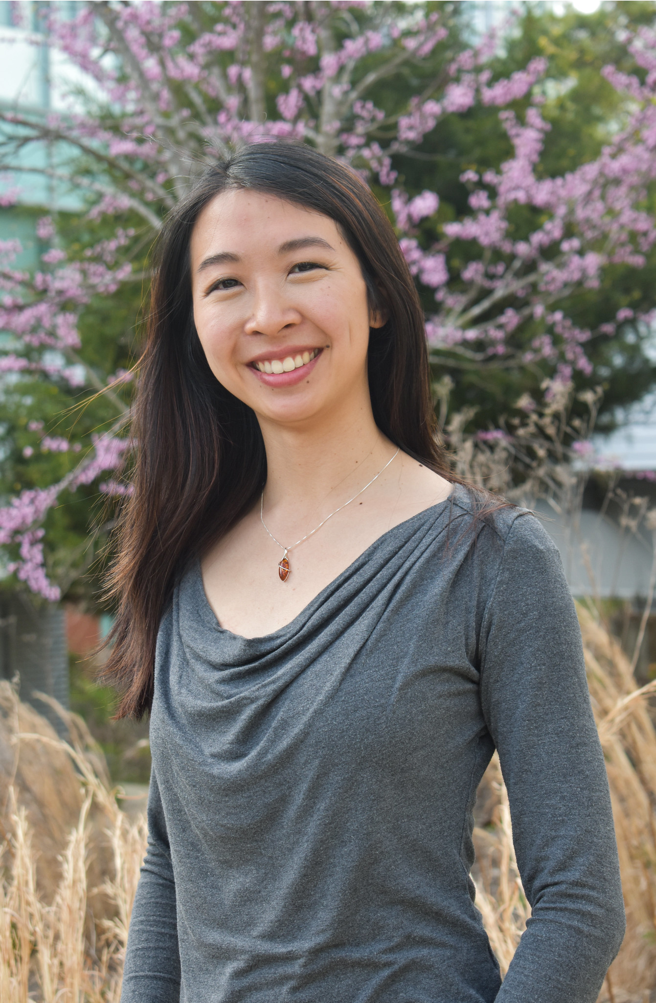
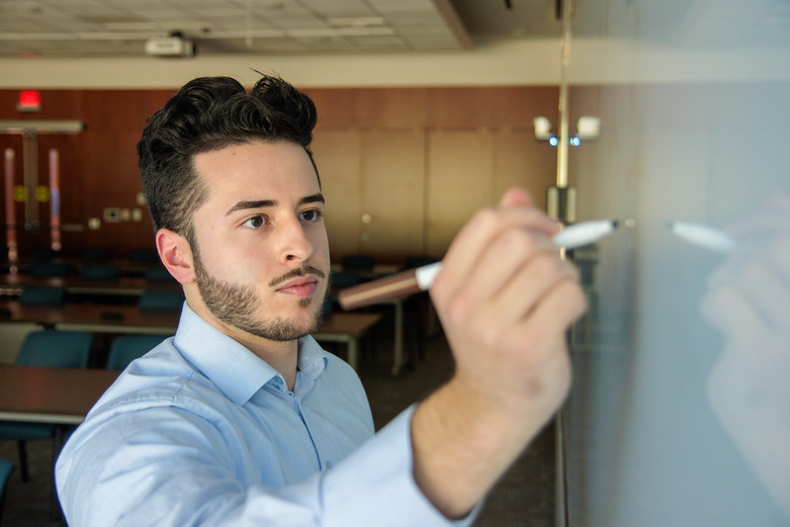
Have Fun!
Try their ideas for a different kind of photo
Make use of fun spaces around our “official” stations

Slide 24
Editing

Slide 25
Editing
Expect this to take several hours.
Practice with our practice session photos to get an idea of your flow
We usually try to deliver within about 2-3 weeks
Start with identifying the 2 – 6 best photos per subject – there is no need to edit every photo.
Use batch edit where possible to speed things up
I usually batch edit several sets of subjects (under similar lighting) and then go back and tweak each one as needed

Slide 26
Editing
Keep an eye on white balance, especially if there was a mix of interior and natural light.
Take advantage of streamlining effort. Try "Auto" - that may be the only edit you need. In Lightroom, you can edit one photo (using AI Adaptive Preset tools that automatically identify the subject and apply a "polished" or "professional" filter) to your liking, and then select all photos that were in similar conditions and select Sync to apply the same edits.

Slide 27
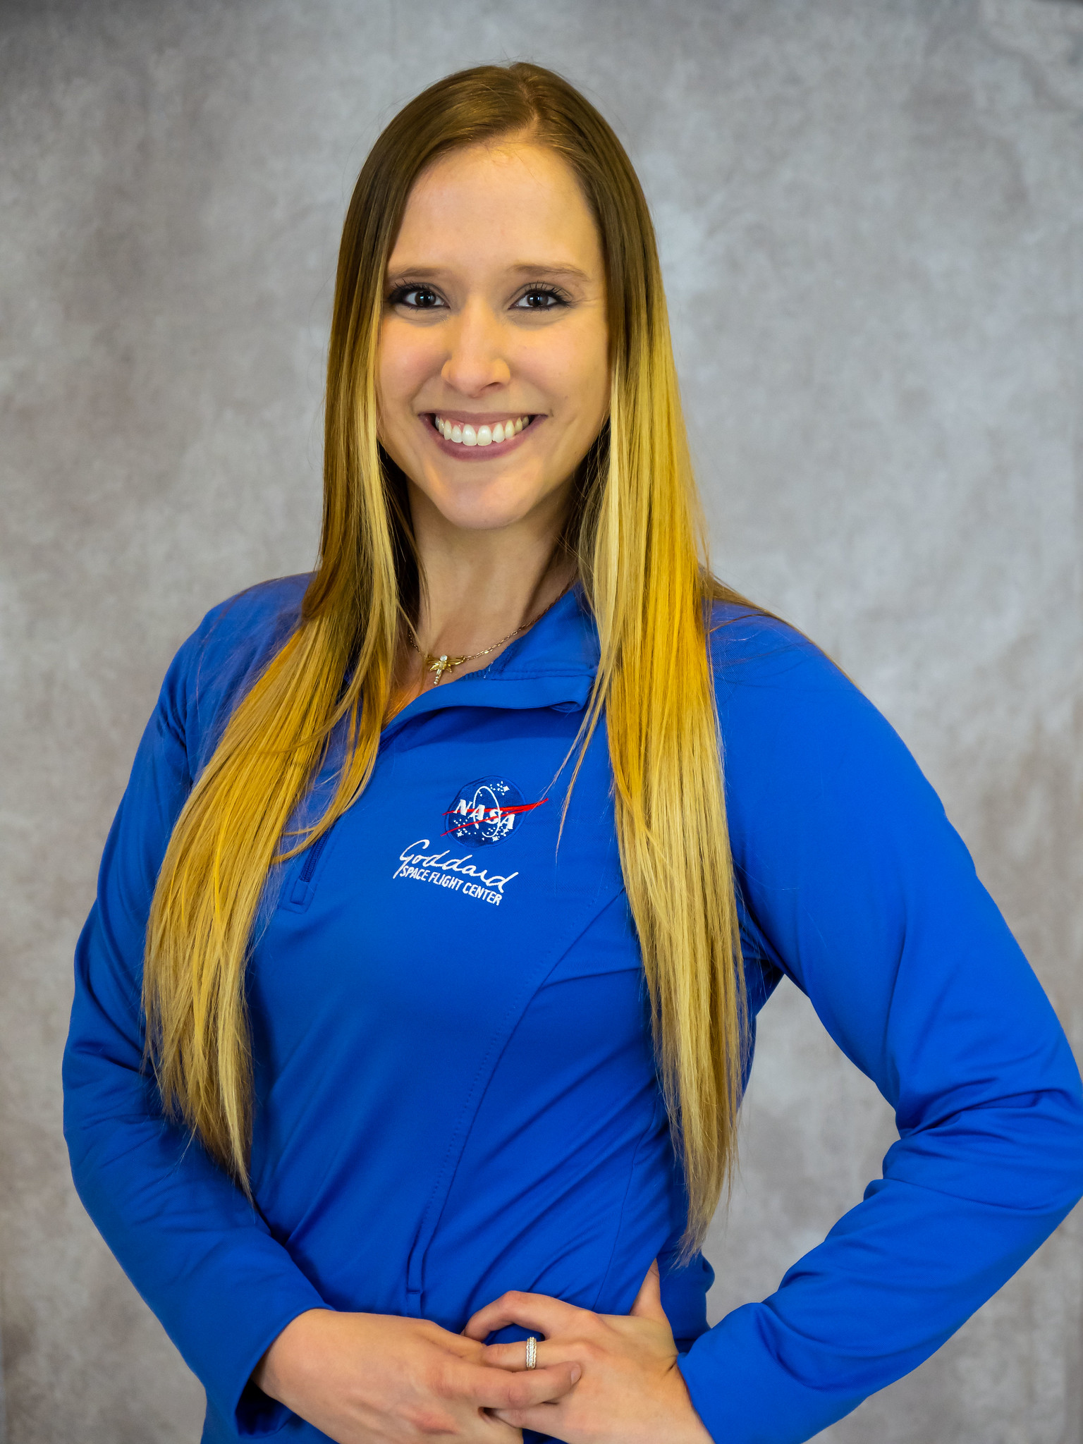
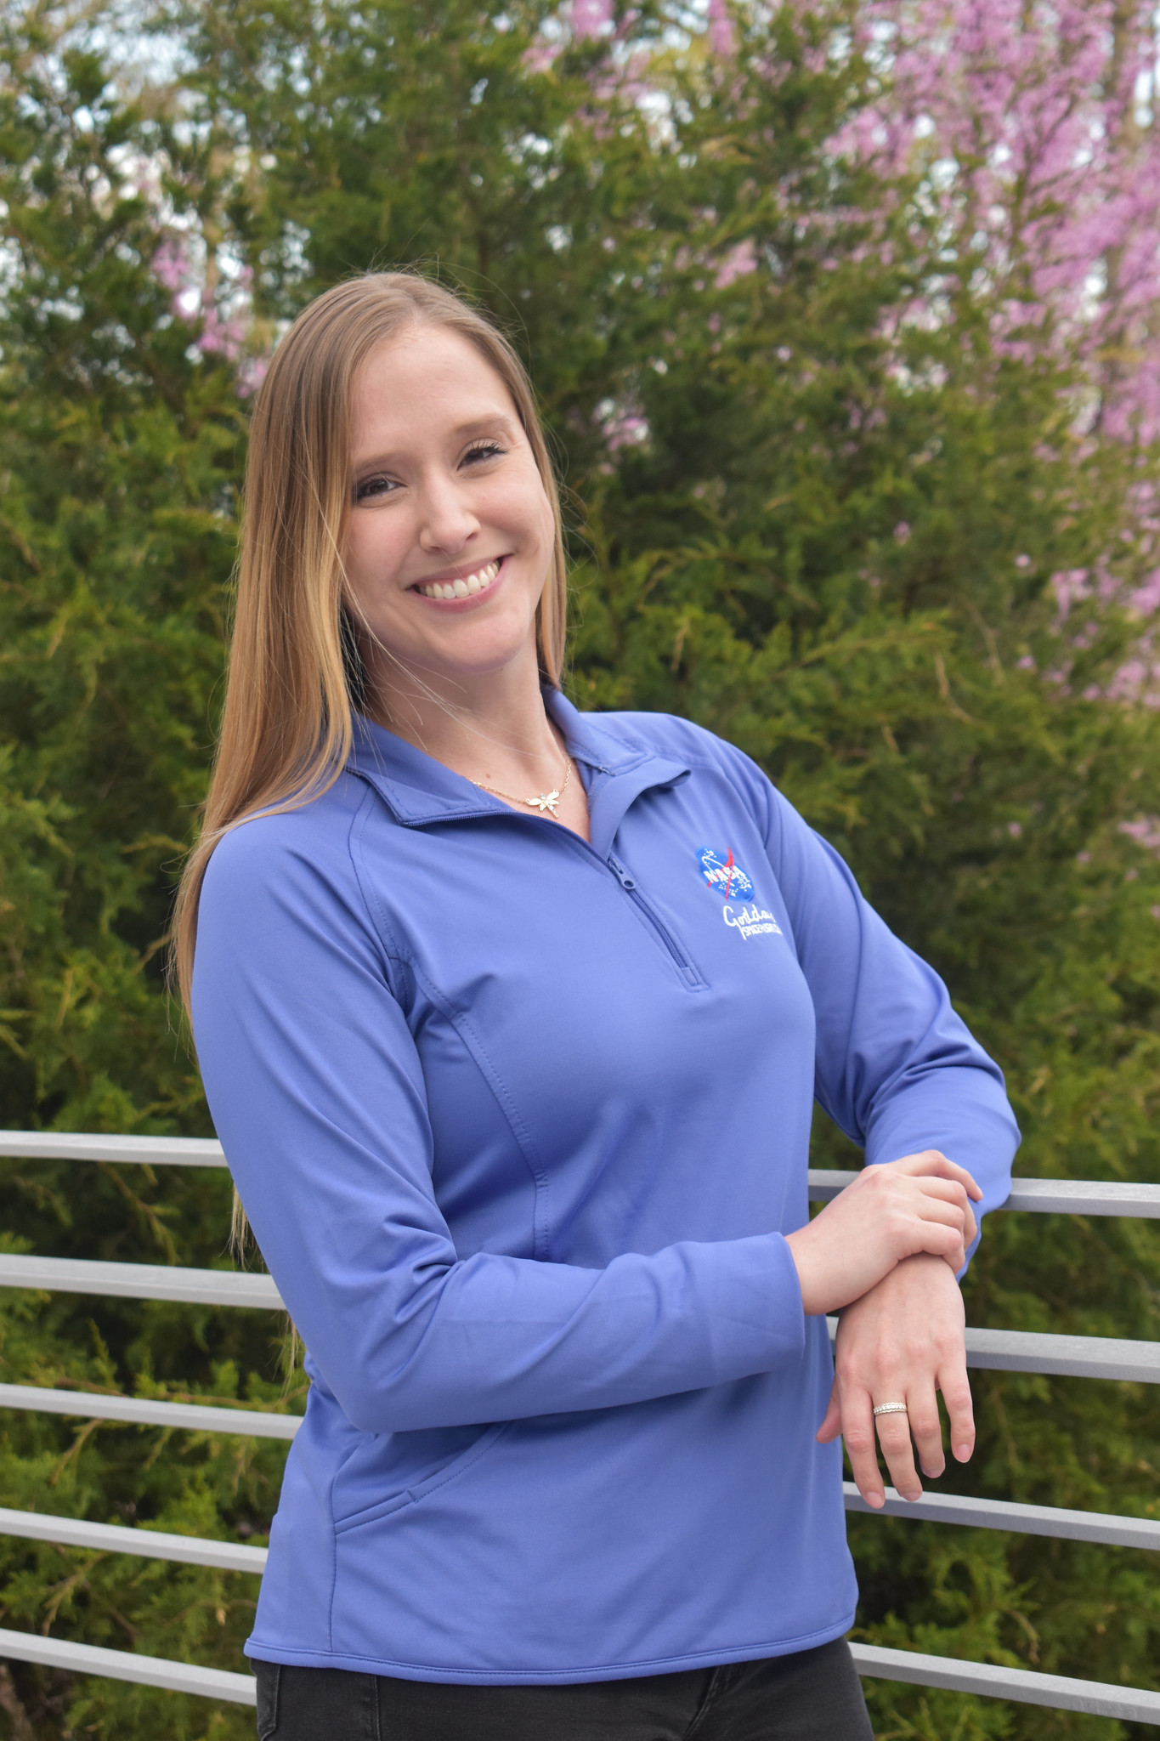
Variation by Editor (and Lighting) is Normal
Scott Hull
Seth Abramczyk
Emily Beckman

Slide 28
How to Be the Organizer

Slide 29
Rotating Stations
Pros
Cons
Subjects have a large range of preferences. Giving them a variety will keep everyone happier
Less pressure on the photographer, especially beginners – if your pictures don’t turn out, hopefully someone else’s did
Subject might wear clothes that just don’t work with a background (for example white on white or black on black)
Sometimes a subject and a photographer just don’t jive super well together, but they might do better in a different pair
Subjects get more photos
A bit more chaotic
May not be able to fit as many subjects into a time frame
Subject may spend less time at each station

Slide 30
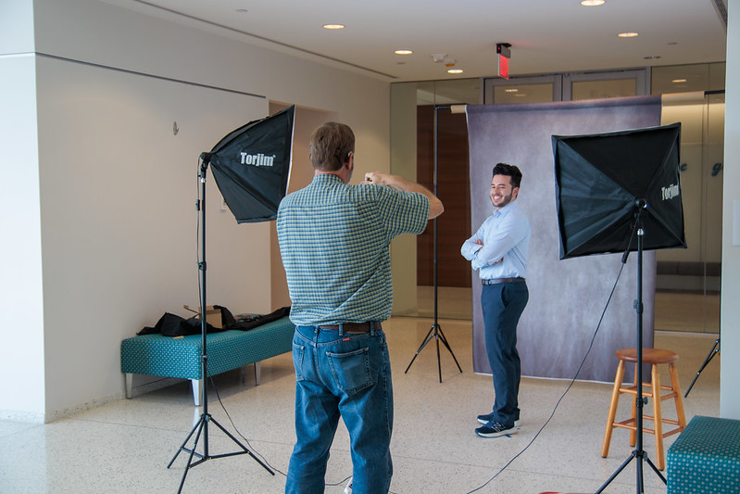
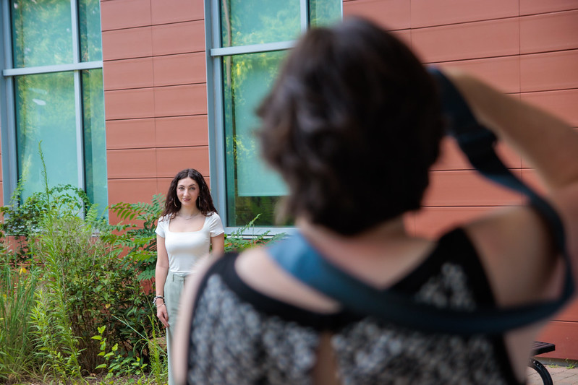
Location
Building 36 Atrium
Plenty of space to set up backdrops, outside area, stairs
This is where we've had all sessions so far
Other Ideas
Library
Visitor center rocket garden (on an overcast day)
B34 hallway with big astrophysics images. (Might be difficult to step back far enough for a good shot.)
On a hot day, don't have them wait outside
They will get flushed and sweaty. Have them wait indoors.

Slide 31
Setup
Takes about 45 minutes to be comfortably set up by the time the early arrivers get there
Take a couple of pictures of each other before people arrive to test out the light, start feeling comfortable again, get positioning right, etc.
Put up signs for each station number to help people figure out where to go
Each station should have a basket or table where subjects can put their badge and the contents of their pockets

Slide 32
Other Logistics
Recruiting, working with intern coordinator, and filling slots can take considerable time.
Put an announcement in GSFC Dateline several weeks ahead and the week ahead.
Consider asking NGAPS+ if there aren't enough interns.
Mid career folks also need headshots!
Ask them to wear solid color clothing rather than busy patterns
It's best if there is a dedicated coordinator from the photo club. They can help orient arriving subjects, check in on the photographers, resolve issues. A second floating photograph who acts a helper to the coordinator can step in as needed (ie if a photographer is falling behind or needs a break). These roles can also take BTS photos, which are very valuable.
We’ve done signups using google sheets which has worked well (lets people sign up for a time slot easily)
Ask people to sign up with their email address – it’ll make it a lot easier for you to send out the “how to access your photos” email later
Practice session
Very important especially if there are any new participants or if it’s been a while since our last workshop
Have a sign-in sheet for them to use before going to stations (also good to have some snacks nearby)

