Slide 1
Color Profiles
Color profiles in photography
Bob Peters, GSFC Photo Club

Slide 2
What defines color?
Saturation, hue, brightness, or 3 colors, most cameras use Super RGB (higher saturation than RGB), amount of red, green, blue
Does the camera sensor accurately record color
Does the monitor accurately display color recorded by the camera
Does the printer/projector accurately reproduce the color of the monitor
Reproducing color print especially iffy because different papers will produce different colors from the same printer and same ink.

Slide 3
What is an ICC Profile?
“In color management, an ICC profile is a set of data that characterizes a color input or output device, or a color space, according to standards promulgated by the International Color Consortium (ICC). Profiles describe the color attributes of a particular device or viewing requirement by defining a mapping between the device source or target color space and a profile connection space (PCS)…. Mappings may be specified using tables, to which interpolation is applied, or through a series of parameters for transformations.”

Slide 4
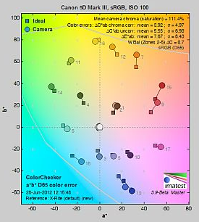
Deviations from Real color

Slide 5
The Flow
Does the camera sensor accurately record color -> Does the monitor accurately display color recorded by the camera -> does the printer/projector accurately reproduce the color of the monitor
Scene Camera Monitor Print
This talk
Color Monkey

Slide 6
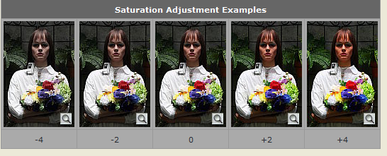
You don’t always want accurate color
Most people prefer more saturated colors that accurate colors
People almost always want warmer face tones, even experienced photographers do not judge color accurately

Slide 7
Printer Profiles
Either printer software or photo editing software (Photoshop) can be used to profile printer
Profiles are paper specific, type and brand
Paper profiles supplied by printer are specific to printer manufacturers paper, 3rd party paper suppliers supply profiles for common printers
Printer profiles are easier to use, fewer profiles
Can make custom profiles with appropriate software/hardware

Slide 8
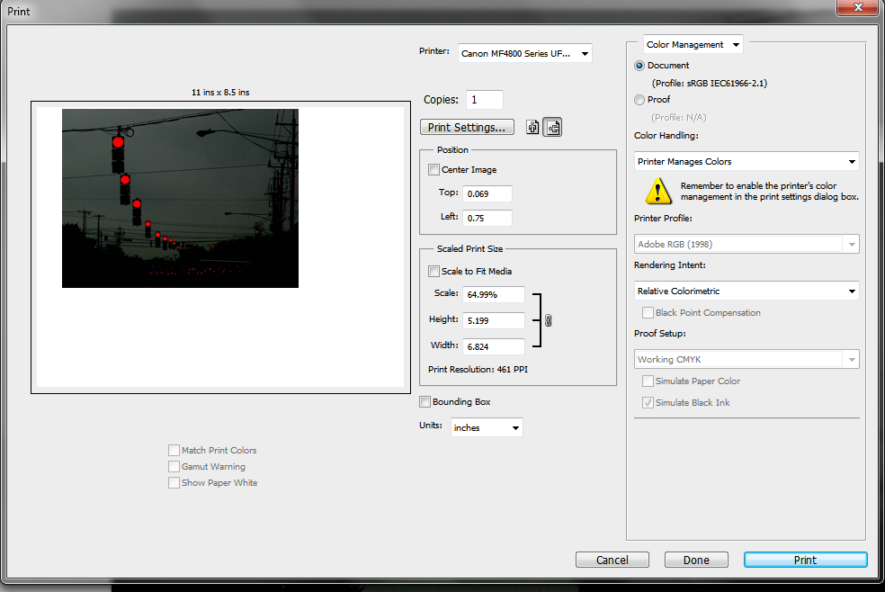
Printer Software Manages Color

Slide 9
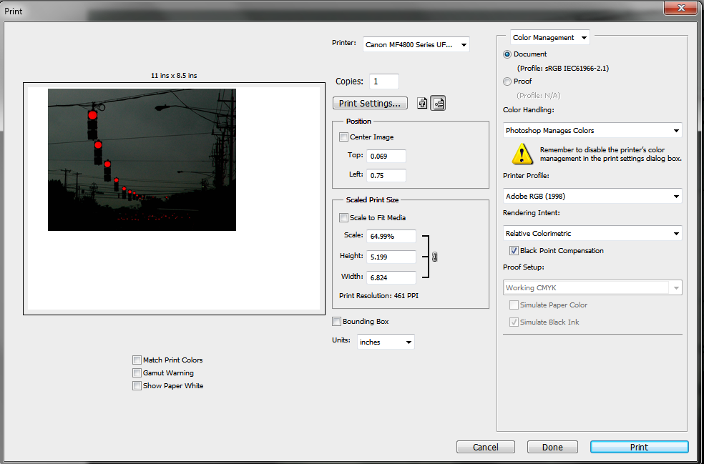
PhotoShop manages color

Slide 10
Double Profiles
If Photoshop manages color, Printer software must be set to “no color correction” or similar
If printer software is color correction, PhotoShop must be set to “Printer Manages color”
Never, ever have both printer and Photoshop manage colors!!!!!!

Slide 11
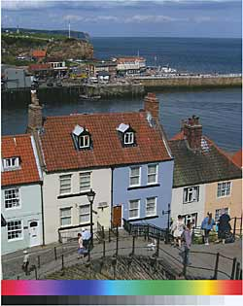
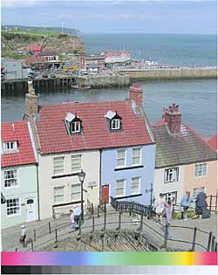
Double Profiling
Double profile

