Slide 1
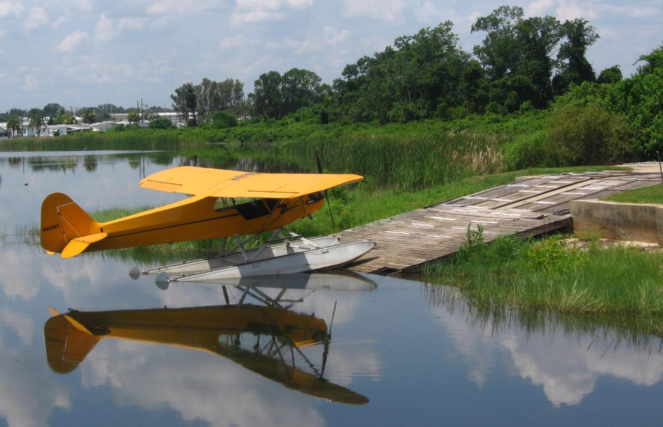
Aviation Photography 101
Peter Knudtson
402-680-5409 | peter.knudtson@gmail.com | Code 597
Notes:
Peter Knudtson
Thank you for time to share photos of aircraft and talk about photographing aircraft
Work for Cd597 in Propulsion. Currently bldg EC in B11
Private pilot
Most phots from time flying and attending fly-ins
Most photos general aviation that are accessible

Slide 2
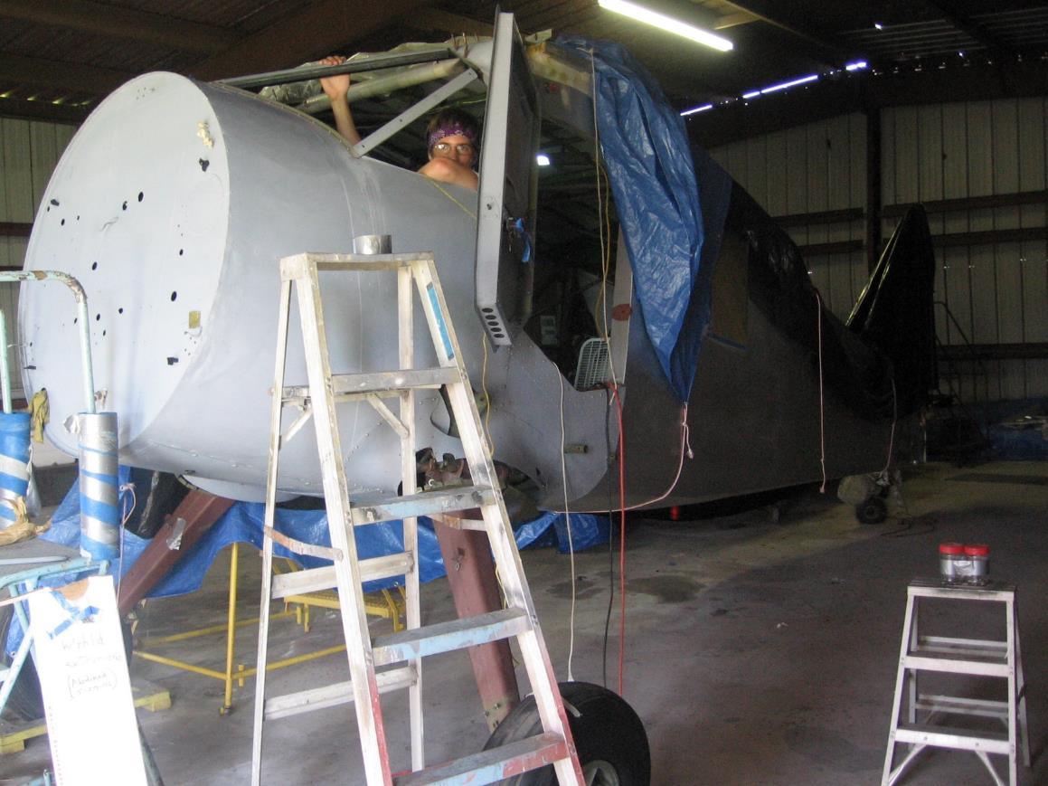
Contents
Where are the Aircraft?
What are our Subjects?
How are we Getting the Shot?
Special Topics
Propellers
Leading the Aircraft
Aerobatics
Time and Atmosphere
Unique and Unusual
Safety First!
Local Opportunities
Resources
Notes:
Talk a little about approach and equipment in each these sections

Slide 3
Where are the Aircraft?
Notes:
- Where are a couple places you might expect to see airplanes?

Slide 4
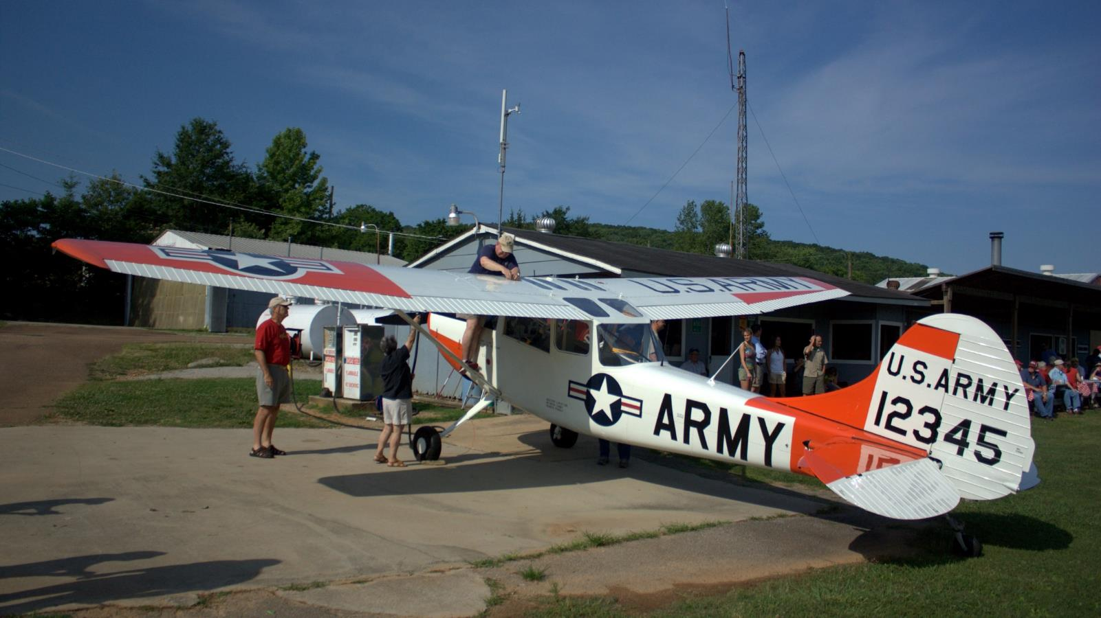
Where are the Aircraft?
At the Airport
Notes:
The obvious location
Commercial airports little more shy about loitering; lookup rules before hand
Small municipal and private airports with sport aviation clubs often have fundraiser events
Good opportunity to meet local pilots and talk about aircraft and aviation; maybe get some good shots or a ride
Dynamic environment
More people

Slide 5
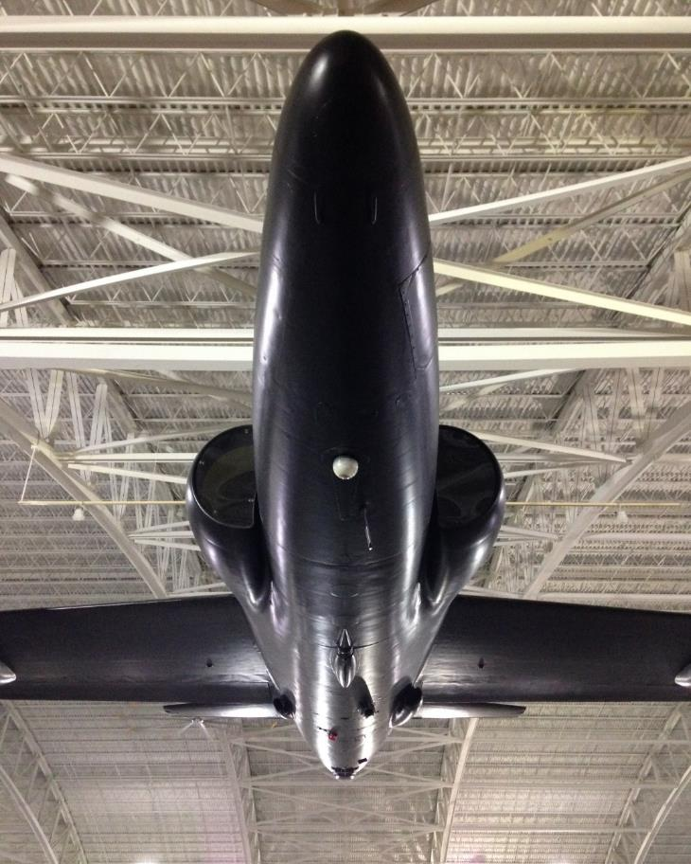
Where are the Aircraft?
At the Museum
Notes:
Great place to see military, vintage, and rare aircraft
Controlled, static environment allows trying different angles
Also includes displays like “Gate Guards”
Static environment
More details

Slide 6
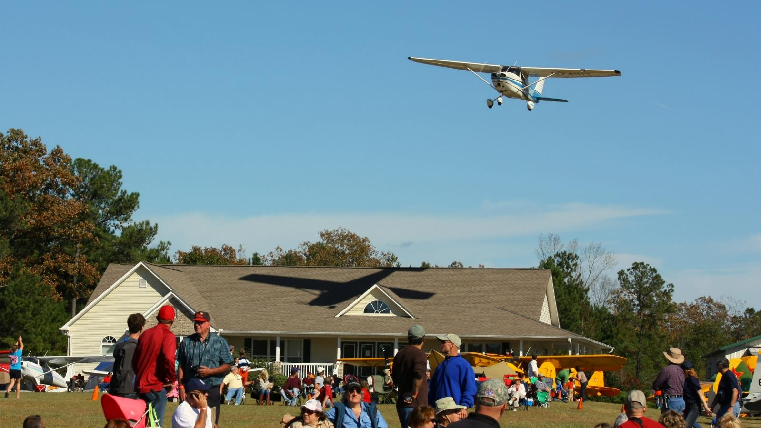
Where are the Aircraft?
In the Wild
Notes:
Most aircraft will be flying at high altitudes; hard to photograph
Aerobatics; takeoff and landing good places to find aircraft flying
Aircraft at work also option: helicopters inspecting powerlines, cropdusters, med flights, etc
Dynamic environment: be conscious of using Live View and overly bright backgrounds
More planes

Slide 7
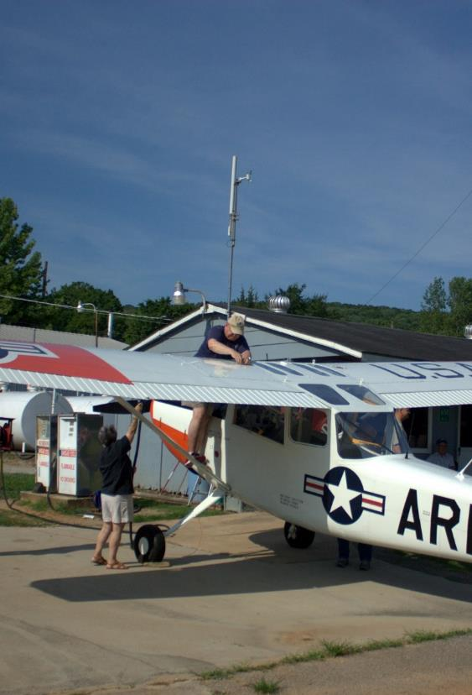
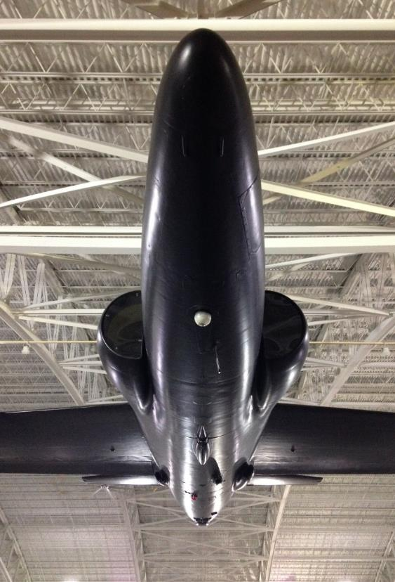
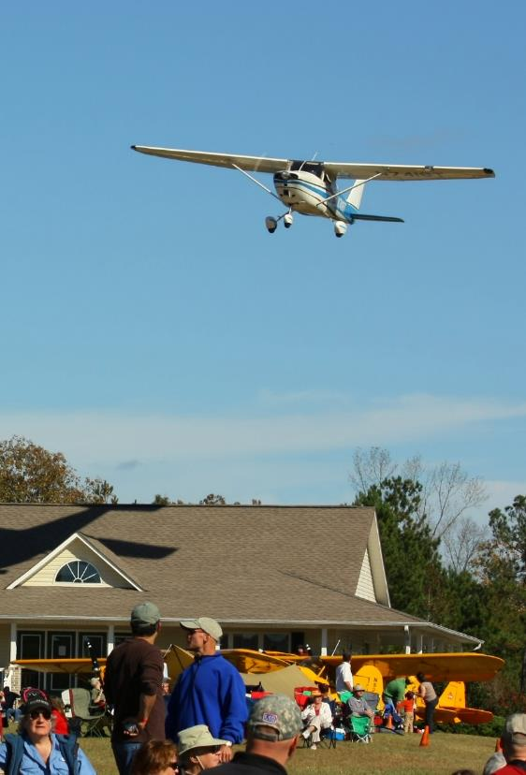
Where are the Aircraft?
At the Airport
At the Museum
In the Wild
Notes:
Airport:
More people interaction
Approach is going to be similar to landscape and street photography with a little portrait work
Good 50mm prime and a zooming telephoto
Image stabilization helps
Museums:
More details
Landscape; maybe some macro and portrait
May not have a lot of space; wide angles helpful
Tripod immensely useful if allowed
Wild:
More planes on their own
Like wildlife photography
If shooting planes up at high altitude, will need telescope or similar
Telephoto and zoom telephoto
Tripod indispensable

Slide 8
What are our Subjects
Notes:
What do we want to photography? I’ve already tipped my hand…

Slide 9
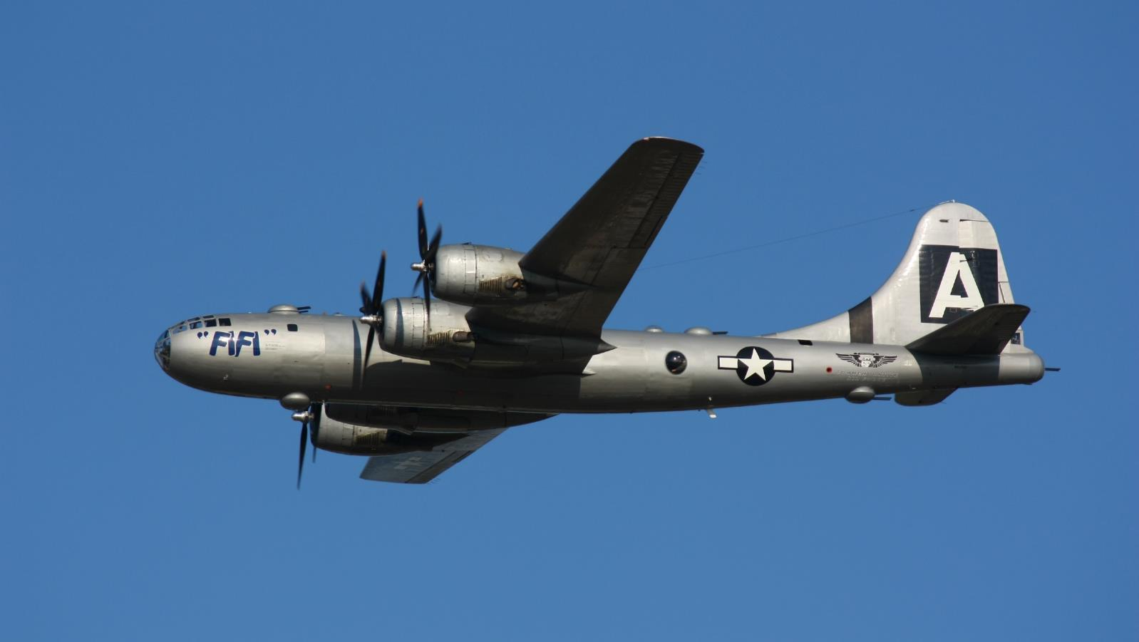
What are our Subjects?
The Aircraft
Notes:
Photos of aircraft on their own or in a landscape setting
The money shots are of planes flying; that’s where people expect to see planes
Go onto Airliners.net; most shots are not of planes in museums

Slide 10
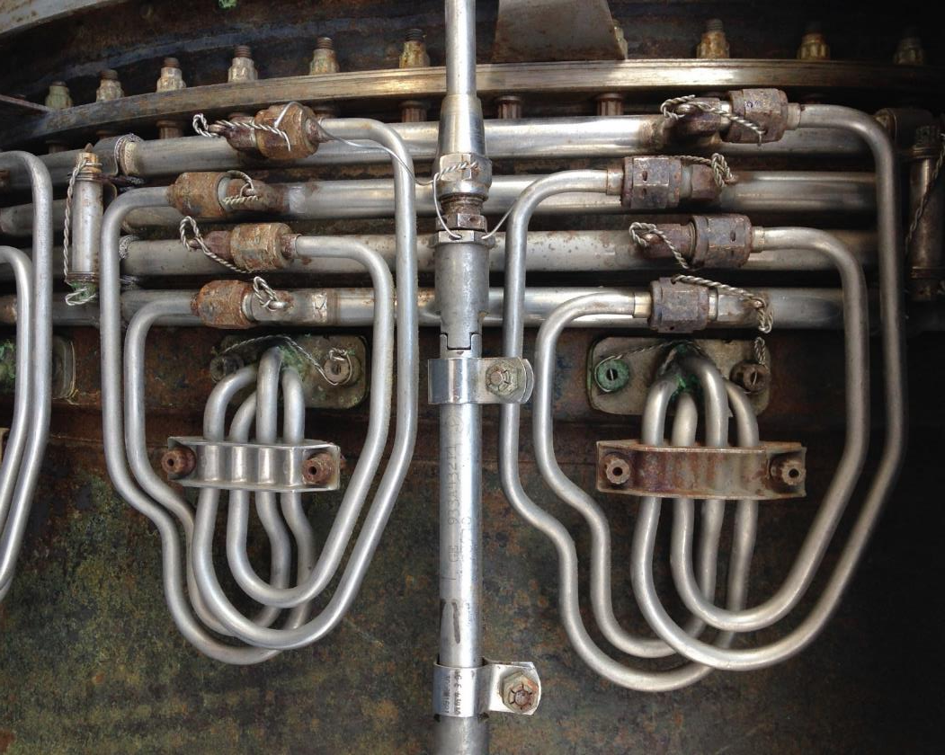
What are our Subjects?
The Details
Notes:
Photos of detailed or macros areas of aircraft
Iconic logos, nameplates, or shapes
Aircraft are amazing works of technical art

Slide 11
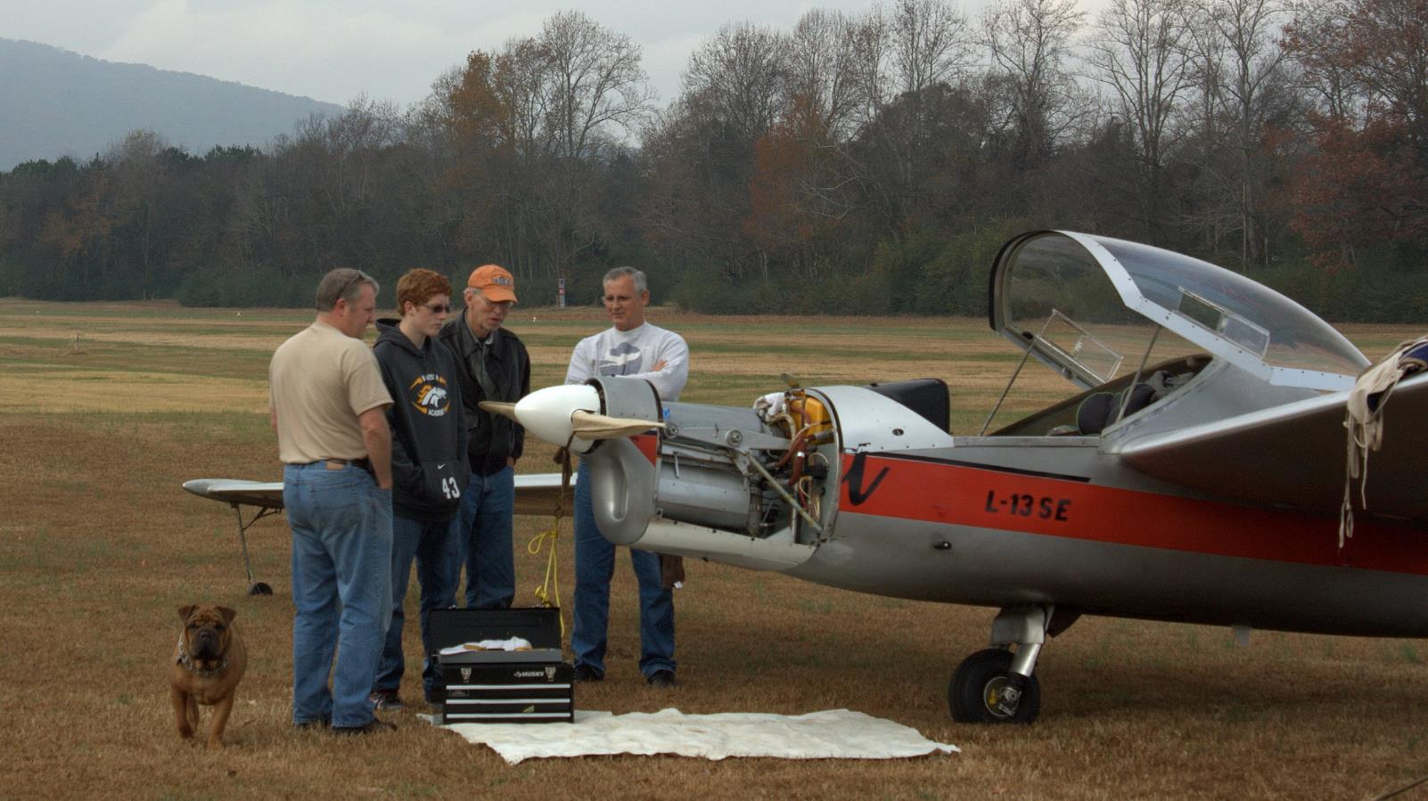
What are our Subjects?
The People
Notes:
Photos of people interacting with aircraft
Photojournalist in nature or portraiture

Slide 12
What are our Subjects?
People
Details
Aircraft
Notes:
Aircraft:
Most of these shots around airports
Approach is going to be similar to landscape and wildlife
Be aware of lighting, light direction
Details:
Most of these shots around airports and museums
Landscape; maybe some macro and portrait
Move around, look from different angles
People:
Most of these shots around airports, some at museums
Approach is going to be similar to landscape and street photography with a little portrait work
Try to get interactions, expressions, human contact with aircraft

Slide 13
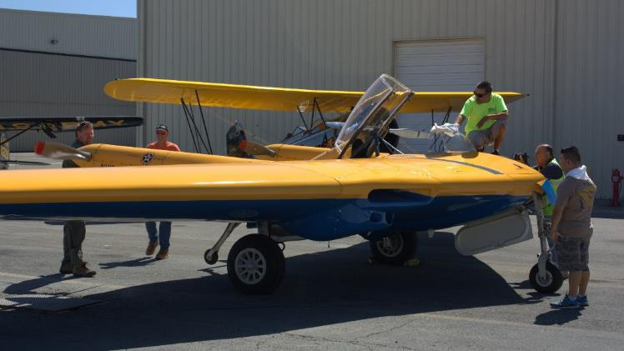
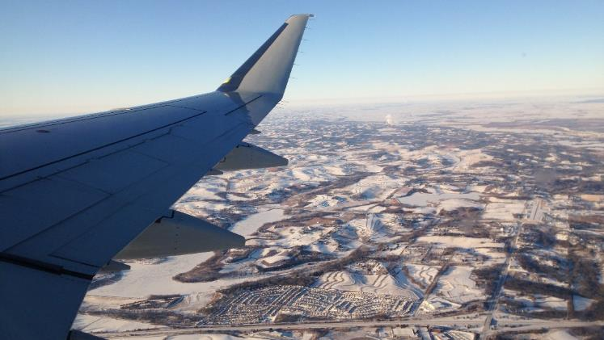
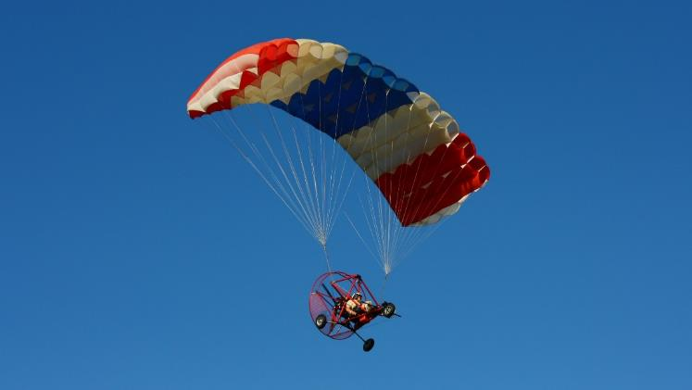
How are we Getting the Shot
Air to Ground
Ground to Ground
Ground to Air
Air to Air?
Notes:
Will not cover last two in details

Slide 14
Special Topic: Propeller Blur
Notes:
- Biggest problem

Slide 15
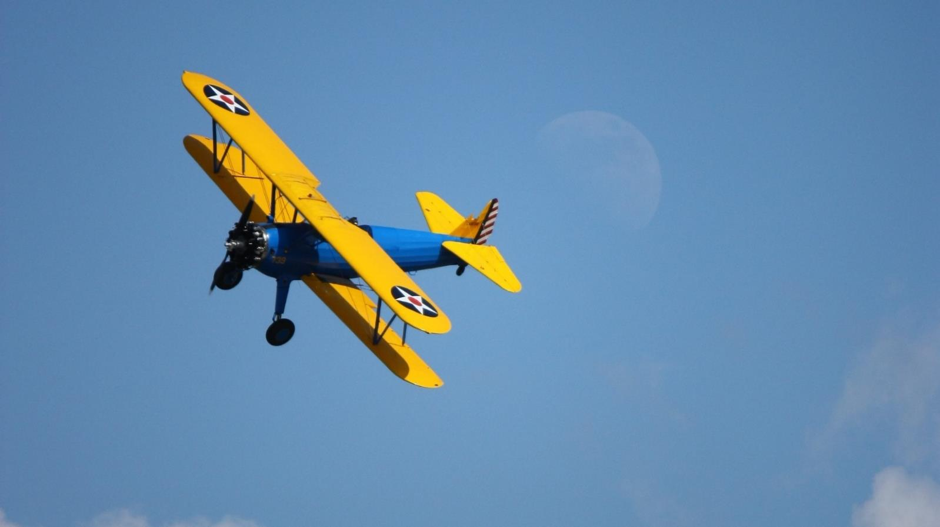
Special Topic: Propeller Blur
Stopped Propeller
Notes:
What’s wrong here?
Would be a good shot otherwise

Slide 16
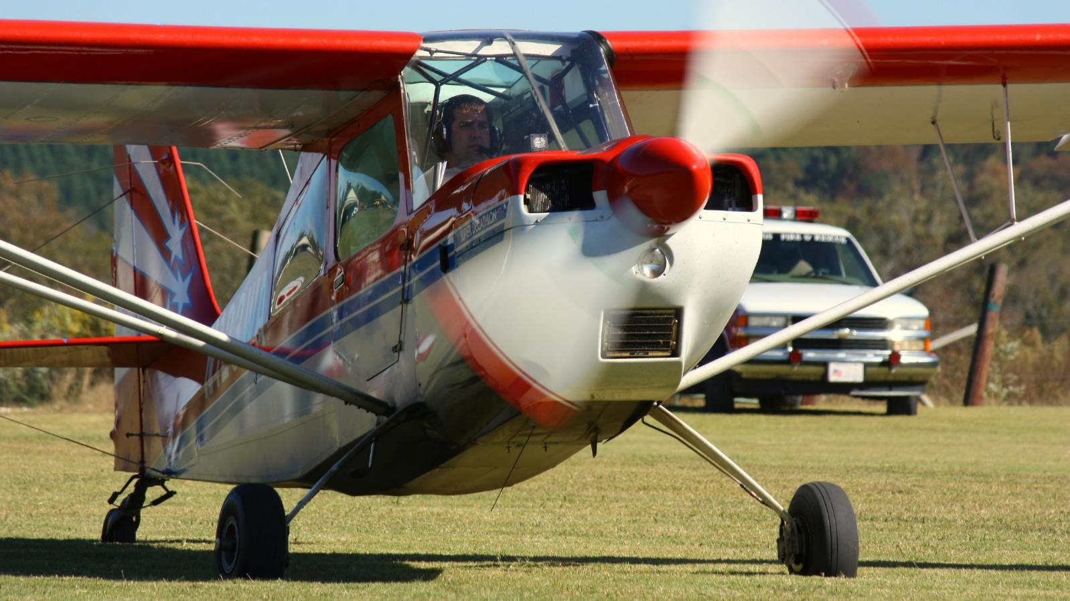
Special Topic: Propeller Blur
Blurred Propeller
Notes:
Shutter priority mode and let aperture do its thing
1/250 or less for prop planes, 1/125 or less for 3+-blade helicopters, 1/60 or less for 2-blade helicopters
Source: Nikon - Taking Great Photographs at Airshows

Slide 17
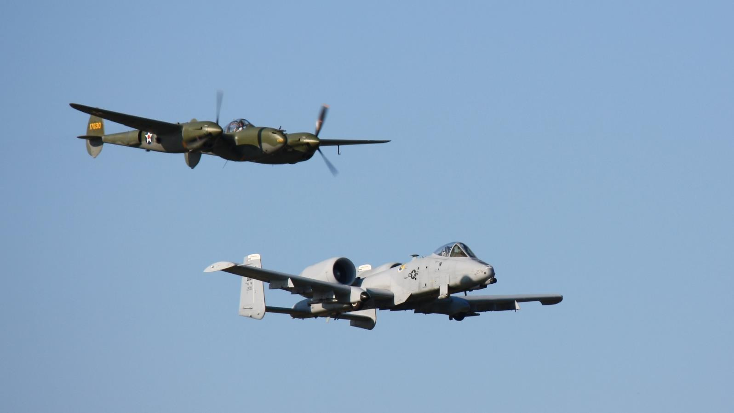
Special Topic: Propeller Blur
Props vs. Jets
Notes:
Likely use an aperture between f/5.6 and f/8
Source: Nikon - Taking Great Photographs at Airshows

Slide 18
Special Topic: Following the Aircraft
Notes:
- With a lower shutter speed, you will need to lead the target to keep in focus

Slide 19
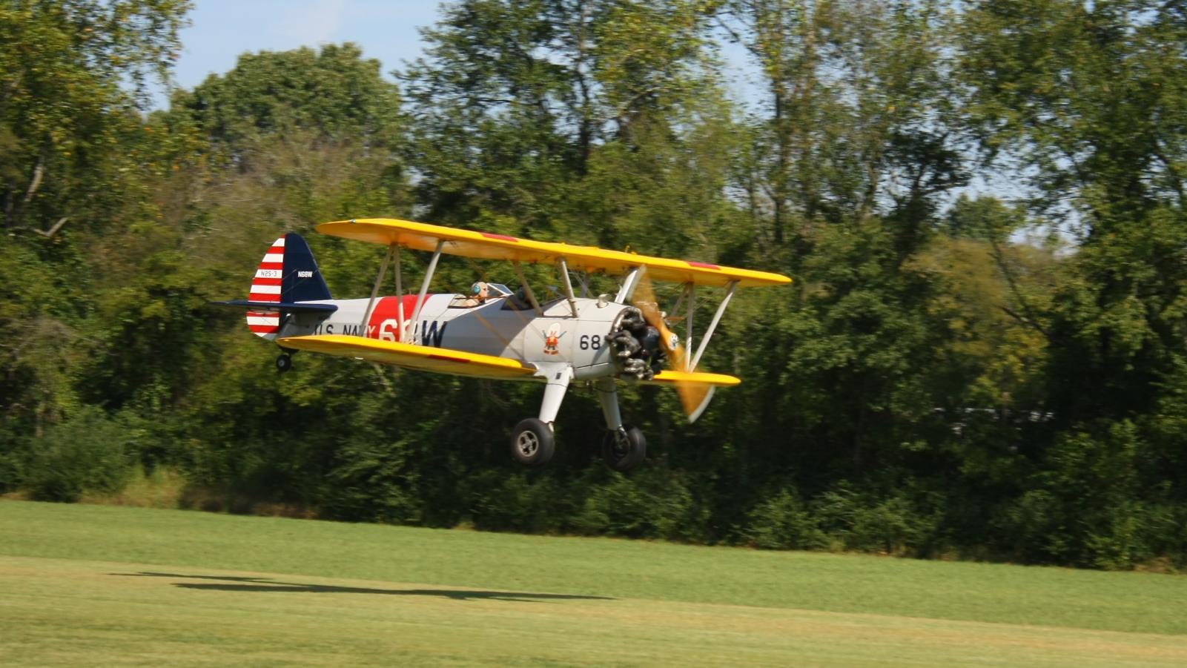
Special Topic: Following the Aircraft
Pan Horizontally
Notes:
A fast autofocus helps, but beware if it begins to hunt and focus to infinity
A little background blur helps emphasize motion

Slide 20
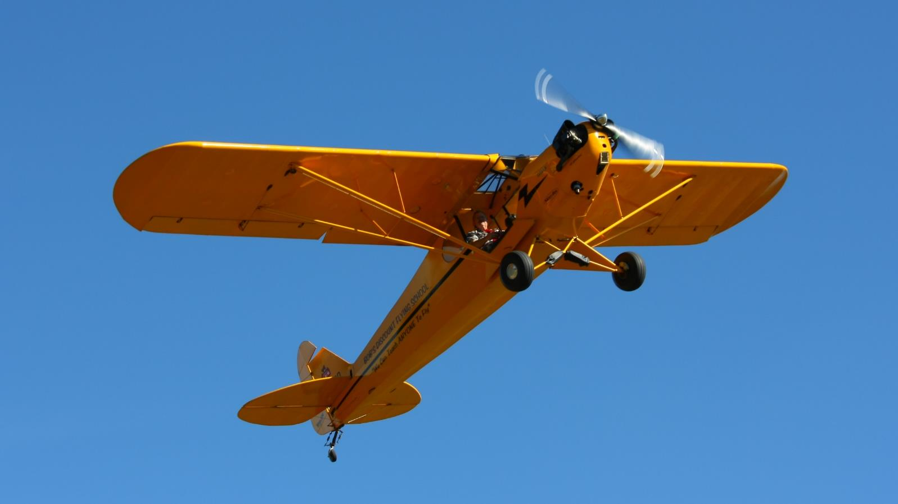
Special Topic: Following the Aircraft
Pan Vertically
Notes:
- Remember to pan up, especially for aerobatics

Slide 21
Special Topic: Aerobatics
Notes:
- This is where a lot of things come together: shutter speed, auto focus, and panning

Slide 22
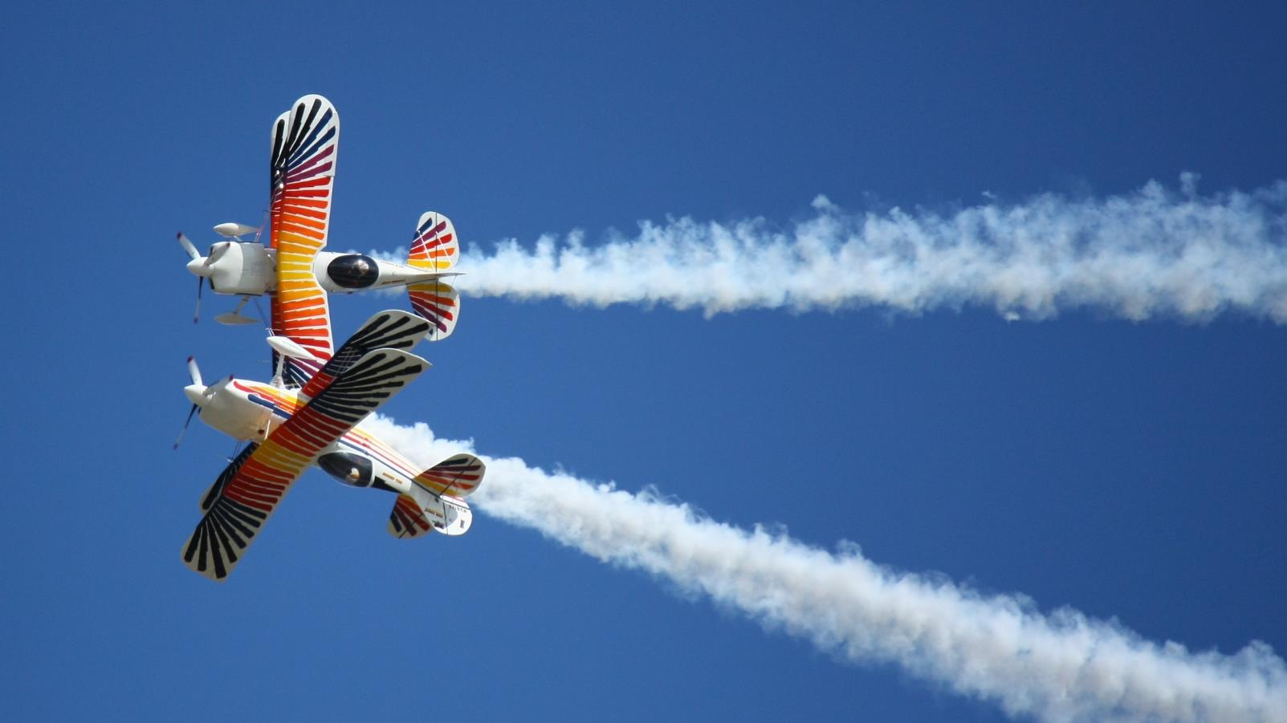
Special Topic: Aerobatics
Zoom Telephoto
Notes:
Zooming telephotos useful to get shot without repositioning

Slide 23
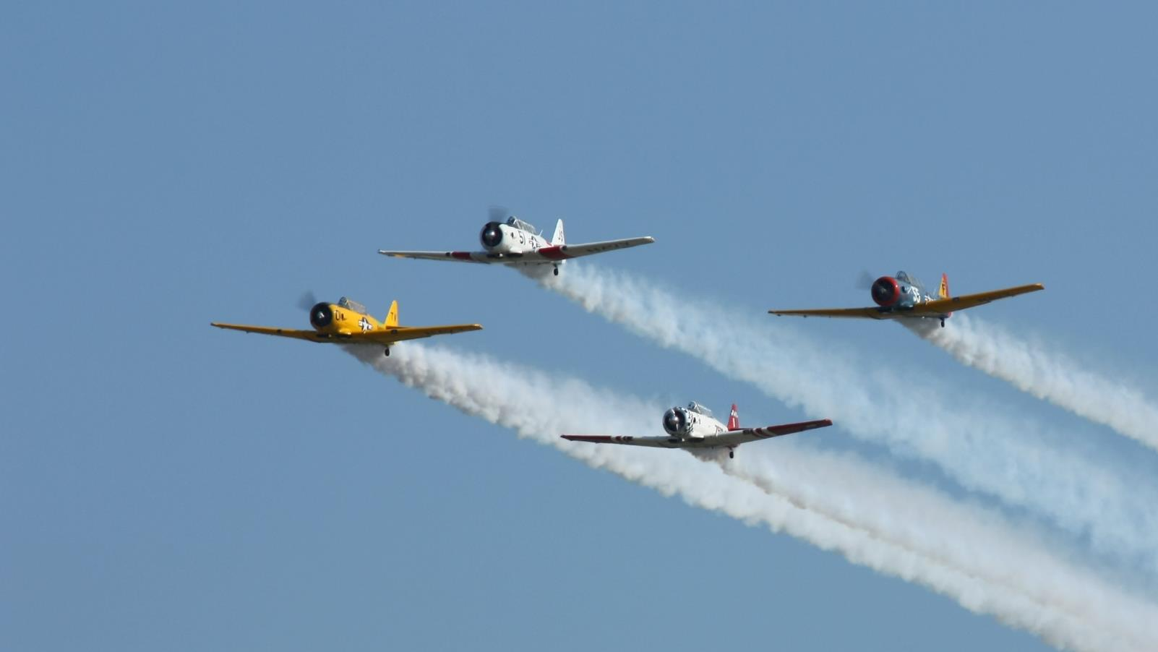
Special Topic: Aerobatics
Formation Flying
Notes:
- Most action at “Airshow Center”, but edges of runway can yield good shots as planes maneuver at edges

Slide 24
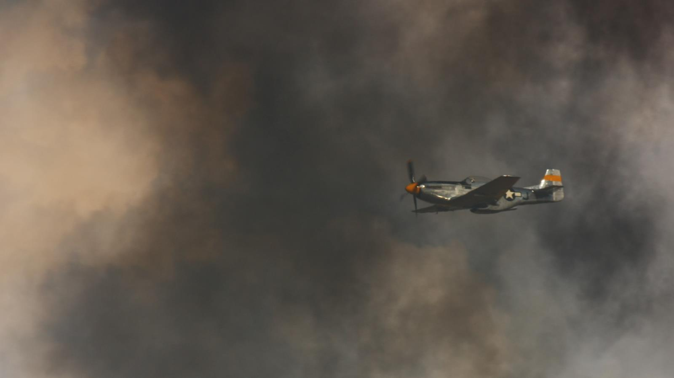
Special Topic: Aerobatics
Smoke Accumulates
Notes:
- Smoke will accumulate, which can be advantage or disadvantage

Slide 25
Special Topic: Time and Atmosphere
Notes:
Don’t run out at the end of the day, or leave when it rains.

Slide 26
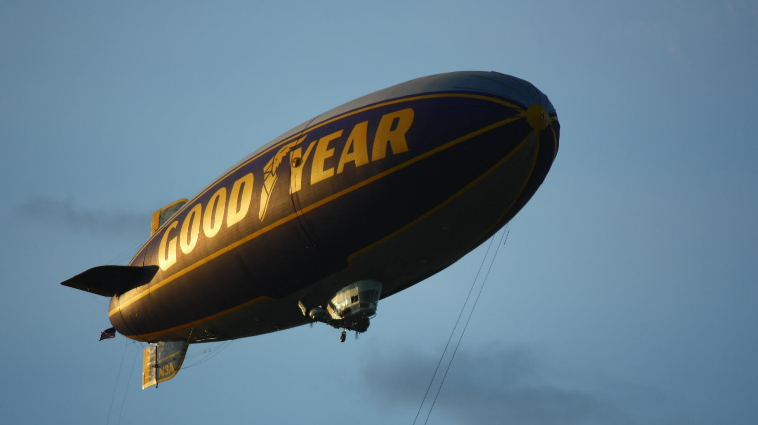
Special Topic: Time and Atmosphere
Lighting
Notes:
- Don’t run out at the end of the day, or leave when it rains.

Slide 27
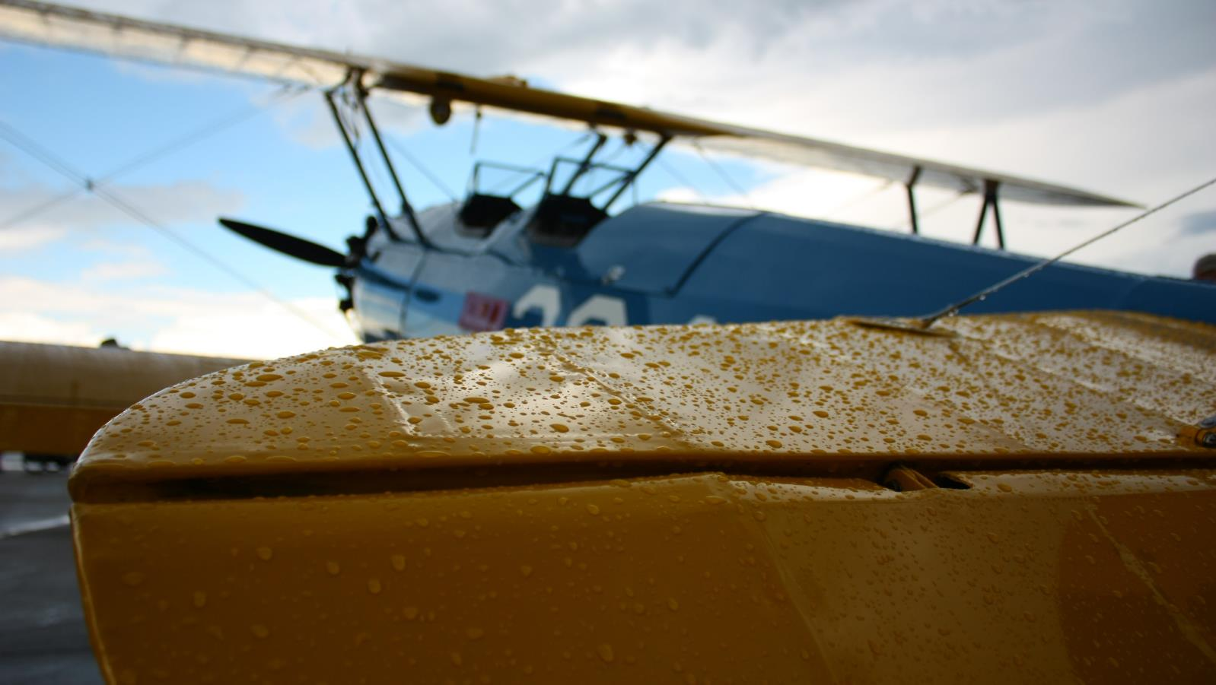
Special Topic: Time and Atmosphere
Rain
Notes:
- Don’t run out at the end of the day, or leave when it rains.

Slide 28
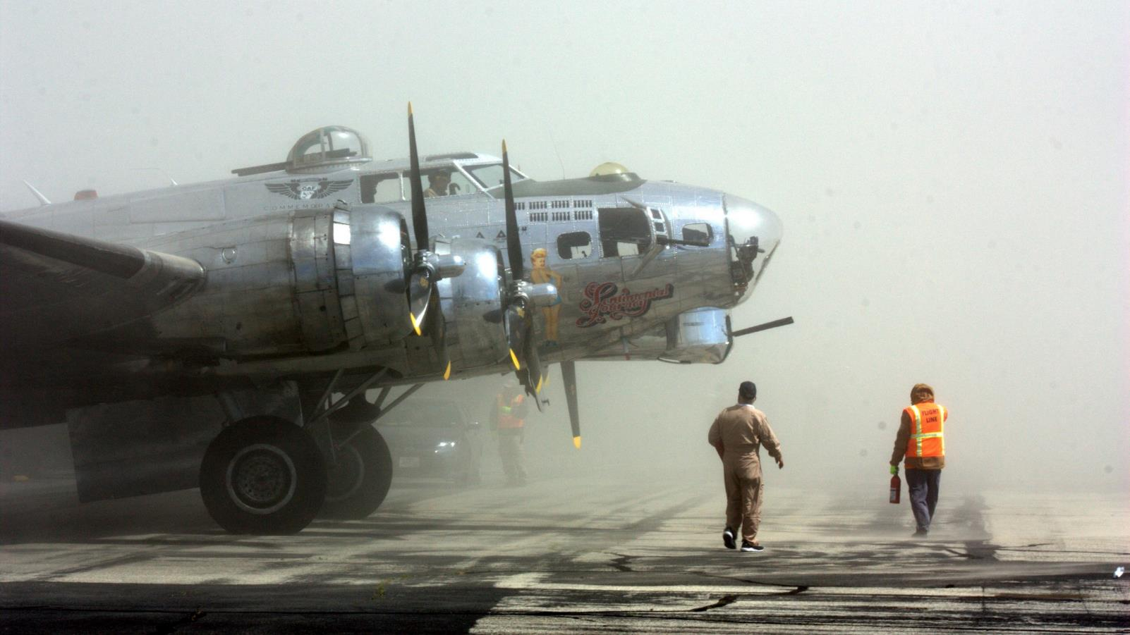
Special Topic: Time and Atmosphere
Haze / Sand
Notes:
- While to good effect, sand and debris blown from helicopters and props can damage equipment

Slide 29
Special Topic: Unique and Unusual
Notes:
- Let’s go hunting!

Slide 30
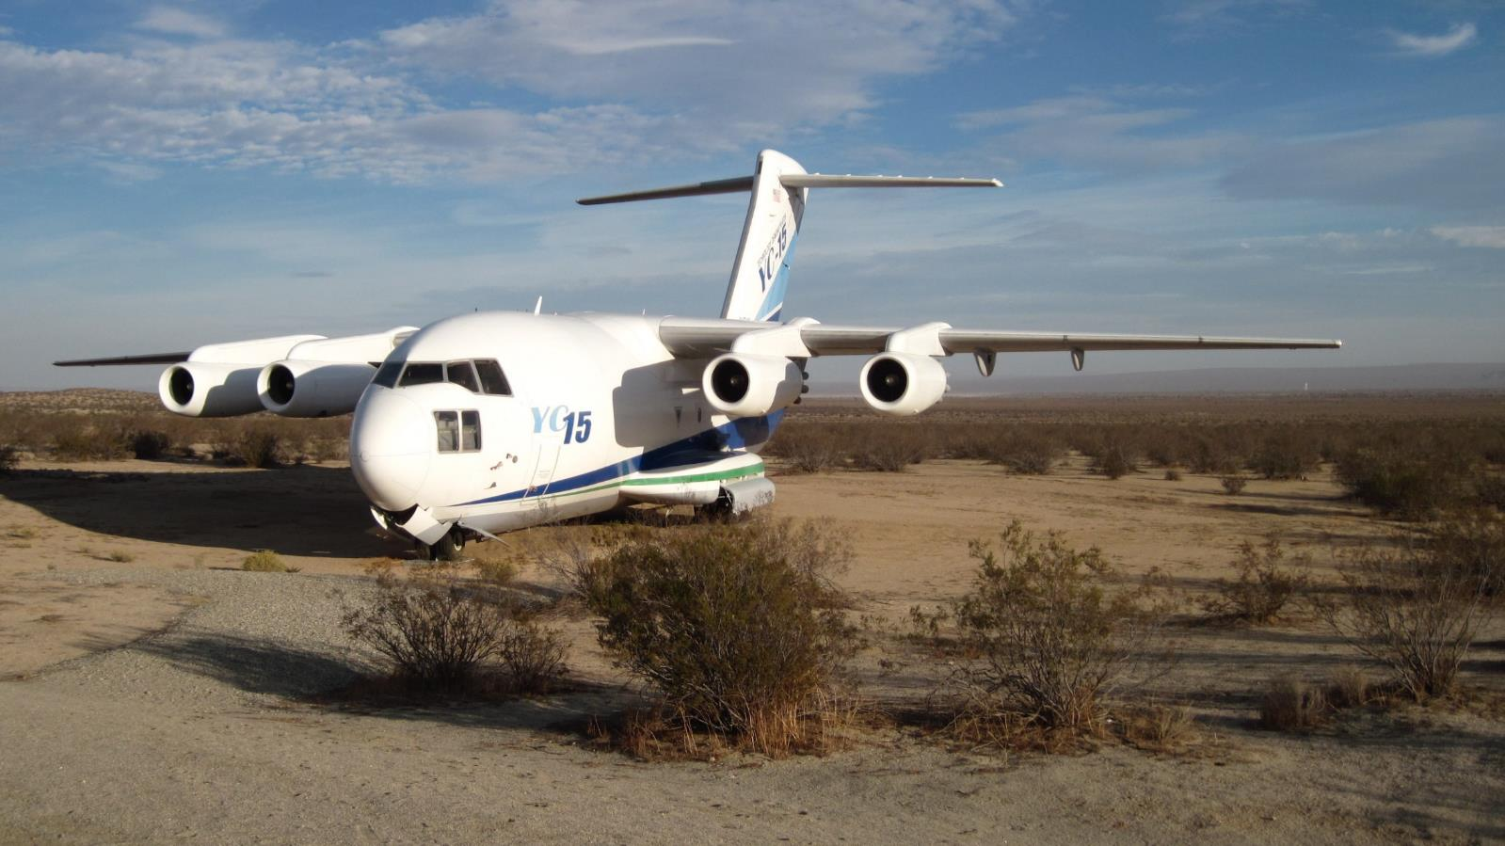
Special Topic: Unique and Unusual
McDonnell Douglas YC-15 – Mojave, CA
Notes:
If traveling, go out of your way to find one-of-a-kind aircraft on display

Slide 31
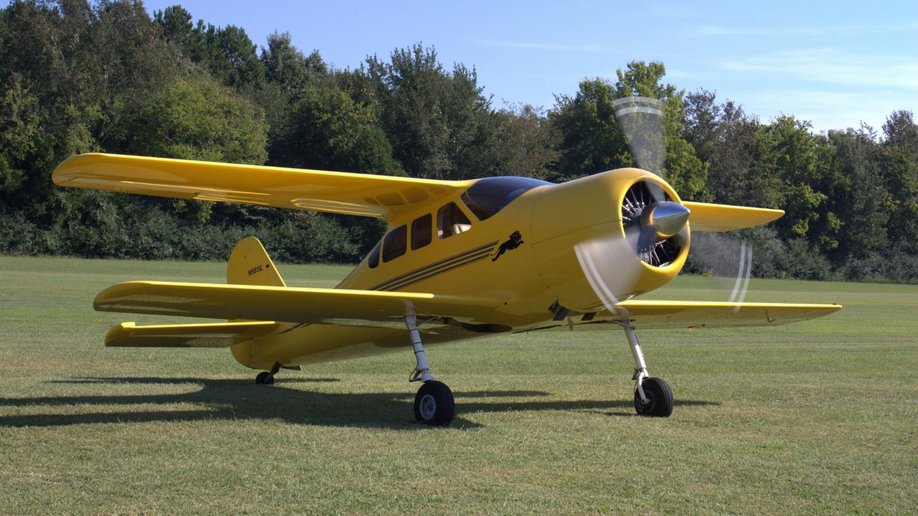
Special Topic: Unique and Unusual
Griffon Lionheart Prototype – Huntsville, AL
Notes:
- Hobbyists keep vintage and custom-built aircraft alive

Slide 32
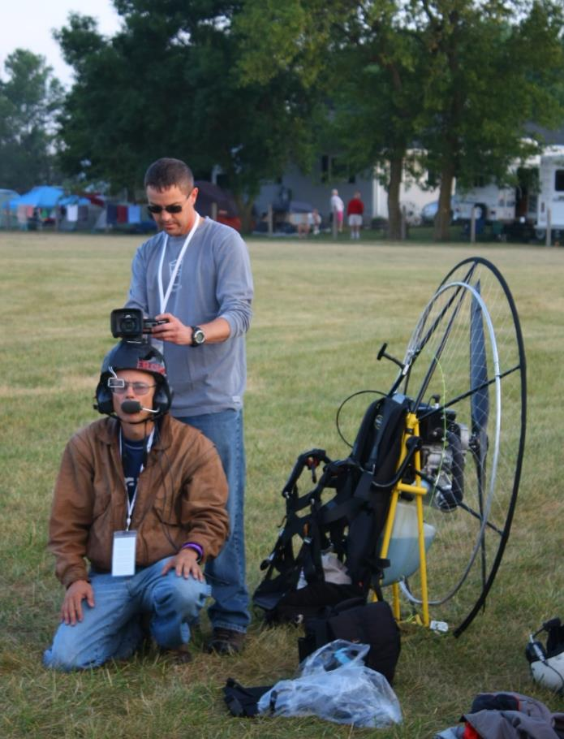
Special Topic: Unique and Unusual
… And this guy is an Aircraft, too!
Notes:
- Expand your ideas of what an aircraft can be

Slide 33
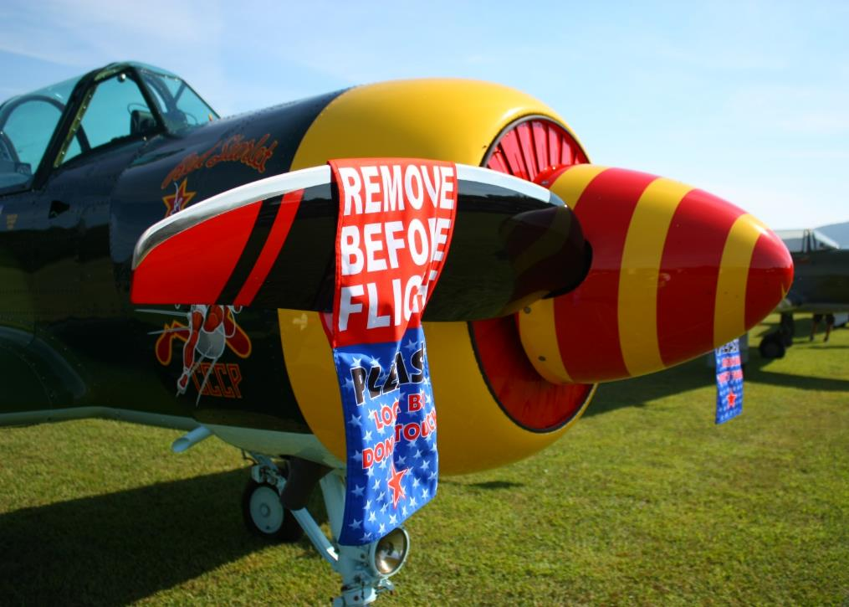
Safety First!
Be safety-conscious around AIRCRAFT
Aircraft have sharp edges and instruments, often at eye-level
Aircraft have fragile surfaces that are easily damaged if touched
Propellers can start if pushed and are difficult to see when moving; stay out of propeller arcs
Jet intakes and blast are almost invisible; stay clear of intakes and exhausts.
Be aware of hot surfaces from engines and the sun
NEVER touch a plane unless the owner says you may

Slide 34
Safety First!
Be safety-conscious at AIRPORTS
No drones!
Keep small children close
NEVER walk onto active taxiways or runways
NEVER walk in front of moving aircraft; pilots have poor visibility
Be safety-conscious OUTSIDE
There is no shade at airports: bring sunscreen, big hats, and plenty of water
Bring hearing protection if you have sensitive ears
Be prepared to walk and stand on hard surfaces

Slide 35
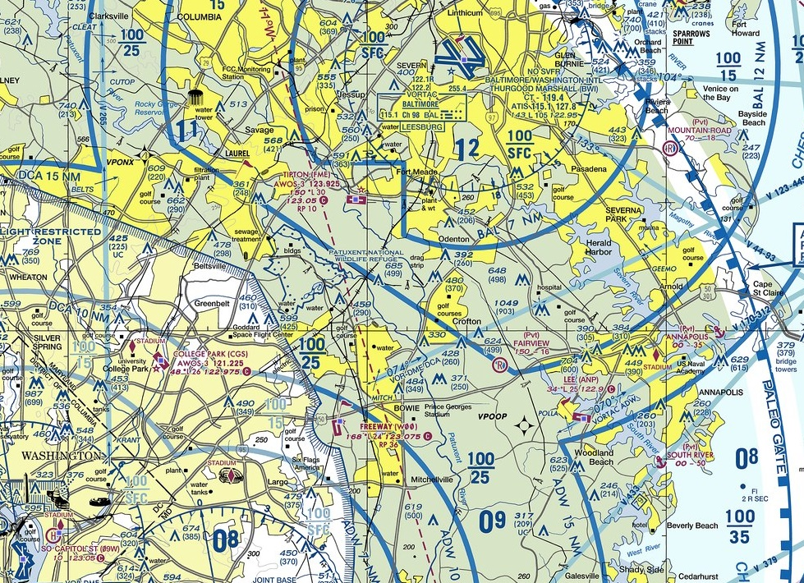
Resources
Museums
National Air and Space Museum (Mall and Dulles)
The National Museum of the United States Air Force — Dayton, OH
National Naval Aviation Museum — Pensacola, FL
The Museum of Flight — Seattle, WA
EAA Aviation Museum – Oshkosh, WI
College Park Aviation Museum
Airshows
AirVenture – Oshkosh, WI
Sun ‘n Fun – Lakeland, FL
Reno Air Races – Reno, NV
Andrews Air Force Base Air Show

Slide 36
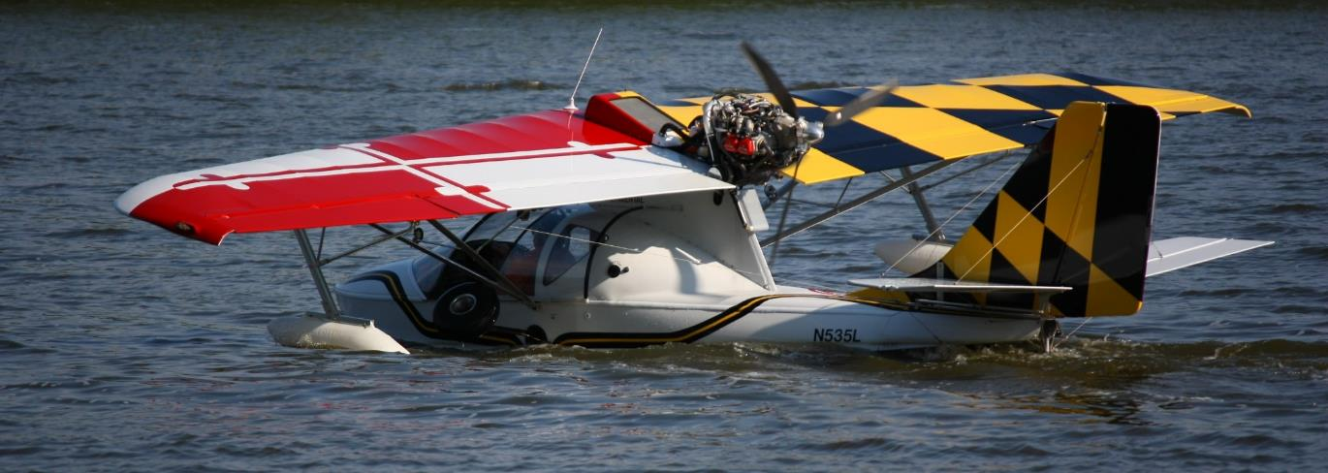
Resources
Aircraft Owners and Pilots Association
Experimental Aircraft Association
Airliners.NET
Nikon - Taking Great Photographs at Airshows
DPReview – Aviation Photography
Sport Aviation
In the Cockpit
EAA Oshkosh: The Best AirVenture Photography

Slide 37
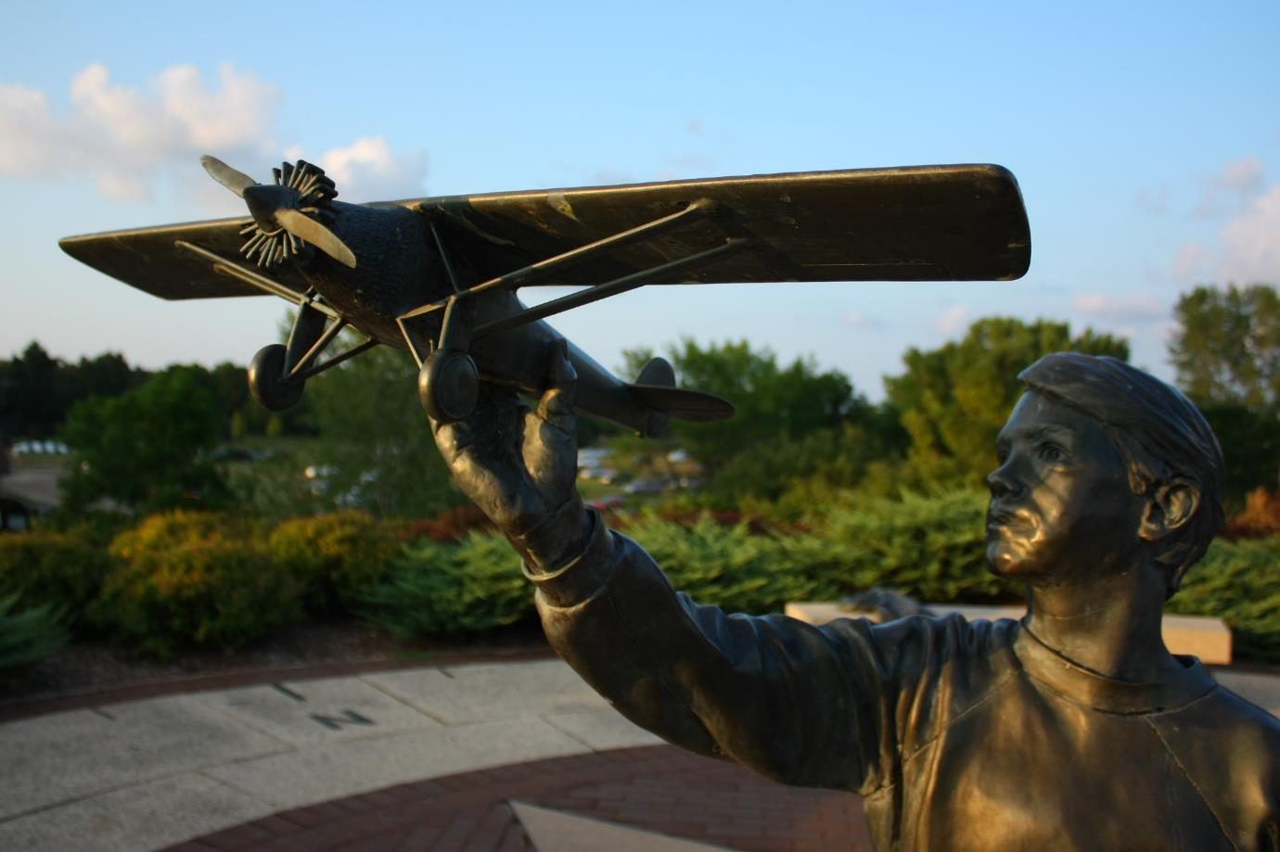
Be Inspired!
Notes:
Practice, have fun, be inspired

Slide 38
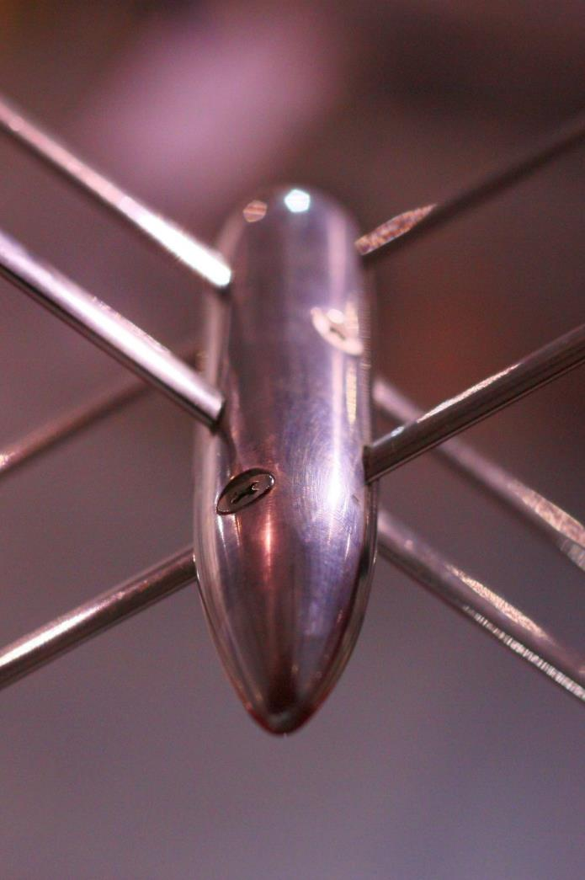
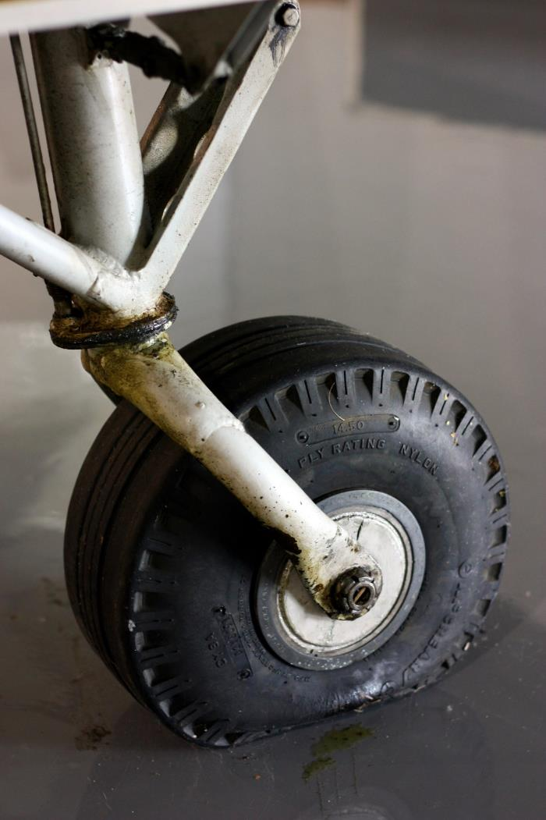

Slide 39
