Slide 1
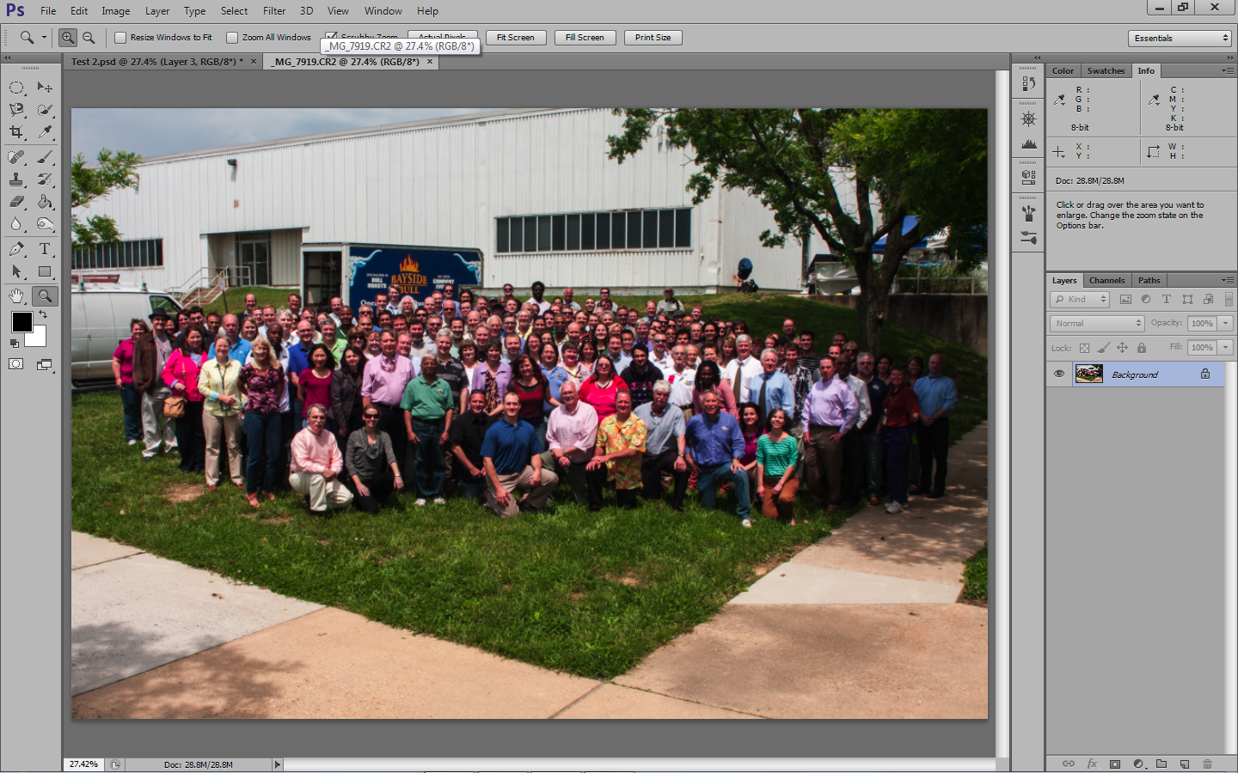
The picture as taken, Note the blue truck, prominent in background.

Slide 2
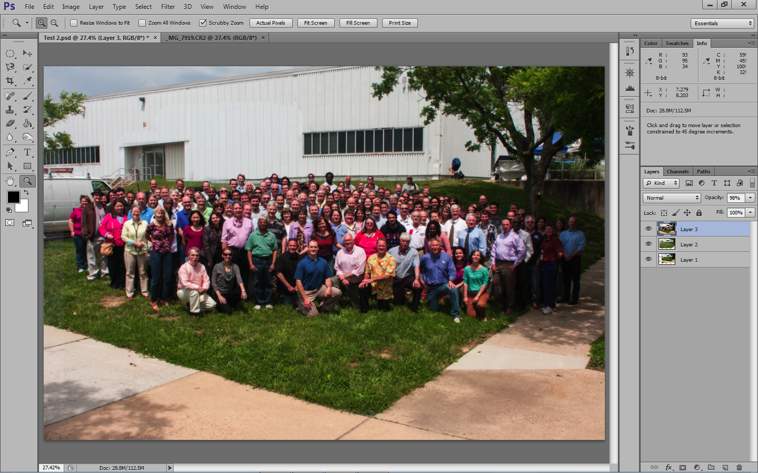
The picture after processing

Slide 3
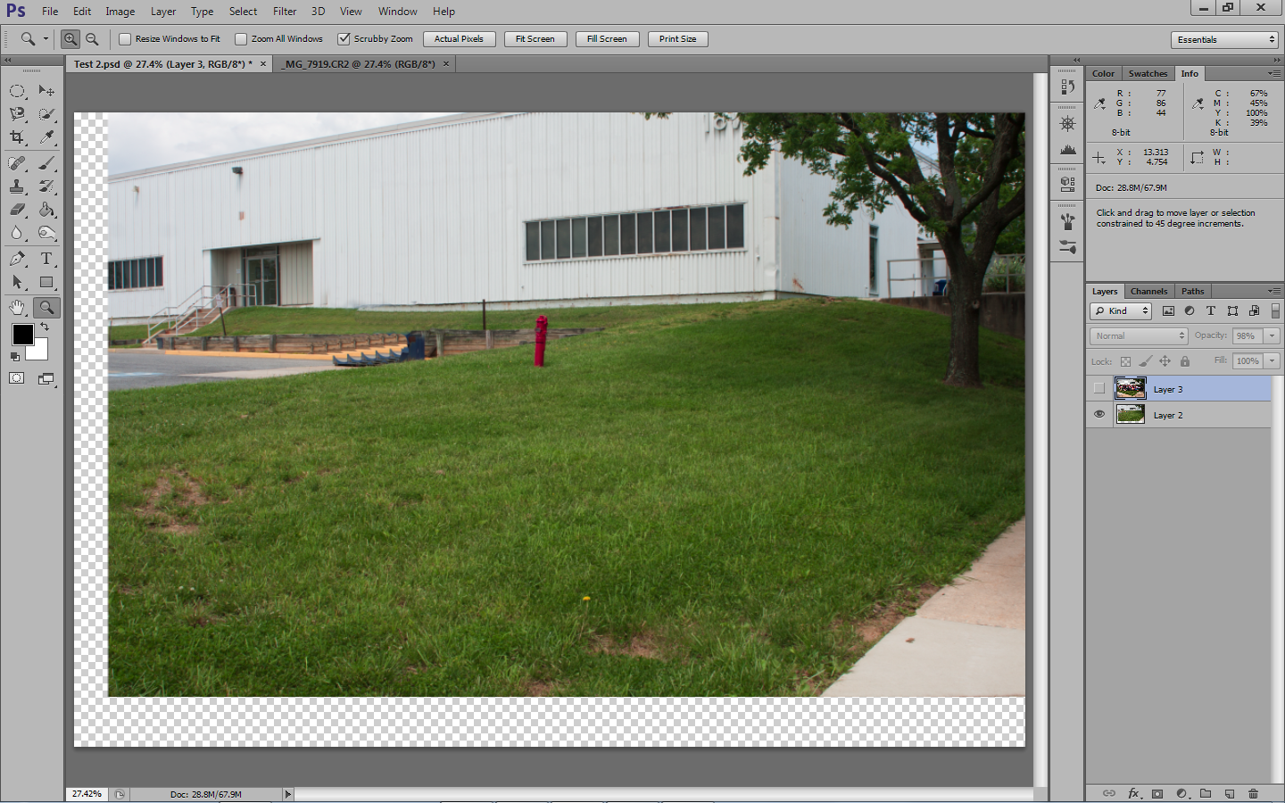
Pre-shoot test shot. Always do ground work before an important shoot. Imported and made a layer below the group picture.

Slide 4
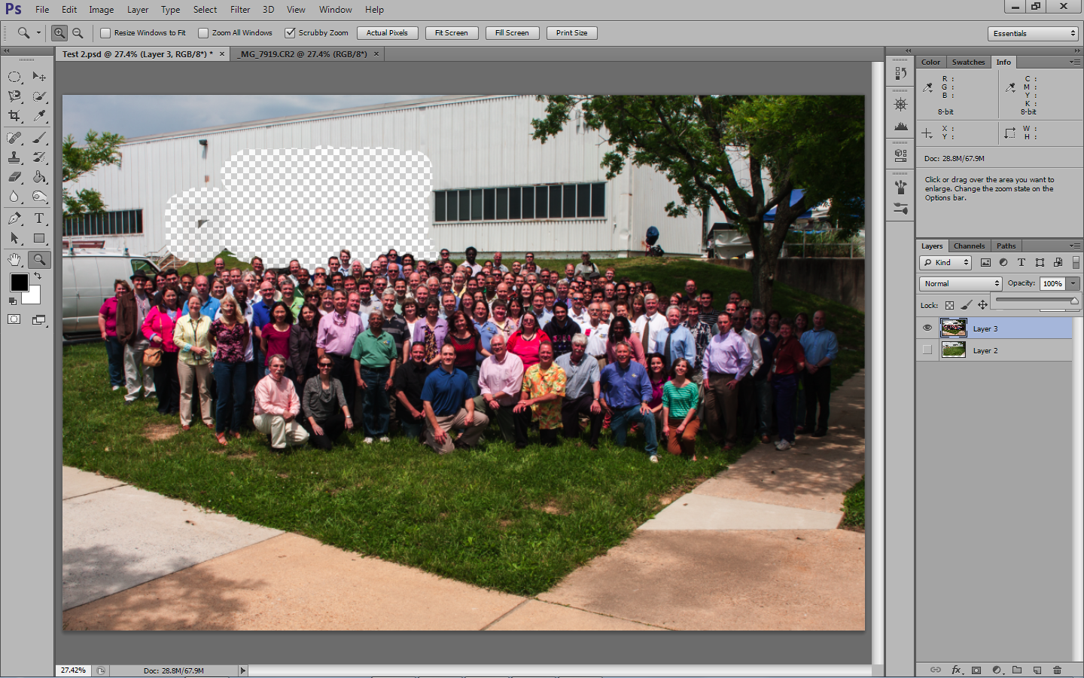
Erased the truck and part of the building , allowing the pre-shoot picture to become visible.

Slide 5
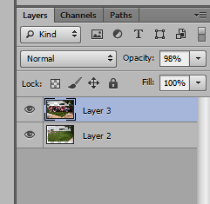

Slide 6
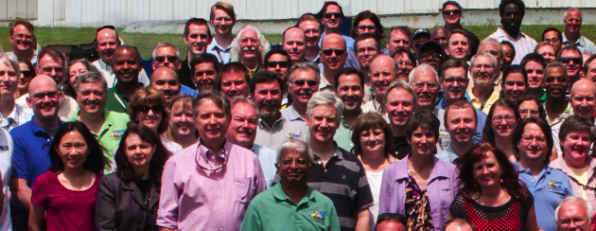
Close-up shows that perfection in editing was not achieved. But unless they went to 20X30 it shouldn’t be a problem.

Slide 7
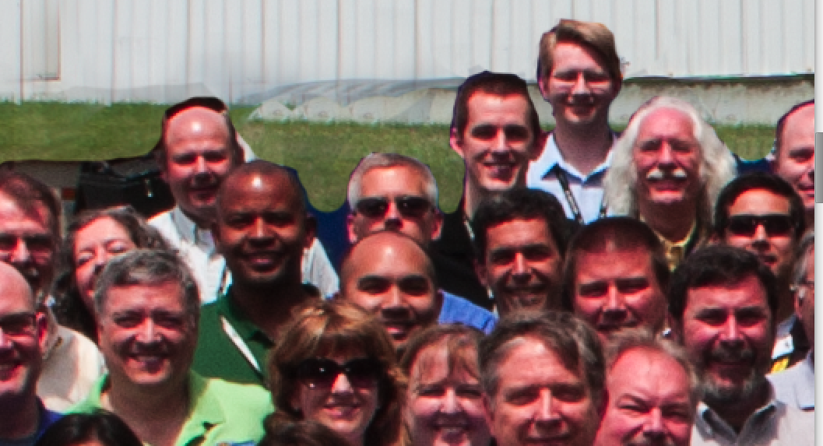
Some blue is still visible.

Slide 8
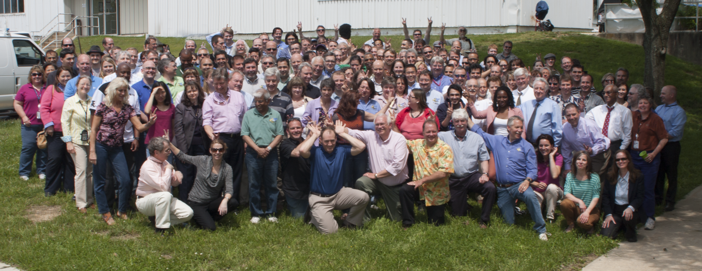
Always engage the client. Shoot straight and then ask them to do bunny ears or jump and wave. Being a photographer is like being God. People will do anything as long as the photographer asks.

Slide 9
