Slide 1
Session 3 Layers Using PhotoShop Elements (or Why Didn’t Someone Tell Me About This Before?)
Nancy Rosenbaum
Karen Smale

Slide 2
Whitening Teeth
Before
After

Slide 3
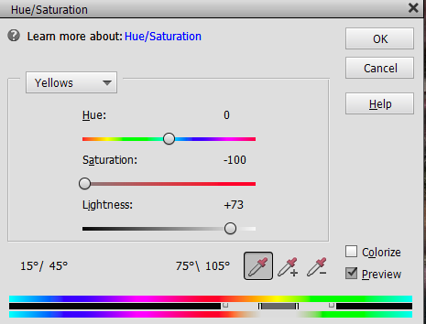
Demo: Whiten Teeth
Open file
Use a selection tool to select teeth
Save selection as layer:
➢Layer ➢New Layer ➢Layer Via Copy
Desaturate teeth:
➢Enhance ➢Adjust Color ➢Adjust Hue/Saturation
Select Yellows
Desaturate yellows
Increase lightness

Slide 4
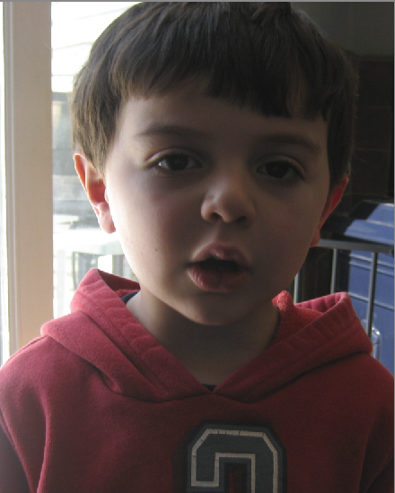
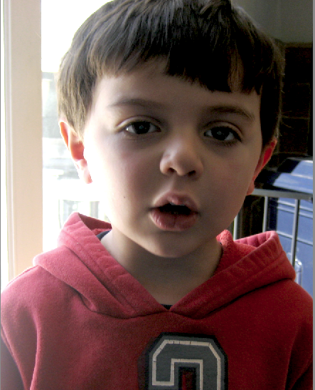
Adding Catchlights (and some brightness/contrast)
Before
After

Slide 5
Demo: Add Catchlights
Open file
Use a selection tool to select eyes
Save selection (to use it again later):
➢ Select ➢Save Selection ➢Name the selection (e.g., “eyes”)
Save selection as layer:
➢Layer ➢New Layer ➢Layer Via Copy
Using the burn/dodge/sponge tool
➢ In the toolbar at the bottom, select Dodge/Range = Shadows, Exposure = 20%
Adjust brush size and “daub” eyes to create catchlights
Dial back intensity using the Opacity slider on the layer
To lighten the eye area, re-load the selection:
➢ Select ➢Load ➢[Selection name]
Select brightness/contrast adjustment layer and adjust
Use paintbrush (with black selected on color palette) to refine mask

Slide 6
Removing Shine and Smoothing Skin
Before
After
Copy background layer
Select the Clone tool
Adjust opacity to 30-50%
Adjust brush size accordingly
Alt-click (or option-click) to select source pixels to clone
Brush or daub the destination

Slide 7
Using Liquify to Alter Shapes
Before
After

Slide 8
Liquify Filter
Navigate to Liquify Filter:
➢Filter
➢Distort
➢Liquify
Liquify Tool Bar:
Warp
Twirl Clockwise
Twirl Counterclockwise
Pucker
Bloat
Shift Pixels (drag up=left)
Reconstruct (undo distortion)
Zoom
Hand (navigate in image)

Slide 9
Demo: Use Liquify to Shape Chin and Nose
Open file
Duplicate layer
Open Liquify (Filter>Distort>Liquify)
Use zoom tool to magnify
Use warp tool to “push” pixels
Use pucker tool to shrink pixels
Use bloat tool to expand pixels

Slide 10
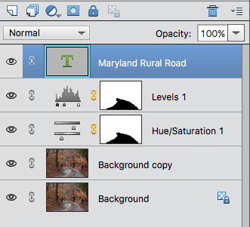
Adding Text
Use the Text tool (T)
Click on your document and start typing
A new layer is created
You can move/modify your text later
If you don’t see anything as you type, make sure you’re on the top layer!
Adjustment layers will affect text layers too!
You can drag and drop layers to change the order – this may have radical consequences!

Slide 11
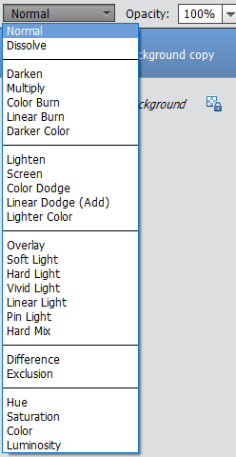
Blending Modes
Blending modes change the way layers react with each other
Must have at least two layers
Some blending modes react differently if the opacity of the blend layer is less than 100%
Blending Mode Menu

Slide 12
Example: Multiply
Before
After, using Multiply blend mode

Slide 13
Example: Darken (Watercolor Effect)
Before
After, using Gaussian Blur on the blend layer and Darken blend mode
Copy background layer
Select ➢Filter ➢Blur ➢ Gaussian Blur
Adjust radius to desired effect
Select the Darken blend mode

Slide 14
Example: Overlay (Sharpening)
Before
After
Copy background layer
Select ➢Filter ➢Other ➢ High Pass
Adjust radius so you can just see the shape outlines
Select the Overlay blend mode

