Slide 1
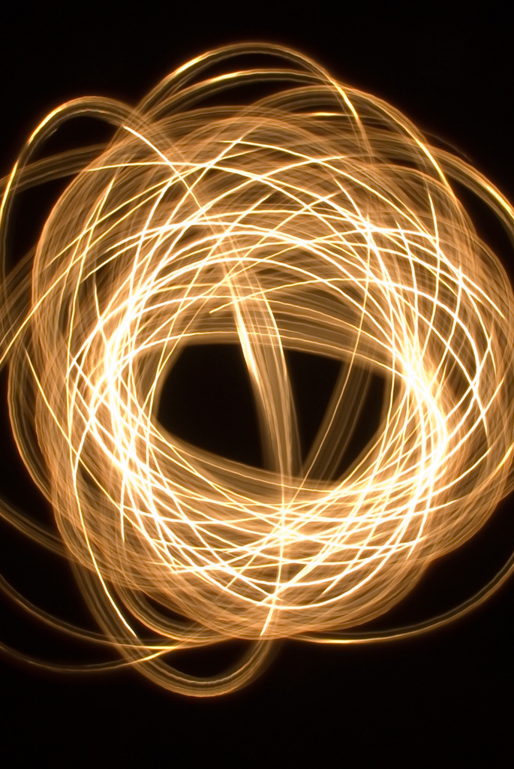
Light Painting
Karen Smale – March 2023

Slide 2
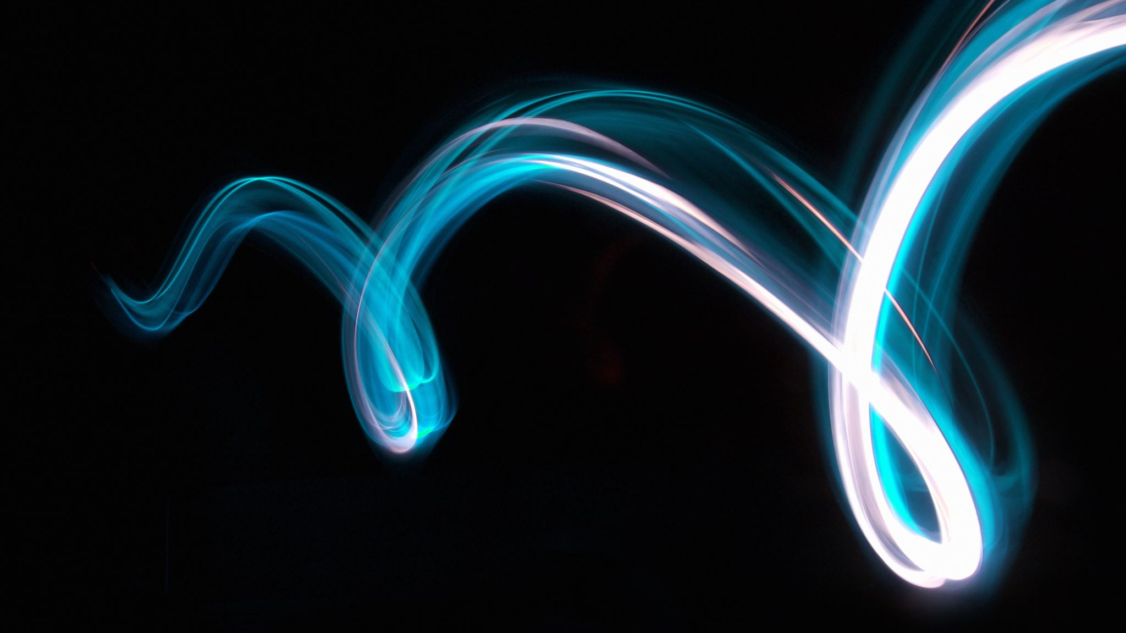
What is Light Painting?
Two types:
Using light to illuminate your subject can add drama to mundane objects or depth and wonder to a larger scene
Using light as your subject (drawing with light) can create fun and unique images
This talk will concentrate on ILLUMINATIVE light painting (#1 above)
Both require
long exposures (so you’ll need a tripod or sturdy surface for your camera)
a hand-held light source such as a flashlight

Slide 3
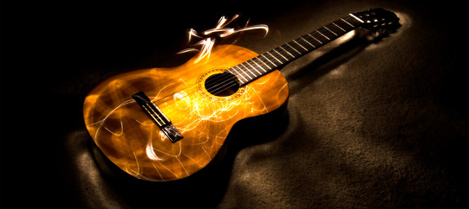
Using light to illuminate
In a dark environment, use a simple flashlight to illuminate your object. Illuminate details with close-up flashlight work, “wash” the subject with the flashlight held farther away. Don’t shine the light toward the camera unless you want “light bugs” in your photo.
Photos © Karen Smale
“Light bugs” created
if you point the flashlight toward the camera

Slide 4
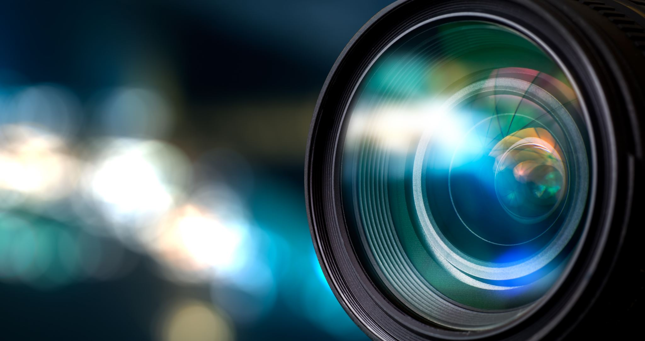
Tools
Camera capable of long exposures
Tripod or stable surface
You may be combining multiple exposures for larger objects, so a tripod is strongly recommended
Flashlights of various sizes/powers
Optional: a snoot on your light source to keep stray light from shining into the camera (more on this in a moment)
Post-processing software to combine multiple exposures

Slide 5
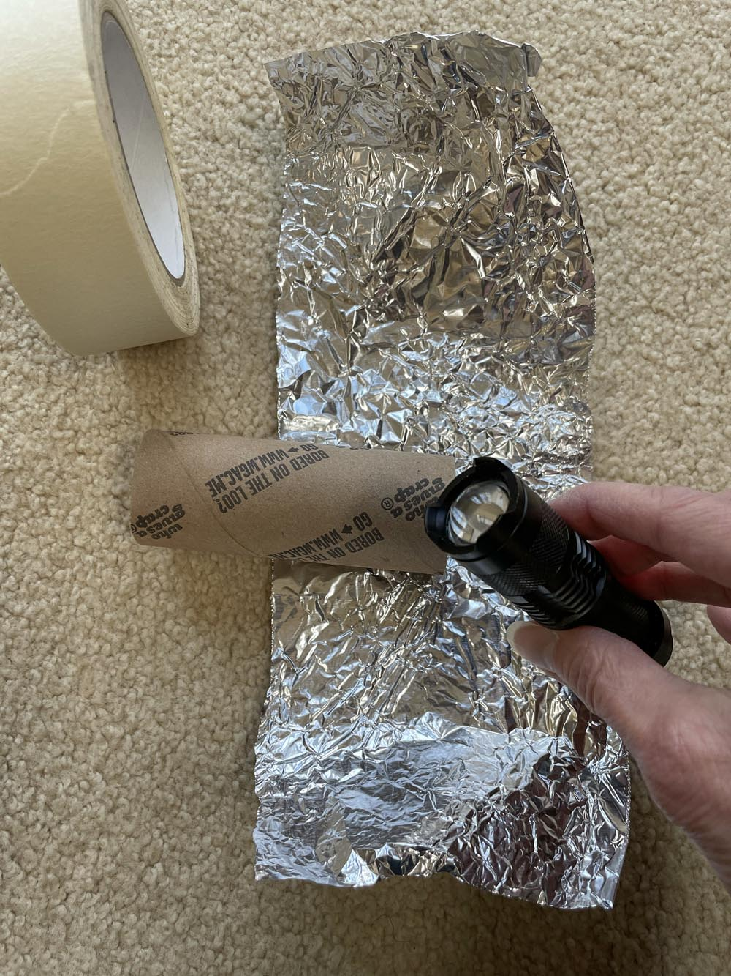
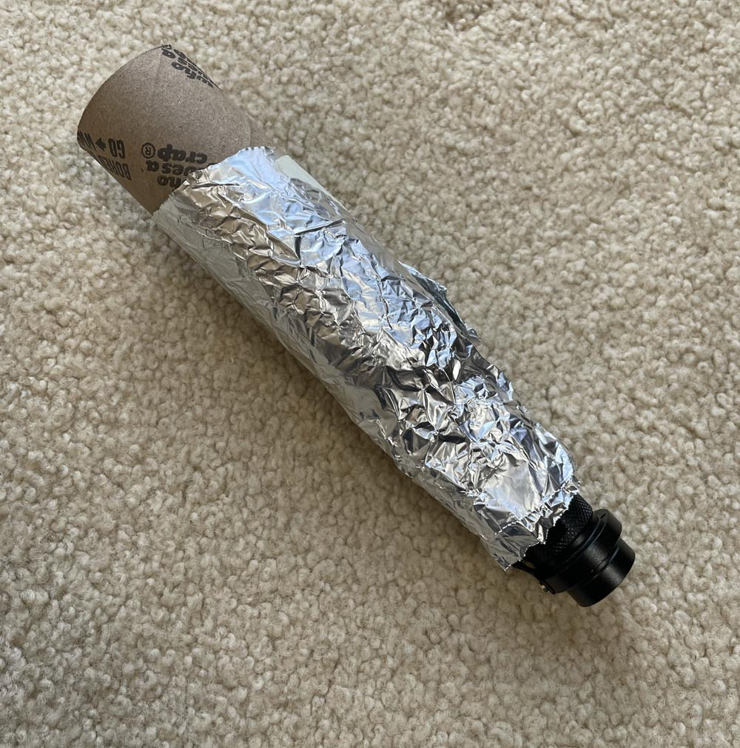
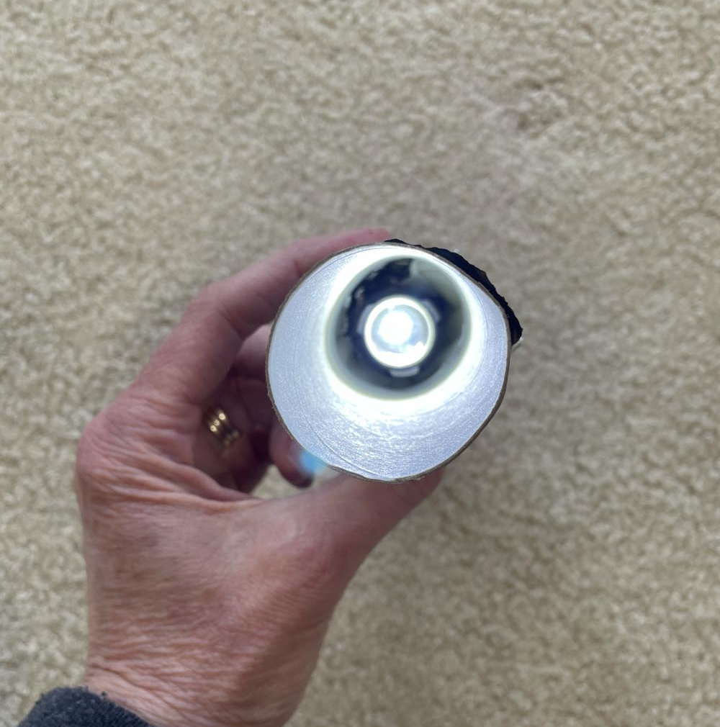
Making a snoot
Optional! But helpful if you find you get “light bugs” too easily.
You’re making something to ensure that the light from your flashlight doesn’t accidentally shine toward your camera. You’ll need:
Aluminum foil
electrical (or other) tape
straw or toilet paper roll (cardboard core) – something cylindrical and hollow

Slide 6
Technique
You can (and likely will) get in the frame – that’s okay!
Keep moving
Don’t illuminate yourself or stand between the thing you’re illuminating and the camera (you want side-light anyway, in most cases)
Wear dark clothing (just in case)
Remember the inverse square law
Illuminating your subject from up close will give a brighter and more focused illumination
Illuminating from afar will give a gentle wash to your subject, but you may have to linger on each area longer to give it enough light
Practice makes perfect (or at least “better”)

Slide 7
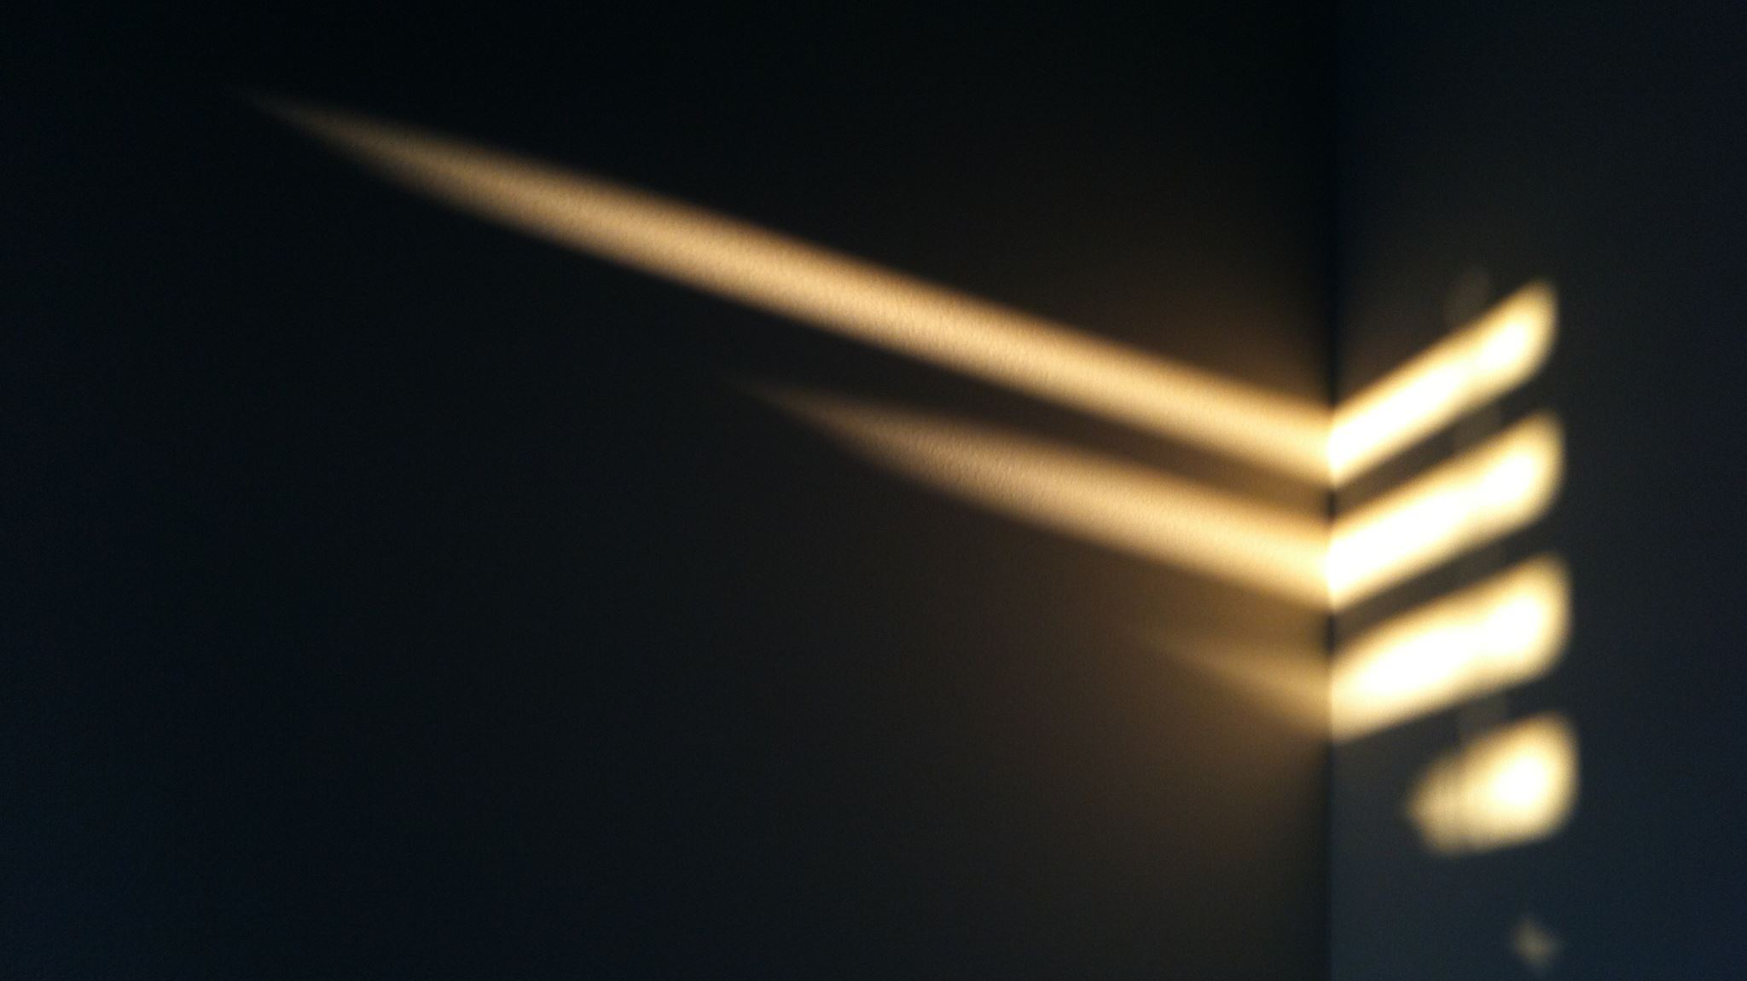
Light Painting Small Objects
Set up in a small room, closet, or basement where you can completely control the ambient light
Compose your photo with the lights on; focus and then lock focus, turn off vibration control
Set exposure to 30 sec or 60 sec (shutter priority or full manual mode), low ISO
The time you choose should be long enough to get your painting done; it won’t matter if it’s too long because once you stop painting, it’s just dark and your sensor won’t pick up any light.
Lights out!
Take a test shot of un-illuminated subject to see where background/stray light comes in, then either
Fix the stray light problem (close shades/doors) or
Set exposure accordingly so that it will appear minimal relative to your painted areas
Release the shutter and paint your subject
Don’t illuminate yourself unless you want to be in the photo
Don’t point the flashlight at the camera if you don’t want “light bugs”
Review your image and try again!

Slide 8
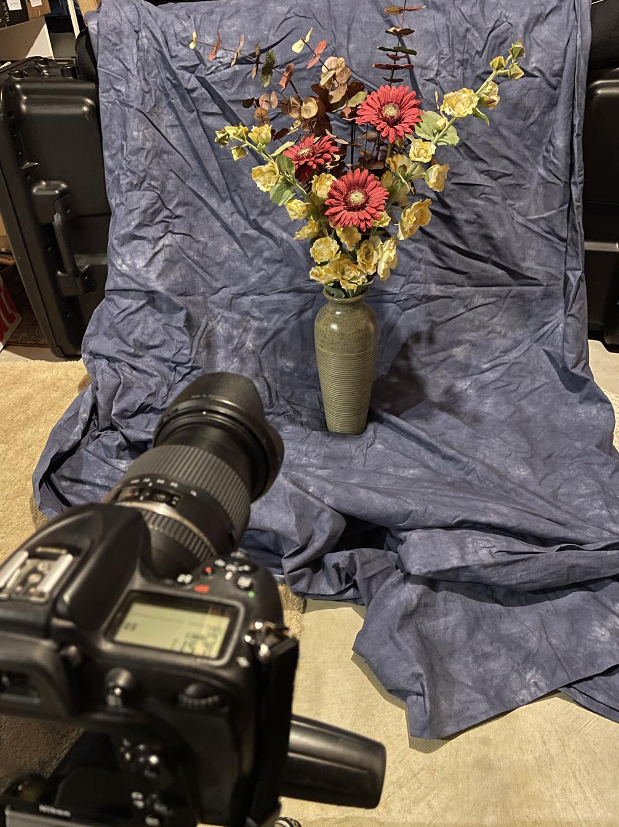
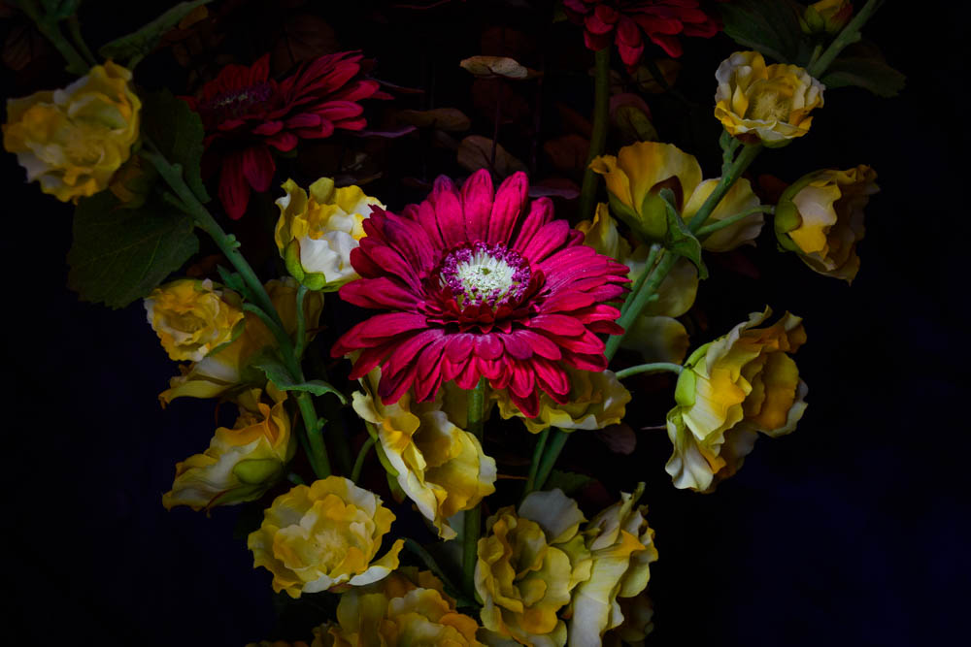
Example Setup
15 second exposure;
it took 7 tries to get this right

Slide 9
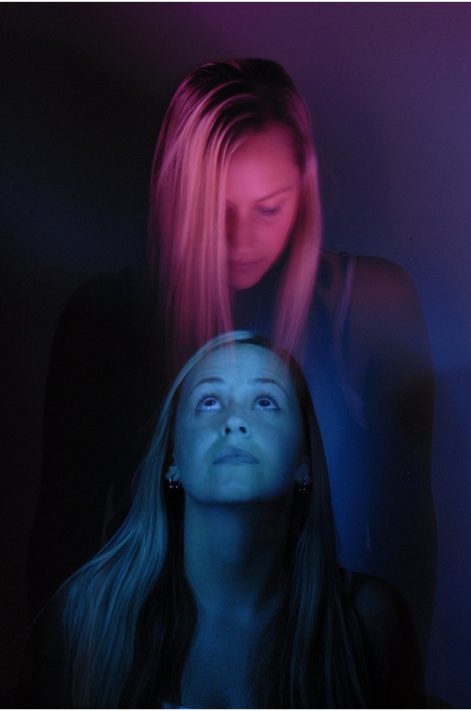
Another example
Light painted model, one light source with blue gel, one with red gel.
The model sat for the first half of the exposure, illuminated with blue light from the left and above. Then lights out, and she moved to a standing position and she was illuminated with the red light from the right and below.
Photo ©Arik Gorban, used with permission

Slide 10
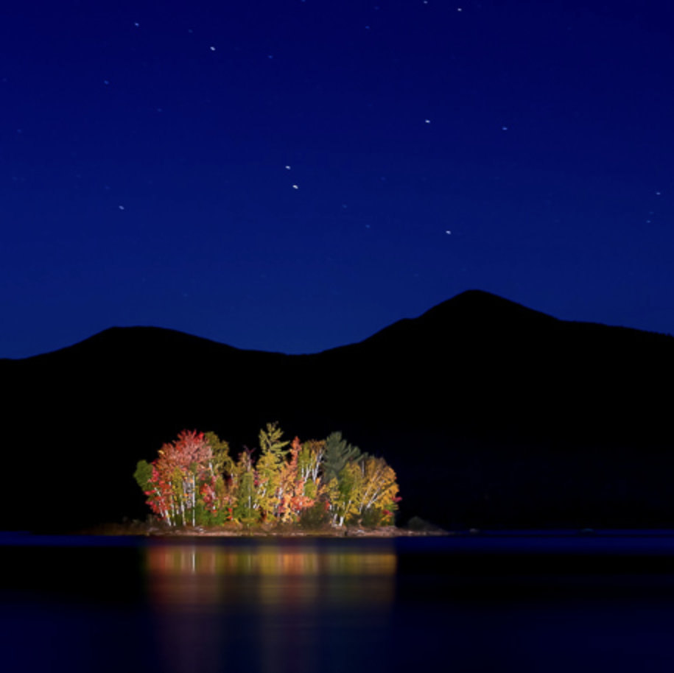
Light Painting Large Objects
Dark location
Illuminate your subject, focus, lock focus
Set exposure to 30 sec or 60 sec (shutter priority or full manual mode), low ISO
Take a test shot to determine background light sources and intensity and adjust exposure accordingly (Do you want stars or star trails? Blue hour sky? Other illuminated parts of the scene you can’t control?)
Larger and more complex objects (parked cars, old barns, abandoned buildings) might require multiple exposures so you don’t have to get it all done in one try. These can be combined later in Photoshop (see tutorial in “resources” slide).
Release the shutter and paint your subject
Don’t illuminate yourself unless you want to be in the photo
Don’t point the flashlight at the camera if you don’t want “light bugs”
Review your image and try again (or add to it in another exposure)
Photo © Loren Fisher (lorenphotos.com)
Island illuminated by high-power spotlight

Slide 11
Combining Exposures
If you made more than one exposure to fully illuminate your subject
Open all the exposures as layers in Photoshop
Select all the layers and align them (if not already aligned)
Select all the layers (except base layer) and choose the Lighten blend mode
Turn off all layers (except for base layer) and turn each layer on one at a time to see each part get illuminated
Fix any issues
Mask or clone out mistakes (like “light bugs”)
Reduce opacity of a layer if it’s too bright
Save your file as a PSD with layers; flatten and save as a JPG

Slide 12
Light Painting (illumination) Resources
Loren Fisher’s excellent tutorial video
https://lorenphotos.com/light-painting-objects-small-and-large/
Digital Photography School
Making the photograph http://digital-photography-school.com/light-painting-part-one-the-photography/
Post processing http://digital-photography-school.com/light-painting-part-two-photoshop/

Slide 13
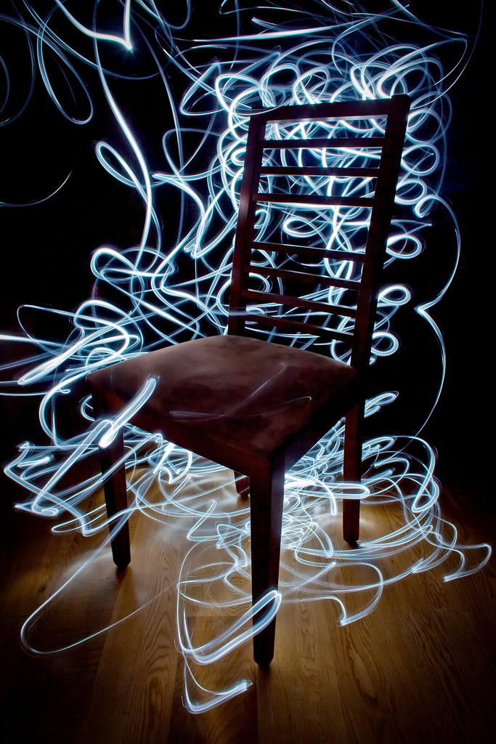
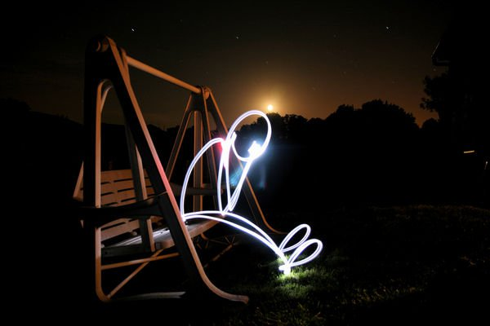
Using light as a subject (drawing)
Photo by rafoto
https://www.flickr.com/photos/rafoto/2653254686/
Photo by Pedro Moura Pinheiro
https://www.flickr.com/photos/pedromourapinheiro/3221587377/
Shine the flashlight toward the camera (not directly into the lens unless you want flaring).

Slide 14
Light Painting with Light as your subject (Drawing with Light)
Dark location
Illuminate your subject, focus, lock focus
Set exposure to 30 sec or 60 sec; low ISO
Determine the “edges” of your painting space (what will be in the frame)
If writing, do it for yourself, then flip image in post-processing
Shine the flashlight toward the camera but not directly into camera lens (causes flare)
Try gels for colors or use other objects as light sources (iPhone, candle, glow sticks, sparklers, etc.)
Try painting objects into existing scenes

Slide 15
Light Painting (drawing) Resources
http://lightpaintingphotography.com/light-painting-tutorials/pipslab/
http://www.thepixelstick.com/
https://expertphotography.com/light-painting-smartphone-photography/

