Slide 1
Video montage tutorial
James Paul Mason
James.p.mason@nasa.gov, code: 671
2018-07-11

Slide 2
Engineering video montage
The building and testing of the MinXSS CubeSat at University of Colorado, Boulder
youtu.be/pw2-xLI6v6A

Slide 3
Wedding Reception video montage
Made for my wedding in November, to play on a projector at the reception
youtube.com/watch?v=hL58SW4ZI5c

Slide 4
Rocket launch video (simple) montage
We put two GoPros on a sounding rocket a few weeks ago
Montage is just putting the two videos side by side and in sync
youtu.be/kDx1Huj8sgQ

Slide 5
Software
iMovie (macOS free equivalent of Garage Band)
Final Cut Pro (macOS professional [$] equivalent of Logic Pro)
Lightworks (cross platform free)
Adobe Premier Pro (cross platform professional [$])
Lots of others, just Google it

Slide 6
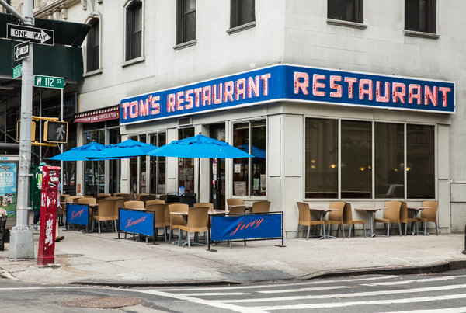
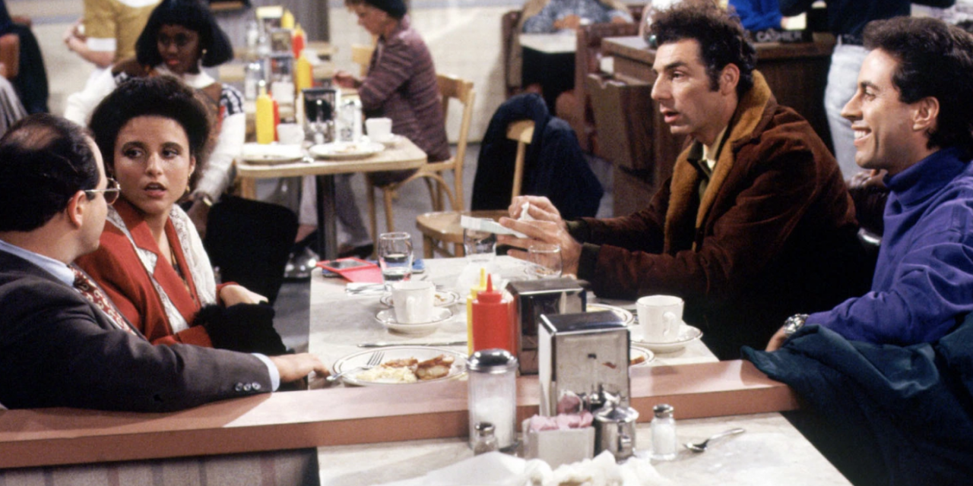
Tips from pro video editor (online course)
The two that really stuck with me:
Establishing shots: frame the scene then cut to more focused shots* (e.g., Seinfeld café)
Cut on action: natural transition* (e.g., chef chops knife down, cut to another shot where the knife is still down)
*Unless you deliberately want to elicit a particular reaction

Slide 7
Other tips
Modern phones often have a Live ( )/Motion ( ) Photos mode (Harry Potter ( ) pictures) – Use it by default!!
Use video rather than still images as much as possible to take advantage of the medium*
Text should be minimized
Show don’t tell
Plenty of other media for reading
Pacing: steady*
*Unless you deliberately want to elicit a particular reaction

