Slide 1
Basic Post Processing with Photoshop Elements Photo 102
Scott Hull
March 2022

Slide 2
What is Post Processing?
My definition: Post processing is that last 20% of digital photography that turns snapshots into postcard quality images
The camera can only do so much
Post processing can adjust or fix
Exposure issues (brightness, contrast, color)
Sharpness
Cropping
Distractions
You can also add text, combine two photos, and a lot more
Basically, it helps you achieve your vision when you took the photo

Slide 3
Ethics
Personal choice as to how much editing you are comfortable with
With raw files, there is no ‘real’ exposure recipe
Some are willing to only do cropping and exposure
Some will remove distractions
Some replace skies, combine images, or get really unrealistic or artistic
Your threshold doesn’t need to be fixed for all images
Artist Spotlight examples
Both have a journalism background, and try to get the image ‘right’ in camera
Tom Bol: Will remove distractions, but doesn’t swap out skies or backgrounds
Billie Weiss: Cropping and exposure only; needs to reflect reality

Slide 4
Example 1: Exposure, contrast, distractions, vignette

Slide 5
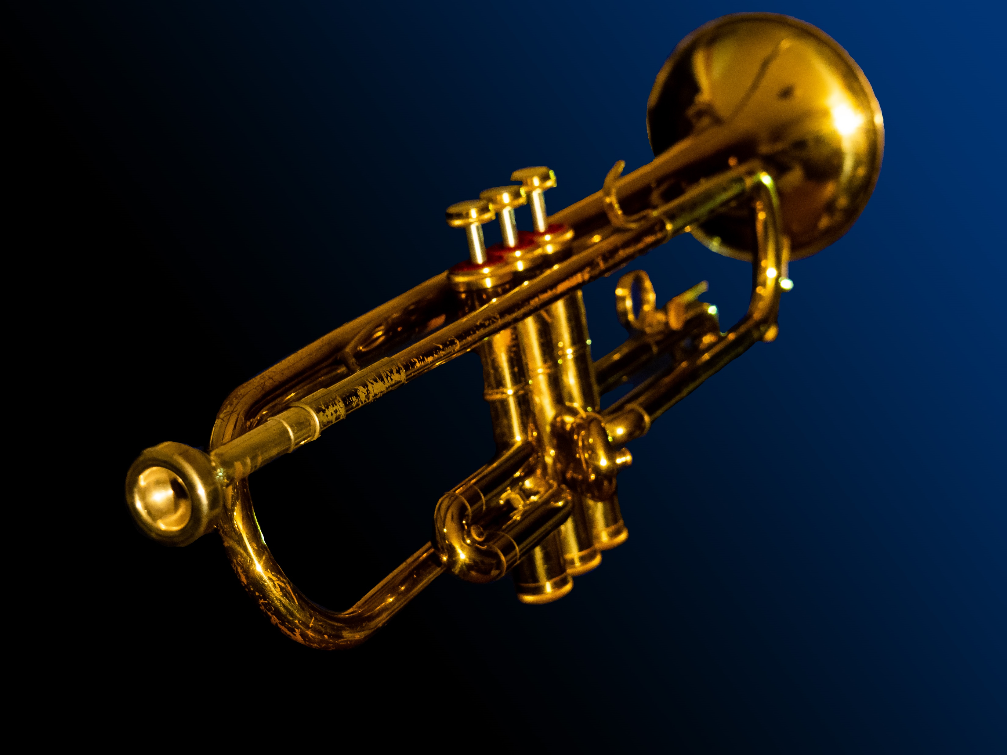
Example 2 Exposure, contrast, removed threads, sharpness, distractions, replaced background

Slide 6
Example 3: Over the top in my book…

Slide 7
Why Photoshop Elements (PSE)?
More approachable than “full Photoshop” Creative Cloud
Offers about 90% of the tools in CC that you will probably use
Learn the basic tools, then maybe move to CC if you need the full tool set
More editing tools than Lightroom
Lightroom is designed first as an organizer, with some editing tools
Layers is an important tool for some edits, for example
PSE has pre-packaged quick and guided edits for beginners
It’s cheap – sort of
Buy it once, use it for years
CC & LR are $10 per month; PSE 2022 is $100

Slide 8
Step 1: Import Your Images
PSE has a reduced version of Adobe Camera Raw (ACR)
This is the place to make GLOBAL adjustments
Exposure: Brightness, Contrast, and Color
Detail: Sharpness and Noise reduction
Raw files will open in ACR automatically
Defaults to your pre-set camera ‘recipe’ for that camera
Develop your preferences, then save the Camera Raw Defaults
Saves LOADS of time
For JPEG files, use the “Open in Camera Raw” option
Starts from all zeroes, and needs to be adjusted each time

Slide 9
Camera Raw – Basic/ Exposure Adjustments
White Balance
Crop
Leveling Tool
Full Screen
Sharpness and Noise
2
1
Hand Tool
3
White Balance Adjustment
4
Brightness Contrast
Highlight/Shadow
White and Black point
5
6
Magnification Select
Refinements
7
Toggle Views

Slide 10
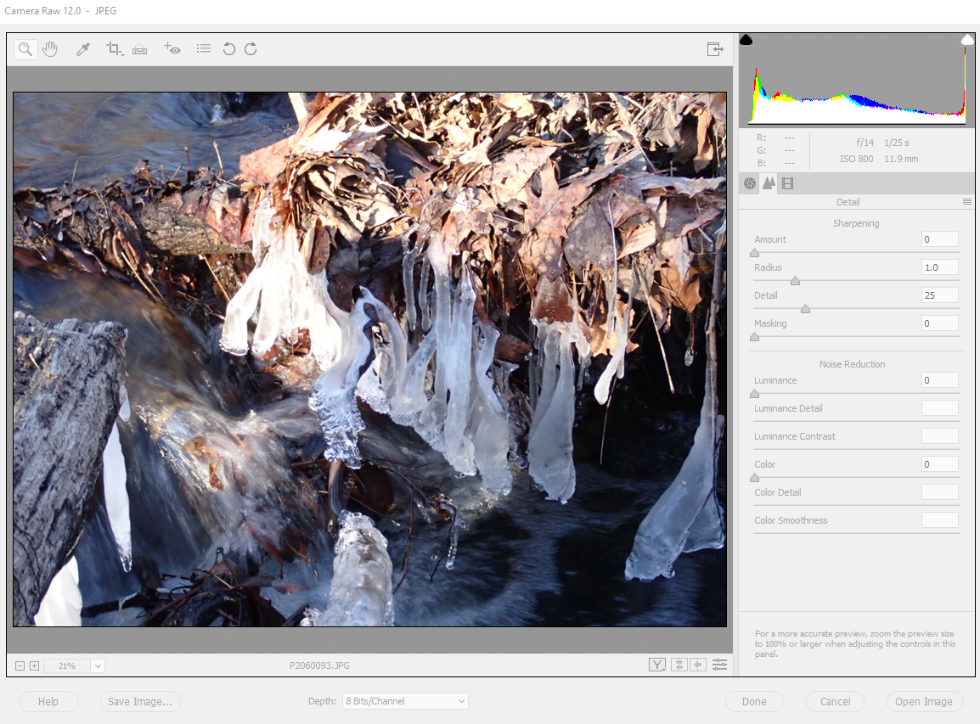
Camera Raw – Detail/ Sharpness and Noise Red.
Sharpness
Amount Radius
Masking
3
1
2
Noise Reduction
5
4
Magnification Select 100%
6
Open Image(s)

Slide 11
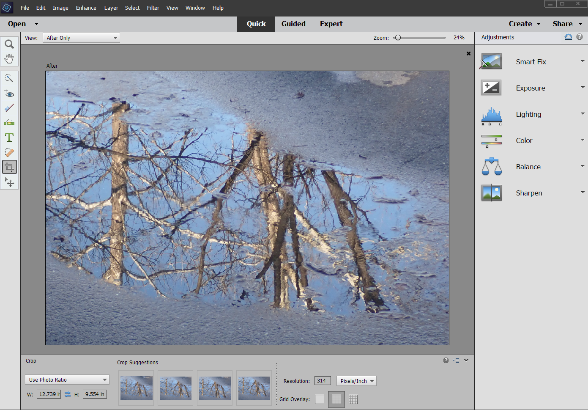
Quick Mode
Basic edits
Global edits on the right side
Detail edits on the left side with tools
Menu options are available
Mostly for beginners

Slide 12
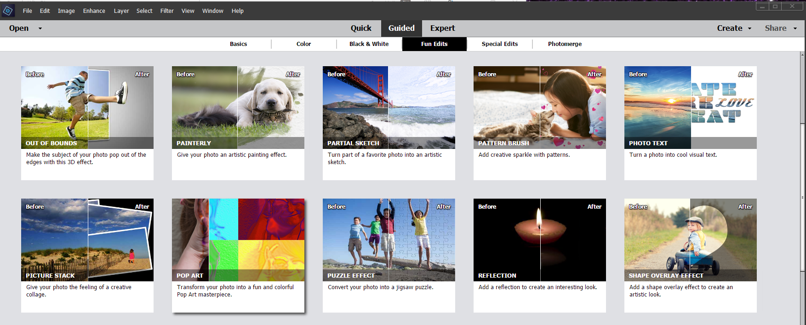
Guided Mode
“Canned” effects, some basic, some combinations of many steps
Some can be useful to experienced users, to save time
Six groups of effects: 50 options

Slide 13
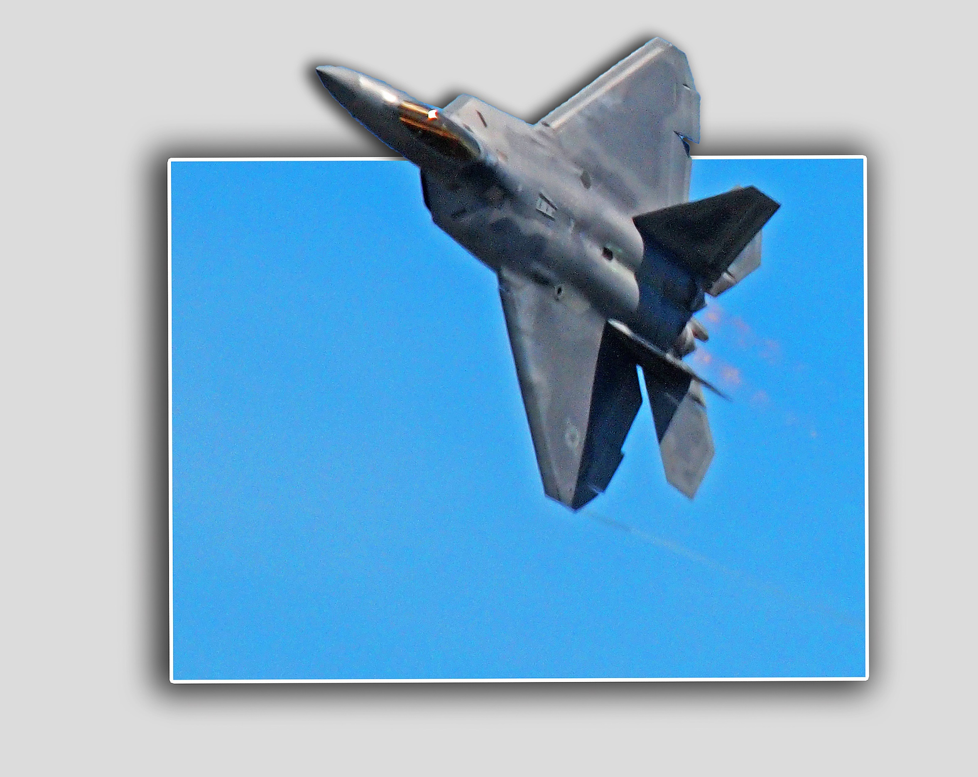
“Out of Bounds” Example

Slide 14
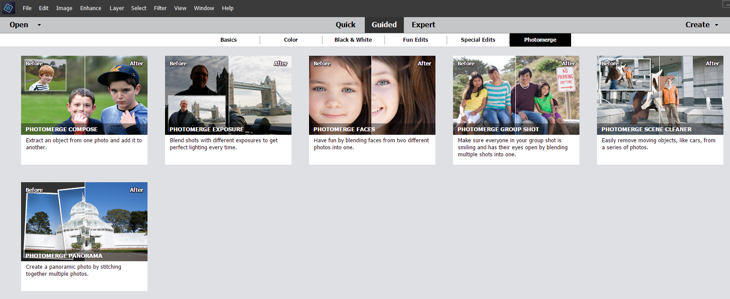
Photomerge
Very handy for combining photos easily and quickly
I have used this for large group shots, merging up to five photos

Slide 15
Expert Mode
This is where we will make LOCAL edits
Not just for “experts”, but accept the flattery
Lots of tools in the menus and the collection on the left
Try them out, and see what they do
Get messy, make mistakes, and LEARN from them
PHOTOSHOP ALWAYS HAS AT LEAST TWO WAYS TO DO ANYTHING
The tools (and shortcuts) you use will probably evolve over time
Tackle the biggest distractions first, then whittle them down
I tend to embellish with text, etc. last

Slide 16
Most Useful Menus (for me, at least) slide 1
File Menu (21 options)
Open in Camera Raw, Save As, File Info
Edit Menu (17 options)
Copy, Paste, Undo
Image Menu (8 options)
Resize: Image Size (resolution), and Canvas Size (bigger space around image)
Enhance Menu (21 options)
Adjust Color: Adjust Saturation, Adjust Sharpness, Adjust Lighting
Layer Menu (19 options)
Duplicate Layer, Merge Visible layers, New Layer

Slide 17
Most Useful Menus (for me, at least) slide 2
Select Menu (16 options)
Select All, Inverse, Refine Edge
Filter Menu (15 options)
Correct Camera Distortion, Blur, Noise: Dust and Scratches, Reduce Noise
View Menu (14 options)
Fit on Screen (Ctrl + 0), Rulers, Grid
Window Menu (17 options)
Tools, History, Layers
Help Menu (14 options)
self-explanatory (152 total options; I use 27)

Slide 18
Most Useful Tools (for me, at least)
View Group
Zoom (Alt + mouse wheel),
Select Group
Marquee, Quick Selection, Move
Enhance Group
Spot Healing Brush, Clone Stamp, Sharpen/Blur, Dodge/Burn
Draw Group
Brush (for masks), Color Picker, Gradient, Paint Bucket, Text
Modify Group
Crop
Color: Foreground/Background, Reset to B/W (26 Tools; I use 15)

Slide 19
Layers Panel
Accessed from the View Menu
“Layers” is a whole several-hour class in itself
Key features that I use (PSE has much more than I use)
View the layers, and arrange their order
Add a Mask: lets you hide whole large portions of that layer
White reveals, black conceals (and gray partially conceals)
Mask starts out white, paint in with Paintbrush Tool or Paint Bucket
New Mask, New Fill Mask
Hide (eyeball) and Opacity slider
Blending Modes: Darken/Multiply, Lighten/Screen

Slide 20
Common Shortcuts That I Use
Ctrl + Z: Undo, Ctrl + Y: Redo
Ctrl + X: Cut, Ctrl + C: Copy, Ctrl + V: Move
Ctrl + 0: Fit on Screen, Alt + mouse wheel: zoom in/out on most tools
[ : Shrink brush size, ] : Grow brush size, { : Soften brush, } ; Harden brush

