Slide 1
The Photomerge Tool Set in Photoshop Elements
Scott Hull
Goddard Photography Club May 10,2023

Slide 2
Agenda
Photomerge in Different Adobe Photo Editors
The Photomerge Tool Set in PSE
Demos
Group Shot
Compose
Exposure

Slide 3
Photomerge in Different Products
 | Photoshop Elements | Lightroom | ‘Full’ Photoshop
Compose | ✓
Exposure | ✓ | ✓
Faces | ✓
Group Shot | ✓
Scene Cleaner | ✓
Panorama | ✓ | ✓ | ✓

Slide 4
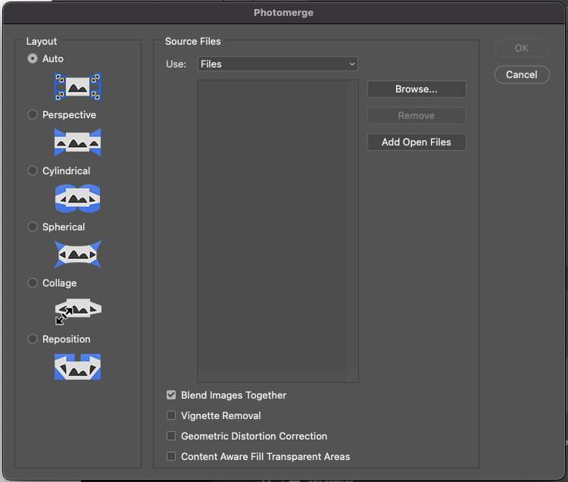
Photomerge in ‘Full’ Photoshop
I don’t have the tool, or any experience with it
Online videos show how easy it is to import files and merge them
Five different options to adjust how the images are merged, plus auto to automatically select based on the lens used
In the videos it works quite well
Can also be used to assemble collages

Slide 5
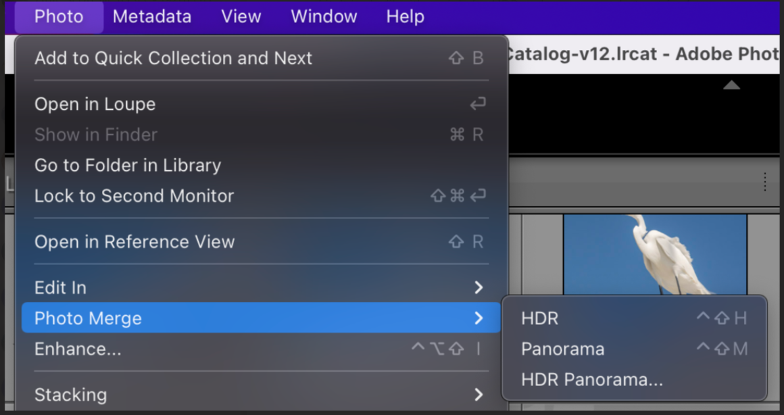
Photo Merge in Lightroom
HDR and Panorama options
Described as Photo Merge (two words)
Again, I don’t own Lightroom, and I have no experience with it
Online videos show how these work How to "Photomerge" Images in Adobe Lightroom (tutsplus.com)
Compared to PSE, this is a more natural, ‘in-line’ process

Slide 6
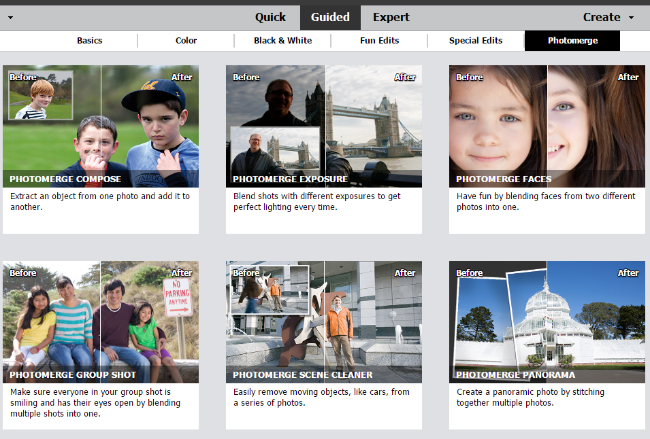
Photomerge in Photoshop Elements
Six different tools
Basically intended for beginners, to do creative things quickly and easily
Some of these would be easy if you have a working knowledge of layers
Sometimes a real timesaver, though
PSE has five other menus of similar tool sets

Slide 7
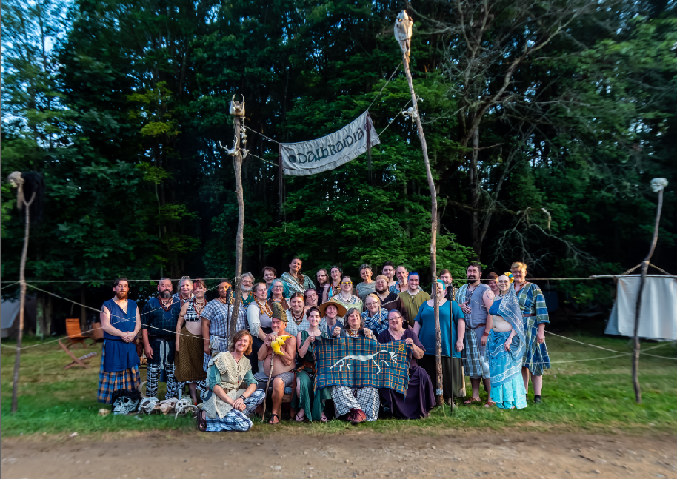
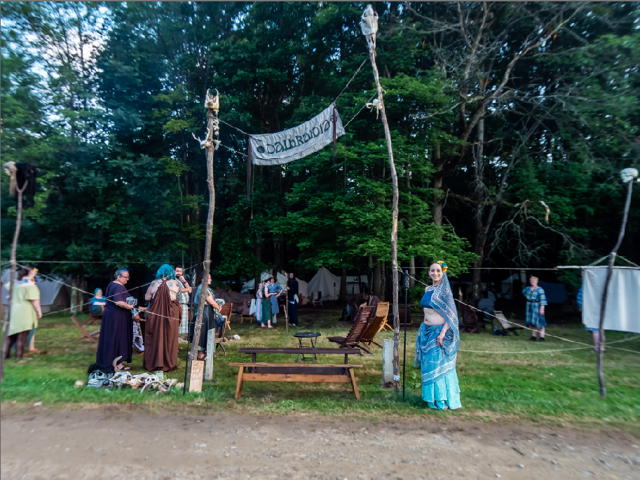
Compose Tool
“Extract an object from one photo and add it to another.”
For example, someone showed up late to the group photo
This could be done manually pretty easily using layers

Slide 8
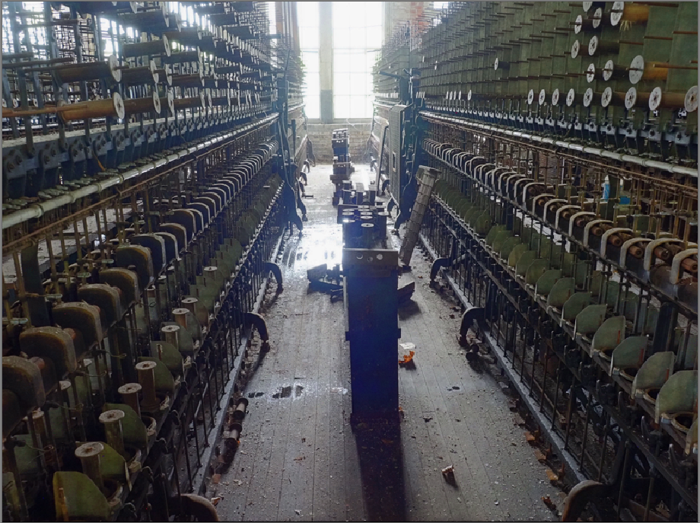
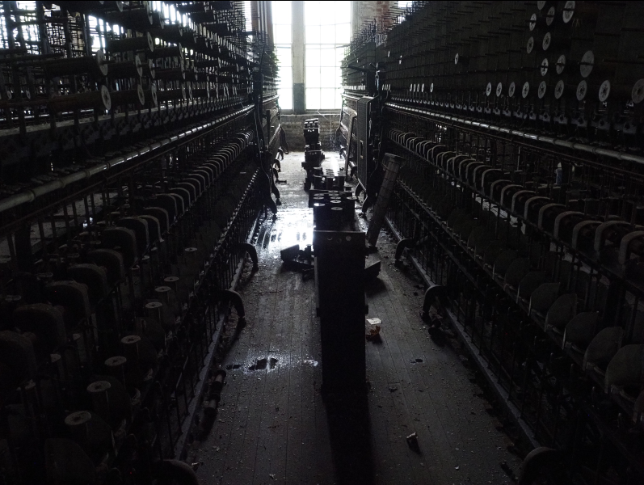
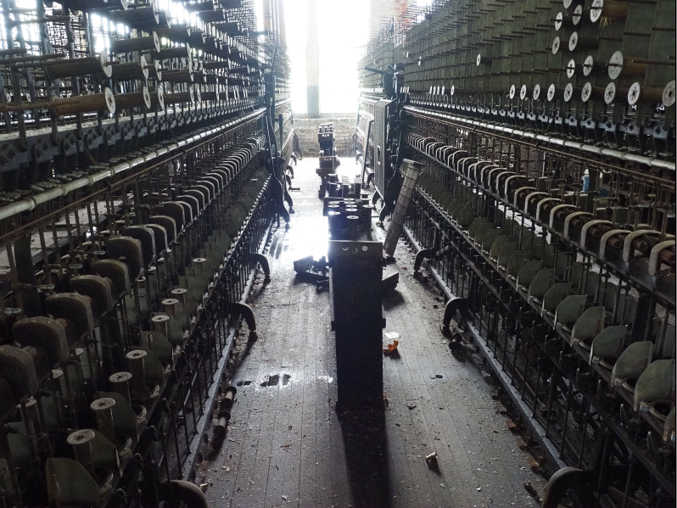
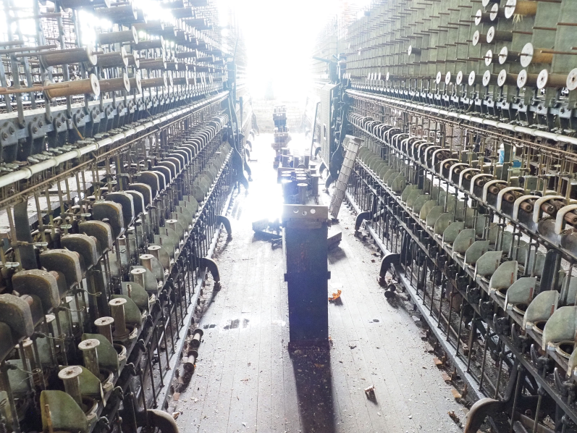
Exposure Tool
“Blend shots with different exposures to get perfect lighting every time.”
Effectively HDR blending
Automatic mode worked pretty well
Some adjustment sliders available
Would be more difficult to do with layers
+
+
=

Slide 9
Faces Tool
“Have fun by blending faces from two different photos into one.”
Crashed for me every time I tried to use it: not fun
Don’t bother
Maybe I’m doing something wrong, but it sounds silly anyway

Slide 10
Group Shot Tool
This is the tool I use the most
Large group shots, some people are always blinking, sneezing, talking, moving, etc.
Pick the best base image (most people look good) and several images where individuals look better than in the base image
Very easy import/replacement of multiple faces
Photomerge does some adjustment of the surrounding area to (usually) blend the new face in seamlessly
Only once have I needed to do this manually

Slide 11
Scene Cleaner Tool
“Easily remove moving objects, like cars, from a series of photos.”
Their example shows someone walking through two photos
Requires a reference image with an otherwise pristine background
Again, should be pretty easy to do manually with layers
Photomerge may apply some automatic refinement to save you some time

Slide 12
Panorama Tool
“Create a panoramic photo by stitching together multiple photos.”
Kind of obvious; aligns and adjusts angles and exposures
Best results if you follow good panorama procedures
Tripod for stability
25% overlap from image to image

Slide 13
Demos

