Slide 1
Portrait Photo Retouching
2 Methods
Karen Smale
GSFC Photo Club
Aug 14, 2013
Notes:
Holiday Inn Express
Photoshop & Portrait Professional

Slide 2
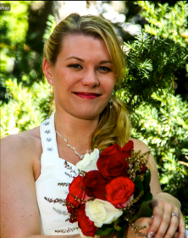
Before & After (& After)
Original Photoshop Portrait Professional

Slide 3
Photoshop
Fix major problems first (cropping, white balance, exposure, major skin blemishes)
Smooth skin
Copy original layer, blur (radius~14; threshold~24)
Create layer mask (fill with black) and paint with white at ~40% where you want the blur to come through (soften wrinkles, blemishes, shine) – not eyes or edges
Notes:
Using masks makes things infinitely adjustable. Softening/blurring removes wrinkles, freckles, blemishes, shine, goose bumps, stray hairs…

Slide 4
Photoshop (cont’d)
Enhance the Eyes
Increase color saturation
adjustment layer (hue/saturation) & increase saturation, fill mask with black and paint eyes with ~50% white
Darken pupil, add catch light and exit point for that light on the opposite side
new layer, fill 50% grey and select “overlay” blending mode
paint with black to make darker, paint with white to make things lighter
Clear red veins from white of eyes – desaturate, don’t whiten!

Slide 5
Photoshop (cont’d)
Draw the viewer’s eye into the subject
Vignette: new layer 50% grey in overlay blending mode, paint with big black brush in the corners/background
OR adjustment layer (levels) and paint person back in
Blur background: Same process as blurring skin

Slide 6
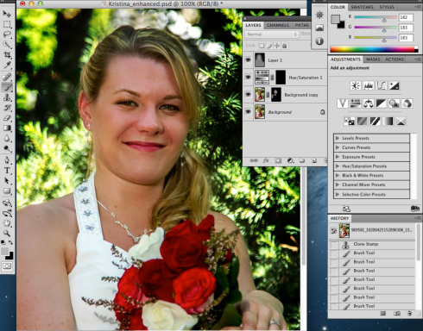
Demo Photoshop

Slide 7
Portrait Professional
Load image, select male/female & child/adult
Basic changes are made based on the above selection
Further refinements to face/mouth/nose/eye shape, eye color, lighting, skin smoothing, hair, etc. as sliders
Brush to remove blemishes / smooth skin

Slide 8
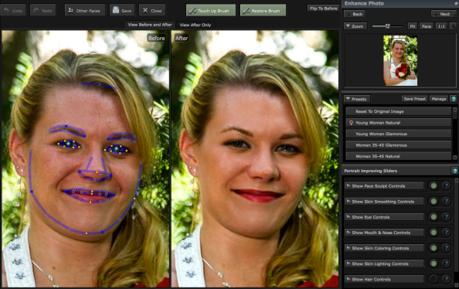
Demo Portrait Professional

Slide 9
Pros & Cons
Photoshop
Pros: extreme fine-tuning, total control, total photo adjustments (background mods, vignetting, etc)
Cons: time consuming, huge learning curve, much harder to do shaping changes
Portrait Professional
Pros: very quick results, can make non-model material look great without effort
Cons: adjusts face, not much else

Slide 10
More Befores & Afters
Photoshop
Portrait Professional & Photoshop

Slide 11
More and more…
Portrait Professional

