Slide 1
Post Processing Tools for Spot and Object Removal
Nancy Rosenbaum
Goddard Photo Club

Slide 2
“Photography deals exquisitely with appearances, but nothing is what it appears to be.”
Duane Michals

Slide 3
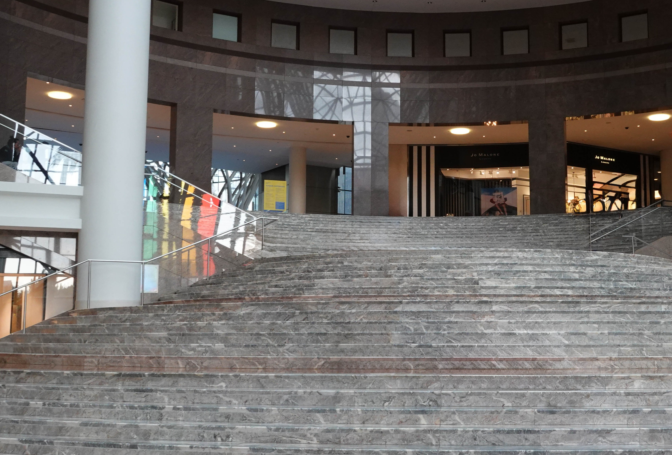
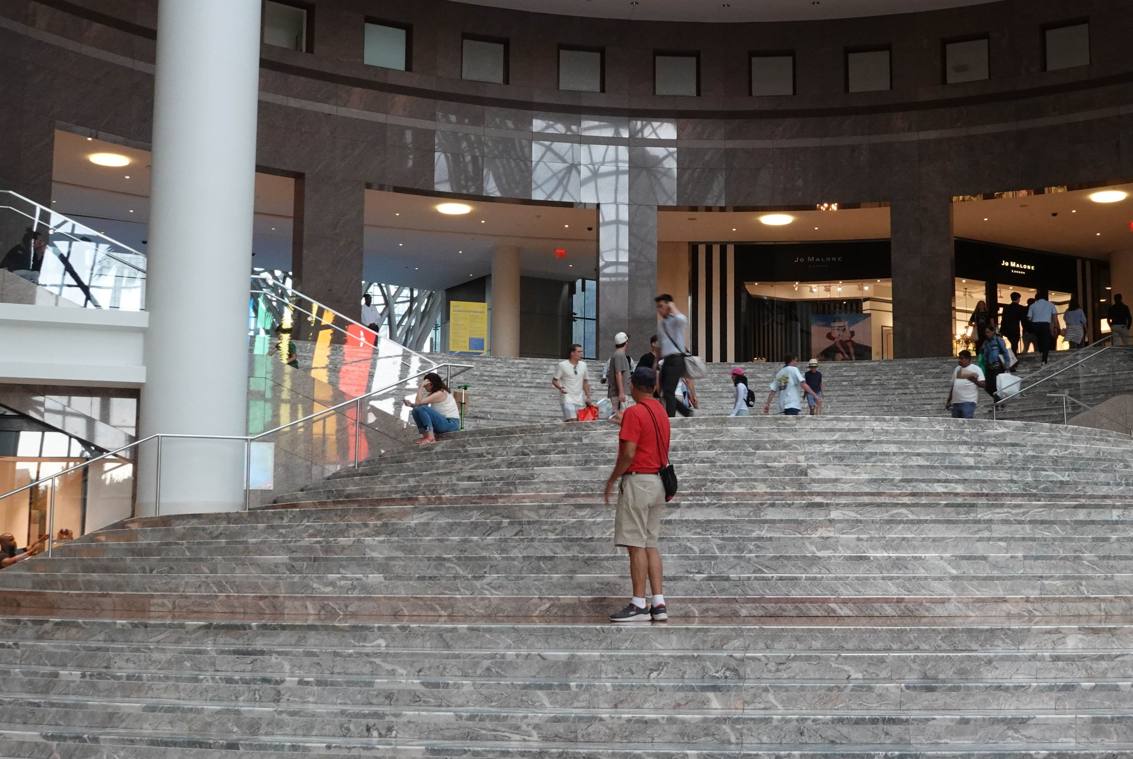
How can you
get this
from this?

Slide 4
Agenda
Overview of Lightroom/Adobe Camera Raw (LR/ACR) and PhotoShop (PS) tools for spot and object removal
Lightroom demo
Healing
Content-Aware Remove
PhotoShop demo
Spot healing brush
Healing brush
Fill
Remove
Conclusion

Slide 5
Terms
Term | Meaning
Target | Pixels to be repaired/replaced
Source | Pixels to be sampled
Content-aware | Capability that enhances LR and PS tools to determine how to best make up differences made in editing
Brush | Tool in PS and LR that works like a paintbrush. Use it to “paint” across image for targeted editing
Feather/ Hardness | Setting that determines the hardness or softness of a selection or brush’s edge. minimum feather = maximum hardness
Selection tools | Collection of tools in LR and PS for isolating parts of image to edit. Examples in LR are brush (freehand), sky, subject, object, person, background, gradients, and luminance and color range. Examples in PS are marquee (box, circle), lasso (freehand), magic wand, color range, object, and focus area

Slide 6
Removal Tools
LR/ACR | Description | PS | Description
Content-aware remove | Intelligently creates new information to patch the selected area | Spot healing brush | For removing spots or blemishes in small areas with simple backgrounds. Samples surrounding pixels
Healing | Matches texture, lighting, transparency, and shading of pixels being healed | Healing brush | Similar to spot healing brush, but for larger areas or when desiring more control over sampled area. Matches texture, lighting, transparency, and shading of pixels being healed
Clone | Duplicates sampled area to selected area | Clone stamp | Duplicates pixels from sampled area to selected area
 |  | Remove | For removing unwanted objects. Fills in background. Effective with complex background and edges
 |  | Patch | For removing unwanted objects. Content-aware synthesizes nearby content. You have control over the source area. Good for skin retouching
 |  | Fill | For replacing pixels when colors and textures are consistent
 |  | Content-aware fill | For greater control of sampled area when replacing pixels or objects

Slide 7
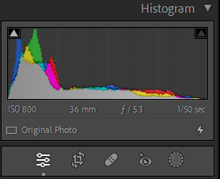
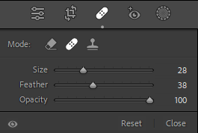
Lightroom Healing Tools
Content-aware, Healing, and Clone tools are on the masking toolbar, usually found in upper right-hand corner of Develop module
Greatly improved in most recent updates
All three tools have size and opacity (transparency) sliders; Healing and Clone tools also have feather slider to adjust hardness of edge of healed area
Adjust brush size using slider, bracket keys ([ ]) on keyboard, or mouse wheel. Use brush size slightly larger than spot to be removed
TIP: When you click Healing tools icon, Visualize Spots checkbox and slider appear below image. This is a great way to find spots you might otherwise miss

Slide 8
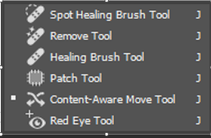
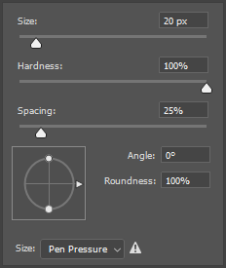
PhotoShop Healing Tools
Healing tools
Grouped on PhotoShop toolbar, typically found on left side of screen
Hover and right-click to get drop-down options
Adjust brush size and characteristics with shortcut (B) or dropdown from ribbon bar
Spot Healing Brush: Brush over area to repair image
Healing Brush: Alt-click to define source point to use to repair image, then brush over area to be repaired. May need to repeat source selection, depending on size and complexity of replacement
TIP: A good practice in PS for non-destructive editing is to duplicate background layer before any edits. Suggest renaming new layer “Retouching” or some such
Healing Tools Group
Brush options

Slide 9
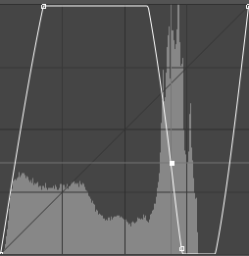
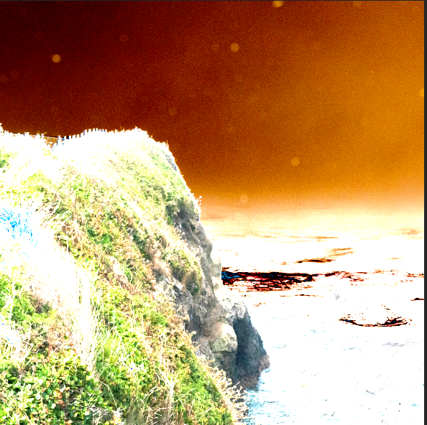
PhotoShop Healing Tools, Cont’d.
TIP: PS doesn’t have a “Visualize Spots” feature like LR. You can get a similar result using a Curves adjustment layer, as follows:
Duplicate background layer and make it the active layer.
Create a new Curves adjustment layer on top of the duplicate layer.
Adjust the line to make a sine wave; you may need to play with it to make the spots appear.
Make background copy layer the active layer.
Curves, adjusted to
Make spots appear
Image without curve
Image with curve

Slide 10
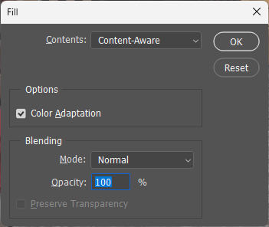
PhotoShop Fill
Duplicate background layer and make it the active layer.
Using the Lasso or Polygonal Lasso selection tool, loosely select the object to be removed.
Select Edit/Fill from the menu or Shift-F5 (on a laptop, you may need to press Shift-Alt-F5).
See screen capture to the right for Fill dialog box settings.
Press OK.
Press Ctrl/Command-D to de-select.
Tips:
Include shadows when you remove objects
Sometimes PS does a better job of biting off small pieces, rather than large pieces at once
…
Free-hand selection
Straight line selection
Free-hand selection tools
Fill Dialog Box

Slide 11
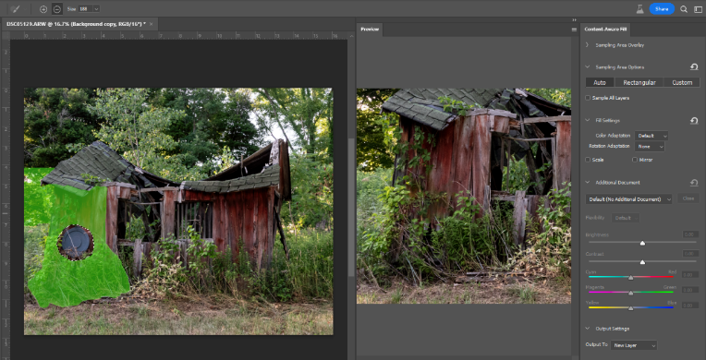
PhotoShop Content-Aware Fill
Duplicate background layer and make it the active layer.
Using the Lasso or Polygonal Lasso selection tool, loosely select the object to be removed.
A split screen opens, showing the image highlighting the sampled areas, a preview window, and a dialog box with settings.
Using the plus or minus signs in the options bar at the top of the screen, brush over the sampled areas to add or subtract them from the sample.
Click OK to accept the change.
Content-Aware Fill Screen

Slide 12
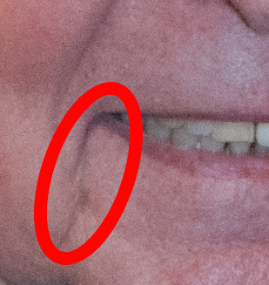
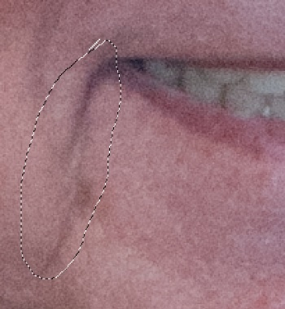
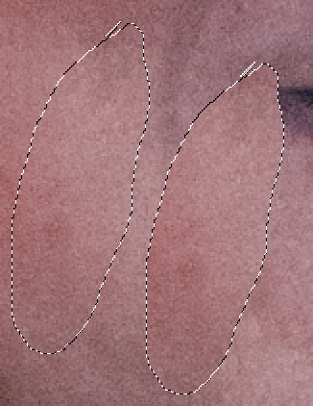
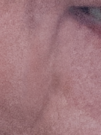
PhotoShop Healing Tools, Cont’d. - Patch
Duplicate background layer and make it the active layer.
In Patch tool options below menu bar, select Sample All Layers.
Draw circle around area to be patched, then drag to source area. Target area will show result of patch.
To fade the effect, press Ctrl/Command-Shift-F to get opacity slider.
TIP: For reducing laugh lines, a good opacity is 30% for children and 60% for adults
Target
Source
Target on right;
source on left
Result at 40%
opacity
Patch Tool Options Bar

Slide 13
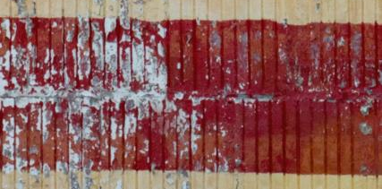
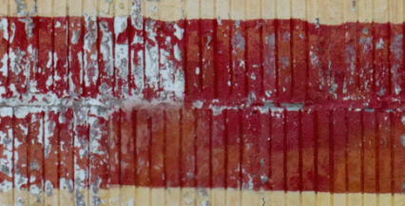
PhotoShop Tools – Clone Stamp
Duplicate background layer and make it active layer.
Alt-click to select source.
Position cursor over target and paint. You may need to select a new source every few strokes.
Tip: Back off opacity for more natural blend
Area to be healed (target)
Source area
Result (79% opacity)
Clone Stamp Options Bar

Slide 14
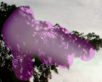
PhotoShop Healing Tools Cont’d. - Remove
Duplicate background layer or create a blank layer and make it the active layer.
In Remove tool options, select Sample All Layers.
Remove after each stroke:
Checked – Applies fill after single stroke
Unchecked – Allows multiple brush strokes before applying fill
Select area to be replaced.
TIP: Repeat process to improve result or remove artifacts around edges
Reflection to be removed
Selection
Remove Tool Options Bar

Slide 15
“All photographs are accurate. None of them is the truth.”
Richard Avedon

Slide 16
Many Roads to Get to Your Destination
Multiple methods in both Lightroom/ Adobe Camera Raw (LR/ACR) and PhotoShop (PS) to do the same things
Some are interchangeable in some situations, and some are not
Play with different tools to become familiar with how they work

