Slide 1
Post-processing to improve your photos in Photoshop & Lightroom
Kristin Rutkowski & Karen Smale
September 18, 2020
Notes:
To address common things mentioned by judges at Showcase and Critique

Slide 2
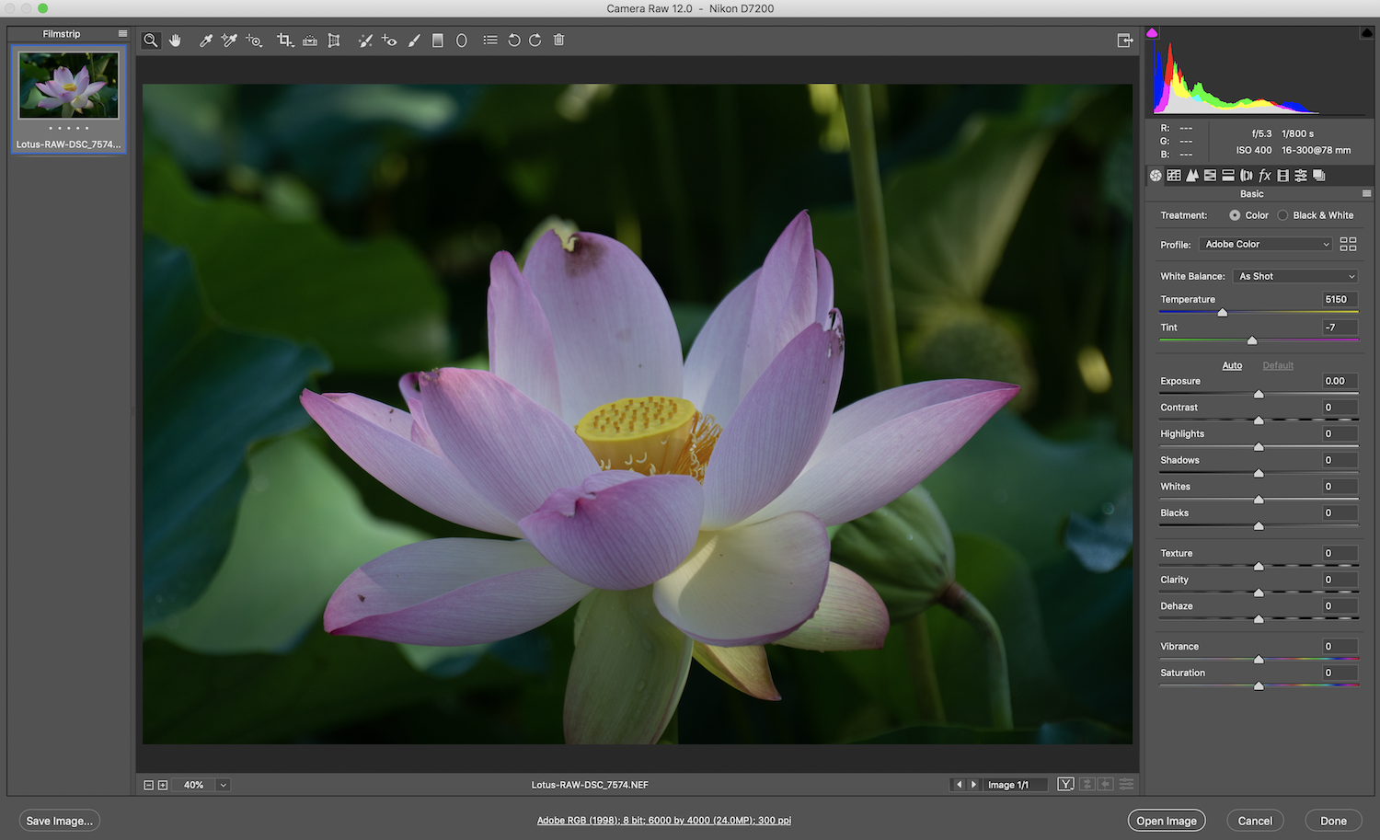
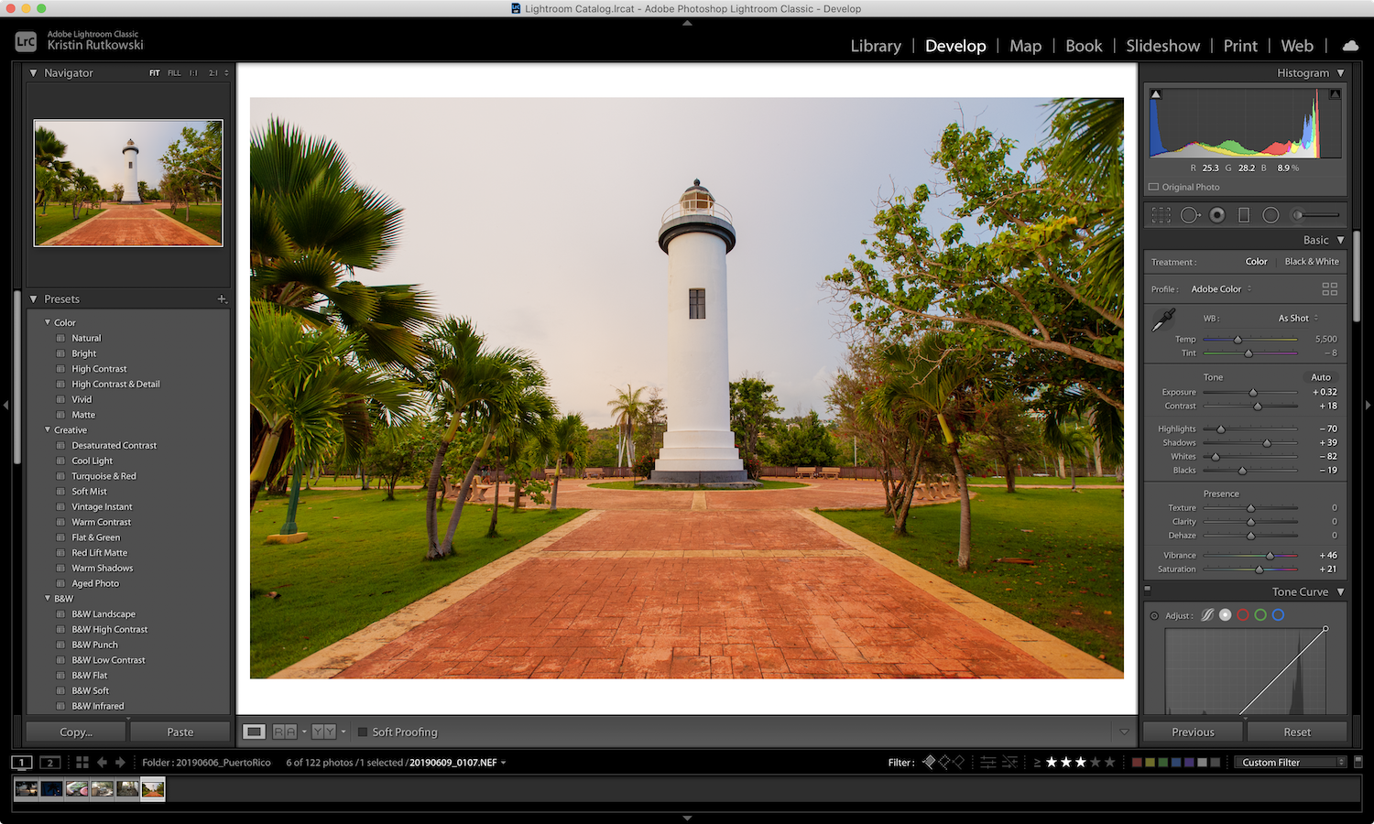
Photoshop Adobe Camera Raw & Lightroom
Notes:
Very similar features
Assumes basic working knowledge of PS or Lightroom but doesn’t go into advanced features (or even layers!)

Slide 3
Common post-processing techniques
Global adjustments
Bring out detail in shadows
Tone down hot-spots
Modify saturation, white balance, etc. if needed
Crop
Fill the frame
Remove anything that doesn’t make the photo better
Eliminate distractions
Clone them out (healing brush & clone tool)
Crop them out
Add vignettes if they’re near photo edges
Selectively edit specific areas of the photo
Adjustment brush
To enhance compositional lines
To eliminate hot spots that remain after global adjustments
To saturate/desaturate
Blur tool, smudge tool
Notes:
Plan: take turns to demo each of these techniques in Photoshop (mostly using Adobe Camera Raw, a plug-in) and in Lightroom.
There are 17 ways to do everything in Photoshop (and maybe Lightroom). This is how WE do these things. YMMV.
Encourage others to do this talk for their favorite editing package (or to show another way to do these things)

Slide 4
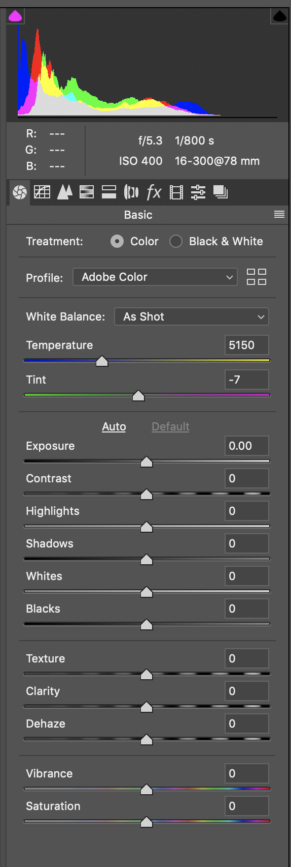
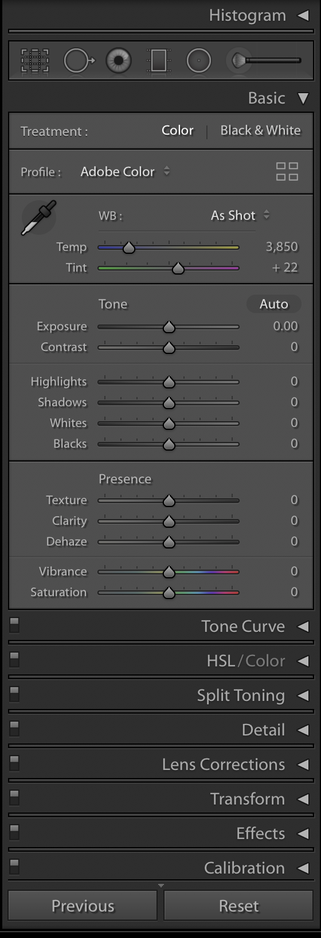
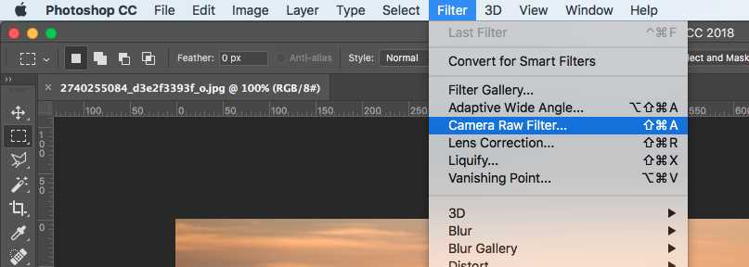
Global adjustments
Bring out detail in shadows & tone down hot-spots
Adjust saturation, white balance, and clarity
Modify hue, saturation, luminence (HSL)
Photoshop Adobe Camera Raw Lightroom
Notes:
Demo global adjustments in ACR and Lightroom

Slide 5
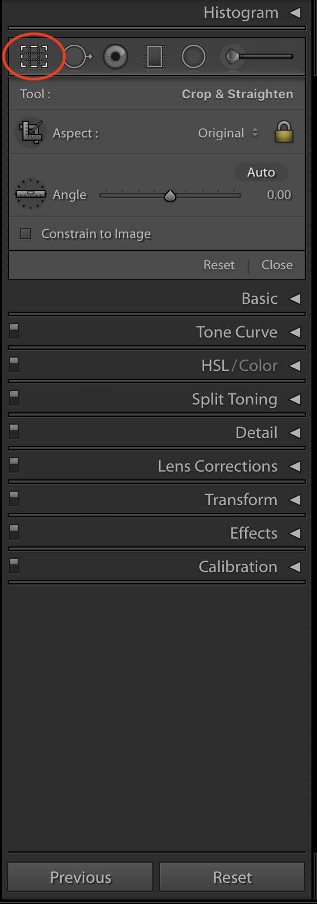
Crop
This can remove distractions and make the composition better
Think about cropping with your feet/zoom, but leave a bit of padding for lens correction and perspective/level corrections
PS Elements ACR tools
Photoshop ACR tools Photoshop tools
Lightroom
Notes:
Demo crop tool including straightening in Photoshop, ACR, and Lightroom
Mention perspective – to be at the end of the presentation?

Slide 6
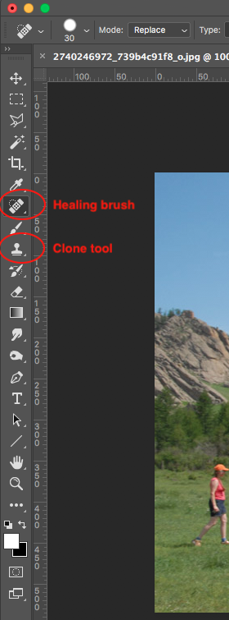
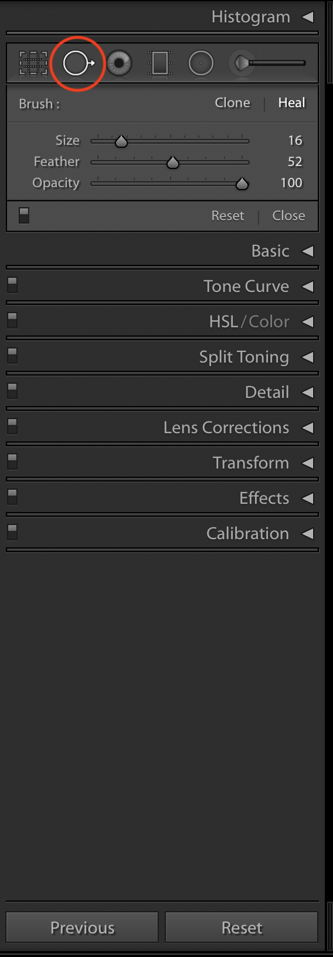
Eliminate distractions
Crop them out
Clone them out
Healing brush
Clone tool
Photoshop ACR
Photoshop Lightroom
Notes:
Demo healing brush, clone tool in Photoshop, ACR, and Lightroom

Slide 7
Eliminate distractions (continued)
Add vignettes if distractions are near photo edges
This also helps to lead the eye to the subject
(Vignette is its own filter in PS Elements)
Adobe Camera Raw (for vignettes)
Lightroom vignette Lightroom radial filter
Notes:
Demo vignetting in ACR and Lightroom

Slide 8
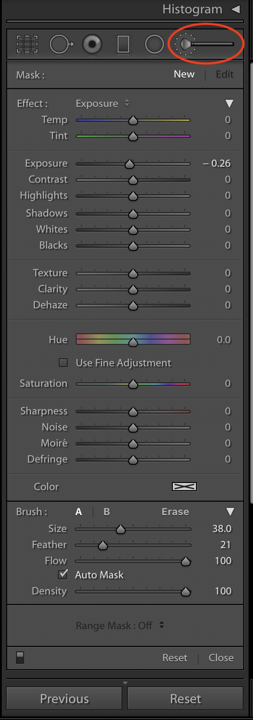
Brush tool
Can selectively edit very specific areas of the photo
To enhance compositional lines
To eliminate hot spots that remain after global adjustments
To saturate/desaturate parts of your photo
(This is not available in PS Elements ACR, but dodge/burn/saturation tools – and maybe adjustment layers – are in Elements itself)
Adobe Camera Raw Lightroom
Notes:
Demo use of the tools to do the above 3 things
Mention this also can be done using adjustment layers (and masks) in PS

Slide 9
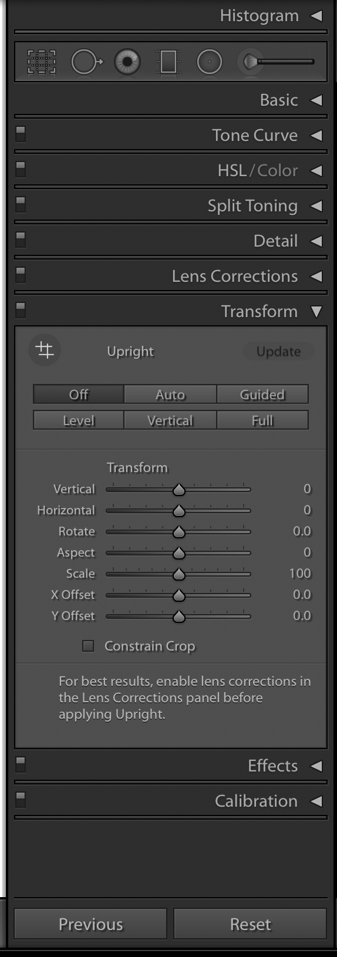
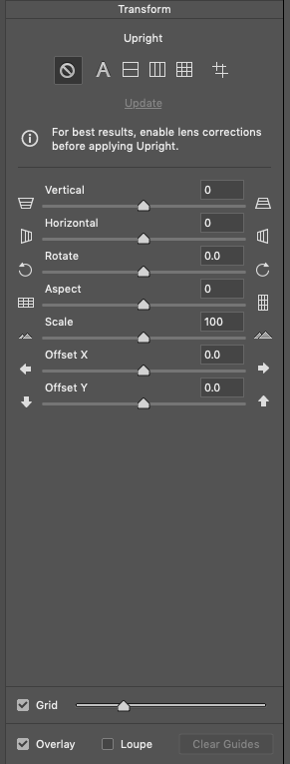
Transform tool
Used to fix perspective distortions (usually on architecture)
Photoshop ACR Lightroom

Slide 10
Before & After images
We will post some before and after images in a Flickr album. Look for an email with the link.

Slide 11
Q&A

