Slide 1
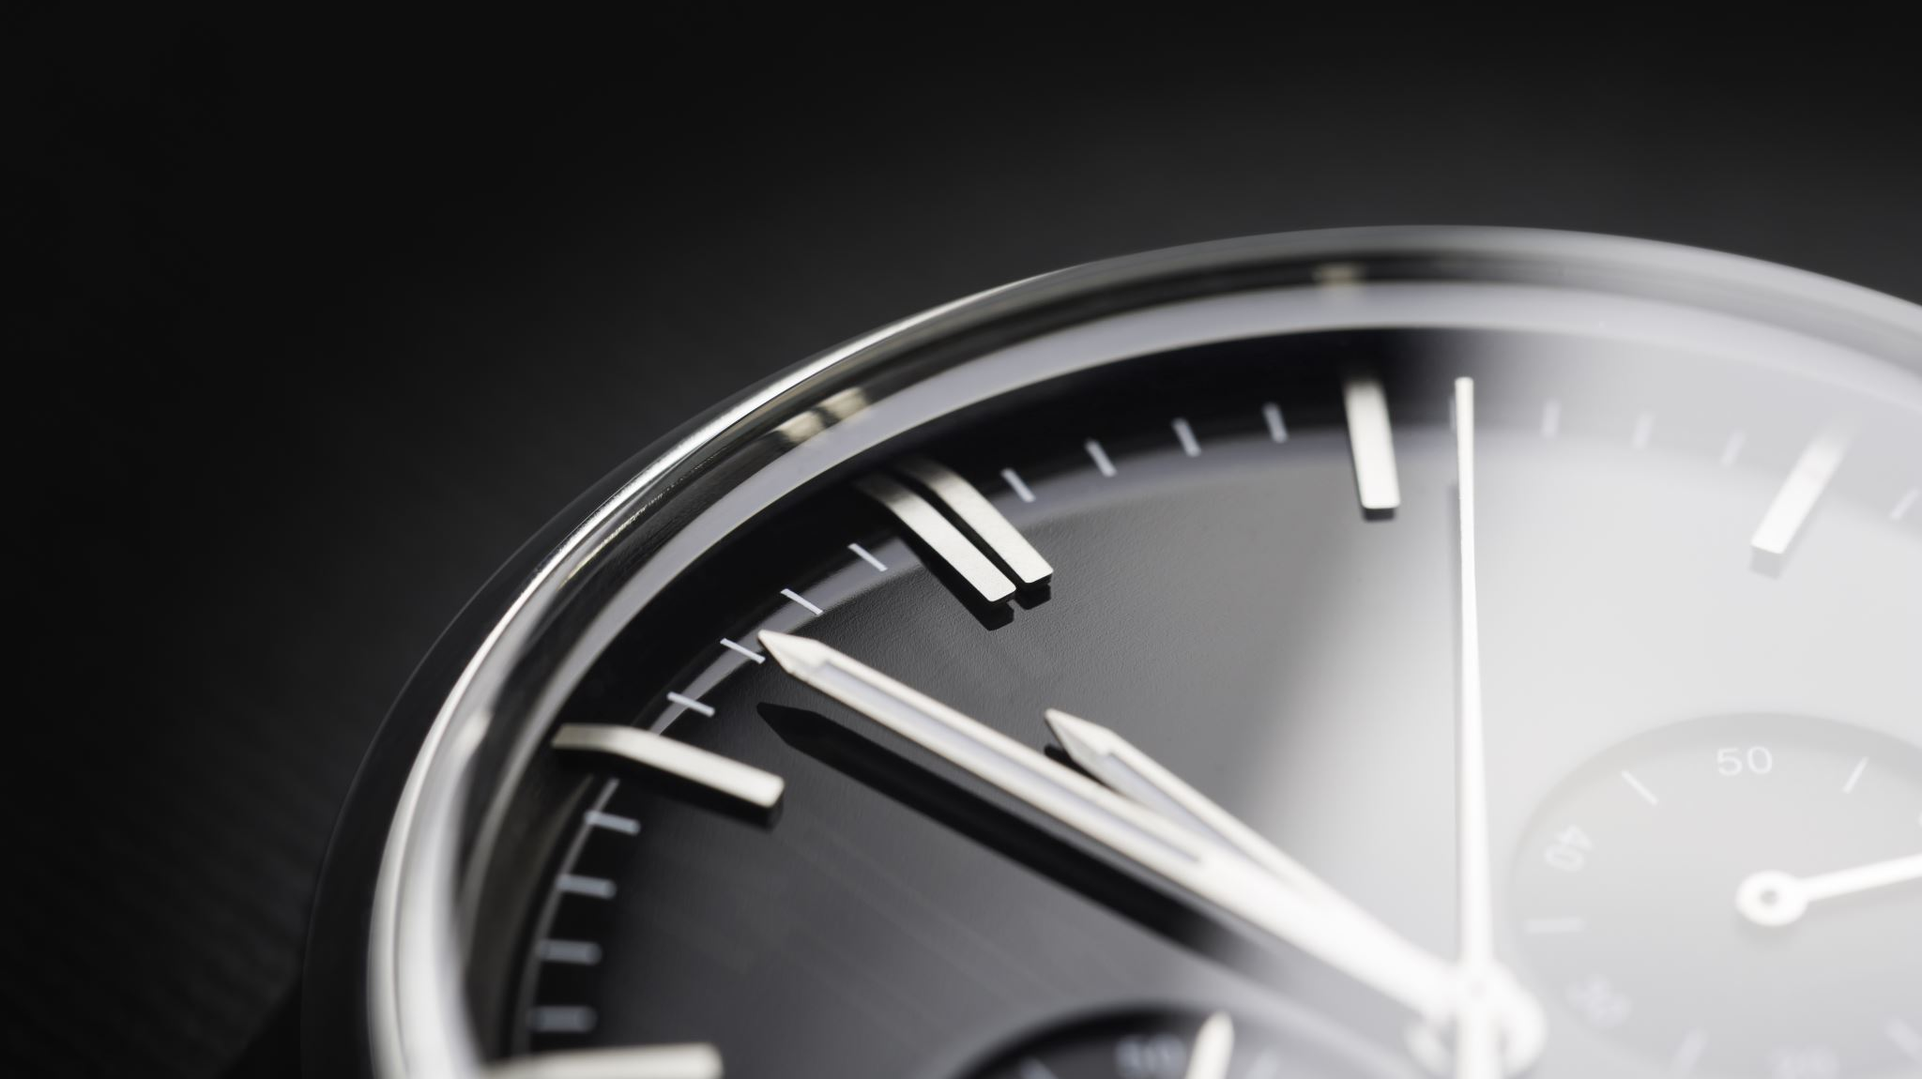
Time-lapse Photography
Karen Smale
Goddard Photo Club
March 2021

Slide 2
What is Time-lapse Photography?
Sequential photos captured over minutes, hours, days, months
Put together in a video to compress that time to seconds or minutes
Allows you to see a slowly-changing scene at a much faster pace

Slide 3
What you’ll need
Tripod
Dedicated to the task (so think about how long it will be out of service of other photography you may want to do)
Intervalometer (for short-term time-lapses)
Allows photos to be taken at regular intervals
Most modern cameras have one built in
Other items you might need:
Fully-charged batteries! (and turn off rear LCD if shooting a LONG time)
Neutral Density (ND) filter (if shooting water or other reflective surfaces where you might want longer exposures)
Cable release or mirror-lock-up (if shooting long exposures, like for astrophotography)
Time-lapse rail system if you want camera motion!

Slide 4
The process: Settings
Manual EVERYTHING (to make your post-processing easier)
Manual focus
Manual shooting mode
Manual White Balance
Low ISO to minimize noise
Turn off image stabilization (always a good idea on a tripod)
Choose a lens, ISO, shutter speed, and aperture appropriate for the scene and lighting you expect to have during the entire set of exposures. Wide apertures and slow-ish shutter speeds are best to avoid “flicker” and give you a smoother looking video. For bright daytime, you might need a ND filter.

Slide 5
Tips on choosing time intervals
Make sure your time interval is a bit longer than each exposure
Interval = exposure time + time for camera to “get ready” for the next shot
Some interval examples:
Capturing the movement of the sun across the sky – 15 to 30 seconds
Sunrise/Sunset and or Moonrise/Moonset – 1 to 3 seconds
Slow moving clouds – 5 to 10 seconds
Fast moving clouds – 1 to 3 seconds
Seasons – 1 shot every day at about the same time

Slide 6
How long will you need to shoot?
Calculating:
At 24 fps, if you want a 10-sec video, that’s 240 frames. If you’re shooting normal cloud movement (every 5 seconds), that’s 240 frames x 5 seconds = 1200 seconds = 20 minutes of shooting.
Remember to keep your interval a bit longer than your exposure time, so –in this case– your exposure should be less than 3.5 to 4 seconds.
A long-ish exposure like this will smooth out the movement of the clouds so it’ll look more natural.
Bring a book if your intervals are long!

Slide 7
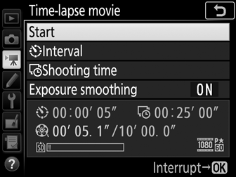
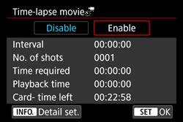
Note: Camera vs. Video
Nikon
Canon
Some cameras make time-lapse movies in the “video” settings and do everything for you, including output a video straight out of the camera – but they’re often limited to a certain interval (1 sec to 10 minutes) or length of finished movie. This might be sufficient for your needs! But… we’re assuming we’re shooting frames in the ”camera” mode instead of “video” mode, allowing us more flexibility in post-production.
Here are the Time-lapse MOVIE menus for Nikon and Canon →

Slide 8
Time-lapse video: Making Breakfast
Video settings version
Pros:
Straight out of the camera!
Cons:
No control over frame rate speed

Slide 9
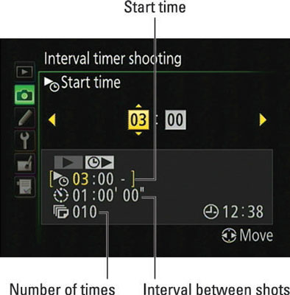
Camera settings menu: Setting it up
Once you’ve decided on your settings (aperture, exposure, ISO, intervals), you’ll need to program the camera using the intervalometer. Nikon: “Interval Timer Shooting”
The menu here shows that the camera will shoot 10 frames at a rate of 1 frame per hour, starting at 3am. (You can also set it to start shooting “now”.)

Slide 10
Post-processing
Don’t go into a time lapse shoot with the mindset of “I’ll just shoot in RAW and edit later”. When you’re dealing with hundreds of photos, any step you can skip in your editing workflow can literally save you hours of post processing time.
Some good applications to create time-lapse are:
Lightroom & Photoshop (demo today)
iMovie (Mac – allows slower frame rates & cross-fading) (no longer available for non-mobile devices)
Chronolapse (Windows – not tested)
Many others available
I used this resource (with lots of step-by-step screenshots) for the demo in this talk: https://digital-photography-school.com/how-to-shoot-and-process-a-time-lapse-movie-quick-method/

Slide 11
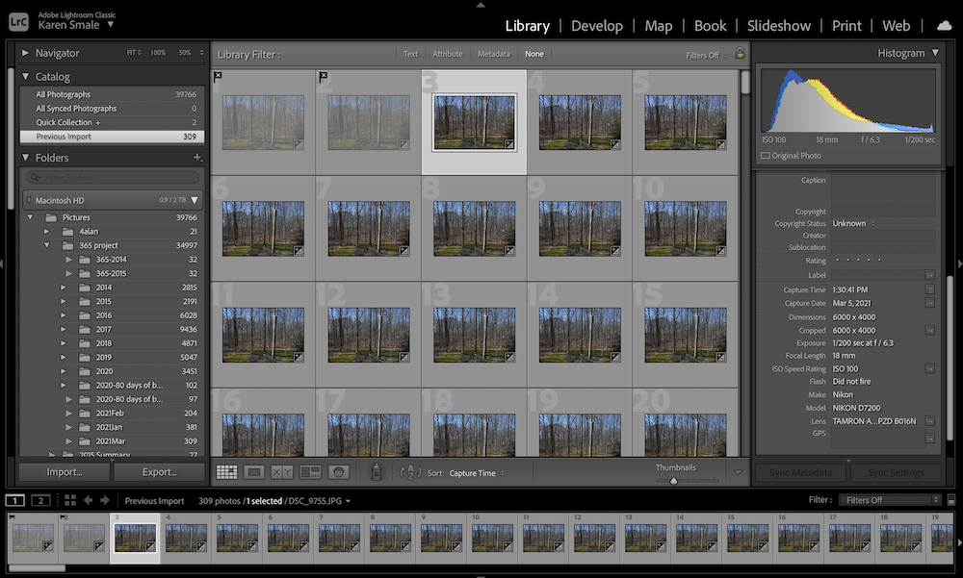
Lightroom frame editing process
Import all your photos into Lightroom
Choose the first image and do some basic processing in the Develop module (straighten/crop to appropriate aspect ratio, fix shadows/highlights, color balance, what-have-you)
Select ALL the images and click on “Sync” and check “all” on the Sync settings and Synchronize.
If you have highly-variable lighting, you’ll need to spot-edit individual frames. This is where the time-consuming effort is!

Slide 12
Lightroom, continued
File > Export: change resolution to 1920x1080px for standard wide-screen TV; 1440x960px for computer monitors, etc.) and choose jpeg as your file type
If you have gaps in your numbering, renumber on export (or fill the gap with a copy of an adjacent photo)
Save your photos to a separate folder

Slide 13
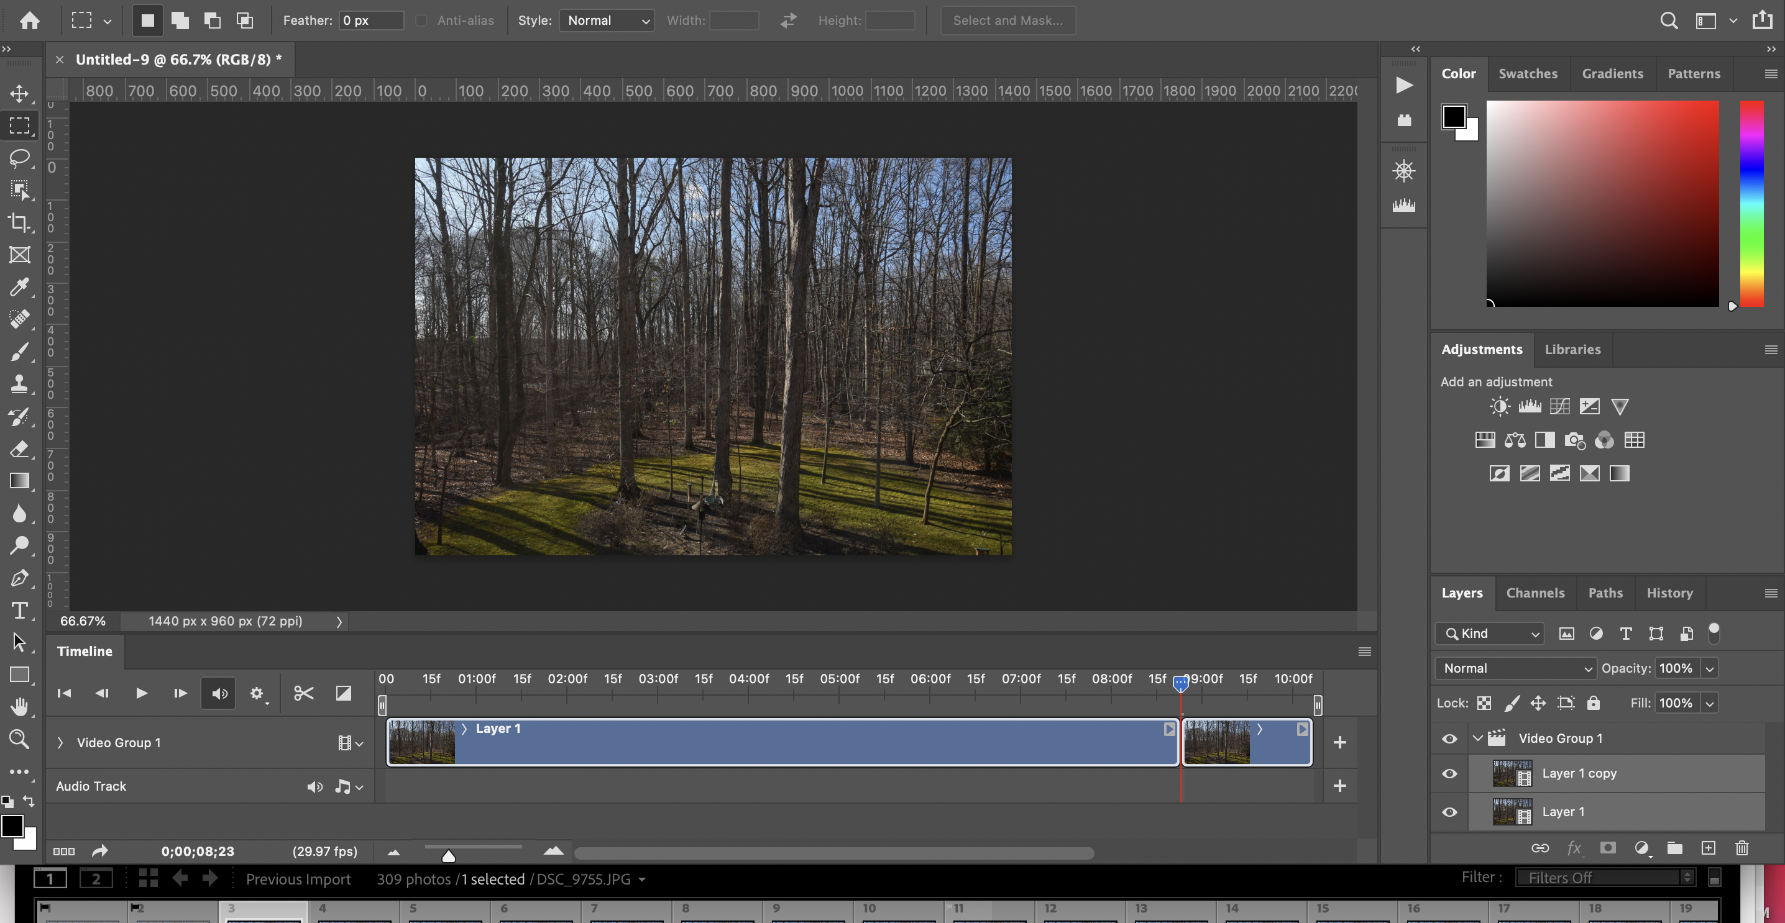
Photoshop video creation
Open Photoshop and choose File > Open and select JUST the first image in your sequence. Check the box at the bottom of the window for “Image Sequence” and click “Open”
Choose your frame rate (you can change it later – but frames get dropped to keep the clip length the same!)
29.97fps is NTSC frame rate
Go to Window > Timeline; a new strip will appear near the bottom of your PS window; the “play” button will play your time-lapse
the first pass will render at less than the selected frame rate; play again for the correct frame rate)

Slide 14
Photoshop, continued
Make any adjustments (change frame rate, add audio, add more clips, trim the clip, etc.)
File > Export > Render video (name your export, choose your presets, quality, etc.)
Enjoy your finished product!
Photoshop Premier Elements: there is a Guided Edit that will walk you through this; not available in Photoshop Elements

Slide 15
Demo
Using Lightroom & Photoshop

Slide 16
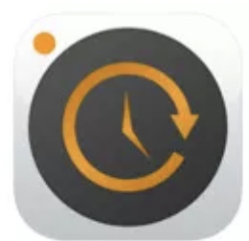
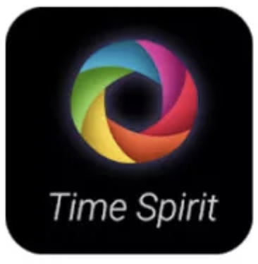
Other apps
iMovie (allows for lower frame rates)
Time-lapse apps for your phone:
Native Camera apps
Best for iPhone: Timelapse
Best for Android: Time Lapse Camera / Time Spirit

