Slide 1
What Makes a Good Competition Photo ?
By
Roz Kleffman

Slide 2
There are a number of
things that make a
photograph GOOD

Slide 3
Great subject
Good composition
Great light
Exposure/color

Slide 4
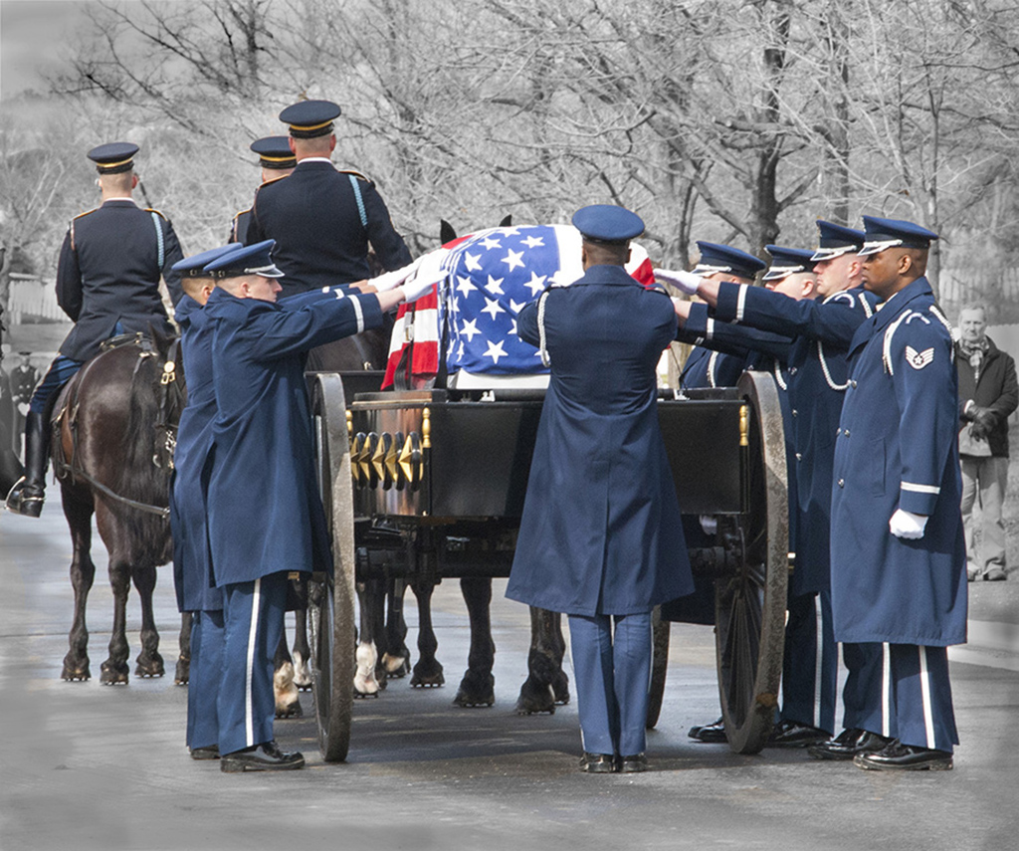

Slide 5
Some additional considerations
Lines
Shapes
Tones
Textures
Space
Balance

Slide 7
You may consider
Leading lines to direct the viewer in to the photo
Movement inside the picture
Mood felt when observing the picture

Slide 9
COMPETITION
Photos
need
WOW

Slide 10
Something to get the judge
interested in looking at the
photo longer

Slide 11
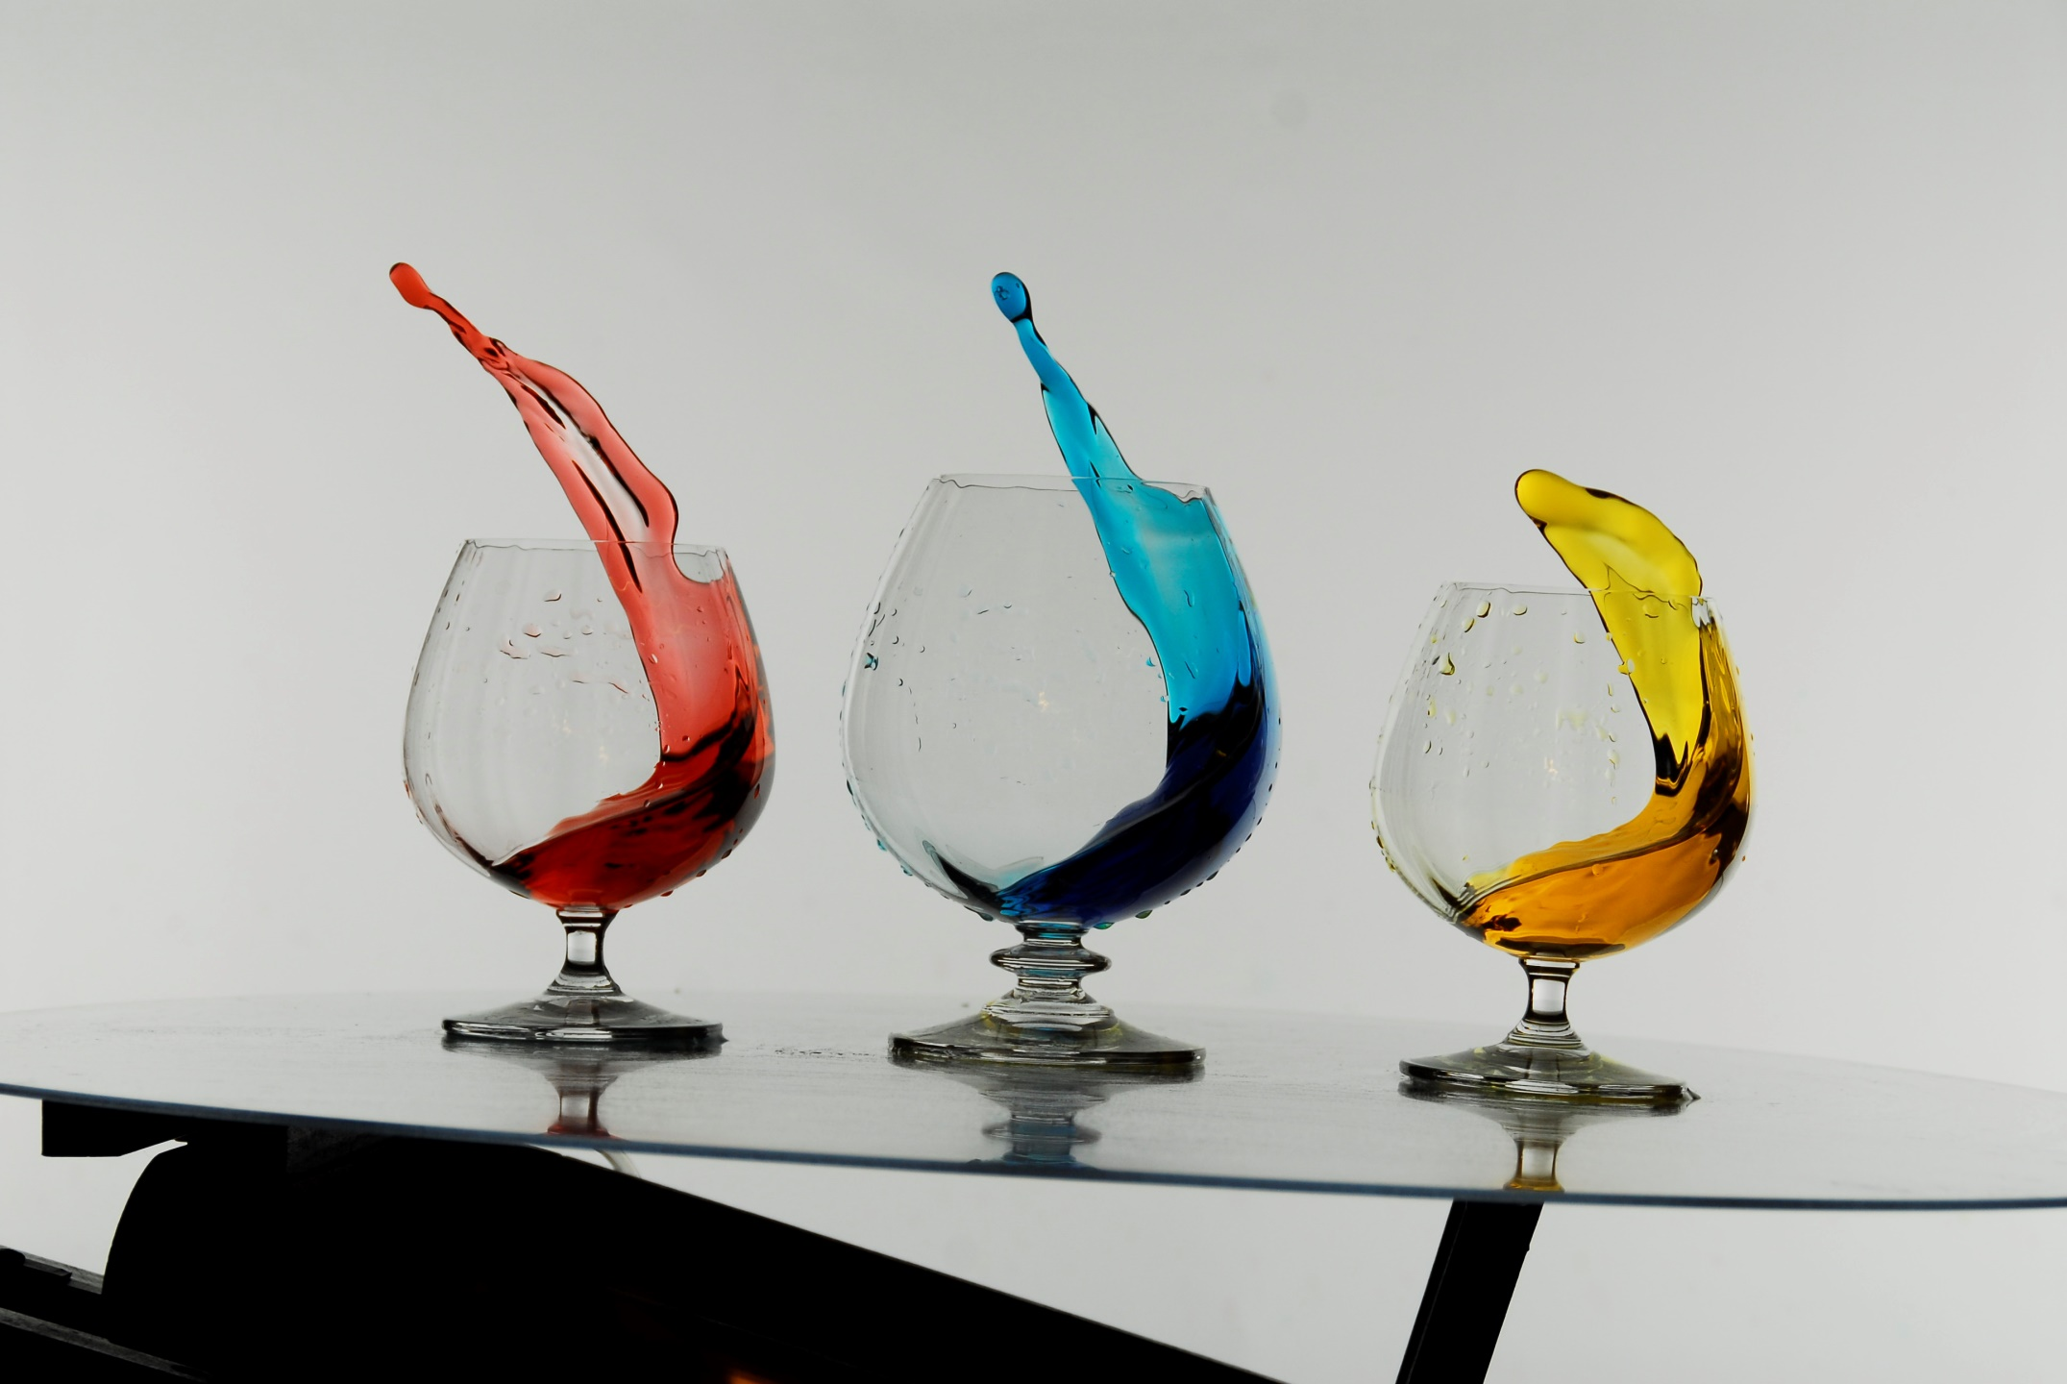

Slide 12
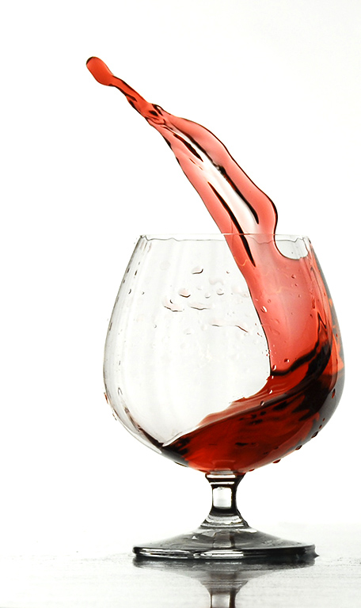

Slide 13
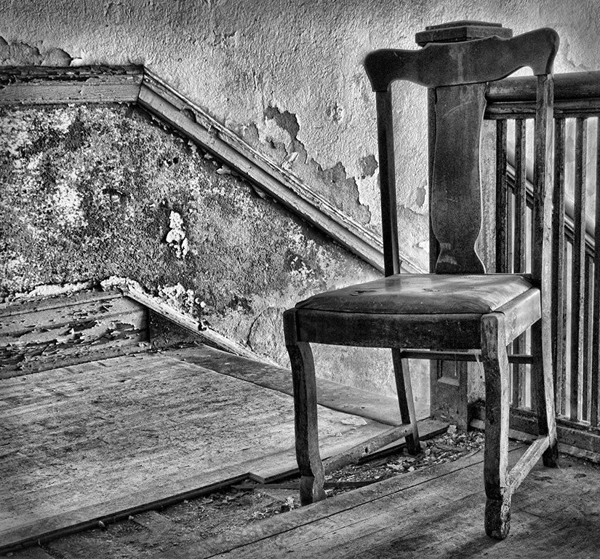

Slide 14
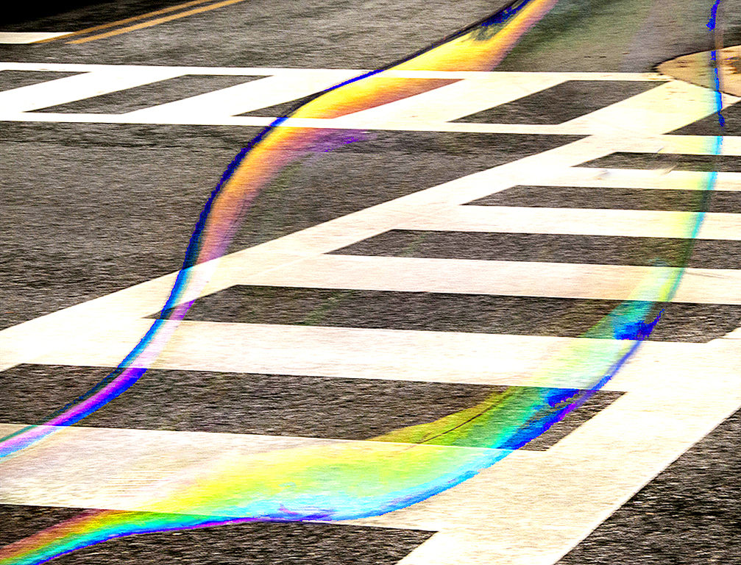

Slide 15
WOW
WONDER
WINNERS

Slide 16
Distractors
Clutter
Bright areas/burn out/blocked up
Unpleasant colors
Out of focus areas
Dead space
Cutting off objects or shapes
Poor exposures
Over done subjects
Poor lighting
Tilted horizons
Over processing
Gremlins

Slide 17
Distractors leave the viewer
Confused
Disinterested
Bored
UN-WOWED

Slide 18
Clean up your distractors
Check your edges
Darken bright areas
Present only what you need to tell the story/Crop your photo
Unclutter your photo/ clone out those gremlins
Straighten horizons
Study famous photos
Look for interesting subjects/ animals with behaviors
Direct the viewers attention to the subject
Enter competition and learn from the critiques/ take notes

Slide 19
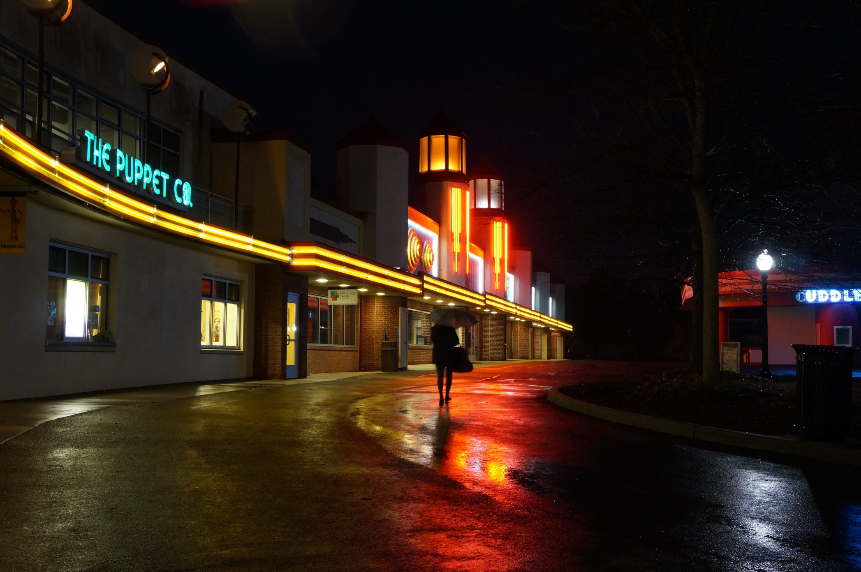
Distractors- cluttered/ bright areas / missing the subject

Slide 20
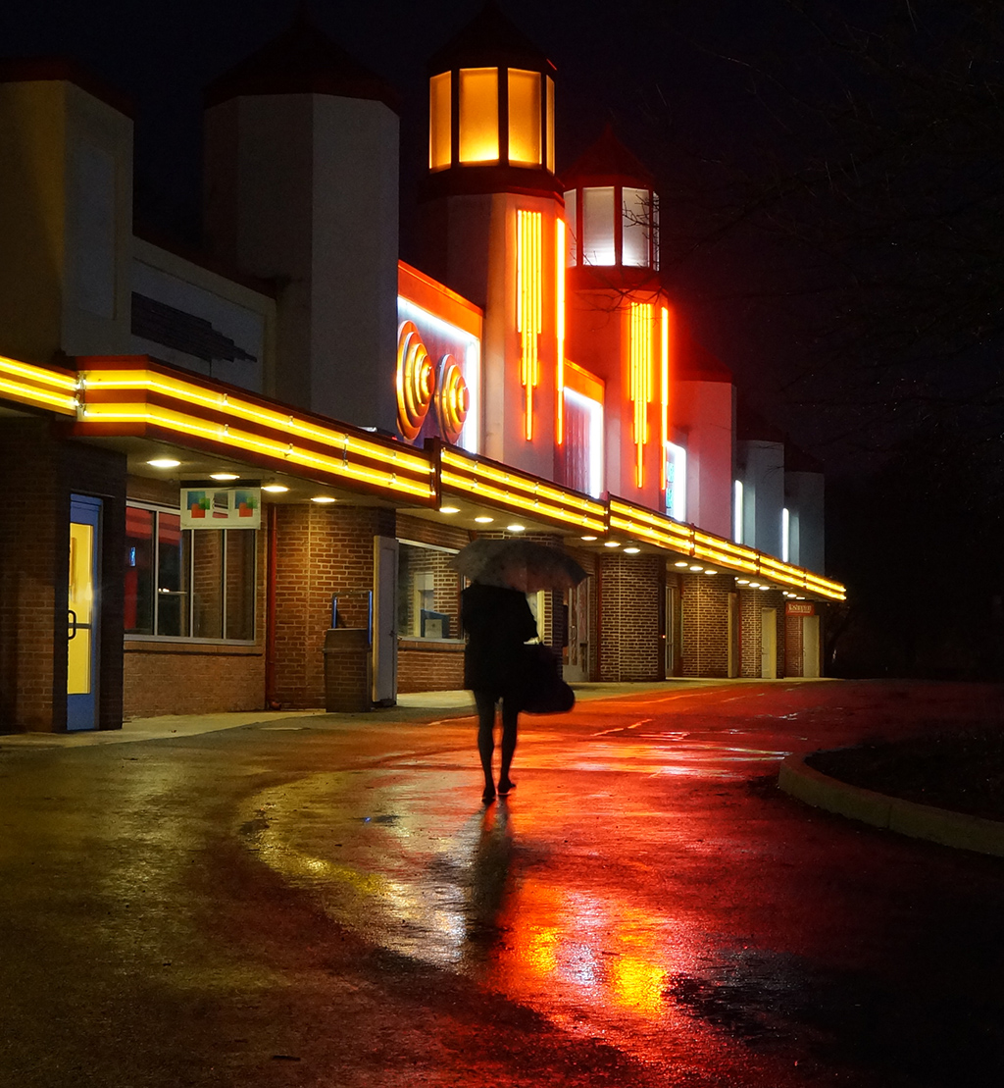

Slide 21
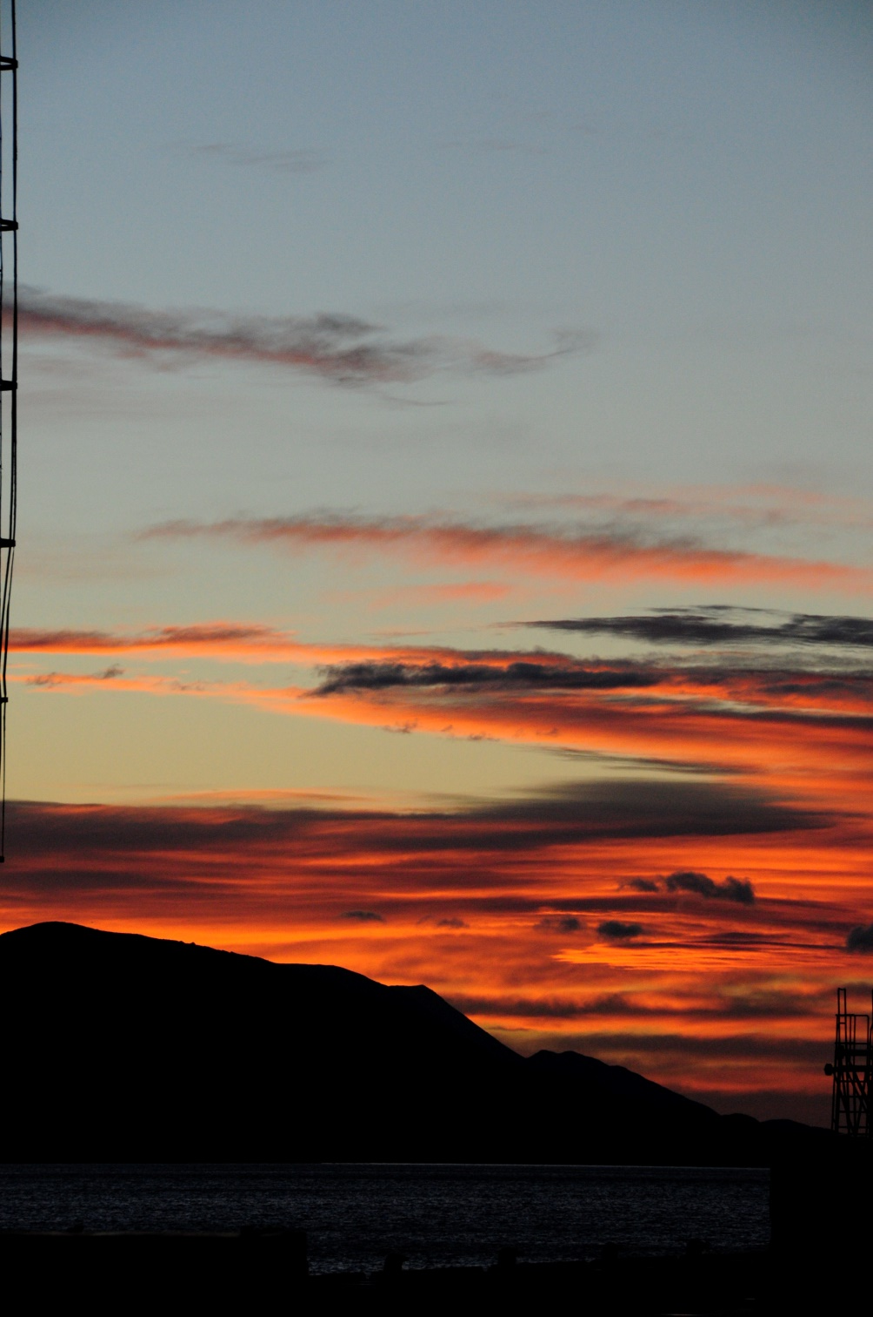

Slide 22
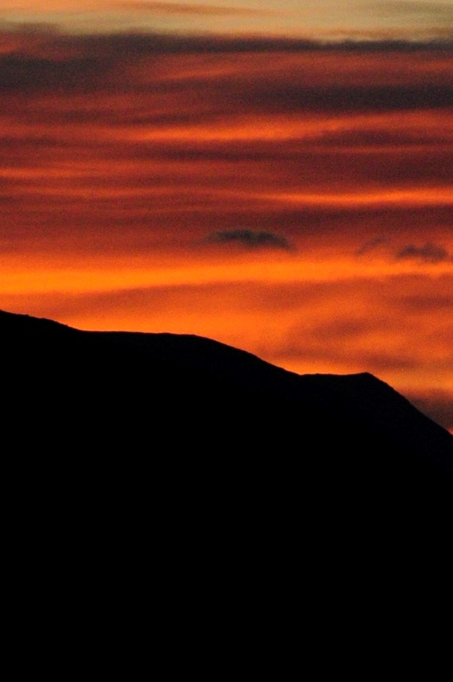

Slide 23
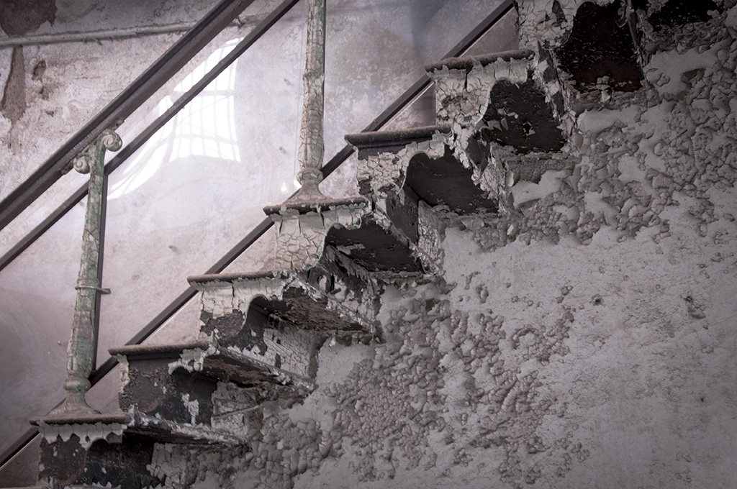

Slide 24
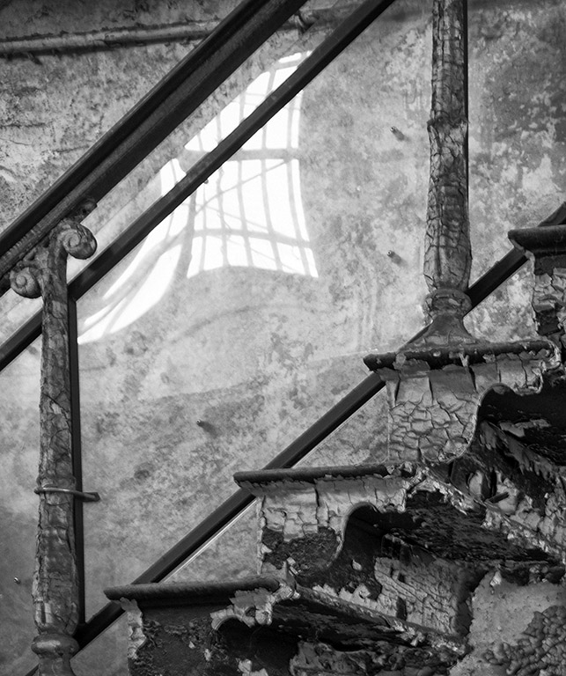

Slide 25
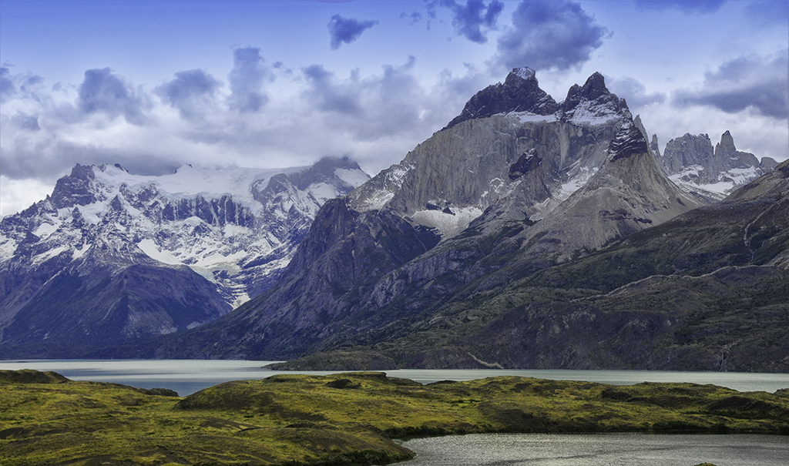
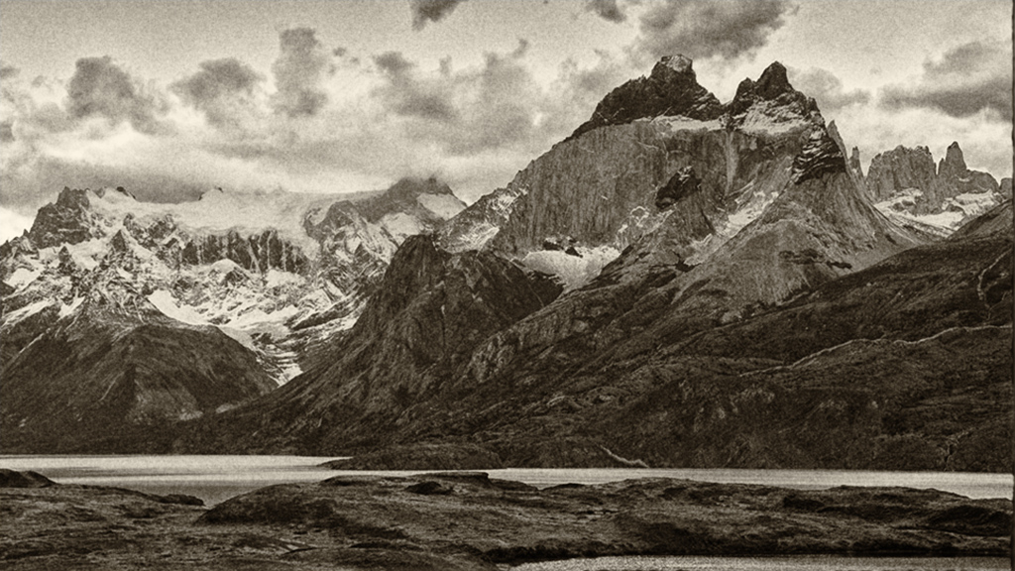

Slide 26
Judges measure CRAFTMANSHIP
Camera control
Processing
Rules of Photography
PHOTOGRAPHY
CREATIVITY
VISION
TEACHABLE SKILLS
MASTERY

