Slide 1
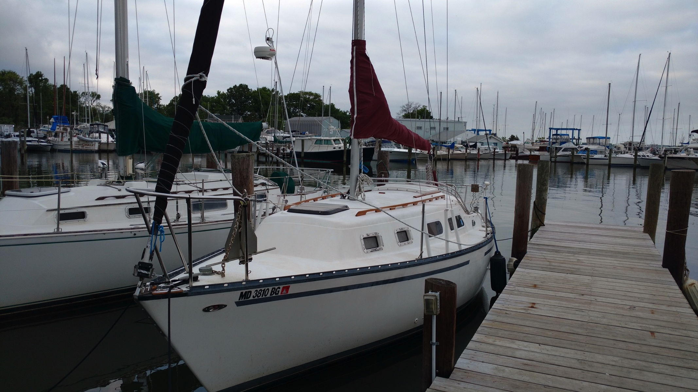
Goddard Sailing Association Hunter 27 Cruiser Qualification Course

Slide 2
Requirements for Cruiser Helm Qualification
Member of GSA for at least one year and member in good standing for the current year
Qualified Flying Scot Helm
Five successful charters in command of a Flying Scot
Completion of on water qualification card with a qualified cruiser instructor
If born after 1 July 1972, hold Maryland Safe Boating certificate or state approved equivalent.

Slide 3
Course Overview
Part One – “Take Luck” Systems
Part Two – Sailing Equipment and Procedures
Part Three – Rules of the Road and Emergency Procedures.
Part Four – Piloting and Navigation

Slide 4
GSA Cruiser Qualification Course
Part One – Take Luck Ship Systems
Version 9

Slide 5
Part One – Take Luck Ship Systems
Required Equipment
Nav Station / Chart Table
Batteries and battery switch
Cabin lighting and shore power connection
Bilge Pump
VHF radio – radio telephone procedures
Cockpit instrumentation – navigation, depth finder
Running lights
Diesel inboard – motor controls, fuel tank. Operating procedures.
Marine Head and Holding Tank – tank pumping procedures
Galley and Water system

Slide 6
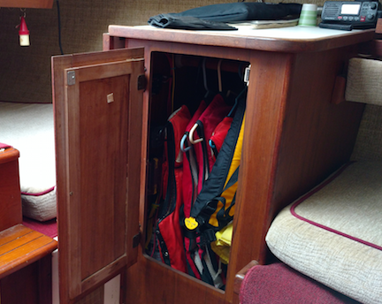
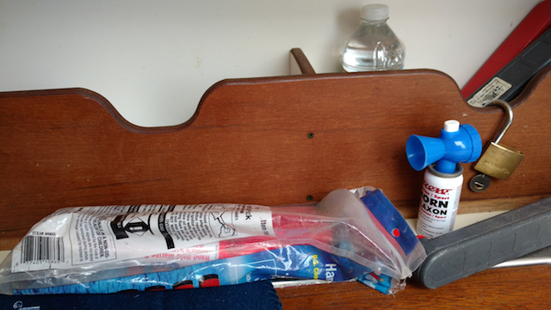
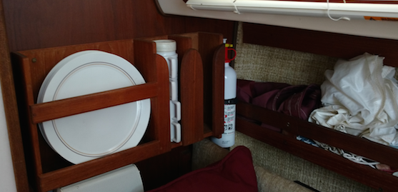
Required Equipment
Personal Flotation Device (PFD)
AKA Life Jacket
1 Per person (appropriate size)
Plus 1 Throwable
Air Horn
Flares (3): Day & Night
Fire Extinguisher
Check for in the green!
Trash placard

Slide 7
Cabin Interior Layout

Slide 8
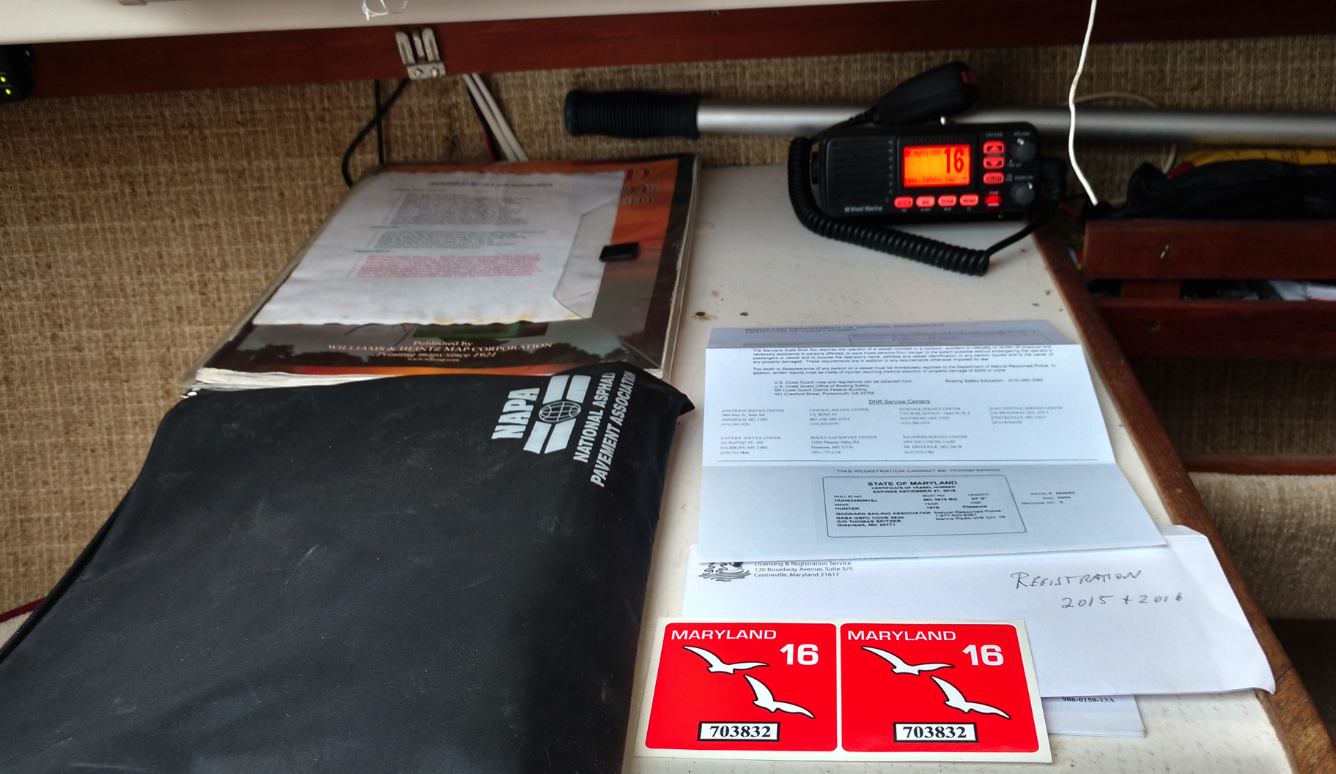
Nav Station – Chart Table
Contains Navigation charts, ships papers, etc.
Radio

Slide 9
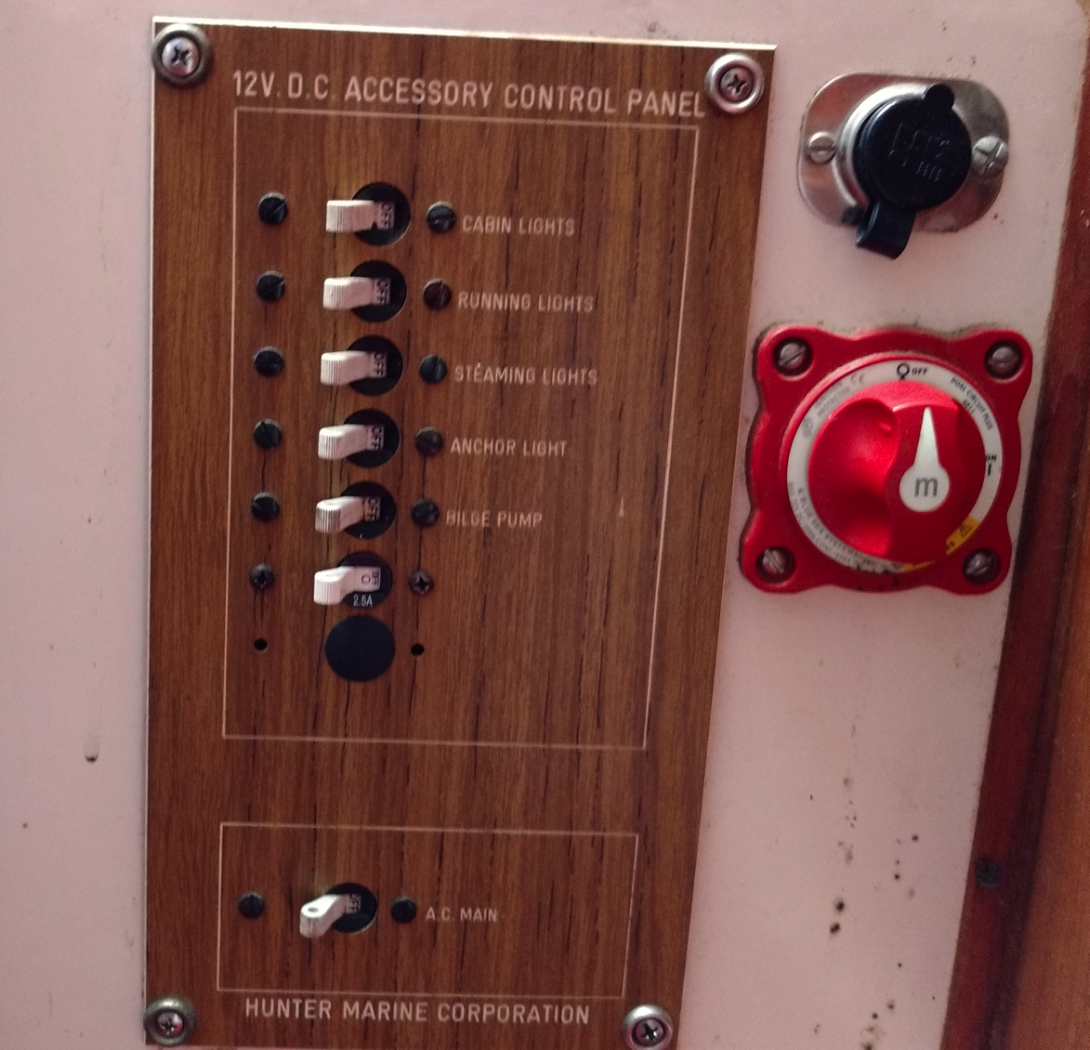
Battery Switch
Battery switch has three positions: OFF, ON, ON
Do NOT switch Batteries while the engine is running
There is also a cigarette lighter socket
Battery Switch shown in OFF position

Slide 10
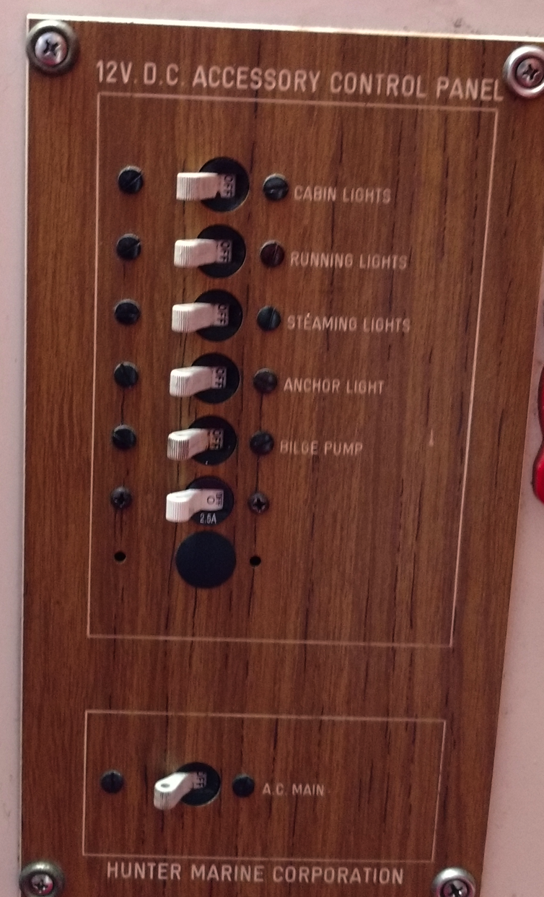
DC Power and Cabin Lighting
12 VDC Power Control Panel
(inside next to nav station)
Light Switches
Cabin Lights
Running Lights
Steaming Light (bow lights)
Anchor Light
Bilge pump switch:
On – overrides float switch
Off – Automatic float switch
(Leave in Off)
External Power Switch
With shore AC power cord/plug

Slide 11
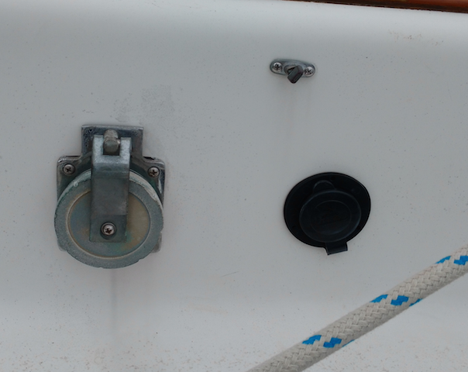
Shore Power
110 VAC utility outlets are provided.
110 VAC is provided through the shore power connection and cable
Make sure the shore power connection is securely fastened. Take a loop around a stanchion or other support so the cable itself is not bearing all the weight.
Shore Power
Hole for standard extension cord
Shore Power
Connector

Slide 12
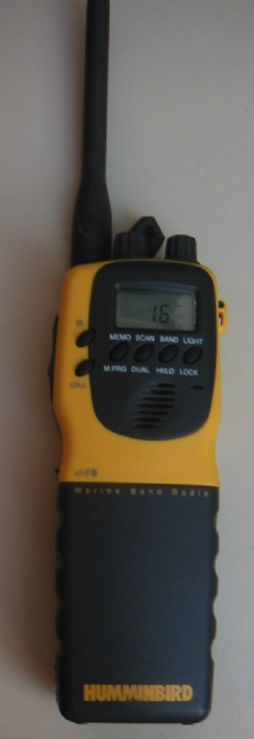
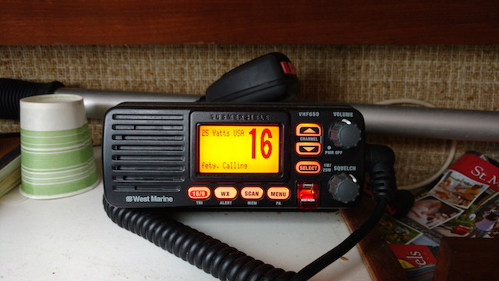
VHF radios
Main radio is in the cabin – at the Nav Station, on the chart table.
Must have main battery switch turned on
Radio is turned on at the unit.
Hand-held back-up radio in the chart desk (or charging in the shed).
Radio License no longer required

Slide 13
VHF radio – channels and procedures
Channels
16 – International Distress and Hailing
13 – draw bridges, ship to ship
22A – USCG Liaison
68, 69, 71, 72, 78A – common working channels
WX1 – WX7 – NOAA weather
Radio watch – We are not required to carry a radio, but since we do so voluntarily, we are required to guard (listen on) Channel 16 when not using the radio ourselves.

Slide 14
VHF radio – channels and procedures (2)
Boat to Boat or Marina
Make initial contact on Channel 16
(but some marinas monitor channel 68)
Switch to a working channel: 68, 69, 71, 72, 78A
Switch back to channel 16 when done
Voice protocol – normal traffic
“Coast Guard Annapolis, this is sloop Take Luck on channel 22A, Over”
First Light, this Coast Guard Annapolis, go ahead”
(State business, “Over”) - back and forth
(Conclude, “Out, Take Luck switching back to channel 16”)
Voice protocol – Distress Call! – Channel 16
MAYDAY! MAYDAY! MAYDAY! This is TAKE LUCK, TAKE LUCK, TAKE LUCK, MD 3810 BG one half mile south of the Thomas Point Light. I have a 55 year old male on board experiencing chest pains, request medical evacuation. Three persons total on board. Take Luck is 27 foot sloop, white with black trim. OVER

Slide 15
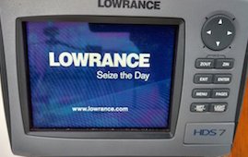
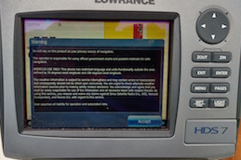
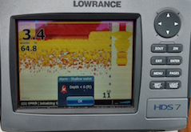
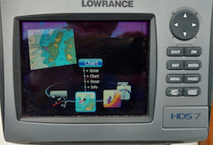
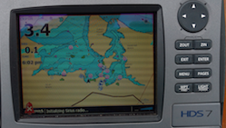
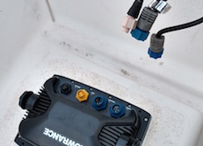
Cockpit Instrumentation
Use Power button to turn on
Use Enter button to accept
Use Page button to change chart
Use Direction buttons to scroll
Use Enter button to select
Note: may need to plug in & mount LowRange consol
Plugs are slotted and go in one way only
Don’t use Factory Reset
Use Exit button if stuck

Slide 16
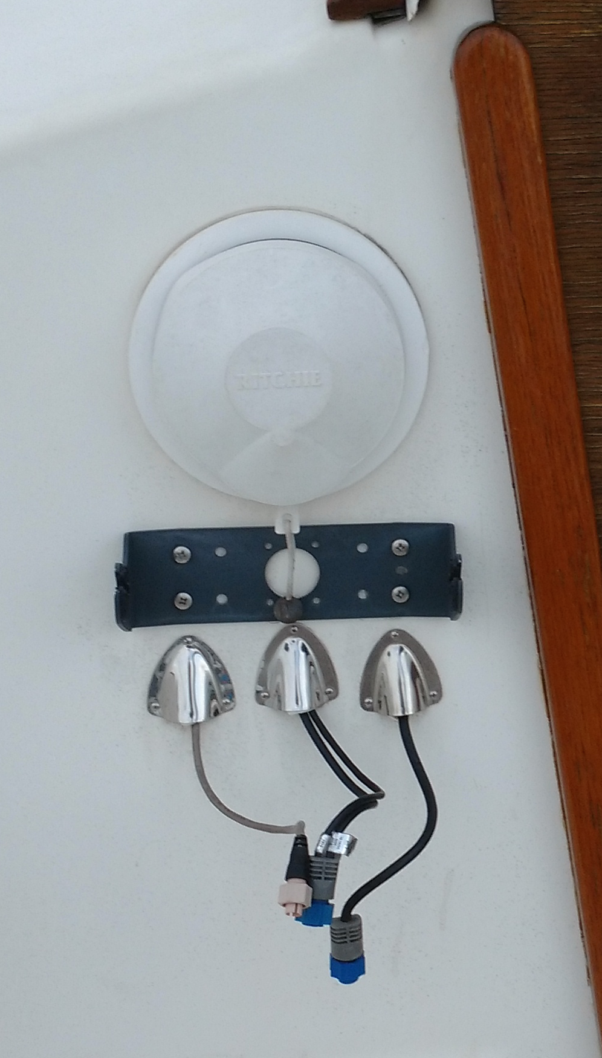
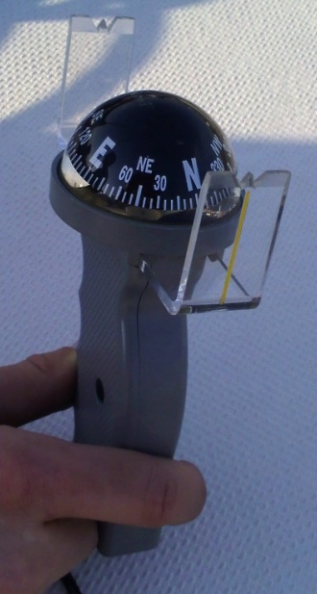
Magnetic Compasses
Reads magnetic, not true heading.
Magnetic variation in the Chesapeake Bay is about 10° W (i.e. True North (0°) will read 10° on the compass).
Local magnetic variations can differ
Metal on the boat also affects the compass (“Deviation”)
When steering a compass course, note that the boat turns, not the compass! (might be counter-intuitive)
“Right Raise, Left Lower”
Needs power for backlight only.
Hand Compass:
remove & stow compass cover

Slide 17
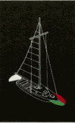
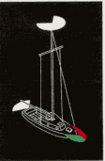
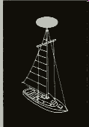
Running Lights
Separate qualification required for night operation!
But in case you are “out” and it gets dark…
Switches are on the DC power panel
“Navigation Lights” are required when underway from sunset to sunrise
Under sail – side lights (red and green combo on the bow pulpit) and white stern light required
Under power – side lights, stern light and “steaming light” (forward white – 2/3 way up the mast)
At anchor – 360° anchor light (top of mast) only.
Sailing
Under Power
At Anchor

Slide 18
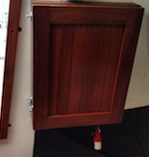
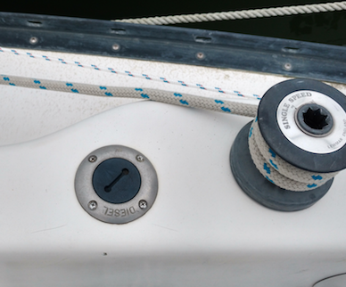
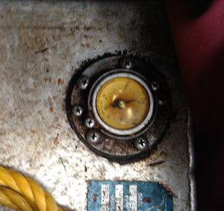
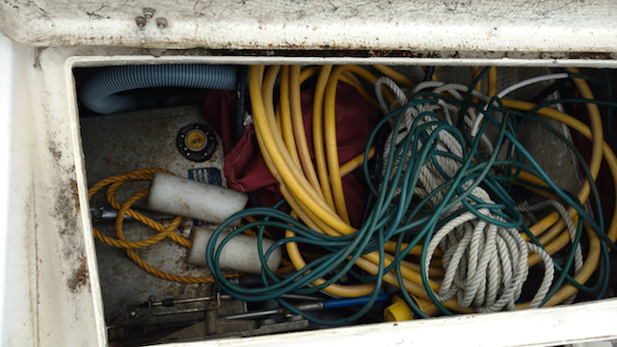
Diesel inboard
Diesel inboard motor
Electric start
Charges the battery (but slowly)
Key is located inside cabin – port inside
Diesel fuel only (starboard)
Fuel gauge (starboard)
Half full tank (12 gal. Tank)
+10 hours running
0.5-0.6 gal. per hour

Slide 19
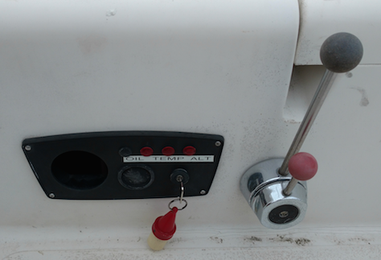
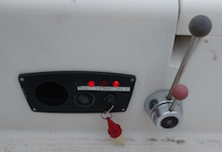
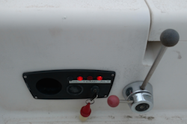
Diesel inboard - 1
Gearshift
neutral position
Starting position:
Gearshift in neutral
Throttle in idle
(between 9-10 o’clock position)
Throttle
off position
Warning Lights (Oil & Alternator)
Come on when start key is on
Go off when motor is running
Start Key
on position
Turn Start Key to right
engages starter motor
start engine
Set Throttle
10 o’clock position to start engine

Slide 20
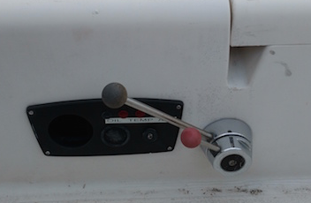
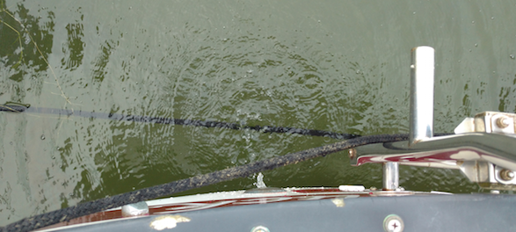
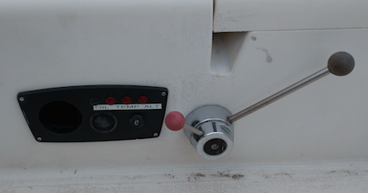
Diesel inboard - 2
Forward
Cooling Water discharge when motor is running
Throttle up
To shut down engine
set to Neutral and turn Throttle to off
do not turn key off before engine stops
Throttle back to idle to change gears
Reverse

Slide 21
Diesel Operation - 3

Slide 22
Diesel Inboard - 4 Operating procedures
Check fuel level before leaving dock – refill (Charter fee includes fuel)
Set battery switch On
Do not switch batteries while engine is running!
Set Gearshift to neutral (centered), Throttle to 10 o’clock position.
Insert Key, turn to on, and then to start. When engine fires, check for cooling water discharge from the motor stalk.
SHUT DOWN IF THERE IS NO COOLING WATER FLOW!
Remove engine key after starting or stopping (to avoid kicking it)
Reduce engine speed to idle (10 o’clock) before shifting gears
To shut down/secure the engine –
Shift to gearshift to neutral (12 o’clock)
Set throttle to off (12 o’clock)
Do not turn key off before engine stops!
Turn key to off; remove and return to hook in cabin

Slide 23
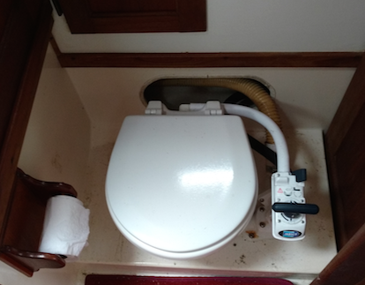
Toilet (Head)
Never put anything in the toilet unless you have eaten it first
(marine toilet paper is OK too)

Slide 24
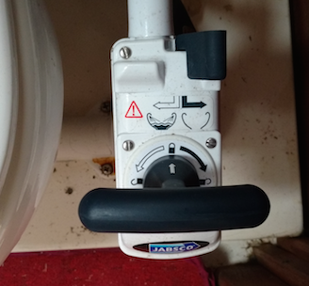
Toilet (Head) 2 - Operation
Consider whether to add seawater to the bowl before use. If so, switch to “Wet Bowl” and pump handle.
After use, first empty the bowl by pumping the handle in “Dry Bowl” position.
Then move the switch to “Wet Bowl” and pump some more to flush with sea water
Then switch back to “Dry Bowl” and pump out the sea water.
All this goes into the holding tank -- so don’t overfill!
Wet Bowl
Dry Bowl

Slide 25
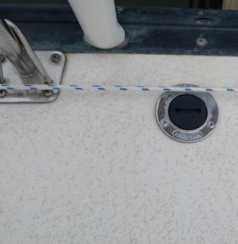
Toilet (Head) 3 – Pump Out
Pump out is available at many gas docks
Chesapeake Bay is a “No Discharge Zone”
Club policy is to empty the holding tank monthly
But check the tank to make sure it has room
cost of pump-outs is included in the charter fee, and is reimbursable if you pay.
Pump out fitting on Deck – labeled “Waste” (starboard)

Slide 26
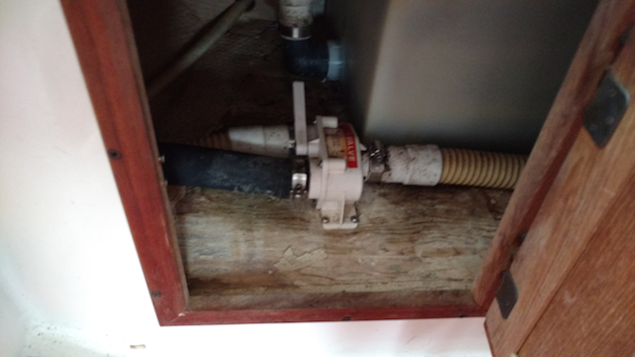
Toilet (Head) 4 – Tanks & Valves
Holding tank is under the Vee Berth
Check tank fullness for pump out
No adjustment need for waste pump out
Seawater intake for flushing under starboard berth
Waste switch set to Tank
Do not touch!

Slide 27
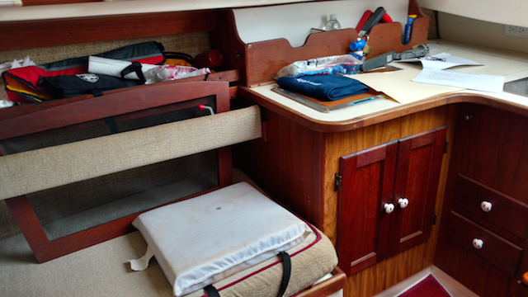
Galley
Sink/wash basin
fresh water drain
holding tank in bow– not potable
Icebox

