Slide 1
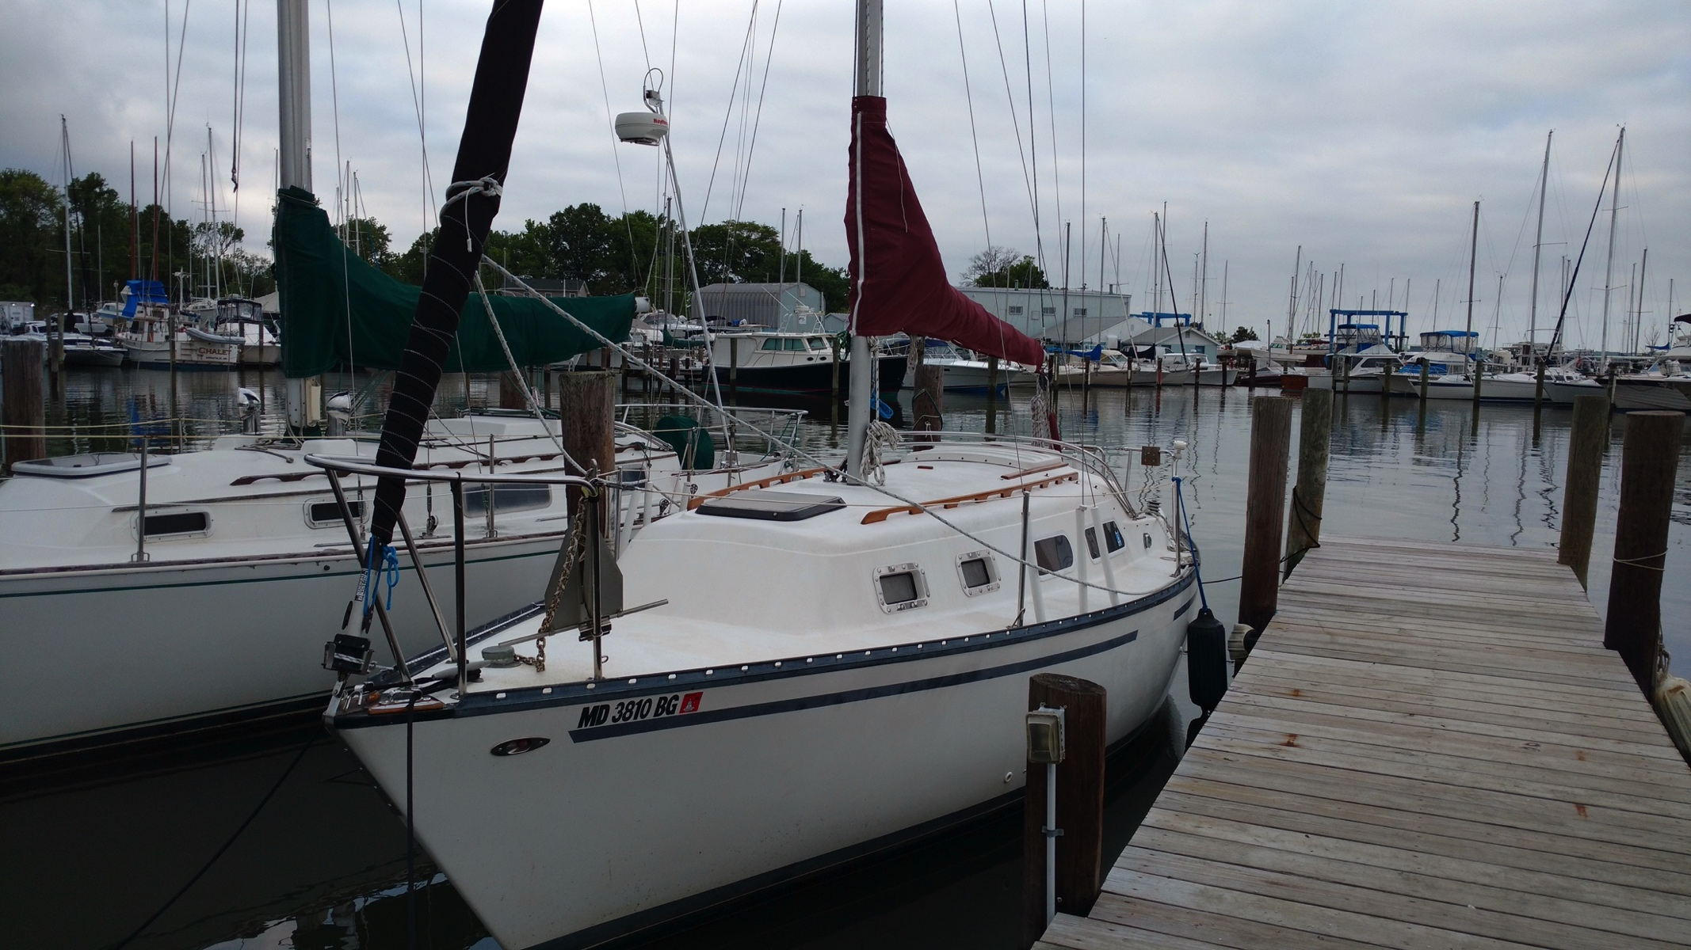
Goddard Sailing Association Hunter 27 Cruiser Qualification Course

Slide 2
GSA Cruiser Qualification Course
Part Two – Sailing Equipment and Procedures

Slide 3
GSA Cruiser Qualification Course Part Two – Sailing Equipment and Procedures
Halyards
Roller furling jib
Jib Sheeting -- winches
Main Sheet
Reefing the main
Topping lift
Bimini
Anchoring

Slide 4
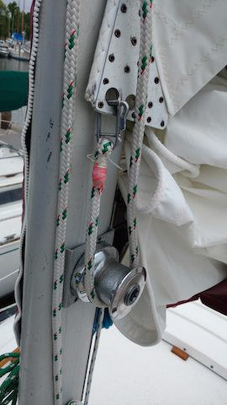
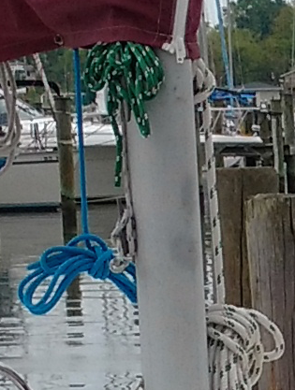
Halyards
Main halyard – raising the mainsail
Slacken the mainsheet; re-jam
Release the downhaul (optional)
Start (and stow) boom locked in top pin position
Insert the head of the luff rope in the mast slot
Raise the main from port side using the halyard and run around the winch
Cleat the halyard at the base of the mast
Release the track pin, allow the boom to fall
Snug and cleat the downhaul
Topping Lift
Check for slack
Check cleat to mask
Jib halyard
Check cleat to mask

Slide 5
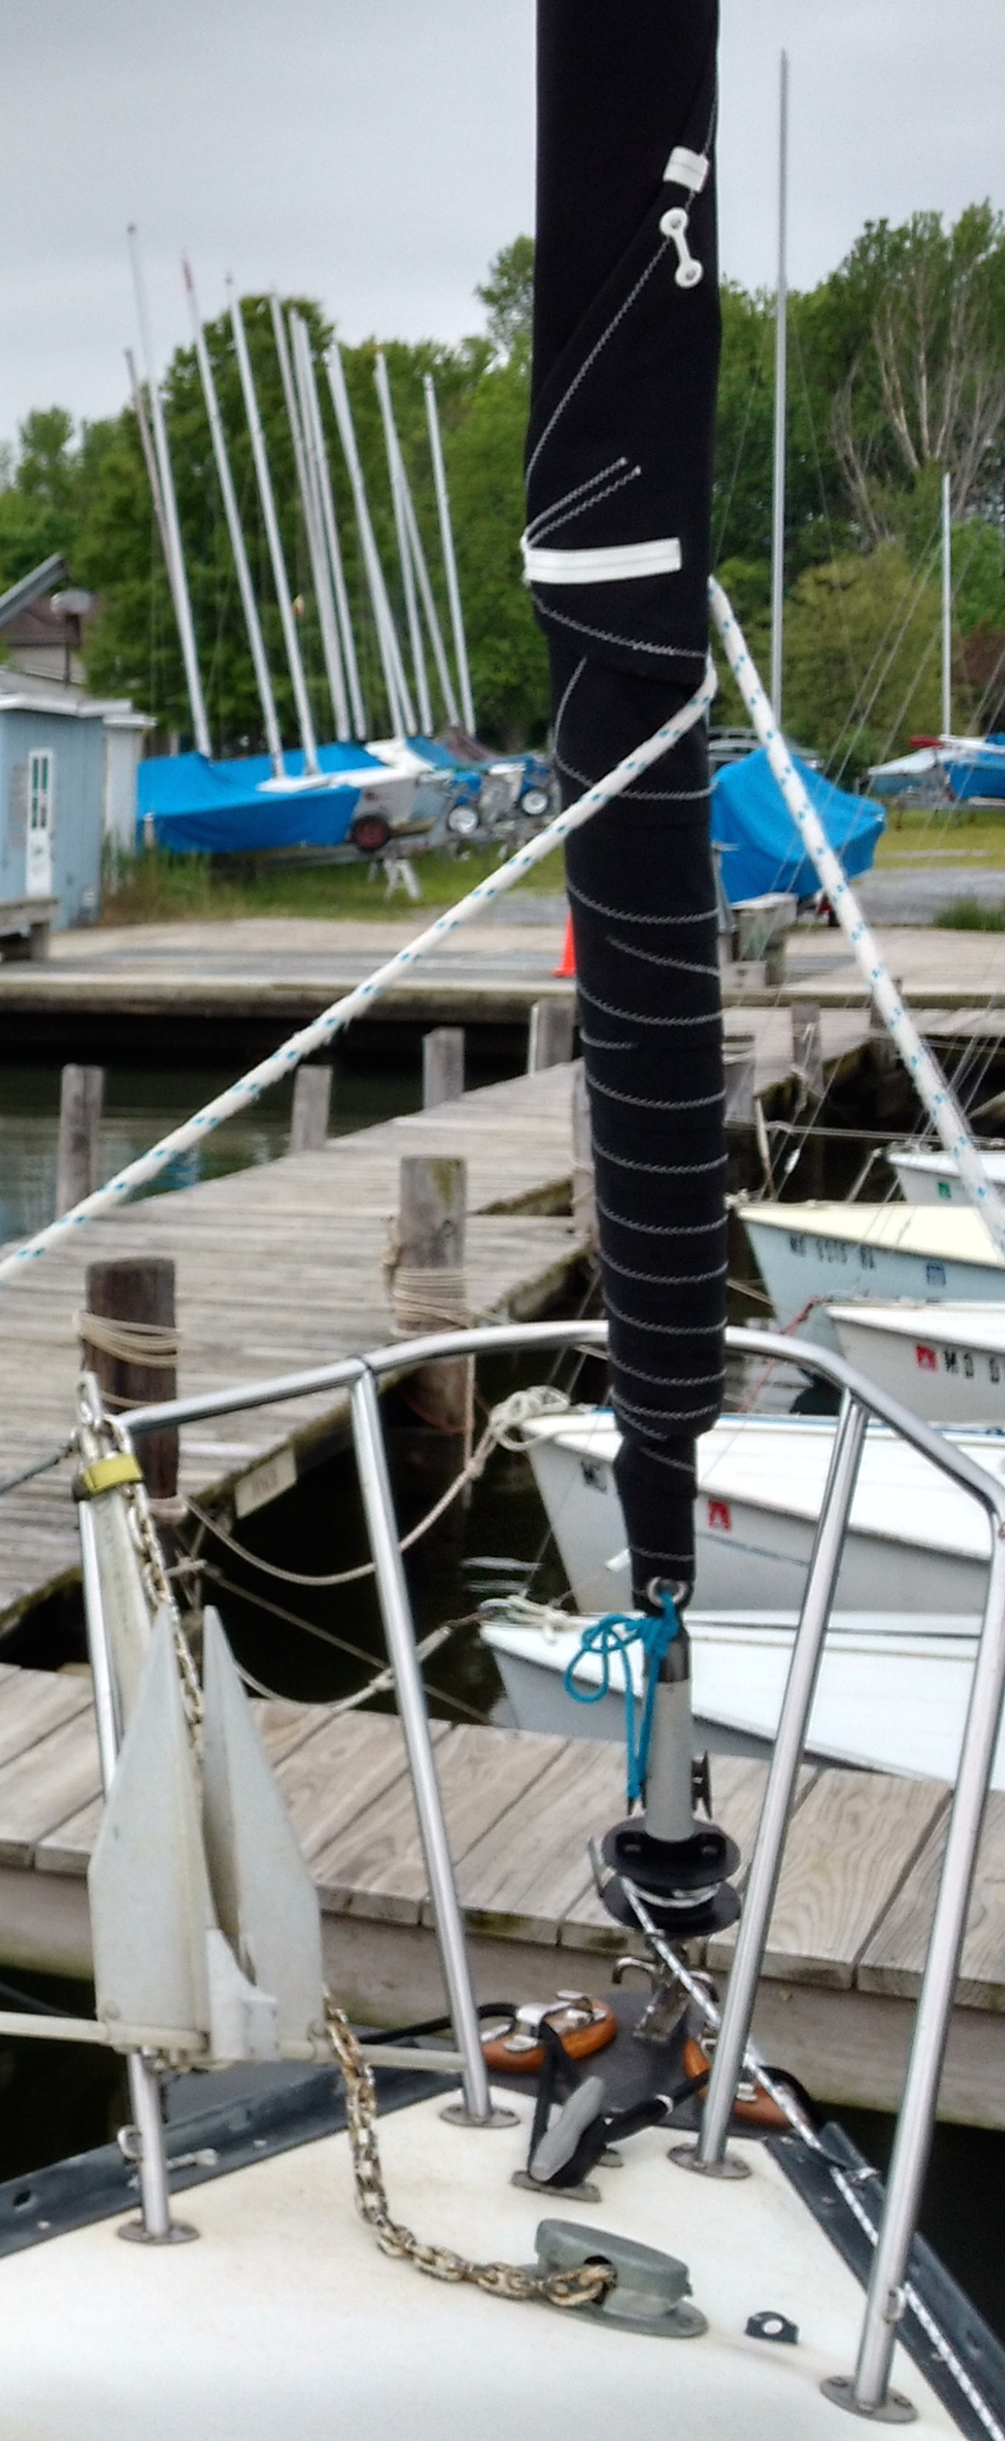
Roller furling jib
Jib wraps around the forestay for easy deployment and retraction
Leave the jib halyard up at all times!
Can be used partially-furled in high winds
Controlled by the jib furling line – leads to the cockpit
To unfurl:
Heading: close reach to broad reach
Un-cleat the furling line and lay the line out untangled
Pull out appropriate jib sheet
Make sure the “lazy” jib sheet is free
To furl
apply slight “back pressure” to jib sheet
Pull on furling line
Continue until jib sheets wrap once around the sail
Cleat
In high winds, watch out for a flapping Clew!
Back pressure helps sail / line wrap smoothly

Slide 6
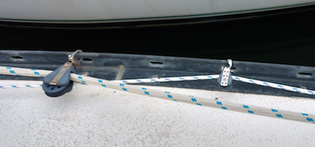
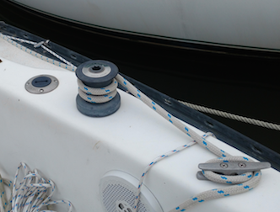
Jib Sheeting
Port and starboard jib winches – increase sheeting force
Both winches are the same part
only turn clockwise
Winch Handles stored in cabin
Use a single turn initially, when sheeting in by hand
Then 3 turns, when using winch handle – apply moderate tension to free end of sheet
Winches have ratchets – can sheet in by going back and forth
jib furling line

Slide 7
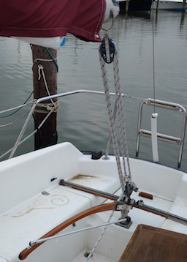
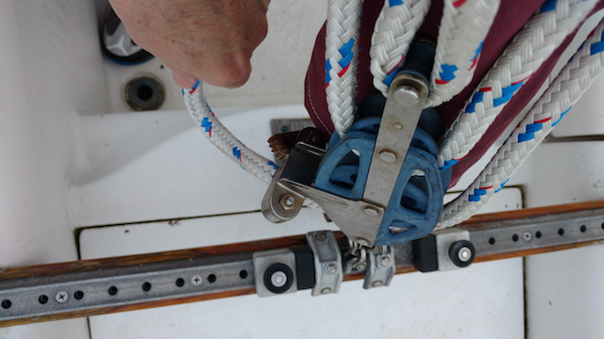
Main Sheet
Attached aft end of the boom
4:1 Block
Jam Cleat
Pull down to release
Traveler
Center upwind
Ease downwind
Jam Cleat

Slide 8
Weather Helm
Tendency for boat to turn into the wind
Especially in strong winds
May require considerable force on the tiller to hold a course
Remedies:
Slight: Adjust (tighten) backstay
Moderate or severe: Reduce Sail
Reef Main
Partially furl jib
Either reduction helps weather helm

Slide 9
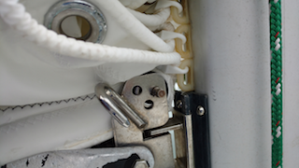
Reefing the Mainsail
Head close to the wind
On either jib or motor
Ease mainsheet
At the Mast:
Lower main halyard
Put Reef Cringle on luff over tack hook
Tighten halyard
Reef Cringle
tack hook

Slide 10
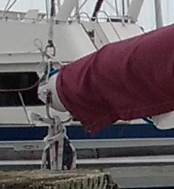
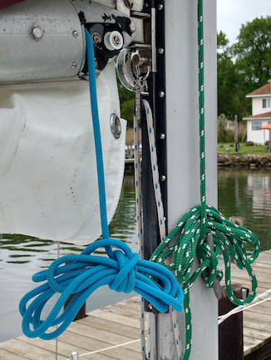
Reefing the Mainsail (2)
Near the end of the boom:
Ensure the reefing line goes through Leech Cringle
Tighten the reefing line:
on aft-boom goes through reef cringle on leech of the sail, through boom to jam cleat forward.
Serves as outhaul when reefed
Dress sail with lines through reef points
Optional
Non load bearing
Shaking out the reef
Reverse reefing procedure
jam cleat
downhaul

Slide 11
Other
Topping lift
Holds boom up when the mainsail is down
Adjustable at the base of the mast
Do not sheet against the topping lift!
Should remain slightly loose
Bimini
Shades the cockpit

Slide 12
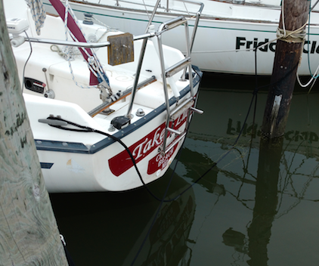
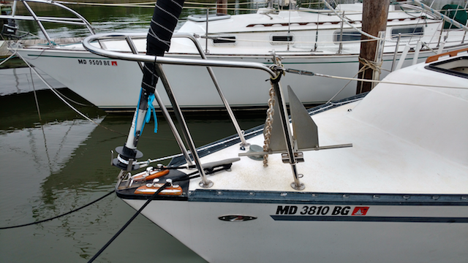
Mooring Lines
Through chocks in bow
Crossed in the stern

Slide 13
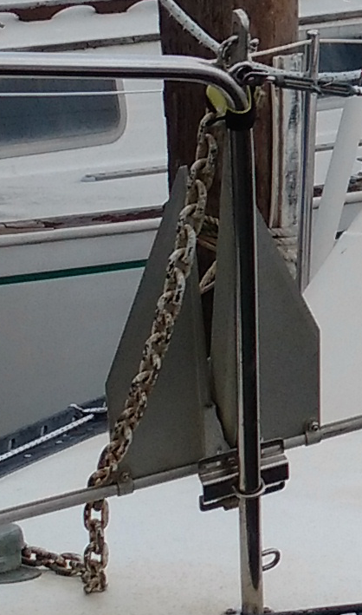
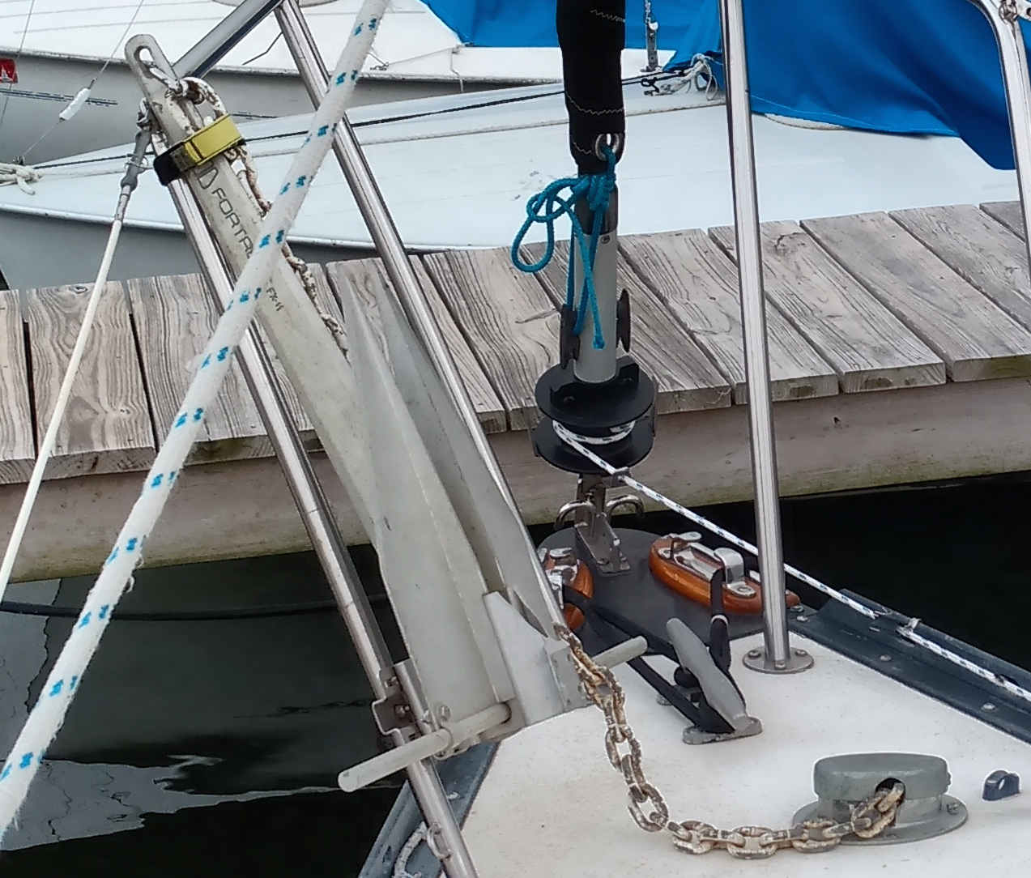
Anchor Holder
Velcro Fastener
Sets in gripping bracket on rail
Remove/stow deck cover
Let out through port bow chock
Deck cover

Slide 14
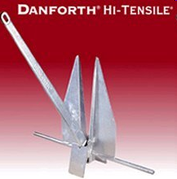
Anchoring
Scope: Ratio of length of line to “vertical” drop from bow to the bottom (at high tide)
5:1 Lunch Hook
7:1 Overnight
10:1 Storm
Spot selection:
Protected, 360° swinging room
To Anchor:
Prepare anchor
Head to wind, dead stop, Drop anchor
Back away (motor or wind), take a bite to set the anchor
Let out appropriate scope, cleat
Anchor Light
Check for drifting
To leave anchor:
Get directly above anchor (pull or motor) – anchor line vertical
Cleat anchor line – the boat’s momentum will free anchor
Pull up (weigh) the anchor, clean and stow

