Slide 1
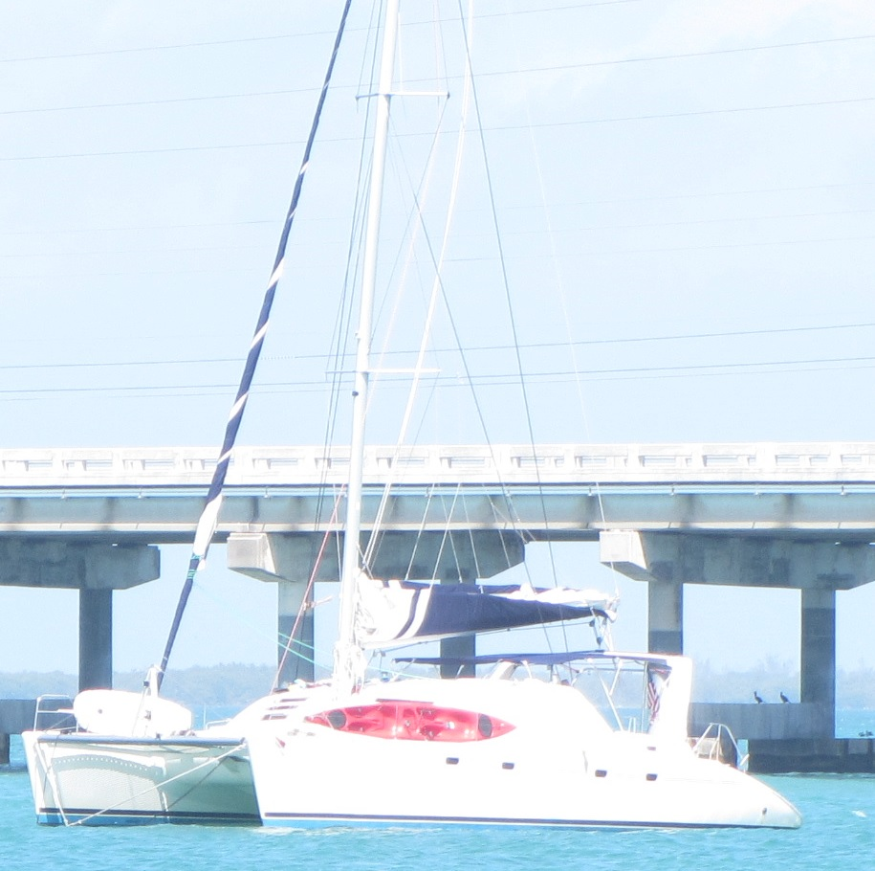
Florida Keys Sailing Trip 2014

Slide 2
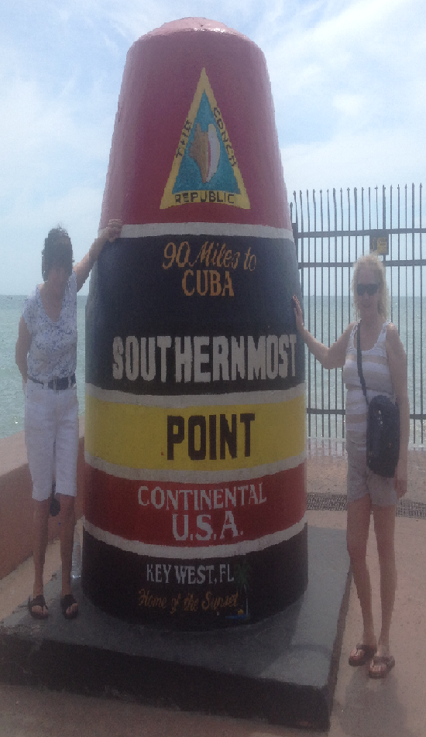
Key West
Maria and Robin visited Key West prior to the sail.

Slide 3
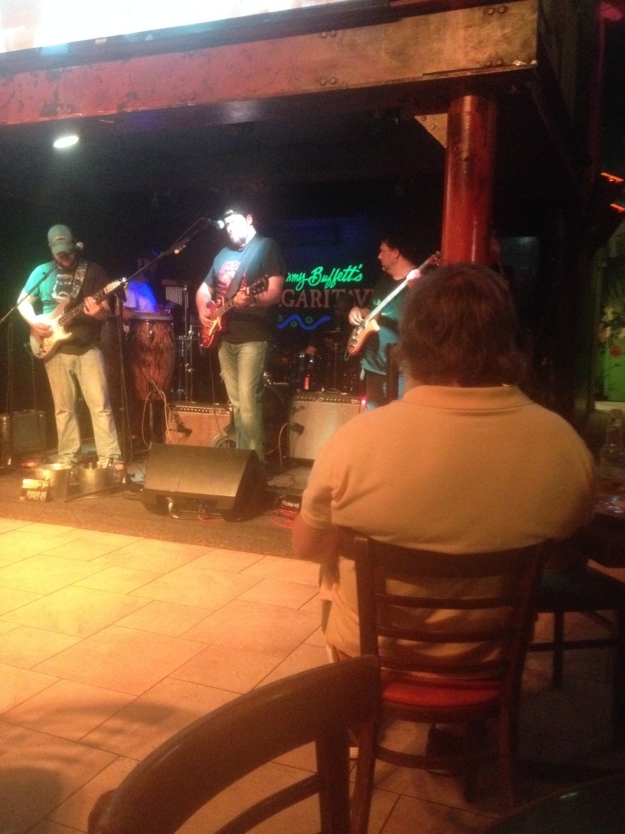
Sloppy Joe’s and Jimmy Buffet’s Margaretville

Slide 4
Enjoying a margarita

Slide 5
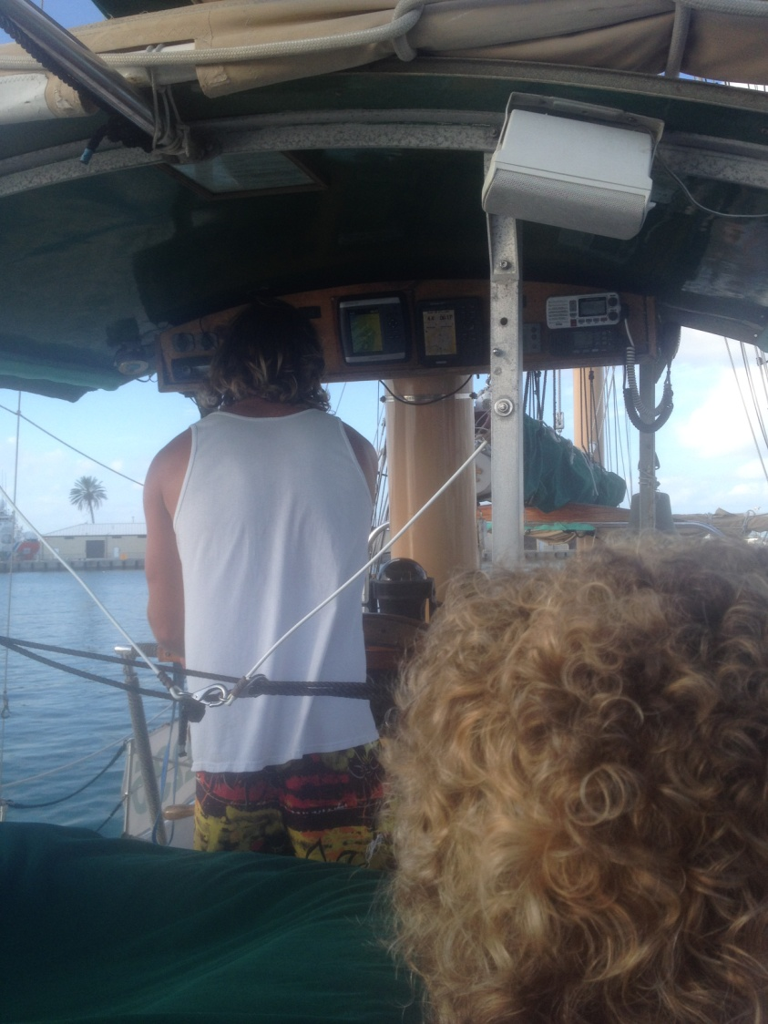
Sunset Sail on the Jolly Rover and Capt’n Rio

Slide 6
Stalking the enemy ship and blasting them with our cannon!

Slide 7
The Setting Sun

Slide 8
Ready to blast them again!

Slide 9
Going

Slide 10
Going

Slide 11
Gone

Slide 12
Mallory Square at Night

Slide 13
Maria’s new friend

Slide 14
Key Largo – Pirate’s Choice

Slide 15
Our Boat – Boarded in Key Largo

Slide 16
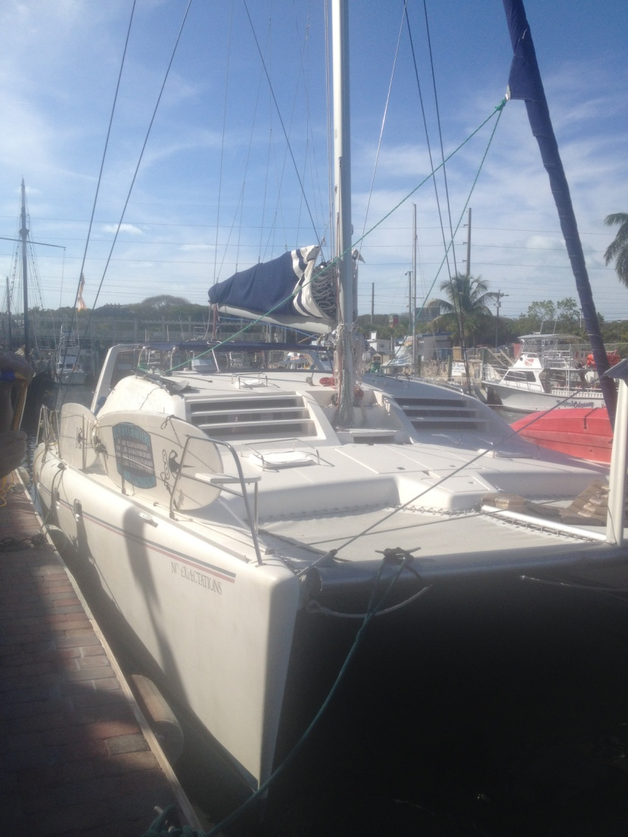
No Expectations 47’ by 23’ Beam – 4 Cabins/4 Heads

Slide 17
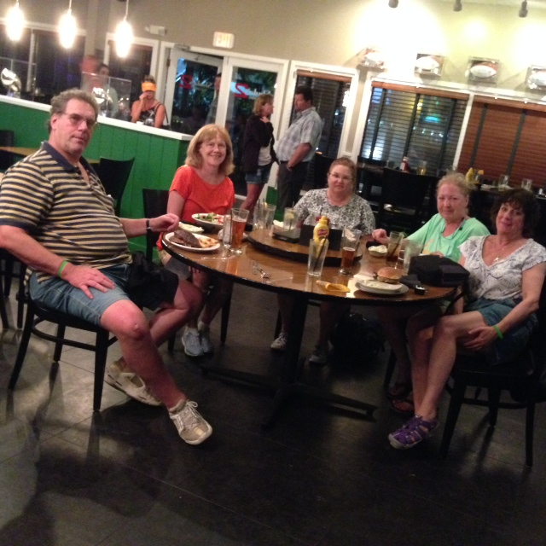
Our first day and dinner out

Slide 18
Cool Picture

Slide 19
Our Captain – Capt’n Andy

Slide 20
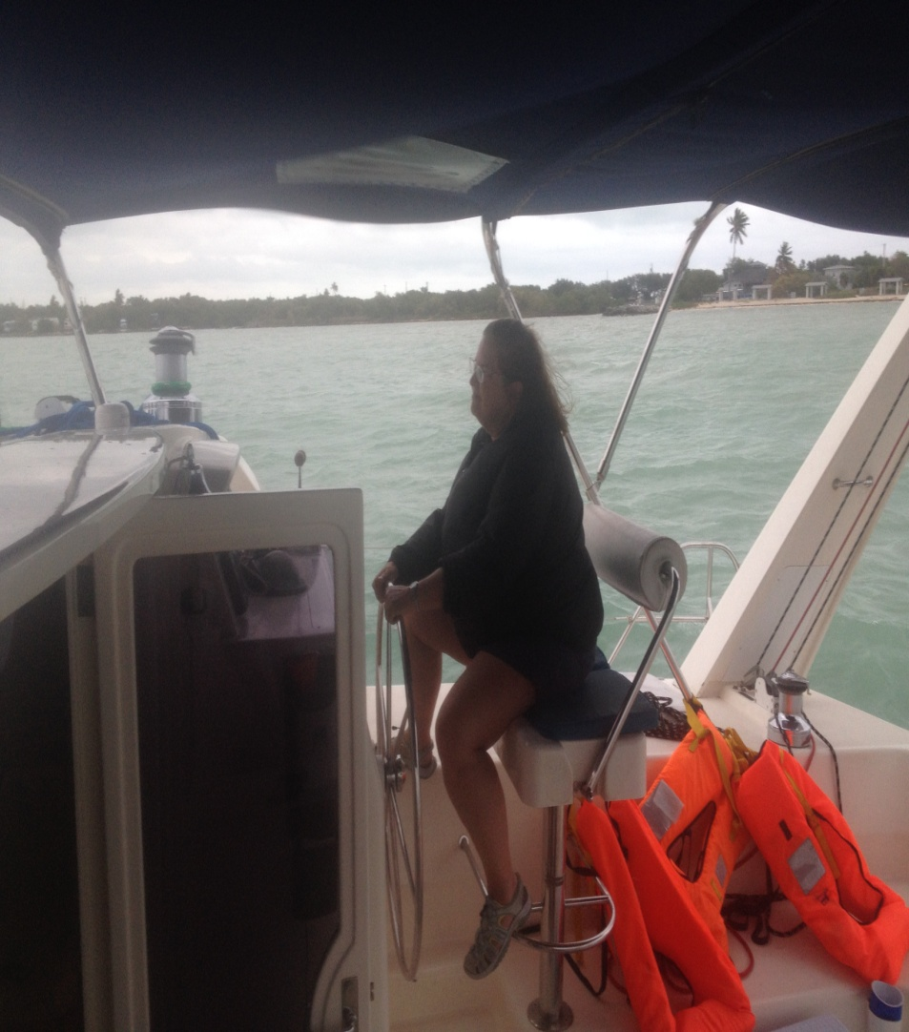
Our Crew
Nancy
Kim

Slide 21
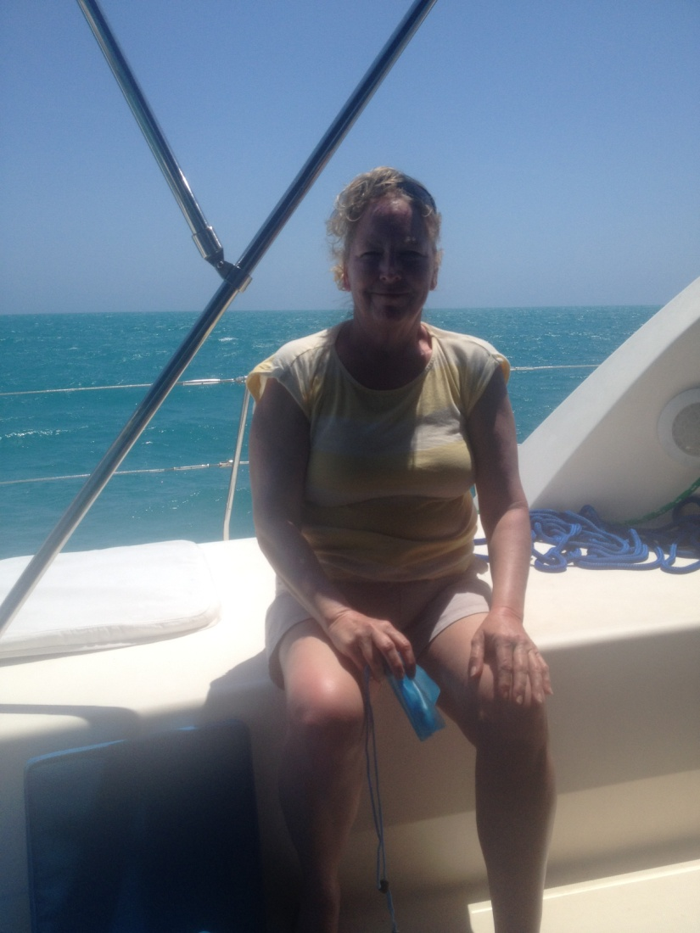
Our Crew
Maria
Robin

Slide 22
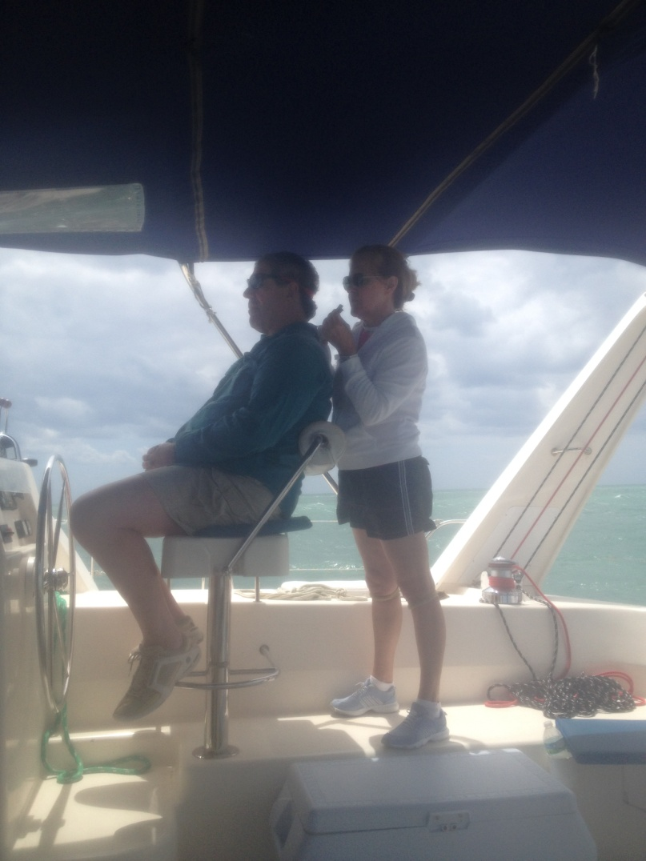
Capt’n Andy and Nancy

Slide 23
Our Itinerary

Slide 24
Keys Map – Key Largo to Bahia Honda

Slide 25
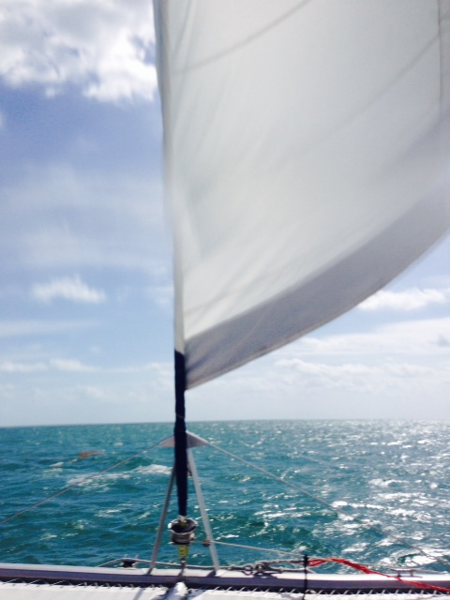
Underway
On our way to Molasses Reef – warm and sunny but very windy and choppy

Slide 26
Tracking Our Course

Slide 27
Kim’s Just Chill’n

Slide 28
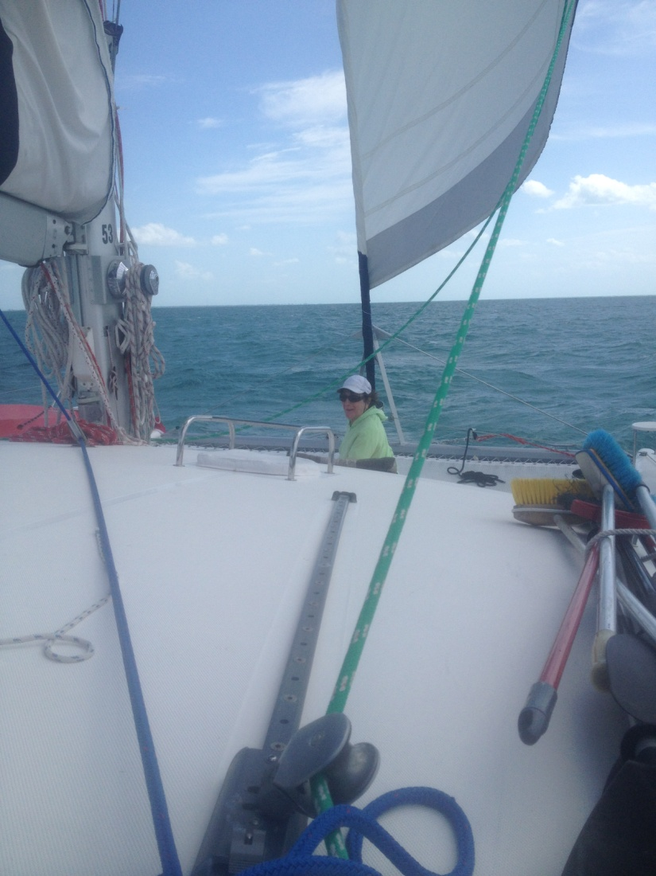
Underway
Robin, Nancy, and Maria taking their positions

Slide 29
Molasses Reef – Daring the Waves Too rough to let go of the boat while in the water, so we stuck our cameras underwater

Slide 30
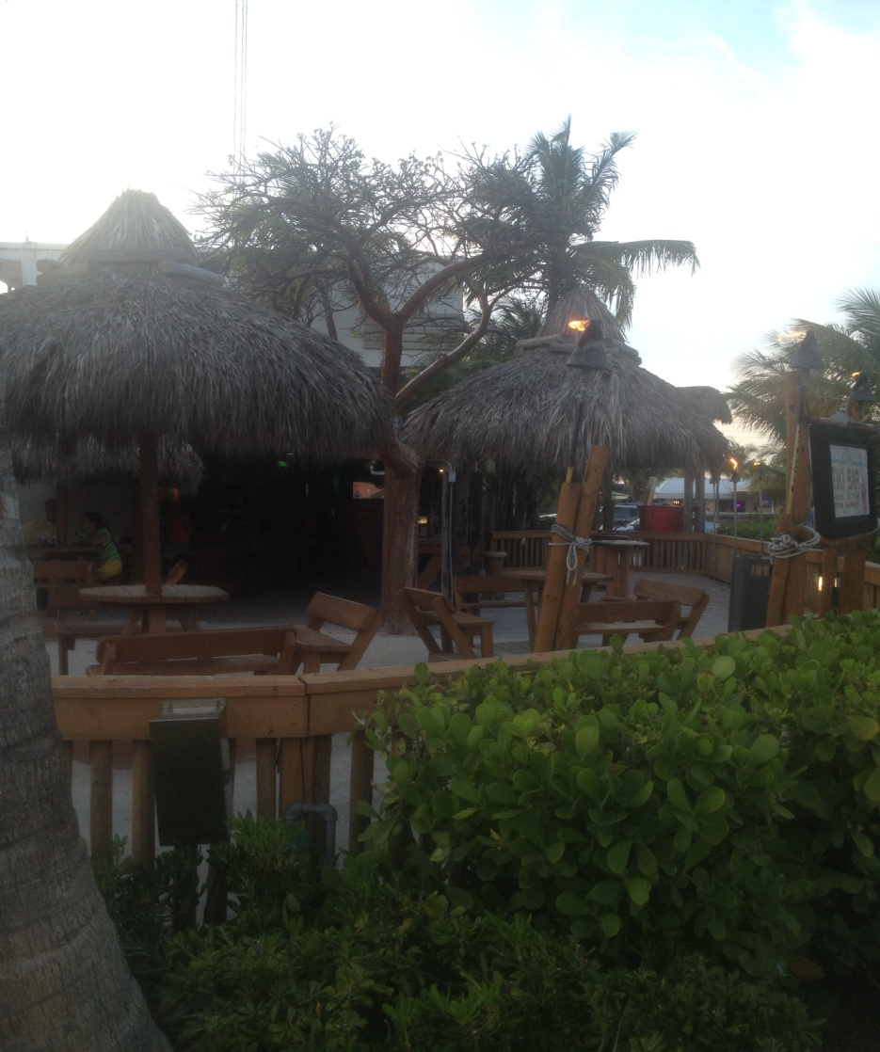
1st Stop - Holiday Isle Resort & Marina Tiki Bar

Slide 31
Reeling in a shark

Slide 32
Chill’n by the fire pit

Slide 33
2nd Stop – Bahia Honda

Slide 34
Chill’n at Bahia Honda

Slide 35
Our new friend, the manatee, who swam into the harbor – didn’t know petting manatees was against the law.

Slide 36
Snorkeling at Bahia Honda

Slide 37
More Snorkeling

Slide 38
Underwater Selfie

Slide 39
Storm Rolling In Bahia Honda

Slide 40
Watching the Anchor as We Drift

Slide 41
Florida Sunsets

Slide 42
Other Marinas Underway Near Marathon

Slide 43
The African Queen

Slide 44
Profile and Capt’n Mike

Slide 45
A Real Steam Engine Started with an outboard and switched to the steam engine

Slide 46
A Little Memorabilia Remember what happened to the Gin?

Slide 47
Capt’n Maria and Capt’n Mike

Slide 48
Maria, Kim, Robin, Capt’n Mike, and a newly married couple

Slide 49
Our Final Sunset Key Largo, Florida

Slide 50
The Crew

Slide 51
Proud Sailors

