Slide 1
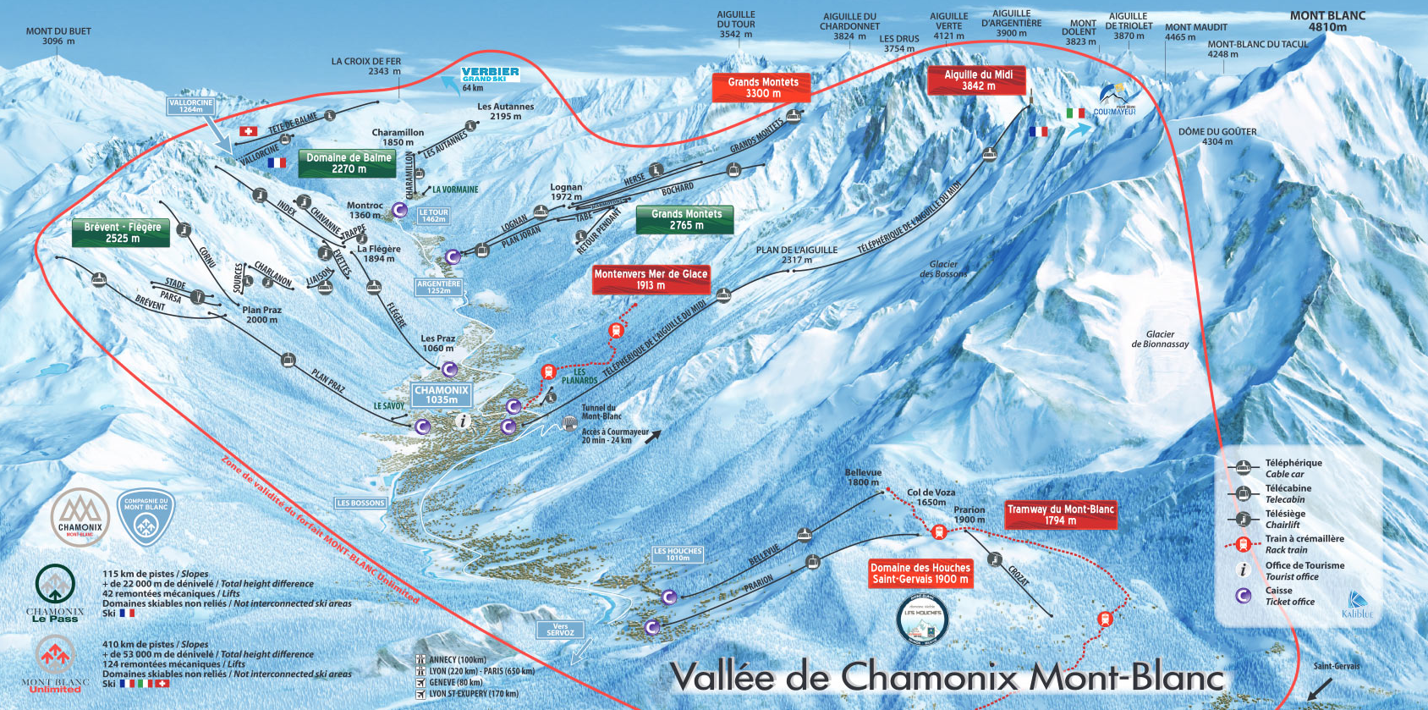
GODDARD SKI CLUB http://gewa.gsfc.nasa.gov/clubs/ski/ March 10 – 18, 2023 $2299/person (Standard Dbl. occupancy) $2449/person (Superior Dbl. occupancy)
Chamonix France
Sitting at the base of the highest mountain in western Europe, Chamonix Mont-Blanc Valley is a beloved bucket list destination. In this iconic landscape, big mountain features surround the stunning backdrop of Mont Blanc and blend seamlessly with enchanting valley villages stuffed with French charm, food, and fun. With its 5 ski resorts (Grands Montets, Les Houches, Le Tour/Balme, La Flegere and Le Brevent) Chamonix Mont-Blanc offers the perfect ski holiday. We will be staying at a 3* Hotel with breakfast and 3-course dinner provided daily.
COST INCLUDES:
7 Nights Lodging with breakfast and dinner daily
Round Trip airfare (United non-stop IAD to Geneva) – deduct $1000 for no airfare
Ground transportation
All applicable taxes and fees
Minimum of 2 Group Events
MAKE CHECKS PAYABLE TO: GODDARD SKI CLUB AND MAIL TO ADDRESS BELOW (with signed trip and membership applications, which can be found at http://gewa.gsfc.nasa.gov/clubs/ski/) : Payment schedule: $500 by October 1, $1000 by December 1, and Trip Balance by January 1, 2022
TRIP LEADER: | TOM JOHNSON / 240-997-3192 EMAIL: Thomas.E.Johnson@nasa.gov | ADDRESS: | 6222 Knoll Hill Drive Berlin, MD 21811

