Slide 1
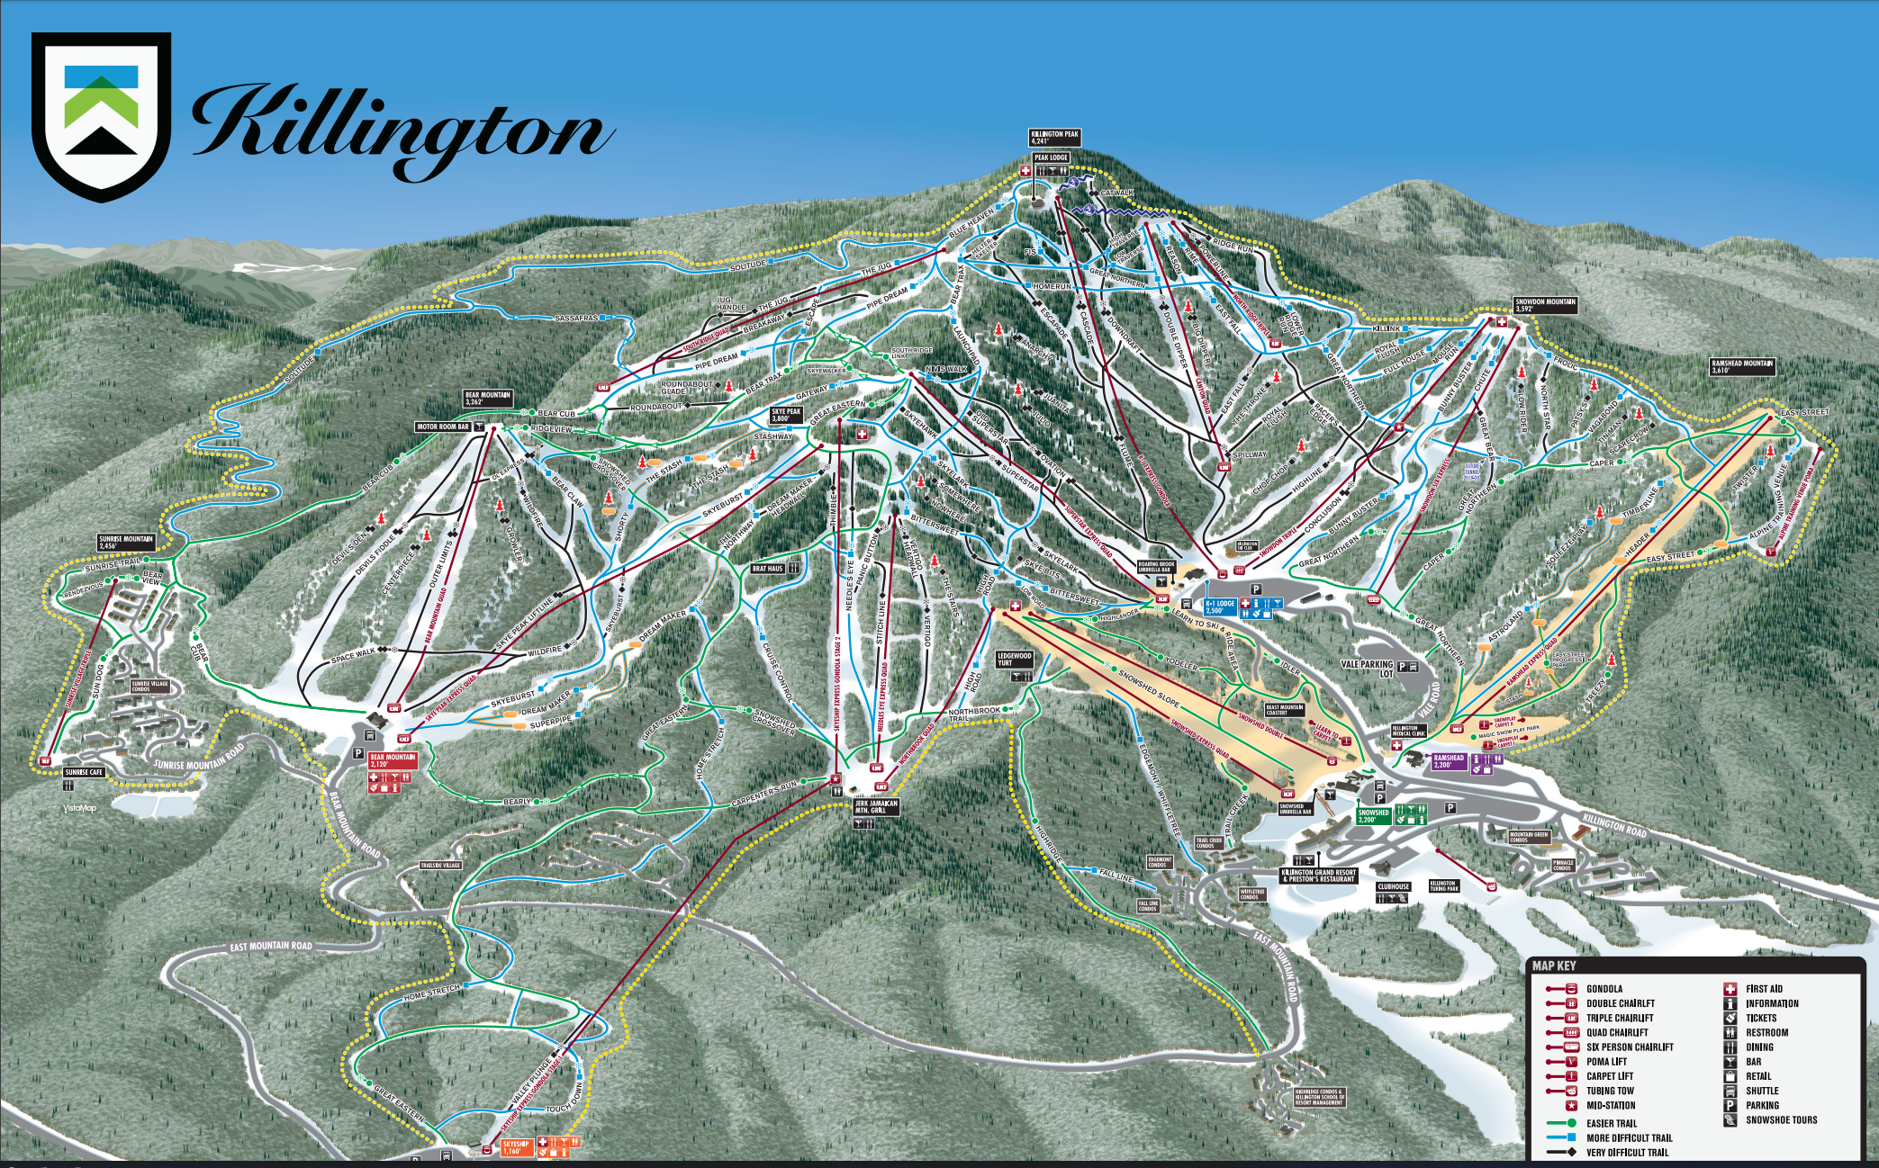
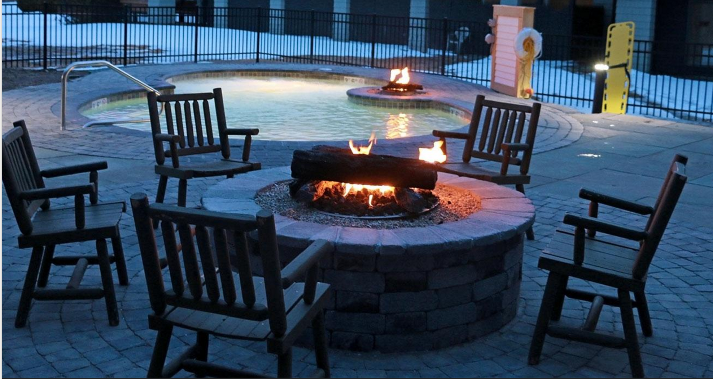
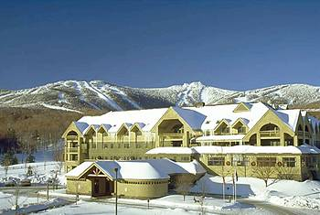
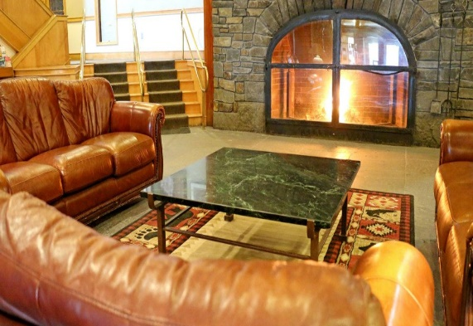
Goddard Ski Club
http://gewa.gsfc.nasa.gov/clubs/ski/
Killington, VT
January 2 – 5, 2020
3 days - $425/person*
Included:
3 days lift tickets (Fri – Sun) at Killington Resort
3 nights lodging (Thurs – Sat) at the Killington Mountain Lodge
Hot breakfast daily
Group après ski event
Club souvenir
All applicable taxes and fees
**Carpooling will be arranged for those who are interested (see trip application)**
Killington Mtn. Lodge Features:
Heated outdoor and indoor pools & hot tubs, free shuttle to slopes (~1 mile), fireside lounge, cocktail bar, walking distance to shops\restaurants\bars (http://killingtonmountainlodge.com/)
*Prices based on double occupancy. Pricing available for single, triple, quad rooms, as well as extended stays for those interested.
For more information, contact Matt Ekinci (Trip Leader) matthewekinci@gmail.com, 570-242-7361.
Payment Schedule: $200 by November 15, trip balance by December 13.
Best Skiing on the East Coast!
Elevation: 4,241’ Vertical Drop: 3,050’
Trails: 155 (17% green, 40% blue, 43% black)
Lifts: 21

