Slide 1
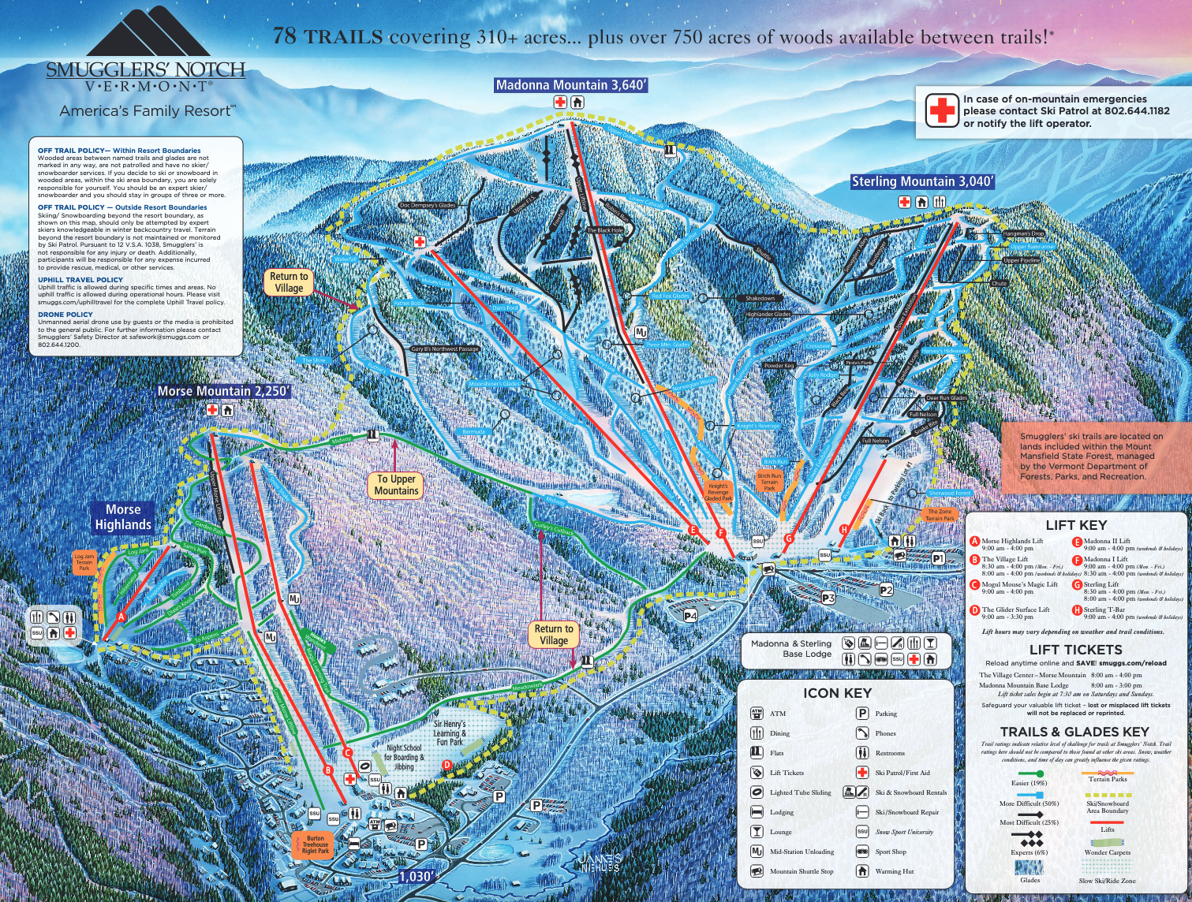
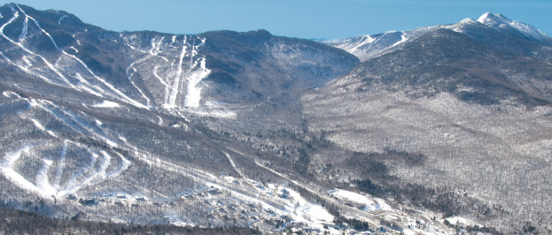
Goddard Ski Club 1st Annual trip to Smugglers Notch, Vermont
What’s included:
5 Night Slopeside Condominium Lodging
6 Day Lift Ticket (day of arrival complimentary)
Village Activities & Entertainment / FUNZONE 2.0 / Indoor Pool
Ice Skating & Tubing Hill
Après Ski Event
Ski/board rental @ $35/day
Trip Dates: February 26-March 3, 2023
Rate for 5 nights:
$565 per person (Kid 3 – 11)
$615 per person (Kid 12 – 18)
$665 per person (Adult Skier)
$565 per person (Adult Non-Skier)
Rates Are Inclusive of All Taxes
2 bedrooms 4-5 ppl, 3 bedrooms 6-7ppl, Studios at 2ppl
*$100 Deposit PP Due October 15th, Final payment due January 31st
Contact Trip Leader Pete Dell for additional information peter.j.dell@nasa.gov or 757-854-8604
Rated #1 Overall, #1 for Kids & #1 for Service by Ski Magazine Readers Survey. 78 trails, 3 mountains, Northern Vermont’s Biggest Vertical Rise of 2610 Feet

Slide 2
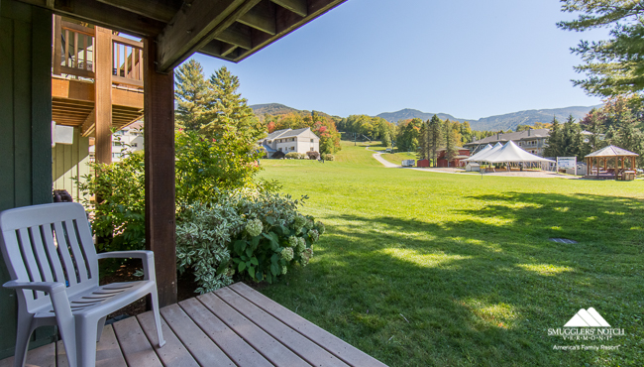
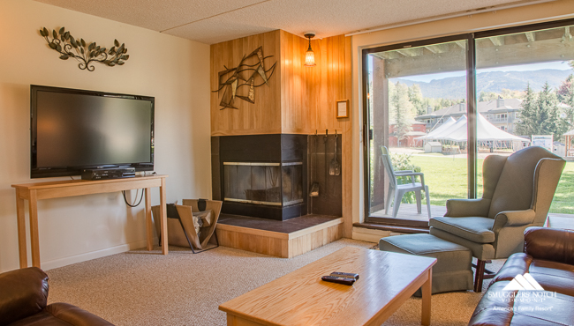
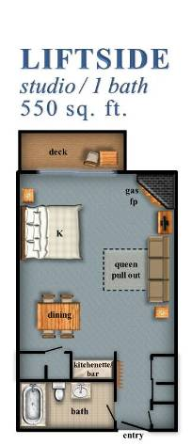
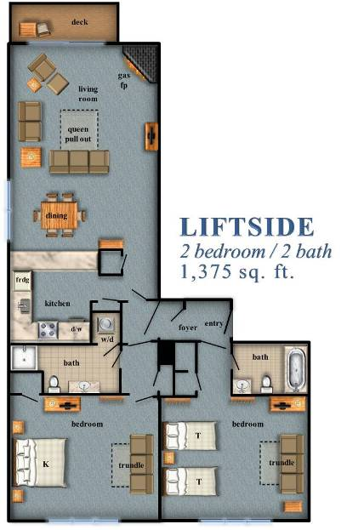
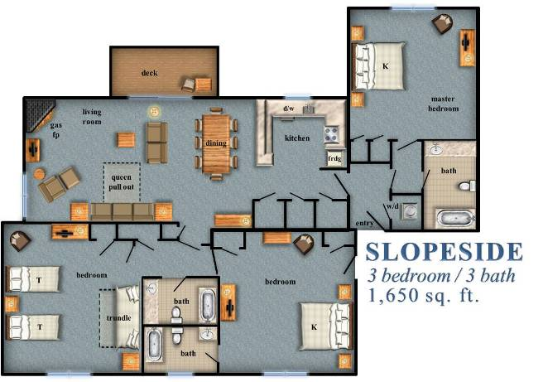
Sample Lodging (Ski in/Ski Out)!
https://www.smuggs.com/pages/winter/lodging/liftside-studio.php
https://www.smuggs.com/pages/winter/lodging/liftside2.php
https://www.smuggs.com/pages/winter/lodging/slopeside3.php

